Slide 1


Flight Climate https://vivekkatial.shinyapps.io/greenet_shiny/

Slide 2

Focus Area: AI for Earth
Motivate airlines to reduce their carbon emissions
Notes:
Our solution aims to motivate airline companies to reduce their carbon emissions

Slide 3

Problem: Lack of real-time insights on airline sustainability
2% of global CO₂ emissions
Report wait times
Notes:
Lact of real time insights for consumers and airlines
Airlines account for 2% of global CO₂ emissions.
Companies wishing to reduce their impact have significant wait times for reports resulting in slow action.

Slide 4
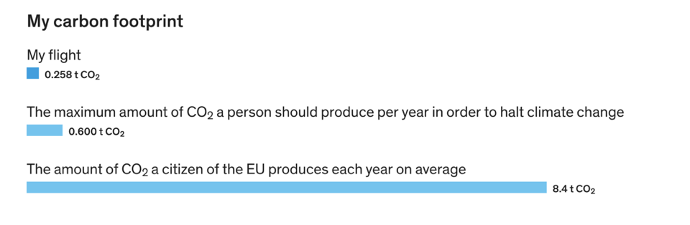

Slide 5


Effectiveness of Flight Climate
Our solution simultaneously motivates consumers and companies to reduce their carbon footprint.
Consumers can easily choose flights with the smallest amount of carbon emissions
Companies can see how they compare to other airlines, and see the public sentiment towards them and their sustainability efforts

Slide 6
Consumers have simple calculations
We add more variables
Companies have real-time evaluation
Partnerships with flight aggregators
Cost of labour, data
Innovation & Feasibility
Notes:
Consumers are currently able to calculate the carbon emissions of a flight given start and end destination. However, this does not take into account the different aircraft and practices of different airlines. Our consumer facing solution will incorporate these differences to show the best flights.
The main value for companies comes from real-time evaluation of their emissions and practices.
We require partnerships with flight aggregators, such as Expedia and Skyscanner, to display our metrics in their search results. Our hypothesis is that a “green tick” on a flight may encourage consumers to finalise purchases faster.
Our only cost is the cost of labour in building our solution. We do not rely on any hardware. However, we may want to purchase access to other datasets for ongoing, accurate results.

Slide 7
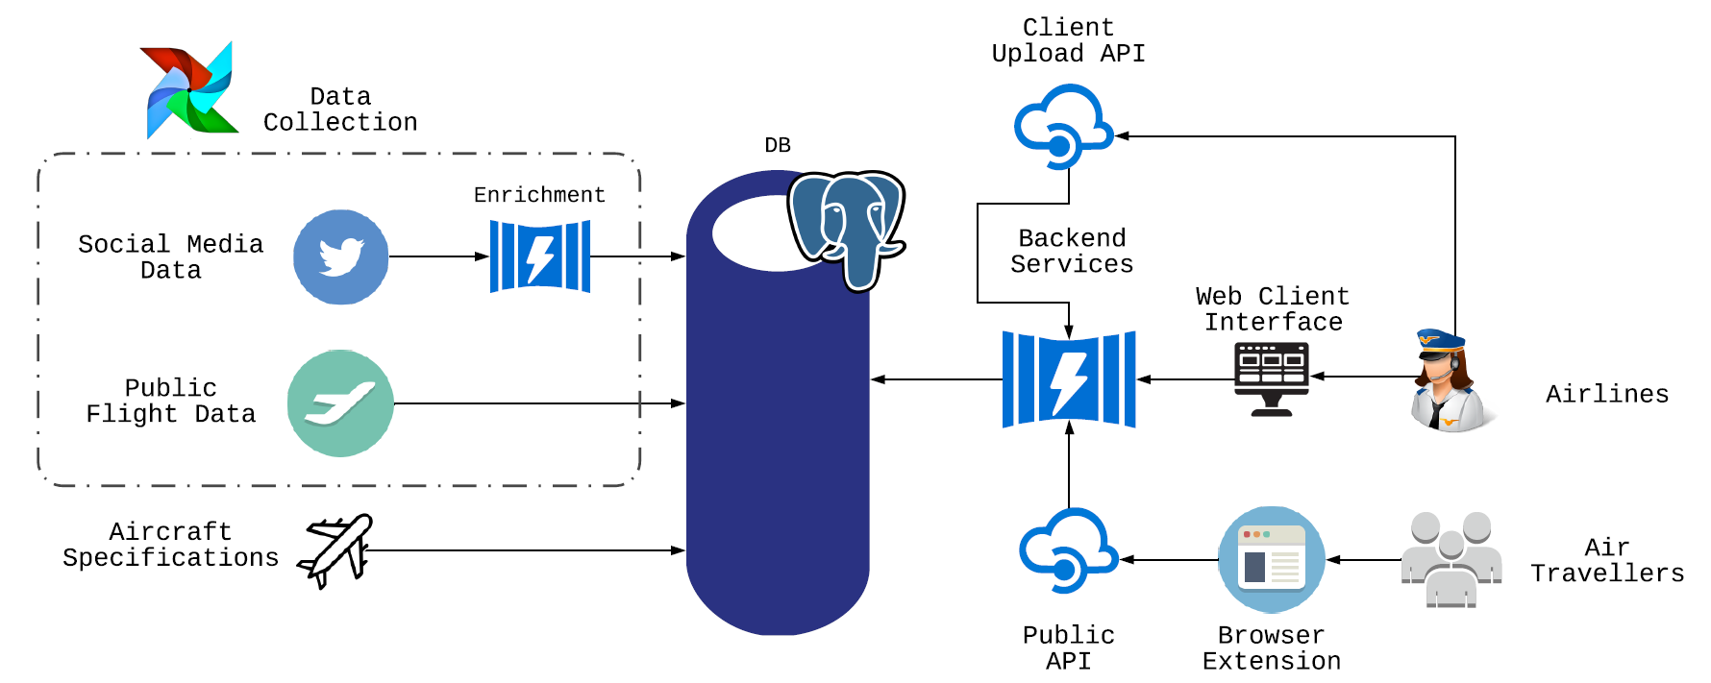
Solution Design

Slide 8

Now, a demo https://vivekkatial.shinyapps.io/greenet_shiny/

Slide 9
Roadmap
More variables for sustainability ranking
Manufacture through to service analysis
Create overall carbon footprint
Notes:
e.g. thinking about plastic packaging

