Slide 1
Inverse Problems, Constraint Satisfaction, Reversible Logic, Invertible Logic and Grover Quantum Oracles for Practical Problems
Marek Perkowski
Department of Electrical and Computer Engineering
Portland State University
Friday, July 10th 2020

Slide 2
What is an Oracle?
Technical aspects can be found in the paper and its references
Here I want to concentrate on fundamental ideas and our philosophy
So that everybody can start using these ideas in their related areas of research

Slide 3

Classical Boolean Circuits propagate signals only from inputs to outputs
a b
c d
1
1
1
1
1
1
1
1
1
1
1
1
1
1
1
1
1
What is an Oracle in Quantum Computing?
A Boolean function with one output we will call an Oracle
Oracle is a fundamental concept in Grover Algorithm, which is the famous quantum algorithm with many applications.
Propagating signal through a combinational circuit from input to output is called evaluation of the oracle.
With input combination a=1,b=1,c=1,d=1 we need to propagate signal only once through this oracle to obtain value “1” on output.

Slide 4
The Essence of Quantum Algorithm of Grover

Slide 5
A gold ball in a box or a miracle of a quantum algorithm
We have one gold ball in a black box and 99 black balls.
We do not know anything about what is inside the box, other that there is a gold ball inside.
We reach to the box, if the ball is gold we are happy, otherwise we remove the black ball from the box and reach again.
We repeat this until we find the gold ball.
In the best case we find the ball in the first attempt, in the worst case - in the attempt number 100.
On average we need to reach 50 times to the box.
In quantum we need to reach only √100 =10 times to find the gold ball.
Why it is so?
The answer is quantum superposition or quantum parallelism

Slide 6
Classical Gold Ball (illustrated with 4 balls)
3
4
1
2
We use a sequential search algorithm in a non-organized (uninformed) database (space)
Quantum Gold Ball
Initial quantum state
Black balls are shrinked
Processor for ball 1
1
Processor for ball 2
2
First iteration of Grover Loop
Second iteration of Grover Loop
Measurement
Processor for ball 3
3
3
The winner is
Processor for ball 4
4
time
Gold ball grows
4 processors
We use a parallel search algorithm using superposition in Hilbert Space
Notes:
Every potential solution has a hypothetical processor

Slide 7
Modern Quantum Computer is a Hybrid Machine
Classical Computer
Boolean Algebra
Special Controller
Problem specific data
Sequential pulses that control qubit transformations
Initialization
Calculations
Measurement
Quantum Mechanics
Quantum states in Hilbert Space
Quantum states in Hilbert Space
Classical binary States
Grey Rectangle here is a Hilbert Space
1000 qubits = 2¹⁰⁰⁰ “processors”

Slide 8
Conclusion on Grover
Power of quantum computing is in very high parallelism.
Having 2 particles is equivalent to having 4 computers.
Having n particles means that we have a parallel computer with 2^{n} processors.
Now there are universal quantum computers with 100 qubits (particles).
This means 2¹⁰⁰ processors working in parallel.
But this parallelism is not for all problems.
Let us go back to oracles

Slide 9
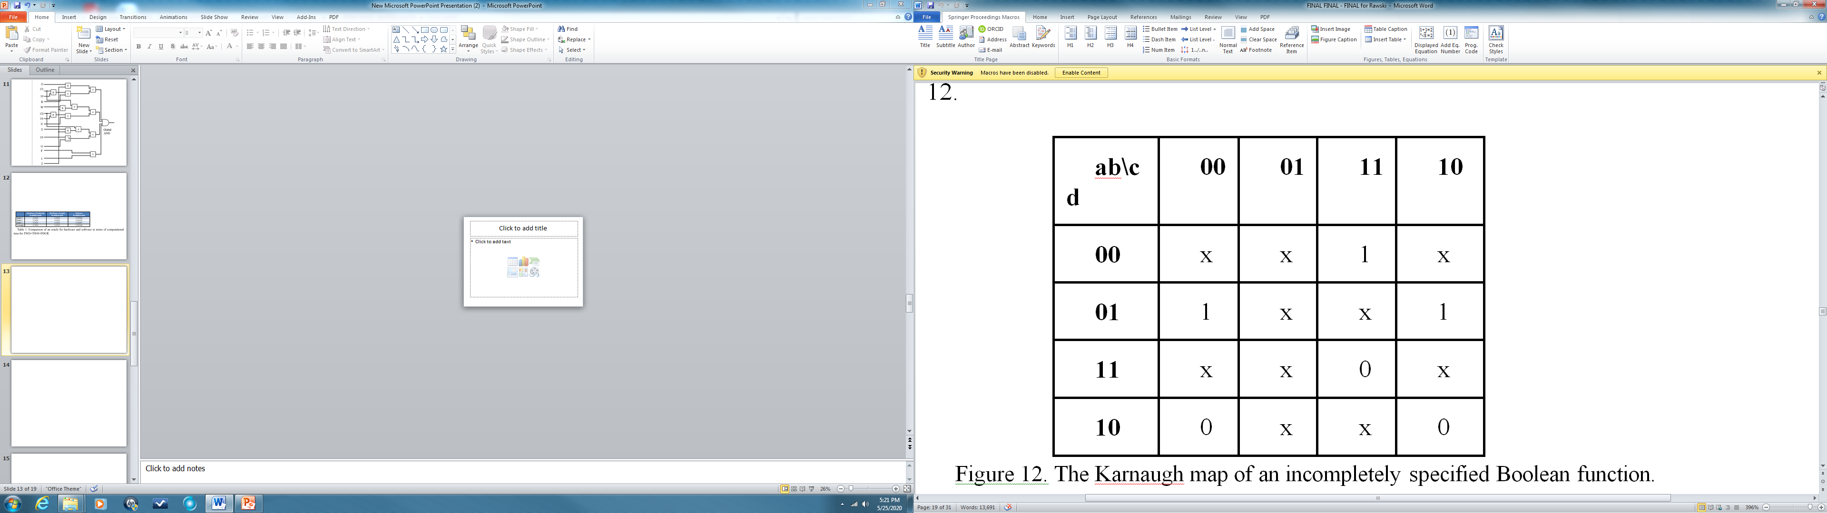
Boolean Function formulation of the Gold Ball problem
a,b\c,d
0
Now the gold ball is a “1”, the black balls are the “0”.
I want to find for which combination of input a,b,c,d the output is 1.
I do not know what is the function, I can only guess the inputs and check the output.
This is like a testing problem.
I give one minterm at a time.
In the worst case I need to test 16 minterms.
In the best case I need to test 1 minterm, on average I need 8 minterms.
Grover will find the solution in √16 = 4 tests.
0
0
0
0
0
0
0
0
0
1
0
0
0
0
0
False minterm
True minterm
Assume that the oracle circuit of function F2 is just a tree of two-input AND gates with 64 inputs in total.
To find the 1 of function, the oracle in classical logic would be evaluated 2⁶⁴ number of times.
Grover Algorithm would evaluate the oracle “only” 2^ (64/2) = 2³² times which may be also not practical.
However, in Invertible logic in which one propagates the signals from output to inputs, the Invertible Logic method would need only one evaluation of the oracle realized with invertible gates

Slide 10
Inverse Problems

Slide 11
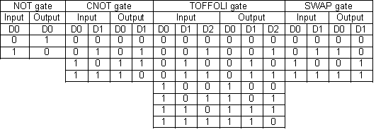
Inverse Problems for functions
Inverse Problems for relations
domain
co-domain
b
1
c
a b c d e f g h
2
1 2 3 4 5 6
a
RELATION
3
e
d
f
g
4
What are all letters that map to number k ?
a b c d e f g h
5
1 2 3 4 5 6
h
6
F=1111
What are all letters that map to number k ?
Is characteristic function satisfied?
Characteristic function
Notes:
Domain codomain

Slide 12
Examples of Inverse Problems solved by Invertible Logic
1
1
adder
adder
?
3
2
2
?
0
adder
adder
3
3
?
3
1
adder
3
2
……
3
adder
3
0

Slide 13
… but also…. Generalized Inverse Problems
Signal propagation in all directions
1
1
adder
adder
3
3
?
2
Integer Factorization
?
5
multiplier
multiplier
15
15
Cryptography
Quantum cryptography
Post-quantum cryptography
?
3
3
multiplier
15
5
……
1
multiplier
15
15
Notes:
Some inputs , some outputs

Slide 14
Reversible Logic

Slide 15

Notation for Classical Boolean Logic Gates and Invertible Logic Gates
a
a
a
a * b
b
INVERTER
AND
a
a⊕b
b
a
EXOR
a + b
b
These gates propagate from inputs to outputs
OR

Slide 16
Notation for Reversible Logic Gates
a
a
Inverter
a
a
.
a
a
a
a
Controlled-NOT or Feynman Gate
b
a⊕b
a⊕b
b
.
a
a
a
a
Controlled-Controlled-NOT or Toffoli Gate
.
b
b
b
b
c
ab⊕c
ab⊕c
c
These gates are in reversible logic. Propagate from input to output or from output to input.
In quantum realization they allow for superposition and entanglement

Slide 17
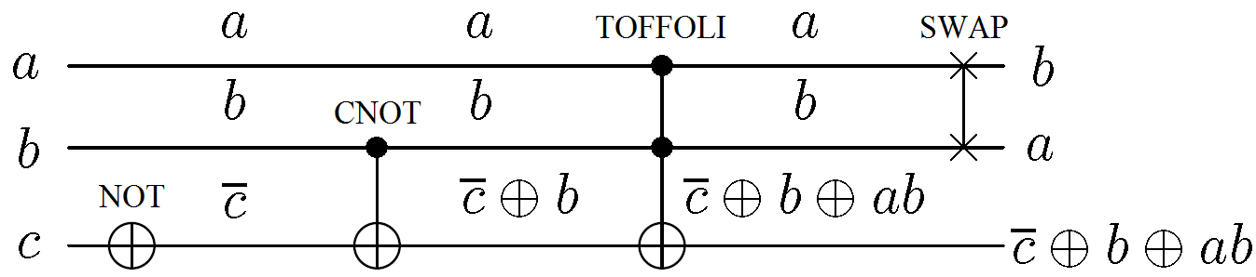
Reversible Circuits from Reversible Gates
Truth Tables
These are reversible functions, one-to-one mappings or permutations.
These are also reversible gates from which reversible circuits are composed.
Schematic Diagram
This is an example of a circuit created from reversible gates without ancilla bits.
The corresponding function is reversible.

Slide 18
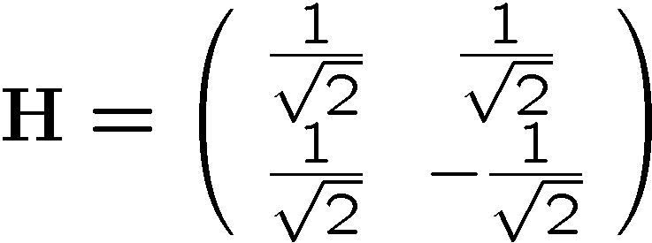
Hadamard Transform
Single qubit
H
⊗
=
H
1 | 1 | 1 | 1
1 | -1 | 1 | -1
1 | 1 | -1 | -1
1 | -1 | -1 | 1
H
=
1/2
Parallel connection of two Hadamard gates is calculated by Kronecker Product (tensor product)
Here I calculated Kronecker product of two Hadamards

Slide 19
Hadamard Transform
|0⟩
H
1/2|00⟩+1/2|01⟩+1/2|10⟩+1/2|11⟩
|0⟩
H
After vector of Hadamards we have equal superposition of all states from my problem space

Slide 20
Invertible Logic

Slide 21
What is Invertible Logic?
Invertible Logic algebraically is exactly the same as classical Boolean Logic.
The only difference is that the invertible logic CIRCUIT can just propagate signals:
  From inputs to outputs
  From outputs to inputs
  From any subset of inputs and outputs and internal signals in any direction.
Invented by Professor Datta from Purdue as a result of investigation of Deep Recursive Neural Nets.
a b
c d
1
1
1
1
1
1
1
1
1
1
1
So now, in only one evaluation of oracle we find the solution a=1,b=1, c=1,d=1. F = abcd.
This is an example of Inverse Problem
For n=64 variables the quantum Grover Algorithm will need to evaluate the Oracle 2³² times. NOT GOOD.
Invertible Logic will find solution in only one evaluation of oracle.

Slide 22
Few important points
The creator of the oracle does not know the function like we can see it in a Karnaugh Map.
He can create the oracle as a circuit without knowing the function.
This oracle can be evaluated using:
  A classical Boolean Oracle
  A Quantum Oracle
  An Invertible Logic Oracle.

Slide 23
How Invertible Logic works?
1
Deterministic propagation
1
1
1
0
0
0
0
Non-deterministic propagation
0
1
0
1
0
0
Similarly we can analyze any Boolean Gate or block such as adder

Slide 24
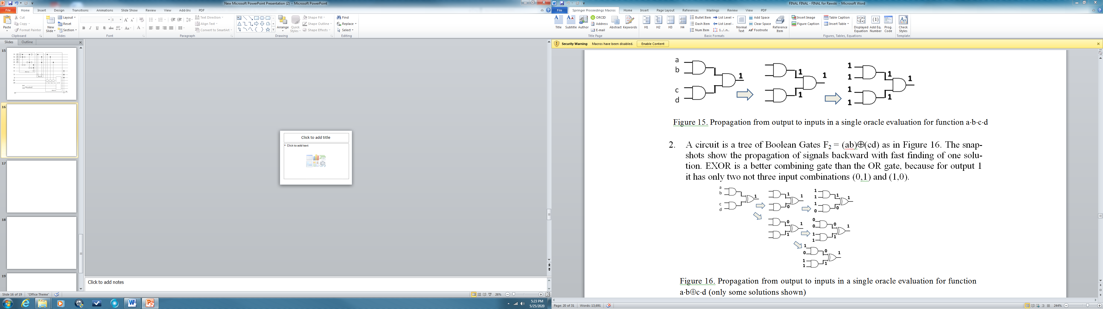
How Invertible Logic works?
Fig. 16
Invertible Logic solves Inverse Problems.
  Graph Coloring
  Integer Factorization
  Cryptology
  Bitcoin
  Puzzles
  Electronic Design Automation
  Inverse Kinematics
And every problem described by an oracle
Invertible Logic is a general concept
It is in principle not related to any technology

Slide 25
A Dream of Universal Method “to Solve All Problems”

Slide 26
Old History of Universal Method for Problem Solving
Raymond Lullus (1232-1316)
Universal Method
Mappings, syllogisms, graphs, MV logic
Symbols, diagrams, relations
Rene Descartes (1596-1650)
Every Problem can be reduced to a single Algebraic Equation
Linear algebra
George Boole (1815-1864)
Every Problem can be reduced to a single Boolean Equation
Boolean algebra
Claude Shannon (1916-2001)
Stanley Petrick (1931-2006)
SAT solvers and NP theory
Pyne and McCluskey
Oracles
Grover
Many, many papers
Every Problem can be reduced to solving an oracle
The research presented in this lecture

Slide 27
George Boole said:
Describe a problem by a set of simple logic equations.
Convert the set of these equations to a single logic equation.
Solve this equation to get all answers.
“universal method” to solve logic problems

Slide 28
History and Ideas
Constraints Satisfaction Problems
Hopfield Nets
Inverse Problems
Boltzmann Machines
Oracles
Optimization Problems
Deep Learning Boltzmann Machines
Generalized Oracles
Magnetic Spin Technology
PSU Methodology to Solve Problems
Perkowski 1981-2020
Prolog Software
Invertible Logic
CMOS
FPGA
Quantum domain
Classical Boolean Logic
Magnetic Spins
Other non-quantum nanotechnologies
Quantum Invertible Logic
Grover Algorithm
Quantum Walk

Slide 29
What is my achievement?
People who work on Invertible Logic do not have a methodology to develop oracles.
We combine our methods of classical, reversible and invertible logic to build a very large class of oracles and reduce problems from various areas to building oracles.
Optimization Problems are reduced to sequence of oracles with modified constraints.

Slide 30
Constraint Satisfaction Problems

Slide 31
Constraint Satisfaction
Given is a set of arithmetic, Boolean, Predicate and other constraints on a set of variables.
Find all vectors of values of variables that satisfy all constraints
Given is a set of arithmetic, Boolean, Predicate and other constraints on a set of variables.
Find all vectors of values of variables that satisfy as many as possible constraints
Optimization
Given
  is a set of arithmetic, Boolean, Predicate and other constraints on a set of variables
  Cost function.
Find all vectors of values of variables that satisfy all constraints AND optimize the cost function

Slide 32
Constraint Satisfaction Problems
Graph Coloring
Maximum Clique
Maximum Independent Set
SAT and MAX-SAT
8 Queens
Logic Puzzles
Integer Linear Programming
Partition Calculus Problems
POS to SOP conversion
FPRM Minimization
Two-level logic minimization
Finite State Machine Minimization
FSM encoding
Concurrent encoding and minimization of FSM
Ashenhurst-Curtis Decomposition of Logic functions.
Minimum Set of Support
Rule Minimization
Binate Covering
Unate Covering
Logic methods of Machine Learning.
Generalized Traveling Salesman
Generalized Knapsack
Shortest Path and several robot planning tasks
Perkowski
Yiwei Li
Sharavana Kumar, visitor from India
Test generation
Cryptography
Logistic problems
Non-linear Algebraic equations
Wei Zhang, visitor from China
Peng Gao
Wenjun Hou, high school
Jacob Viertel from Germany

Slide 33
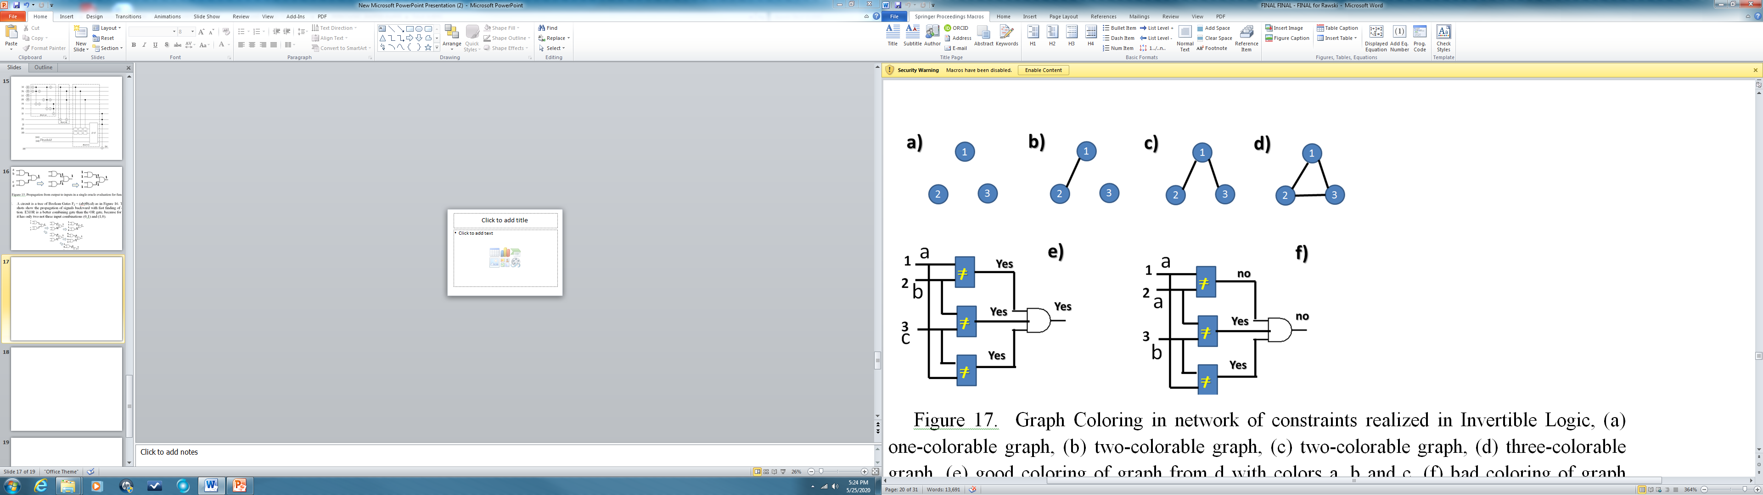
Example of CSP – Graph Coloring
This graph G1 needs three colors
These two graphs need two colors
This graph colored with one color
Oracle for coloring graph G1
Chromatic number of our graph is 3 because we cannot color it with 2 colors a and b
a
1
c
b
2
3

Slide 34
Example of CSP – Graph Coloring
Our Methodology – what we do with the oracle?
Oracle for coloring graph G1
Our methodology creates such general oracle from the specification
a
1
c
b
Backtracking Simulator in PROLOG
2
3
Reversible Logic
Linear Programming
Standard Boolean Gates
Standard Boolean Gates converted to Hamiltonians
Quantum Circuit
FPGA
IBM quantum computer
Quantum Simulator
FPGA with Random Number Generators

Slide 35
We think about gates and blocks as characteristic functions or relations
Think about a gate (a block, a Hamiltonian) as a little processor that likes to minimize its energy
1
I like it. I have minimum energy, I am happy, let us keep my state this way
1
0
0
I like it. I have minimum energy, I am happy, let us keep my state this way
1
I am happy again
1
1
1
0
1
I hate it. I do not have minimum energy. I need to change signals.
1
1
1
0
1

Slide 36
Methodology to solve Constraint Satisfaction Problems and
Optimization Problems based on
Generalized Oracles

Slide 37
Key points of our methodology
Bottom-up rather than Top-Down
Gates and blocks, not Unitary or Permutative Matrices
Use libraries
Blocks: logic, arithmetic, predicates, problem-specific (like controlled counters)
Subset-of-set, versus permutative, versus mappings, versus combinations without repetitions, etc.
Encoding of data (short codes, one-hot, thermometer, etc)
Calculate abstract complexity such as number of iterations of oracle.
Calculate detailed complexity in terms of number of qubits, number of gates, number of pulses, etc.
Reusing of problem reductions, design tricks and verified blocks
Special synthesis algorithms for symmetric functions, ESOPs, PSOE, factorized forms, adders, controlled-adders, constant-multipliers, comparators, etc. = we use engineering design practices.
Using QSHARP, QISKIT, QUIPPER
Using Prolog for Oracle Simulation.
Ternary logic.

Slide 38
Grover Algorithm and Quantum Oracles

Slide 39
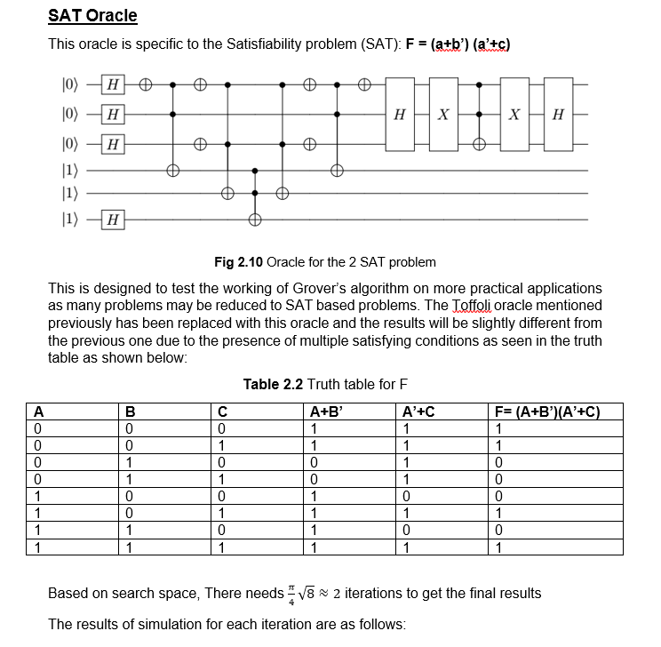
Second Example
Weight 16
Inversion by mean
Weight 8
Remember weights
Weight 4
Weight 2
Weight 1
oracle
One repetition of GroverLoop for 2-SAT Problem, full circuit has two
Problem has 4 solutions, as shown in Truth Table 2.2.
Numbers for solutions
2+1=3
0
1
4+2+1=7
2
3
4
16+4+2+1=23
5
6
7
16+8+4+2+1=31

Slide 40
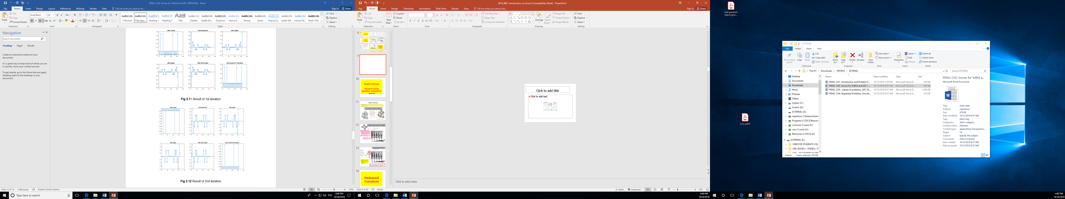
This would be for 2 variables
Superposition
RESULTS OF FIRST ITERATION
1/2|00⟩+1/2|01⟩+1/2|10⟩+1/2|11⟩
After vector of Hadamards all solutions are equally probable
After oracle solutions are in negative phase
32
Magnitude of our 4 solutions is amplified
Phase of our 4 solutions is different

Slide 41
Magnitude of our 4 solutions is amplified

Slide 42
Let us compare states after first and second iteration
3
7
23
31
Even measuring now the probability of finding one of solutions is high
Measuring after two iterations the probability of measuring one of solutions is very high

Slide 43
Grover for Graph Coloring

Slide 44
A Simple Graph Coloring Problem
1
2
3
We need to give all possible colors here
4
Two wires for color of node 1
Two wires for color of node 2
Two wires for color of node 3
Two wires for color of node 4
≠
≠
≠
≠
≠
Gives “1” when nodes 1 and 2 have different colors
1≠3
2≠3
2≠4
3≠4
1≠2
F(x)
Value 1 for good coloring

Slide 45
Sequential Generator and Oracle for Graph Coloring
Sequential Generator
We need to give all possible colors here
Oracle
Counter with 2 ⁸ states
≠
≠
≠
≠
≠
Gives “1” when nodes 1 and 2 have different colors
1 ≠ 3
2 ≠ 3
2 ≠ 4
3 ≠ 4
1≠2
F(x)
Discuss naïve non-quantum circuit with a full counter of minterms
Value 1 for good coloring

Slide 46
00000000
Oracle number 0
Hypothetical
Parallel
Computer
for Graph Coloring
and
2⁸ combinational
oracles
≠
≠
≠
≠
≠
1≠2
1≠3
2≠3
2≠4
3≠4
F(x)
Value 1 for good coloring
2⁸ combinational
oracles
11111111
Oracle number 2 ⁸
≠
≠
≠
≠
≠
1≠2
1≠3
2≠3
2≠4
3≠4
F(x)
Value 1 for good coloring

Slide 47
In case of quantum circuit, combinational parallelism is realized by superposition of states.
Circuit calculates on 2^{n} states at the same time

Slide 48
Simple Graph Coloring Problem
Give Hadamard for each wire to get superposition of all state, which means the set of all colorings
We need to give all possible colors here
|0>
H
|0>
H
|0>
H
|0>
H
……
|0>
H
≠
≠
≠
≠
≠
Now we have quantum oracle with quantum reversible gates
1≠2
1 ≠ 3
2 ≠ 3
2 ≠ 4
3 ≠ 4
f(x)
F(x)
Value 1 for good coloring
Now we will generate whole Kmap at once using quantum properties - Hadamard

Slide 49
From Classical to Quantum Oracles
Classical Oracle
Quantum Oracle
Reversible,
Built from standard quantum gates like Toffoli, CNOT, NOT.
Calculate candidates in parallel, thanks to quantum superposition
Non-reversible,
Built from standard gates like AND,OR,EXOR, NOT.
Calculate candidates sequentially

Slide 50
Reducing
Optimization Problems to
Decision Problems with
Modified Oracles

Slide 51
Grover for Minimum Set of Support Problem
Hybrid Classical-Quantum Computer creates a sequence of modified oracles for Grover
IDEA

Slide 52
Example: Minimum Set of Support
Machine Learning
ACD Decomposition
Rule Simplification
Petrick Function
Unate Covering
Minimum Set of Support Problem
Fundamental Algorithms
POS→ SOP conversion
Binate Covering
SOP Minimization
Test Minimization
Logic Synthesis

Slide 53
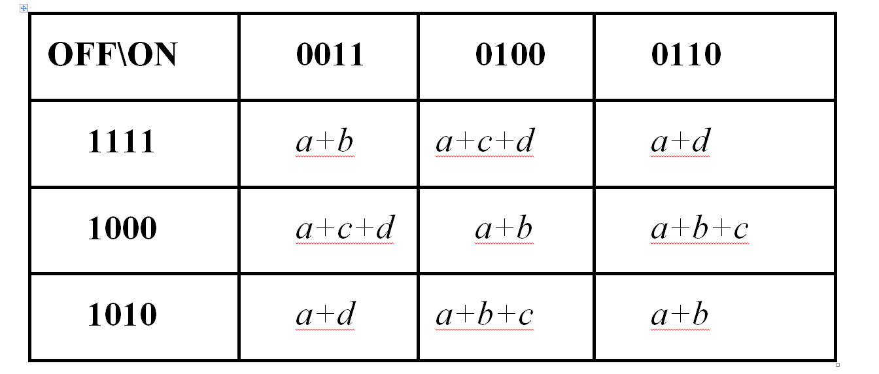
Example: Minimum Set of Support
Karnaugh Map of an incomplete function of 4 variables a,b,c,d. (Mathematically a relation)
ab\cd
Compare evey true minterm with every false minterm
From Relational Specification to Set of simple Boolean Equations

Slide 54
From Individual Equations to a single equation
Local Equations of Boole
Single Equation of Boole
CLASSICAL
(a+b).(a+c+d).(a+d).(a+c+d).(a+b).(a+b+c).(a+d)
.(a+b+c).(a+b)
QUANTUM
Using Laws of Boolean Algebra
solution
(a+b).(a+d)
Oracle
a + bd
POS
SOP

Slide 55

Encoding and explanation of Grover Oracle for this problem
(a+b).(a+d)
Oracle
a + bd
POS
SOP
(a+d)
ENCODING
(a+b)
Solution bd
a = 1000
b = 0100
c = 0010
d = 0001
ab = 1100
acd = 1011
ab\cd
ab\cd
0
0
0
0
0
0
0
0
0
1
1
0
0
0
1
1
1
1
1
1
1
1
Solution a
This cell 1000 is encoding of solution a
Finding solution a we want to exclude all included in a,
such as ab, ac, abc, abcd
Idea of modifying oracles

Slide 56
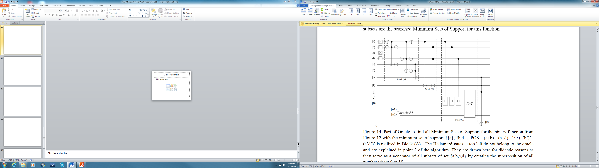
Grover Oracle for all solutions to this problem
Use De Morgan Rule
a b ⊕ 0
a
ENCODING
a = 1000
b = 0100
c = 0010
d = 0001
ab = 1100
acd = 1011
(a+b)
a
b
(a+d)
c
d
0
(a+b).(a+d) ⊕ 0 = (a+b).(a+d)
0
0
This oracle would find all solutions to problem but most of them would be non-minimal

Slide 57
First Grover Oracle for this problem
Controlled adder of 1
Solution bd
ab\cd
0
0
0
0
0
0
Solution a
We find solution a with the cost of 1
Set threshold to 1
Final oracle output

Slide 58
First Grover Oracle for this problem
Solution bd
ab\cd
0
0
0
0
0
0
0 0 0 0
0 0 0 0
Solution a
We find solution a with the cost of 1
We remove all solutions included in a, such as ab, ac, abc, etc
Set threshold to 1
Final oracle output

Slide 59
Second Grover Oracle for this problem
Solution bd
ab\cd
0
0
1 1
0
0
Solution a
|1⟩
Block B
We remove solution a from the set of solutions
Set threshold to 2
Final oracle output

Slide 60
Third Grover Oracle for this problem
ab\cd
0
0
0
0
0
0
0
0
0
0
0
0
0
0
0
0
There is no solution
Grover gives something random, every time different.
We can verify or we can run earlier Quantum Counting to count number of solutions

Slide 61
Invertible Quantum
Quantum Grover
Classical FPGA
Invertible FPGA
Spin and other nano-technologies
Quantum Hopfield Neural Network -based
Small QHNN
Small QHNN
Small QHNN
The idea of Generalized Oracle is central to all these approaches

Slide 62
Conclusions
Presented approach allows to solve all Constraint Satisfaction Problems.
Optimization problems are solved by sequence of CSP with modified oracles.
Oracles can be built in several technologies:
  FPGA,
  magnetic spins
  quantum.
Quantum oracles use reversible logic.
Invertible oracles use invertible logic.
In FPGA we can model both classical and invertible logic oracles.

Slide 63
Conclusions (cont)
When FPGA is used for invertible logic the most important is to create a very high quality Random Number Generator.
  These are subjects of our research
    Commercial Quantum RNG based on Hadamard Gates
    LFSR, EXOR forest, jitter generators
    FPGAs with analog-like random number generators.
FPGA realizations
Prolog Simulations
Quantum realizations of Grover Methodology
Quantum realizations of Invertible Logic with QHNN (Quantum Hopfield Neural Net)
OUR RESEARCH

Slide 64
Magnetic Spin Technology
Neural Networks
Quantum Neural Networks
Invertible Logic
Classical
Digital Circuit Design
Generalized Oracles
Approach
Inverse Problems
Classical Oracle
Reversible
Digital Circuit Design
Constraints Satisfaction Problems
Quantum
Digital Circuit Design
Reversible
Logic
Optimization
Problems

Slide 65
Questions often asked
How practical is this?
When we will have large quantum computers?
Error Detection and Correction.
Can we combine the powers of Invertible Logic and Reversible Logic in Quantum technology to create superior algorithms?
What is the methodology? What is the math?
  Combinatorics, coding theory, numeric representations
  Algorithms and Complexity
  Spectral Methods
  Digital Design
  Algebra, graph theory, partition theory, cube calculus theory
We do not discuss:
  Quantum Technologies
  or Magnetic Spin Technologies
I welcome any question!
Current research
No time to discuss

