Slide 1

Introduction to Web Development: CSS

Slide 2
HTML Recap
Any questions from the homeworks?
If you think of any questions during the session, come write them on the board and we’ll answer them at the end!

Slide 3
Plan for today...
Intro to CSS (Lisa)
What is CSS? CSS syntax
Linking CSS/files
HTML classes and IDs
2. Intro to Github (Clare)
Version control
Creating a repo
Command line
3. Competition
Guidelines

Slide 4
Intro to CSS

Slide 5
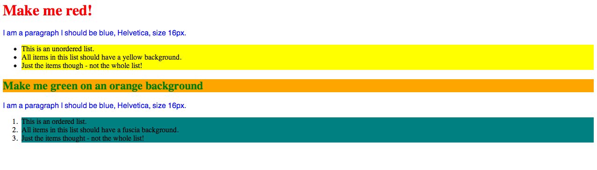
What is CSS?
Adds styling to your HTML
Example: https://codepen.io/dianaklee/pen/JYbbRx

Slide 6
Using CSS
3 ways to use CSS:
1. Inline
2. In style tags inside head
3. In separate file (stylesheet)
<h1 style=”text-size: 14px; color: red;”>HELLOOOOO</h1>

Slide 7
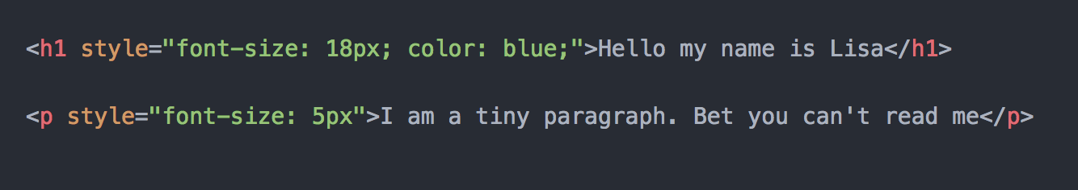
3 ways of using CSS
Inline

Slide 8
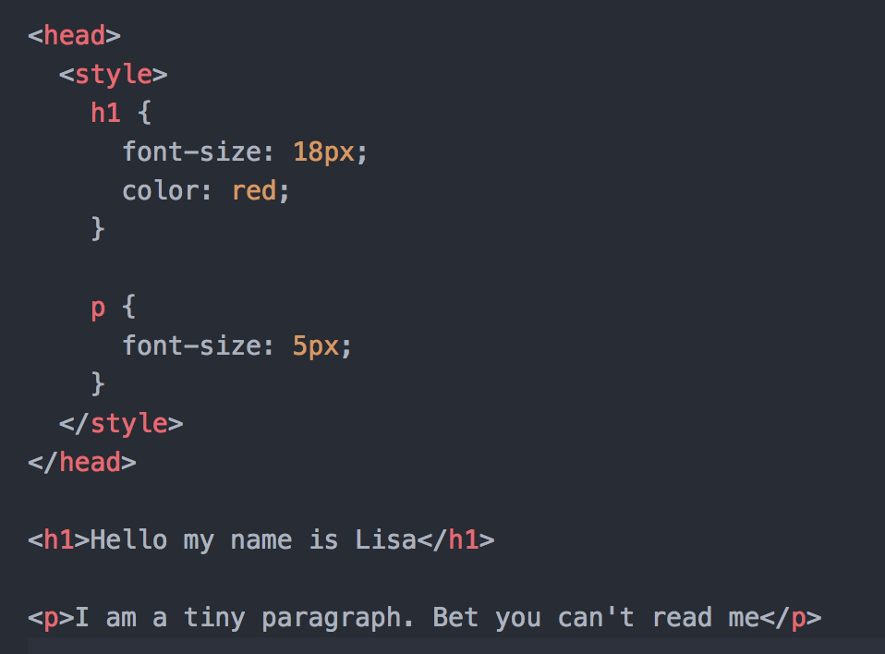
2. In style tags inside page <head>

Slide 9
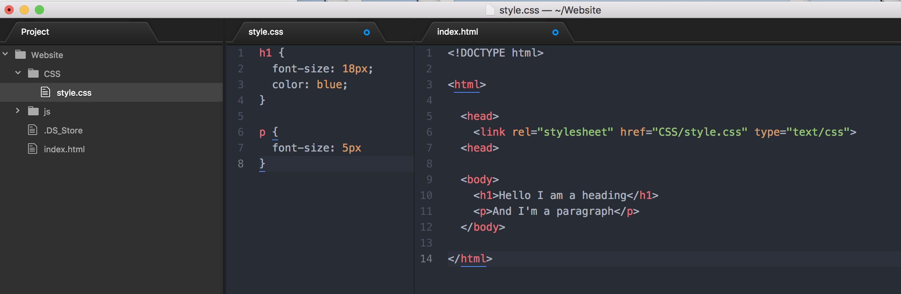
3. In a separate file, linked to your HTML page
Notes:
Most professional is the third way, keeps your code neat. Inline is not so good because you would have to repeat it for every element, complicates your html code etc

Slide 10
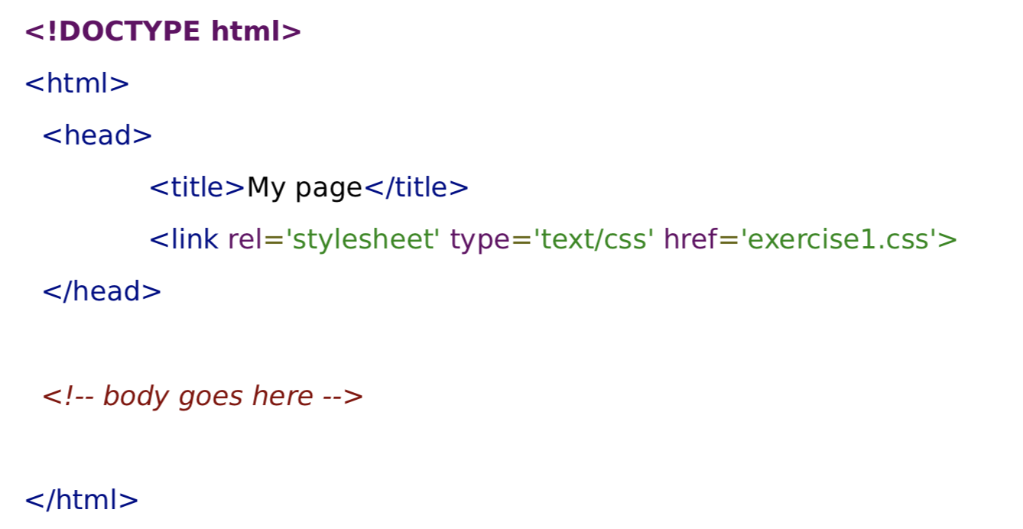
Linking CSS
You need to connect your CSS stylesheet to your HTML file:

Slide 11
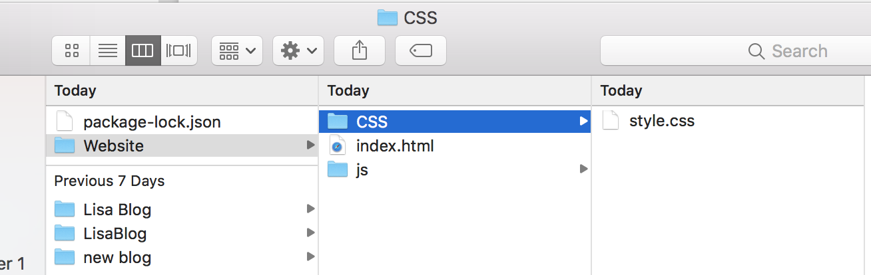
Linking Files
<link rel=“stylesheet” href=“CSS/style.css”>
Notes:
Is everyone comfortable with this layout of file system?

Slide 12
Linking Files
1. External links (eg. A website address – start with http://)
<link rel=“stylesheet” href=“https://maxcdn.bootstrapcdn.com/bootstrap/3.3.7/css/bootstrap.min.css”>
2. Root relative links (start with a slash /)
3. Document relative links (no slash at start)
Notes:
External = used for files held on other sites, eg. In week 5 when we use boostrap, or when you link to javascript files
Root relative: your computer by default takes the root to be the root of your filesystem, eg your user folder on a mac (no idea about PCs!)
Document relative = what you should use for the tasks
Clare: how to explain the . And ..?

Slide 13
CSS Syntax
Selector
Property
h1 {
color: red;
font-size: 16px;
}
Property value (semi colon separates attributes)
Curly brackets!

Slide 14
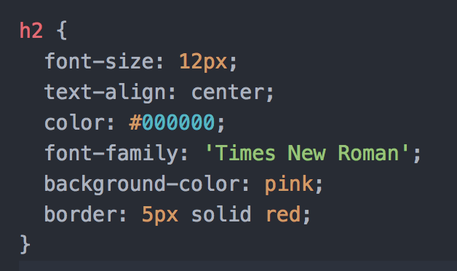
Some useful properties
Font-size
Text-align
Color
Font-family
Background-color
Colour hex codes
#ffffff = white
#000000
#ff0000
HTML Colour Picker CLICKY

Slide 15
Task 2 – Using CSS
Task 1 – Linking CSS
Go to this address: https://github.com/CodeFirstGirls/html2
Download exercise1.html
Add CSS to make it look like the image in exercise1_solution.jpg
If you find that easy, have a go at exercise2.html
EXTENSION:
Add some styling to your About Me page
Eg. Change font and background colors
Change font style and size
Create a new file called style.css
Link style.css to your ‘About Me’ page you made last week inside the <head> tags of your about me html file

Slide 16
Types of selector
By element
eg. H1 {
}
By class
eg. .container {}
By ID
eg. #about-header {}

Slide 17
HTML: Class and ID
Class = for defining a group of HTML elements that you want to give the same CSS
li.navbar or just .navbar to apply to all elements in the navbar
ID = for defining one unique element that you want to give specific CSS to
h1#about-header or just #about-header
Notes:
For example:
Class: You might want to create a class called “blog-post” which gives a specific background and font style to each blog post on your page, but won’t affect the background and font of your ‘about me’ sidebar
ID: You might want to make only the links on your navigation bar pink
Purpose = reduce repetition of code. Also if you decide to change something, you only need to change it once, not change it for every single element with that class

Slide 18
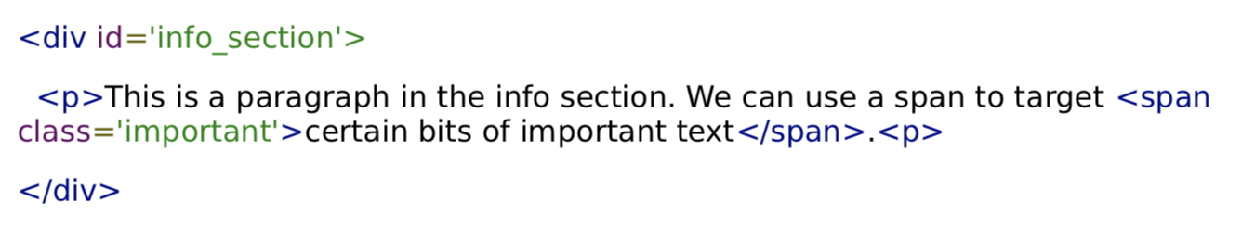
HTML: Div and span
<div></div> stands for division. Block level element
<span></span> is used to apply classes/IDs to sections of text. Inline level element
Note:
Block vs. inline
Notes:
DIv, breaks page into different parts

Slide 19
Universal selector
* {
Font-family: Arial
}

Slide 20
Task
1. Add CSS to your About Me page
Eg. Change font and background colors, font style and size
Create at least one class and one ID and add them to some HTML elements
2. Add one <div> and one <span>

Slide 21
Intro To Github

Slide 22
What is version control?
It lets you track your files over time
If you mess up, you can easily get back to a previous working version
Key to collaborative software development
You can work in teams on the same project
You can manage conflicts in the code in the same file

Slide 23
Advantages (1)
Backup and Restore
You can jump back to any moment in time (even if it was 10 years ago!)
Synchronisation
Share files with people
Stay up-to-date with latest version
Short Term and Long Term Undo
If you mess up, go back to the last known good version

Slide 24
Advantages (2)
Track Changes and Ownership
Every file change receives a message
The person making the change is logged as well
Sandboxing, branching and merging
Insurance against yourself
Test a new feature in isolation
When everything is tested ok – merge it to master!

Slide 25
https://github.com

Slide 26
Key Terms! (1)
Repository
The basic unit of GitHub
A single project folder containing all files
https://github.com/claredevine/personal-website
Branches
Every repository has at least one branch called Master
Branches allow you to work on different parts of a repository at the same time

Slide 27
Key Terms! (2)
Commit
A change in a repository
Every commit needs an associated message describing the change
Commits help others understand what has been done to a repository
https://github.com/claredevine/rangers-website/pull/10/commits
Issue
A note on a repository about something that needs attention
Pull Request
A request to the repository owner to include your code in their project
https://github.com/claredevine/rangers-website/pull/10

Slide 28
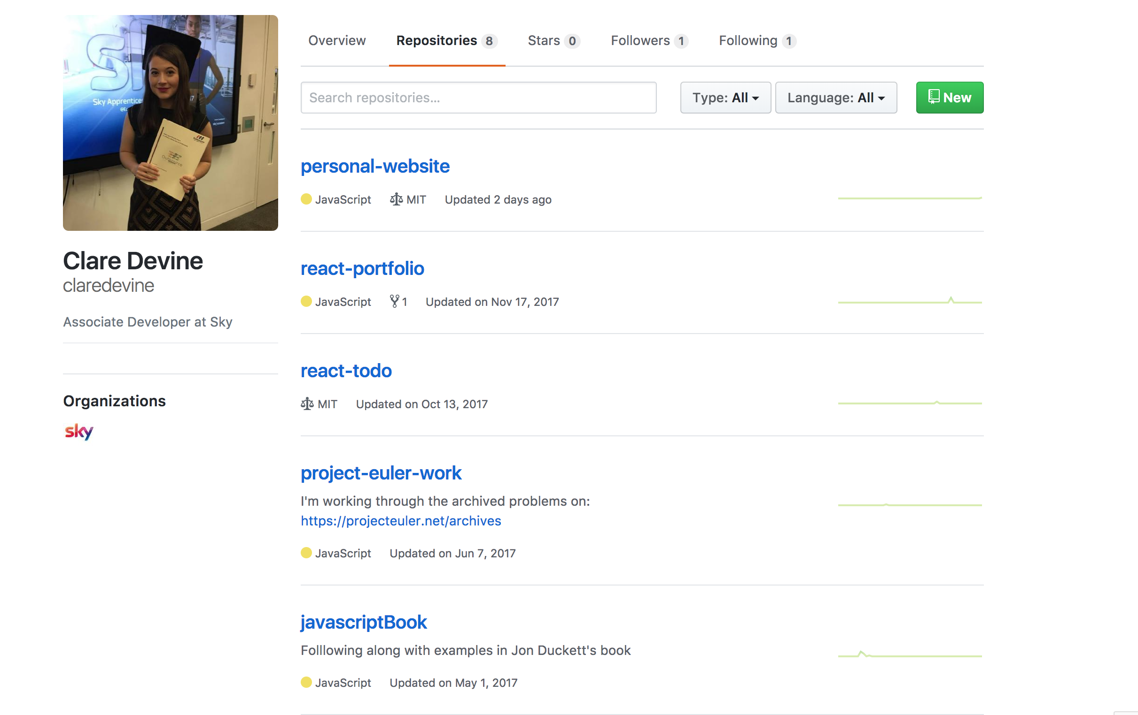
Creating a Repo

Slide 29
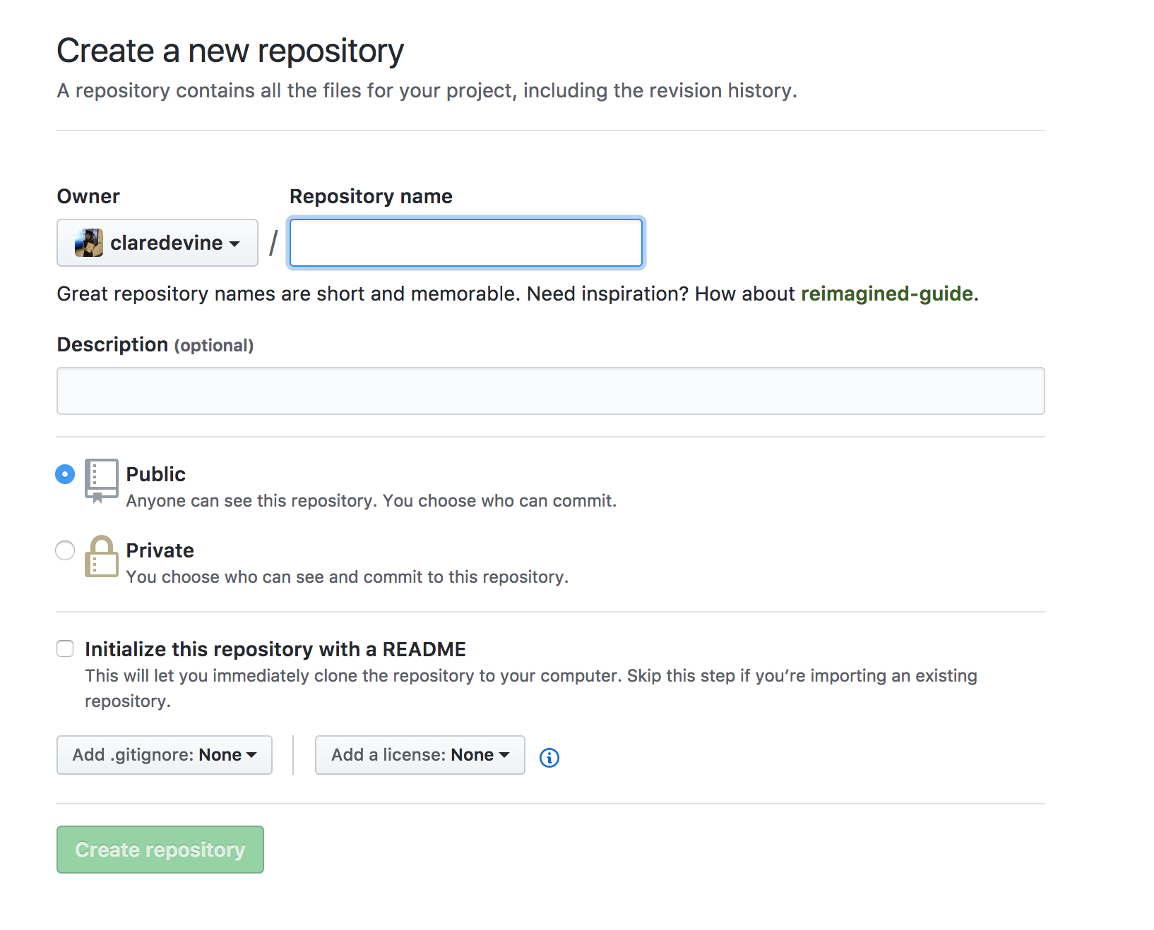
Creating a Repo

Slide 30
Command Line
Mac – Terminal
Windows – Command Prompt

Slide 31
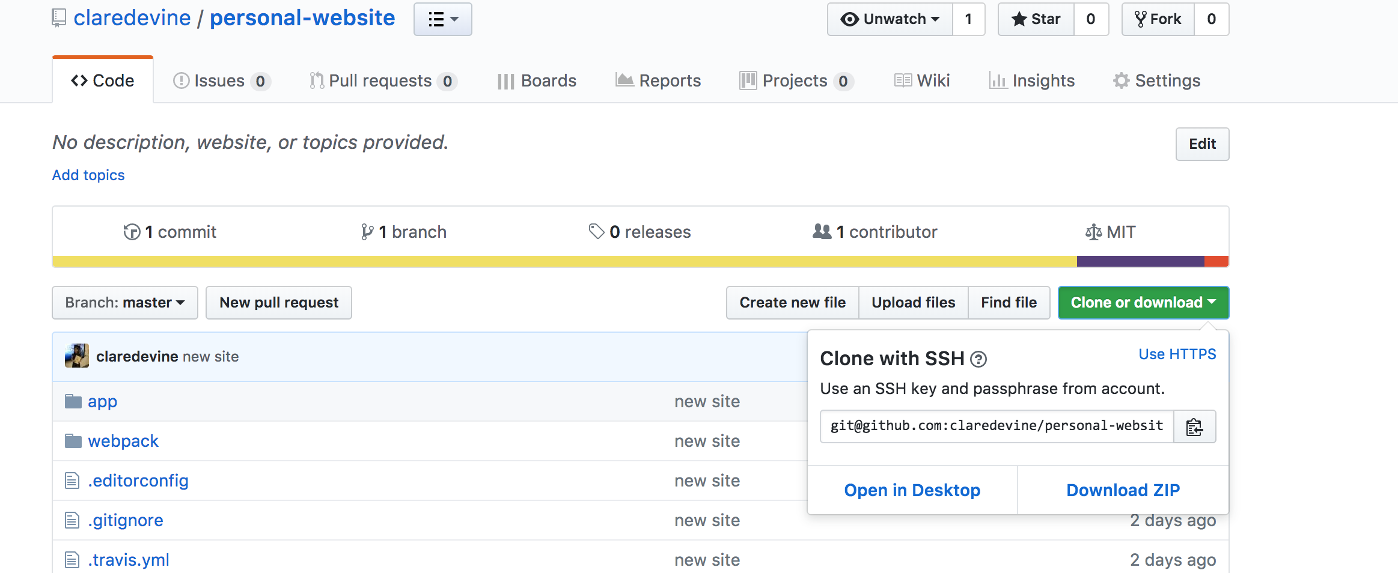
Creating a repo

Slide 32
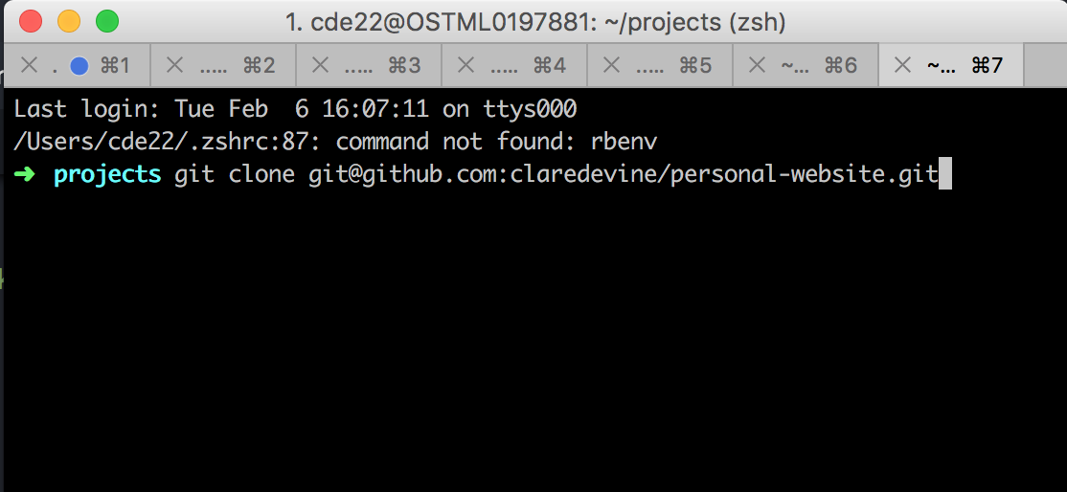
Creating a repo
Then open the file in your code editor!!!

Slide 33
Creating a Repo
cd <REPOSITORY-NAME>
git checkout –b trial-branch

Slide 34
Important commands to know
Committing to a branch
git add .
git commit –m “Message here”
git push
Updating your local version of master
git pull

Slide 35
Competition
Groups of 2-3
Aim to form teams by week 3
Prize = Amazon vouchers
Some of the previous winners:
http://www.codefirstgirls.org.uk/course-competition.html

Slide 36
Competition Guidelines
1. Visually appealing design - good use of CSS, HTML elements, and
Twitter Bootstrap
2. Good formatting:
• Code split into the appropriate files
• Files indented properly
3. Website live on internet (Github page, Heroku or own domain)
4. Extras e.g:
• A contact form (for example name and email)
• Social buttons
• Widgets (eg. )
• A variety of HTML elements (eg.
Note: interactive elements eg. Forms don’t need to work, just be visual
5. (optional) Good organisation
•Version control using GitHub
•Sensible commit messages
Notes:
For those who want to get their interactive elements working, I’m happy to run an extra session to show you how to do this!

Slide 37
Homework!
1. Project 3 on General Assembly Dash
2. Find out what these terms mean:
Framework
API
Toolkit
Library
See you next week!

