Slide 1

PRE-SEED · APRIL 2026
Via
Travel by way of trust.
A three-sided marketplace where creators, stay owners, and travelers exchange influence for access.

Slide 2

The problem
The content-for-stay market runs on cold DMs and lost threads.
FOR CREATORS
FOR STAY OWNERS
FOR TRAVELERS
Pitch into the void.
Drowning in unfit asks.
Reviews don't scale trust.
Hundreds of DMs, no templates, no tracking. No way to prove audience fit before the "no."
Inboxes flooded with creators who will never convert. No signal on audience, no deliverable follow-through.
They want the place their favorite creator actually stayed at — not the one with the most 5-star reviews.
Via
02 / 11

Slide 3
Why now
Creators are the new travel agents.
And the plumbing underneath them is still duct tape.
74%
$500B
3.5x
2M+
of Gen Z travelers say creators influenced their last trip
global short-term rental and boutique stay market
booking intent lift from a creator endorsement vs. ad
mid-tier travel creators with 10K–500K followers globally
Phocuswright, 2024
Skift + AirDNA
MediaKix meta-analysis
HypeAuditor 2025
Via
03 / 11

Slide 4
The solution
Via turns content-for-stay into a marketplace.
WHAT'S BROKEN
WHAT VIA SHIPS
Creators pitch in cold DMs, one-by-one
Application inbox with audience-fit scoring
Owners comp stays with no deliverable proof
Deliverable tracker with approval gates
Travelers book on strangers' reviews
Creator-curated discovery for travelers
Nobody can measure what a stay actually earned
Automatic commission on every booking back to the creator
Via
04 / 11

Slide 5
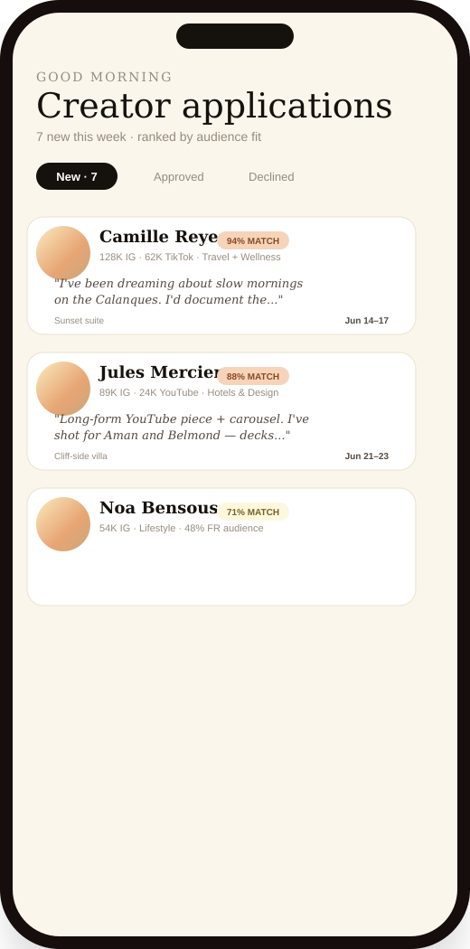
Wedge
We enter as the CRM for content trades.
Own the operational surface first. Marketplace follows the data.
Match-fit scoring
Every application is ranked by audience-fit — not just follower count.
Deliverable tracker
Live owner inbox.
Applications ranked by fit.
Stays don't get comped without proof. Every post has an approval gate.
Owner-first UX
Replaces Gmail folders, Notion trackers, and "did they ever post?" spreadsheets.
Via
05 / 11

Slide 6
Flywheel
Three sides, one loop.
deliverables
CREATORS
STAY OWNERS
apply, post, earn commissions
list, curate, measure reach
TRAVELERS
discover, book, trust the creator
commission
stays
Every booking pays the creator whose content surfaced it — so creators keep curating, owners keep listing, travelers keep trusting.
Via
06 / 11

Slide 7
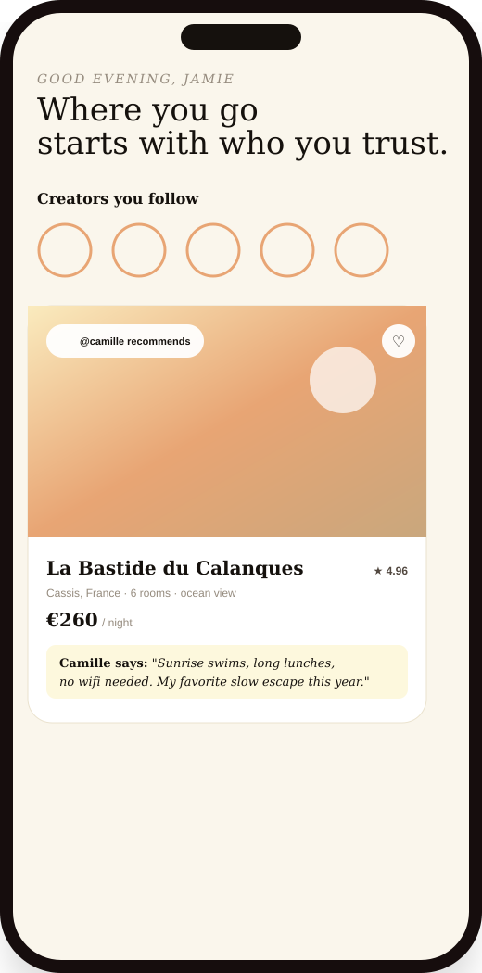
Marketplace
Creators become the shelf.
Where Airbnb sorts by reviews, Via sorts by who you trust.
Follow-graph discovery
Creator-curated collections
Travelers see stays featured by creators they already follow.
Each creator becomes a storefront of vetted stays.
Commission transparency
Two-sided reputation
"Supports @camille · 10%" is shown in the price — not buried in fine print.
Owners rate creators. Creators rate owners. Travelers see both.
Via
07 / 11

Slide 8
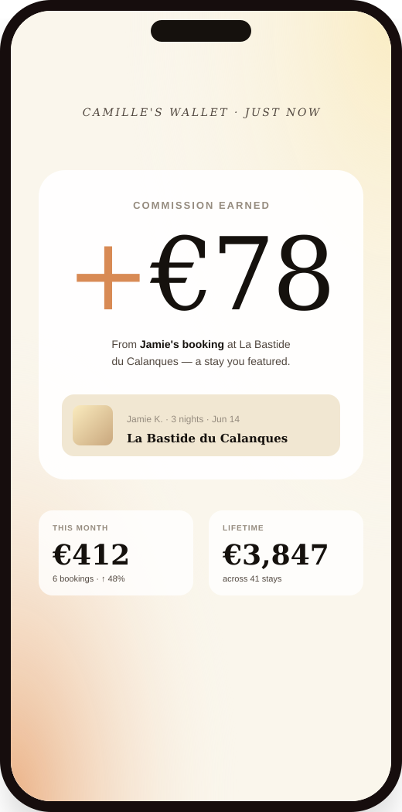
Monetization
Three revenue lines, all aligned.
10%
BOOKING TAKE RATE
On every traveler booking. Creator earns it back; Via keeps 10% of that cut.
$9.99
PREMIUM (CREATOR)
Unlimited applications + priority review + enhanced analytics. Free tier = 1 application / month.
15%
PREMIUM LIFT
Premium creators earn a higher share on bookings they drive — from 10% → 15%.
Creator sees the money. The loop compounds.
Via
08 / 11

Slide 9
Market
Built on two of the biggest consumer markets.
TAM
$500B
TAM
Global short-term + boutique stays market.
SAM
Skift, AirDNA 2024
SAM
$48B
SOM
Influencer-driven travel spend in NA + EU.
$240M
3.5x booking-intent lift × 74% of Gen Z influence
SOM
$240M
Reachable 3-yr: 2M creators × 1.2 bookings/mo × €100 avg × 10%.
Bottom-up, conservative
Via
09 / 11

Slide 10
Founder–problem fit
Why Cierra. Why now.
Founder of Charmed Collective
[ Placeholder — years running the agency, number of creators managed, brand deals closed. ]
[ Portrait ]
Lived the problem daily
[ Placeholder — e.g., "personally ran 200+ content-for-stay trades across Airbnb + boutique hotels before building Via." ]
Network on both sides
Cierra Bellamy
[ Placeholder — warm intros to [N] creators and [N] stay operators ready to onboard at launch. ]
FOUNDER & CEO
Via
10 / 11

Slide 11
THE ASK
We're raising $[ X ]
to launch Via in [ City ] with 50 creators and 20 stays.
40%
Product
40%
Go-to-market
20%
Founding team
MVP polish, two-sided auth, payments, trust + safety.
Seeding the first 50 creators and 20 stays in the pilot city.
One engineer, one creator-ops lead alongside the founder.
Travel by way of trust.
cierra@charmedcollectiveagency.com

