Slide 1

Welcome To CS15!

Slide 2
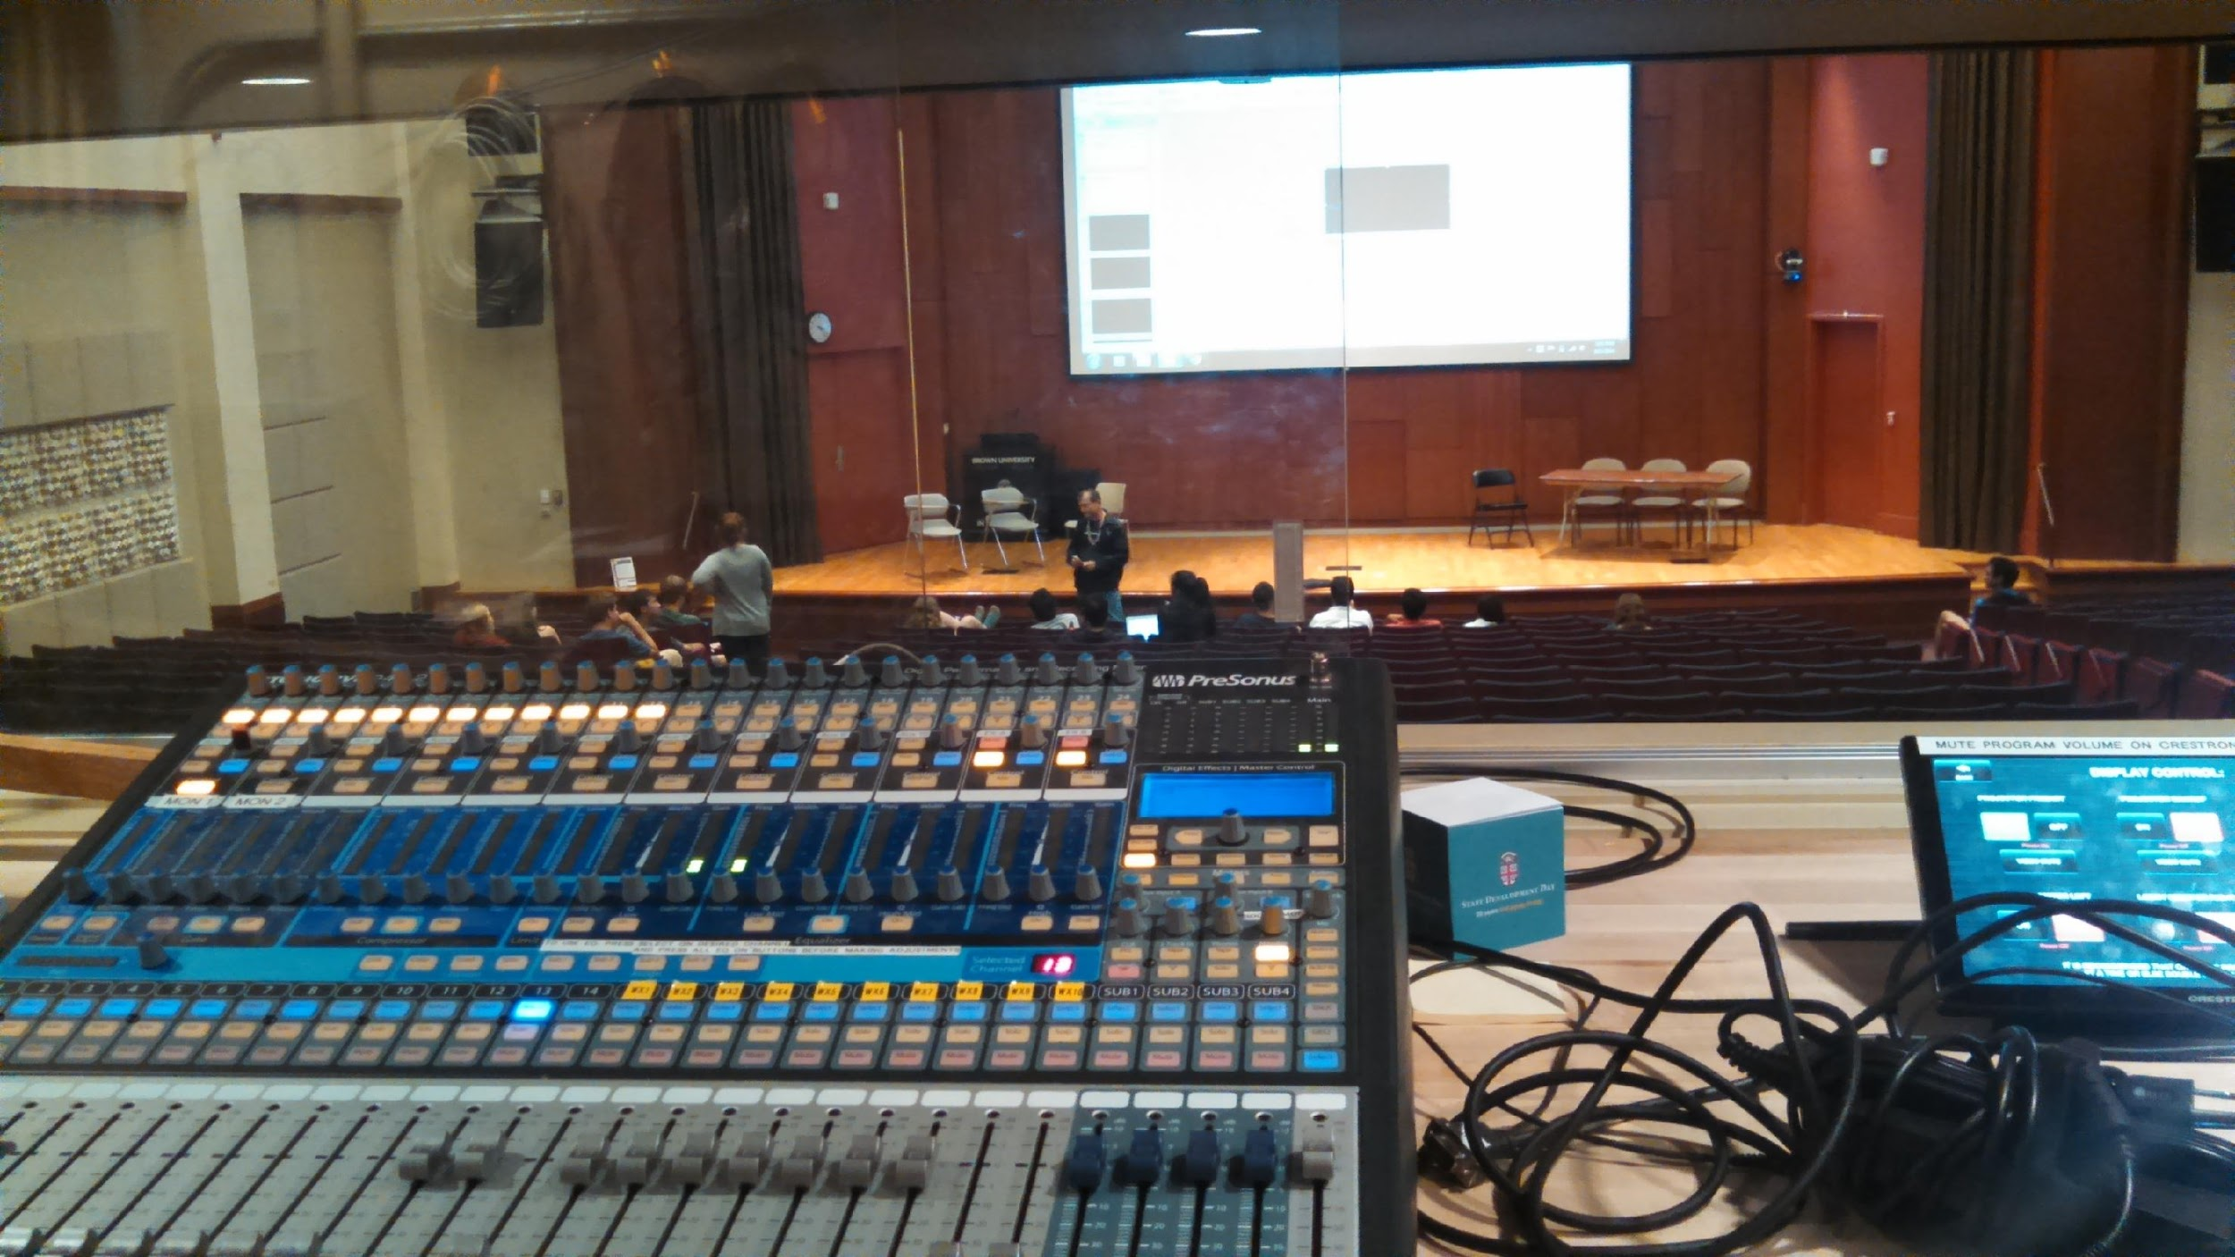
Welcome to CS 15 in Salomon 101!
We encourage you to download the PowerPoint slide deck before lecture and bring your laptop – lets you see clearly and annotate
http://cs.brown.edu/courses/cs015/
We record and give you web access to every lecture
for review
in case you have to miss a lecture
PowerPoint slides come with
associated recording

Slide 3
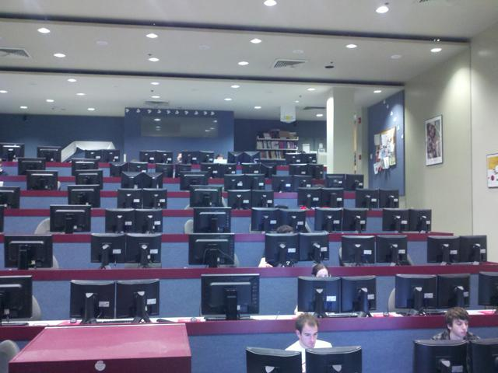
Our Hardware
The Sunlab: 80 PCs running Debian Linux
File Servers
terabytes of disk space for your programs
Can work from your dorm room on your own computer
there will be a Working From Home session
help slides from session will be posted online!

Slide 4
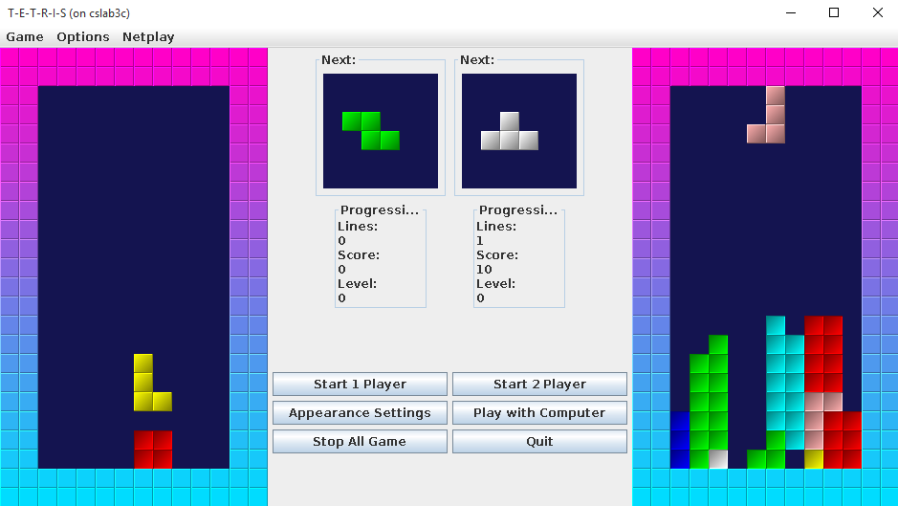
CS15 is All That
Teaches Object-Oriented Programming (OOP)
most common current programming methodology
Brown was earliest to switch to Java for intro courses more than a decade ago
still a dominant web programming language (e.g., Google’s Android)
Teaches fundamental problem solving skills useful in all disciplines
Provides introduction to computer science concepts
Is intense, but fun, especially with interactive graphics
Uses games as a domain, but teaches skills applicable across domains
not a game design course (we have those too, 2D and 3D game engine design)

Slide 5
Who is CS15 For?
Students with varying levels of programming experience, including NONE!
however, CS15 still requires a serious commitment
Most students have little or no programming experience, including the TAs and HTAs when they took the course!
Prospective CS concentrators, who will go on to CS16
This is not a weeding-out course, but is still very difficult
don’t worry!! We expect lots of confusion in the beginning. All 50 TAs are here to help you!

Slide 6
Diversity & Inclusion in CS15
CS15 welcomes all, helps you succeed, and aims to build community. These additional groups are also here for you:
Mosaic+ mosaic.plus.brown@gmail.com
“created to foster Community, inspire Innovation, and provide opportunity to underrepresented minority students.”
Women In Computer Science (WiCS) wics@lists.cs.brown.edu
“formed by female undergraduate students at Brown in the late 1980s, The goal of WiCS is to increase the participation of women in the field of Computer Science.”
Women in Science & Engineering (WiSE) WiSE@brown.edu
“to encourage women who study in all science and engineering fields, by building a community of like-minded scholars that provides peer support on their journey to becoming successful scientists at Brown and beyond.”
Our own CS15 mentorship program!
more on this later

Slide 7


Why Java
Supports interactive OOP
Syntax similar to C++ but simpler, cleaner, and more beginner-friendly
Allows platform-independence: write once, run everywhere (in principle)
One of the most prevalent languages in industry today, e.g., Android, web servers (others include C, C++, C#, Python, Ruby, etc.)
Note: not the same as JavaScript, a less purely object-oriented language used commonly in web applications
OOP is one of several programming paradigms – CS17 uses ReasonML and Racket for “functional programming”

Slide 8
Course Mechanics (1/4)
No quizzes or exams!
no exam time pressure
no “grading on a curve”: you do the work, you get the grade you deserve! Thus A is by far the most common grade
9 Assignments
8 programming assignments, some of which have a design component
from brief homework to Tetris and beyond!
choose from a selection of final projects, or create your own “indy” project
all programs must meet a baseline level of functionality to receive credit, lots of room for “bells and whistles” for fun and extra credit
all programs must be handed in with baseline functionality by end-of-semester!

Slide 9
Course Mechanics (2/4)
Assignments are graded on a hand-in schedule
most assignments have early, on-time, and late hand-in
early hand-in: 2% increase to your grade
late hand-in: 8% decrease from your grade
all assignments must be handed in before the end of the course
TopHat “clicker” questions during lecture
interactive question platform to improve engagement and comprehension
accounts for 5% of your final grade
Weekly discussion/lab sections
graded on mini-assignments and participation
accounts for 12% of your final grade

Slide 10
Course Mechanics (3/4)
Keys to success
increase in program size and complexity throughout the semester
you can’t procrastinate and then cram, unlike in some other courses
start early, start today, start yesterday!!!
other courses don’t teach you to tackle programs of this complexity
TA Hours
45 TAs and 5 Head TAs
180+ TA hours of personalized help per week!!!
more than in any other course!
everyone struggles sooner or later, including the TAs – part of the learning process
we strongly encourage you all to go to hours and get to know the TAs - it is integral to the course (and NOT a sign of weakness!)

Slide 11
Course Mechanics (4/4)
CS15 thrives on your feedback
Questions highly encouraged during lecture! And we will add TopHat questions next week…
We provide a lot of written material; YOU are responsible for digesting all of it

Slide 12

Major Changes This Year (1/2)
Scheduled Conceptual Hours
resource for students to talk about course material
work on mini assignments for section
hopefully gives you the tools to solve your own bug!
Being next on TA hour lines > Pretzel Day

Slide 13

Major Changes This Year (2/2)
Weekly Diagnostics
self-diagnostics at the end of every week
make sure students comprehend the material seen
go over answers at Conceptual Hours

Slide 14
Alternatives to CS15 (1/3)
For Concentrators & Non-concentrators:
CS17 (fall semester) – John Hughes
also, no prior experience required
multiple programming paradigms
multiple programming languages
Racket, ReasonML in CS17; then Java, Scala in CS18
mastery, not mystery → no magic
focus on problem-solving skills/strategies
emphasis on abstraction and scale
integrate programming with analysis of algorithms
multiple application areas (AI, databases, etc.)
pair programming for labs and projects
for more information on other CS courses: http://cs.brown.edu/degrees/undergrad/whatcourse/

Slide 15
Summary of CS15/17 Choice
Both will adequately prepare you for upper-level courses
No prior experience needed for either, similar work loads
Different material covered
CS15 - Object-Oriented Programming, CS17 – Functional Programming
CS15 is more practice-oriented, CS17 is more foundations-oriented
CS15 celebrates magic, while CS17 emphasizes no magic
CS15 has little reliance on TA support code, but uses JavaFX extensively
CS15 allows collaboration on:
mini-assignments, sections, labs
No pair programming on projects
but no tests
CS15: games and skits
Pick based on your taste and what works for you

Slide 16
Alternatives to CS15 (2/3)
For Concentrators & Non-concentrators:
CS0111 (Fall + Spring) – Doug Woos
no prior experience required
the first in a new introductory computing sequence that spreads the foundational concepts over three courses rather than two
“allow more time to combine CS with other studies & mastering the fundamentals”
functional programming and imperative programming
learn Pyret and Python
integrates programming with data science and discussion of use of digital information
less intensive workload
capped at 60 Students, only sequence that is currently capped
fill out this form to be added to waitlist: https://docs.google.com/forms/d/e/1FAIpQLScIqNtQgzQxSytrtsBU1FaKlSMKtmW1axFsNbEod6SjByRWEg/viewform

Slide 17
Alternatives to CS15 and CS17/19
For Non-concentrators:
CS10: Data Fluency for All (Fall) - Amy Greenwald
introduce data literacy, basics of statistics, machine learning, data communication
hands on experience using statistical tools such as 'R' to analyze real world data sets, and 'ggplot' to visualize them.
CS20: The Digital World (Fall) - Donald Stanford
introduction to computing; little emphasis on programming
discusses computing topics such as artificial intelligence, IT security, and digital media
a small introduction to HTML, Photoshop, Access, and Python
CS60: Practical System Skills(Fall) – Leonhard Spiegelberg
introduction to develop hands-on-computing necessary skills to work in a UNIX-like operating system
operating the shell, file system, bash scripting, SSH, version control via git, user and file permissions
locally develop, deploy, and publish a website

Slide 18
Collaboration (1/5)
Brown’s Academic Code
“Academic achievement is evaluated on the basis of work that a student produces independently. A student who obtains credit for work, words, or ideas that are not the products of his or her own effort is dishonest and in violation of Brown’s Academic Code. Such dishonesty undermines the integrity of academic standards of the University. Infringement of the Academic Code entails penalties ranging from reprimand to suspension, dismissal, or expulsion from the University.”

Slide 19
Collaboration (2/5)
CS15 Collaboration Guidelines
Lectures
always allowed to review and discuss with your peers!
Mini-assignments
collaboration and discussion are allowed and encouraged
Lab Section
collaboration and discussion are allowed and encouraged
Programming Assignments
discussion allowed only in Design Section and Conceptual Hours!

Slide 20
Collaboration (3/5)
MOSS (Measure of Software Similarity)
Stanford-hosted AI software used to detect plagiarism - it signals undue similarity and we hand-check the code
used across industries in multi-million dollar lawsuits to protect intellectual property
every year, MOSS finds multiple collaboration violations (we check multiple years!)
last year, 14 cases with 2 or more students each
punishments typically directed NC, parental notification
MOSS is very good at what it does - don’t even think of trying to outwit it! (which is more work than doing the assignment!)
we also check the web
If ever in doubt about what is allowed, ask a TA!
Better to NC an assignment or even the course than being accused (and likely convicted)!
Note we have a Regret Policy

Slide 21

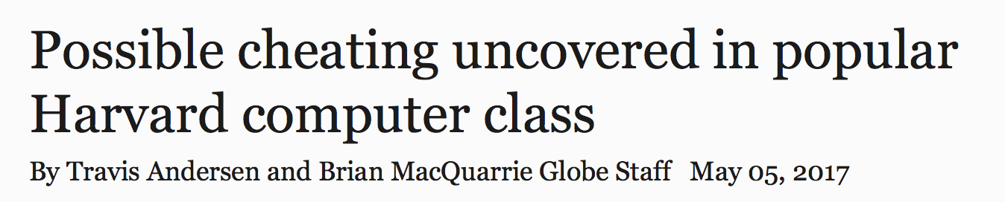
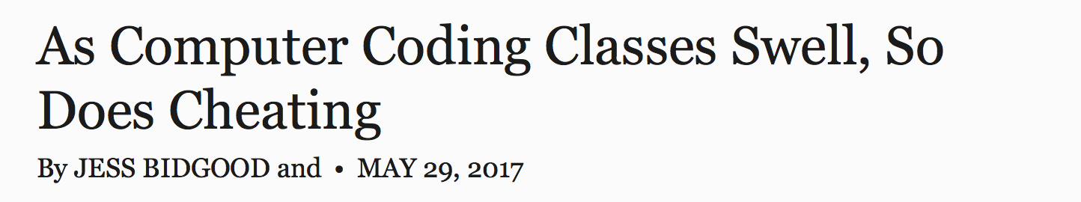




Collaboration (4/5)
The issue of collaboration in intro courses has been in the news in past years:

Slide 22
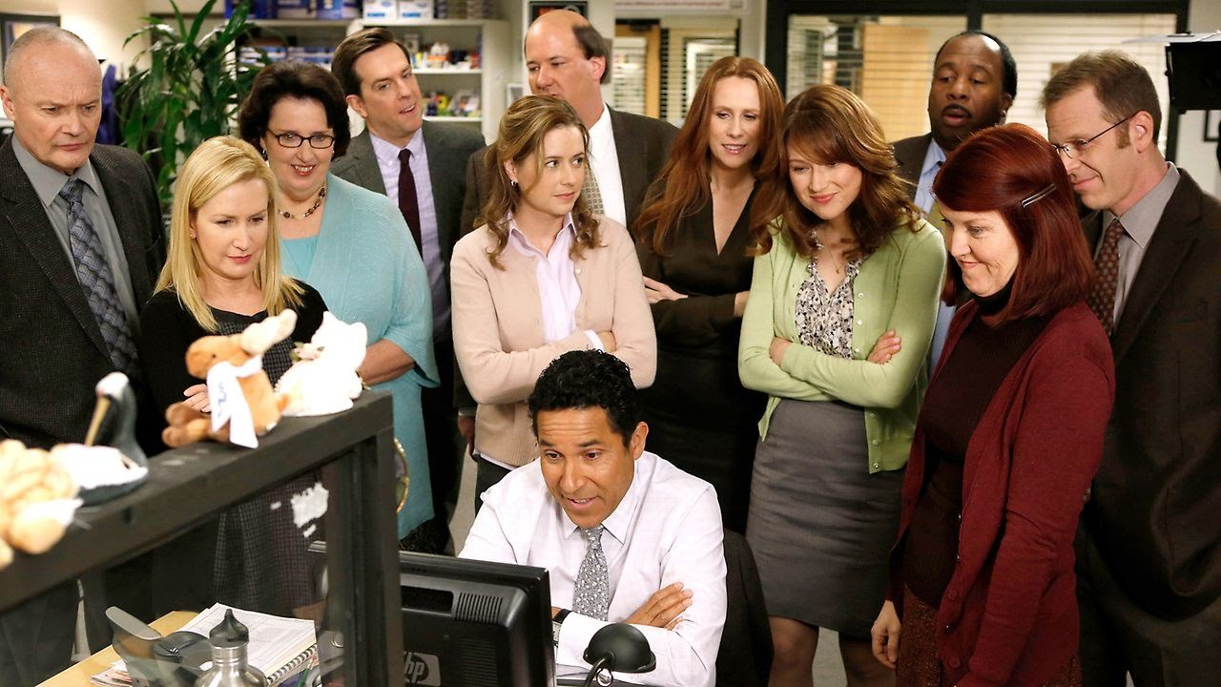
Collaboration (5/5)
Collaboration is not worth the risk
start early and get help when you need it! Lots of resources available to help you succeed in this course

