Slide 1

Game Genre Classification
Sara Cogoli, Hannah Dees

Slide 2

Research question:
How accurately will the machine model classify video games into genres using user-inputted text features, tags, and descriptions?

Slide 3
The overall goal for this project is to create a keyword-driven search tool that helps users discover games by concept rather than by name or popularity. This makes it easier to explore genres, find similar titles, and understand how text-based features can influence classification.
Our Main Goal

Slide 4
How our project works
How the user interacts:
How the model runs:
First, load the model and folder into VisualStudio Code
Then, think of types of games you would like to search for
Lastly, search any keyword or description into the model's search input, and the model will match you with similar games.
A BERT tokenizer converts text into model-ready input
A machine learning classifier predicts the primary genre to display
The system retrieves and displays games that match the predicted genre

Slide 5

Dataset Overview
We are using a Steam Game Dataset from Kaggle.
The dataset holds over 40,000 games
The fields included in the set we used: titles, descriptions, tags, and genres.

Slide 6

Key Techniques
-Text Processing:
Combined multiple text fields into a single input string
Cleaned and normalized text
Tokenized text using BERT tokenizer
-Feature Extraction:
Used BERT embeddings to generate contextual representations of each game.
Explored Word2Vec as an alternate feature extraction method.
-Keyword Search:​
Implemented a simple keyword search tool​
Mapped user keywords to the closest game genre using the classifier​
Returned a list of games whose embeddings are most similar to the user's input

Slide 7
Key Techniques
-Classification:
Trained and supervised a machine learning model to predict the primary game genre
Evaluated multiple classifiers
Measured performance accuracy, precision, and recall
-Clustering:​
Used clustering to support keyword-based game recommendations
Compared cluster grouping to actual genres to analyze model behavior

Slide 8
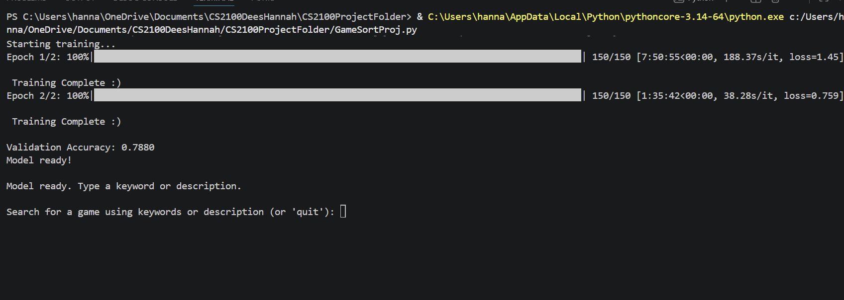
First Training Performance Review
We first used only 3000 items from the set to get the original train
It trained to 78% accuracy

Slide 9
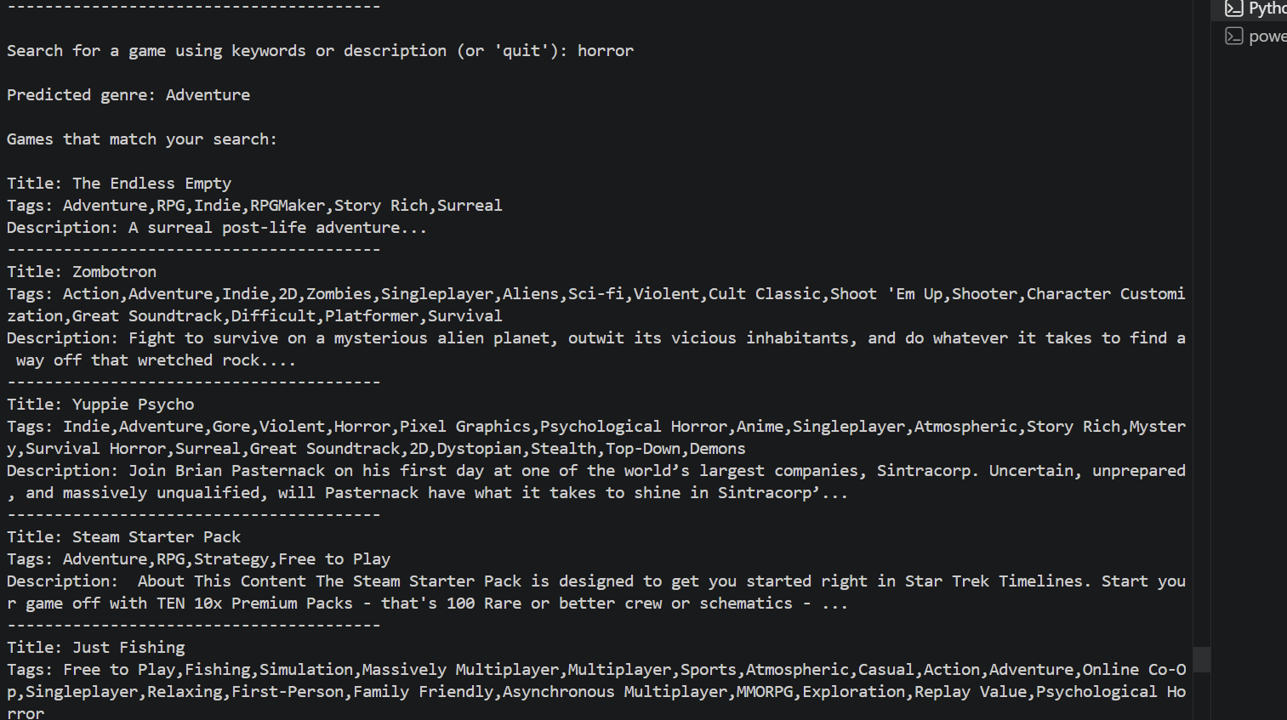
Second Training Performance Review
We then used 9000-12000 items to train with
Both outcomes had a 90% accuracy

Slide 10
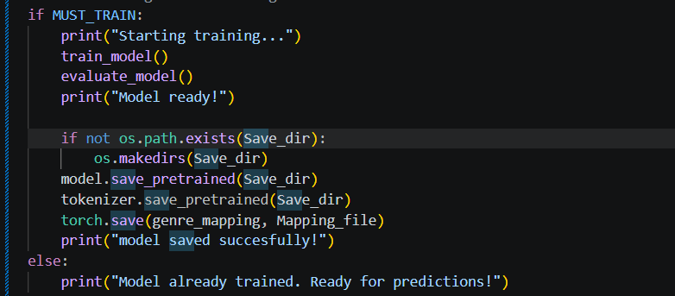
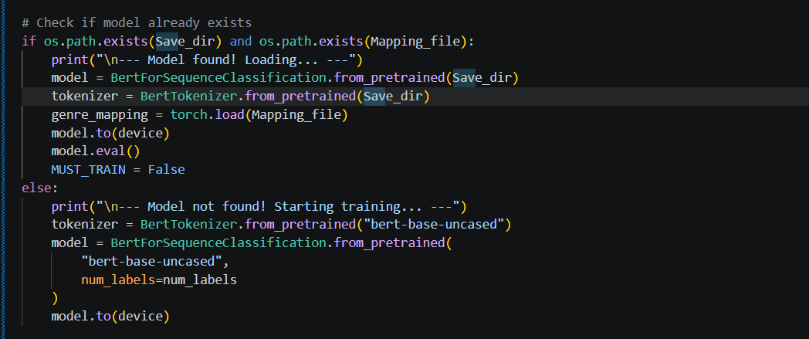
Saving Our Model
Our model,using torch contains torch.save

Slide 11
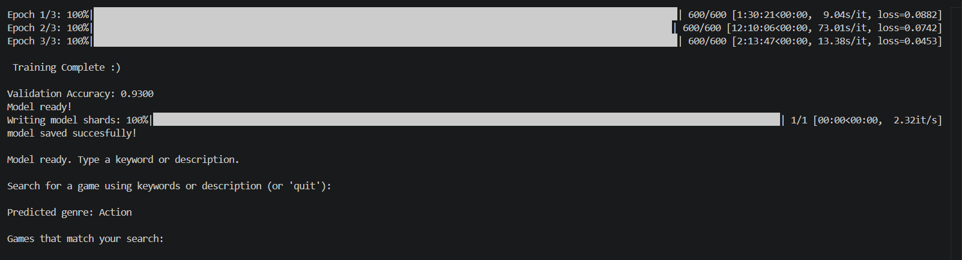
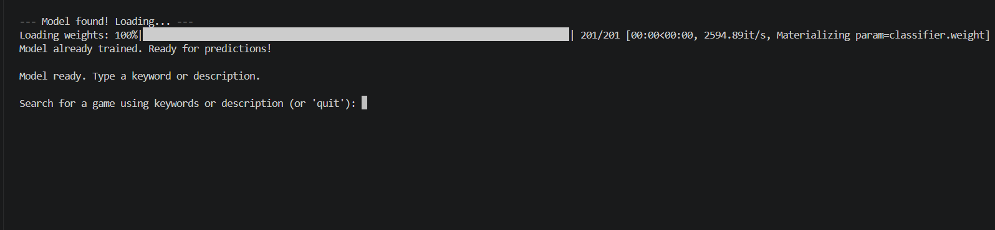
Final Training Performance Review

Slide 12

Thank you! Questions for us?

