Slide 1
Yelp, For Travel Help!
A Flask/JavaScript Travel Guide
Notes:
Hannah starts us off by reading the title.

Slide 2
Purpose of Project
When planning your next trip, it’s easy to know where you want to go! The hardest part is knowing that all your necessities are covered when you get there. With this in mind (and a very helpful API from Yelp), we made a travel guide to assist in your decisions on hotels and restaurants. The map and graph visualizations are customizable and easy for users of any skill level.
The maps and graphs show the top-rated hotels and restaurants for the areas you plan to visit
You can easily filter down to the category and city you’re looking for.
See the locations of each marker on the maps so you know exactly where you’ll be!
Features
Notes:
Hannah made the copy, so Hannah reads the copy.

Slide 3

Sample Yelp API Data
Average Ratings (by Consumer)*
We selected the 10 most populous cities in the United States and used the Yelp API to gather data about them.
The data consisted of information you would have in mind when traveling to a new place: Hotels, Restaurants, and so on.
We then used the most common aspect of Yelp, consumer reviews/ratings, to make comparisons between the cities.
Categories | Austin | New York
Hotels | 3.2 | 2.6
Restaurants | 3.8 | 4.3
*this is sample data. Made up. Fake. All lies.
Notes:
Jeremy takes over here, says some awesome stuff.

Slide 4
The Long and Winding Road (How it was made)
Using Python/JSON, we made API calls to Yelp and made data files that we could examine for key phrases, structure, etc.
Once the data was secured/analyzed, we began building a Flask app to be the backend of our application. This would handle the requests made in the front end by the user.
We built our frontend, user-facing website with HTML, CSS, JS, and Leaflet for a dynamic user interface.
Finally, we set up the dropdown menu selection for the user, the bar charts, and the marker/popups for the selected cities.
Step 1 Extract the Data
Step 2 Flask
Step 3 JavaScript
Step 4 Finished Product
Notes:
Elijah comes in with his 16 bars

Slide 5
Yelp API
Convenient & free!
Notes:
Julianne comes in, reading every single word.

Slide 6
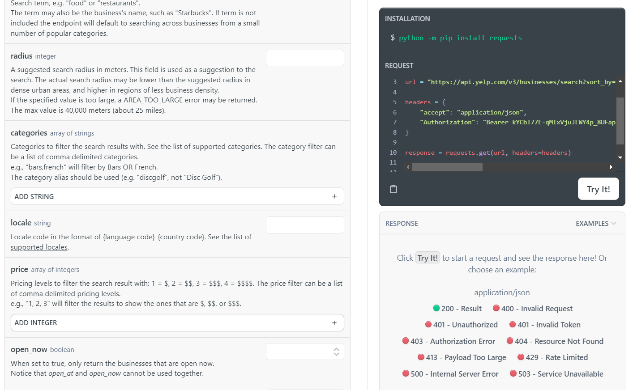
Yelp Fusion API Features
Sample code for a quick start to coding
API request history to keep track of query limits
Legend for error responses
Access to millions of data points in hundreds of categories
Notes:
Julianne continues.

Slide 7
Flask
Totally functional and easy-to-use
Notes:
I love Flask SO MUCH. Jeremy takes over here.

Slide 8

Flask…
Notes:
Jeremy gets a good laugh out of the class, tears are shed, applause is heard for miles around.

Slide 9
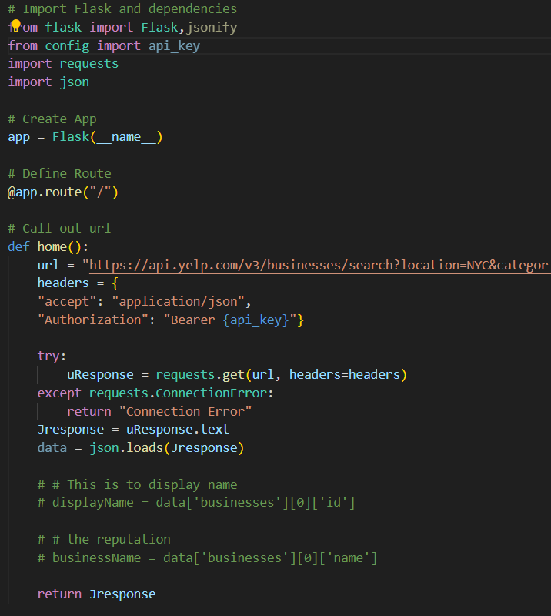
Flask
Our backend and workhorse for our project was Flask.
Flask made requests from our API and grabbed the data for our JavaScript to use and make our displays.
Notes:
Jeremy finishes his faked love of Flask.

Slide 10
Html/JS
Like peanut butter and jelly….or chocolate….or....
Notes:
Elijah jumps in.

Slide 11
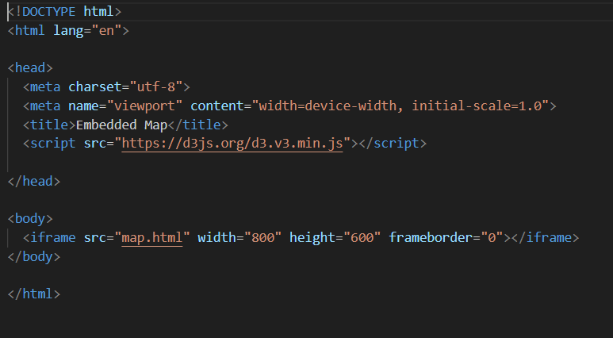
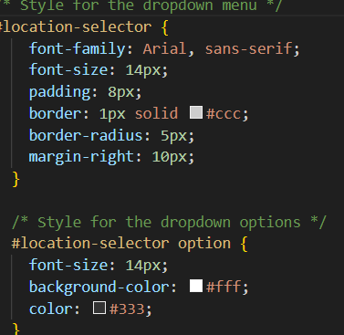
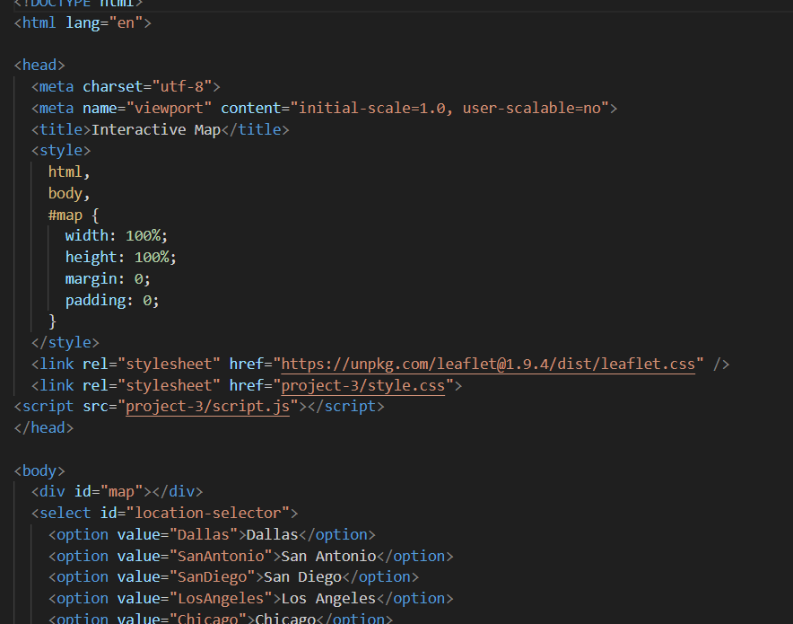
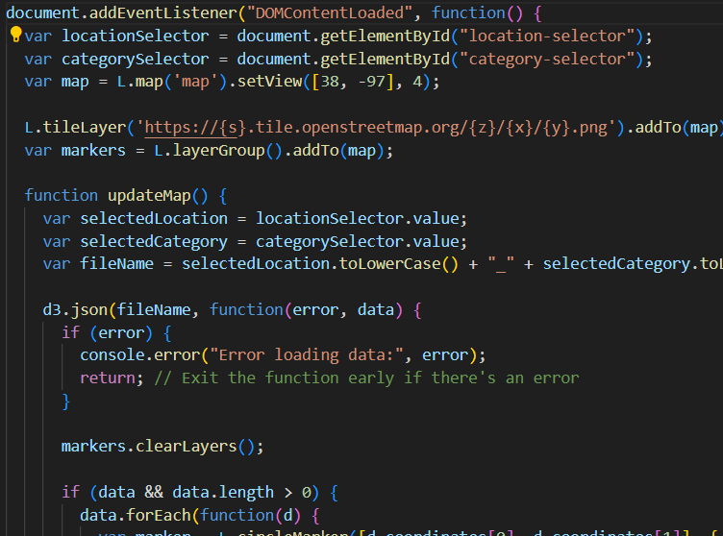
HTML, CSS, JS
We utilized several files to create our web visualizations. (counter-clockwise, from top-left)
1. An index.html file, as our core web document and source location
2. A CSS file for formatting
3. An HTML map file for populating our window map.
4. A JavaScript script file to allow user control of the visualizations and data.
Notes:
Elijah continues with the main components of our Project

Slide 12
Leaflet
You like maps? We put maps IN your maps!
Notes:
Hannah lays down the law

Slide 13

Leaflet
Hopefully will be putting the map we make here. It will be super rad.
Leaflet gave us the power to create markers for our desired locations and bind pop-up messages to each marker, based on user-directed data.
Notes:
Hannah spits truth.

Slide 14
The Finished Project
Look at our beautiful child. LOOK AT HER!
Notes:
Julianne finishes us out

Slide 15
Let’s look at the finished project!
This is where I will put some dope ass screengrabs or a gif of a screen recording. It will be sick. No cap. Deadass. Forreal.
Notes:
Julianne takes it home, woo hoo!

