Slide 1
Yelp, For Travel Help!
A Flask/JavaScript Travel Guide

Slide 2
Purpose of Project
When planning your next trip, it’s easy to know where you want to go! The hardest part is knowing that all your necessities are covered when you get there. With this in mind (and a very helpful API from Yelp), we made a travel guide to assist in your decisions on hotels and restaurants. The map and graph visualizations are customizable and easy for users of any skill level.
The maps and graphs show the top-rated hotels and restaurants for the areas you plan to visit
You can easily filter down to the category and city you’re looking for.
See the locations of each marker on the maps so you know exactly where you’ll be!
Features

Slide 3

Sample Yelp API Data
Average Ratings (by Consumer)*
We selected the 10 most populous cities in the United States and used the Yelp API to gather data about them.
The data consisted of information you would have in mind when traveling to a new place: Hotels, Restaurants, and so on.
We then used the most common aspect of Yelp, consumer reviews/ratings, to make comparisons between the cities.
Categories | Austin | New York
Hotels | 3.2 | 2.6
Restaurants | 3.8 | 4.3
*this is sample data. Made up. Fake. All lies.

Slide 4
The Long and Winding Road (How it was made)
Using Python/JSON, we made API calls to Yelp and made data files that we could examine for key phrases, structure, etc.
Once the data was secured/analyzed, we began building a Flask app to be the backend of our application. This would handle the requests made in the front end by the user.
We built our frontend, user-facing website with HTML, CSS, JS, and Leaflet for a dynamic user interface.
Finally, we set up the dropdown menu selection for the user, the bar charts, and the marker/popups for the selected cities.
Step 1 Extract the Data
Step 2 Flask
Step 3 JavaScript
Step 4 Finished Product

Slide 5
Yelp API
Convenient & free!

Slide 6
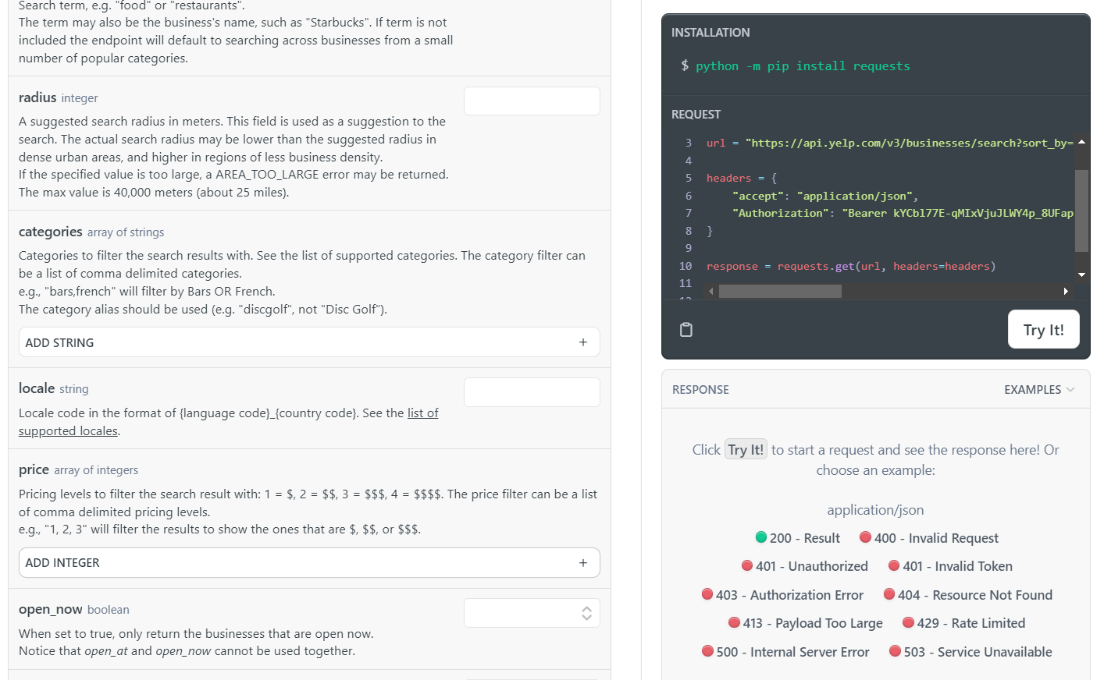
Yelp Fusion API Features
Sample code for a quick start
API request history
Legend for error responses
Access to millions of data points

Slide 7
Flask
Totally functional and easy-to-use

Slide 8

Flask…

Slide 9
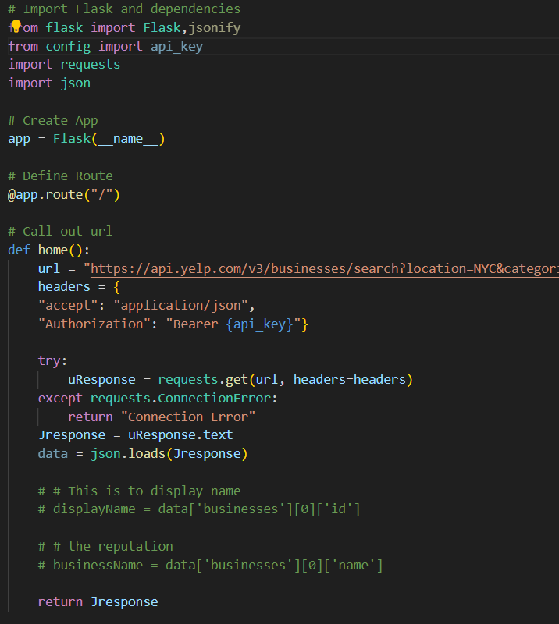
Flask
Our backend and workhorse for our project was Flask.
Flask made requests from our API and grabbed the data for our JavaScript to use and make our displays.

Slide 10
Html/JS
Like peanut butter and jelly….or chocolate….or....

Slide 11
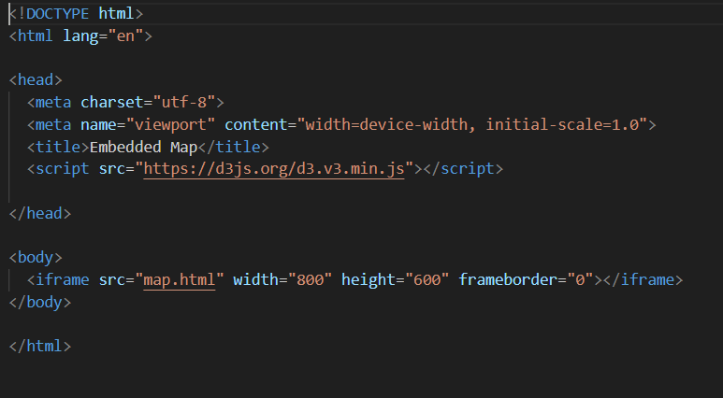
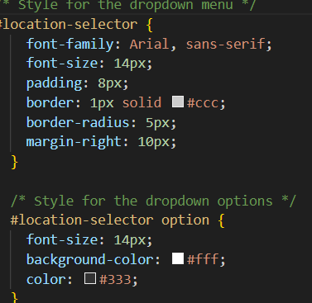
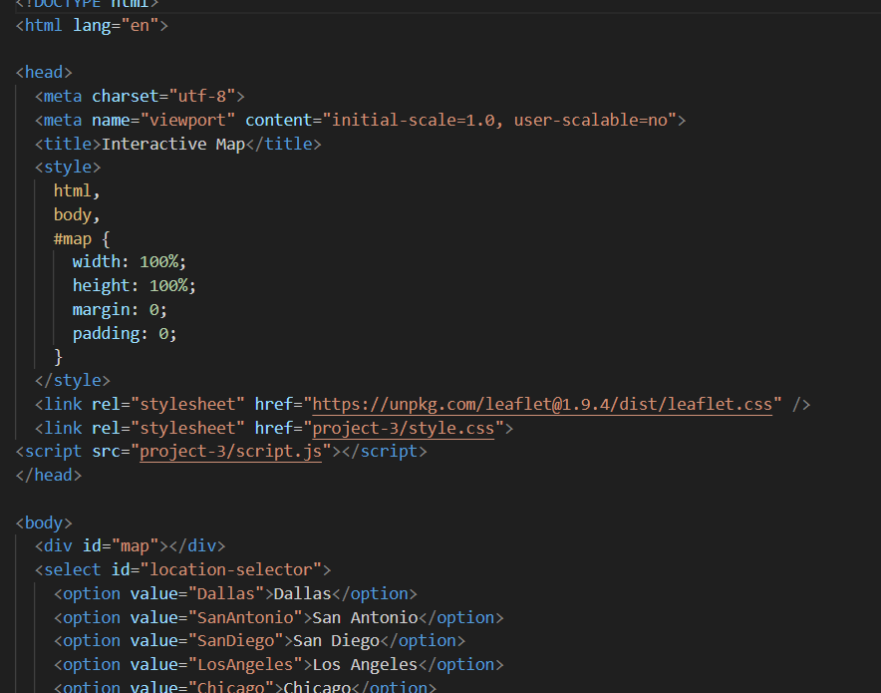
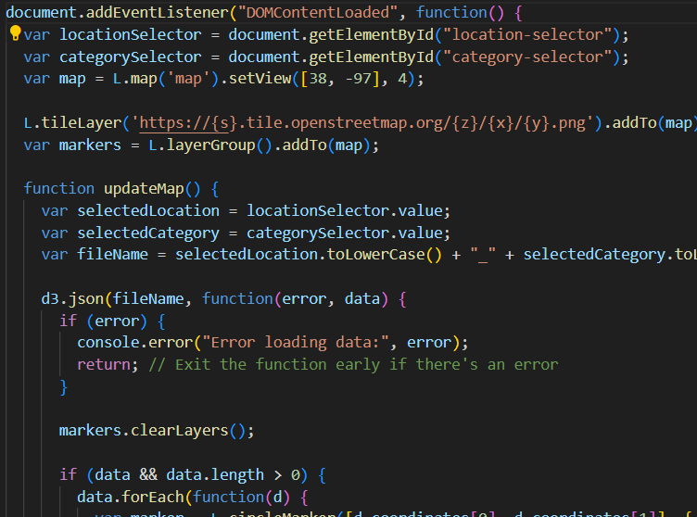
HTML, CSS, JS
We utilized several files to create our web visualizations. (counter-clockwise, from top-left)
1. An index.html file, as our core web document and source location
2. A CSS file for formatting
3. An HTML map file for populating our window map.
4. A JavaScript script file to allow user control of the visualizations and data.

Slide 12
Leaflet
You like maps? We put maps IN your maps!

Slide 13

Leaflet
Hopefully will be putting the map we make here. It will be super rad.
Leaflet gave us the power to create markers for our desired locations and bind pop-up messages to each marker, based on user-directed data.

Slide 14
The Finished Project
Look at our beautiful child. LOOK AT HER!

Slide 15
Let’s look at the finished project!
This is where I will put some dope ass screengrabs or a gif of a screen recording. It will be sick. No cap. Deadass.

