Slide 1
EDA Project for King County WA
Hannah Doyal

Slide 2
Questions and Hypotheses
Question 1: Do the houses in Seattle have worse condition on average?
Corresponding hypothesis: If a house is in Seattle, it is more likely to have a worse condition.
Question 2: Do the houses in Seattle cost more on average?
Corresponding hypothesis: If a house is in Seattle, it is likely to cost more per square foot than an average house in King County.
Question 3: Is having a view correlated with greater square footage?
Corresponding hypothesis: Higher view score is correlated with higher square footage.

Slide 3
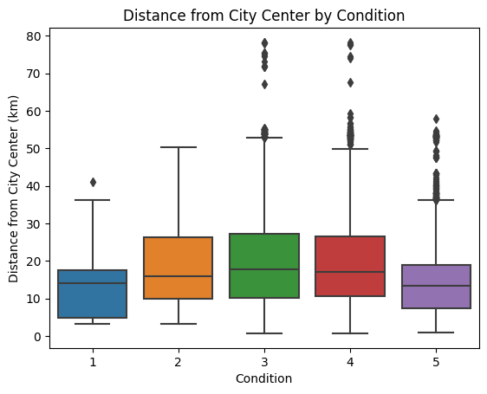
Hypothesis 1: If a house is in Seattle, it is more likely to have a worse condition.
Step 1: Compare the distributions of distance from the city center for each condition scores
Visually this indicates that there is not really a correlation between condition and distance. They all have roughly the same min and median. Conditions 2, 3, and 4 have a slight skew towards further distance, but this is not significant.

Slide 4
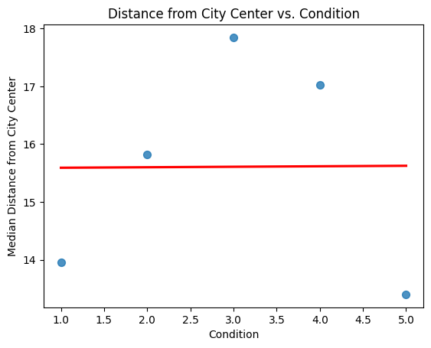
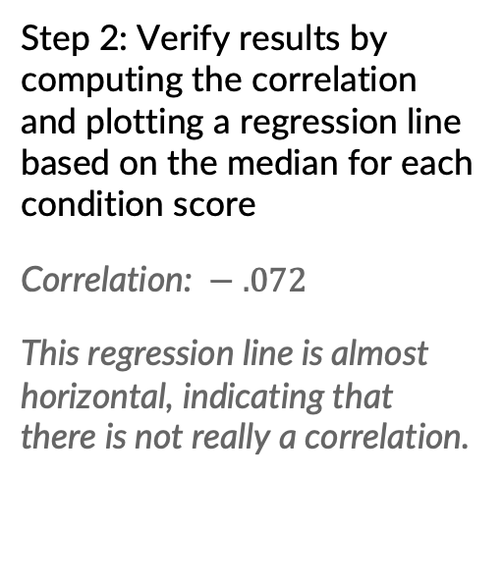
Hypothesis 1: If a house is in Seattle, it is more likely to have a worse condition.
Step 2: Verify results by computing the correlation and plotting a regression line based on the median for each condition score
Correlation: $− .072$
This regression line is almost horizontal, indicating that there is not really a correlation.

Slide 5
Hypothesis 1 Conclusion: This hypothesis was proven incorrect, as there does not seem to be a correlation between the condition of a house and the distance from the city center.

Slide 6
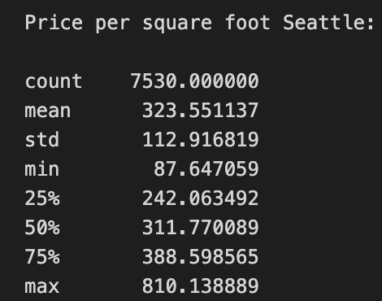
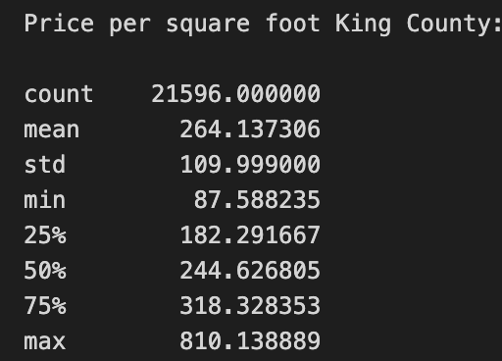
Hypothesis 2: If a house is in Seattle, it is likely to cost more per square foot than an average house in King County.
Step 1: Compare the price per square foot for homes in all of King County as compared with homes only in Seattle
The mean and median of houses in Seattle cost more than the overall values for all of King County.

Slide 7
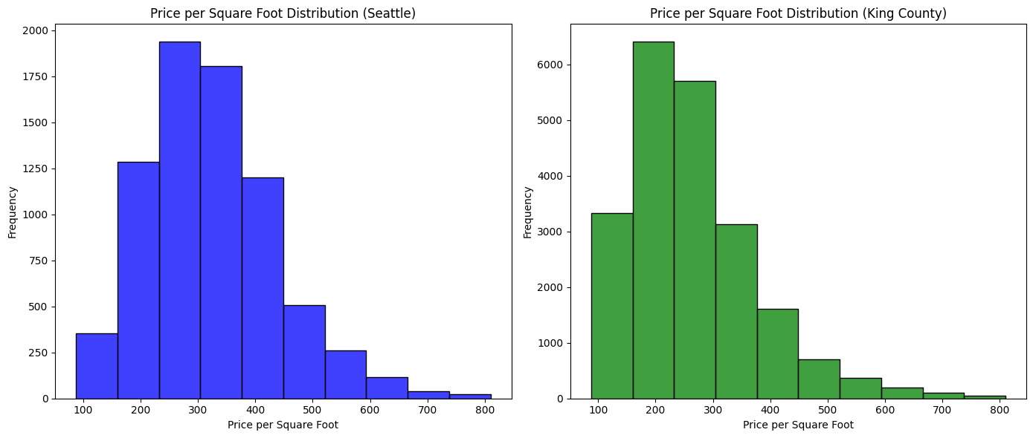
Hypothesis 2: If a house is in Seattle, it is likely to cost more per square foot than an average house in King County.
Step 2: Use a visual aid to confirm this comparison
We can visually verify that the distribution for King County is more heavily concentrated to the left than Seattle. Relative frequency is important here, which is why the y-axes don’t need to correspond.

Slide 8
Hypothesis 2 Conclusion: This hypothesis was proven correct, as the mean and median cost per square foot are greater for houses in Seattle as compared to all of King County.

Slide 9
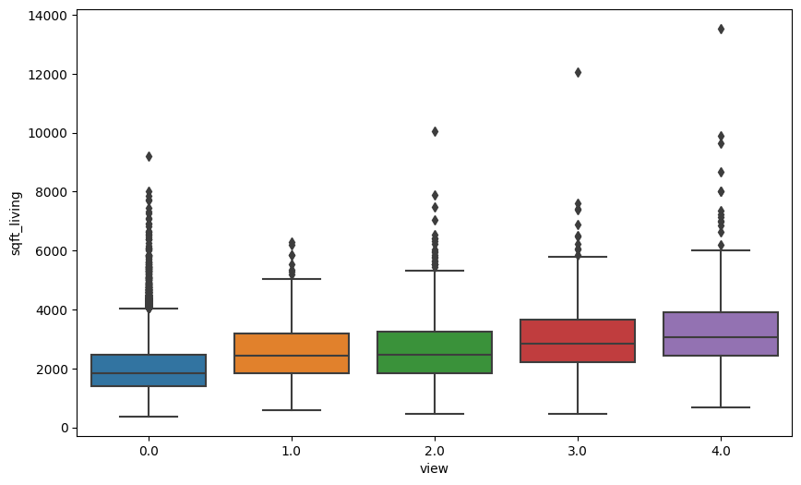
Hypothesis 3: Higher view score is correlated with higher square footage.
Step 1: Compare the distributions for respective view score as they compare to square footage
There are lots of outliers and it seems like there is a general trend upwards for view score and living space. This is not yet concrete

Slide 10
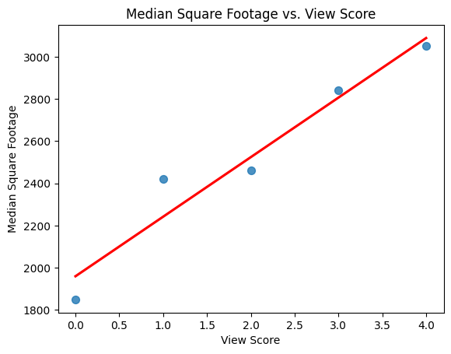
Hypothesis 3: Higher view score is correlated with higher square footage.
Step 2: Determine if the distributions are significantly different from one another (statistically)
Here I use what’s known as a Kruskal-Wallis H test. This compares the medians and the distributions of the groups.
The result of this test indicates that there is a strong correlation between higher view score and higher amount of square footage. This is visually confirmed below:

Slide 11
Hypothesis 3 Conclusion: This hypothesis was proven correct since there is a strong correlation between higher view score and higher square footage.

Slide 12
Client Requirements
My Client: Nicole Johnson
Requirements: She wants a lively, central neighborhood, middle price range, and to buy within a year
Recommendation 1: Buy a house during the second half of the year.
Recommendation 2: Don’t buy a house with less than 3 bedrooms.
Recommendation 3: Look for a home in the $513,000 - $539,000 price range.

Slide 13
First: Create a data frame which only contains mid-priced homes within Seattle
This can be used to manage expectations for the client.
This is determined by finding the median price of homes in Seattle and then making a data frame which only contains homes within 10% of that median price.
Next: Look at summary statistics for relevant columns in this new data frame
This can be used to manage expectations for the client.
This is determined by finding the median price of homes in Seattle and then making a data frame which only contains homes within 10% of that median price.

Slide 14
Recommendation 1: Buy a house during the second half of the year.
Step 1: Make a data frame for each quarter of the year based on the available dates
(the earliest date among the mid price range houses in Seattle is May 2, 2014 and the latest date is May 24, 2015)
Step 2: Run summary statistics for price per square foot and distance from city center for each quarter
Results:
Q3 has both a mean and median below the other quartiles when it comes to distance from the city center.
Q4 is then the next lowest in distance from the city center and has the combined benefit that its price per square foot is less than all other quartiles (in both median and mean), so my client is more likely to get a better value if purchasing then.

Slide 15
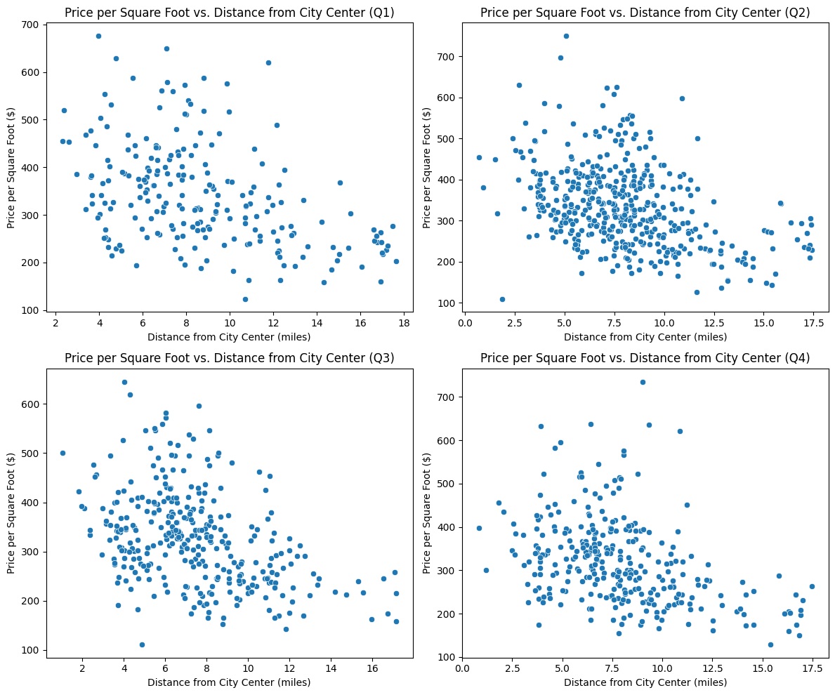
Recommendation 1: Buy a house during the second half of the year.
Step 3: Confirm this recommendation visually

Slide 16
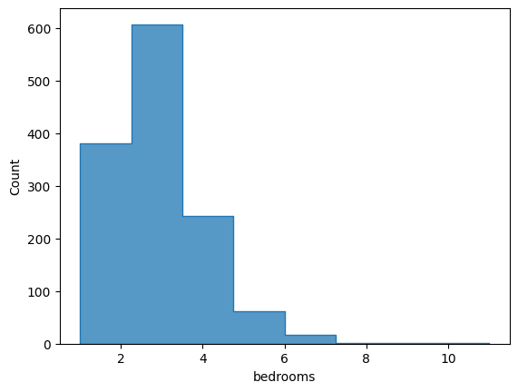
Recommendation 2: Don’t buy a house with less than 3 bedrooms.
Justification 1: The percentage of homes in this price range with less than 3 bedrooms is quite low (28%). This means that she should expect to be able to buy a home with at least 3 bedrooms.
Justification 2: Visual justification via the histogram

Slide 17
Recommendation 3: Look for a home in the $513,000 - $539,000 price range.
Step 1: Divide homes into two groups - homes below the 75th percentile and homes above.
Step 2: Compare the distributions of the distance from the city center among both groups and use a statistical test to determine if the difference is statistically significant.
Results: There IS a significant correlation between being in the upper quartile and being closer to the city center.
Because my client cares a lot about being somewhere lively and this range of prices is still in the “middle range,” this price range is a sweet spot where she is more likely to be close to the city center

