Slide 1
Urban Air Pollution Challenge
Hannah, Tomos, and Daniel

Slide 2
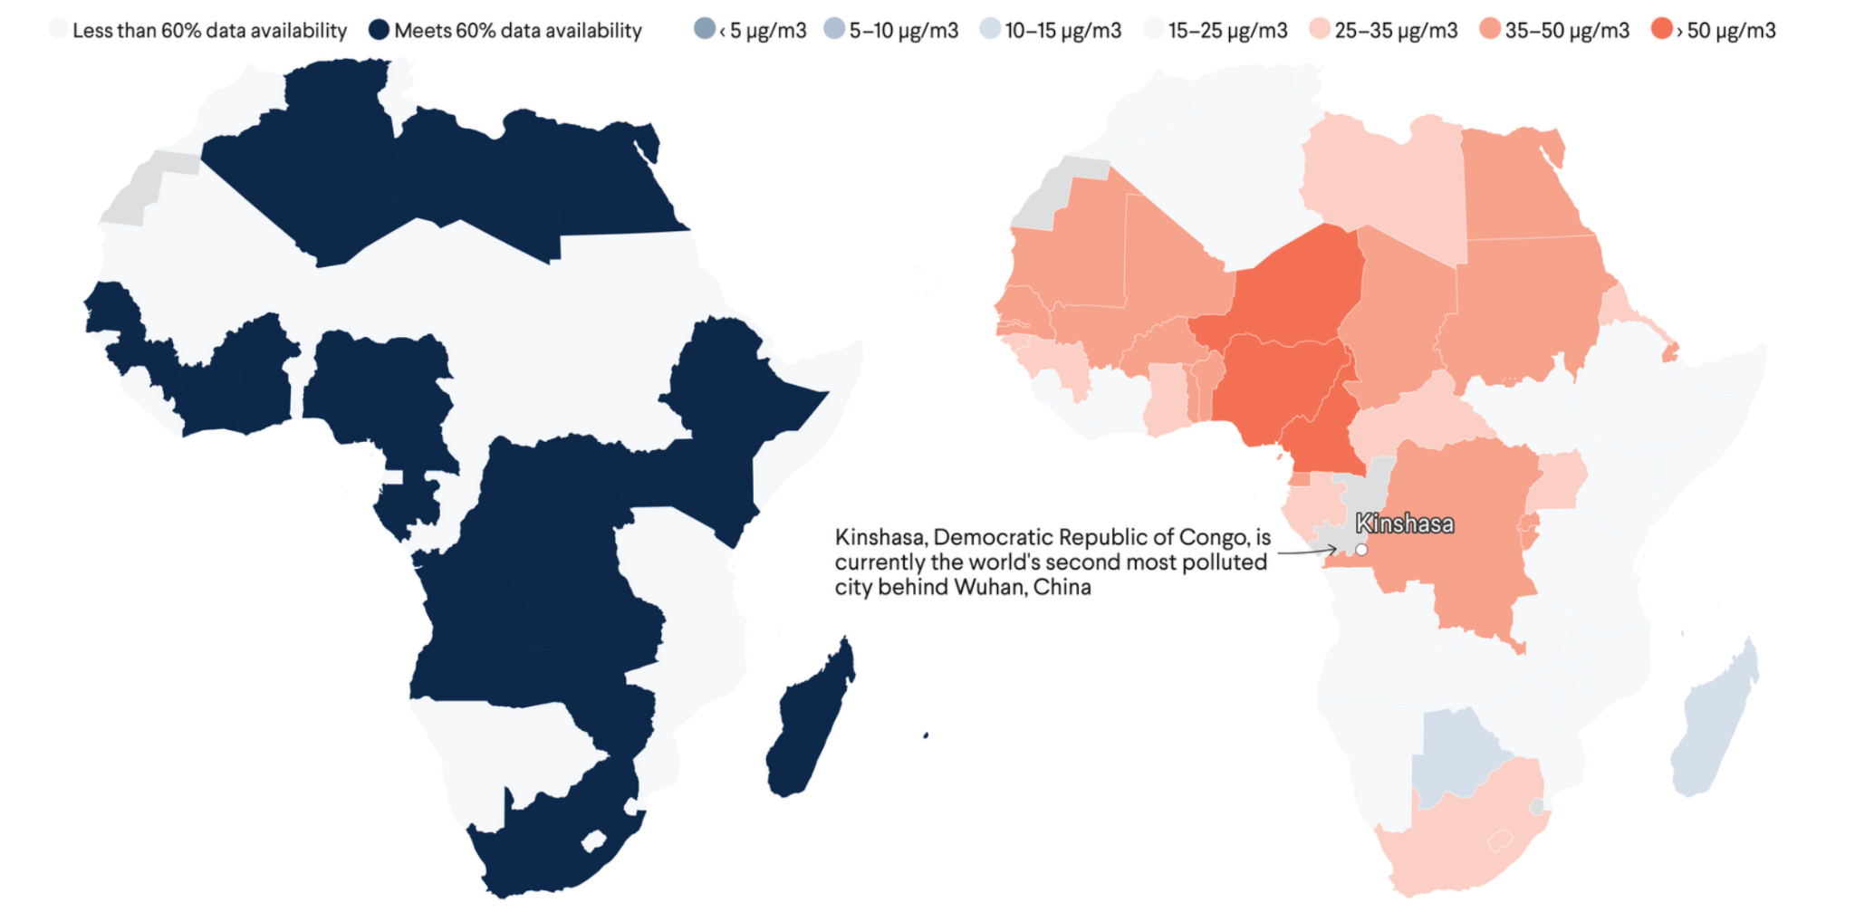
Motivation
PM2.5: fine particulate air pollution < 2.5 μm (natural or manmade)
Accurate PM2.5 tracking crucial - respiratory diseases (COVID-19), cardiovascular disease, cancer.
Some regions saw improved air quality during COVID-19 lockdowns, others, especially African cities, experienced worsening pollution.
Data from ground-based sensors lacking across much of African continent. This challenge aims to predict daily PM2.5 concentrations for various cities without ground-based sensors.
Schroeder, C. C.. Tackling Air Pollution in Africa With Data. Think Global Health. 2024

Slide 3
Method
We approached this challenge by creating models which use satellite data in order to predict PM2.5 and our performance metric is RMSE.
Root Mean-Squared Error is often used for regression-based prediction tasks as it is able to capture how far the predicted values are from actually known values
The models used will help improve air quality monitoring in locations lacking ground based sensors

Slide 4
Data Source
Ground-based sensors – providing daily mean, min, max, variance, and count of PM2.5 readings (μg/m³).
Global Forecast System (GFS) weather data – including temperature, humidity, and wind speed.
Sentinel 5P satellite data – tracking levels of atmospheric HCHO (formaldehyde), SO₂, NO₂, CH₄, O₃ and aerosols.

Slide 5

Challenges with Data
83 features in data set
Missing data points
Lie, Y. et al.. Science 396, 6501 (2021).

Slide 6
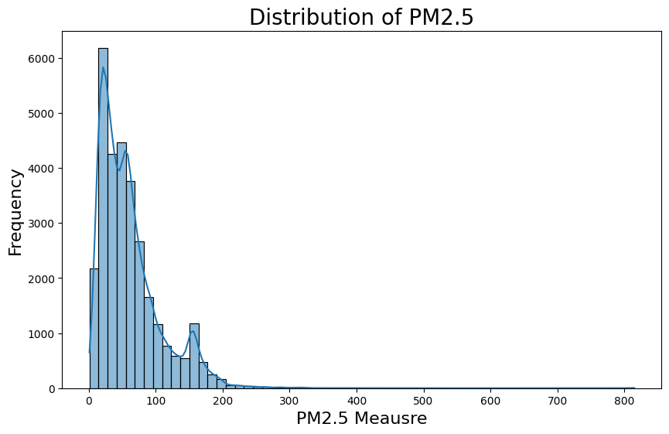
Data Cleaning - Target
PM 2.5 (μg/m³) | Air Quality | Health Impact
0 -12 | Good | No risk most people
12 - 35 | Moderate | Risk sensitive groups
35 - 55 | Unhealthy (sensitive) | Breathing issues sensitive people
55 -150 | Unhealthy | Everyone may feel effects
150 - 250 | Very unhealthy | Serious health effects
250 + | Hazardous | Emergency conditions

Slide 7
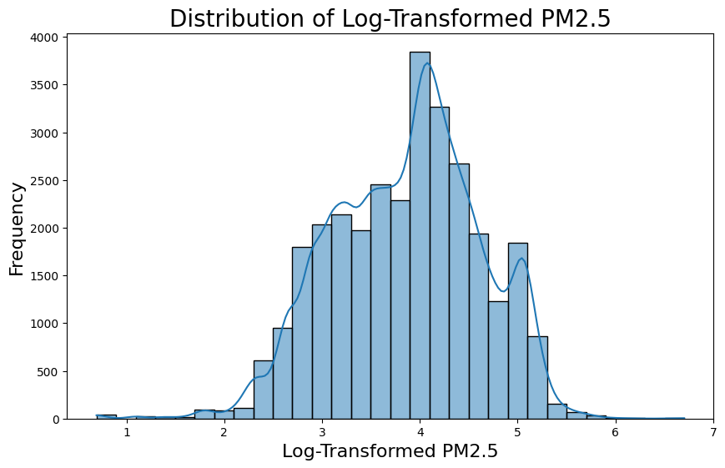
Data Cleaning - Target

Slide 8
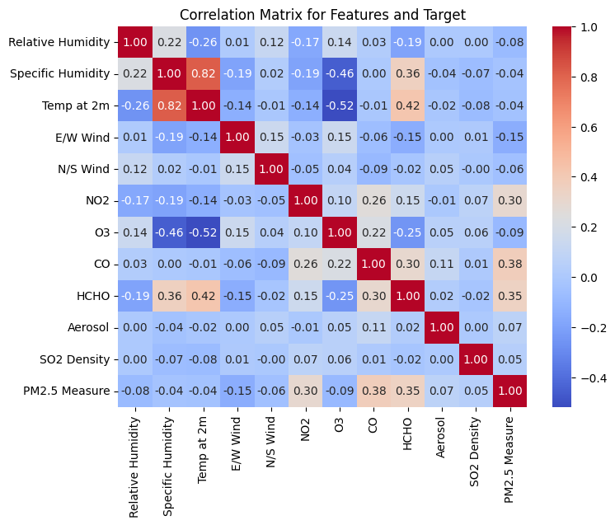
Data Cleaning - Features
Feature selection
Feature correlation

Slide 9
Feature Engineering
Imputation
Mean - normally distributed features
Median - skewed features, outliers
Scaling
Robust scaler - uses median and IQR, effective for skewed data

Slide 10
Modeling
Evaluation metrics used: RMSE and R²
To check for overfitting, metrics compared on train and test data subsets
Baseline Model: Dummy Regressor
Predict mean target value from the training subset for all new observations
Result: RMSE 48.50 (Note: target mean for training data is 61.24)

Slide 11
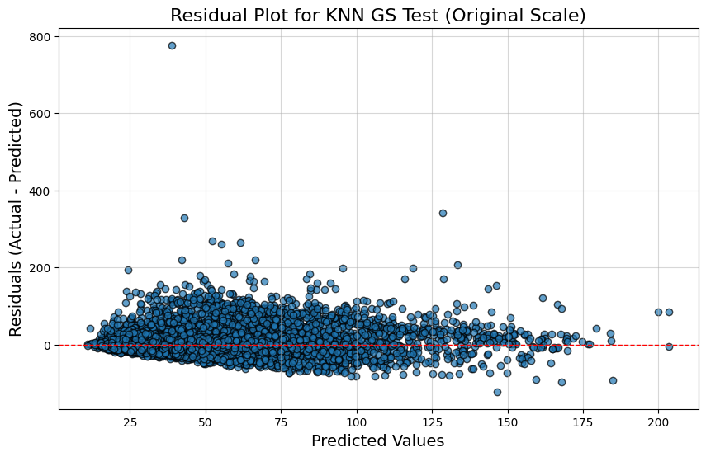
Model 1 - KNN
 | Train | Test
RMSE | 35.10 | 36.43
R² | 0.44 | 0.38
Conclusions: RMSE relatively poor but not too overfit

Slide 12
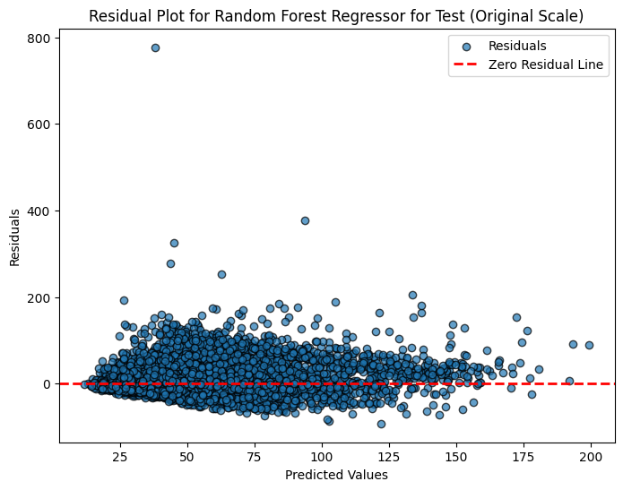
Model 2 - Random Forest
 | Train | Test
RMSE | 24.53 | 35.04
R² | 0.73 | 0.43
Conclusions: Overfit, RMSE relatively poor but better than KNN

Slide 13
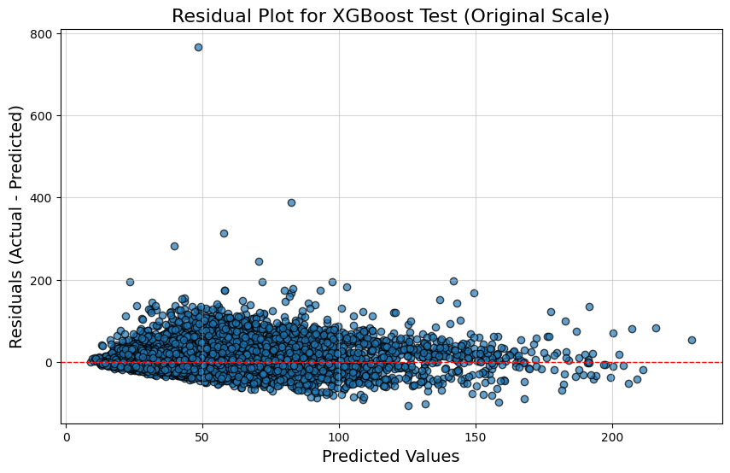
Model 3 - XGBoost
 | Train | Test
RMSE | 28.23 | 34.44
R² | 0.64 | 0.44
Conclusions: Overfit despite including regularization, RMSE and R² best of the three

Slide 14
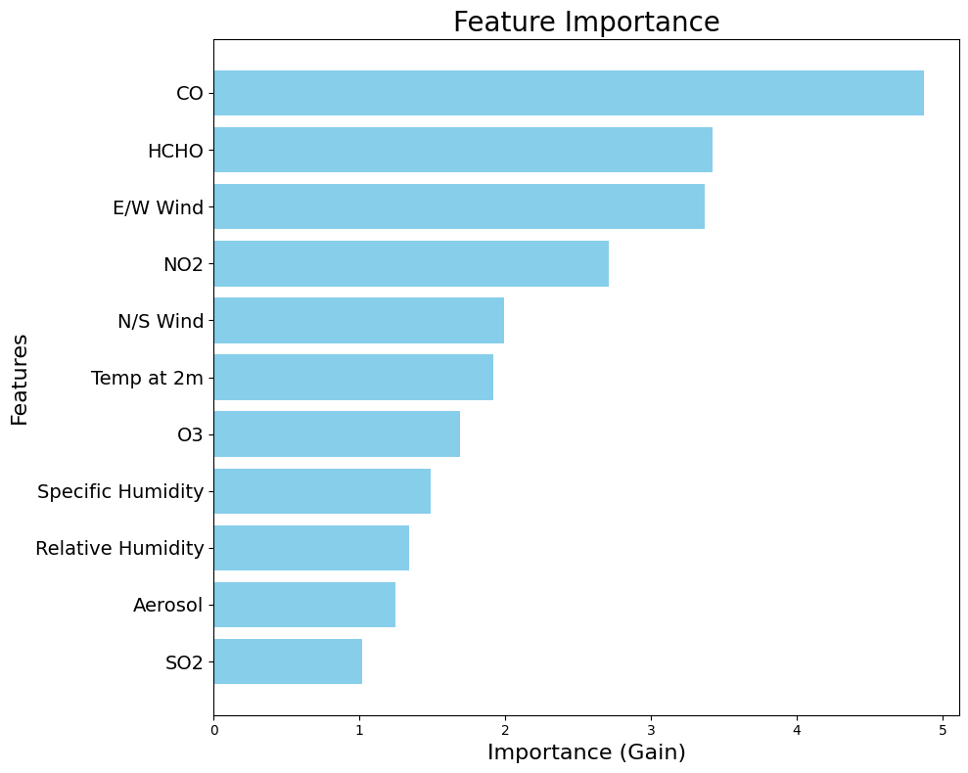
Model 3 - XGBoost
Measure of feature importance is determined by how much a feature improves the model’s split quality (Gain) in terms of error
Here, gain calculates the average improvement in RMSE gained by each split made on a feature

Slide 15
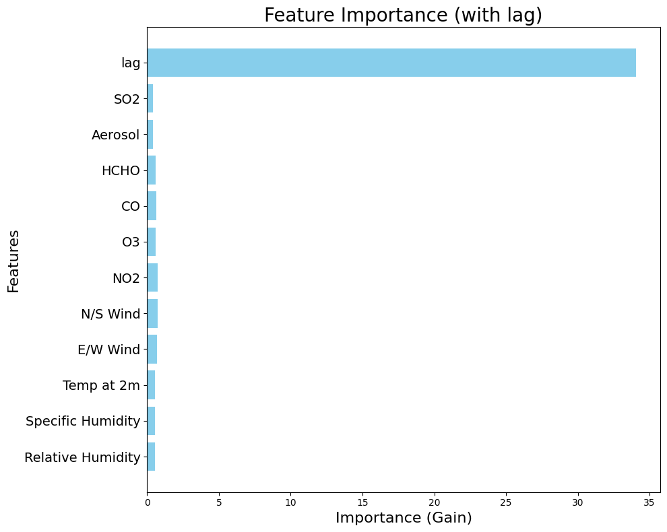
Lag Feature
Introduction of an extra feature which much more greatly reduces prediction errors

Slide 16
Model Comparison and Analysis
Results from test data
 | KNN | KNN + lag | RF | RF + lag | XGBoost | XGBoost + lag
RMSE | 36.43 | 27.46 | 35.04 | 22.31 | 34.45 | 21.79
R² | 0.38 | 0.65 | 0.43 | 0.77 | 0.45 | 0.78

Slide 17
Conclusions
Satellite data can be used to approximate PM2.5 within a reasonable margin in places where there are not ground-based sensors
According to our results, XGBoost is the best choice of model for predicting PM2.5
Future methods that could lead to better predictions:
Stacking / Further Ensemble Methods
Further feature refinement
Weekend/Non-Weekend Consideration
Extreme value removal

