Slide 1
Bullying and its Effect on Academic Performance
Hannah Duncan
Geoffrey Johnston
Vineet Sikri
Melody Yu

Slide 2
Background
Bullying is a major social problem affecting school aged children and adolescents nationwide.
Researchers on school bullying have defined it as “a systematic abuse of power”. The defining features of bullying which distinguish it from other forms of aggressive behavior are that it is (a) repeated and (b) intent to hurt, and (c) there is an imbalance of power between the bully and the victim, with the victim in a weaker and more vulnerable position.
There are four main types of bullying which are most prevalent in school, including physical bullying, verbal bullying, social or relational bullying, and cyberbullying.
Notes:
Melody

Slide 3
Background
Bullying can negatively impact youths’ overall well-being and has been linked to multiple adverse outcomes, including both externalizing and internalizing difficulties. One of the major consequences associated with being the target of bullying is lower academic performance.
For this project, we as data analyst in the field of education, will be looking at national bullying statistics and determining if there is a relationship between bullying and academic performance.
Notes:
Melody

Slide 4
Research questions
What is the prevalence of bullying in school (2015)?
What is the relationship between bullying and academic performance?
What demographic factors can lead to higher instances of bullying? (Socioeconomic, Age, Ethnicity, Location, etc.)
Notes:
Hannah

Slide 5
Data Resources
https://educationdata.urban.org/documentation/
https://nces.ed.gov/programs/crime/student_data.asp
https://usedgov.github.io/
https://www.census.gov/acs/www/data/data-tables-and-tools/data-profiles/2015/
Alhajji, M., Bass, S., & Dai, T. (2019). Cyberbullying, Mental Health, and Violence in Adolescents and Associations With Sex and Race: Data From the 2015 Youth Risk Behavior Survey. Global Pediatric Health, 6.
Notes:
Geoffrey

Slide 6
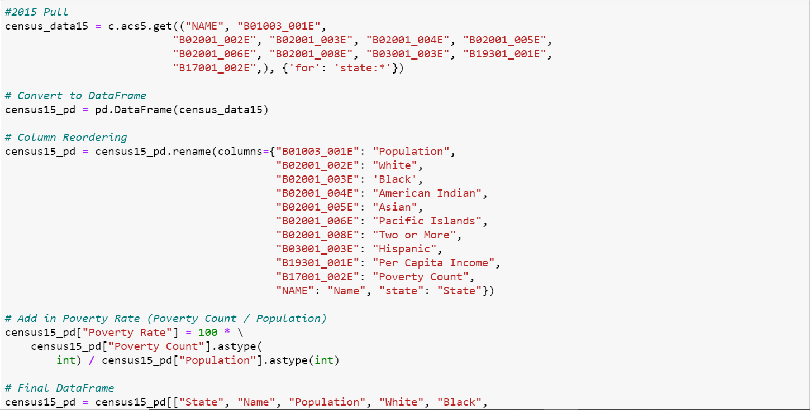
Data Resources
Notes:
Geoffrey

Slide 7
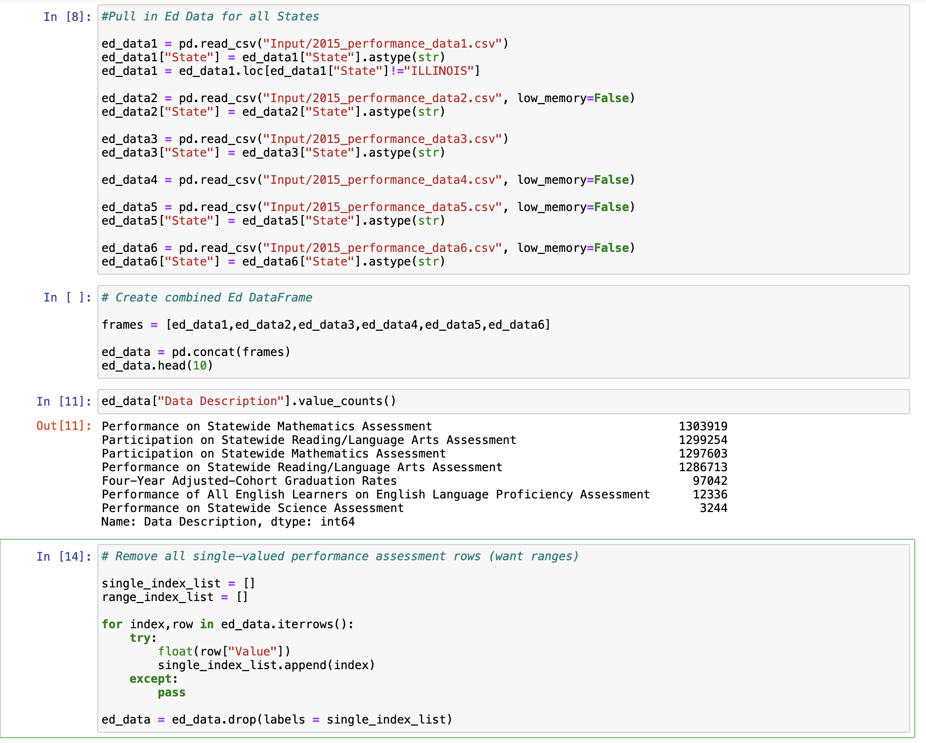
DATA EXPLORATION AND CLEANING PROCESS
Notes:
Hannah

Slide 8
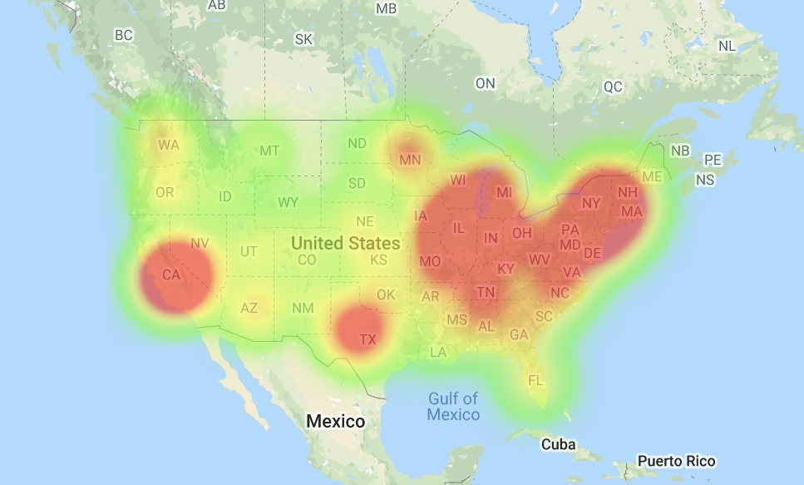
results
Prevalence of bullying
in the United States
Notes:
Hannah

Slide 9
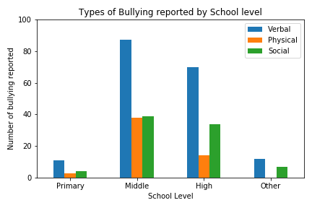
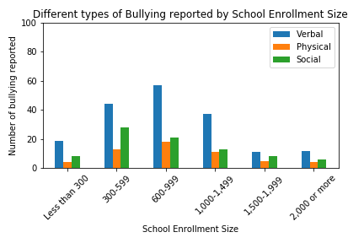
results
Prevalence of traditional bullying (2015)
Notes:
Melody

Slide 10
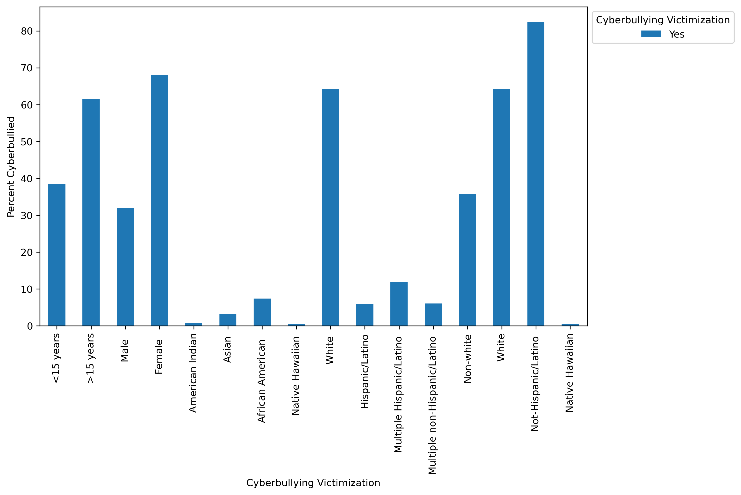
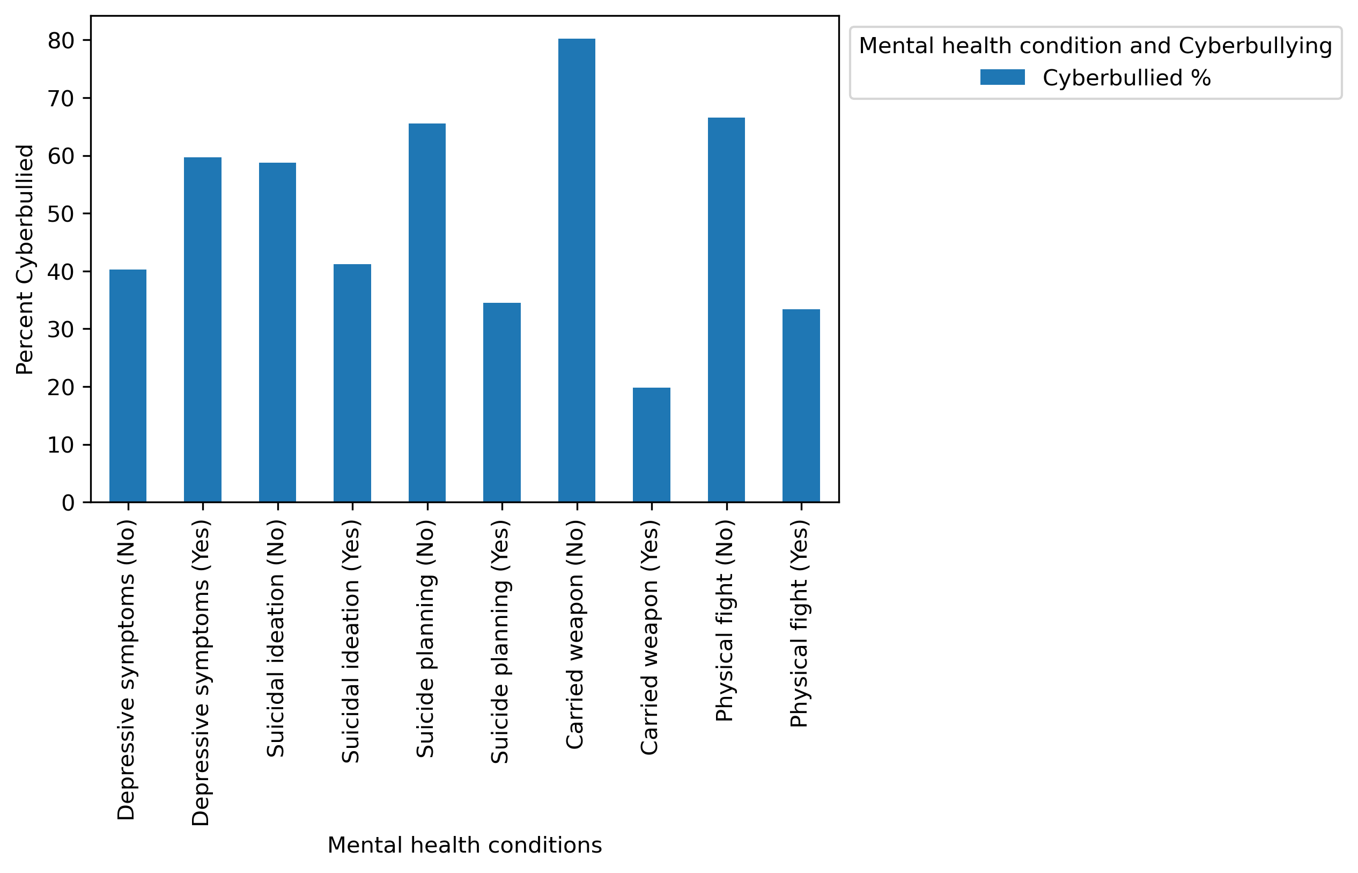
results
Prevalence of cyberbullying (2015)
Notes:
Vineet

Slide 11
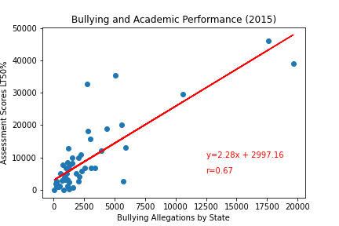
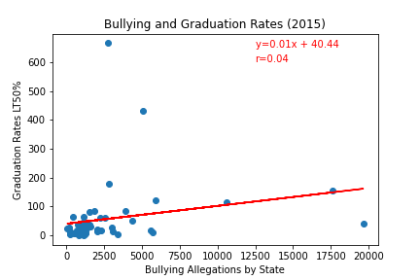
results
Relationship between bullying and academic performance
Assessment scores vs Bullying
y = 2.28x + 2997.16
r = 0.67
Graduation Rates vs Bullying
y = 0.01x + 40.44
r = 0.04
Notes:
Hannah

Slide 12
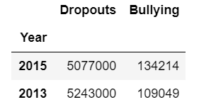
Results
Relationship between bullying and academic performance
Dropout counts vs Bullying
Notes:
Geoffrey

Slide 13
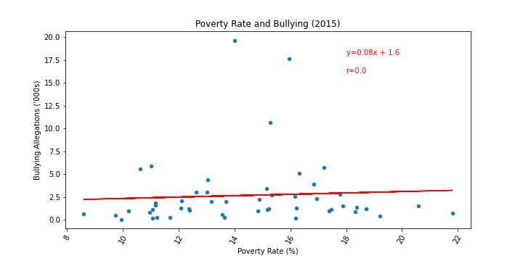
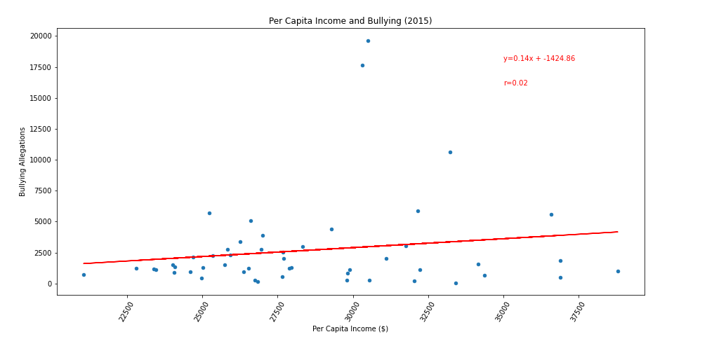
results
Demographic factors and Bullying
Socioeconomic factors:
Poverty rate
y = 0.08x + 1.6
r =0.0
Per capita income
y = 0.14x - 1424.86
r = 0.02
Notes:
Hannah

Slide 14
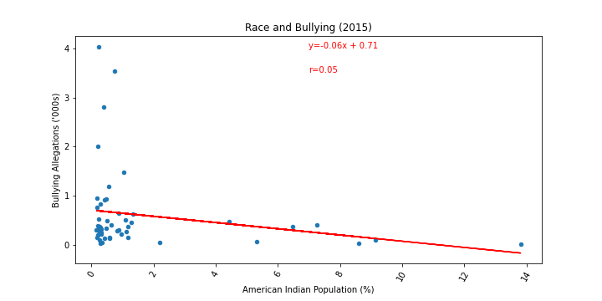
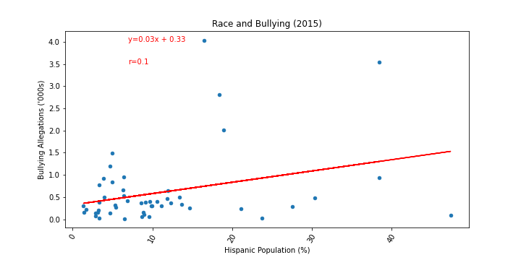
results
Demographic factors and Bullying
Ethnicity factors (samples):
American Indian Population
y = -0.06x + 0.71
r =0.05
Hispanic Population
y = 0.03x + 0.33
r = 0.1
Notes:
Hannah

Slide 15
Summary of results
Bullying is a serious problem in schools nationwide; we see an increase in cyberbullying which is not reported by schools.
We do see correlation between low assessment scores and graduation rates associated with more bullying instances.
Data suggests socioeconomic factors and ethnicities do not have a strong association with bullying.
Notes:
Geoffrey

Slide 16
Limitations
Population and ethnicity data are only based on reported census data.
Bullying data contain only instances of alleged bullying and does not include cyberbullying.
Graduation rates, dropout counts, and test scores are not the only measures of student success.
Assessments given to students are standardized by state; they are not nationally standardized.
Notes:
Geoffrey

Slide 17
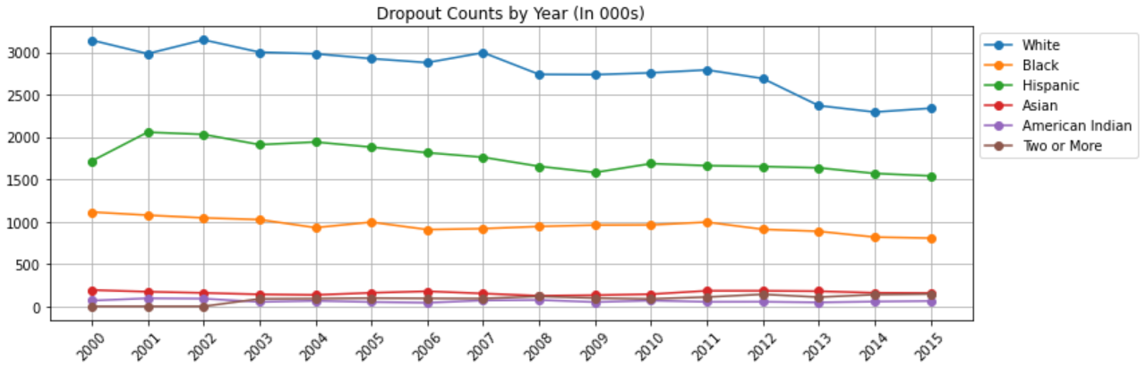
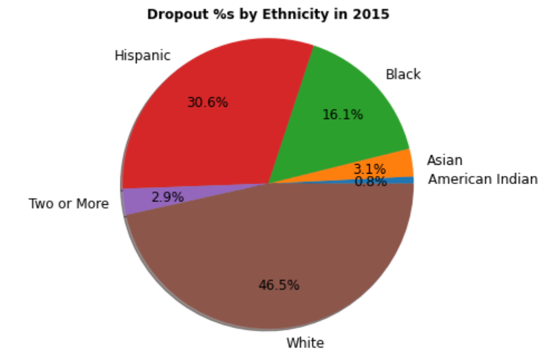
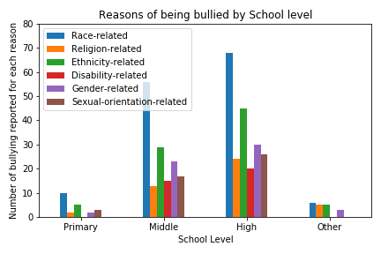
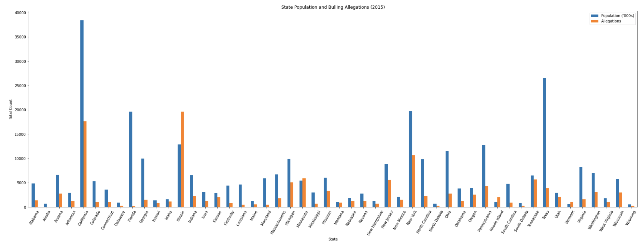
Notes:
Geoffrey

Slide 18
Q&A

