Slide 1
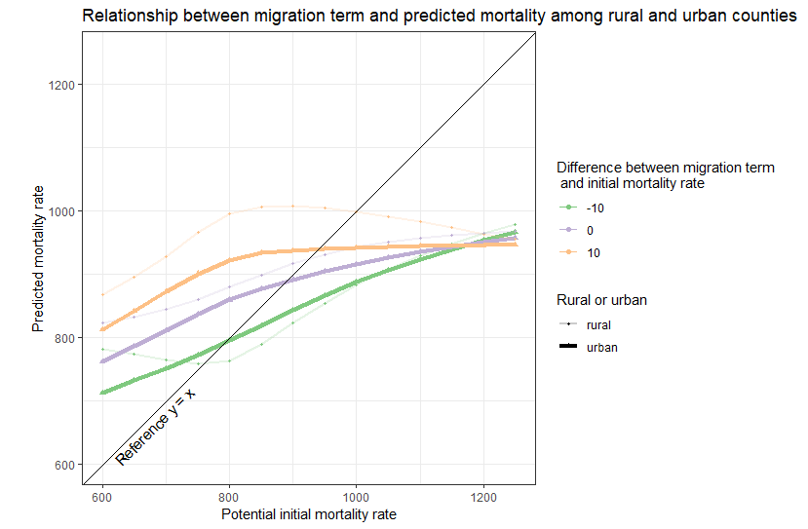
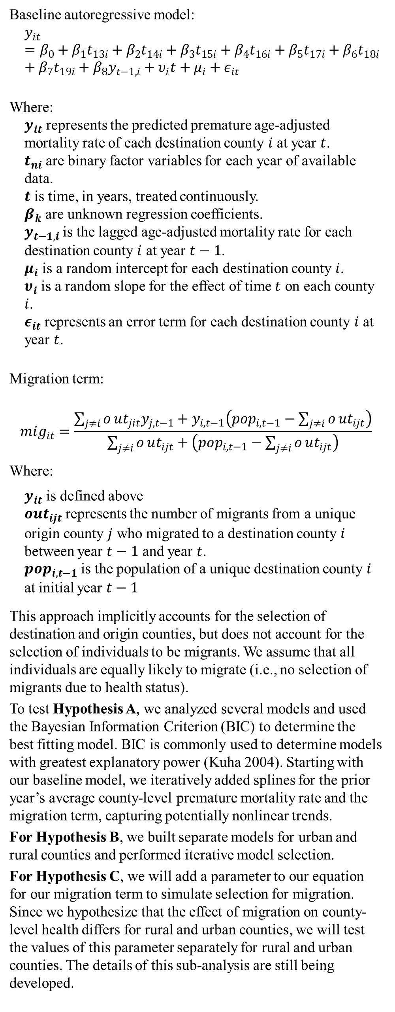
An ecological exploration of how county-level migration can enhance our capacity to understand and explain county-level health Hannah Olson-Williams, Amy Cochran University of Wisconsin, Population Health Sciences
Abstract
Methods
Results and Conclusion
The goal of this work is to explore how county-level migration can enhance our capacity to understand and explain county-level health. Much of physical and mental health is place-based. There are well-established relationships between the built-environment and health outcomes. However, less is understood about how changes in place can affect health. Changes in place can occur both to and by people: when individuals relocate, not only do they experience a change in place, but they take their sociodemographic identities, income, health, employment, and education with them. As a result, the population, culture, and health of the place they are leaving and the place they are arriving changes, if only slightly. In aggregate, these migration-related changes could potentially change the health of the population as a whole. We assess the selection of migrants into and out of counties based on the health of each destination over time using a novel migrationally autoregressive approach which accounts for county-to-county migration as well as the effect of urbanicity.
Baseline autoregressive model:
$$y_{it}=β_{0}+β_{1}t_{13i}+β_{2}t_{14i}+β_{3}t_{15i}+β_{4}t_{16i}+β_{5}t_{17i}+β_{6}t_{18i}+β_{7}t_{19i}+β_{8}y_{t−1,i}+υ_{i}t+μ_{i}+ε_{it}$$
Where:
$y_{it}$ represents the predicted premature age-adjusted mortality rate of each destination county $i$ at year $t$. $t_{ni}$ are binary factor variables for each year of available data. $t$ is time, in years, treated continuously. $β_{k}$ are unknown regression coefficients. $y_{t−1,i}$ is the lagged age-adjusted mortality rate for each destination county $i$ at year $t−1$. $μ_{i}$ is a random intercept for each destination county $i$. $υ_{i}$ is a random slope for the effect of time $t$ on each county $i$. $ε_{it}$ represents an error term for each destination county $i$ at year $t$.
Migration term:
$$mig_{it}=\frac{\sum_{j≠i}^{​}{o}ut_{jit}y_{j,t−1}+y_{i,t−1}\left(pop_{i,t−1}−\sum_{j≠i}^{​}{o}ut_{ijt}\right)}{\sum_{j≠i}^{​}{o}ut_{ijt}+\left(pop_{i,t−1}−\sum_{j≠i}^{​}{o}ut_{ijt}\right)}$$
Where:
$y_{it}$ is defined above $out_{ijt}$ represents the number of migrants from a unique origin county $j$ who migrated to a destination county $i$ between year $t−1$ and year $t$. $pop_{i,t−1}$ is the population of a unique destination county $i$ at initial year $t−1$
This approach implicitly accounts for the selection of destination and origin counties, but does not account for the selection of individuals to be migrants. We assume that all individuals are equally likely to migrate (i.e., no selection of migrants due to health status).
To test Hypothesis A, we analyzed several models and used the Bayesian Information Criterion (BIC) to determine the best fitting model. BIC is commonly used to determine models with greatest explanatory power (Kuha 2004). Starting with our baseline model, we iteratively added splines for the prior year’s average county-level premature mortality rate and the migration term, capturing potentially nonlinear trends.
For Hypothesis B, we built separate models for urban and rural counties and performed iterative model selection.
For Hypothesis C, we will add a parameter to our equation for our migration term to simulate selection for migration. Since we hypothesize that the effect of migration on county-level health differs for rural and urban counties, we will test the values of this parameter separately for rural and urban counties. The details of this sub-analysis are still being developed.
Hypothesis A: migration does matter!
When modeling county-level premature mortality rates, migration does add explanatory power.
Hypothesis B:
Migration from unhealthy counties appears to affect rural counties more than urban counties. Both rural and urban counties experience improvements in county-level health when experiencing in-migration from migrants from healthy counties.
Hypothesis C:
A simulation! That has not yet been completed.
Hypotheses
Hypothesis A: County-to-county migration patterns improve the explainability of autoregressive models of county-level mortality.
Hypothesis B: The role that intercounty migration plays in county-level mortality differs significantly between rural and urban counties.
Hypothesis C: Considering bias in migration patterns improves our ability to explain county-level mortality as well as the differential role that migration plays in urban versus rural counties
Discussion
Limitations of IRS data
Tax payers only
Issues with post 2011 estimates
Sensitivity to natality
Average age of movers is under age 30
Does birth rate matter?
Does net migration matter?
How much does the magnitude of the population shift affect results?
Spatial autocorrelation
Does migration explain patterns in health better than geography can?
Data
County-level estimates of premature age-adjusted mortality available through CDC WONDER
IRS county-to-county migration flow data
Years: 2011 – 2019
Outcome: county-level premature age-adjusted mortality
Primary Explanatory Factor: county-level migration flow
Secondary Explanatory Factor: urbanicity
References

