Slide 1
COMPUTER VISION · RESEARCH PRESENTATION
Food-101 21-Class Image Classification
Scratch CNN vs. Fine-Tuned ResNet-50
Hannah Fee and Cornelius Coleman | October 13, 2026
🍕
🍔
🍣
THE CENTRAL QUESTION
How much does ImageNet pretraining help with fine-grained food recognition?
🍜
🍰
🥗
🥞
🍝
🥧
01

Slide 2
FOOD-101 · EXPERIMENT
Problem statement
Predict one of 21 food labels from a single RGB photograph.
Fine-grained categories share ingredients, textures, and presentation.
Color oversaturation, atypical angles, and some noisy labels add difficulty.
Cheesecake ↔ Carrot cake
Carpaccio ↔ Tartare
Illustrative difficult pairs — replace with real food-image examples if available.
02

Slide 3
FOOD-101 · EXPERIMENT
Research question and targets
BASELINE
TRANSFER
EVALUATION
4-block CNN
ResNet-50
Test accuracy
Randomly initialized
ImageNet pretrained
Plus per-class accuracy
Chance level = 1 / 21 = 4.76%
03

Slide 4
FOOD-101 · EXPERIMENT
Literature: what has been reported?
Paper
Year
Method
Classes
Accuracy
Bossard et al.
2014
Random forest component mining
101
50.76%
Hassannejad et al.
2016
Fine-tuned Inception-V3
101
88.28%
Martinel et al.
2018
WISeR residual network
101
90.27%
Important: 101-class published results are not directly comparable with this 21-class experiment.
Source links included in final references slide.
04

Slide 5
FOOD-101 · EXPERIMENT
Dataset: balanced 21-class subset
21
750
250
FOOD CATEGORIES
TRAIN PER CLASS
TEST PER CLASS
15,750 training-pool images + 5,250 held-out test images
Balanced class counts make overall accuracy informative; retain per-class metrics for failure analysis.
05

Slide 6
FOOD-101 · EXPERIMENT
The split: protect the test set
TRAIN
VALIDATION
TEST
14,175
1,575
5,250
90% of official train
10% seeded · seed 42
Official test · sealed
Both models must use the same classes, data split, and test protocol.
06

Slide 7
FOOD-101 · EXPERIMENT
Baseline model: scratch CNN
Conv 32 channels
Conv 64 channels
Conv 128 channels
Conv 256 channels
BN → ReLU → Pool
BN → ReLU → Pool
BN → ReLU → Pool
BN → ReLU → Pool
Global Avg Pool → Dropout → Linear(21) → Softmax scores
128×128 input · Cross-entropy loss · Adam · No pretrained weights
07

Slide 8
FOOD-101 · EXPERIMENT
Deep model: ResNet-50 transfer learning
ImageNet-pretrained ResNet-50 → new 21-class classifier · 224 × 224 RGB input
Network block
Parameters
Stage 1
Stage 2
conv1 + bn1
9,536
Frozen
Frozen
layer1
215,808
Frozen
Frozen
layer2
1,219,584
Frozen
Frozen
layer3
7,098,368
Frozen
Frozen
layer4
14,964,736
Frozen
Trainable
fc (new head)
43,029
Trainable
Trainable
Trainable parameters: Stage 1 = 43,029 (head only) | Stage 2 = 15,007,765 (layer4 + head)
Head LR 1×10⁻³ · Fine-tuning LR 1×10⁻⁴
8

Slide 9
FOOD-101 · EXPERIMENT
Why residual networks and fine-tuning?
Residual connection
Early ImageNet filters capture reusable edges and textures.
Higher layers capture dish-specific patterns.
F(x)
F(x) + x
A smaller fine-tuning LR protects useful pretrained weights.
Skip path preserves information and eases deep optimization.
~14k training images favor transfer learning over full training.
09

Slide 10
FOOD-101 · EXPERIMENT
Implementation and training pipeline
Load + split
Augment
Train
Validate
Early stop
Restore best
Test once
Augmentation: random resized crop · horizontal flip · color jitter
PyTorch / CUDA · RTX 3060 Laptop GPU · early-stopping patience: 5
10

Slide 11
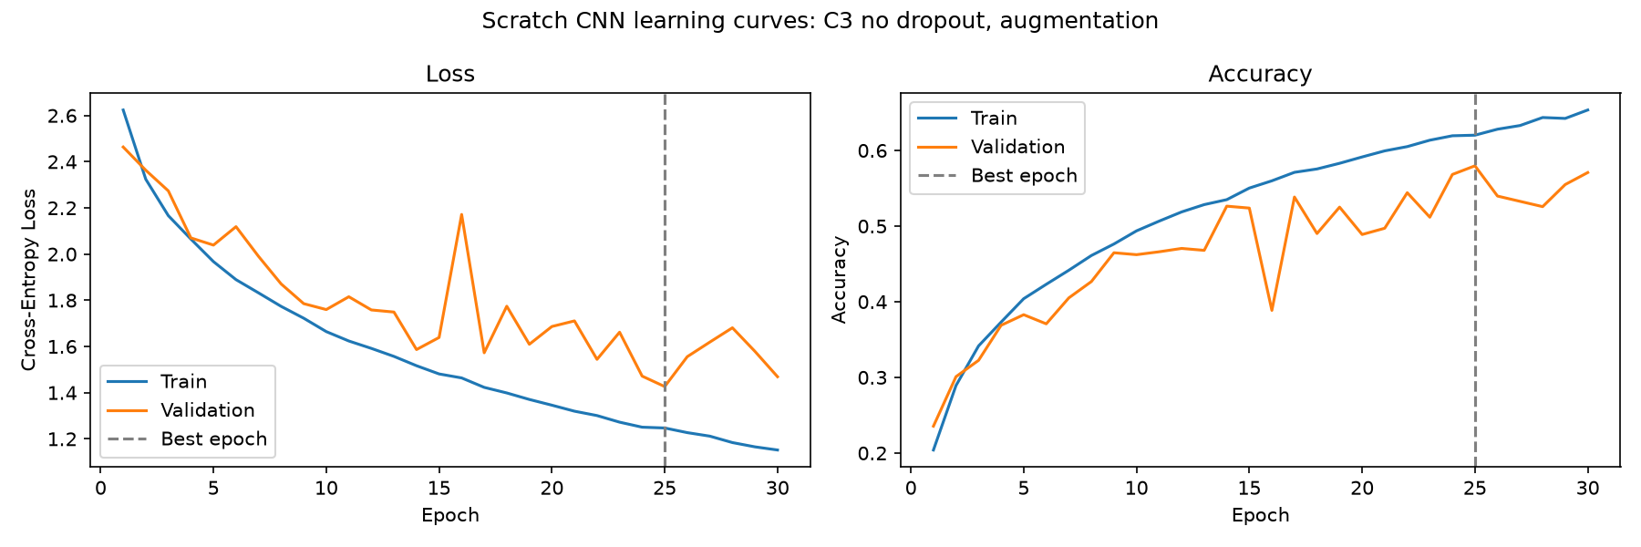
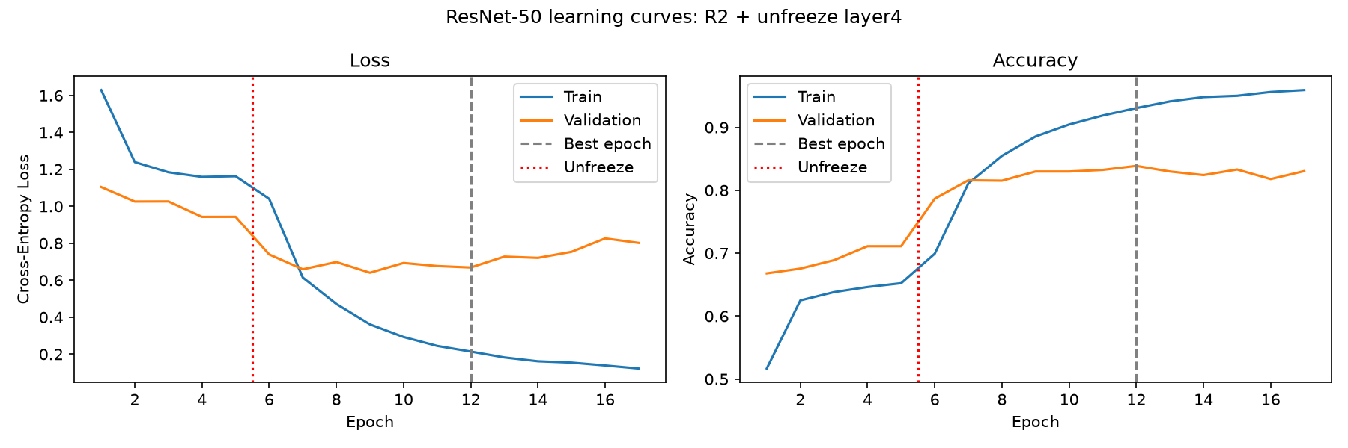
FOOD-101 · EXPERIMENT
Learning curves: transfer learning vs. scratch CNN
Scratch CNN · C3 (best configuration)
ResNet-50 · R2 (layer4 fine-tuned)
CNN best validation 58.0% (epoch 25) | ResNet best validation 83.9% (epoch 12); layer4 unfreezes after epoch 5.
11

Slide 12
FOOD-101 · EXPERIMENT
Hyperparameter experiments: what helped?
Scratch CNN · five configurations
ResNet-50 · six configurations
Run
Dropout
Augment
Val Acc
Best Ep
Run
Val Acc
Gap
Best Ep
C1
0.5
Yes
57.1%
29
R1
71.3%
-6.5 pp
9
R2
83.9%
+9.2 pp
12
C2
0.5
No
50.9%
11
R3
83.9%
+6.7 pp
11
C3
0.0
Yes
58.0%
25
R4
81.5%
+16.5 pp
13
C4
0.0
No
49.1%
10
R5
83.2%
+12.1 pp
20
C5
0.3
Yes
56.8%
25
R6
82.6%
+12.8 pp
13
CNN: augmentation improved generalization; C3 led at 58.0%. ResNet: R2 and R3 tied at 83.9%; no augmentation overfit.
12

Slide 13
FOOD-101 · EXPERIMENT
Test results: ImageNet pretraining makes the difference
SCRATCH CNN · C3
RESNET-50 · R3
TEST IMPROVEMENT
62.7%
86.9%
+24.2 pp
Both models evaluated once on 5,250 held-out images across 21 classes
Model
Classes
Test accuracy
Correct predictions
Random chance
21
4.8%
—
Scratch CNN (C3)
21
62.7%
3,292 / 5,250
Fine-tuned ResNet-50 (R3)
21
86.9%
4,560 / 5,250
Compare against the same 21-class test set, not directly against literature benchmarks on all 101 classes.
13

Slide 14
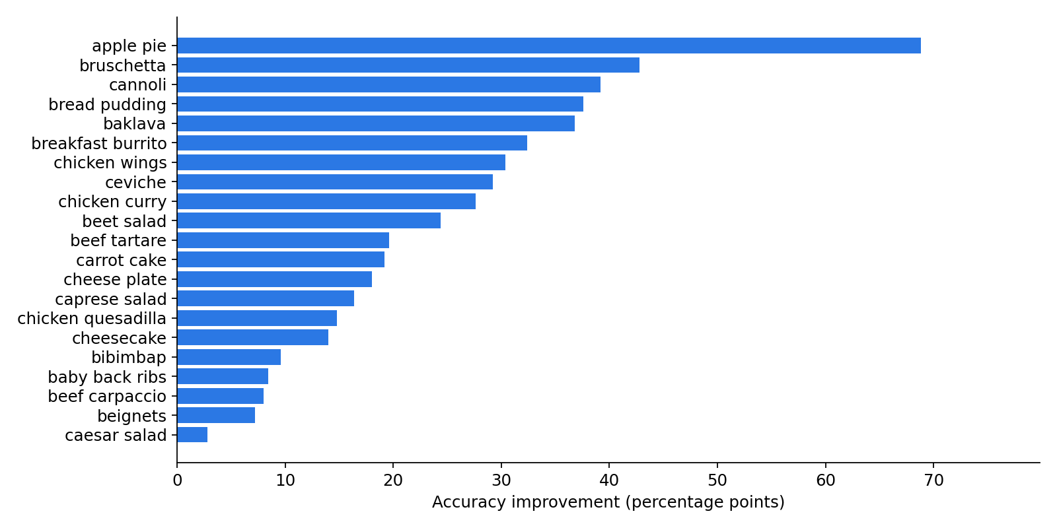
FOOD-101 · EXPERIMENT
Per-class gain: which categories benefited most?
Largest gains
apple pie
+68.8 percentage points
bruschetta
+42.8 percentage points
cannoli
+39.2 percentage points
bread pudding
+37.6 percentage points
Gain = ResNet test accuracy − scratch CNN test accuracy, calculated from both 21-class CSV files.
14

Slide 15
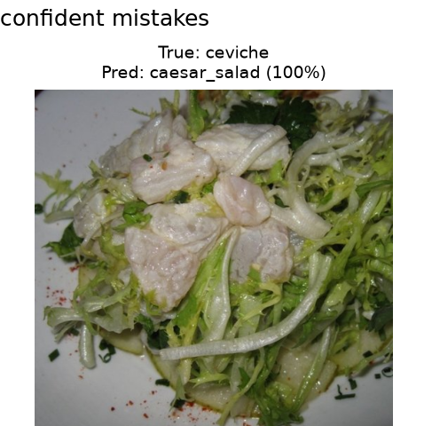
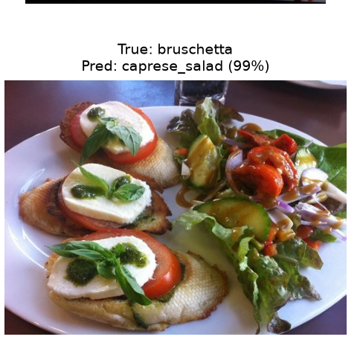
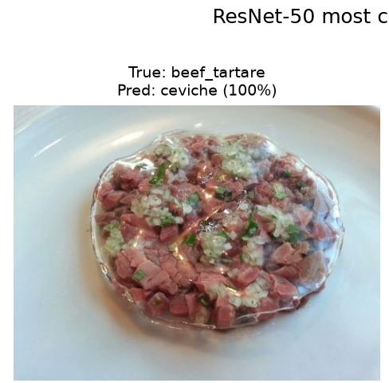
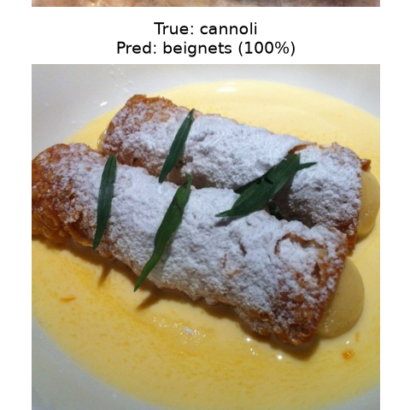
FOOD-101 · EXPERIMENT
Error analysis: both models confuse look-alike foods
Scratch CNN · 62.7% test
ResNet-50 · 86.9% test
Scratch: breakfast burrito → quesadilla 29.6%; bruschetta → caprese salad 18.0%.
ResNet: breakfast burrito → quesadilla 21.6%; apple pie → bread pudding 11.6%.
High-confidence errors are evidence of visually ambiguous features—not proof that the ground-truth labels are wrong.
15

Slide 16
FOOD-101 · EXPERIMENT
Conclusions and discussion
SCRATCH CNN TEST
RESNET-50 TEST
ADVANTAGE
62.7%
86.9%
+24.2 pp
Why the gap?
ImageNet feature transfer delivers a strong starting point; fine-tuning layer4 improved validation by 12.6 points over head-only training.
What did not help?
Removing augmentation reduced ResNet validation to 81.5%; unfreezing layer3 provided no meaningful gain over layer4 alone.
Limits / next steps
21 classes are easier than 101; further test layer-wise learning rates, more balanced augmentation, and error-specific methods.
16

Slide 17
APPENDIX · Q&A
Backup · Scratch CNN configuration details
Run
Dropout
Augment
Train
Val
Gap
Best epoch
C1
0.5
Yes
0.558
0.571
-0.013
29
C2
0.5
No
0.462
0.509
-0.048
11
C3
0.0
Yes
0.620
0.580
+0.040
25
C4
0.0
No
0.554
0.491
+0.063
10
C5
0.3
Yes
0.569
0.568
+0.001
25
All scratch CNN runs: 394,773 trainable parameters, Adam LR = 0.001, 128×128 inputs. C3 selected by validation accuracy.
17

Slide 18
APPENDIX · Q&A
Backup · ResNet-50 configuration details
Run
Unfrozen
Fine-tune LR
Train
Val
Gap
Best epoch
R1
none (head only)
-
0.648
0.713
-0.065
9
R2
layer4
0.0001
0.931
0.839
+0.092
12
R3
layer3+layer4
0.0001
0.906
0.839
+0.067
11
R4
layer4
0.0001
0.980
0.815
+0.165
13
R5
layer4
0.001
0.953
0.832
+0.121
20
R6
layer4
0.0001
0.954
0.826
+0.128
13
R2 ≈ R3 on validation (83.9%); R2 is more parameter-efficient, while the R3 checkpoint is reported as the test model.
18

Slide 19
APPENDIX · Q&A
Backup · Full 21-class accuracy comparison
Food category
CNN
ResNet
Gain
Food category
CNN
ResNet
Gain
apple pie
4.0%
72.8%
+68.8 pp
caesar salad
91.2%
94.0%
+2.8 pp
baby back ribs
82.8%
91.2%
+8.4 pp
cannoli
50.8%
90.0%
+39.2 pp
baklava
52.8%
89.6%
+36.8 pp
caprese salad
71.2%
87.6%
+16.4 pp
beef carpaccio
84.4%
92.4%
+8.0 pp
carrot cake
65.6%
84.8%
+19.2 pp
beef tartare
72.0%
91.6%
+19.6 pp
ceviche
57.2%
86.4%
+29.2 pp
beet salad
56.0%
80.4%
+24.4 pp
cheese plate
74.4%
92.4%
+18.0 pp
beignets
84.4%
91.6%
+7.2 pp
cheesecake
67.6%
81.6%
+14.0 pp
bibimbap
84.8%
94.4%
+9.6 pp
chicken curry
63.6%
91.2%
+27.6 pp
bread pudding
41.2%
78.8%
+37.6 pp
chicken quesadilla
78.4%
93.2%
+14.8 pp
breakfast burrito
30.0%
62.4%
+32.4 pp
chicken wings
66.8%
97.2%
+30.4 pp
bruschetta
37.6%
80.4%
+42.8 pp
250 test images per class. All per-class values taken from the supplied scratch and ResNet CSV outputs.
19

Slide 20
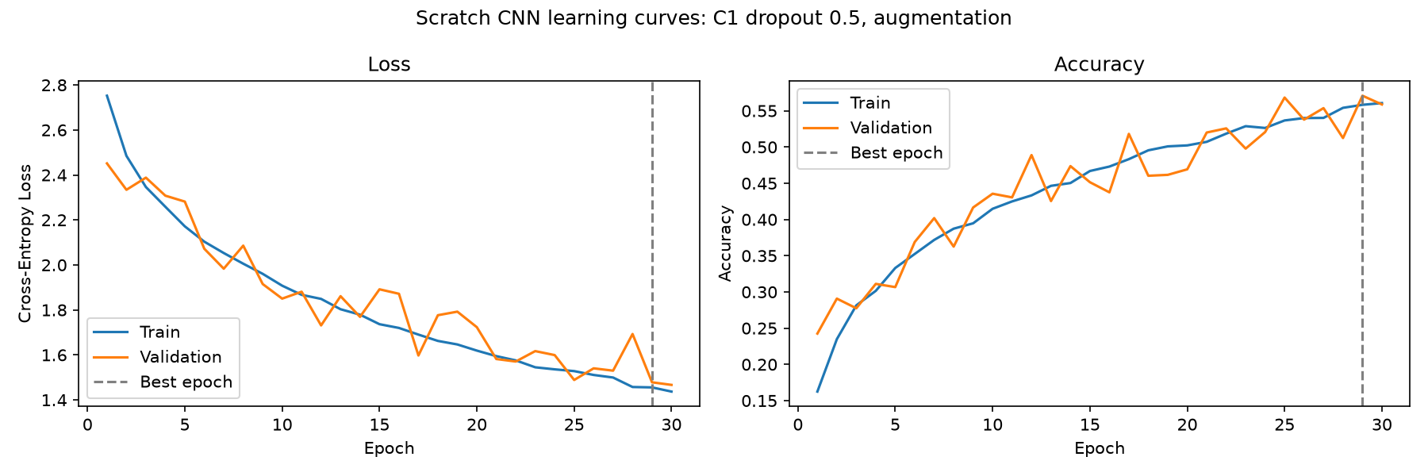
APPENDIX · LEARNING CURVES
Backup · Learning curves: C1 dropout .5 + augmentation
Blue = training; orange = validation; gray dashed = best checkpoint; red dotted (ResNet R2–R6) = unfreeze.
20

Slide 21
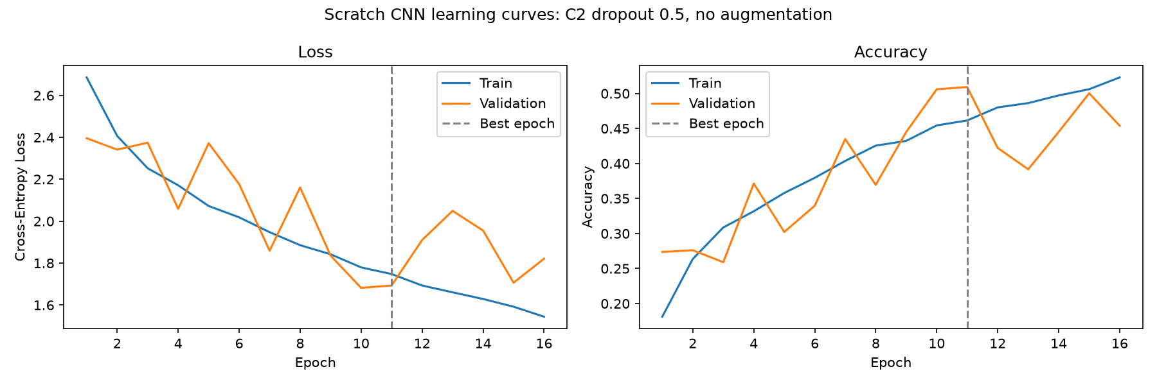
APPENDIX · LEARNING CURVES
Backup · Learning curves: C2 dropout .5, no augmentation
Blue = training; orange = validation; gray dashed = best checkpoint; red dotted (ResNet R2–R6) = unfreeze.
21

Slide 22
APPENDIX · LEARNING CURVES
Backup · Learning curves: C3 no dropout + augmentation
Blue = training; orange = validation; gray dashed = best checkpoint; red dotted (ResNet R2–R6) = unfreeze.
22

Slide 23
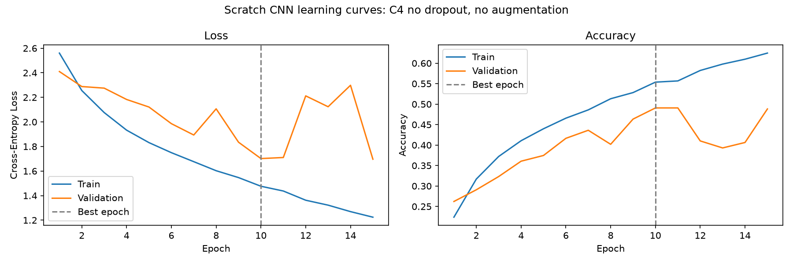
APPENDIX · LEARNING CURVES
Backup · Learning curves: C4 no dropout, no augmentation
Blue = training; orange = validation; gray dashed = best checkpoint; red dotted (ResNet R2–R6) = unfreeze.
23

Slide 24
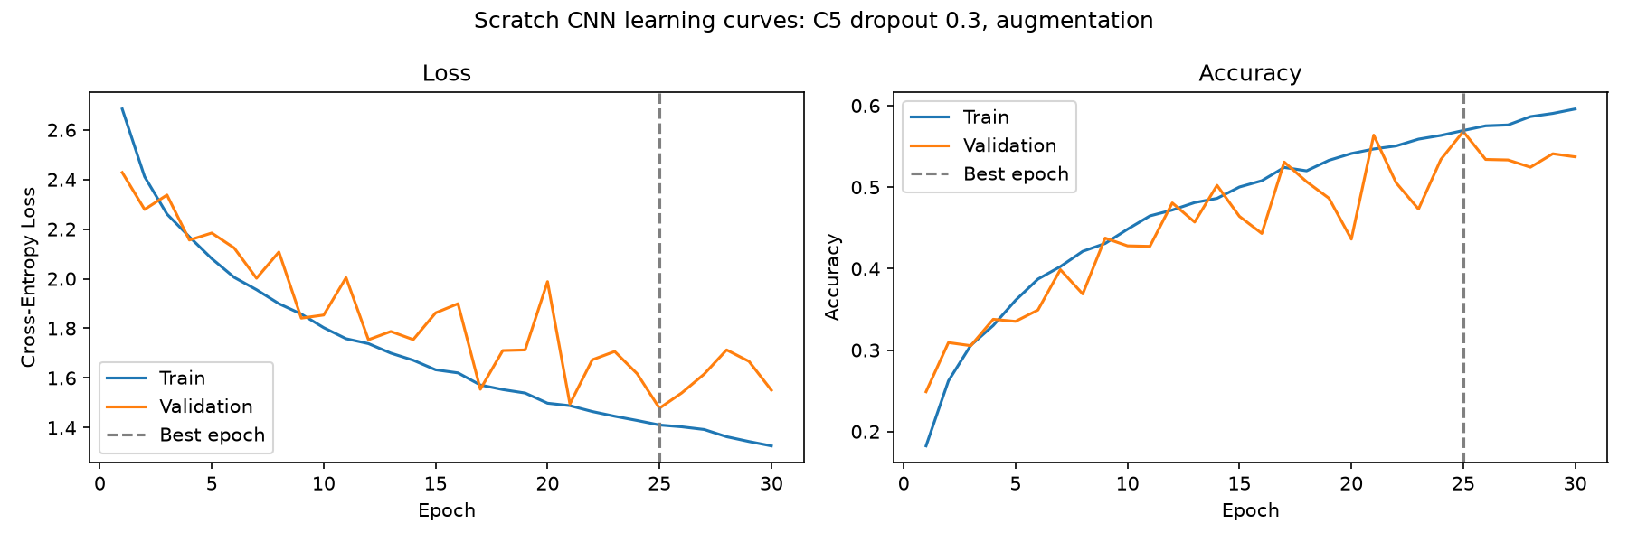
APPENDIX · LEARNING CURVES
Backup · Learning curves: C5 dropout .3 + augmentation
Blue = training; orange = validation; gray dashed = best checkpoint; red dotted (ResNet R2–R6) = unfreeze.
24

Slide 25
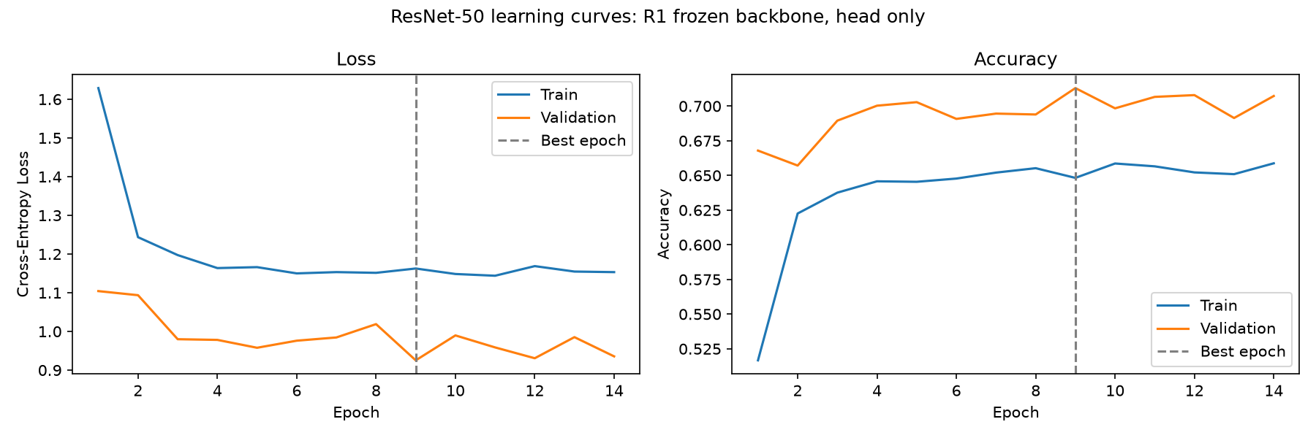
APPENDIX · LEARNING CURVES
Backup · Learning curves: R1 head-only
Blue = training; orange = validation; gray dashed = best checkpoint; red dotted (ResNet R2–R6) = unfreeze.
25

Slide 26
APPENDIX · LEARNING CURVES
Backup · Learning curves: R2 fine-tuned layer4
Blue = training; orange = validation; gray dashed = best checkpoint; red dotted (ResNet R2–R6) = unfreeze.
26

Slide 27
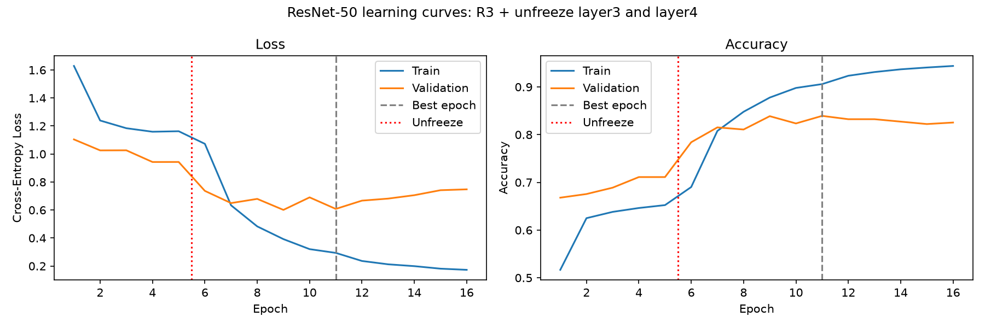
APPENDIX · LEARNING CURVES
Backup · Learning curves: R3 fine-tuned layer3+4
Blue = training; orange = validation; gray dashed = best checkpoint; red dotted (ResNet R2–R6) = unfreeze.
27

Slide 28
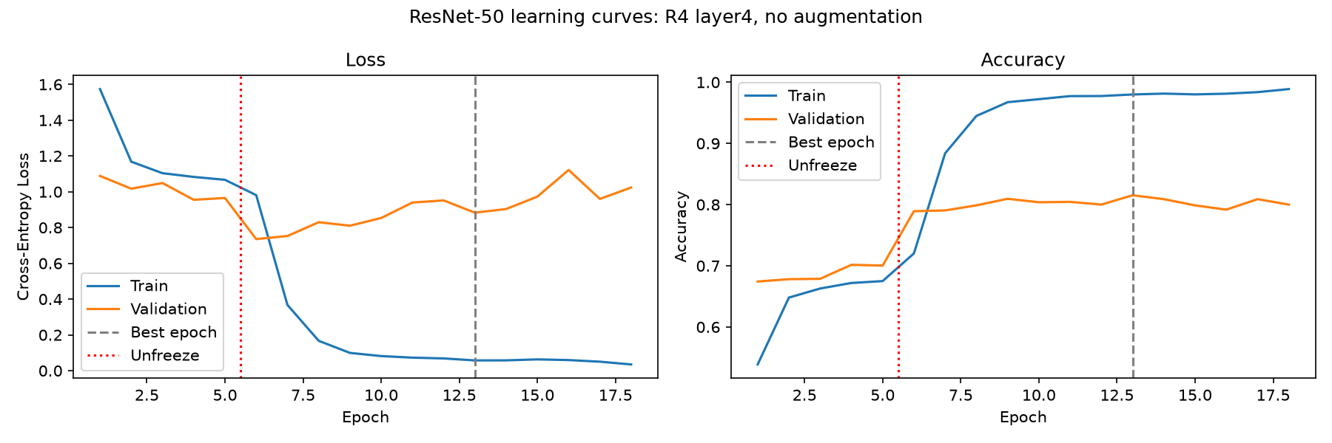
APPENDIX · LEARNING CURVES
Backup · Learning curves: R4 without augmentation
Blue = training; orange = validation; gray dashed = best checkpoint; red dotted (ResNet R2–R6) = unfreeze.
28

Slide 29
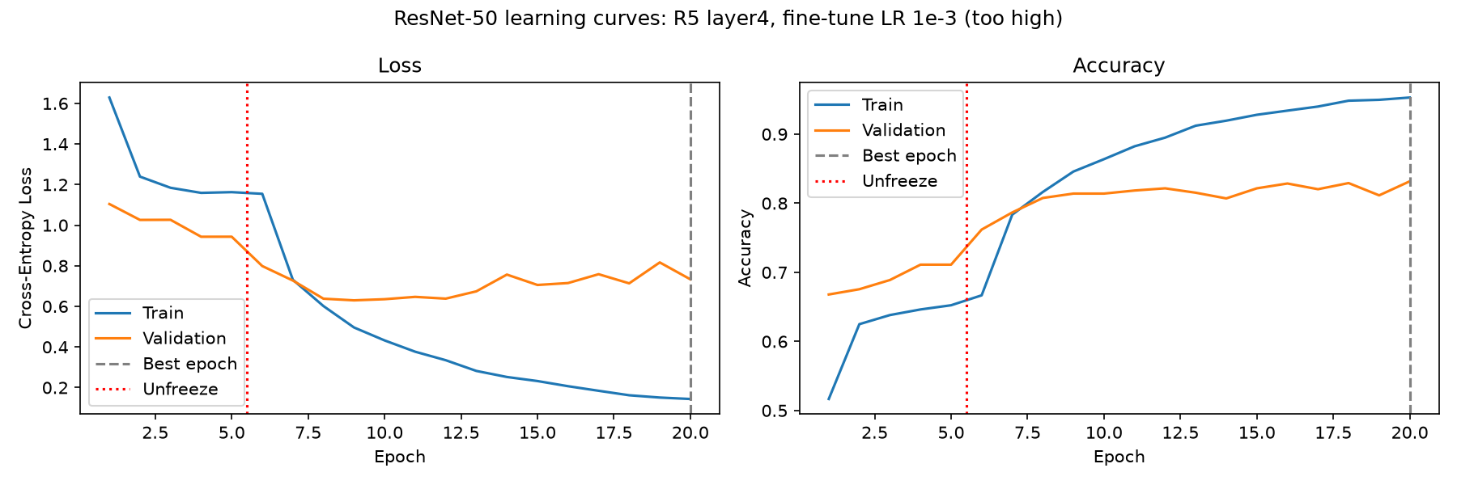
APPENDIX · LEARNING CURVES
Backup · Learning curves: R5 fine-tune LR 1e−3
Blue = training; orange = validation; gray dashed = best checkpoint; red dotted (ResNet R2–R6) = unfreeze.
29

Slide 30
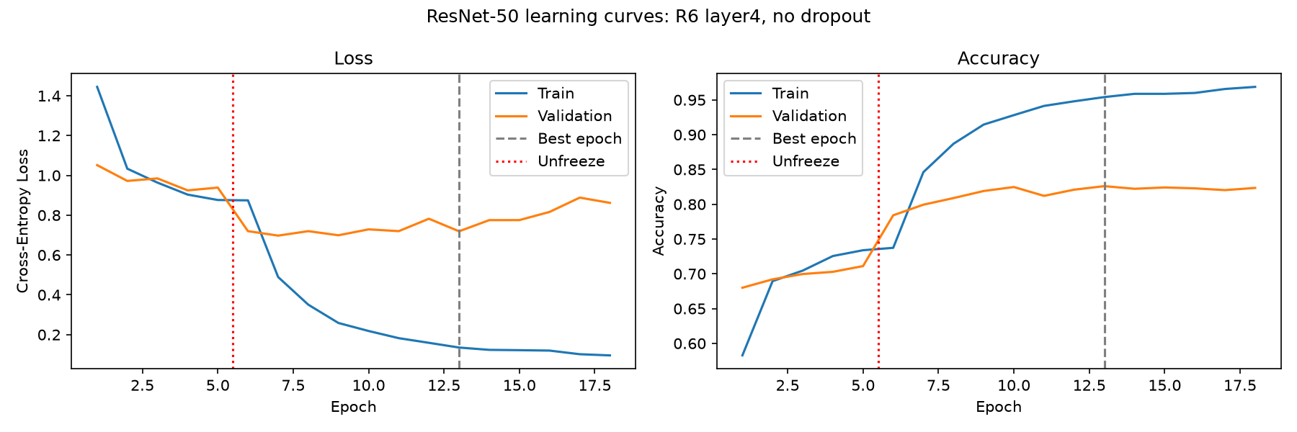
APPENDIX · LEARNING CURVES
Backup · Learning curves: R6 without dropout
Blue = training; orange = validation; gray dashed = best checkpoint; red dotted (ResNet R2–R6) = unfreeze.
30

Slide 31
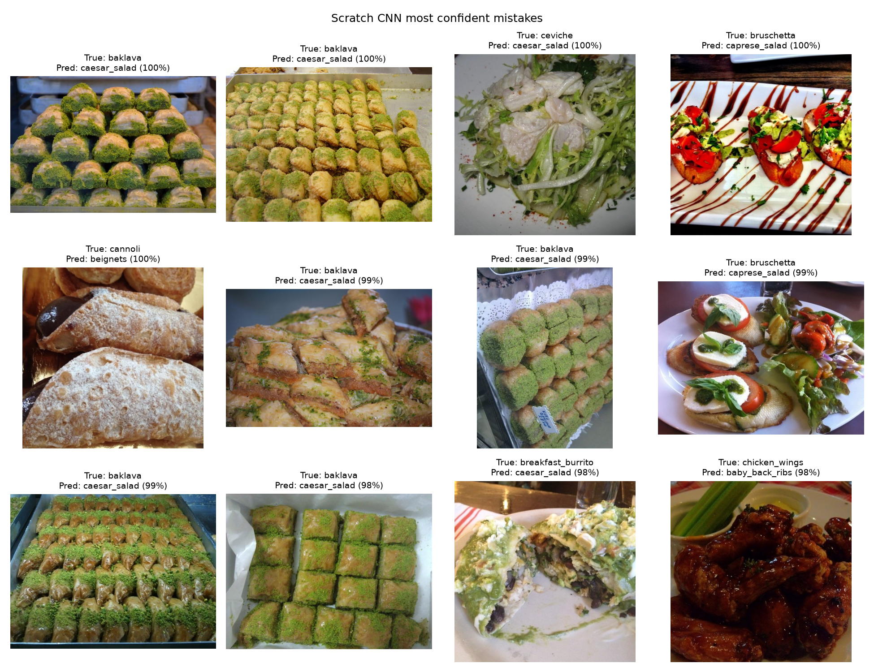
APPENDIX · ERROR ANALYSIS
Backup · Scratch CNN high-confidence mistakes
Each example shows its true label, predicted label and model confidence; confidence alone does not imply correctness.
31

Slide 32
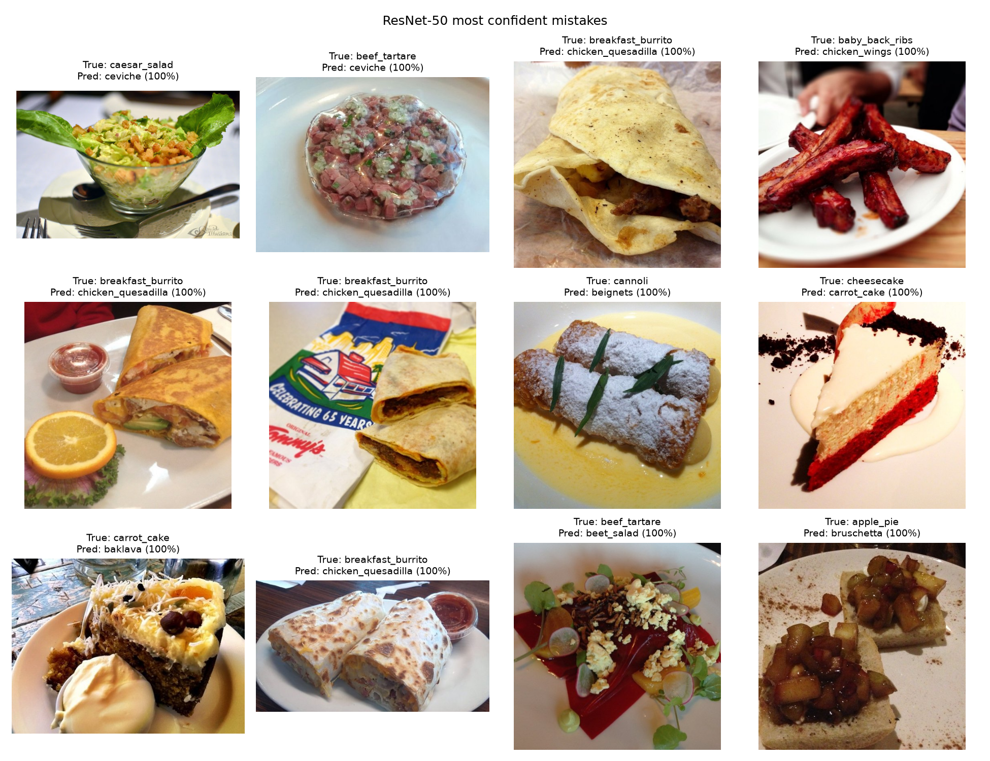
APPENDIX · ERROR ANALYSIS
Backup · ResNet-50 high-confidence mistakes
Each example shows its true label, predicted label and model confidence; confidence alone does not imply correctness.
32

Slide 33
APPENDIX · RESULTS
Backup · Per-class transfer-learning improvement
Computed from the provided per_class_resnet50.csv and per_class_scratch_cnn.csv files.
33

Slide 34
APPENDIX · REFERENCES
Sources and implementation notes
1. Bossard, Guillaumin & Van Gool (2014). Food-101: Mining Discriminative Components with Random Forests. ECCV.
2. Hassannejad et al. (2016). Food Image Recognition Using Very Deep Convolutional Networks.
3. Martinel et al. (2018). Wide-Slice Residual Networks for Food Recognition. WACV.
4. PyTorch / torchvision: ResNet-50 ImageNet pretrained weights and fine-tuning documentation.
5. Experimental metrics and figures: supplied training scripts, CSV exports, and learning-curve / mistakes PNGs.
Literature reports are for 101-class classification; this experiment uses a 21-class subset.
34

Slide 35
CLOSING REMARKS
Why ResNet-50 instead of EfficientNet?
ResNet-50 is a well-established, permitted CNN architecture with a straightforward freeze/unfreeze structure. It made transfer learning easy to interpret. EfficientNet would be a worthwhile controlled follow-up, but we did not benchmark it here.
Why freeze some layers?
Lower-level ImageNet features are broadly reusable; freezing them reduces computation and limits overfitting. We fine-tuned the high-level layer4 features to adapt to food categories, then measured the validation gain.
Did pretraining alone cause the entire 24.2-point gain?
We cannot say that. The ResNet and scratch CNN differ in architecture, parameter count, and input resolution as well as pretraining. The experiment demonstrates a practical model-performance advantage, not a single-variable causal ablation of pretraining.
Why is ResNet test accuracy higher than validation?
The reported test accuracy is 86.9 percent and best validation accuracy is 83.9 percent. The validation set contains 1,575 images compared with 5,250 test images, so its estimate can fluctuate more. Sampling differences and checkpoint selection can contribute; we should not assume the datasets have identical difficulty.
Why not compare 86.9 percent directly with 90.27 percent from WISeR?
WISeR reports performance on all 101 categories, while our evaluation has only 21. Different class counts and potentially different protocols make direct rankings misleading.
Why did dropout help ResNet but not the scratch CNN?
The two models have different capacity and optimization behavior. In our particular runs, ResNet R2 outperformed R6 without dropout, while scratch CNN C3 without dropout slightly beat C1 with 0.5 dropout. These are empirical observations; repeated runs would test their stability.
Was the validation split stratified?
The scratch CNN script uses a fixed random seed and a 10 percent holdout, but does not specify stratify=... in train_test_split. The source training pool is balanced across classes, but the validation split is not explicitly enforced to be class-balanced. This should be corrected in the slide or implementation before making the stronger claim.
Why is the scratch CNN so poor on apple pie?
It classified only 10 of 250 apple-pie examples correctly. The confusion output shows many errors into bread pudding and chicken quesadilla. We can describe that pattern, but not determine a single cause without more targeted image inspection or saliency analysis.
What if you had more time?
Run repeated random seeds, compare equal image resolutions, test discriminative layer-wise learning rates, use class-targeted augmentation, and include a stronger scratch baseline. Those experiments would separate sources of performance gains more rigorously.
34

