Slide 1
Analysis of Protein Structure Deviations in SCN2A Mutations
Assessing the Relationship Between Structural Changes and Pathogenicity
Hannah Wimpy

Slide 2
Introduction
SCN2A mutations have been linked to various neurodevelopmental disorders, including epilepsy and autism.
This project investigates how structural deviations caused by these mutations can predict their pathogenicity.

Slide 3
Project Motivation
Why does this matter?
SCN2A is critical for neural development, and mutations can profoundly impact neurological function.
Understanding these mutations helps predict clinical outcomes and guides treatment strategies.

Slide 4
Research Question and Hypothesis
Research Question: Can RMSD and SASA predict the pathogenicity of SCN2A mutations and their associated clinical outcomes?
Hypothesis: Mutations causing larger deviations in protein structure are more likely to be pathogenic and associated with epilepsy or autism.

Slide 5
Data and Methodology
Data: SCN2A gene variants, including RMSD and SASA metrics, with clinical classifications.
Methodology:
- Fetch SCN2A variant data from UniProt.
- Generate mutant protein structures and calculate RMSD/SASA.
- Classify mutations based on clinical outcomes.
Tools: UniProt, Modeller, RandomForest, HistGradientBoosting.

Slide 6
Data Processing Pipeline
1. Fetch SCN2A variant data from UniProt.
2. Generate mutant protein structures.
3. Calculate RMSD and SASA for wild-type and mutant structures.
4. Classify mutations and assess hypothesis support.
5. Visualization and Analysis.

Slide 7
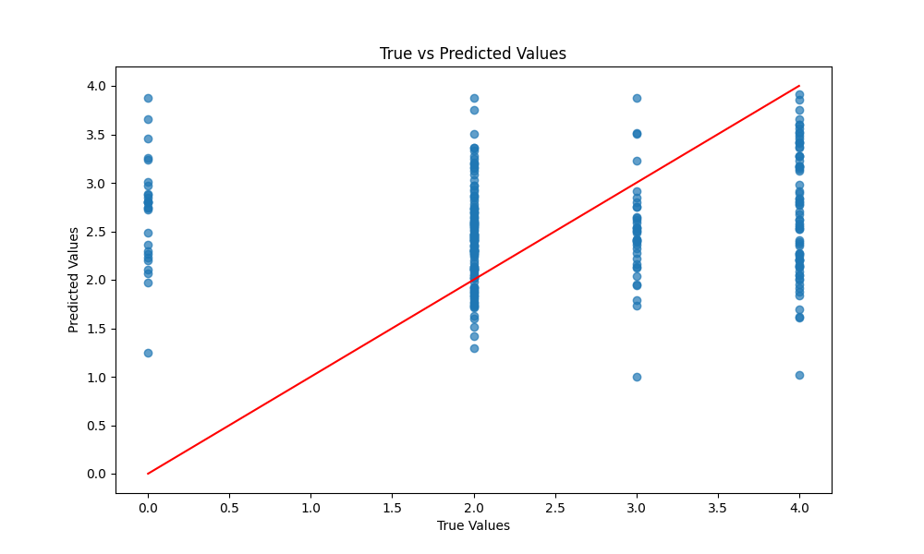
Regression Analysis: True vs Predicted
Key Metrics:
- Mean Squared Error (MSE): 1.6657
- R² Score: -0.1463

Slide 8
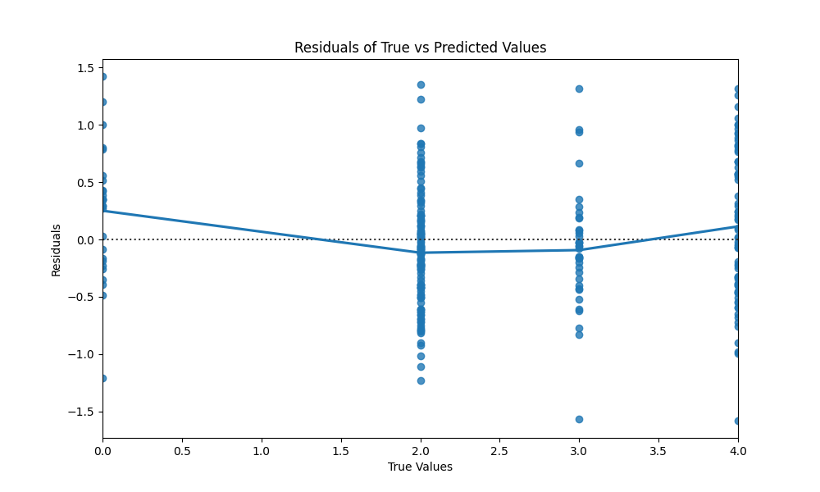
Regression Analysis: Residuals

Slide 9
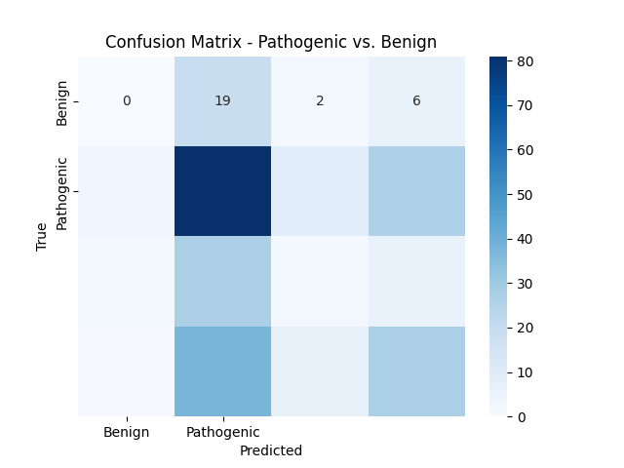
Classification Analysis Results
Key Metrics:
- Accuracy: 0.4297
- F1 Score: 0.3869

Slide 10
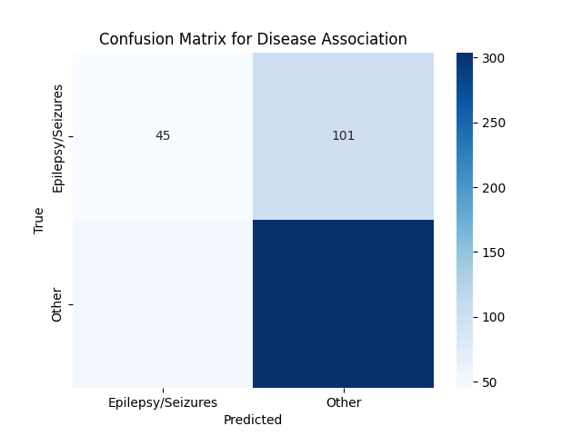
Association Analysis Results
Key Metrics:
- Accuracy: 0.6952
- F1 Score: 0.6743

Slide 11
Interpretation of Results
Key Findings:
- The regression model did not effectively explain variance, suggesting RMSD and SASA alone may not be sufficient predictors.
- The classification model achieved limited success, indicating some potential but requiring further refinement.
- Association analysis showed better results, suggesting RMSD and SASA may be more effective for predicting specific clinical outcomes like epilepsy or autism.

Slide 12
Conclusion and Implications
Results suggest that RMSD and SASA can be used as effective metrics for predicting the pathogenicity of SCN2A mutations.
These findings have significant implications for future research and clinical applications.

Slide 13
Future Work
Future directions include:
- Expanding the dataset to include more variants.
- Exploring additional structural metrics.
- Translating structural insights into clinical interventions.

Slide 14
Challenges Faced and Overcoming Them
Ensuring the accuracy of structural predictions was challenging. This required a deep understanding of bioinformatics tools and critical evaluation of the results.
Consulting literature and seeking feedback from peers and mentors were key to overcoming these challenges.

Slide 15
Questions and Discussion
Thank you for your attention. I'm happy to answer any questions you might have.

