Slide 1
Pawgress
MAD
ASG Stage 2
Team 2

Slide 2

Recap!
Turn completing tasks into caring for your virtual pet.
Task Management - create, prioritise, filter and track tasks, with timers to measure time spent.
Gamified Rewards - completing work earns currency that can be spent on items for your pet.
Productivity Analytics - visualises task completion to help users understand their habits.
Social Experience - add friends and interact with the wider community.
Engagement Features - daily challenges, streaks, motivational quotes and reminders encourage users
Pawgress

Slide 3
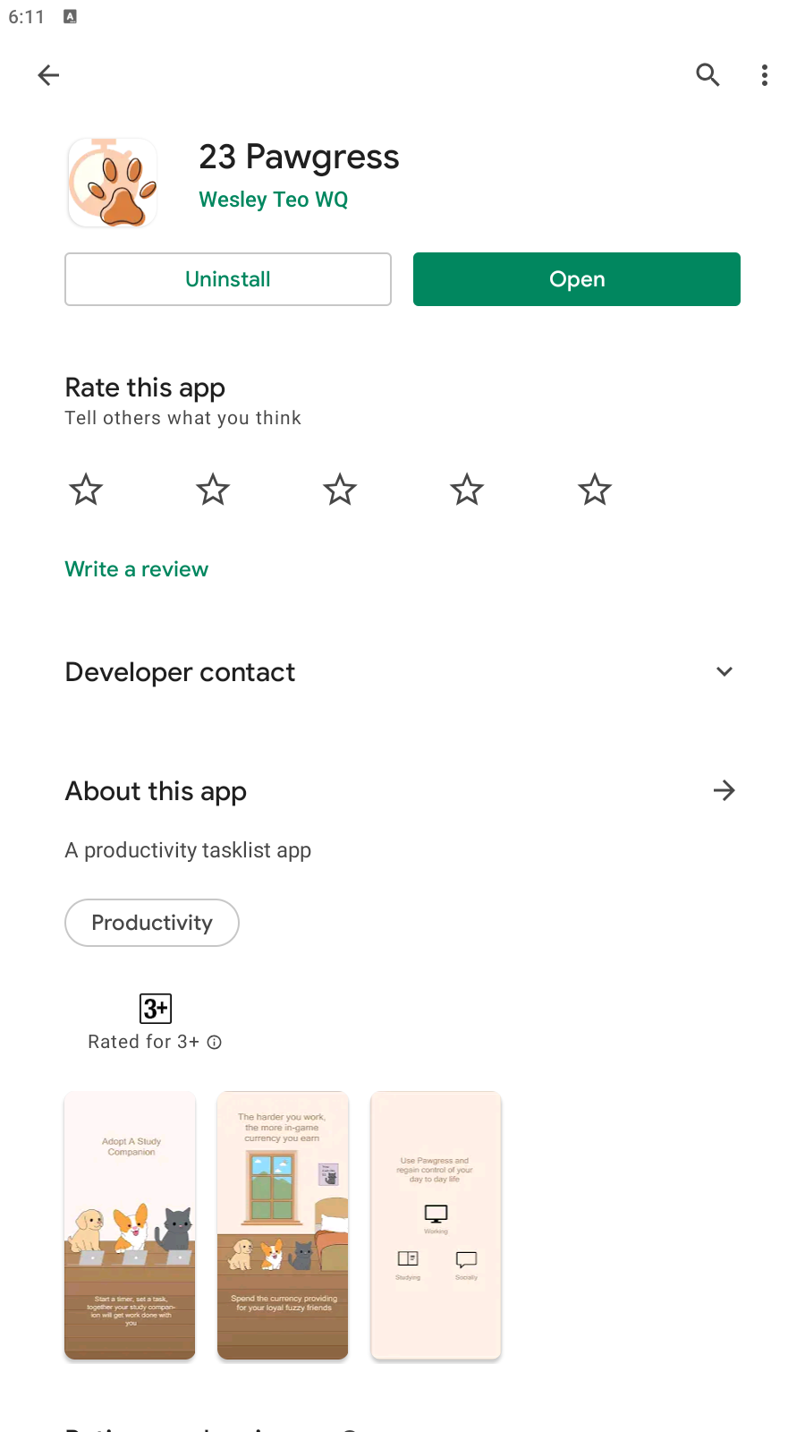
Recap!
Category : Productivity
Pawgress

Slide 4
Then
vs
Now
Spending of currency
Daily Challenges
Task Analytics
Task Prioritising, Task Filtering
Notification
Changing profile picture
Dark theme
Friends system
Random motivational msg (quotes) using API
Firebase implementation
Account Creation and Log-in
Pet selection
Daily Login (streaks)
Navigation bar to switch between tabs
Homepage, compiled task list
Task List under Task tab, create, edit, do task
Task timer, tracks down how much time spent on each task
Basic designs

Slide 5
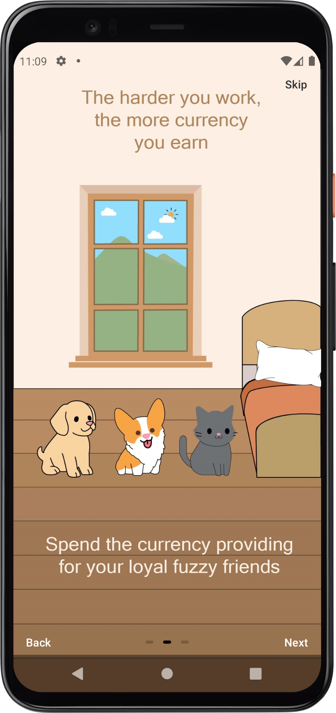
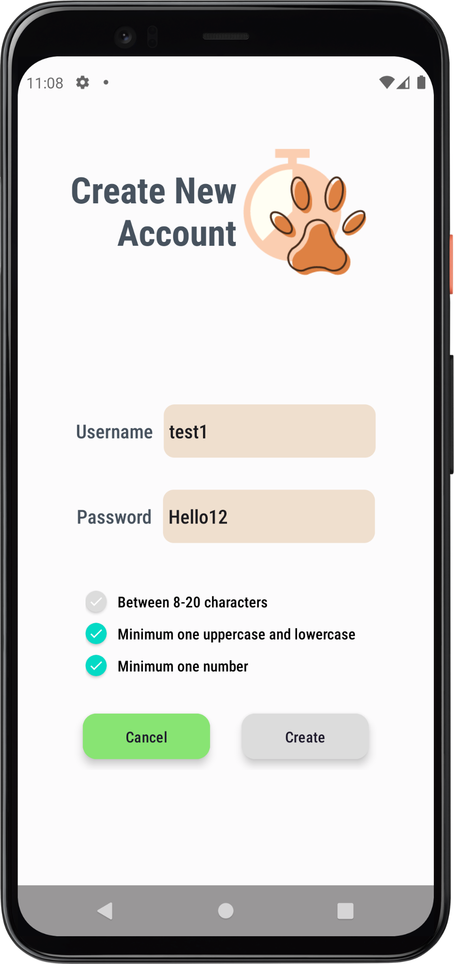
Tutorial Page & Account
Concepts Applied :
Tutorial Page
  Viewpager
  Circle Indicator
Account ( Edit & Creation )
  TextWatcher
  CardView

Slide 6
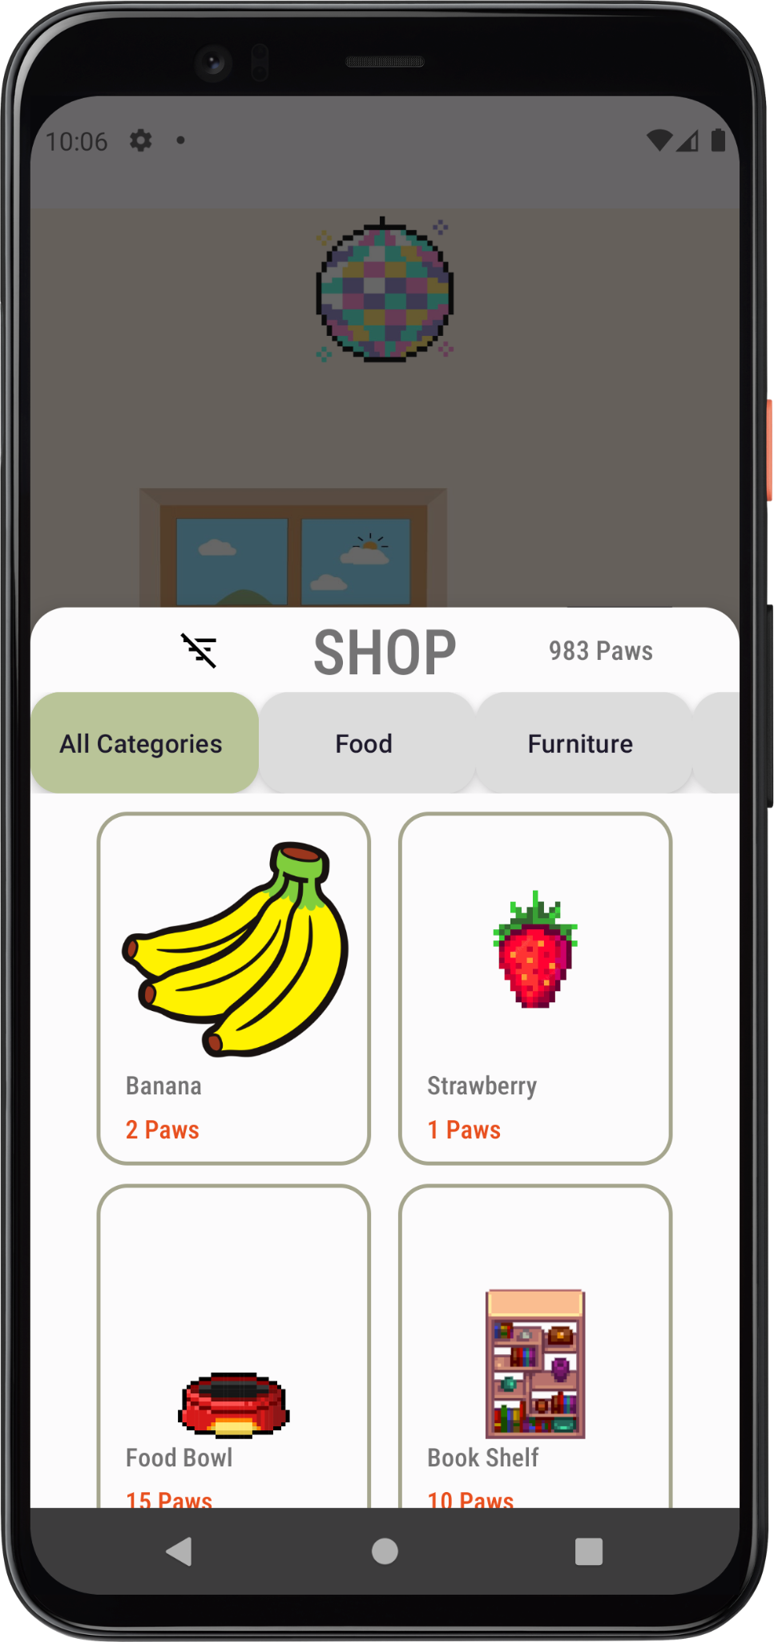
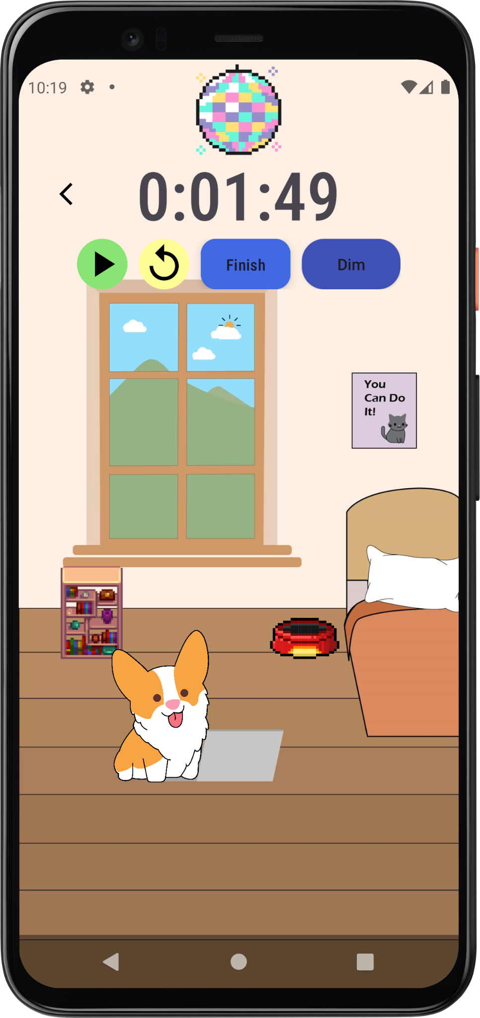
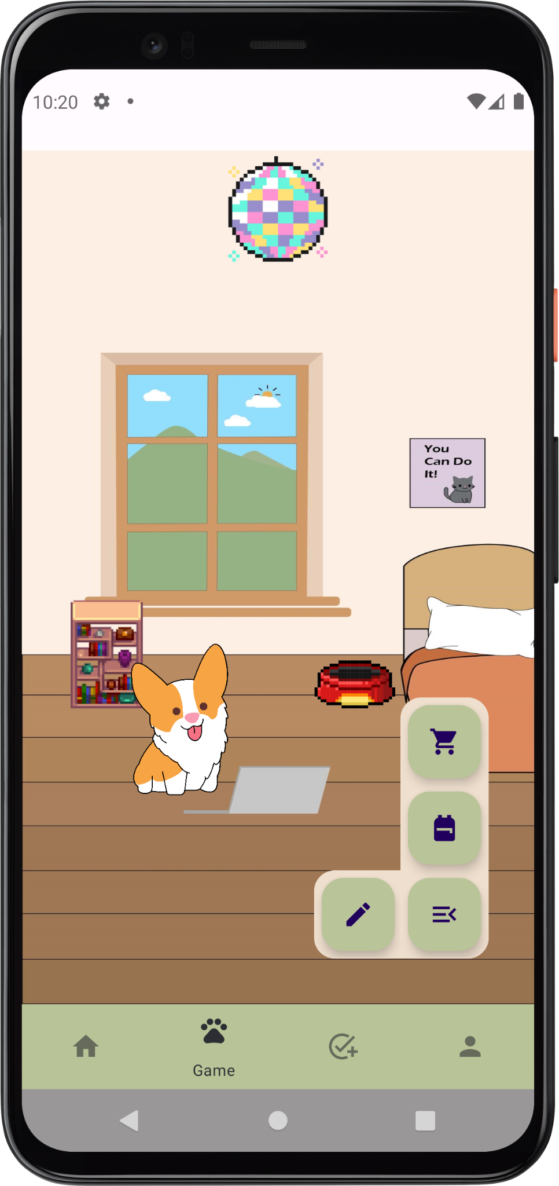
Shop Inventory & Game
Concepts Applied :
Modal & Persistent bottom sheet dialog
Horizontal ScrollView
Firebase Storage
Bitmap
Android Animations

Slide 7
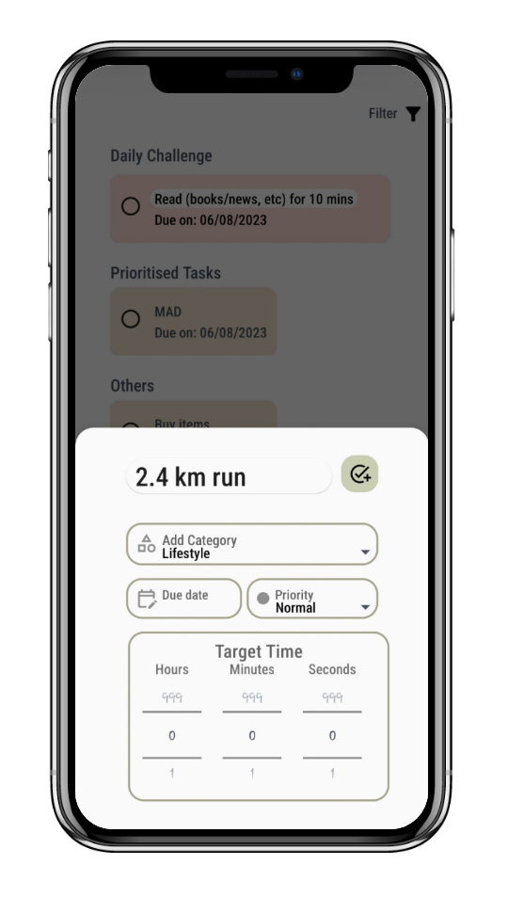
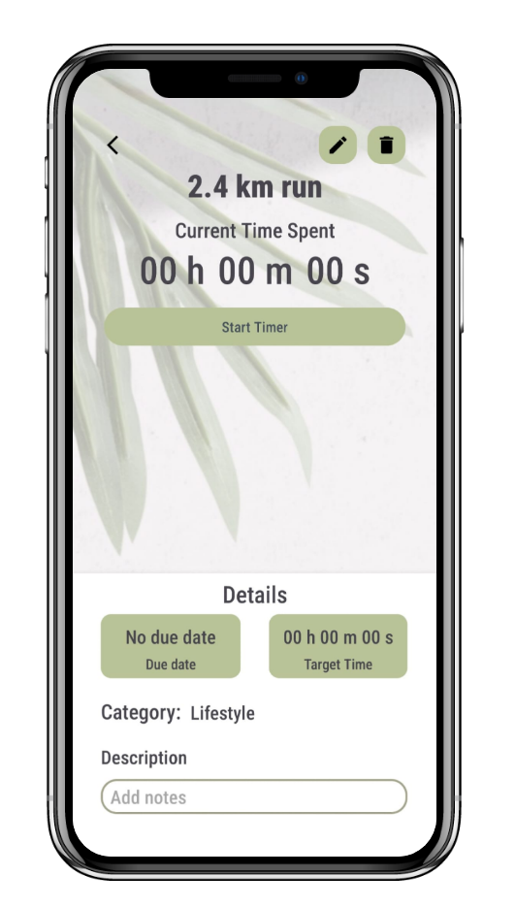
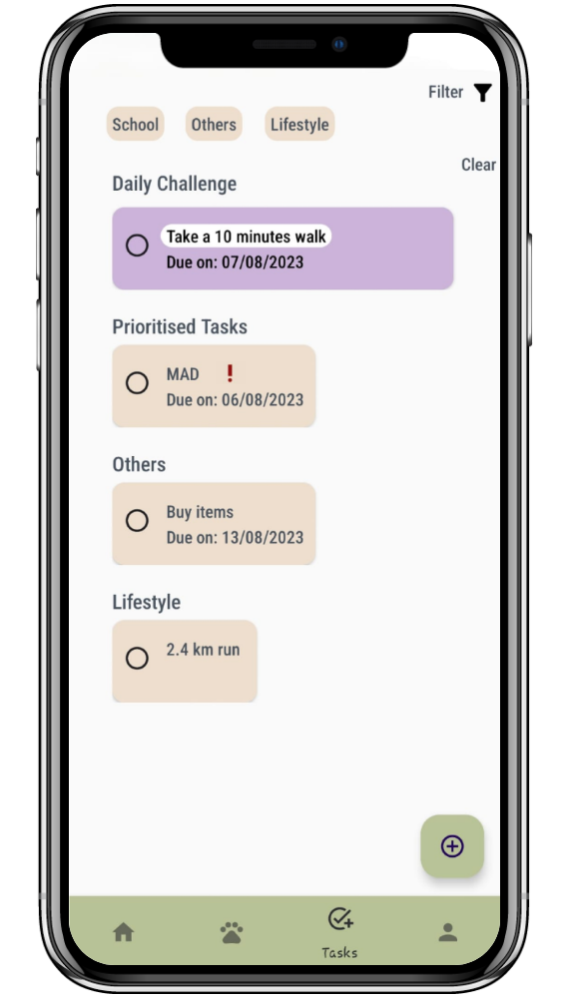
Tasks
Feature Changes:
Set due date and task priority
Task filtering
Edit or delete tasks in task view
New Concepts applied:
Modal & Persistent bottom sheet dialog
Nested Recycler View
Date Picker Dialog
Dropdown Spinner

Slide 8
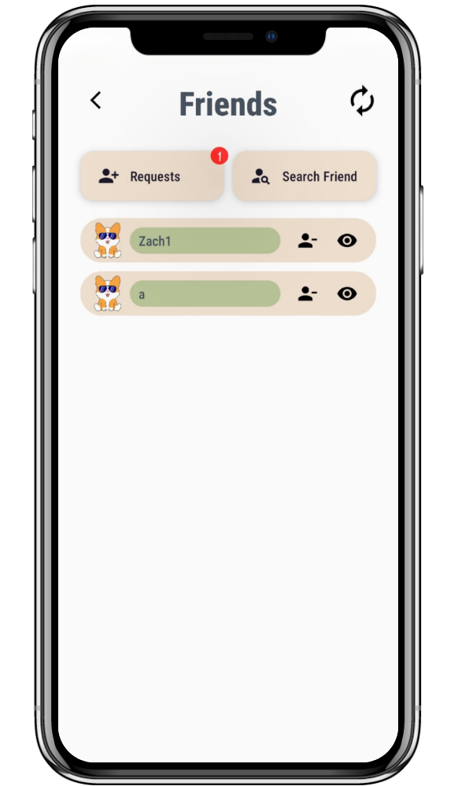
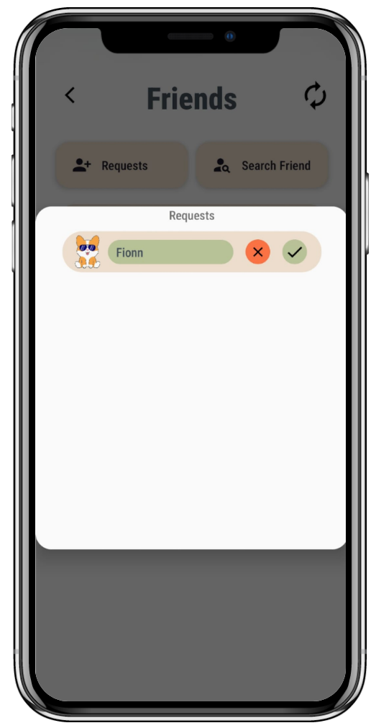
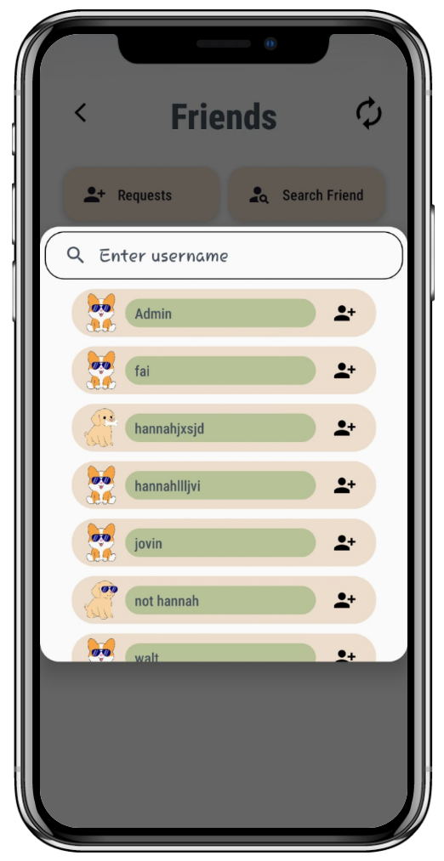
Friends
New Concepts Applied:
Firebase Storage
Dialog
SearchView

Slide 9
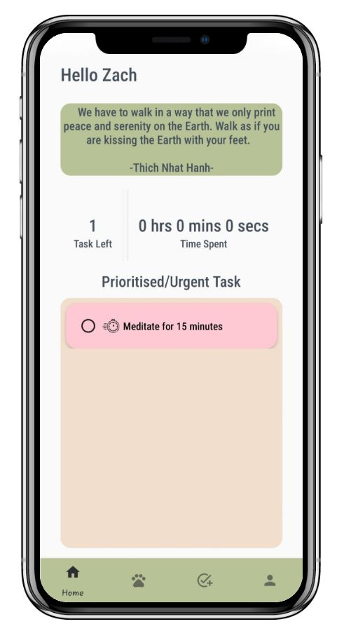
Motivational Quote
New Concepts Applied:
API (https://zenquotes.io/api/random)

Slide 10
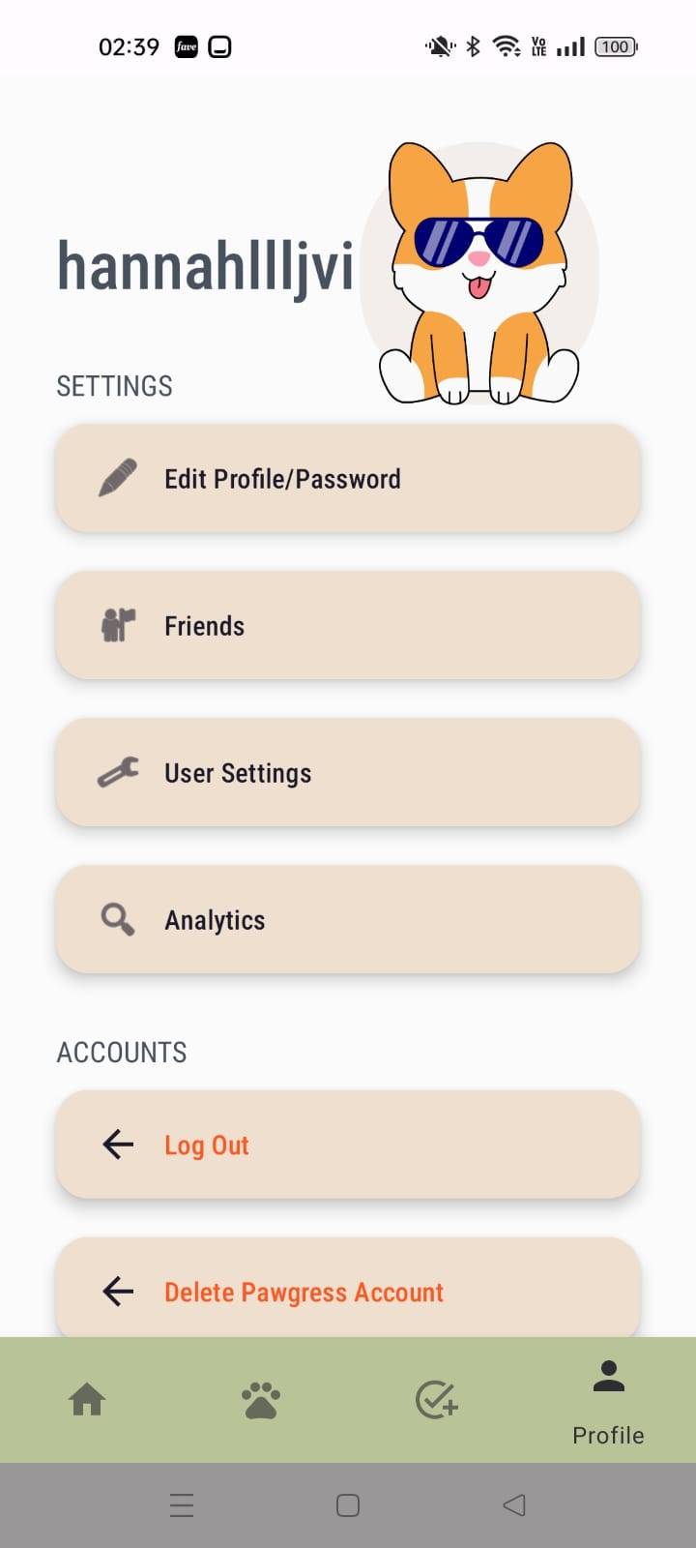
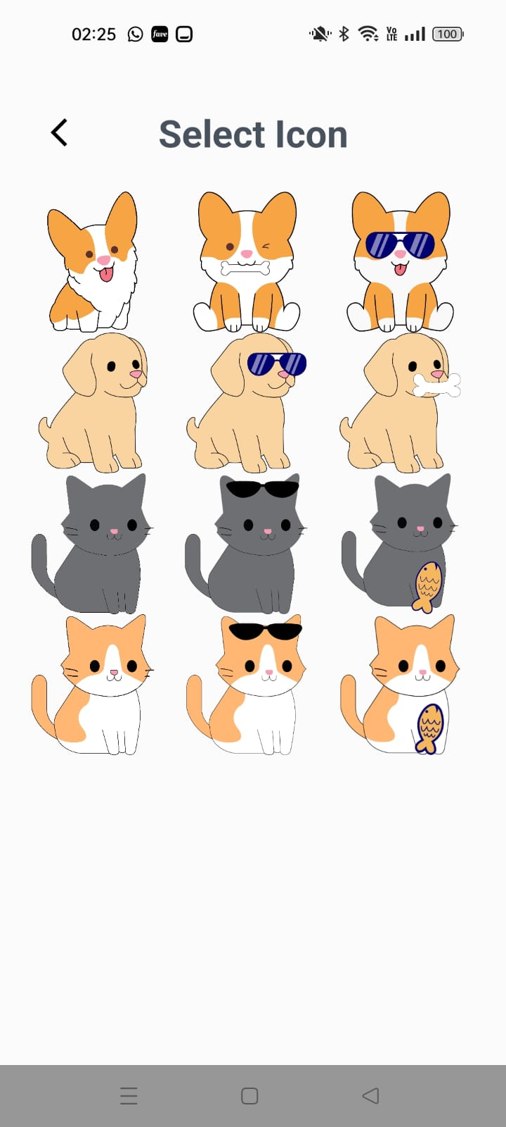
Profile Picture
Concepts Applied :
RecyclerView and Adapter
ViewHolder
SharedPreferences
Intents
Listeners and Callbacks
GridLayoutManager
How it Works? :
Users can set their profile through User Settings > Profile Picture and the new profile picture will be displayed accordingly in the Profile Tab

Slide 11
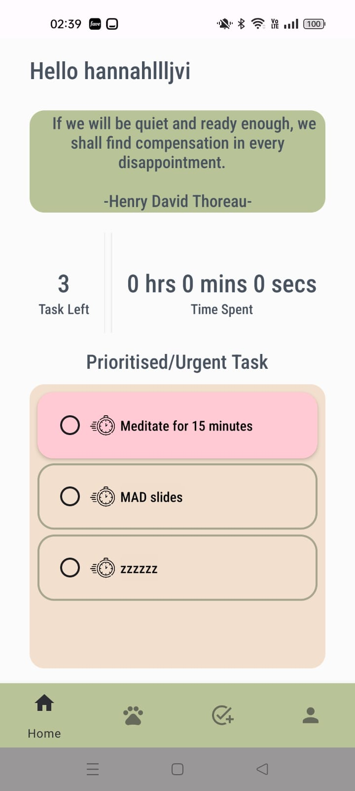
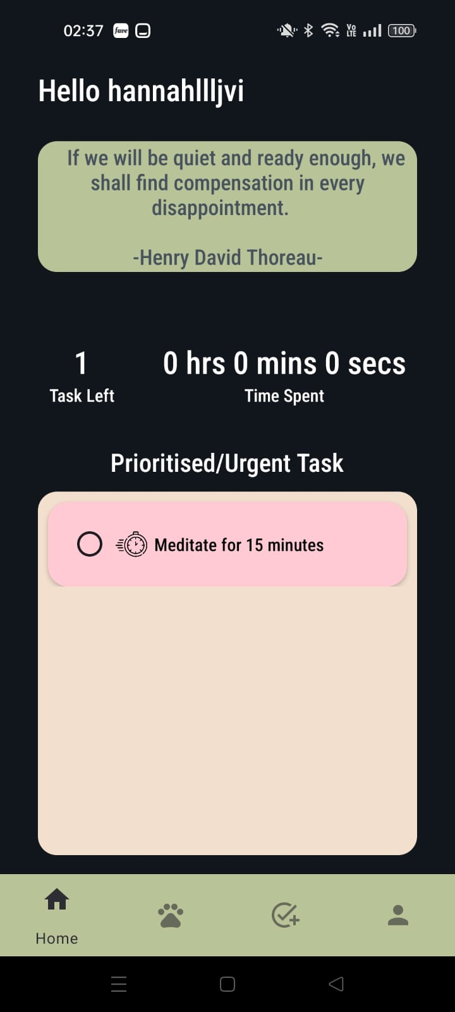
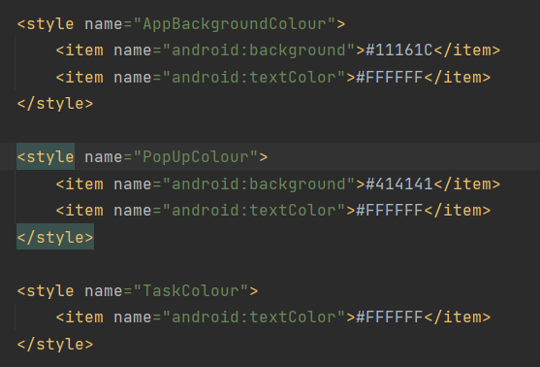
Themes
Created styles with the same name in themes.xml(night) and themes.xml
Applied the styles inside of the various layout xml files
As users toggle between light and dark mode, UI changes accordingly

Slide 12
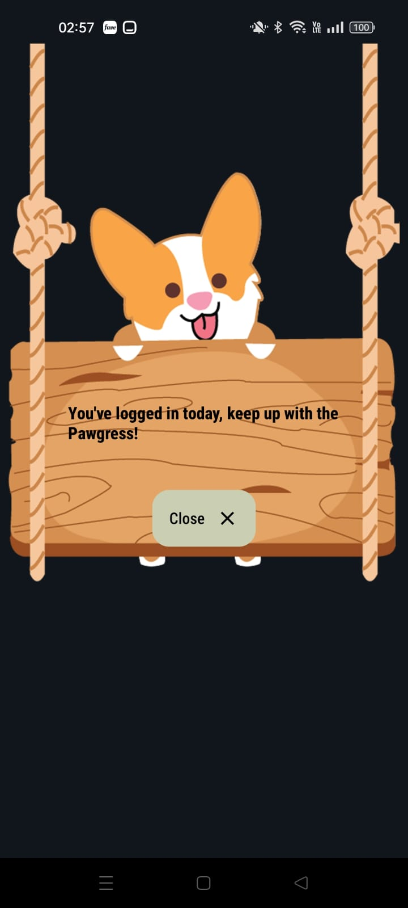
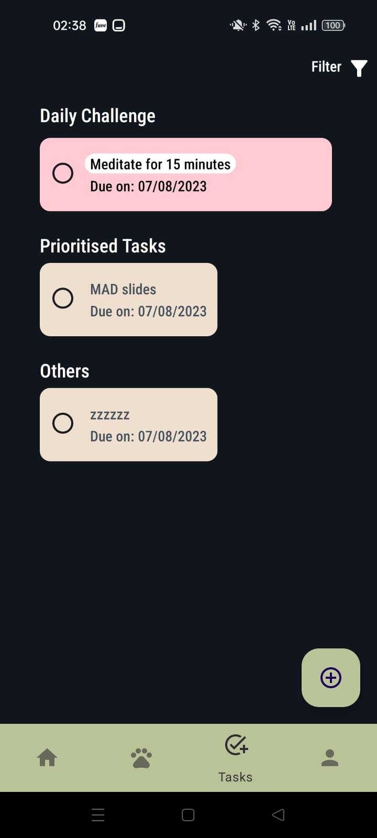
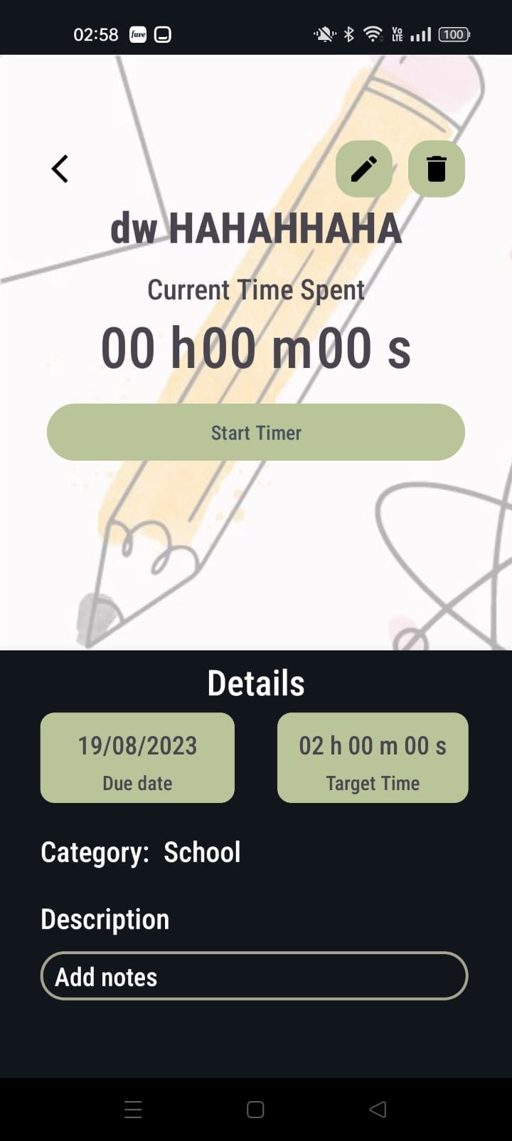
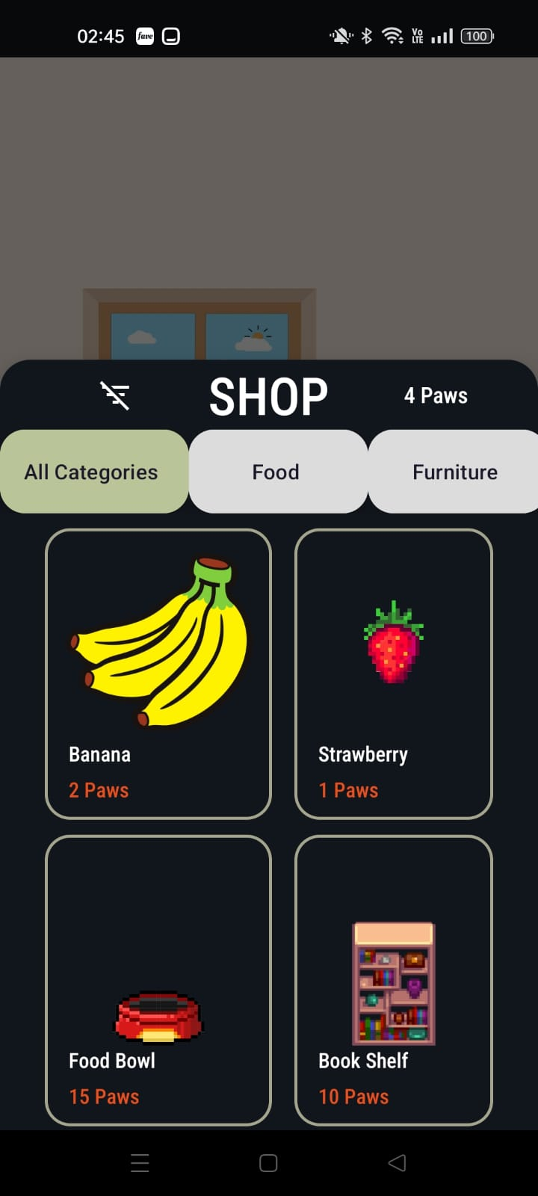
Themes - Dark Mode

Slide 13
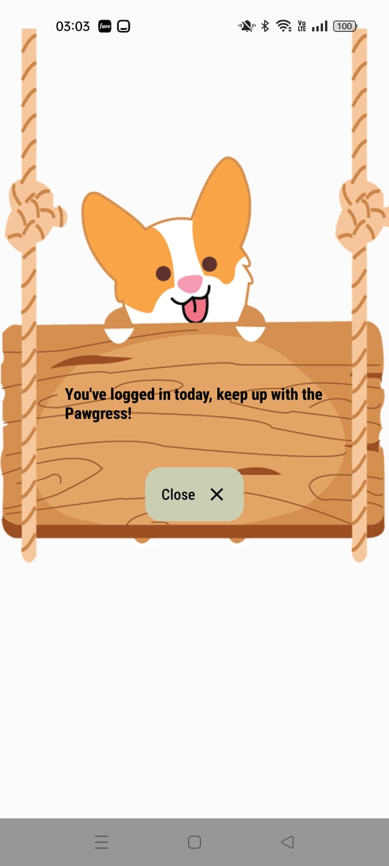
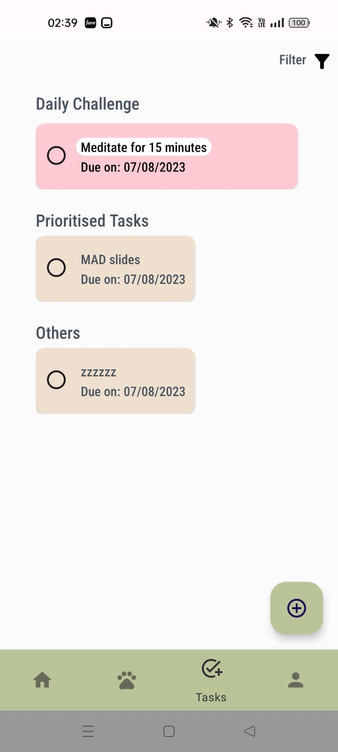
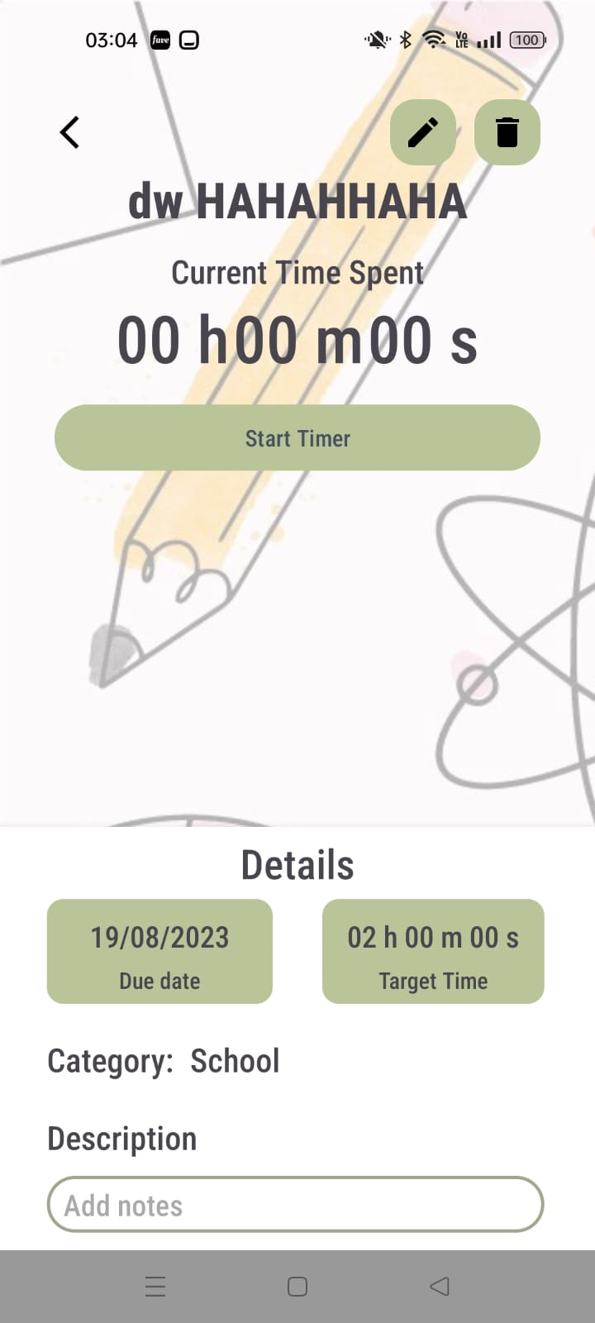
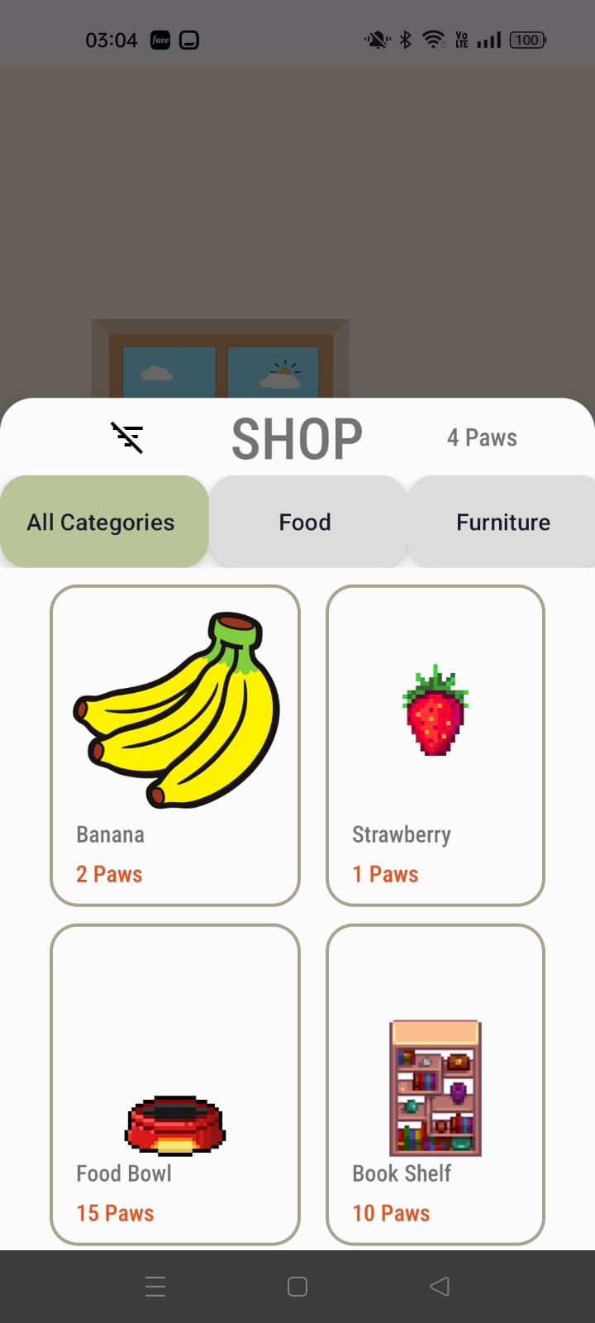
Themes - Light Mode

Slide 14
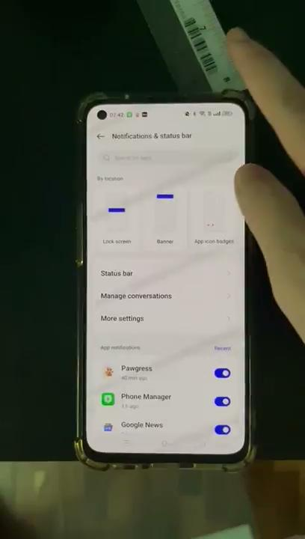
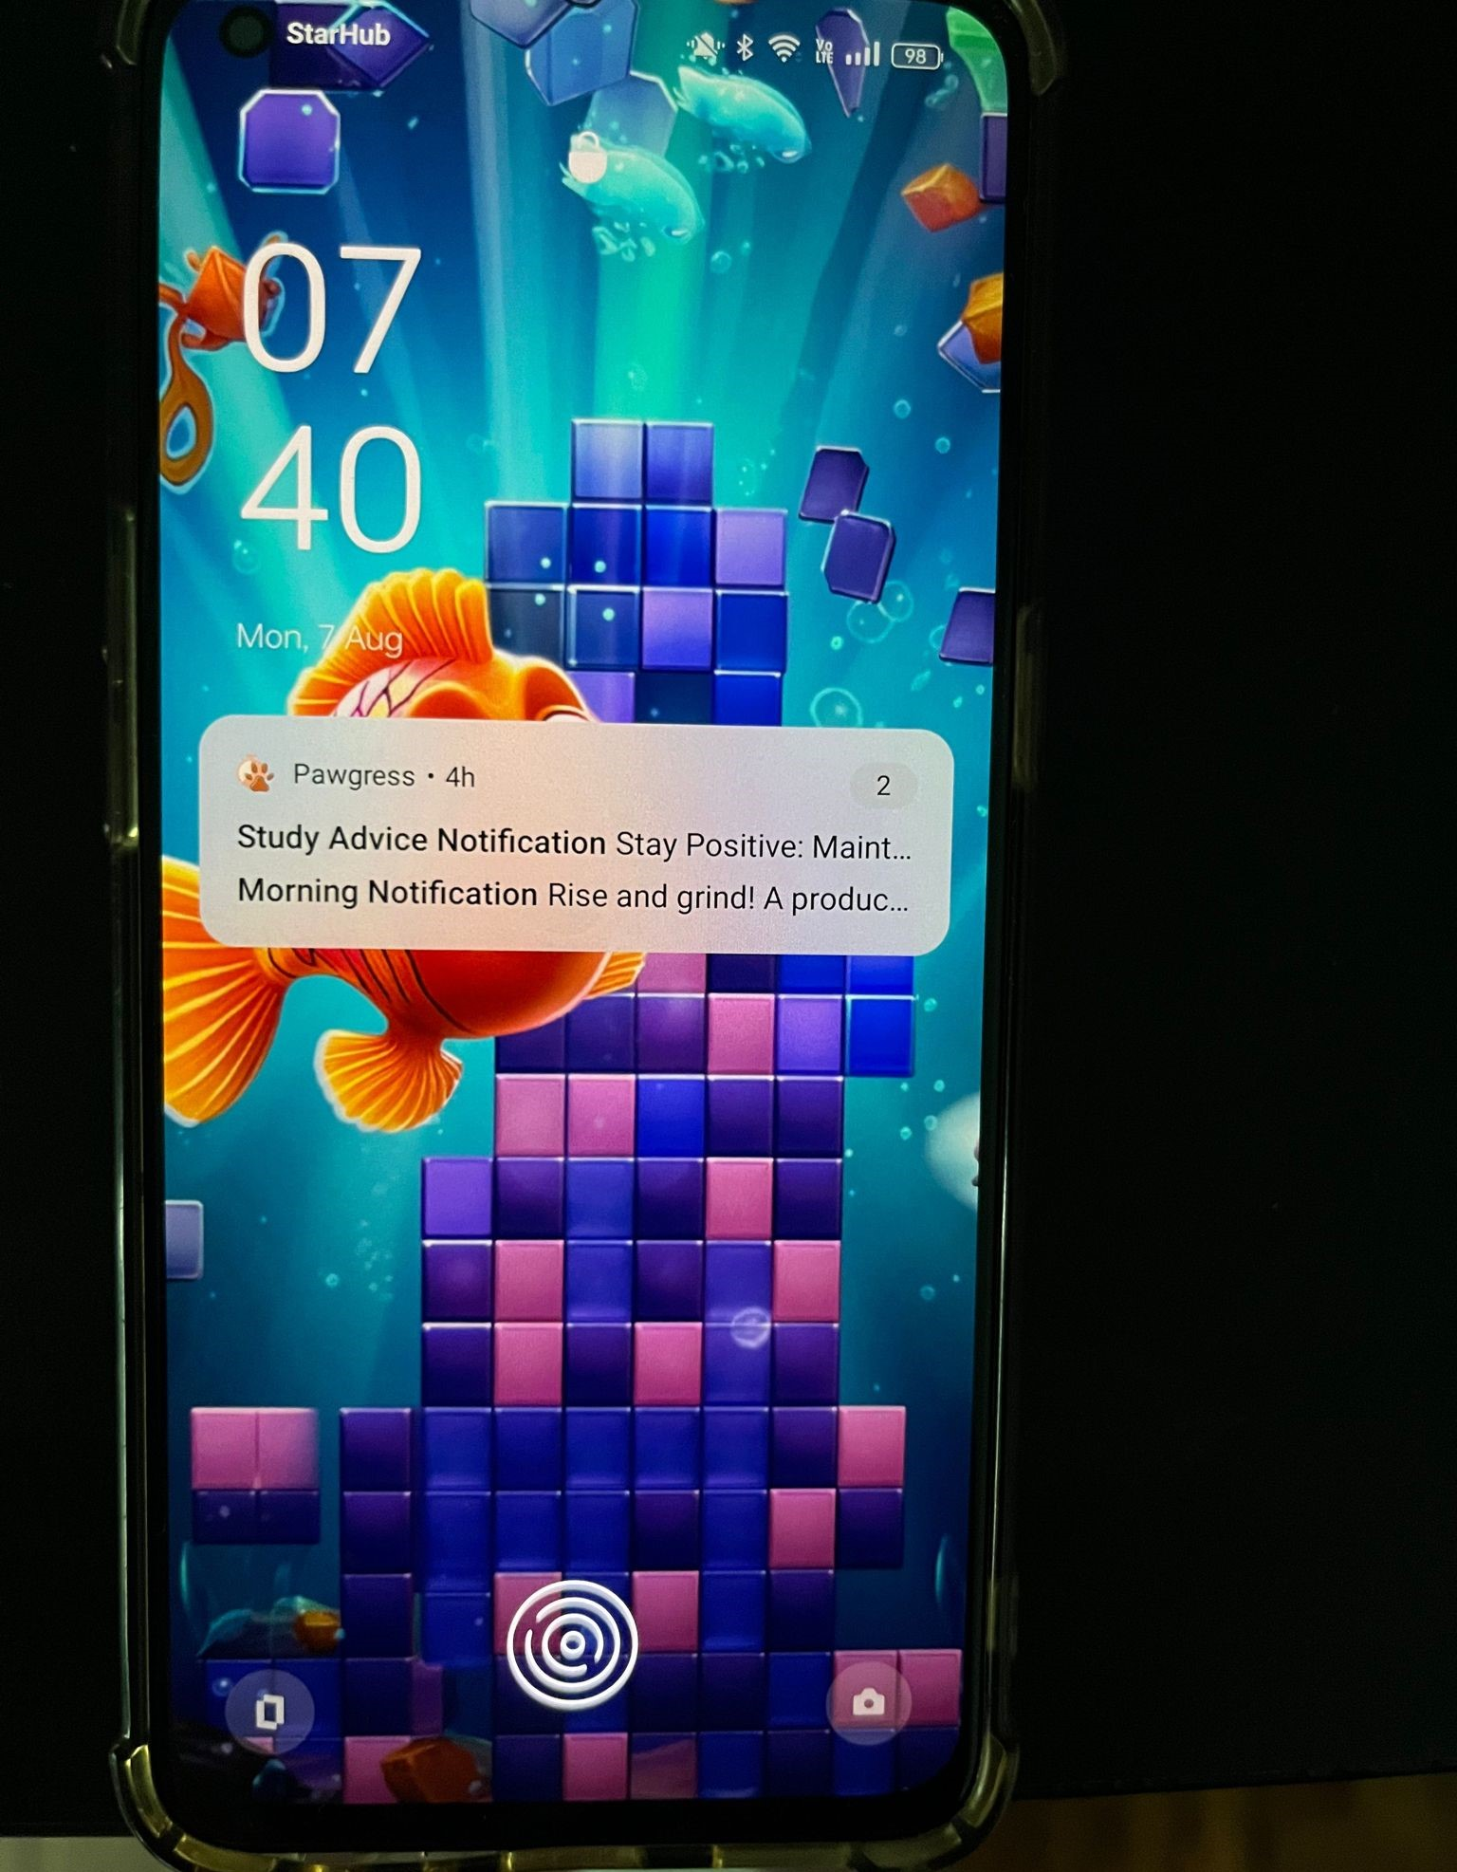
Notifications
New Concepts Applied :
Broadcast Receiver
NotificationManager and NotificationChannel
AlarmManager and PendingIntent
NotificationCompat.Builder
PendingIntent for Broadcast
How it Works? :
A morning + study advice notification is sent daily at 7am to encourage and remind users to complete their task due soon

Slide 15
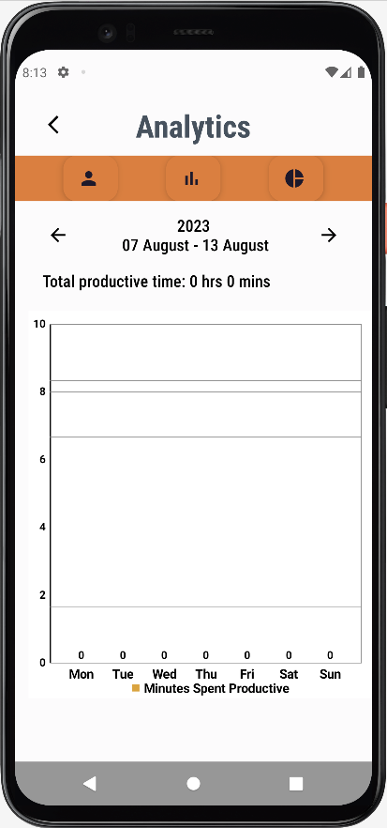
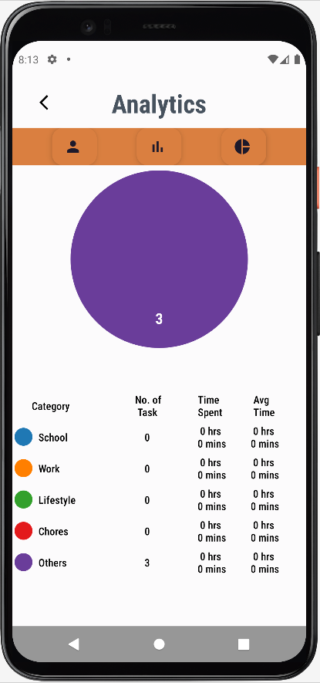
Task Analytics
New Concepts applied:
MPAndroidChart Library
Bar chart settings
Pie chart settings

Slide 16
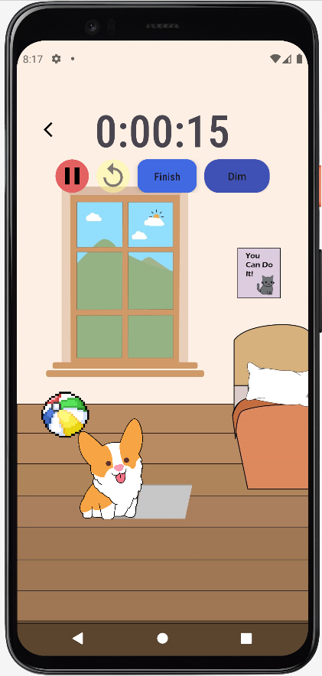
Dim Screen brightness (QOL)
New Concepts applied:
Settings.System.SCREEN_BRIGHTNESS (obtain current screen brightness)
WindowManager (allow toggling between dimmed and normal)

Slide 17
App
Demonstration

