Slide 1

DIABETES HEALTH
INDICATORS DATASET
Hannah Lashway, Sierra Sarkis, Thripura Pakala, Neyda Morales
Project 4 - Group 7

Slide 2
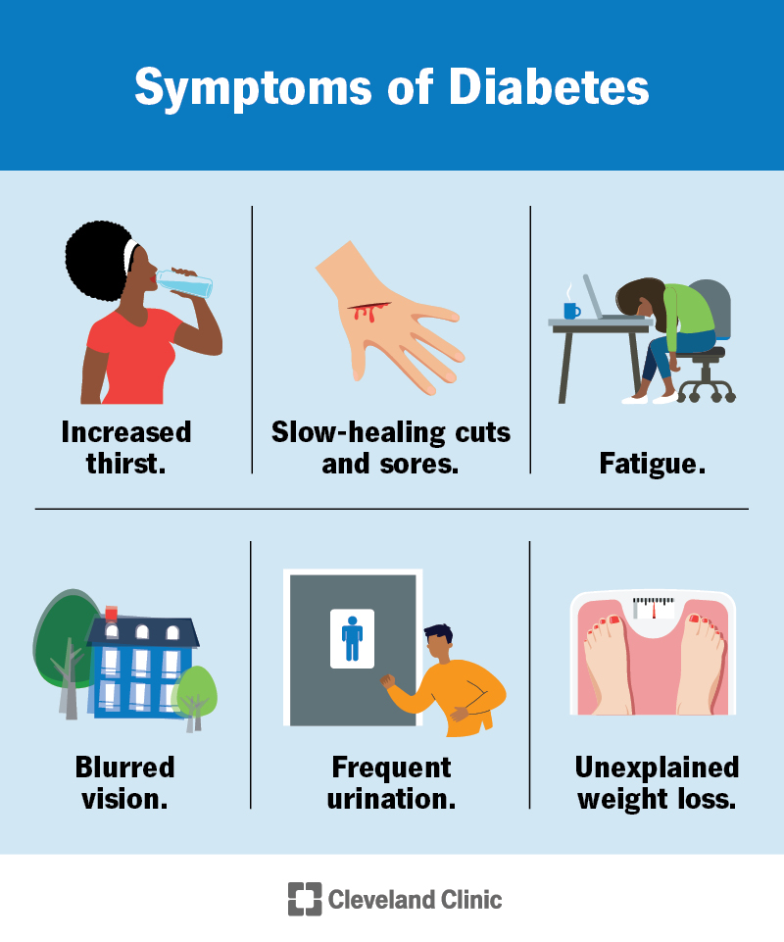
Purpose
The purpose of the Diabetes Health Indicators Dataset is to provide comprehensive health-related information that can be used to understand the factors contributing to diabetes. This dataset includes healthcare statistics, lifestyle survey information, demographic details, lab test results, and responses to survey questions. By analyzing this data, researchers and healthcare professionals can identify patterns and correlations that may help in predicting, preventing, and managing diabetes more effectively.

Slide 3
Inspiration
Diabetes is among the top 10 chronic diseases in the US, affecting 38.4 million people as of 2021.
Researchers explore data from the Behavioral Risk Factor Surveillance System (BRFSS) collected by the CDC to identify patterns and correlations that could help in predicting, preventing, and managing diabetes.
The Diabetes Health Indicators Dataset allows researchers to build effective risk prediction models for diabetes using machine learning techniques.

Slide 4
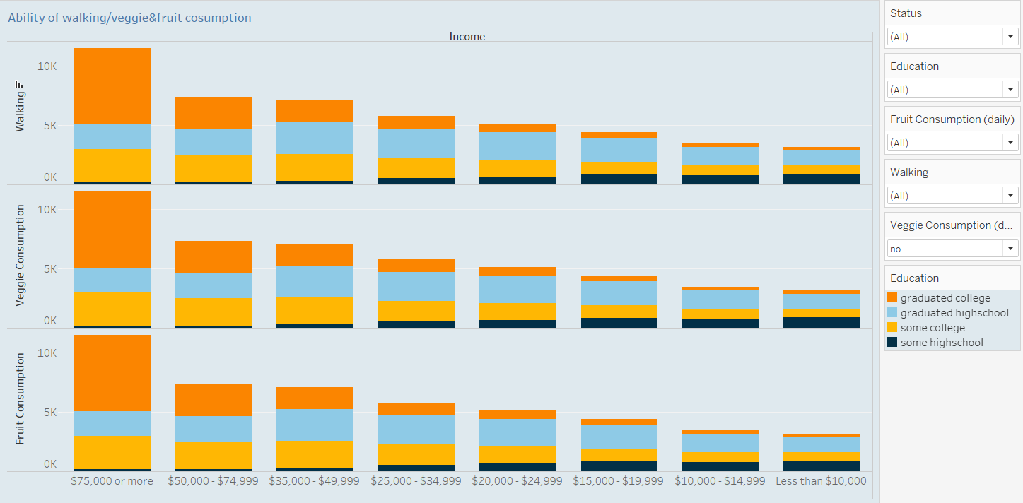
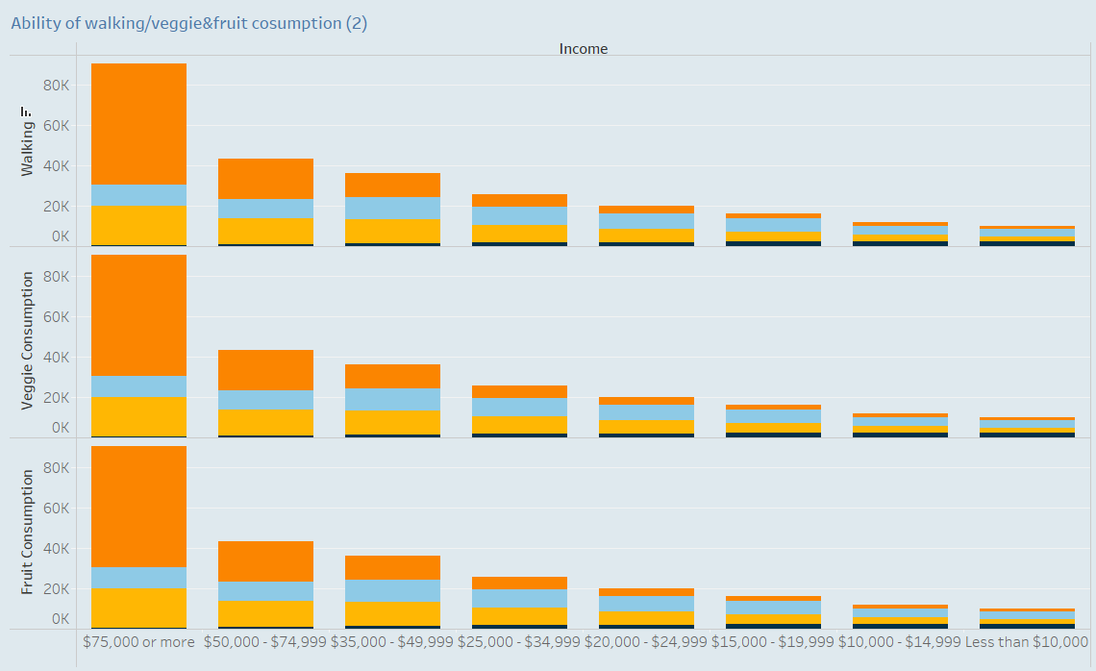
Research Question 1
What do income and education tell us about lifestyle factors (such as physical activity and diet)?
30+ min walk: Percentage of people who walk for over 30 minutes.
Veggies 1+ times/day: Percentage of people who consume vegetables at least once a day.
Fruit 1+ times/day: Percentage of people who consume fruits at least once a day.
Education: Orange is graduated college, Light blue is graduated high school, yellow is some college, and dark blue is some high school
Income Brackets: Each set of bars is divided into income brackets, showing how these health behaviors vary across different income levels.
The graph can help identify trends and disparities in lifestyle choices based on income and education. For example, it might show whether higher income groups are more likely to engage in physical activity and consume fruits/vegetables compared to lower income groups.

Slide 5
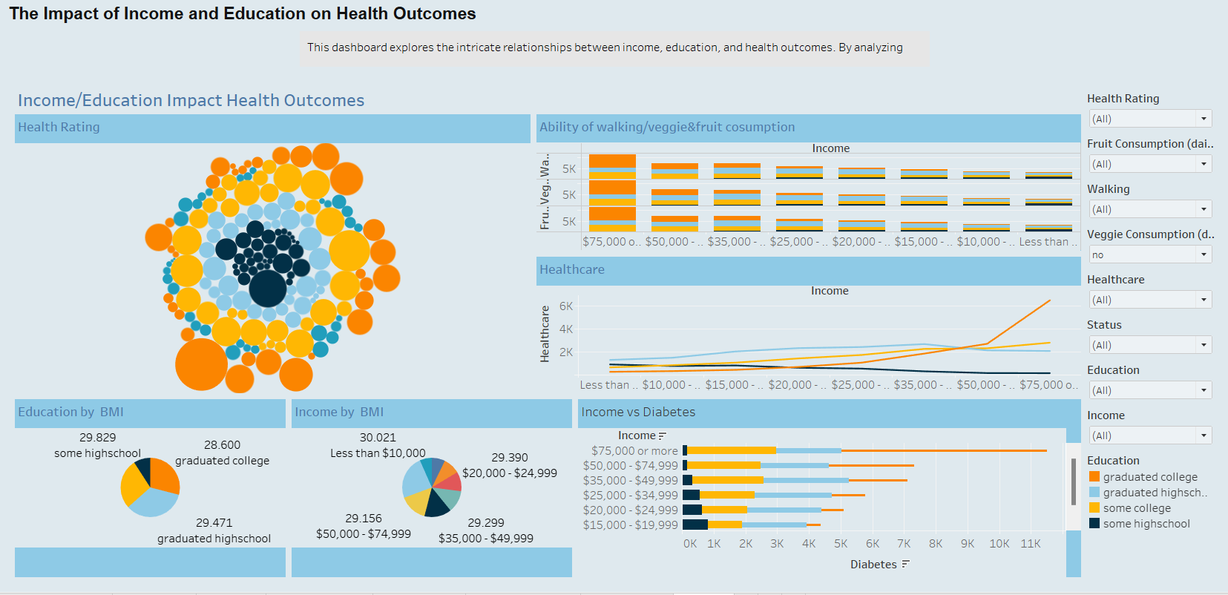
Research Question 2
What is the impact of socioeconomic factors (education and income) on diabetes health indicators (Health Rating, Healthcare, Income)?
This dashboard answers our second Research Question and explores the intricate relationships between income, education, and health outcomes. By analyzing various visualizations, we can uncover key insights into how these factors interplay to influence overall health.
Tableau

Slide 6
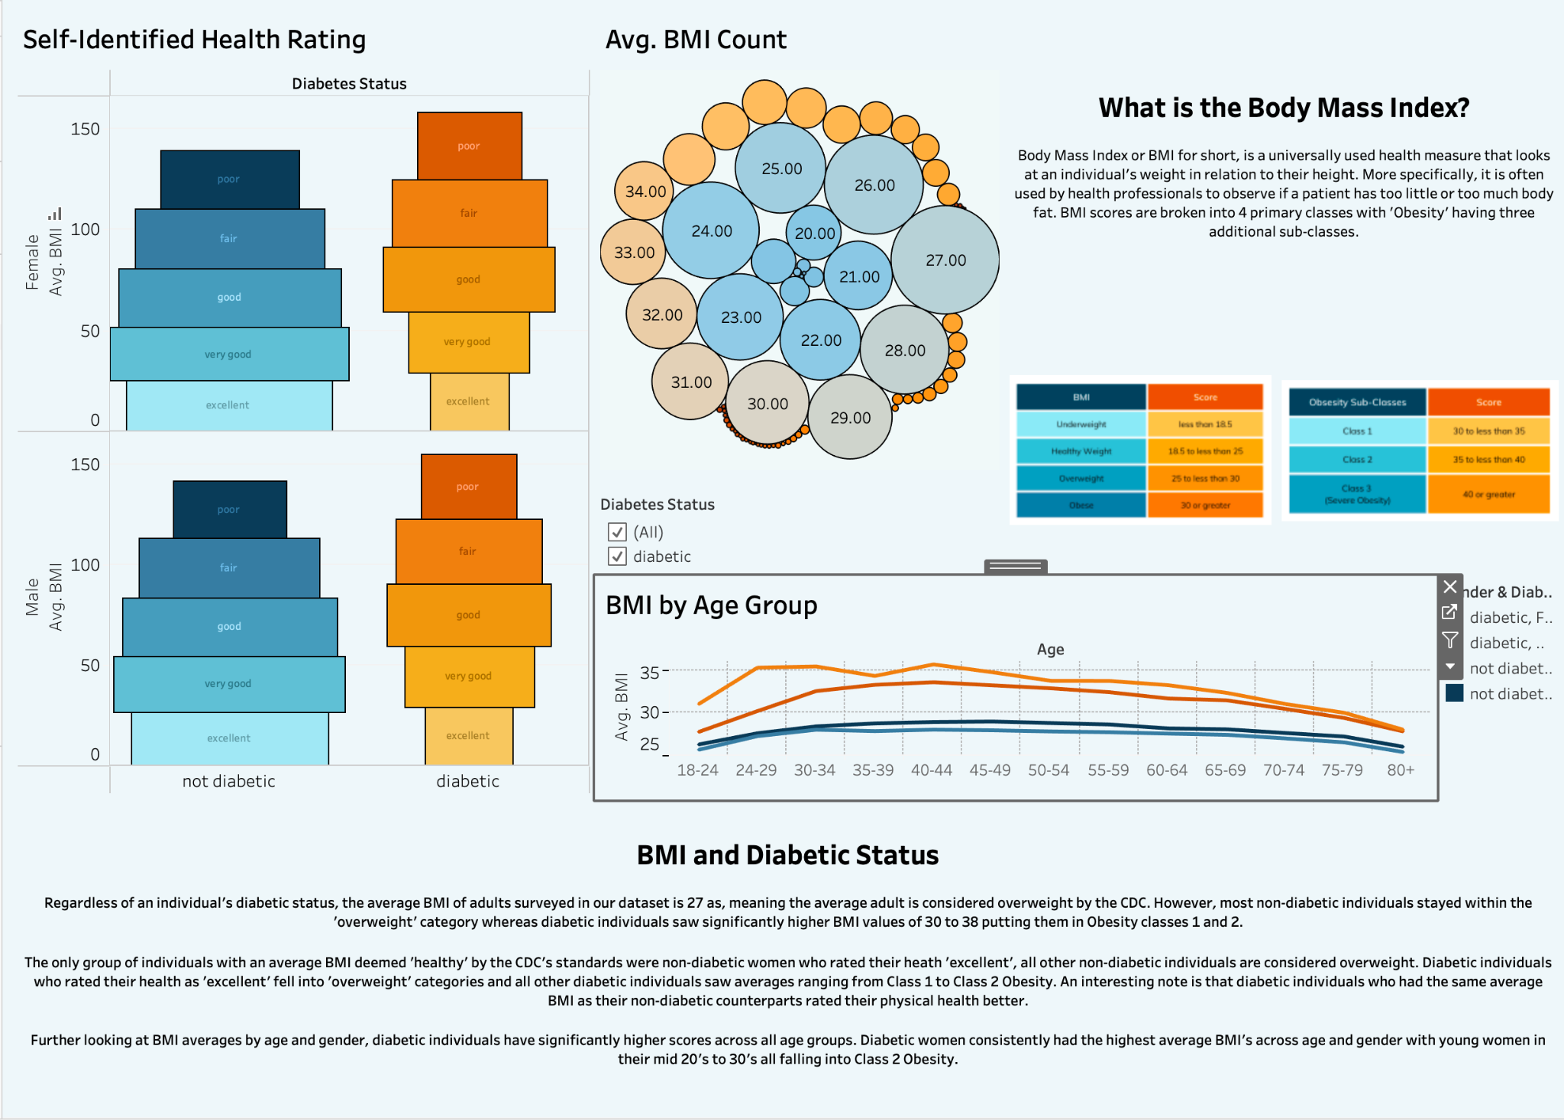
Research Question 3
How do various health indicators relate to diabetes?
This dashboard answers our third research question, which looks to see how health conditions relate to diabetes status and management. In particular we focused on the Body Mass Index (BMI) and how an individual’s BMI score and subsequent weight category related to their gender, age, and diabetic status.
Tableau

Slide 7

LIVE
DEMO
APP

Slide 8
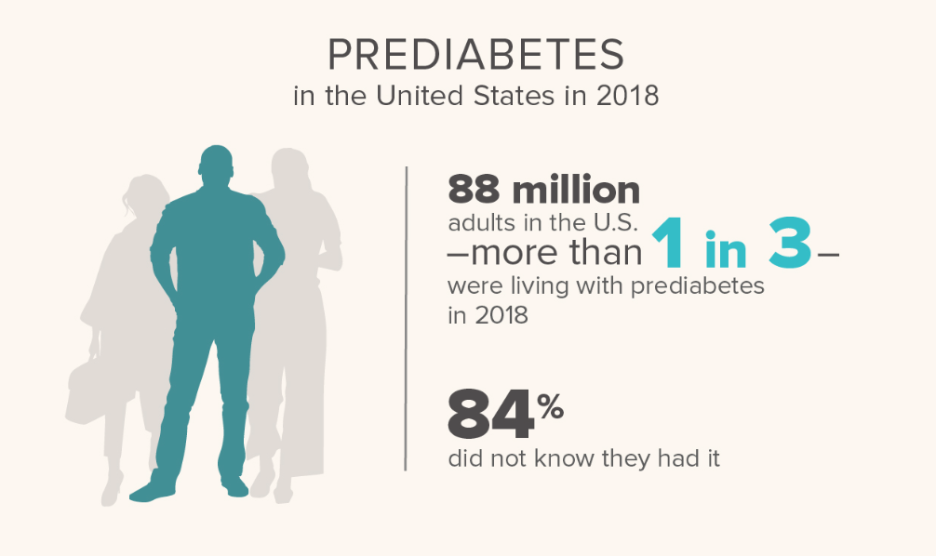
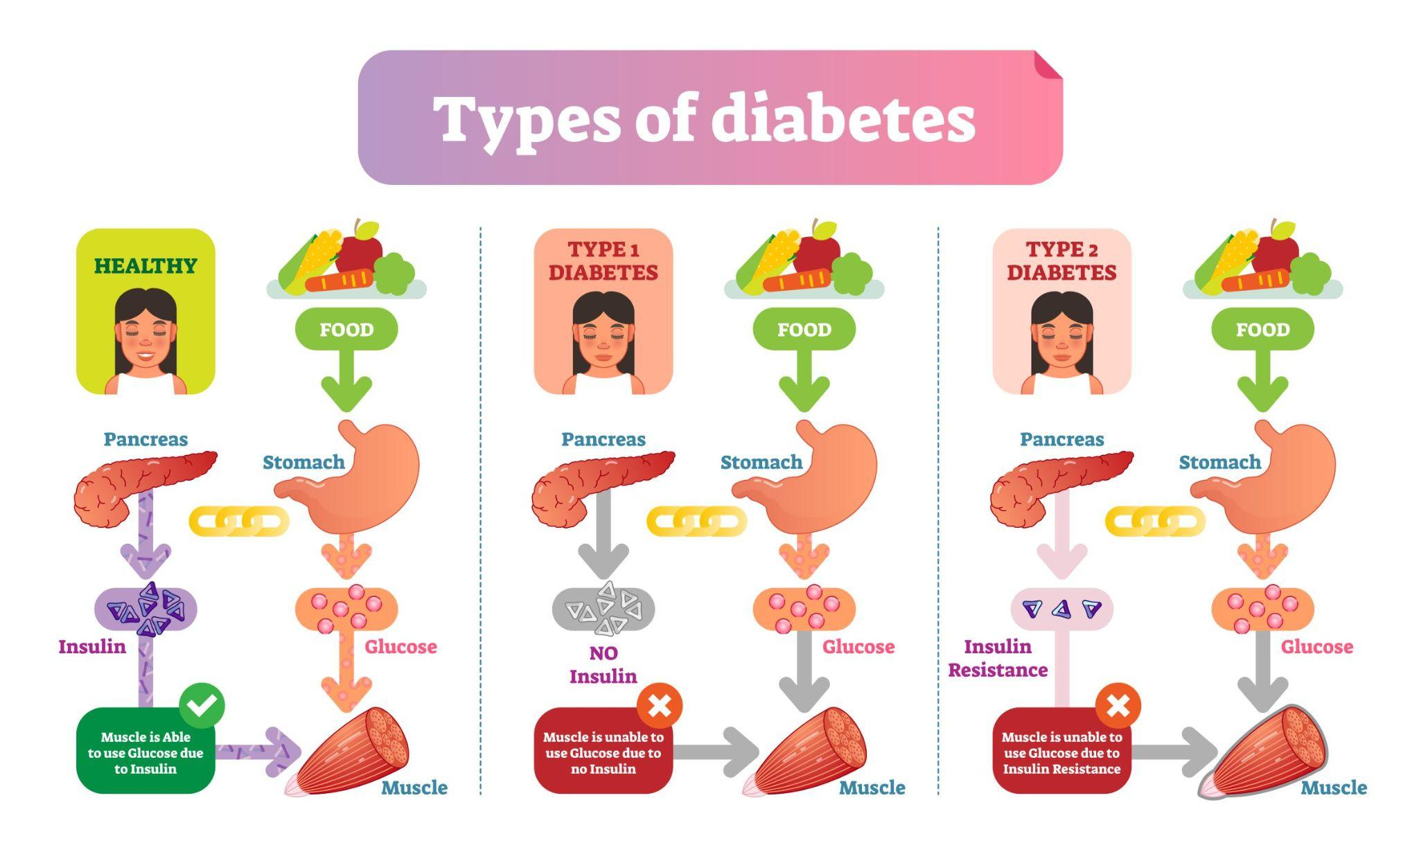
Conclusions
Higher income and higher education have a strong positive correlation to more physical activity and more consumption of healthier foods.
On average, most adults are considered overweight by the CDC, and individuals that are considered diabetic have BMI scores that reach obesity levels.
The only group considered to be healthy were non-diabetic women.
Diabetic individuals have significantly higher BMI scores across all age groups.

Slide 9
Bias/Limitations
Biases
Imbalanced dataset:
Majority of individuals surveyed were non-diabetic and made over $75,000 annually
Outdated data:
Data was collected from a 2015 survey
Limitations
Lack of data:
Dataset was previously cleaned and excluded information from original survey such as pregnancy and ethnicity.
We did not have any time-frame information to observe any trends in behavior changes in relation to a pre-diabetic, diabetic or heart disease diagnosis.

Slide 10

Future Work
Exploring Alternative Models: We could experiment with alternative models, such as the Balanced Random Forest, to improve performance and robustness.
Implementing Pipeline in Inference Notebook: We could incorporate a data pipeline in our inference notebook to streamline the workflow and enhance reproducibility.
Reducing Dataset Noise: We could better tailor the dataset by removing categories that are not necessary for our exploration and analysis which would enhance the quality of the input data.

