Slide 1
Evolutionary Computation
Instructor: Sushil Louis, sushil@cse.unr.edu, http://www.cse.unr.edu/~sushil

Slide 2
Genetic Algorithm
Generate pop(0)
Evaluate pop(0)
T=0
While (T < maxGen) do
Select pop(T+1) from pop(T)
Recombine pop(T+1)
Evaluate pop(T+1)
T = T + 1
Done

Slide 3
How does it work
String decoded f(x^2) fi/Sum(fi) Expected Actual
01101 | 13 | 169 | 0.14 | 0.58 | 1
11000 | 24 | 576 | 0.49 | 1.97 | 2
01000 | 8 | 64 | 0.06 | 0.22 | 0
10011 | 19 | 361 | 0.31 | 1.23 | 1
Sum |  | 1170 | 1.0 | 4.00 | 4.00
Avg |  | 293 | .25 | 1.00 | 1.00
Max |  | 576 | .49 | 1.97 | 2.00

Slide 4
How does it work cont’d
String mate offspring decoded f(x^2)
0110|1 | 2 | 01100 | 12 | 144
1100|0 | 1 | 11001 | 25 | 625
11|000 | 4 | 11011 | 27 | 729
10|011 | 3 | 10000 | 16 | 256
Sum |  |  |  | 1754
Avg |  |  |  | 439
Max |  |  |  | 729

Slide 5
GA code
Here is some new GA code
Otherwise, there is code on the internet in multiple languages and the
ECSL Lab has developed well understood, local code

Slide 6
Randomized versus Random versus Deterministic search algorithms
We want fast, reliable, near-optimal solutions from our algorithms
Reliability
Speed
Performance
Deterministic
Search once
Random
Average over multiple runs
Randomized hill climber, GA, SA, …
Average over multiple runs
We need reproducible results so understand the role of the random seed in a random number generator

Slide 7
Representations
Why binary?
Later
Multiple parameters (x, y, z…)
Encode x, encode y, encode z, … concatenate encodings to build chromosome
As an example consider the DeJong Functions
And now for something completely different: Floorplanning
TSP
Later
JSSP/OSSP/…
Later

Slide 8
Representations
[-x..y] ?
Min, max, precision and number of bits

Slide 9
GA Theory
Why fitness proportional selection?
Fitness proportional selection optimizes the tradeoff between exploration and exploitation. Minimizes the expected loss from choosing unwisely among competing schema
Why binary representations?
Binary representations maximize the ratio of the number of schemas to number of strings
Excuse me, but what is a schema?
Mutation can be thought of as beam hill-climbing. Why have crossover?
Crossover allows information exchange that can lead to better performance in some spaces

Slide 10
Schemas and Schema Theorem
How do we analyze GAs?
Individuals do not survive
Bits and pieces of individuals survive
Three questions:
What do these bits and pieces signify?
How do we describe bits and pieces?
What happens to these bits and pieces over time?

Slide 11
Schemas
What does part of a string that encodes a candidate solution signify?
1
1
1
0
0
0
A point in the search space
1
1
1
An area of the search space
Different kinds of crossover lead to different kinds of areas that need to be described
1
0
1
A different kind of area
1
*
*
0
1
*
A schema denotes a portion of the search space

Slide 12
Schema notation
Schema H = 01*0* denotes the set of strings:
01000
01001
01100
01101

Slide 13
Schema properties
Order of a schema H →O(H)
Number of fixed positions
O(10**0) = 3
Defining length of a schema
Distance between first and last fixed position
d(10**0) = 4
d(*1*00) = 3

Slide 14
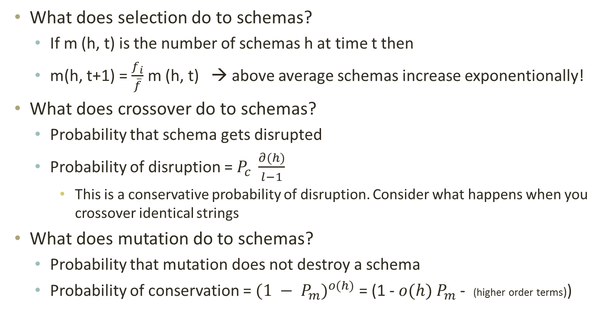
What does GA do to schemas?
What does selection do to schemas?
If m (h, t) is the number of schemas h at time t then
m(h, t+1) = $\frac{f_{i}}{\overline{f}}$ m (h, t) → above average schemas increase exponentionally!
What does crossover do to schemas?
Probability that schema gets disrupted
Probability of disruption = $P_{c} \frac{∂(h)}{l−1}$
This is a conservative probability of disruption. Consider what happens when you crossover identical strings
What does mutation do to schemas?
Probability that mutation does not destroy a schema
Probability of conservation = ${(1 − P_{m})}^{o(h)}$ = (1 - $o(h)$ $P_{m}$ - (higher order terms))

Slide 15
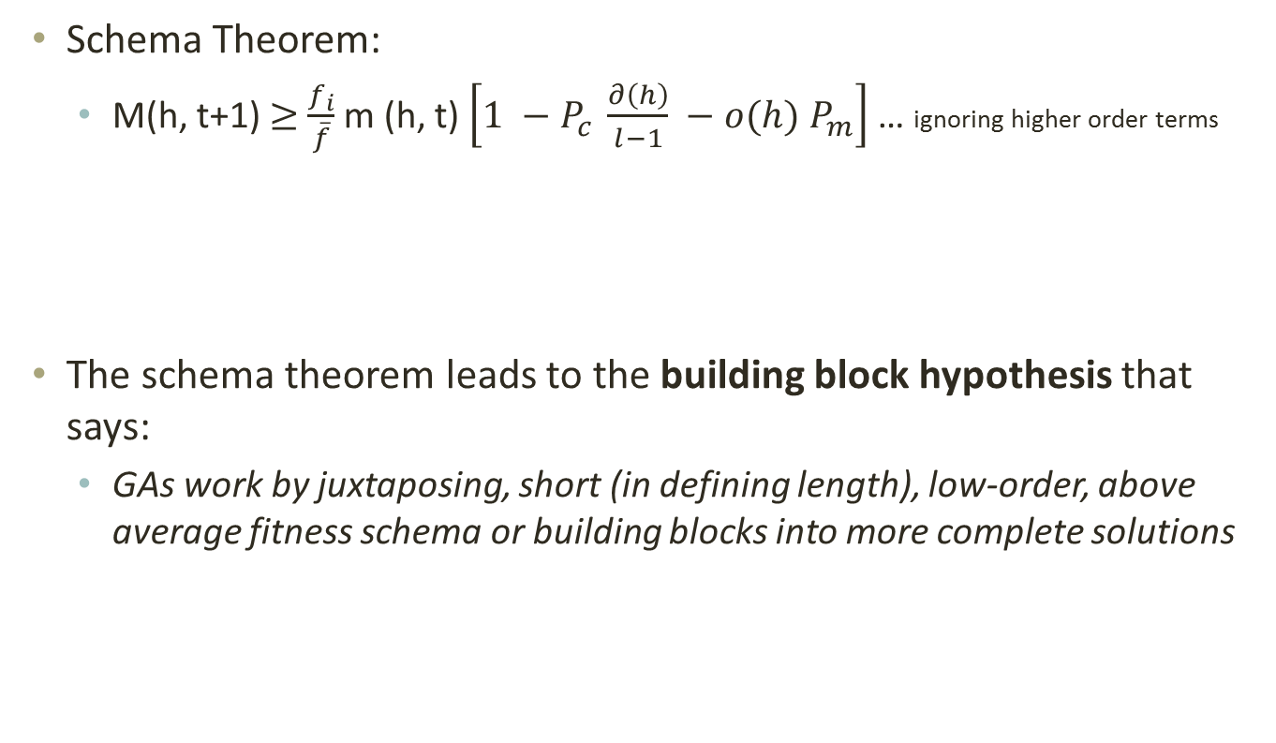
The Schema theorem
Schema Theorem:
M(h, t+1) $≥$ $\frac{f_{i}}{\overline{f}}$ m (h, t) $\left[1 −P_{c} \frac{∂\left(h\right)}{l−1} −o(h) P_{m}\right]$ … ignoring higher order terms
The schema theorem leads to the building block hypothesis that says:
GAs work by juxtaposing, short (in defining length), low-order, above average fitness schema or building blocks into more complete solutions

Slide 16
Schema processing
String decoded f(x^2) fi/Sum(fi) Expected Actual
01101 | 13 | 169 | 0.14 | 0.58 | 1
11000 | 24 | 576 | 0.49 | 1.97 | 2
01000 | 8 | 64 | 0.06 | 0.22 | 0
10011 | 19 | 361 | 0.31 | 1.23 | 1
Sum |  | 1170 | 1.0 | 4.00 | 4.00
Avg |  | 293 | .25 | 1.00 | 1.00
Max |  | 576 | .49 | 1.97 | 2.00
 |  | Fitness
1**** | 2,4 | 469 |  | 3.2 | 3
*10** | 2,3 | 320 |  | 2.18 | 2
1***0 | 2 | 576 |  | 1.97 | 2

Slide 17
Schema processing…
String mate offspring decoded f(x^2)
0110|1 | 2 | 01100 | 12 | 144
1100|0 | 1 | 11001 | 25 | 625
11|000 | 4 | 11011 | 27 | 729
10|011 | 3 | 10000 | 16 | 256
Sum |  |  |  | 1754
Avg |  |  |  | 439
Max |  |  |  | 729
 | Exp count | Actual | Represented by | Exp after all ops | Actual after all ops
1**** | 3.2 | 3 | 2,3,4 | 3.2 | 3 | 2,3,4
*10** | 2.18 | 2 | 2,3 | 1.64 | 2 | 2,3
1***0 | 1.97 | 2 | 2,3 | 0.0 | 1 | 4

Slide 18
Questions
Parameter values:
Populations size? As large as possible (for x^2 start with 50)
Number of generations? Depends on selection strategy and problem (for x^2 pop of 50 try 100)
Debug hint: Try popsize of 2 run for 1 generation
Crossover probability (pcross):
Depends on selection strategy and problem (try 0.667)
What do you expect the GA “does” when pcross and pmut are 0?
Mutation probability (pmut):
Depends on selection strategy and problem (try 0.001)
What do you expect to see when pmut is high (0.2) or low (0.0)?
Problem: What do you expect on fitness function:
F(x) = 100, F(x) = number of ones. F(x) = x^2, F(x) = 2^x, F(x) = x!

Slide 19
Representations
[-x..y] ?
Min, max, precision and number of bits

Slide 20
For each parameter in chrom
Min + decode(chrom[start], size) * precision
Precision = (max – min) / 2^n
n = Ceiling(logbase2(max – min))

Slide 21
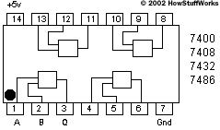
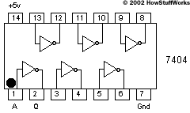
Designing a parity checker
Parity: if even number of 1s in input correct output is 0, else output is 1
Important for computer memory and data communication chips
Search for circuit that performs parity checking
What is the genotype? – selected, crossed over and mutated
A circuit is the phenotype – evaluated for fitness.
How do you construct a phenotype from a genotype to evaluate?

Slide 22
What is a genotype?
A genotype is a bit string that codes for a phenotype
1
1
0
1
0
0
1
0
0
1
1
1
Randomly chosen crossover point
1
1
1
1
1
1
1
1
0
0
0
0
Parents
Crossover
Offspring
0
0
0
0
0
0
0
0
1
1
1
1
Mutation
1
1
1
1
1
1
Randomly chosen mutation point
1
1
1
1
0
1

Slide 23
Genotype to Phenotype mapping
A circuit is made of logic gates. Receives input from the 1st column and we check output at last column.
1
6
11
16
21
26
31
Each group of five bits codes for one of 16 possible gates and the location of second input
146

Slide 24
Genotype to Phenotype mapping
150 length binary string
1
1
0
1
0
0
1
0
0
1
1
1
1
0
1
1
1
0
1
1 row of 150
becomes
6 rows of 25
0
1
0
1
0
0
1
1
0
0
0
0
0
0
1
0
1
1
0
0
1
1
1
0
1
1
0
0
0
1
0
0
0
0
1

Slide 25
Evaluating the phenotype
Feed the gate an input combination
Check whether the output produced by a decoded member of the population is correct
Give one point for each correct output
That is: Simulate the circuit
The black box can be a simulation

Slide 26
Circuits
Parity Checker
Adder

Slide 27
Predicting subsurface structure
Find subsurface structure that agrees with experimental observations
Mining, oil exploration, swimming pools

Slide 28
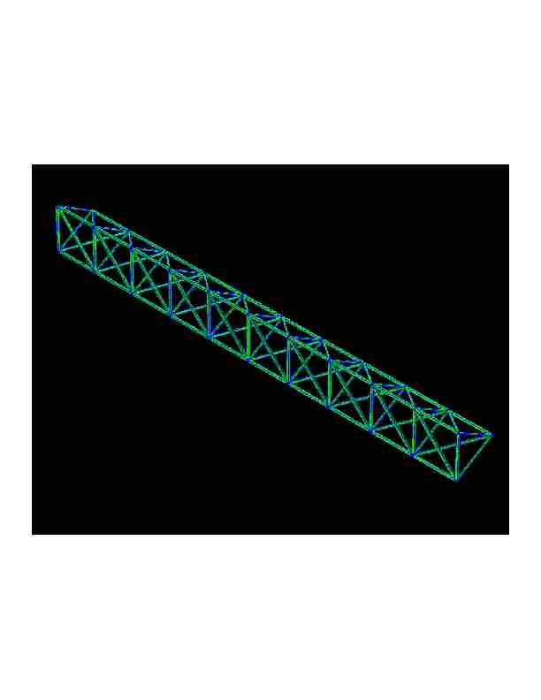
Designing a truss
Find a truss configuration that minimizes vibration, minimizes weight, and maximizes stiffness

Slide 29
Traveling Salesperson Problem
Find a shortest length tour of N cities
N! possible tours
10! = 3628800
70! = 11978571669969891796072783721689098736458938142546425857555362864628009582789845319680000000000000000
Chip layout, truck routing, logistics

Slide 30
GA Theory
Why fitness proportional selection?
Fitness proportional selection optimizes the tradeoff between exploration and exploitation. Minimizes the expected loss from choosing unwisely among competing schema
Why binary representations?
Binary representations maximize the ratio of the number of schemas to number of strings
Excuse me, but what is a schema?
Mutation can be thought of as beam hill-climbing. Why have crossover?
Crossover allows information exchange that can lead to better performance in some spaces

Slide 31
Schemas and Schema Theorem
How do we analyze GAs?
Individuals do not survive
Bits and pieces of individuals survive
Three questions:
What do these bits and pieces signify?
How do we describe bits and pieces?
What happens to these bits and pieces over time?

Slide 32
Schemas
What does part of a string that encodes a candidate solution signify?
1
1
1
0
0
0
A point in the search space
1
1
1
An area of the search space
Different kinds of crossover lead to different kinds of areas that need to be described
1
0
1
A different kind of area
1
*
*
0
1
*
A schema denotes a portion of the search space

Slide 33
Schema notation
Schema H = 01*0* denotes the set of strings:
01000
01001
01100
01101

Slide 34
Schema properties
Order of a schema H →O(H)
Number of fixed positions
O(10**0) = 3
Defining length of a schema
Distance between first and last fixed position
d(10**0) = 4
d(*1*00) = 3

Slide 35
What does GA do to schemas?
What does selection do to schemas?
If m (h, t) is the number of schemas h at time t then
m(h, t+1) = $\frac{f_{i}}{\overline{f}}$ m (h, t) → above average schemas increase exponentionally!
What does crossover do to schemas?
Probability that schema gets disrupted
Probability of disruption = $P_{c} \frac{∂(h)}{l−1}$
This is a conservative probability of disruption. Consider what happens when you crossover identical strings
What does mutation do to schemas?
Probability that mutation does not destroy a schema
Probability of conservation = ${(1 − P_{m})}^{o(h)}$ = (1 - $o(h)$ $P_{m}$ - (higher order terms))

Slide 36
The Schema theorem
Schema Theorem:
M(h, t+1) $≥$ $\frac{f_{i}}{\overline{f}}$ m (h, t) $\left[1 −P_{c} \frac{∂\left(h\right)}{l−1} −o(h) P_{m}\right]$ … ignoring higher order terms
The schema theorem leads to the building block hypothesis that says:
GAs work by juxtaposing, short (in defining length), low-order, above average fitness schema or building blocks into more complete solutions

Slide 37
Search
Problem solving by searching for a solution in a space of possible solutions
Uninformed versus Informed search
Atomic representation of state
Solutions are fixed sequences of actions

