Slide 1
Evolutionary Computation
Instructor: Sushil Louis, sushil@cse.unr.edu,
http://www.cse.unr.edu/~sushil

Slide 2
Informed Search
Best First Search
A*
Heuristics
Basic idea
Order nodes for expansion using a specific search strategy
Order nodes, n, using an evaluation function f(n)
Most evaluation functions include a heuristic h(n)
For example: Estimated cost of the cheapest path from the state at node n to a goal state
Heuristics provide domain information to guide informed search

Slide 3
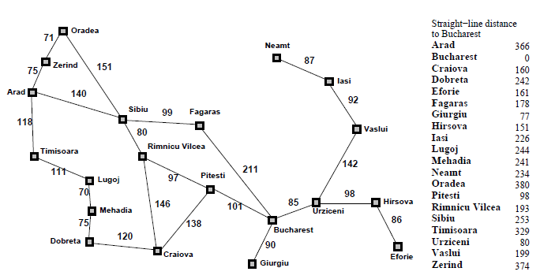
Romania with straight line distance heuristic
h(n) = straight line distance to Bucharest

Slide 4
Greedy search
F(n) = h(n) = straight line distance to goal
Draw the search tree and list nodes in order of expansion (5 minutes)
Time?
Space?
Complete?
Optimal?

Slide 5
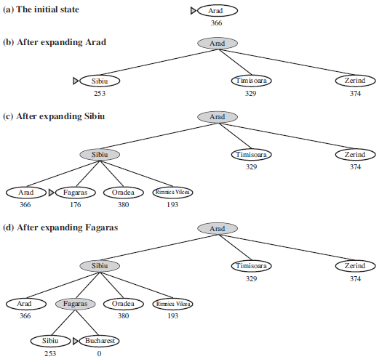
Greedy search

Slide 6
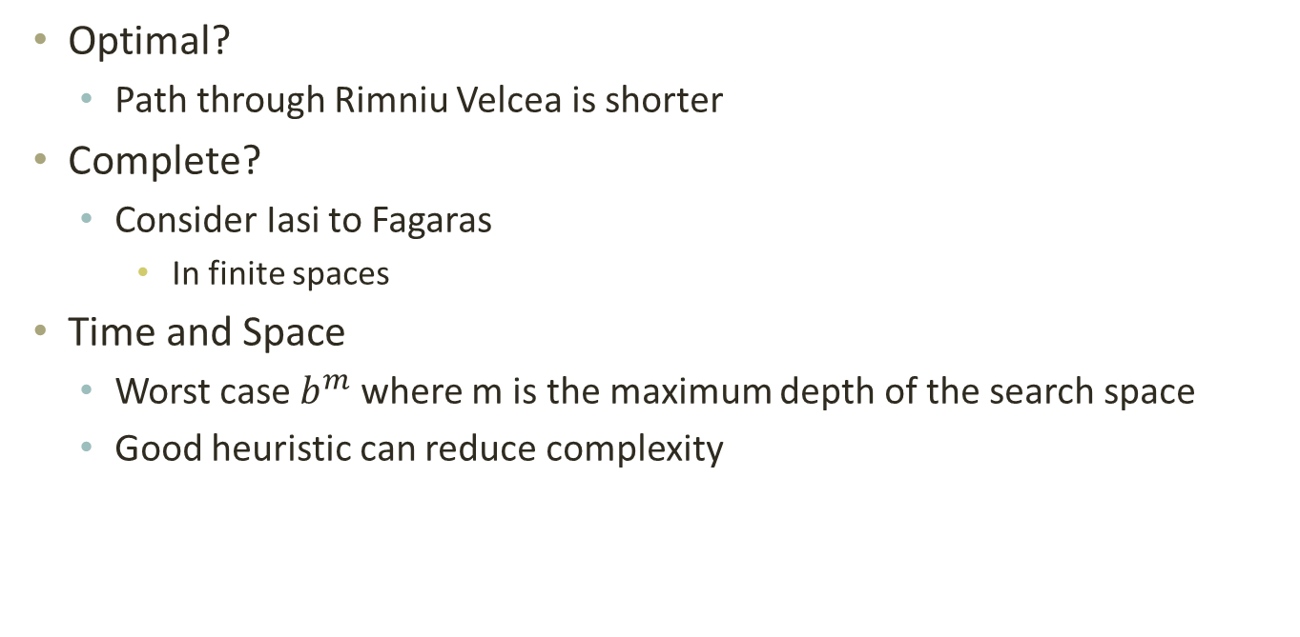
Greedy analysis
Optimal?
Path through Rimniu Velcea is shorter
Complete?
Consider Iasi to Fagaras
In finite spaces
Time and Space
Worst case $b^{m}$ where m is the maximum depth of the search space
Good heuristic can reduce complexity

Slide 7

$$A^{∗}$$
f(n) = g(n) + h(n)
= cost to state + estimated cost to goal
= estimated cost of cheapest solution through n

Slide 8
$$A^{∗}$$
Draw the search tree and list the nodes and their associated cities in order of expansion for going from Arad to Bucharest
5 minutes

Slide 9
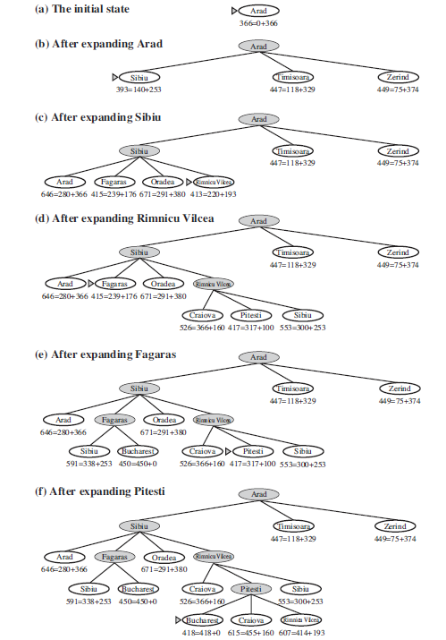
A*

Slide 10
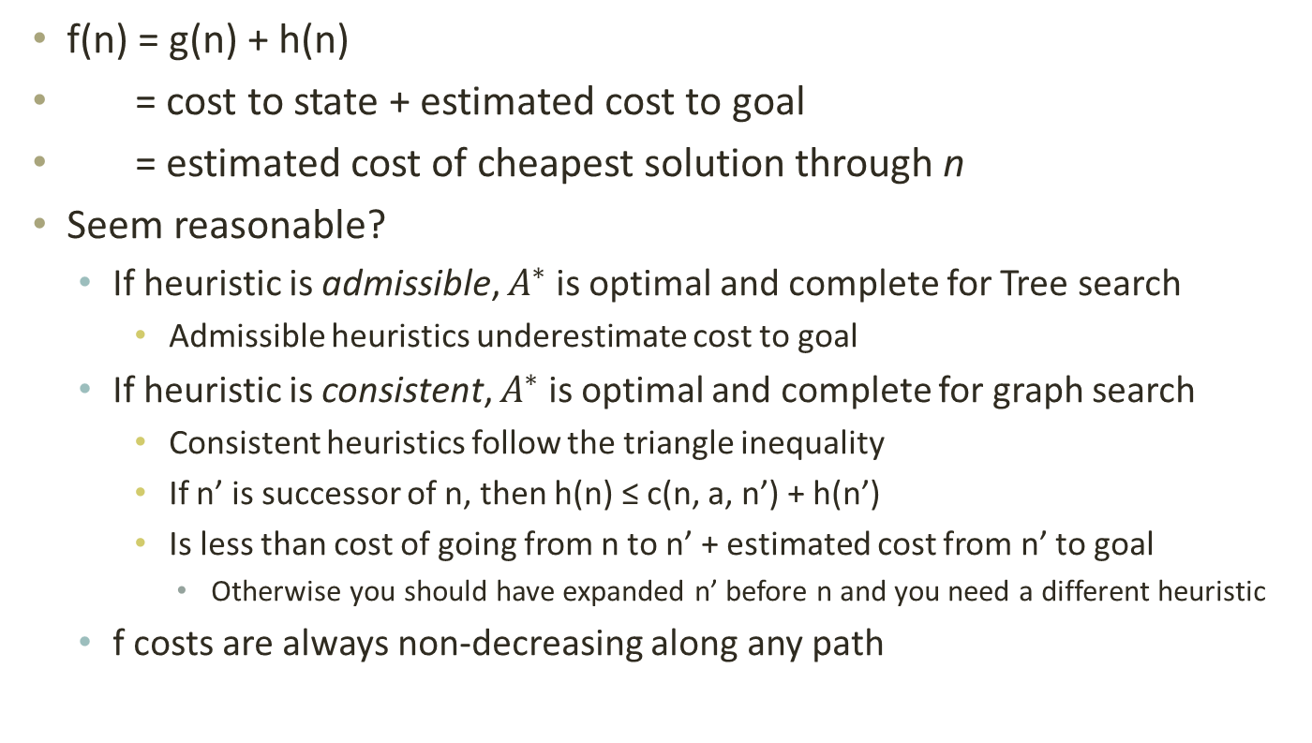
$$A^{∗}$$
f(n) = g(n) + h(n)
= cost to state + estimated cost to goal
= estimated cost of cheapest solution through n
Seem reasonable?
If heuristic is admissible, $A^{∗}$ is optimal and complete for Tree search
Admissible heuristics underestimate cost to goal
If heuristic is consistent, $A^{∗}$ is optimal and complete for graph search
Consistent heuristics follow the triangle inequality
If n’ is successor of n, then h(n) ≤ c(n, a, n’) + h(n’)
Is less than cost of going from n to n’ + estimated cost from n’ to goal
Otherwise you should have expanded n’ before n and you need a different heuristic
f costs are always non-decreasing along any path

Slide 11
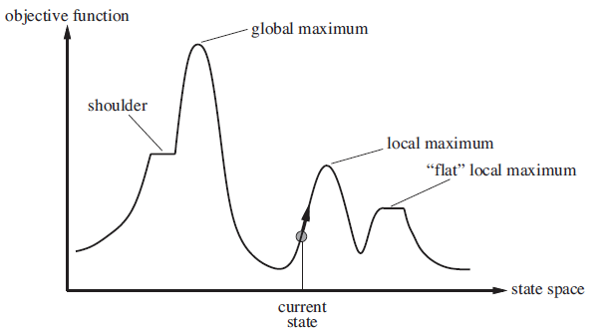
Non-classical search
- Path does not matter, just the final state
- Maximize objective function

Slide 12
Model
We have a black box “evaluate” function that returns an objective function value
Evaluate
candidate state
Obj. func
Application dependent fitness function

Slide 13
Consider a problem
Combination lock
30 digit combination lock
How many combinations?

Slide 14
Generate and test
Generate a candidate solution and test to see if it solves the problem
Repeat
Information used by this algorithm
You know when you have found the solution
No candidate solution is better than another EXCEPT for the correct combination

Slide 15
Combination lock
Obj.
Function
Solutions →

Slide 16
Generate and Test is Search
Exhaustive Search
How many must you try before p(success)>0.5 ?
How long will this take?
Will you eventually open the lock?
Random Search
Same!
RES ➔ Random or Exhaustive Search

Slide 17
Search techniques
Hill Climbing/Gradient Descent Needs more information
You are getting closer OR You are getting further away from correct combination
Quicker
Problems
Distance metric could be misleading
Local hills

Slide 18
Hill climbing issues
- Path does not matter, just the final state
- Maximize objective function

Slide 19
Search as a solution to hard problems
Strategy: generate a potential solution and see if it solves the problem
Make use of information available to guide the generation of potential solutions
How much information is available?
Very little: We know the solution when we find it
Lots: linear, continuous, …
A little: Compare two solutions and tell which is “better”

Slide 20
Search tradeoff
Very little information for search implies we have no algorithm other than RES. We have to explore the space thoroughly since there is no other information to exploit
Lots of information (linear, continuous, …) means that we can exploit this information to arrive directly at a solution, without any exploration
Little information (partial ordering) implies that we need to use this information to tradeoff exploration of the search space versus exploiting the information to concentrate search in promising areas

Slide 21
Exploration vs Exploitation
More exploration means
Better chance of finding solution (more robust)
Takes longer
Versus
More exploitation means
Less chance of finding solution, better chance of getting stuck in a local optimum
Takes less time

Slide 22
Choosing a search algorithm
The amount of information available about a problem influences our choice of search algorithm and how we tune this algorithm
How does a search algorithm balance exploration of a search space against exploitation of (possibly misleading) information about the search space?
What assumptions is the algorithm making?

Slide 23
Information used by RES
Exhaustive Search
Random Search
Found solution or not
Obj.
Function
Solutions →

Slide 24
Search techniques
Hill Climbing/Gradient Descent Needs more information
You are getting closer OR You are getting further away from correct combination
Gradient information (partial ordering)
Problems
Distance metric could be misleading
Local hills

Slide 25
Search techniques
Parallel hillclimbing
Everyone has a different starting point
Perhaps not everyone will be stuck at a local optima
More robust, perhaps quicker

Slide 26
Genetic Algorithms
Parallel hillclimbing with information exchange among candidate solutions
Population of candidate solutions
Crossover for information exchange
Good across a variety of problem domains

Slide 27
Assignment 1
Maximize a function
100 bits – we use integers whose values are 0, 1

Slide 28
Applications
Boeing 777 engines designed by GE
I2 technologies ERP package uses Gas
John Deere – manufacturing optimization
US Army – Logistics
Cap Gemini + KiQ – Marketing, credit, and insurance modeling

Slide 29
Niche
Poorly-understood problems
Non-linear, Discontinuous, multiple optima,…
No other method works well
Search, Optimization, Machine Learning
Quickly produces good (usable) solutions
Not guaranteed to find optimum

Slide 30
History
1960’s, Larry Fogel – “Evolutionary Programming”
1970’s, John Holland – “Adaptation in Natural and Artificial Systems”
1970’s, Hans-Paul Schwefel – “Evolutionary Strategies”
1980’s, John Koza – “Genetic Programming”
Natural Selection is a great search/optimization algorithm
GAs: Crossover plays an important role in this search/optimization
Fitness evaluated on candidate solution
GAs: Operators work on an encoding of solution

Slide 31
History
1989, David Goldberg – our textbook
Consolidated body of work in one book
Provided examples and code
Readable and accessible introduction
2011, GECCO , 600+ attendees
Industrial use of Gas
Combinations with other techniques

Slide 32
Start: Genetic Algorithms
Model Natural Selection the process of Evolution
Search through a space of candidate solutions
Work with an encoding of the solution
Non-deterministic (not random)
Parallel search

Slide 33
Vocabulary
Natural Selection is the process of evolution – Darwin
Evolution works on populations of organisms
A chromosome is made up of genes
The various values of a gene are its alleles
A genotype is the set of genes making up an organism
Genotype specifies phenotype
Phenotype is the organism that gets evaluated
Selection depends on fitness
During reproduction, chromosomes crossover with high probability
Genes mutate with very low probability

Slide 34
Genetic Algorithm
Generate pop(0)
Evaluate pop(0)
T=0
While (not converged) do
Select pop(T+1) from pop(T)
Recombine pop(T+1)
Evaluate pop(T+1)
T = T + 1
Done

Slide 35
Genetic Algorithm
Generate pop(0)
Evaluate pop(0)
T=0
While (not converged) do
Select pop(T+1) from pop(T)
Recombine pop(T+1)
Evaluate pop(T+1)
T = T + 1
Done

Slide 36
Generate pop(0)
Initialize population with randomly generated strings of 1’s and 0’s
for(i = 0 ; i < popSize; i++){
for(j = 0; j < chromLen; j++){
Pop[i].chrom[j] = flip(0.5);
}
}

Slide 37
Genetic Algorithm
Generate pop(0)
Evaluate pop(0)
T=0
While (not converged) do
Select pop(T+1) from pop(T)
Recombine pop(T+1)
Evaluate pop(T+1)
T = T + 1
Done

Slide 38
Evaluate pop(0)
Evaluate
Decoded individual
Fitness
Application dependent fitness function

Slide 39
Genetic Algorithm
Generate pop(0)
Evaluate pop(0)
T=0
While (T < maxGen) do
Select pop(T+1) from pop(T)
Recombine pop(T+1)
Evaluate pop(T+1)
T = T + 1
Done

Slide 40
Genetic Algorithm
Generate pop(0)
Evaluate pop(0)
T=0
While (T < maxGen) do
Select pop(T+1) from pop(T)
Recombine pop(T+1)
Evaluate pop(T+1)
T = T + 1
Done

Slide 41
Selection
Each member of the population gets a share of the pie proportional to fitness relative to other members of the population
Spin the roulette wheel pie and pick the individual that the ball lands on
Focuses search in promising areas

Slide 42
Code
int roulette(IPTR pop, double sumFitness, int popsize)
{
/* select a single individual by roulette wheel selection */
double rand,partsum;
int i;
partsum = 0.0; i = 0;
rand = f_random() * sumFitness;
i = -1;
do{
i++;
partsum += pop[i].fitness;
} while (partsum < rand && i < popsize - 1) ;
return i;
}

Slide 43
Genetic Algorithm
Generate pop(0)
Evaluate pop(0)
T=0
While (T < maxGen) do
Select pop(T+1) from pop(T)
Recombine pop(T+1)
Evaluate pop(T+1)
T = T + 1
Done

Slide 44
Crossover and mutation
Mutation Probability = 0.001
Insurance
Xover Probability = 0.7
Exploration operator

Slide 45
Crossover code
void crossover(POPULATION *p, IPTR p1, IPTR p2, IPTR c1, IPTR c2)
{
/* p1,p2,c1,c2,m1,m2,mc1,mc2 */
int *pi1,*pi2,*ci1,*ci2;
int xp, i;
pi1 = p1->chrom;
pi2 = p2->chrom;
ci1 = c1->chrom;
ci2 = c2->chrom;
if(flip(p->pCross)){
xp = rnd(0, p->lchrom - 1);
for(i = 0; i < xp; i++){
ci1[i] = muteX(p, pi1[i]);
ci2[i] = muteX(p, pi2[i]);
}
for(i = xp; i < p->lchrom; i++){
ci1[i] = muteX(p, pi2[i]);
ci2[i] = muteX(p, pi1[i]);
}
} else {
for(i = 0; i < p->lchrom; i++){
ci1[i] = muteX(p, pi1[i]);
ci2[i] = muteX(p, pi2[i]);
}
}
}

Slide 46
Mutation code
int muteX(POPULATION *p, int pa)
{
return (flip(p->pMut) ? 1 - pa : pa);
}

Slide 47
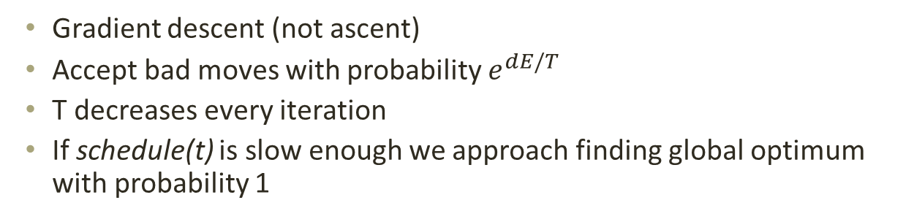
Simulated annealing
Gradient descent (not ascent)
Accept bad moves with probability $e^{dE/T}$
T decreases every iteration
If schedule(t) is slow enough we approach finding global optimum with probability 1

Slide 48
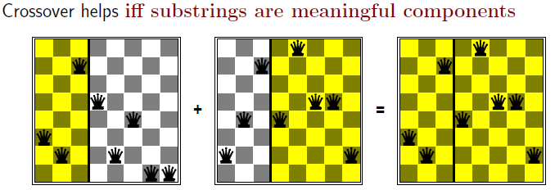
Crossover helps if

Slide 49
Linear and quadratic programming
Constrained optimization
Optimize f(x) subject to
Linear convex constraints – polynomial time in number of vars
Quadratic constraints – special cases polynomial time

