Slide 1
Evolutionary Computation
Instructor: Sushil Louis, sushil@cse.unr.edu, http://www.cse.unr.edu/~sushil

Slide 2
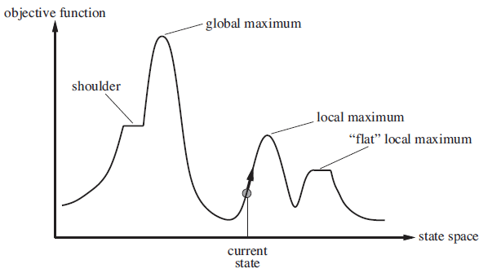
Non-classical search
- Path does not matter, just the final state
- Maximize objective function

Slide 3
Model
We have a black box “evaluate” function that returns an objective function value
Evaluate
candidate state
Obj. func
Application dependent fitness function

Slide 4
More detailed GA
Generate pop(0)
Evaluate pop(0)
T=0
While (not converged) do
Select pop(T+1) from pop(T)
Recombine pop(T+1)
Evaluate pop(T+1)
T = T + 1
Done

Slide 5
Generate pop(0)
Initialize population with randomly generated strings of 1’s and 0’s
for(i = 0 ; i < popSize; i++){
for(j = 0; j < chromLen; j++){
Pop[i].chrom[j] = flip(0.5);
}
}

Slide 6
Genetic Algorithm
Generate pop(0)
Evaluate pop(0)
T=0
While (not converged) do
Select pop(T+1) from pop(T)
Recombine pop(T+1)
Evaluate pop(T+1)
T = T + 1
Done

Slide 7
Evaluate pop(0)
Evaluate
Decoded individual
Fitness
Application dependent fitness function

Slide 8
Genetic Algorithm
Generate pop(0)
Evaluate pop(0)
T=0
While (T < maxGen) do
Select pop(T+1) from pop(T)
Recombine pop(T+1)
Evaluate pop(T+1)
T = T + 1
Done

Slide 9
Genetic Algorithm
Generate pop(0)
Evaluate pop(0)
T=0
While (T < maxGen) do
Select pop(T+1) from pop(T)
Recombine pop(T+1)
Evaluate pop(T+1)
T = T + 1
Done

Slide 10
Selection
Each member of the population gets a share of the pie proportional to fitness relative to other members of the population
Spin the roulette wheel pie and pick the individual that the ball lands on
Focuses search in promising areas

Slide 11
Code
int roulette(IPTR pop, double sumFitness, int popsize)
{
/* select a single individual by roulette wheel selection */
double rand,partsum;
int i;
partsum = 0.0; i = 0;
rand = f_random() * sumFitness;
i = -1;
do{
i++;
partsum += pop[i].fitness;
} while (partsum < rand && i < popsize - 1) ;
return i;
}

Slide 12
Genetic Algorithm
Generate pop(0)
Evaluate pop(0)
T=0
While (T < maxGen) do
Select pop(T+1) from pop(T)
Recombine pop(T+1)
Evaluate pop(T+1)
T = T + 1
Done

Slide 13
Crossover and mutation
Mutation Probability = 0.001
Insurance
Xover Probability = 0.7
Exploration operator

Slide 14
Crossover code
void crossover(POPULATION *p, IPTR p1, IPTR p2, IPTR c1, IPTR c2)
{
/* p1,p2,c1,c2,m1,m2,mc1,mc2 */
int *pi1,*pi2,*ci1,*ci2;
int xp, i;
pi1 = p1->chrom;
pi2 = p2->chrom;
ci1 = c1->chrom;
ci2 = c2->chrom;
if(flip(p->pCross)){
xp = rnd(0, p->lchrom - 1);
for(i = 0; i < xp; i++){
ci1[i] = muteX(p, pi1[i]);
ci2[i] = muteX(p, pi2[i]);
}
for(i = xp; i < p->lchrom; i++){
ci1[i] = muteX(p, pi2[i]);
ci2[i] = muteX(p, pi1[i]);
}
} else {
for(i = 0; i < p->lchrom; i++){
ci1[i] = muteX(p, pi1[i]);
ci2[i] = muteX(p, pi2[i]);
}
}
}

Slide 15
Mutation code
int muteX(POPULATION *p, int pa)
{
return (flip(p->pMut) ? 1 - pa : pa);
}

Slide 16
How does it work?
Toy example, hand cranked
Maximize f(x) = x^2 in the range [0 .. 31]
Binary representation is simple
00000 ➔ 0
00001 ➔ 1
…
11111 ➔ 31
Population size ➔ 4
maxGen = 2

Slide 17
How does it work
String decoded f(x^2) fi/Sum(fi) Expected Actual
01101 | 13 | 169 | 0.14 | 0.58 | 1
11000 | 24 | 576 | 0.49 | 1.97 | 2
01000 | 8 | 64 | 0.06 | 0.22 | 0
10011 | 19 | 361 | 0.31 | 1.23 | 1
Sum |  | 1170 | 1.0 | 4.00 | 4.00
Avg |  | 293 | .25 | 1.00 | 1.00
Max |  | 576 | .49 | 1.97 | 2.00

Slide 18
How does it work cont’d
String mate offspring decoded f(x^2)
0110|1 | 2 | 01100 | 12 | 144
1100|0 | 1 | 11001 | 25 | 625
11|000 | 4 | 11011 | 27 | 729
10|011 | 3 | 10000 | 16 | 256
Sum |  |  |  | 1754
Avg |  |  |  | 439
Max |  |  |  | 729

Slide 19
Randomized versus Random versus Deterministic search algorithms
We want fast, reliable, near-optimal solutions from our algorithms
Reliability
Speed
Performance
Deterministic
Search once
Random
Average over multiple runs
Randomized hill climber, GA, SA, …
Average over multiple runs
We need reproducible results so understand the role of the random seed in a random number generator

Slide 20
Representations
Why binary?
Later
Multiple parameters (x, y, z…)
Encode x, encode y, encode z, … concatenate encodings to build chromosome
As an example consider the DeJong Functions
And now for something completely different: Floorplanning
TSP
Later
JSSP/OSSP/…
Later

Slide 21
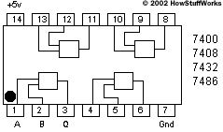
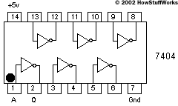
Designing a parity checker
Parity: if even number of 1s in input correct output is 0, else output is 1
Important for computer memory and data communication chips
Search for circuit that performs parity checking
What is the genotype? – selected, crossed over and mutated
A circuit is the phenotype – evaluated for fitness.
How do you construct a phenotype from a genotype to evaluate?

Slide 22
What is a genotype?
A genotype is a bit string that codes for a phenotype
1
1
0
1
0
0
1
0
0
1
1
1
Randomly chosen crossover point
1
1
1
1
1
1
1
1
0
0
0
0
Parents
Crossover
Offspring
0
0
0
0
0
0
0
0
1
1
1
1
Mutation
1
1
1
1
1
1
Randomly chosen mutation point
1
1
1
1
0
1

Slide 23
Genotype to Phenotype mapping
A circuit is made of logic gates. Receives input from the 1st column and we check output at last column.
1
6
11
16
21
26
31
Each group of five bits codes for one of 16 possible gates and the location of second input
146

Slide 24
Genotype to Phenotype mapping
150 length binary string
1
1
0
1
0
0
1
0
0
1
1
1
1
0
1
1
1
0
1
1 row of 150
becomes
6 rows of 25
0
1
0
1
0
0
1
1
0
0
0
0
0
0
1
0
1
1
0
0
1
1
1
0
1
1
0
0
0
1
0
0
0
0
1

Slide 25
Evaluating the phenotype
Feed the gate an input combination
Check whether the output produced by a decoded member of the population is correct
Give one point for each correct output
That is: Simulate the circuit
The black box can be a simulation

Slide 26
Circuits
Parity Checker
Adder

Slide 27
Predicting subsurface structure
Find subsurface structure that agrees with experimental observations
Mining, oil exploration, swimming pools

Slide 28
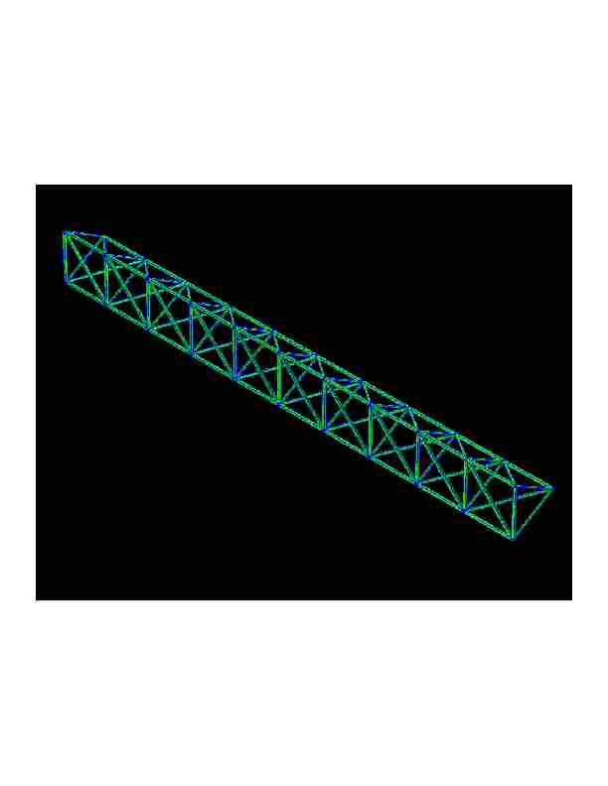
Designing a truss
Find a truss configuration that minimizes vibration, minimizes weight, and maximizes stiffness

Slide 29
Traveling Salesperson Problem
Find a shortest length tour of N cities
N! possible tours
10! = 3628800
70! = 11978571669969891796072783721689098736458938142546425857555362864628009582789845319680000000000000000
Chip layout, truck routing, logistics

Slide 30
GA Theory
Why fitness proportional selection?
Fitness proportional selection optimizes the tradeoff between exploration and exploitation. Minimizes the expected loss from choosing unwisely among competing schema
Why binary representations?
Binary representations maximize the ratio of the number of schemas to number of strings
Excuse me, but what is a schema?
Mutation can be thought of as beam hill-climbing. Why have crossover?
Crossover allows information exchange that can lead to better performance in some spaces

Slide 31
Schemas and Schema Theorem
How do we analyze GAs?
Individuals do not survive
Bits and pieces of individuals survive
Three questions:
What do these bits and pieces signify?
How do we describe bits and pieces?
What happens to these bits and pieces over time?

Slide 32
Schemas
What does part of a string that encodes a candidate solution signify?
1
1
1
0
0
0
A point in the search space
1
1
1
An area of the search space
Different kinds of crossover lead to different kinds of areas that need to be described
1
0
1
A different kind of area
1
*
*
0
1
*
A schema denotes a portion of the search space

Slide 33
Schema notation
Schema H = 01*0* denotes the set of strings:
01000
01001
01100
01101

Slide 34
Schema properties
Order of a schema H →O(H)
Number of fixed positions
O(10**0) = 3
Defining length of a schema
Distance between first and last fixed position
d(10**0) = 4
d(*1*00) = 3

Slide 35
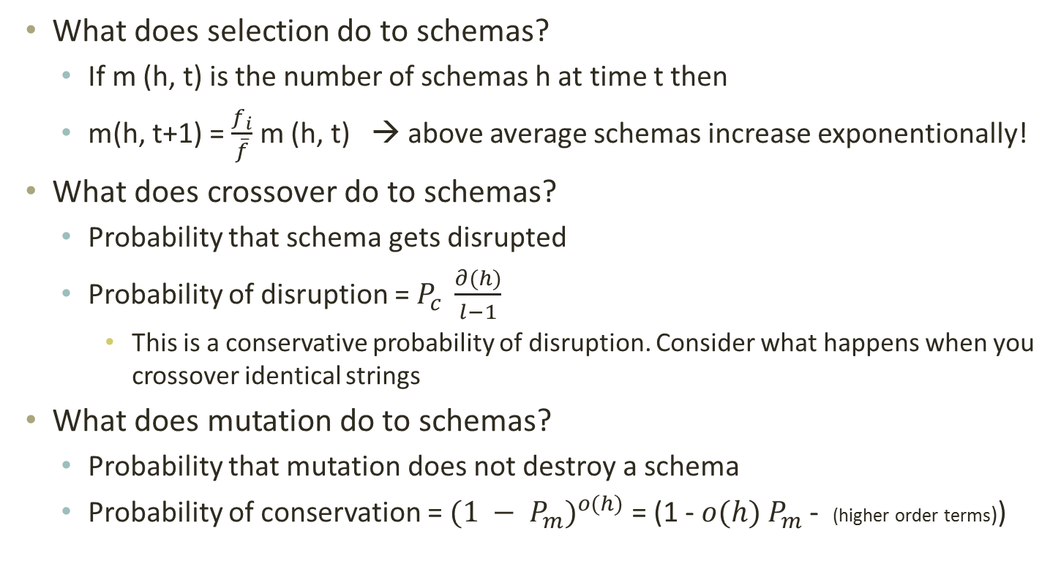
What does GA do to schemas?
What does selection do to schemas?
If m (h, t) is the number of schemas h at time t then
m(h, t+1) = $\frac{f_{i}}{\overline{f}}$ m (h, t) → above average schemas increase exponentionally!
What does crossover do to schemas?
Probability that schema gets disrupted
Probability of disruption = $P_{c} \frac{∂(h)}{l−1}$
This is a conservative probability of disruption. Consider what happens when you crossover identical strings
What does mutation do to schemas?
Probability that mutation does not destroy a schema
Probability of conservation = ${(1 − P_{m})}^{o(h)}$ = (1 - $o(h)$ $P_{m}$ - (higher order terms))

Slide 36
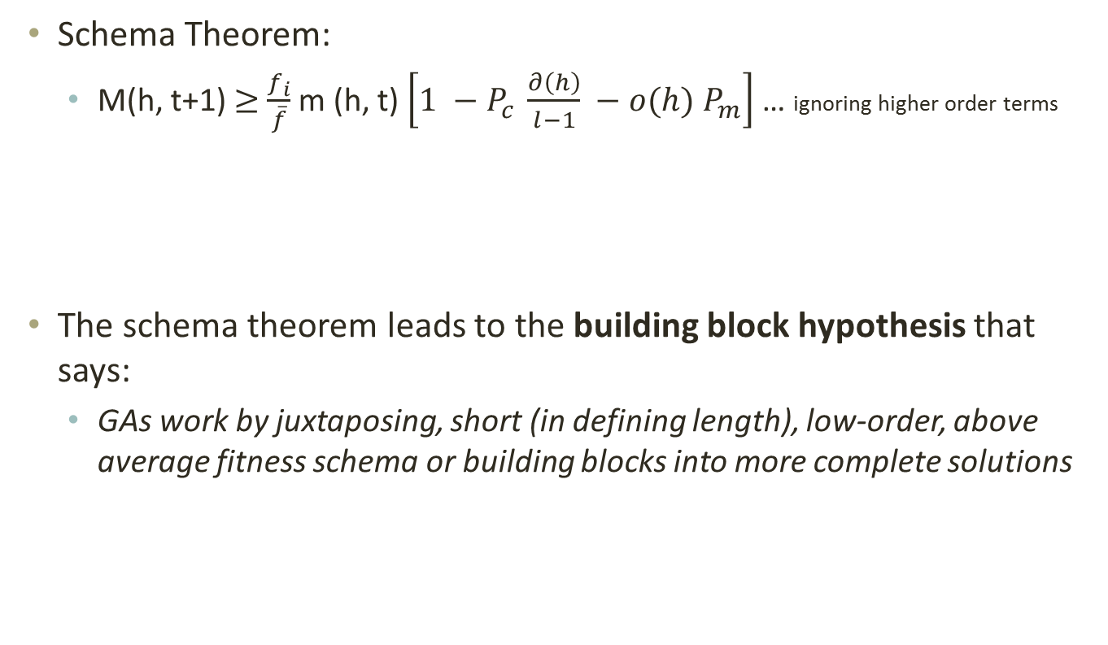
The Schema theorem
Schema Theorem:
M(h, t+1) $≥$ $\frac{f_{i}}{\overline{f}}$ m (h, t) $\left[1 −P_{c} \frac{∂\left(h\right)}{l−1} −o(h) P_{m}\right]$ … ignoring higher order terms
The schema theorem leads to the building block hypothesis that says:
GAs work by juxtaposing, short (in defining length), low-order, above average fitness schema or building blocks into more complete solutions

Slide 37
Games and game trees
Multi-agent systems + competitive environment → games and adversarial search
In game theory any multiagent environment is a game as long as each agent has “significant” impact on others
In AI many games were
Game theoretically: Deterministic, Turn taking, Two-player, Zero-sum, Perfect information
AI: deterministic, fully observable environments in which two agents act alternately and utility values at the end are equal but opposite. One wins the other loses
Chess, Checkers
Not Poker, backgammon,

Slide 38
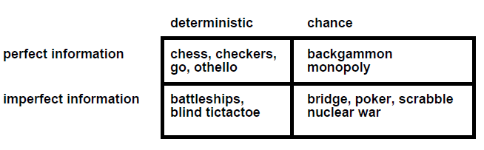
Game types
Starcraft? Counterstrike? Halo? WoW?

Slide 39
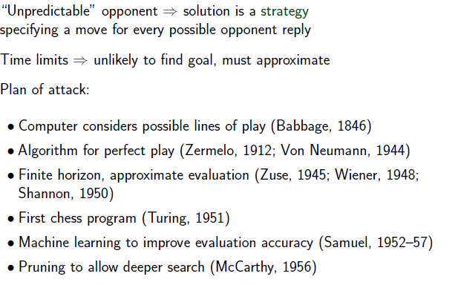
Search in Games

Slide 40
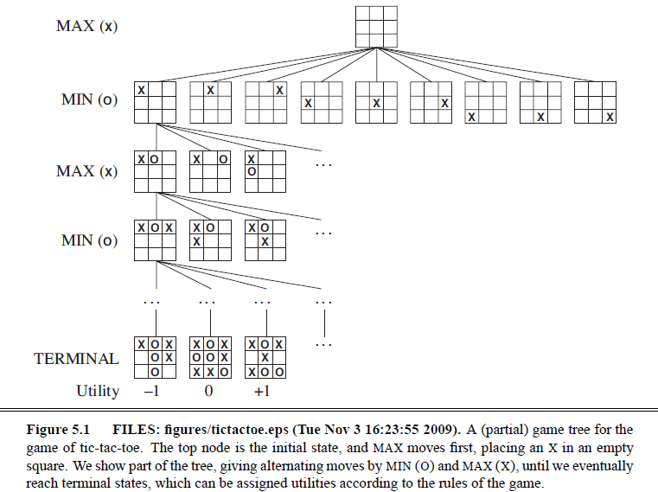
Tic-Tac-Toe

Slide 41
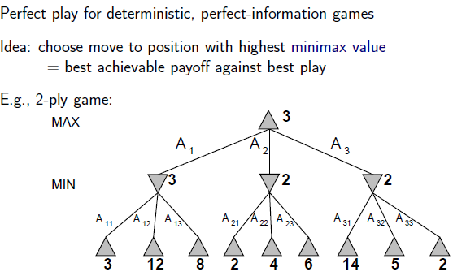
Minimax search

Slide 42
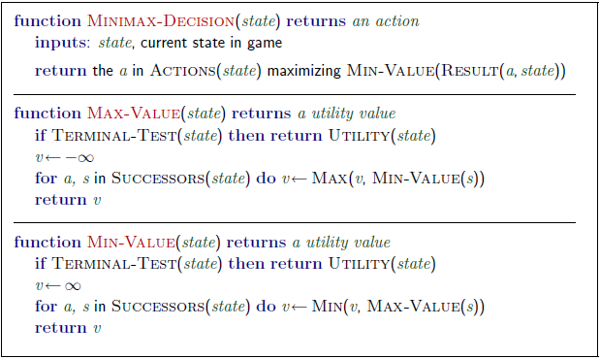
Minimax algorithm

Slide 43
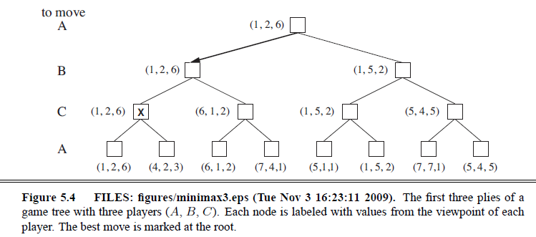
3 player Minimax
Two player minimax reduces to one number because utilities are opposite – knowing one is enough
But there should actually be a vector of two utilities with player choosing to maximize their utility at their turn
So with three players → you have a 3 vector
Alliances?

Slide 44
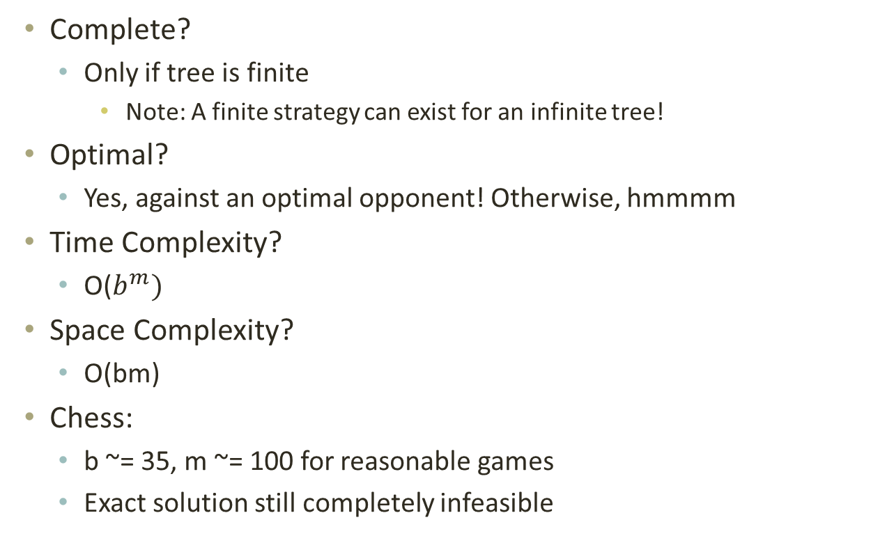
Minimax properties
Complete?
Only if tree is finite
Note: A finite strategy can exist for an infinite tree!
Optimal?
Yes, against an optimal opponent! Otherwise, hmmmm
Time Complexity?
O($b^{m})$
Space Complexity?
O(bm)
Chess:
b ~= 35, m ~= 100 for reasonable games
Exact solution still completely infeasible

Slide 45
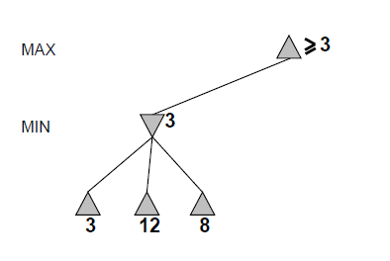
Alpha-beta pruning

Slide 46
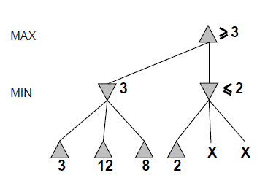
Alpha-beta

Slide 47
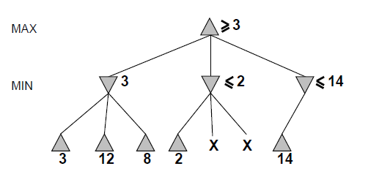
Alpha-beta

Slide 48
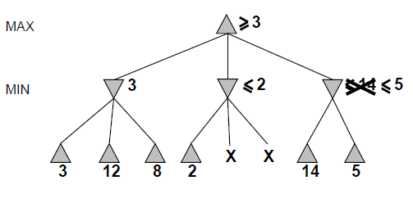
Alpha-beta

Slide 49
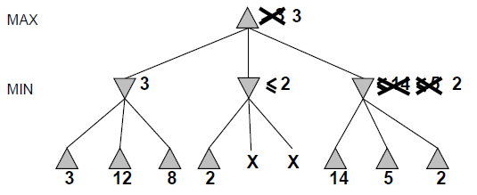
Alpha-beta

Slide 50
Alpha-beta
Alpha is the best value (for Max) found so far at any choice point along the path for Max
Best means highest
If utility v is worse than alpha, max will avoid it
Beta is the best value (for Min) found so far at any choice point along the path for Min
Best means lowest
If utility v is larger than beta, min will avoid it

Slide 51
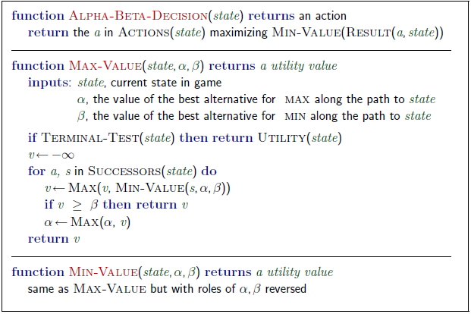
Alpha-beta algorithm

Slide 52
Alpha beta example
Minimax(root)
= max (min (3, 12, 8), min(2, x, y), min (14, 5, 2))
= max(3, min(2, x, y), 2)
= max(3, aValue <= 2, 2)
= 3

Slide 53
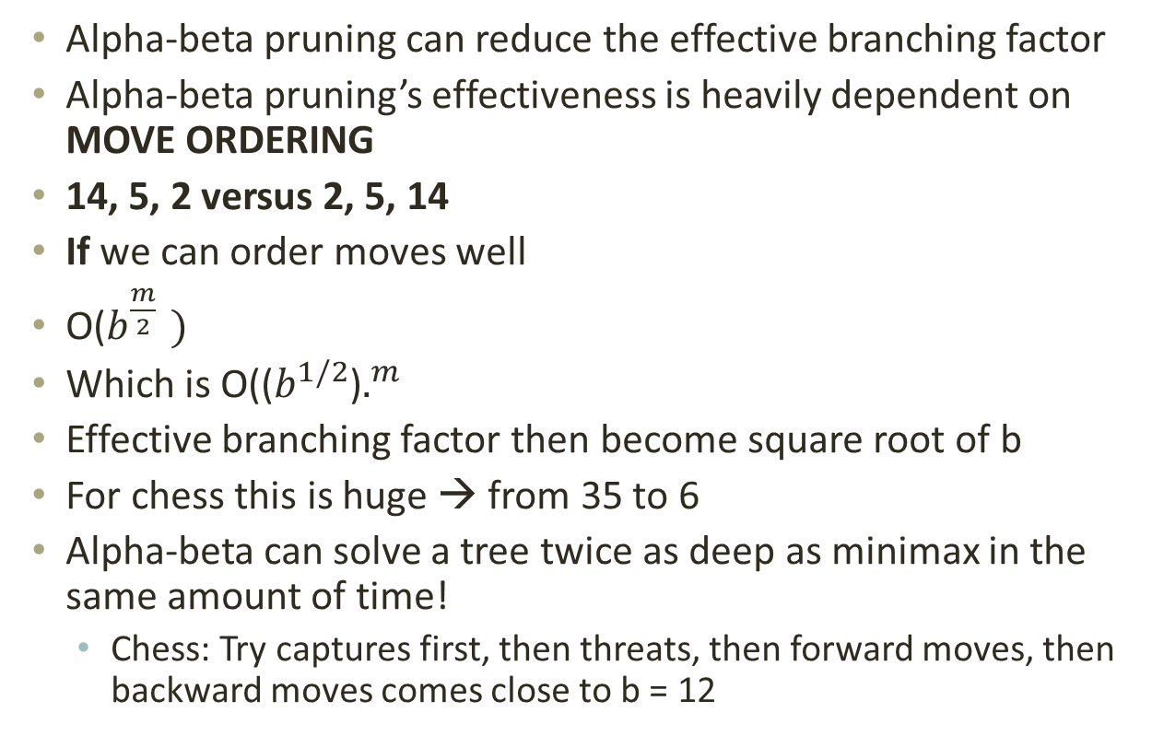
Alpha-beta pruning analysis
Alpha-beta pruning can reduce the effective branching factor
Alpha-beta pruning’s effectiveness is heavily dependent on MOVE ORDERING
14, 5, 2 versus 2, 5, 14
If we can order moves well
O($b^{\frac{m}{2} })$
Which is O(($b^{1/2}$)$.^{m}$
Effective branching factor then become square root of b
For chess this is huge → from 35 to 6
Alpha-beta can solve a tree twice as deep as minimax in the same amount of time!
Chess: Try captures first, then threats, then forward moves, then backward moves comes close to b = 12

Slide 54
Imperfect information
You still cannot reach all leaves of the chess search tree!
What can we do?
Go as deep as you can, then
Utility Value = Evaluate(Current Board)
Proposed in 1950 by Claude Shannon

Slide 55
Search
Problem solving by searching for a solution in a space of possible solutions
Uninformed versus Informed search
Atomic representation of state
Solutions are fixed sequences of actions

