Slide 1
Data analytics in business
Forecasting Demand

Slide 2
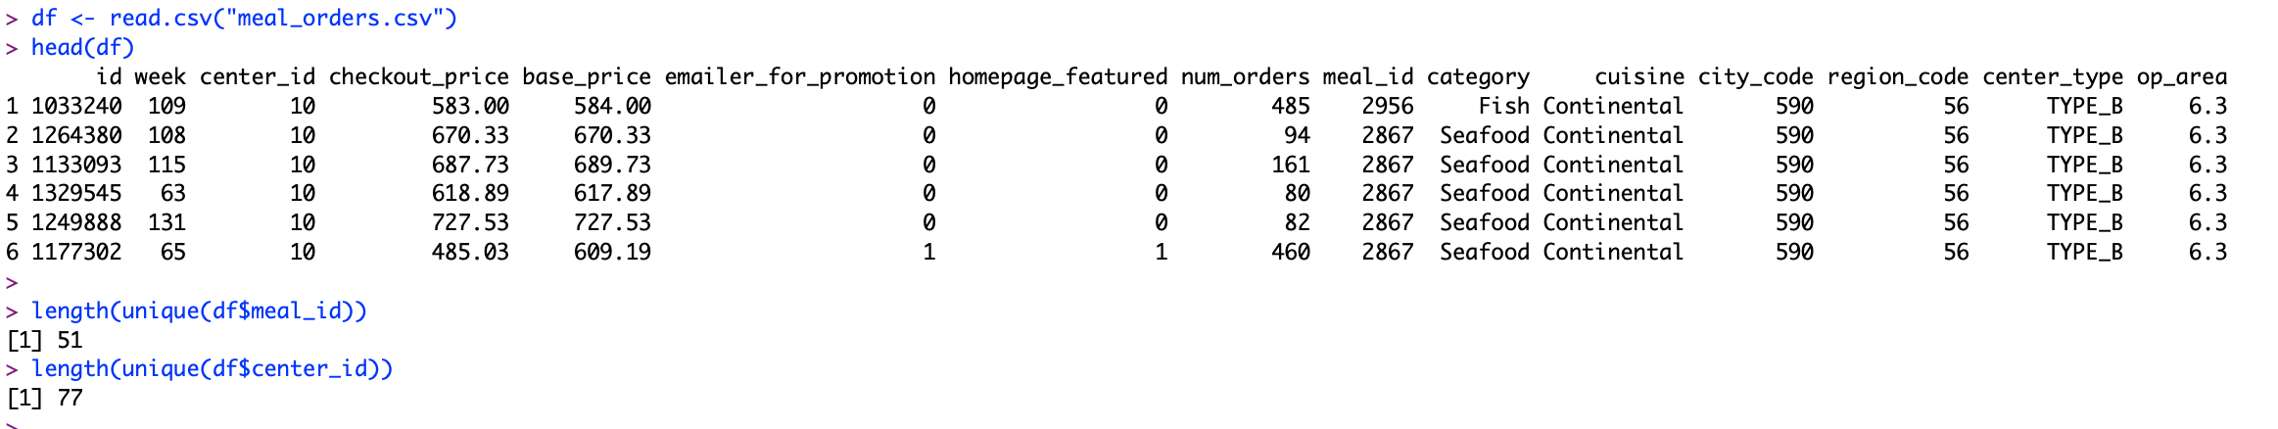
Data exploration
The data is from a meal delivery company that operates in multiple cities, it has number of orders received for each meal at different fulfillment center for week 1 to week 145.
First let’s explore the data. This data set has 51 different meal options, 77 different distribution centers, and 456,548 total rows.

Slide 3
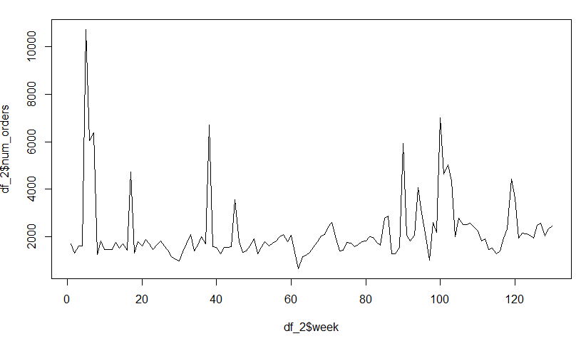
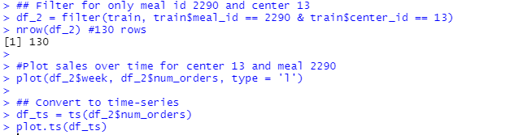

Data exploration
Imagine we work in fulfillment center 13 and we want to forecast demand for Indian Rice Bowl, meal id 2290.
Let’s filter the data to only the information we are interested in. We will also separate the data into training and a test set with the last 15 weeks to score our predictions.
Then we can plot the sales of meal 2290 over time.

Slide 4
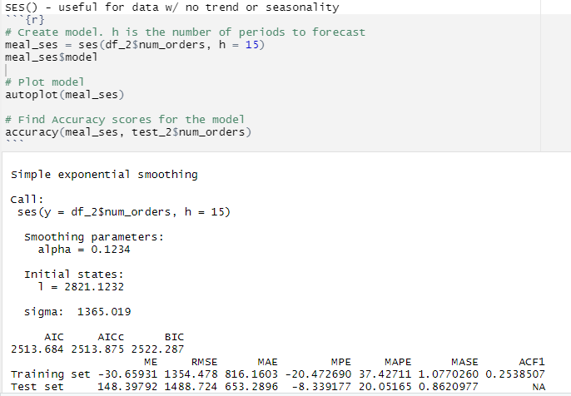
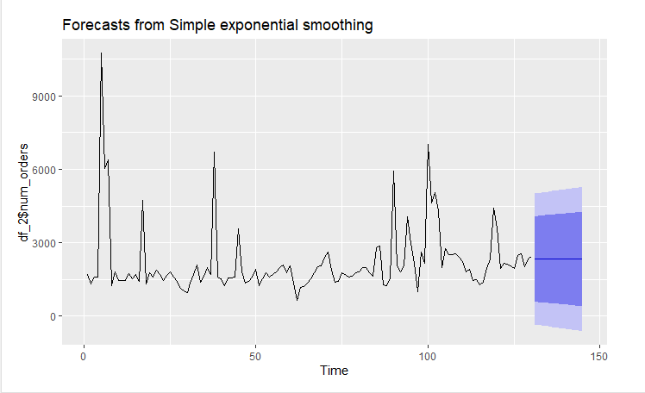
Simple Exponential Smoothing
First, we’ll use ses() for simple exponential smoothing. H = the number of periods we want to predict out to

Slide 5
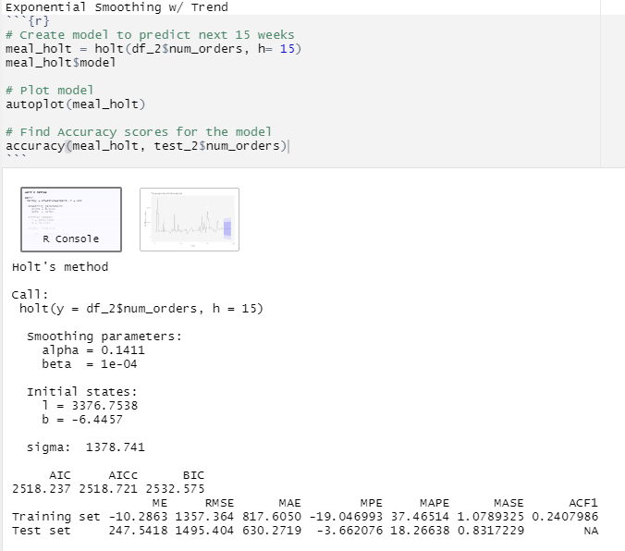
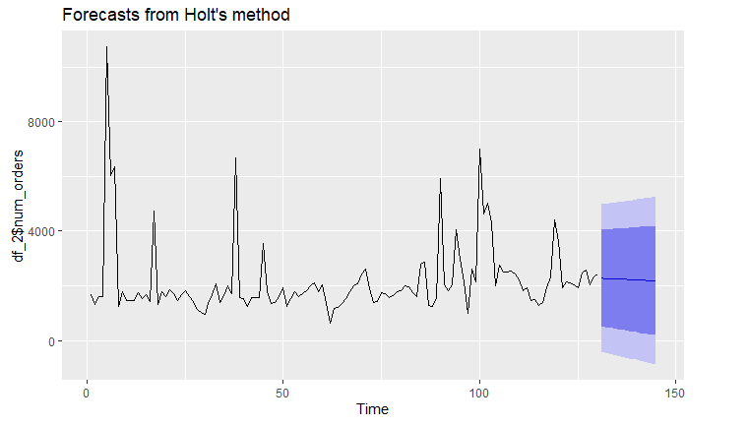
Holt Winters – Exponential Smoothing with trend
Next, we’ll use Holt’s method to forecast using exponential smoothing with trend.

Slide 6
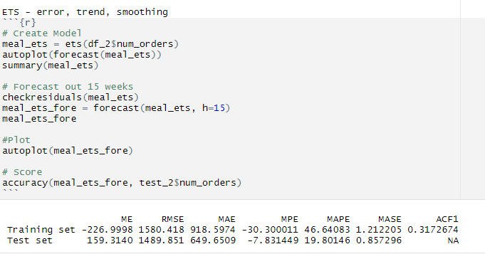
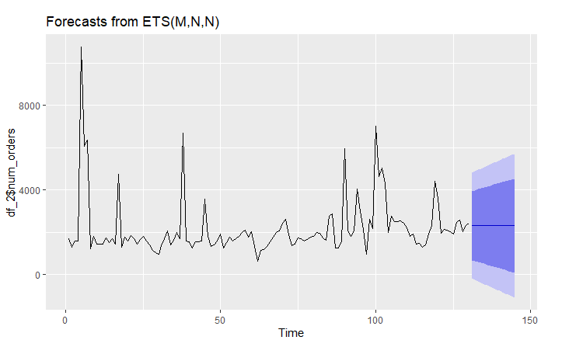
ETS() – Error, Trend, and Smoothing
Next, we’ll use the ETS() method to forecast out the next 15 weeks.

Slide 7
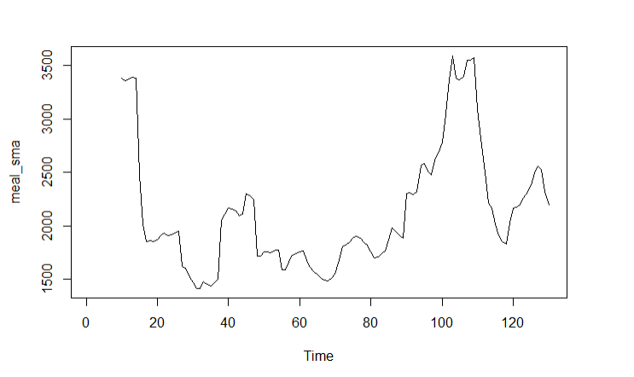
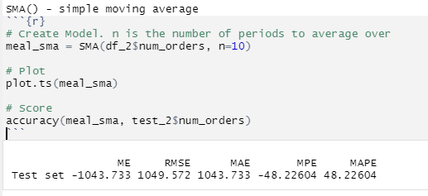
Simple Moving Average
Then, we’ll use simple moving average. N is the number of periods to average over.

Slide 8
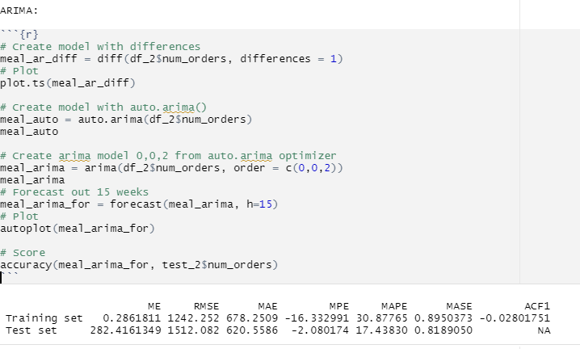
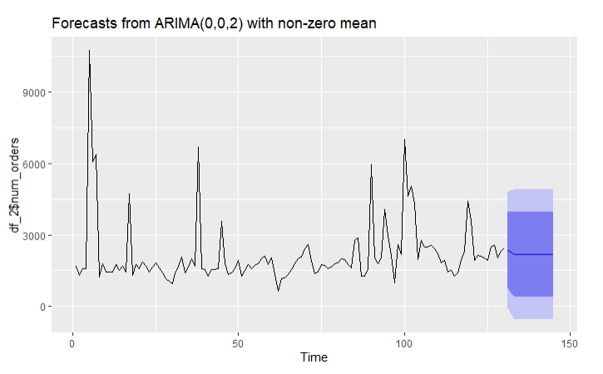
ARIMA
Finally, we’ll compare that to ARIMA. We can use auto.arima to find the optimal values for p, d, and q

Slide 9
Accuracy Score
We can then compare the accuracy scores for each model, trying to minimize the testing errors.
Next, we can try different fulfillment center locations or different meal ids to see which patterns of data work best with each model. For instance, do any of the meals have cyclical patterns?

