Slide 1
Numbers and concepts

Slide 2
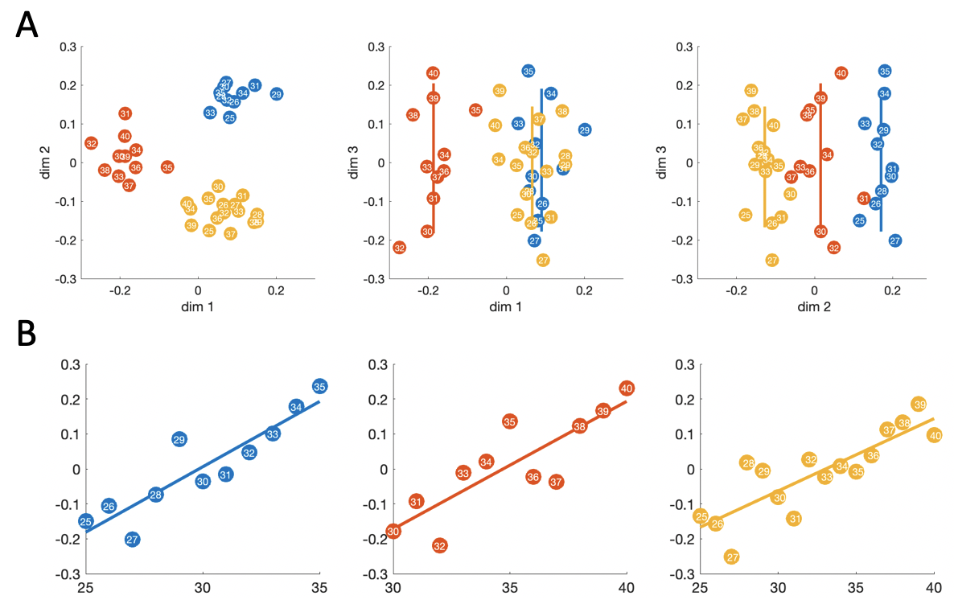
Fabrice’s next tattoo (EEG)

Slide 3
Hannah’s matching tattoo (NN)
“is input A > input B?”. Both inputs passed into network simultaneously.
Sequential trial structure, input A on trial t becomes input B on trial t+1
24 pseudorandomly ordered blocks across 3 contexts (8 blocks each)
Context explicitly labeled as a separate one-hot input
Magnitude lines are clear and parallel-looking across contexts, but separated by context
The higher range context has a longer-looking magnitude line
Averaging hidden unit activations over input B (previously shown number), labeling by input A

Slide 4

Hannah’s matching tattoo (NN)

Slide 5
Hannah’s matching tattoo (NN)
Also looks to me like absolute magnitude coding to me
(see position of pale diagonals)

Slide 6
Hannah’s matching tattoo (NN)

