Slide 1

Karnaugh Maps
Chapter 10:
Notes:
This lecture will explain how to use Karnaugh Maps or K-maps.

Slide 2
Karnaugh Maps
Simplification of Boolean functions yields:
simpler digital circuits
usually faster digital circuits
Using Boolean identities
time-consuming
error-prone
K-Maps
Easy, systematic method to reduce Boolean expressions
Notes:
Simplification of Boolean functions leads to simpler (and usually faster) digital circuits.
Simplifying Boolean functions using identities is time-consuming and error-prone.
This will present K-Maps, an easy, systematic method for reducing Boolean expressions.

Slide 3
Karnaugh Maps
Maurice Karnaugh
telecommunications engineer
Bell Labs
1953
While exploring digital logic and its application to the design of telephone circuits
Invented a graphical way of visualizing
Applied it to simplifying Boolean expressions
Graphical representation
named Karnaugh map or Kmap
in his honor
Notes:
In 1953, Maurice Karnaugh was a telecommunications engineer at Bell Labs.
While exploring the new field of digital logic and its application to the design of telephone circuits, he invented a graphical way of visualizing and then simplifying Boolean expressions.
This graphical representation, now known as a Karnaugh map, or Kmap, is named in his honor.

Slide 4
Karnaugh Maps
Kmap
matrix of rows and columns
represent output values of Boolean function
Output values placed in each cell
derived from the minterms of a Boolean function
Minterm is a product term
contains all of the function’s variables exactly once
either complemented or not complemented
Notes:
A Kmap is a matrix consisting of rows and columns that represent the output values of a Boolean function.
The output values placed in each cell are derived from the minterms of a Boolean function.
A minterm is a product term that contains all of the function’s variables exactly once, either complemented or not complemented.

Slide 5


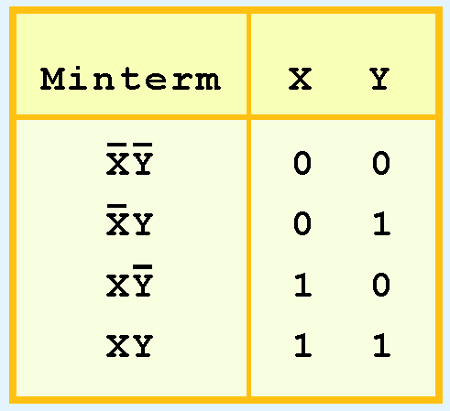
Karnaugh Maps
Minterms for function having the inputs x and y:
Consider the Boolean function:
Its minterms are:
Notes:
For example, the minterms for a function having the inputs x and y are shown here.
Consider this Boolean function:
Its minterms are shown here

Slide 6
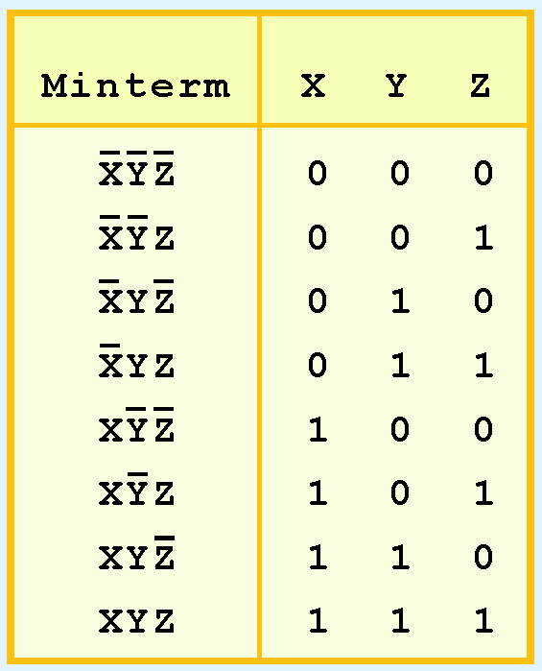
Karnaugh Maps
Function with three inputs
Minterms are shown in this diagram
Notes:
Similarly, a function having three inputs, has the minterms that are shown at the right.

Slide 7
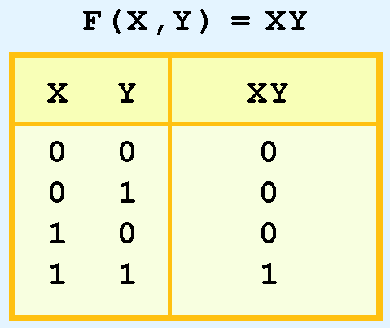
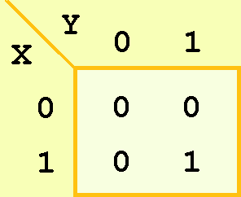
Karnaugh Maps
A Kmap has a cell for each minterm
It has a cell for each line for the truth table of a function.
Truth table for function
F(x,y) = xy
along with Kmap
Notes:
A Kmap has a cell for each minterm.
This means that it has a cell for each line for the truth table of a function.
The truth table for the function F(x,y) = xy is shown at the right along with its corresponding Kmap.

Slide 8
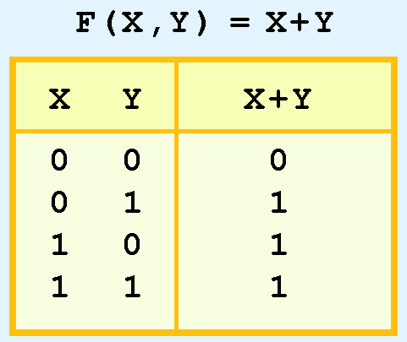
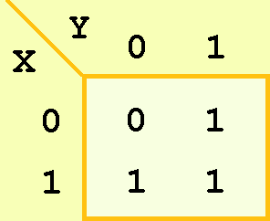

Karnaugh Maps
Truth table and KMap for the function
F(x,y) = x + y
Function is equivalent to OR of all of the minterms that have a value of 1
Thus:
Notes:
As another example, we give the truth table and KMap for the function, F(x,y) = x + y at the right.
This function is equivalent to the OR of all of the minterms that have a value of 1.
Therefore X or Y equals this sum of these minterms.

Slide 9
Karnaugh Maps
Minterm function derived from Kmap
not in simplest terms
Reduce the complicated expression to its simplest terms
find adjacent 1s in the Kmap
collected into groups that are powers of two
In this example, there are two such groups.
Can you find them?
Notes:
Of course, the minterm function that we derived from our Kmap was not in simplest terms.
That’s what we started with in this example.
We can, however, reduce our complicated expression to its simplest terms by finding adjacent 1s in the Kmap that can be collected into groups that are powers of two.

Slide 10
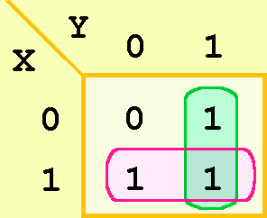
Karnaugh Maps
Best way of selecting two groups of 1s
shown below
Both groups are powers of two and the groups overlap
Notes:
The best way of selecting two groups of 1s form our simple Kmap is shown below.
We see that both groups are powers of two and that the groups overlap.

Slide 11
Karnaugh Maps
Rules of Kmap simplification are:
Groupings can contain only 1s; no 0s
Groups can be formed only at right angles; diagonal groups are not allowed
Number of 1s in a group must be a power of 2 – even if it contains a single 1
Groups must be made as large as possible
Groups can overlap and wrap around the sides of the Kmap
Notes:
Here are the rules of Kmap simplification
Groupings can contain only 1s; no 0s.
Groups can be formed only at right angles; diagonal groups are not allowed.
The number of 1s in a group must be a power of 2 – even if it contains a single 1.
The groups must be made as large as possible.
Groups can overlap and wrap around the sides of the Kmap.

Slide 12
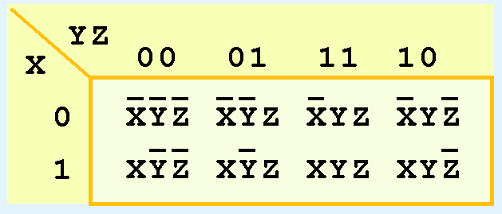
Karnaugh Maps
Kmap for three variables
shown below
Each minterm is placed in a cell
that cell will hold its value
Note: values for the yz combination
form a pattern that is not a normal binary sequence (It is the Grey-scale)
Notes:
A Kmap for three variables is constructed as shown in the diagram below.
We have placed each minterm in the cell that will hold its value.
Notice that the values for the yz combination at the top of the matrix form a pattern that is not a normal binary sequence (It is the Grey-scale).
Using the grey scale pattern is critical to simplifying the expressions.

Slide 13
Karnaugh Maps
First row of the Kmap
minterms where x is zero
First column
minterms where y and z both are zero
Notes:
Thus, the first row of the Kmap contains all minterms where x has a value of zero.
The first column contains all minterms where y and z both have a value of zero.

Slide 14
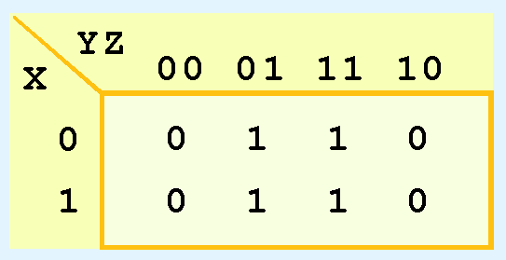
Karnaugh Maps
Consider the function:
Its Kmap is given below.
What is the largest group of 1s that is a power of 2?
Notes:
Consider this function:
Its Kmap is given below.
Each minterm in the function is given a one in the K-Map like this:
Can you find the largest group of 1s that is a power of 2?

Slide 15
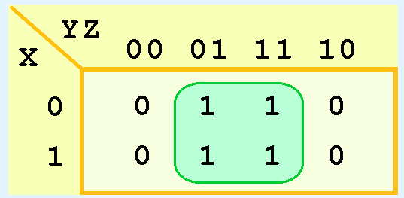
Karnaugh Maps
Grouping shows changes in the variables x and y have no influence upon the value of the function
The function:
reduces to F(x) = z.
You could verify this reduction with identities or a truth table.
Notes:
This grouping tells us that changes in the variables x and y have no influence upon the value of the function: They are irrelevant.
This means that the function, reduces to F(x) = z
You could verify this reduction with identities or a truth table

Slide 16
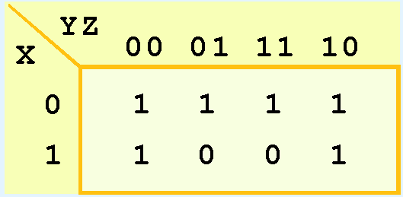
Karnaugh Maps
Next -Consider the function:
Kmap is shown below
There are two groupings of 1s
Can you find them?
Notes:
Now for a more complicated Kmap. Consider the function:
Its Kmap is shown below. There are two groupings of 1s.
Can you find them? – Remember that the groupings can wrap around the ends.

Slide 17
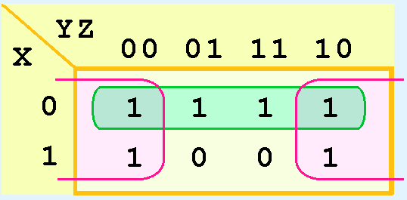
Karnaugh Maps
One group wraps around the sides of the Kmap
Values of x and y are not relevant to the term of the function in pink group
What does this tell us about the term of the function?
Z = 0 in the pink group so one term is
What about the green group in the top row?
Notes:
In this Kmap, we see an example of a group that wraps around the sides of a Kmap.
The pink group tells us that the values of x and y are not relevant to the term of the function that is encompassed by the group.
What does this tell us about the term of the function? What is Z’s value in the pink group?
What about the green group in the top row? What is X’s value in the green group?

Slide 18

Karnaugh Maps
Green group the top row
only the value of x is significant X=0
It is complemented or 0 in that row
the other term of the reduced function is
Our reduced function is:
Recall that we had four minterms in our original function!
Notes:
The green group in the top row tells us that only the value of x is significant in that group.
We see that it is complemented or 0 in that row, so the other term of the reduced function is .
Our reduced function is not X or not Z

Slide 19
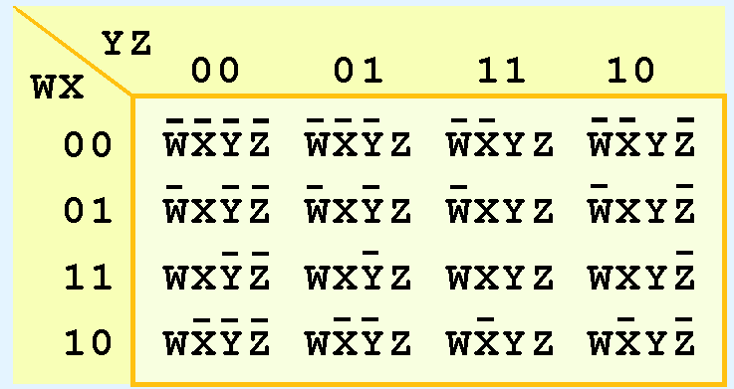
Karnaugh Maps
Model can be extended to 16 minterms
produced by a four-input function
Format below for 16-minterm Kmap
Notes:
Our model can be extended to accommodate the 16 minterms that are produced by a four-input function.
This is the format for a 16-minterm Kmap.

Slide 20
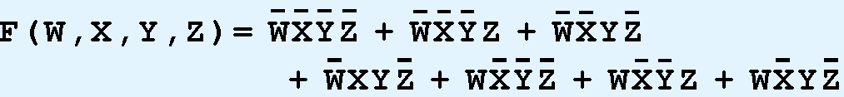
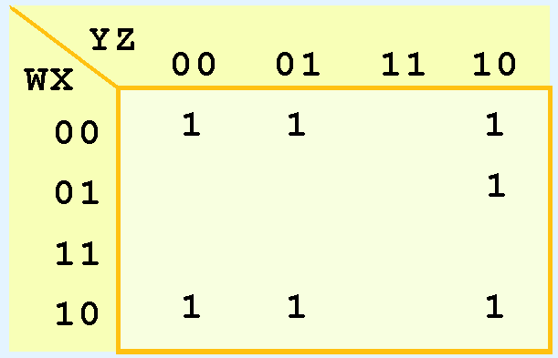
Karnaugh Maps
Kmap shown below populated with the nonzero minterms from the function:
Can you identify (only) three groups in this Kmap?
Recall that groups can overlap.
Notes:
The Kmap shown below has been populated with the nonzero minterms from this function
Can you identify (only) three groups in this Kmap?

Slide 21
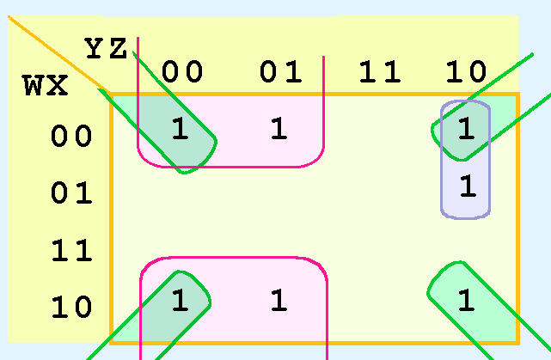
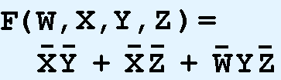
Karnaugh Maps
Three groups consist of:
A purple group entirely within the Kmap at the right.
A pink group that wraps the top and bottom.
A green group that spans the corners.
Three terms in the final function:
Notes:
Three groups consist of:
A purple group entirely within the Kmap at the right produces not W and Y and not Z
A pink group that wraps the top and bottom produces not X and not Y
A green group that spans the corners produces not X and not Z
Thus we have three terms in our final function

Slide 22
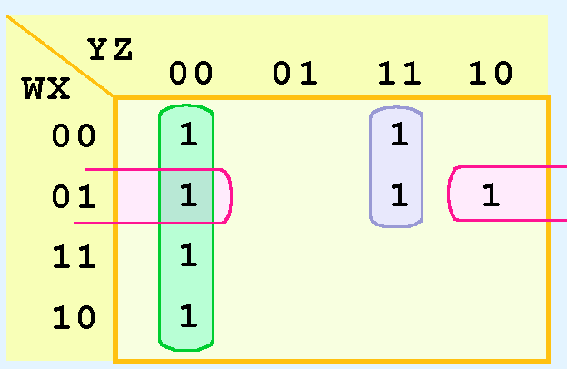
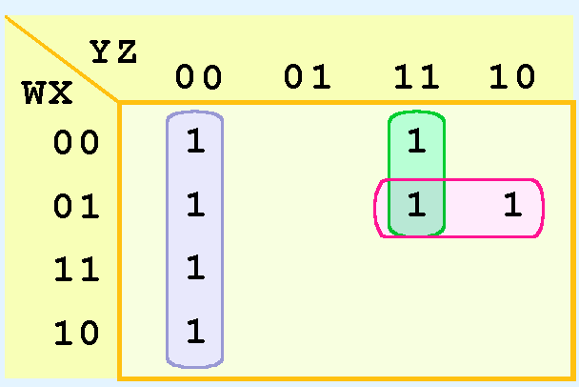
Karnaugh Maps
Different ways to pick groups within a Kmap
Must choose
Keep groups as large as possible
Different functions that result
Logically equivalent.
Notes:
It is possible to have a choice as to how to pick groups within a Kmap, while keeping the groups as large as possible.
The (different) functions that result from the groupings below are logically equivalent.

Slide 23
Don’t Care: Example
Real circuits don’t always have an output defined for every input.
Calculator displays consist of 7-segment LEDs –
These LEDs can display 2 ⁷ -1 patterns
Only ten patterns are useful
Circuit is design such that a particular set of inputs can never happen
don’t care condition
Don’t Cares help simplify Kmap circuit
Notes:
Real circuits don’t always need to have an output defined for every possible input.
For example, some calculator displays consist of 7-segment LEDs. These LEDs can display 2 ⁷ -1 patterns, but only ten of them are useful.
If a circuit is designed so that a particular set of inputs can never happen, we call this set of inputs a don’t care condition.
They are very helpful to us in Kmap circuit simplification.

Slide 24
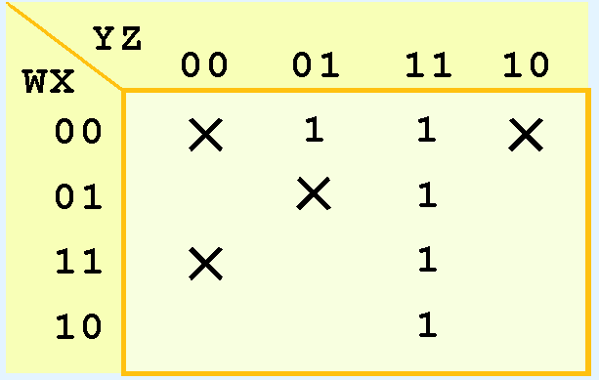
Don’t Care: Example
Don’t care condition is identified by an X in the cell of the minterm(s) for the don’t care inputs
X’s can be included or ignored when creating groups for simplification
Notes:
In a Kmap, a don’t care condition is identified by an X in the cell of the minterm(s) for the don’t care inputs, as shown below.
In performing the simplification, we are free to include or ignore the X’s when creating our groups.

Slide 25

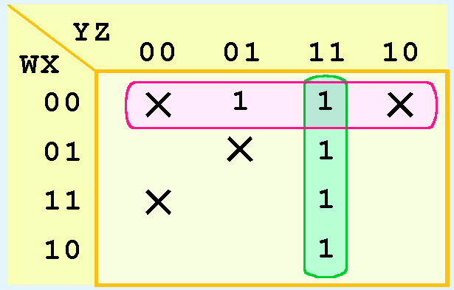
Don’t Care: Example
One grouping of the Kmap below
This function is the result:
Notes:
In one way of grouping the Kmap below, the result is this function:

Slide 26

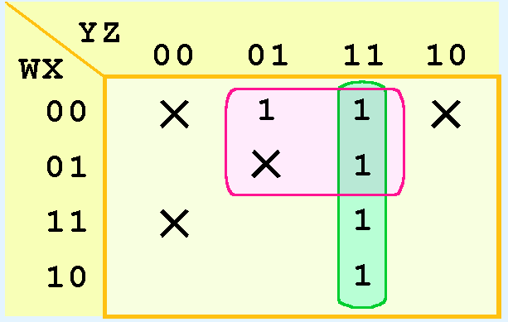
3A.6 Don’t Care Conditions
Don’t Care: Example
A different grouping yields this function:
Notes:
A different grouping yields this function

Slide 27
3A.6 Don’t Care Conditions
Don’t Care: Example
The truth table of:
is different from the truth table of:
Values for which they differ - the inputs for which have don’t care conditions
Notes:
In this case the truth tables of these are different, however the values for which they differ are the inputs which have don’t care conditions.

Slide 28
Karnaugh Maps
K-maps are a powerful tool for simplifying Boolean expressions to find the simplest functional equivalent
Let’s work an example step-by-step
Notes:
K-maps are a powerful tool for simplifying Boolean expressions to find the simplest functional equivalent
Let’s work an example step-by-step

Slide 29
Karnaugh Maps
Use K-map to simplify the following expression:
F(x,y,z) = xy’z’ + x’y’z + xz’ + y’z + x’
First note three variables in the expression F( )
therefore K-map will have 2³=8 cells
Next determine where each variable will be represented
yz
x
Notes:
We will use a K-map to simplify the following expression
First we note that there are three variables in the expression F( ), therefore our K-map will have 2³=8 cells.
Next determine where each variable will be represented.

Slide 30
Next arrange literal values for x,y and z so binary vectors next to each other differ by only one bit
Logically adjacent vectors are also physically adjacent. (grey code order)
yz
00 01 11 10
x
0
1
Now place ones (true values) in K-map to show which binary vectors satisfy the expression F( )
F(x,y,z) = xy’z’ + x’y’z + xz’ + y’z + x’
100
001
1-0
100
110
-01
001
101
0--
000
001
010
011
yz
00 01 11 10
x
0
1
1
1
1
1
1
1
1
Notes:
Next we arrange the literal values for x,y and z so that binary vectors that are next to each other differ by only one bit. In other words we make sure that logically adjacent vectors are also physically adjacent. (grey code order)
Now we place ones (true values) into the K-map to show which binary vectors satisfy the expression F( ).
This term is represented by this 1
This term is represented by this 1
This term is represented by these 2 ones
And This term by these 2 ones
Finally this term is represented by these 4 ones

Slide 31
Find smallest number of the largest rectangular patterns of 1’s whose sizes are integer powers of two. The size of a selected rectangle of ones must contain 1,2,4,. . .,2^{n} cells. In this example 4 is the limit.
Choose a set of these rectangles such that every 1 is in at least one of the rectangles. Here are a few candidates:
yz
yz
00 01 11 10
00 01 11 10
x
x
0
1
1
1
1
1
0
1
1
1
1
1
1
1
1
1
1
1
In each case, all the 1’s in three rectangles of the required dimensions.
Map below is best because it uses larger patterns (3 groups of 4).
Finally, convert these patterns back into terms in the simplified expression for F( ).
yz
00 01 11 10
x
0
1
1
1
1
1
1
1
1
F(x,y,z) = x’ + y’ + z’
Notes:
Now we find the smallest number of the largest rectangular patterns of 1’s whose sizes are integer powers of two. That is, the length of a selected rectangle of ones must be of length 1,2,4,. . .,2^{n}. Of course in this example 4 is the limit. We must choose a set of these rectangles such that every 1 is in at least one of the rectangles. Here are a few candidates.
In each case we have contained all the 1’s in three rectangles of the required dimensions. The map below is best because it uses larger patterns (3 groups of 4).
Finally we convert these pattern back into terms in the simplified expression for F( ).

Slide 32
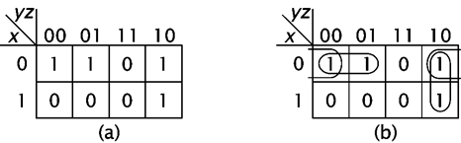
K-map Example
x | y | z | x'y'+yz'+yz'
0 | 0 | 0 | 1
0 | 0 | 1 | 1
0 | 1 | 0 | 1
0 | 1 | 1 | 0
1 | 0 | 0 | 0
1 | 0 | 1 | 0
1 | 1 | 0 | 1
1 | 1 | 1 | 0
Let’s consider (xy’+yz)’ = x’y’ + x’z’ + yz’
Group together the 1s in the map:
g1: x’y’z’+x’y’z=x’y’(z’+z)=x’y’
g2: x’yz’+xyz’ = yz’(x’+x)=yz’
g3: x’yz’+x’y’z’=x’z’(y+y’)=x’z’
To derive a minimal expression we must select the fewest groups that cover all active minterms (1s).
(xy’+yz)’= x’y’+yz’
Notes:
Let’s consider this example:
There are three groupings of 1s.
However, two groups cover all of the ones so the third group is not needed.
To derive a minimal expression we must select the fewest groups that cover all active minterms (1s).

Slide 33
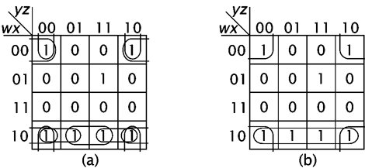
K-map for more complex function
The final minimized function is:
x’z’ + wx’ + w’xyz
Notes:
Here is an example for a more complex function and the final minimized function.
Only these groupings are needed for the final function.

Slide 34
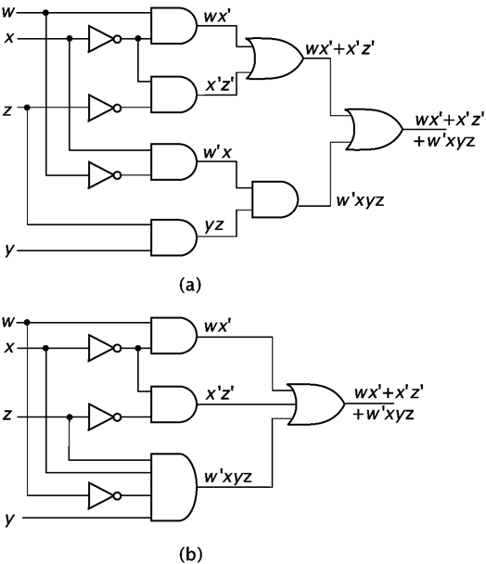
Circuit implementation of the function in the previous slide:
using two input gates (Figure a)
using two and four input gates (Figure b).
Notes:
Here is the circuit implementation of the function in the previous slide:
using two input gates (Figure a)
and using two and four input gates (Figure b).

Slide 35
3A Conclusion
Karnaugh Maps
Kmaps - graphical method of simplifying Boolean expressions
Kmap - matrix consisting of outputs of minterms of a Boolean function
Kmaps - reviewed 2- 3- and 4-input
Method can be extended to any number of inputs through use of multiple tables
Notes:
In review:
Kmaps provide an easy graphical method of simplifying Boolean expressions.
A Kmap is a matrix consisting of the outputs of the minterms of a Boolean function.
In this section, we have discussed 2- 3- and 4-input Kmaps. This method can be extended to any number of inputs through the use of multiple tables.
view:

Slide 36
3A Conclusion
Karnaugh Maps
Recapping the rules of Kmap simplification:
Groupings can contain only 1s; no 0s.
Groups can be formed only at right angles; diagonal groups are not allowed
Number of 1s in a group must be a power of 2
– even if it contains a single 1
Groups must be made as large as possible
Groups can overlap and wrap around the sides of the Kmap
Use don’t care conditions when you can
Select the fewest groups that cover all active minterms (1s)
Notes:
Recapping the rules of Kmap simplification:
Groupings can contain only 1s; no 0s.
Groups can be formed only at right angles; diagonal groups are not allowed
Number of 1s in a group must be a power of 2
– even if it contains a single 1
Groups must be made as large as possible
Groups can overlap and wrap around the sides of the Kmap
Use don’t care conditions when you can
Select the fewest groups that cover all active minterms (1s)

