Slide 1
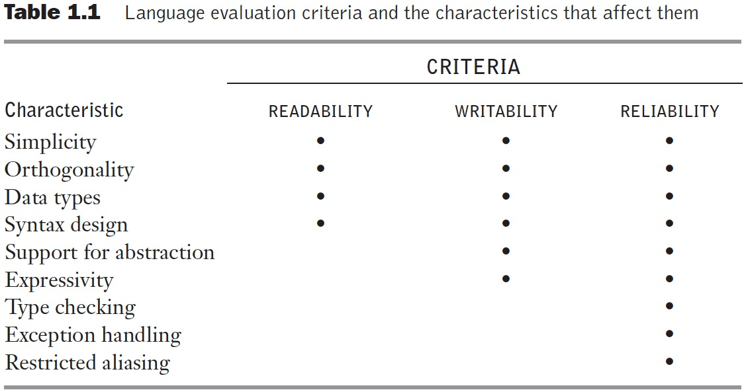
Table 1.1 Language evaluation criteria and the characteristics that affect them

Slide 2
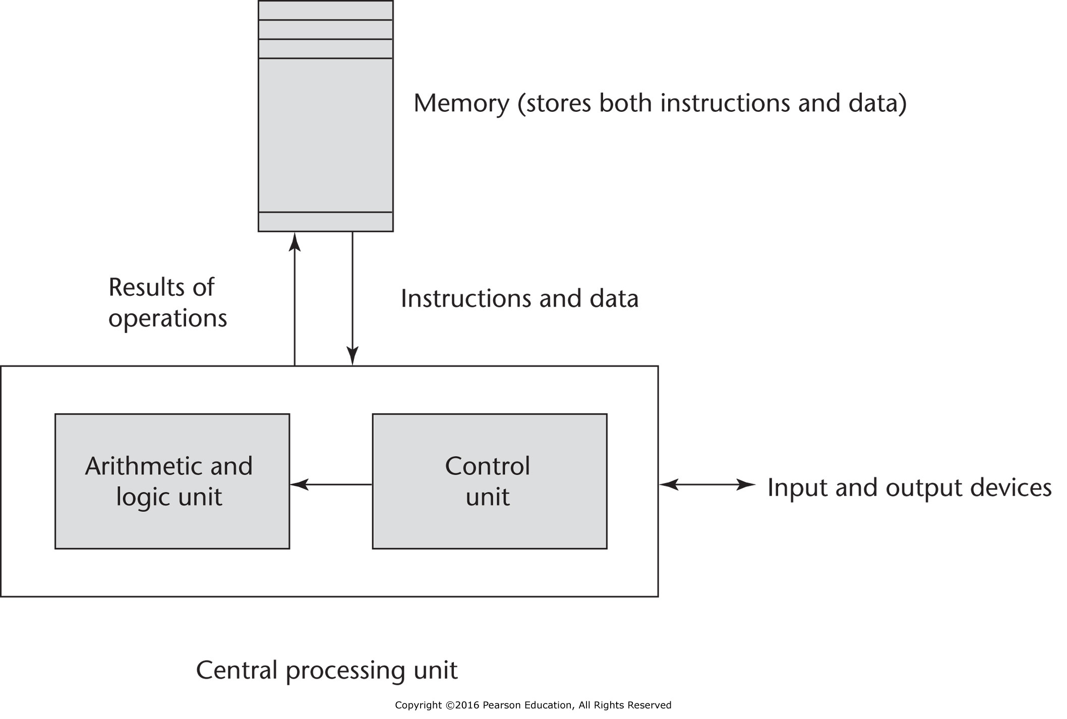
Figure 1.1 The von Neumann computer architecture

Slide 3
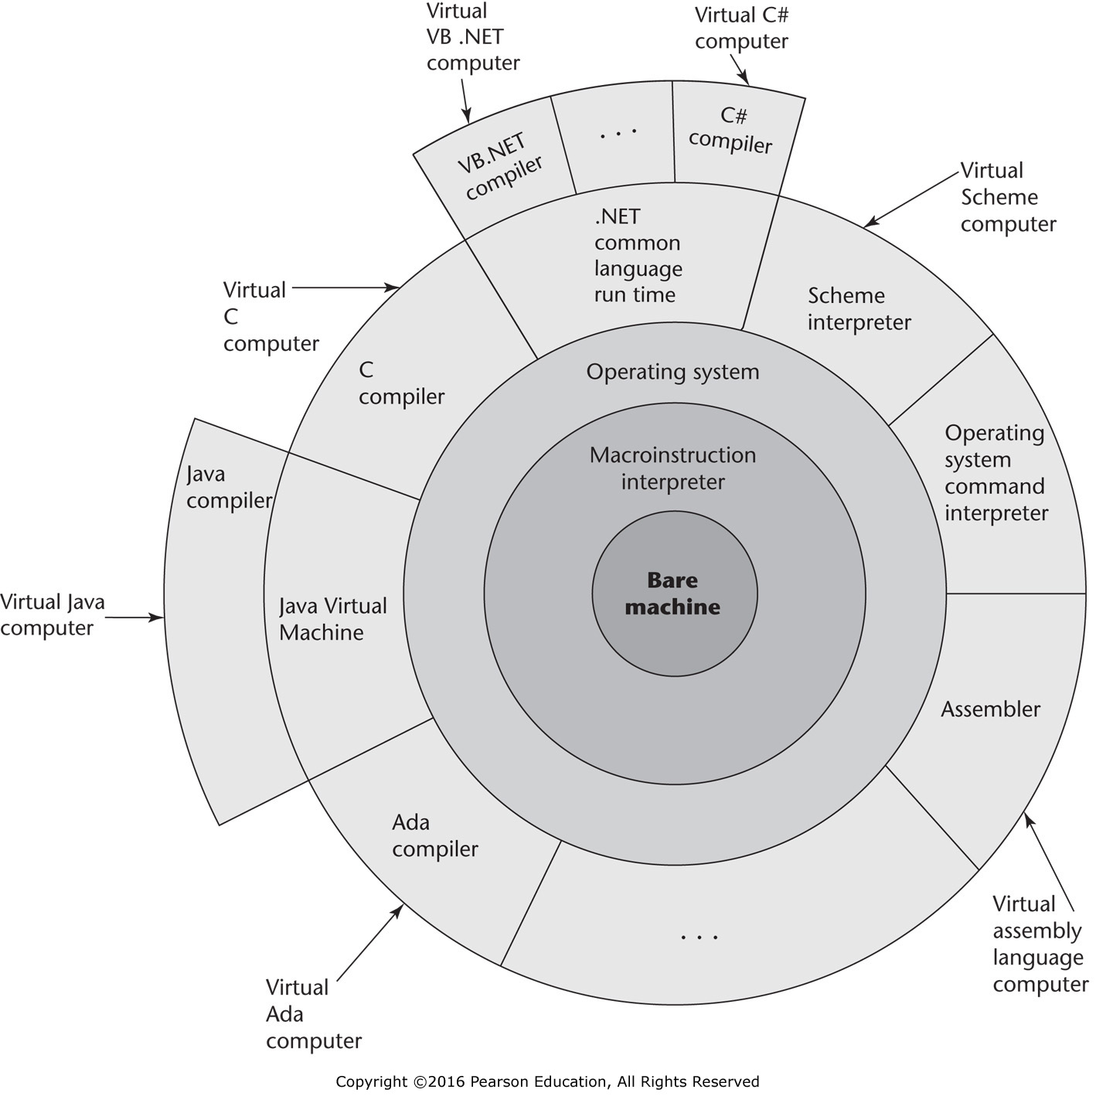
Figure 1.2 Layered interface of virtual computers, provided by a typical computer system

Slide 4
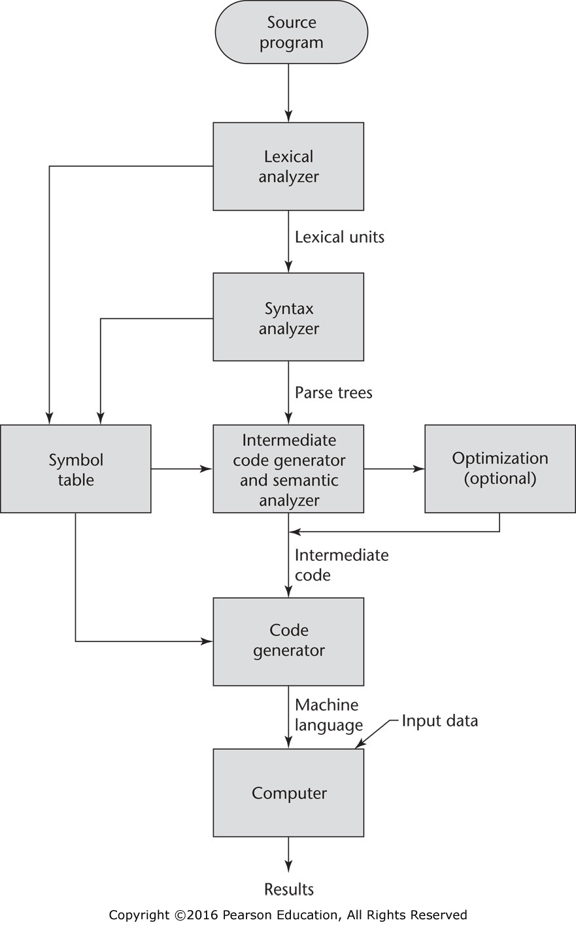
Figure 1.3 The compilation process

Slide 5
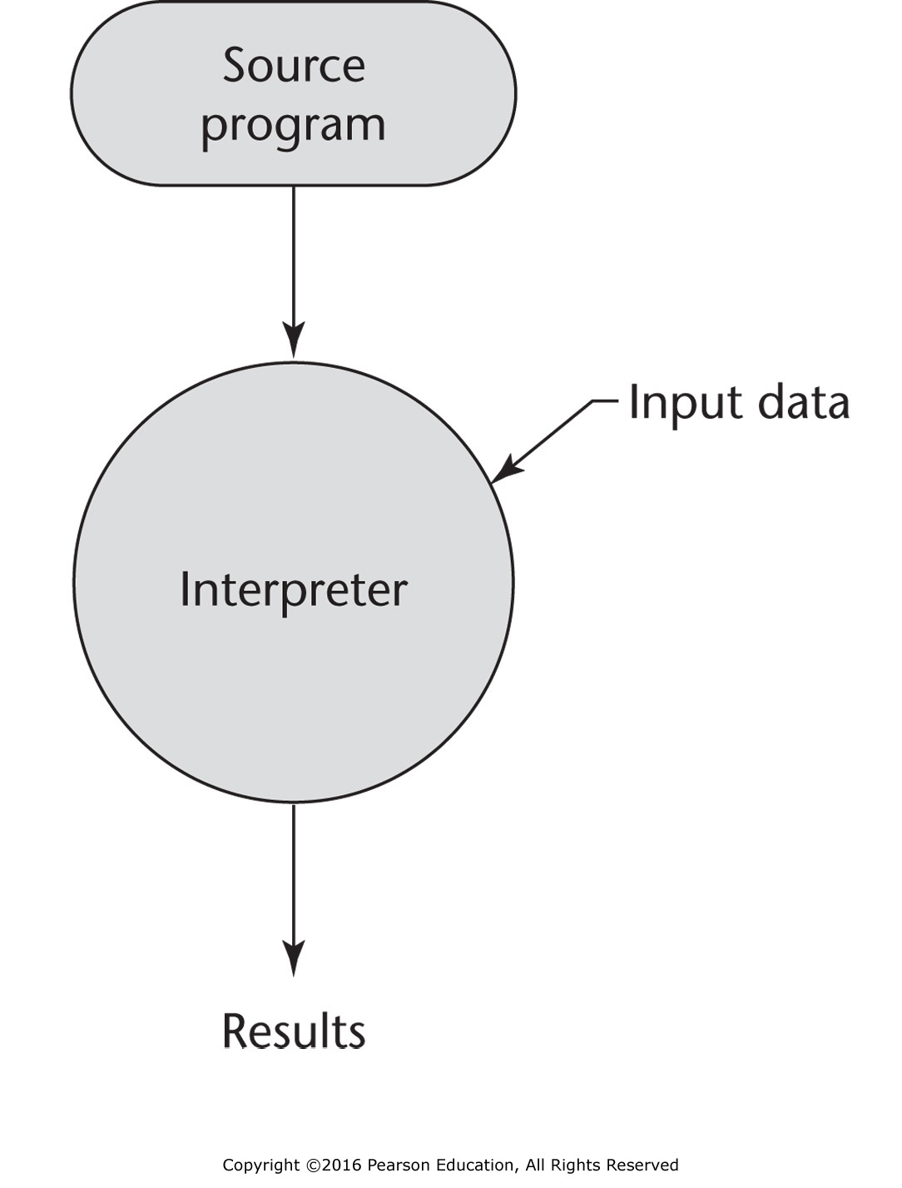
Figure 1.4 Pure interpretation

Slide 6
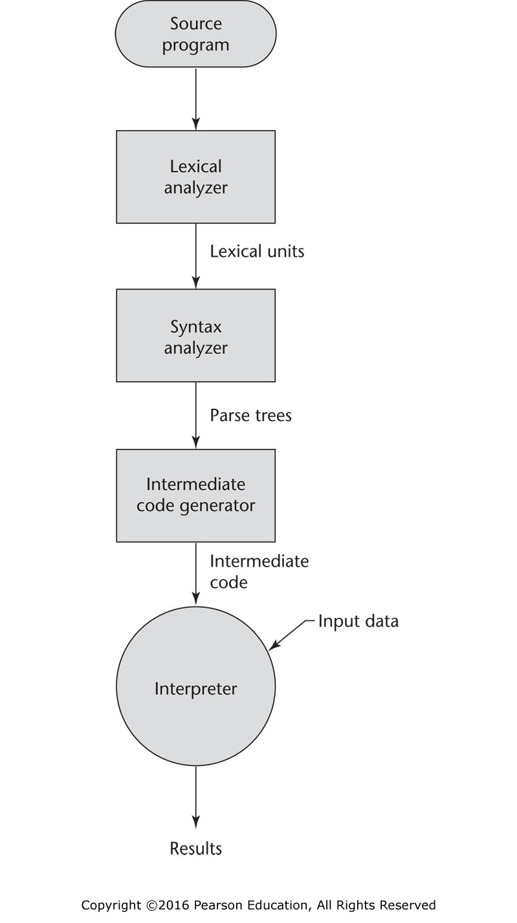
Figure 1.5 Hybrid implementation system

