Slide 1
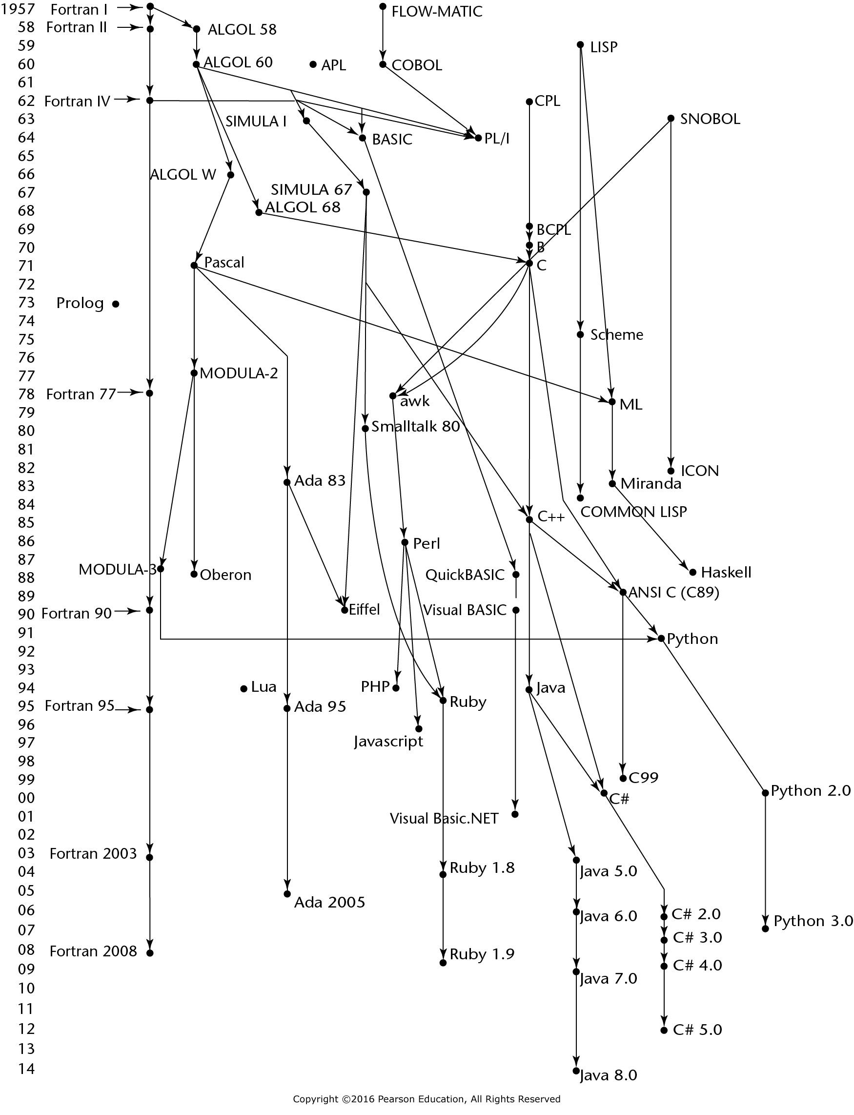
Figure 2.1 Genealogy of common high-level programming languages

Slide 2
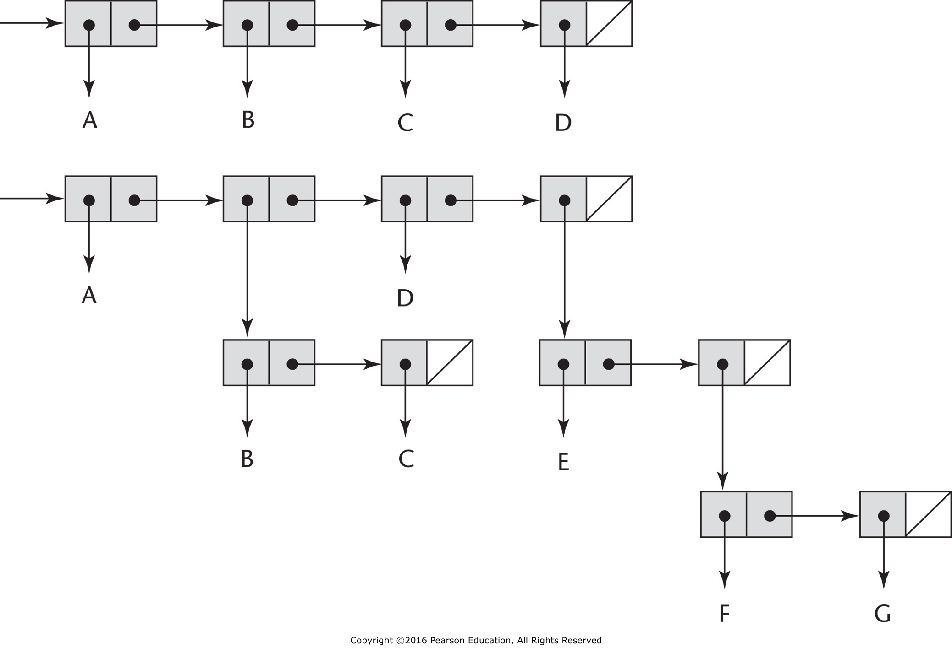
Figure 2.2 Internal representation of two Lisp lists

