Slide 1
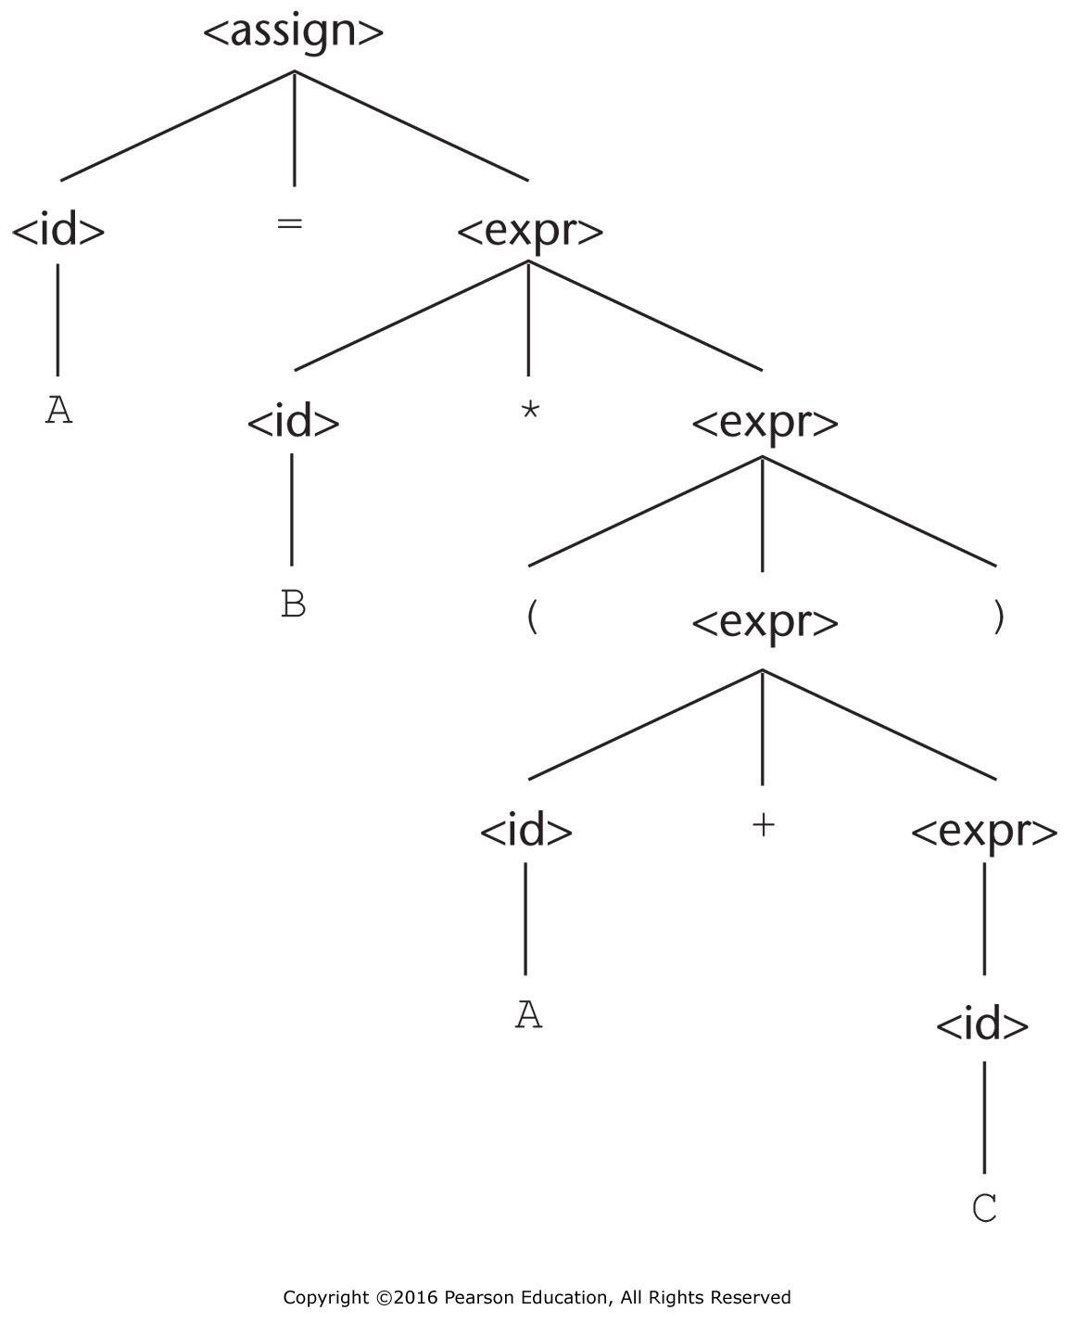
Figure 3.1 A parse tree for the simple statement A = B * (A + C)

Slide 2
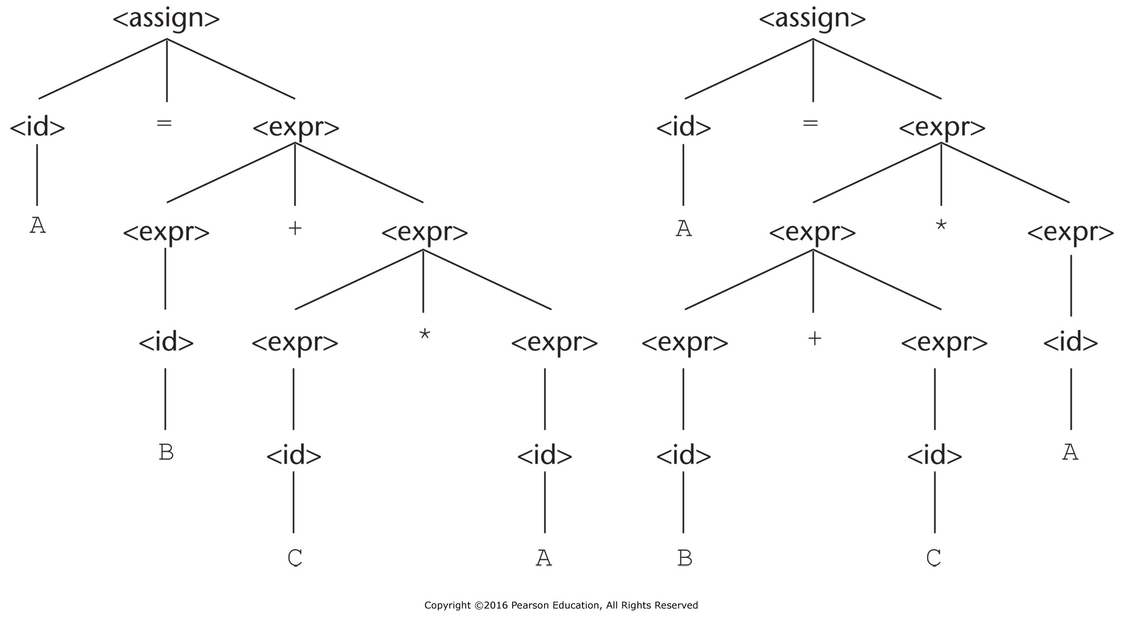
Figure 3.2 Two distinct parse trees for the same sentence, A = B + C * A

Slide 3
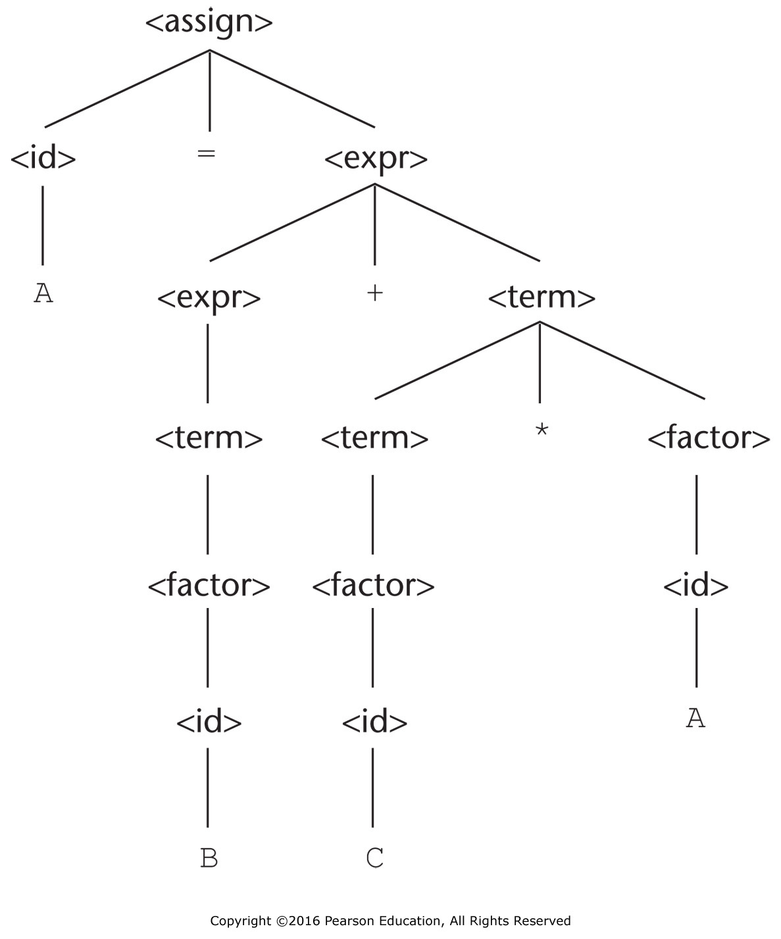
Figure 3.3 The unique parse tree for A = B + C * A using an unambiguous grammar

Slide 4
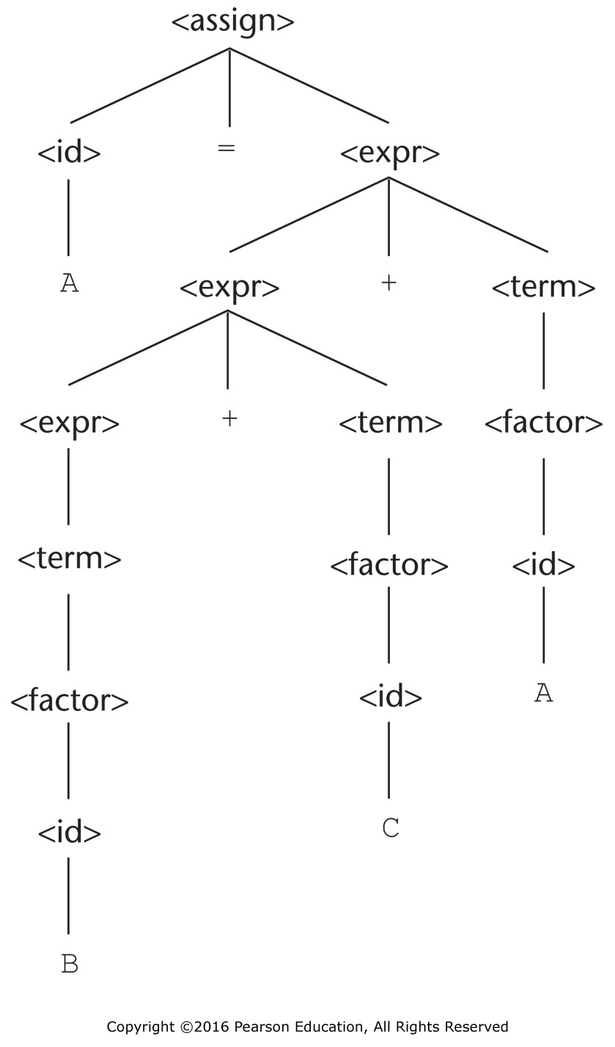
Figure 3.4 A parse tree for A = B + C + A illustrating the associativity of addition

Slide 5
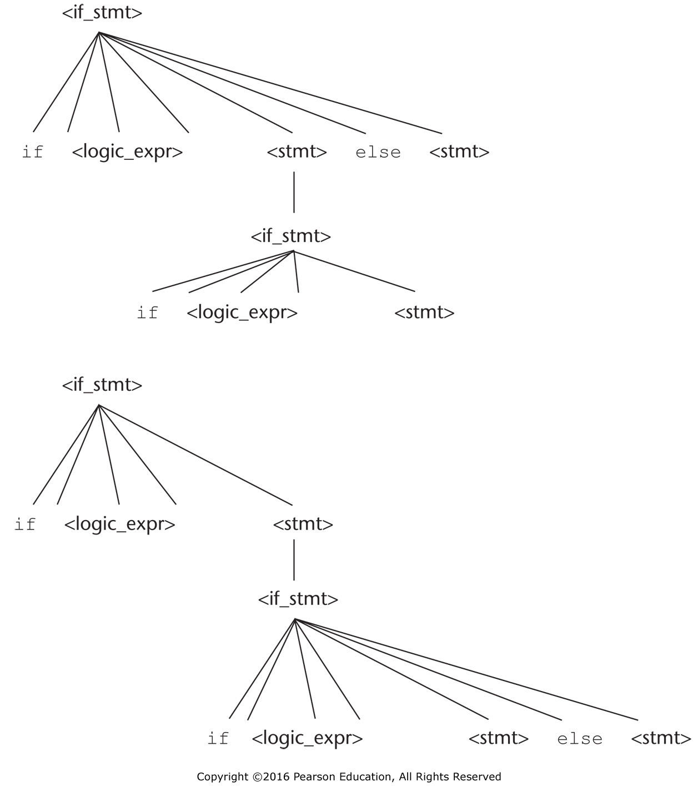
Figure 3.5 Two distinct parse trees for the same sentential form

Slide 6
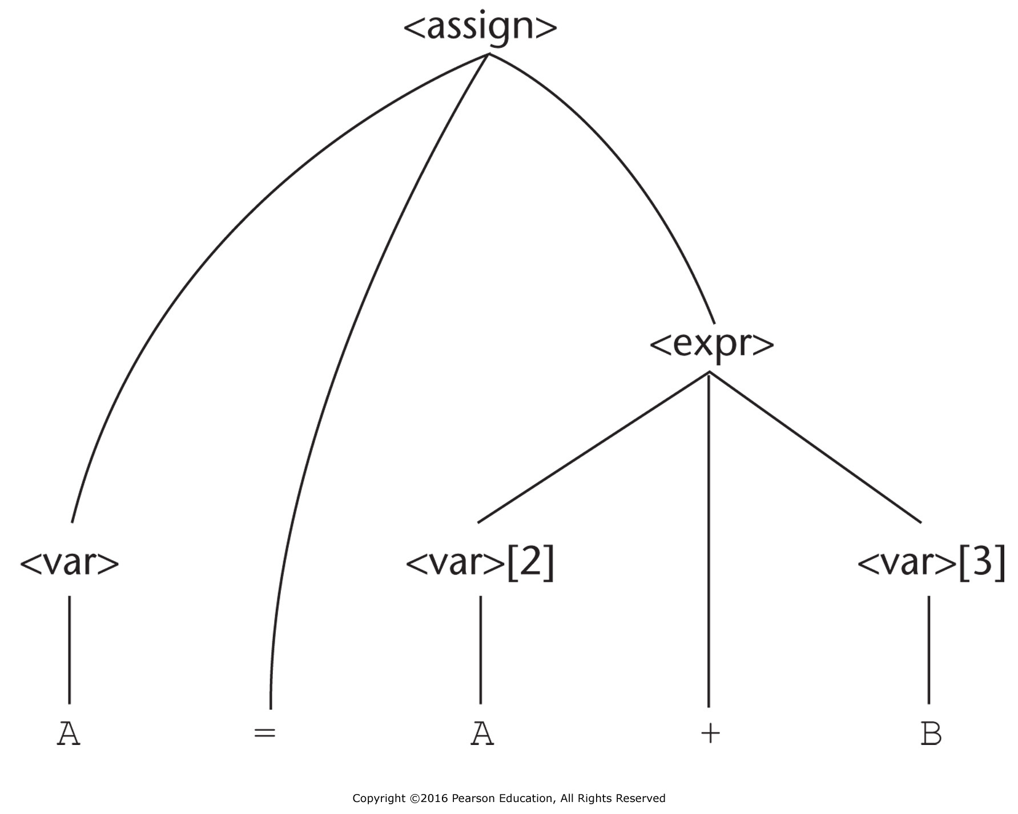
Figure 3.6 A parse tree for A = A + B

Slide 7
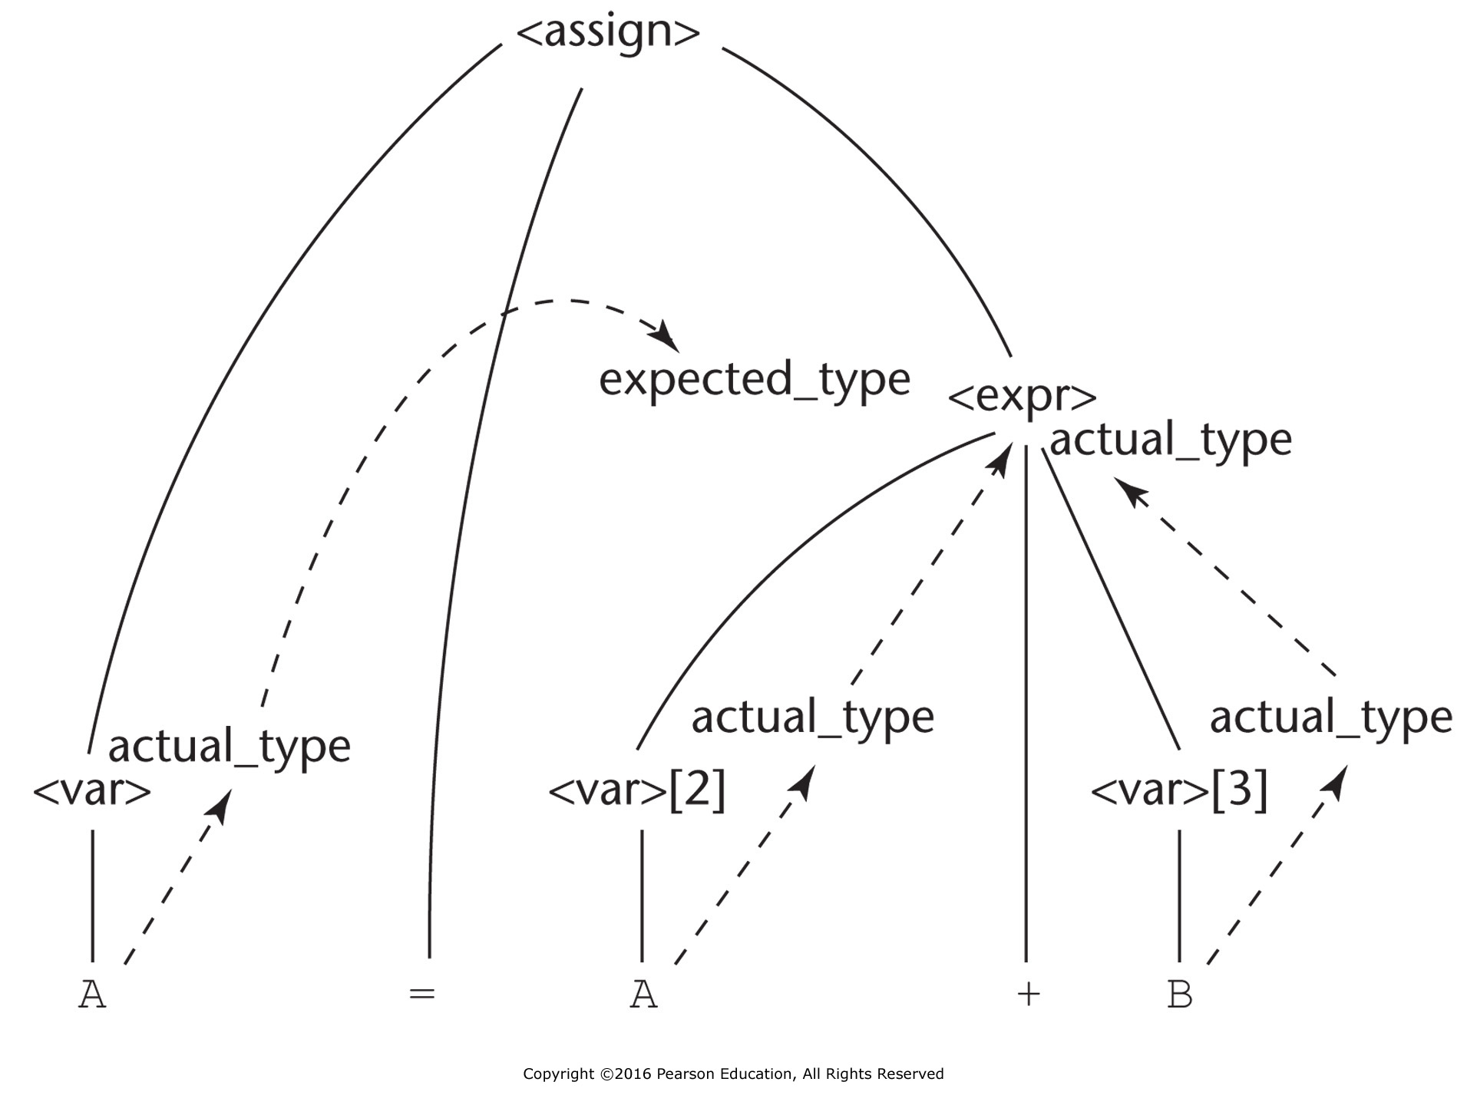
Figure 3.7 The flow of attributes in the tree

Slide 8
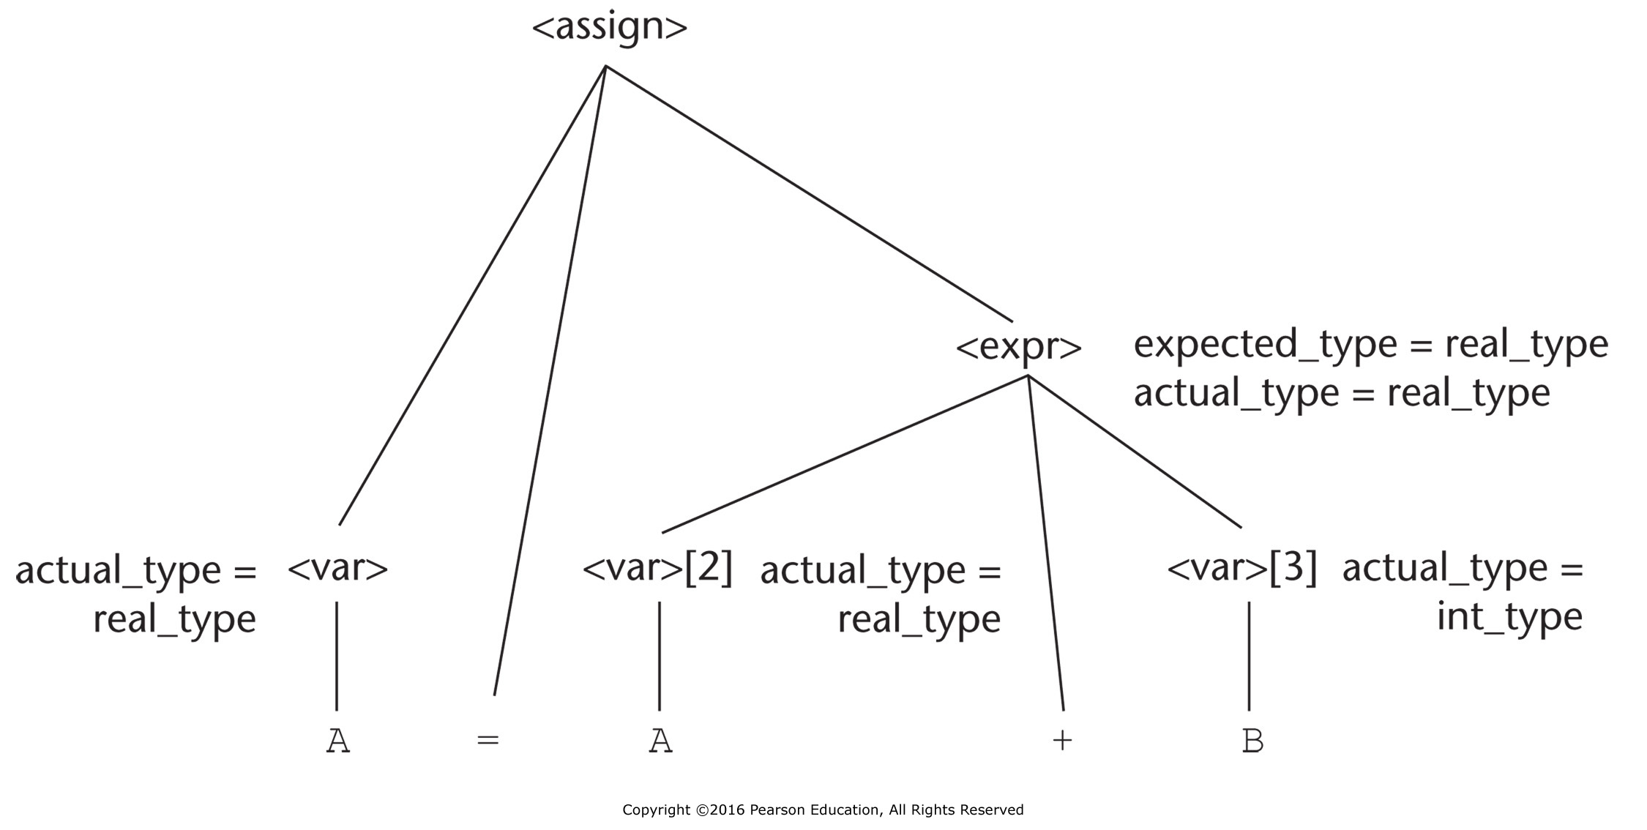
Figure 3.8 A fully attributed parse tree

Slide 9
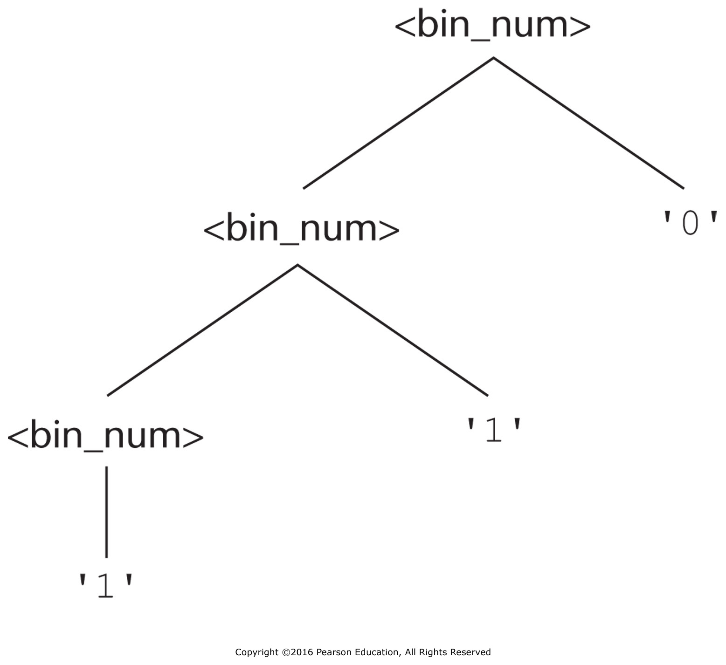
Figure 3.9 A parse tree of the binary number 110

Slide 10
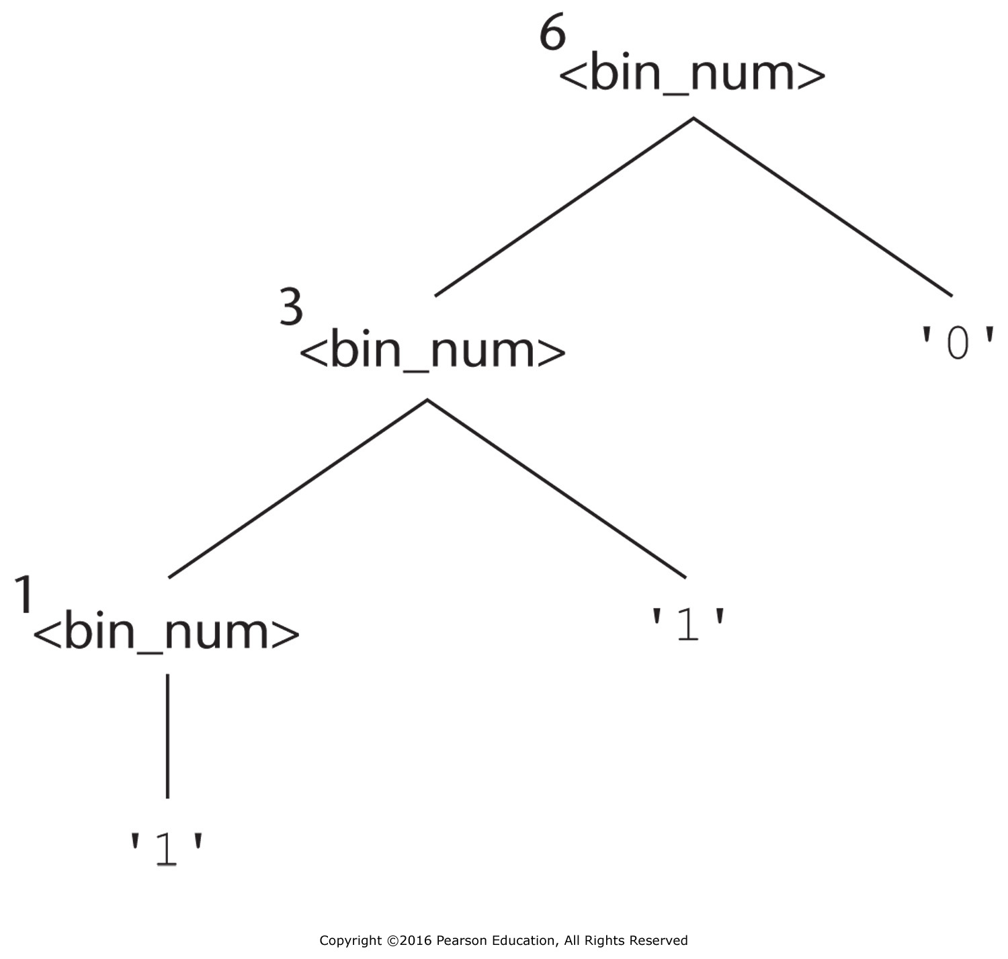
Figure 3.10 A parse tree with denoted objects for 110

