Slide 1
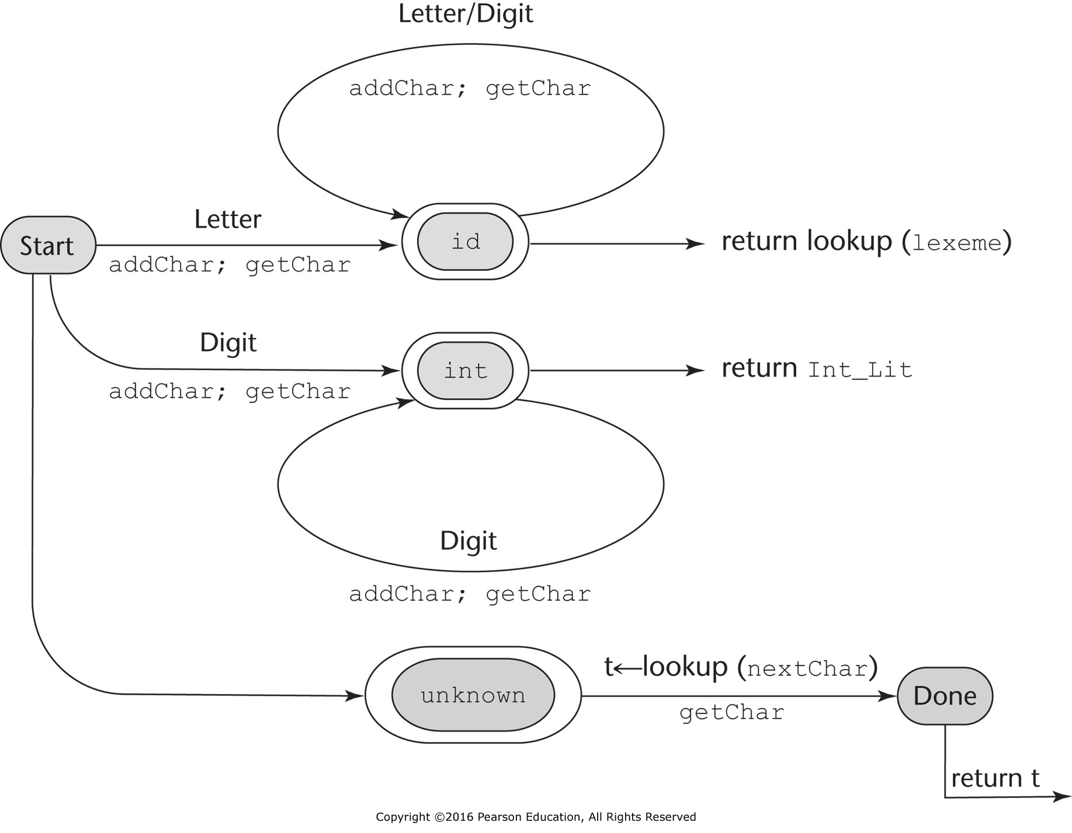
Figure 4.1 A state diagram to recognize names, parentheses, and arithmetic operators

Slide 2
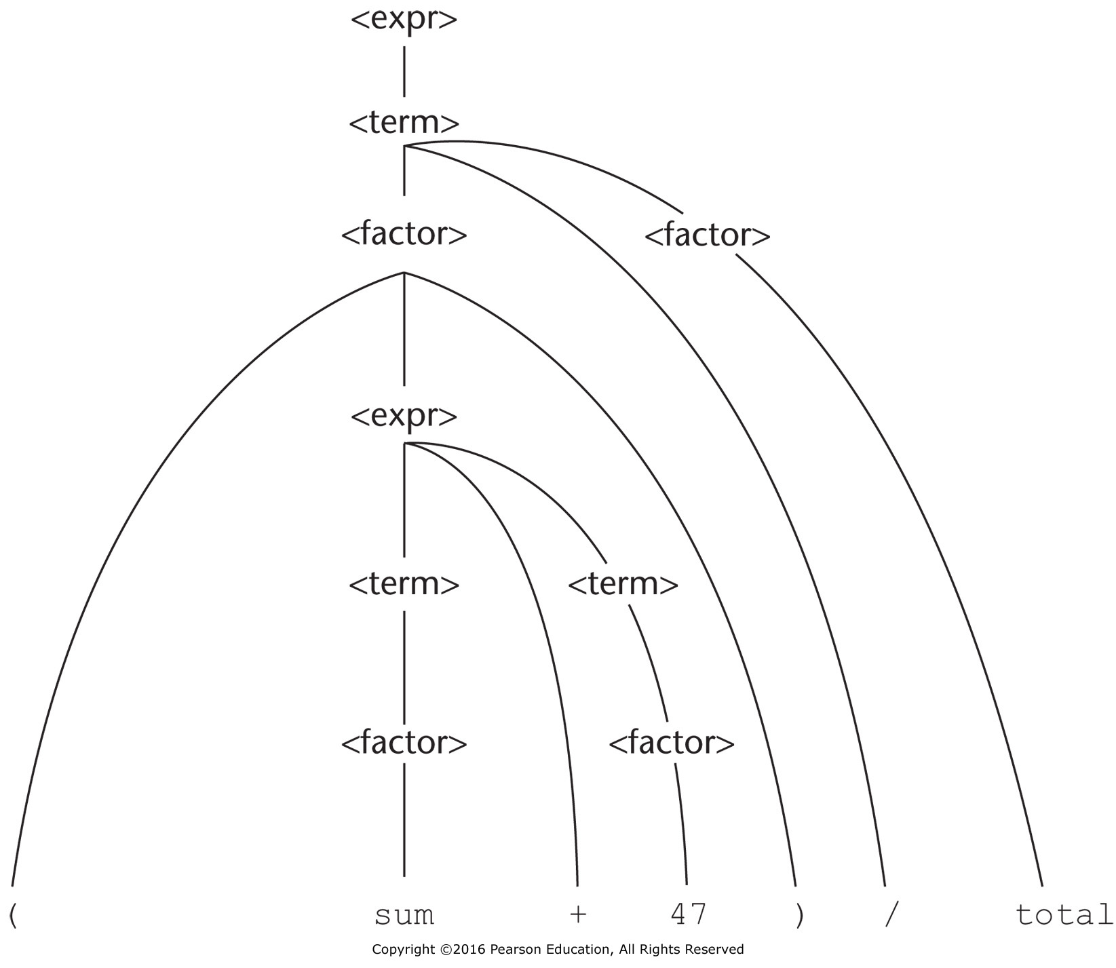
Figure 4.2 Parse tree for (sum + 47) / total

Slide 3
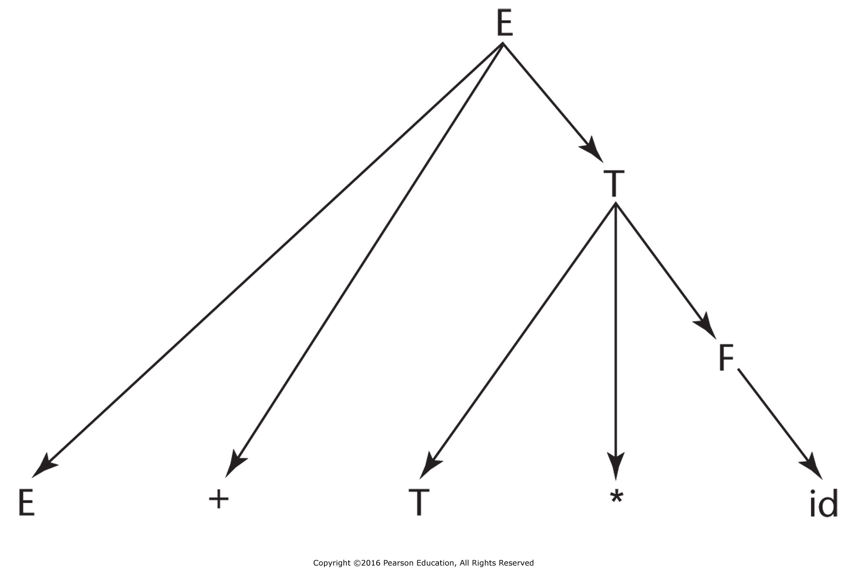
Figure 4.3 A parse tree for E + T * id

Slide 4
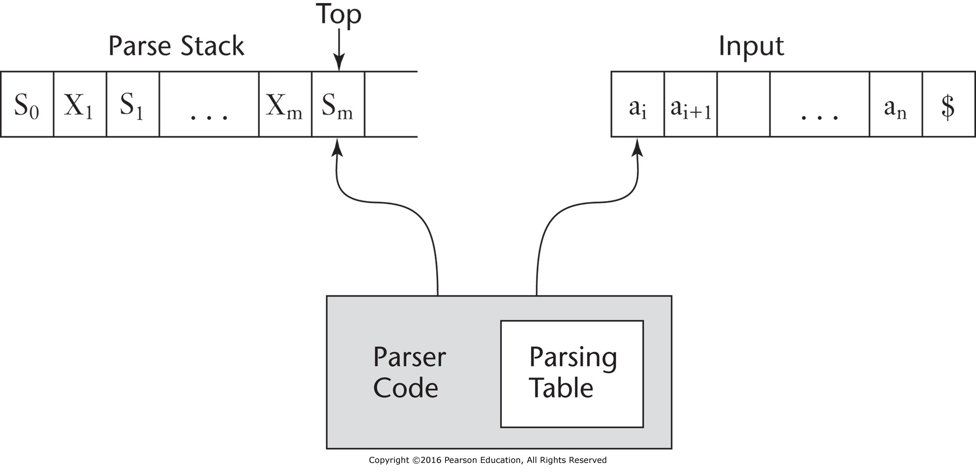
Figure 4.4 The structure of an LR parser

Slide 5
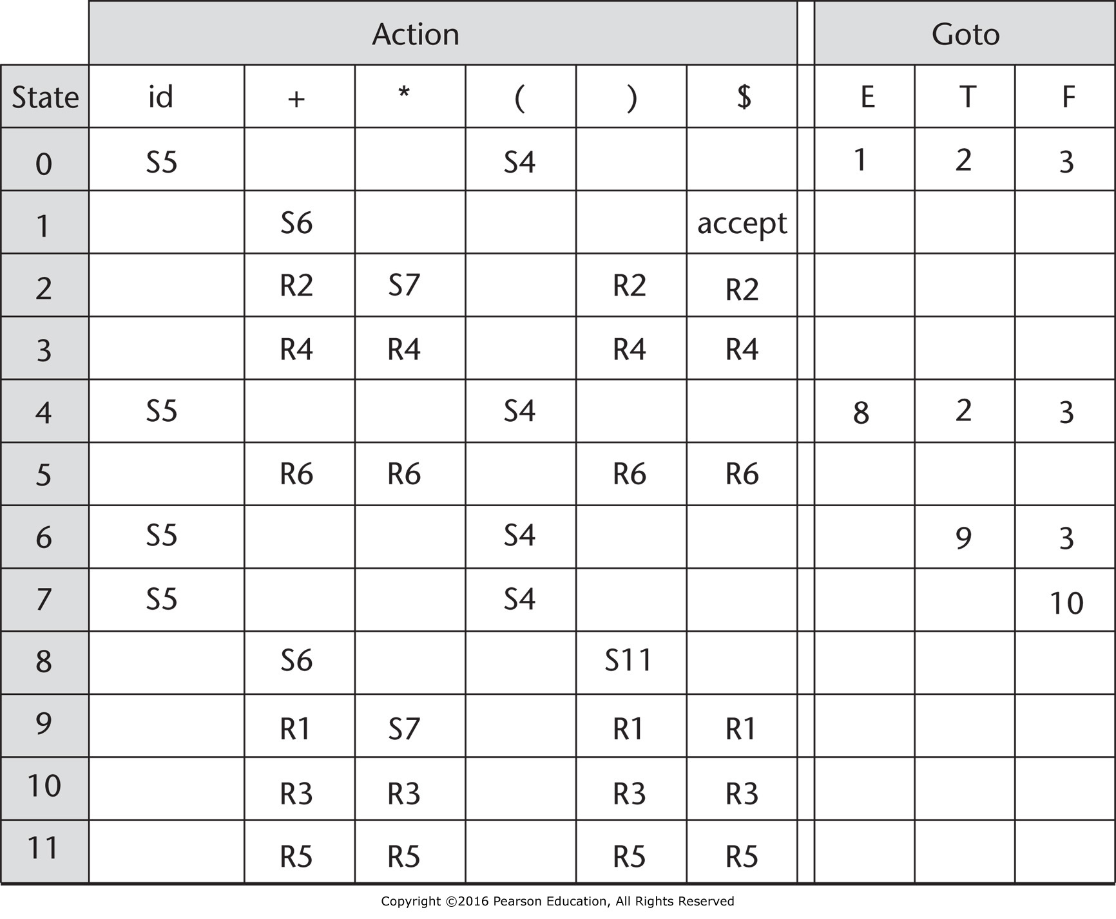
Figure 4.5 The LR parsing table for an arithmetic expression grammar

