Slide 1
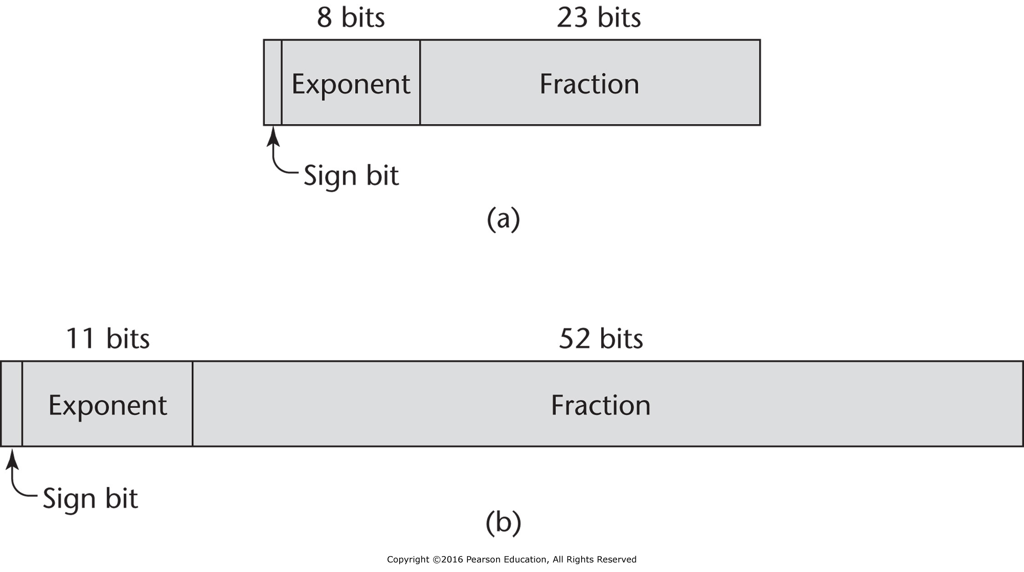
Figure 6.1 IEEE floating-point formats: (a) single precision, (b) double precision

Slide 2
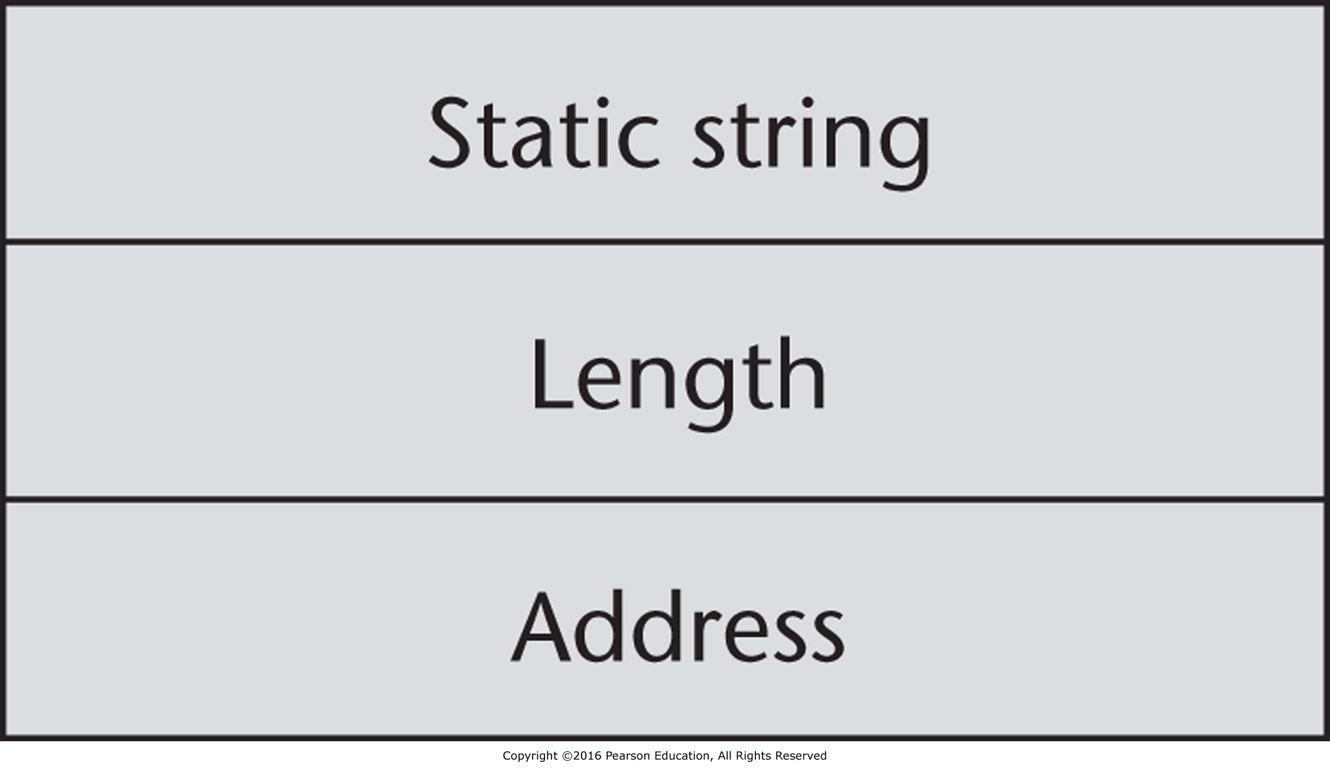
Figure 6.2 Compile-time descriptor for static strings

Slide 3
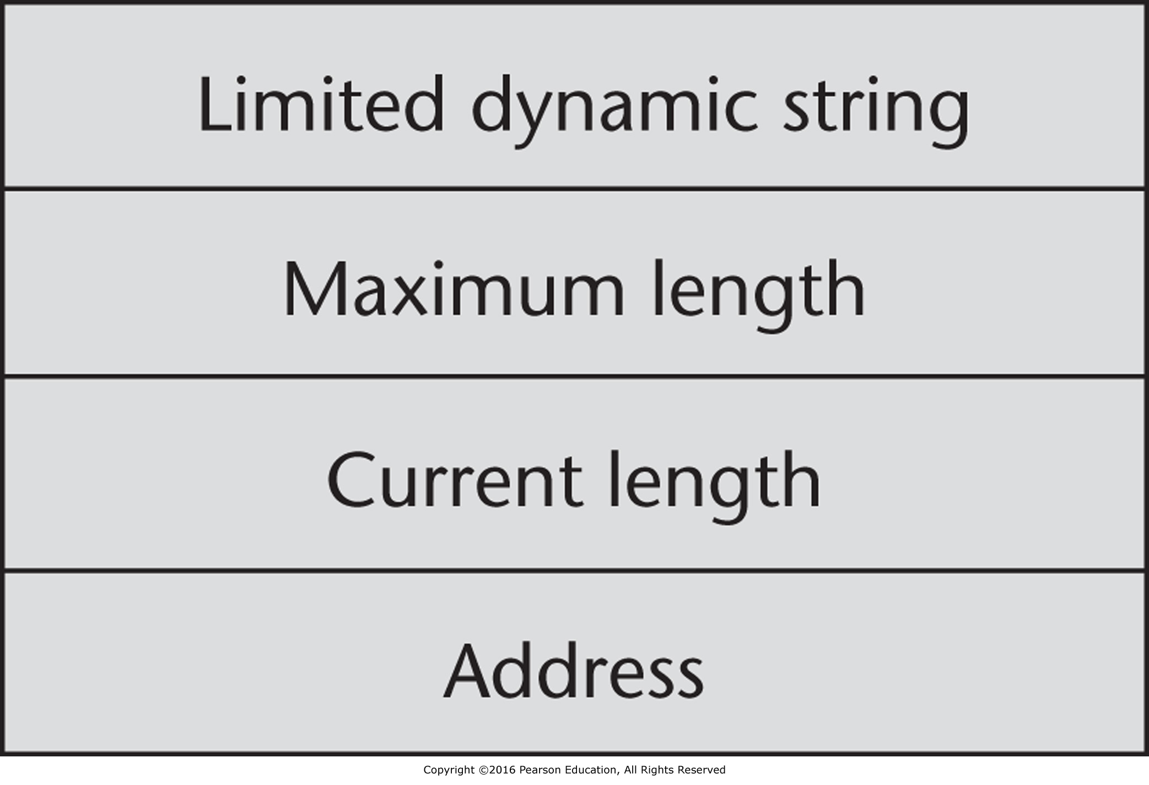
Figure 6.3 Run-time descriptor for limited dynamic strings

Slide 4
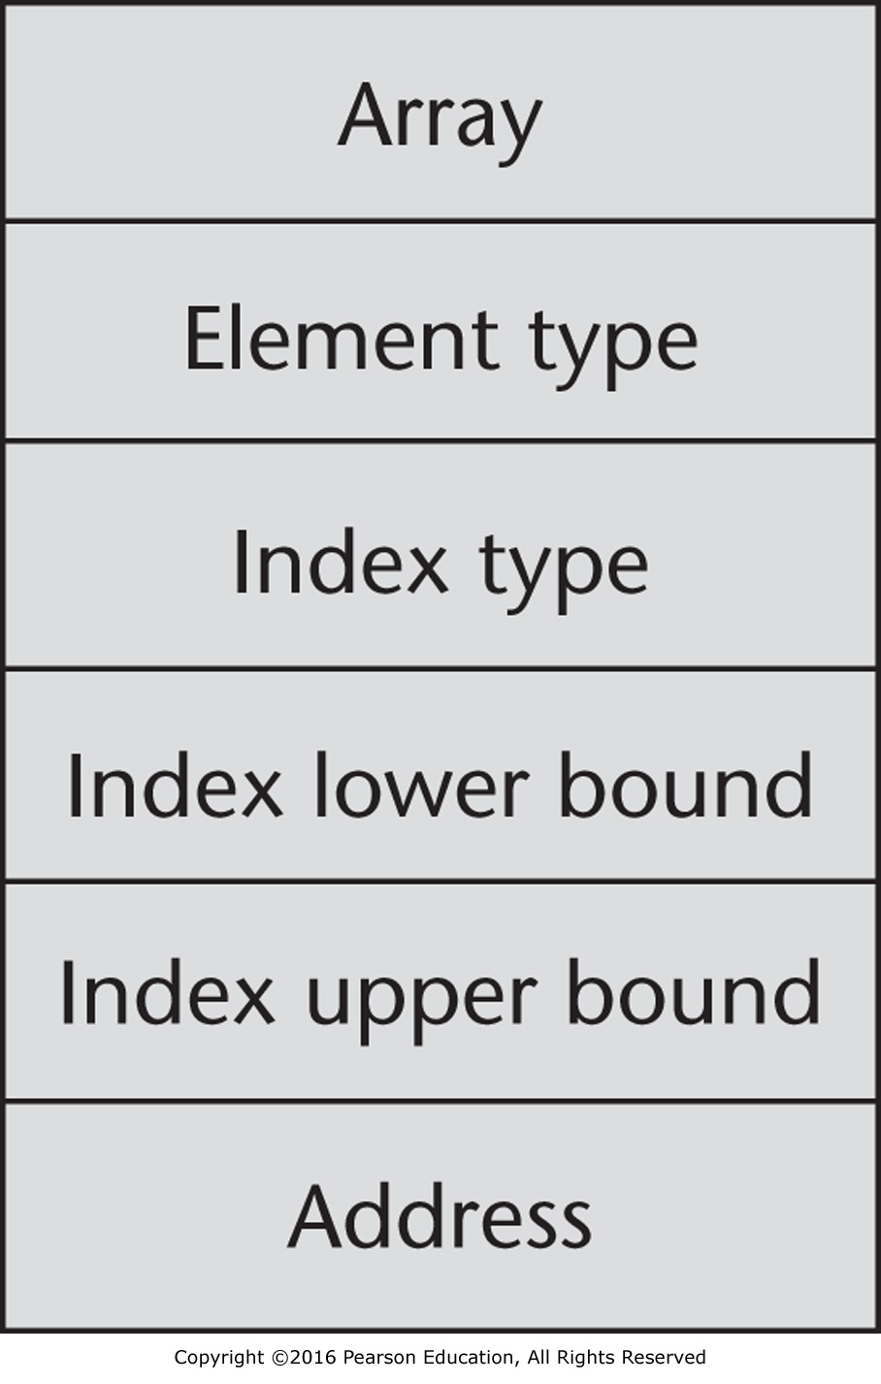
Figure 6.4 Compile-time descriptor for single-dimensioned arrays

Slide 5
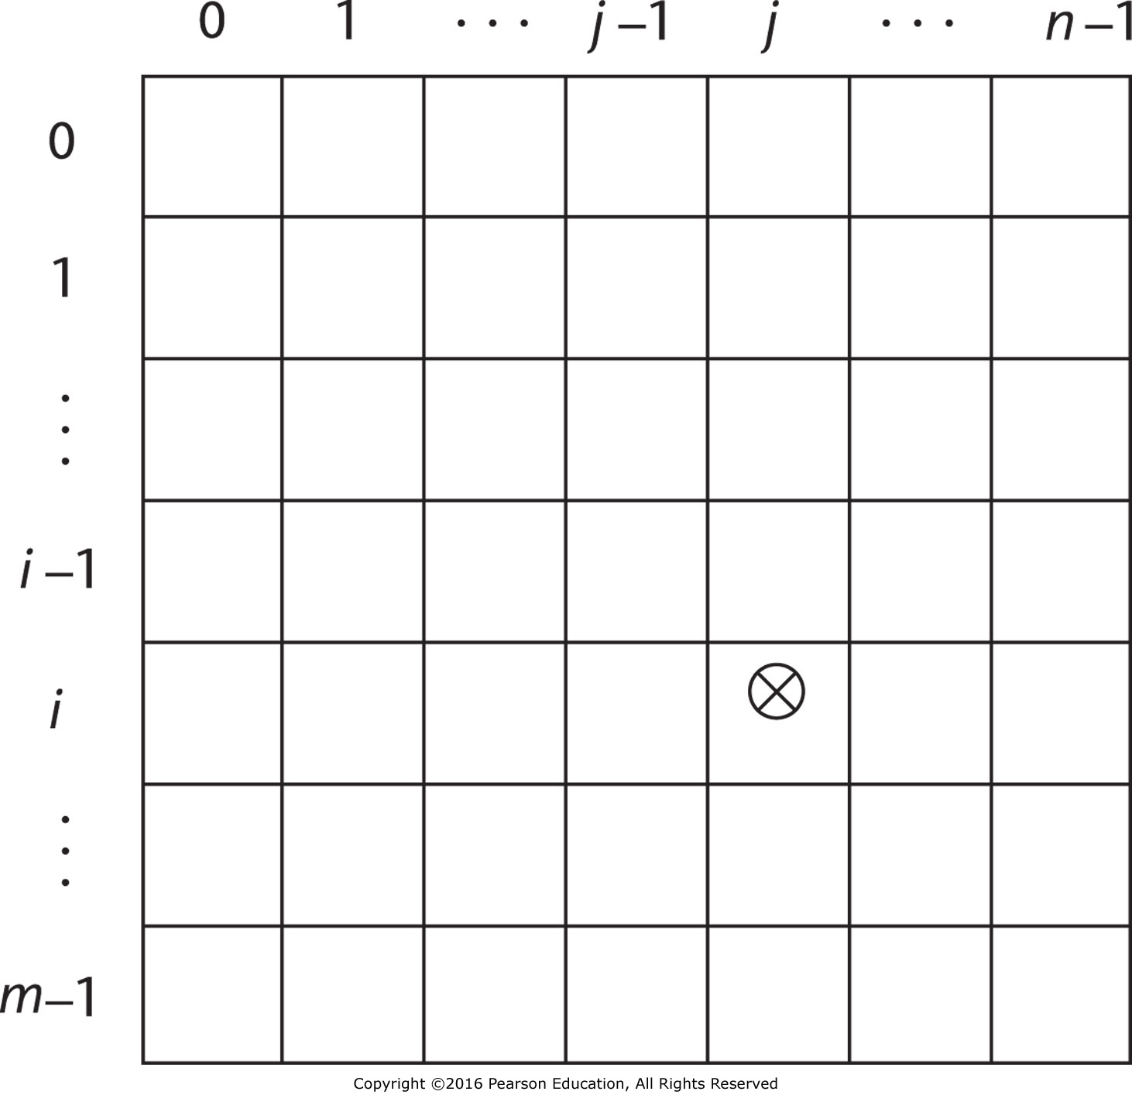
Figure 6.5 The location of the [i,j] element in a matrix

Slide 6
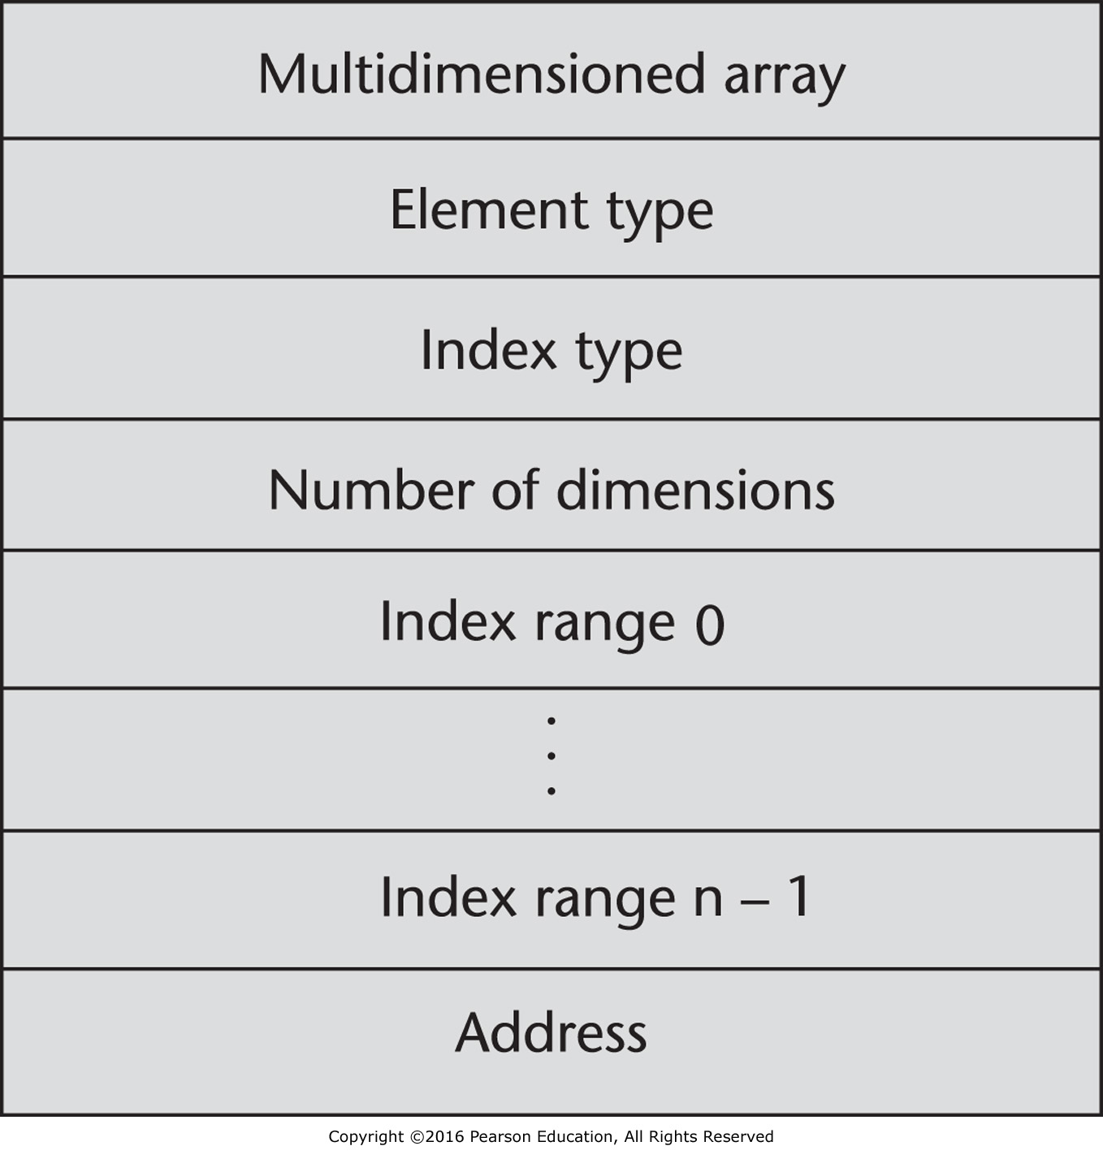
Figure 6.6 A compile-time descriptor for a multidimensional array

Slide 7
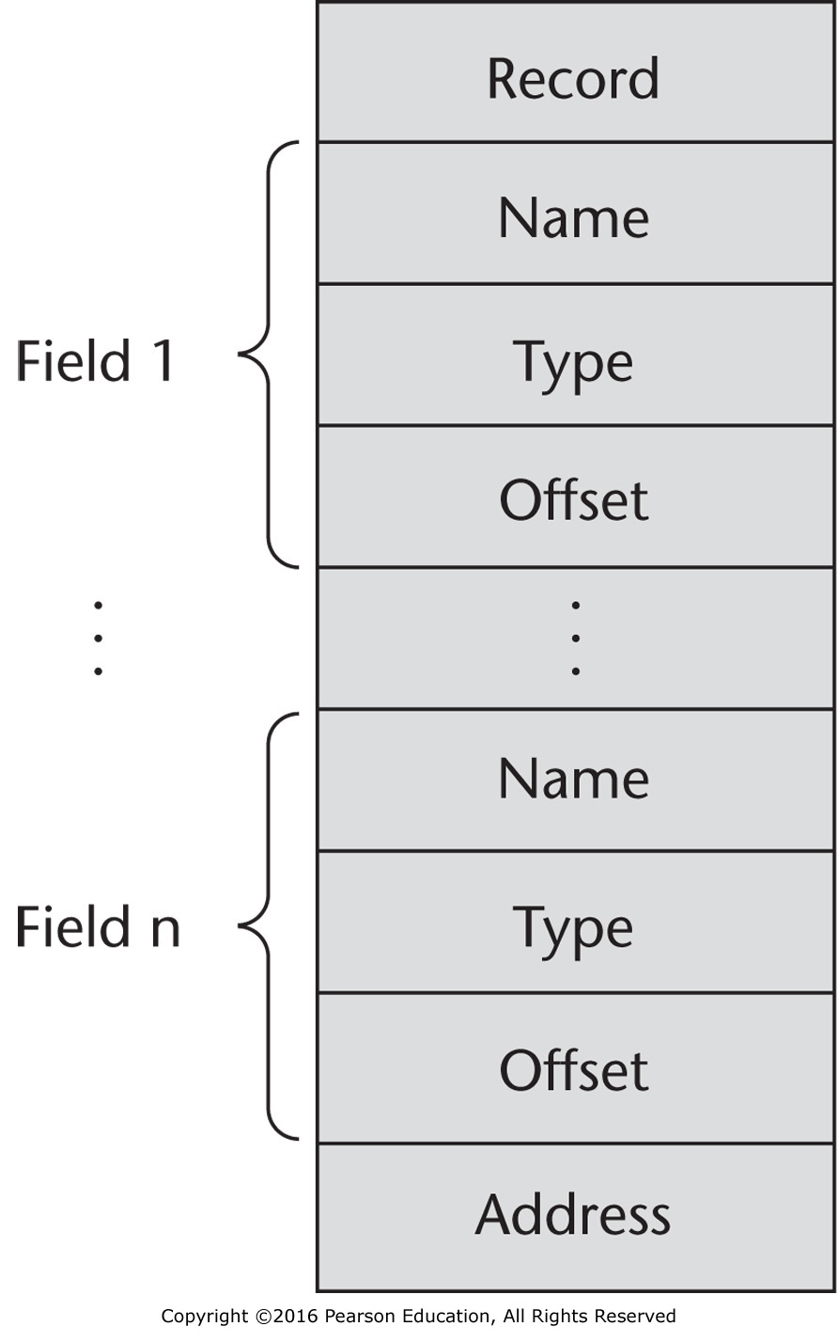
Figure 6.7 A compile-time descriptor for a record

Slide 8
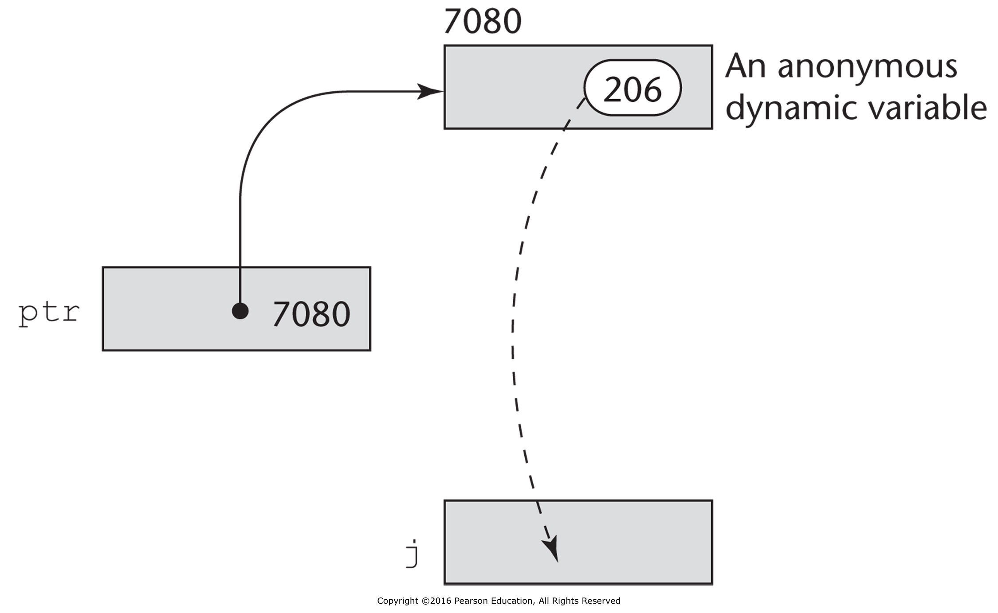
Figure 6.8 The assignment operation j = *ptr

Slide 9
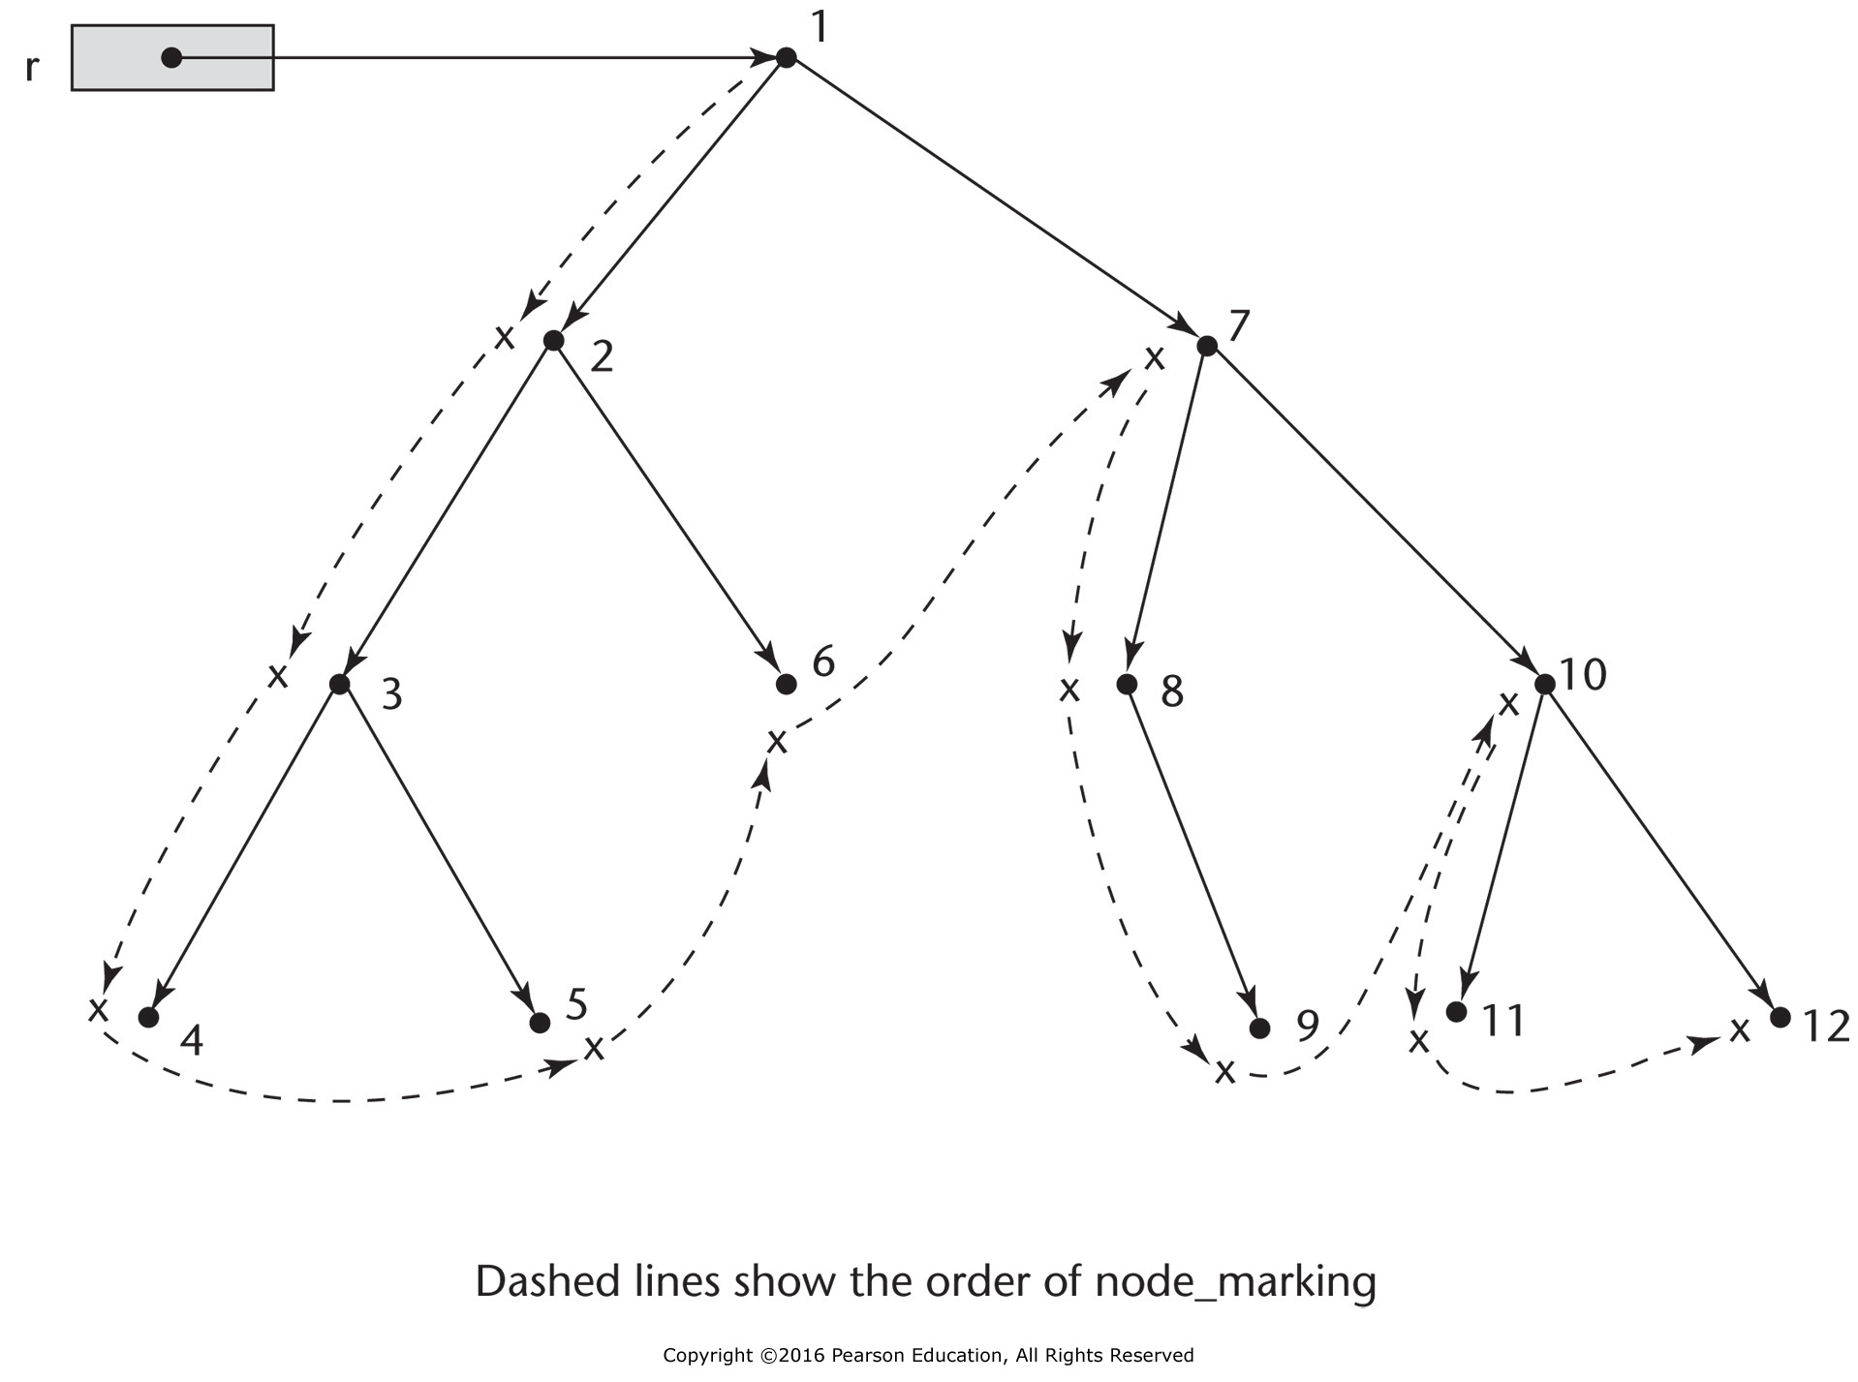
Figure 6.9 An example of the actions of the marking algorithm

