Slide 1
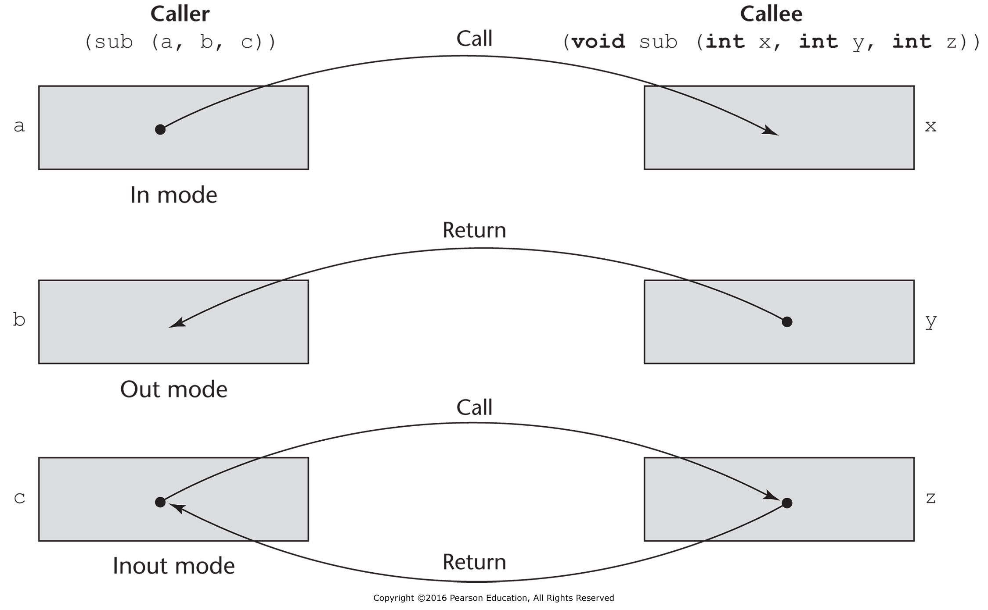
Figure 9.1 The three semantics models of parameter passing when physical moves are used

Slide 2
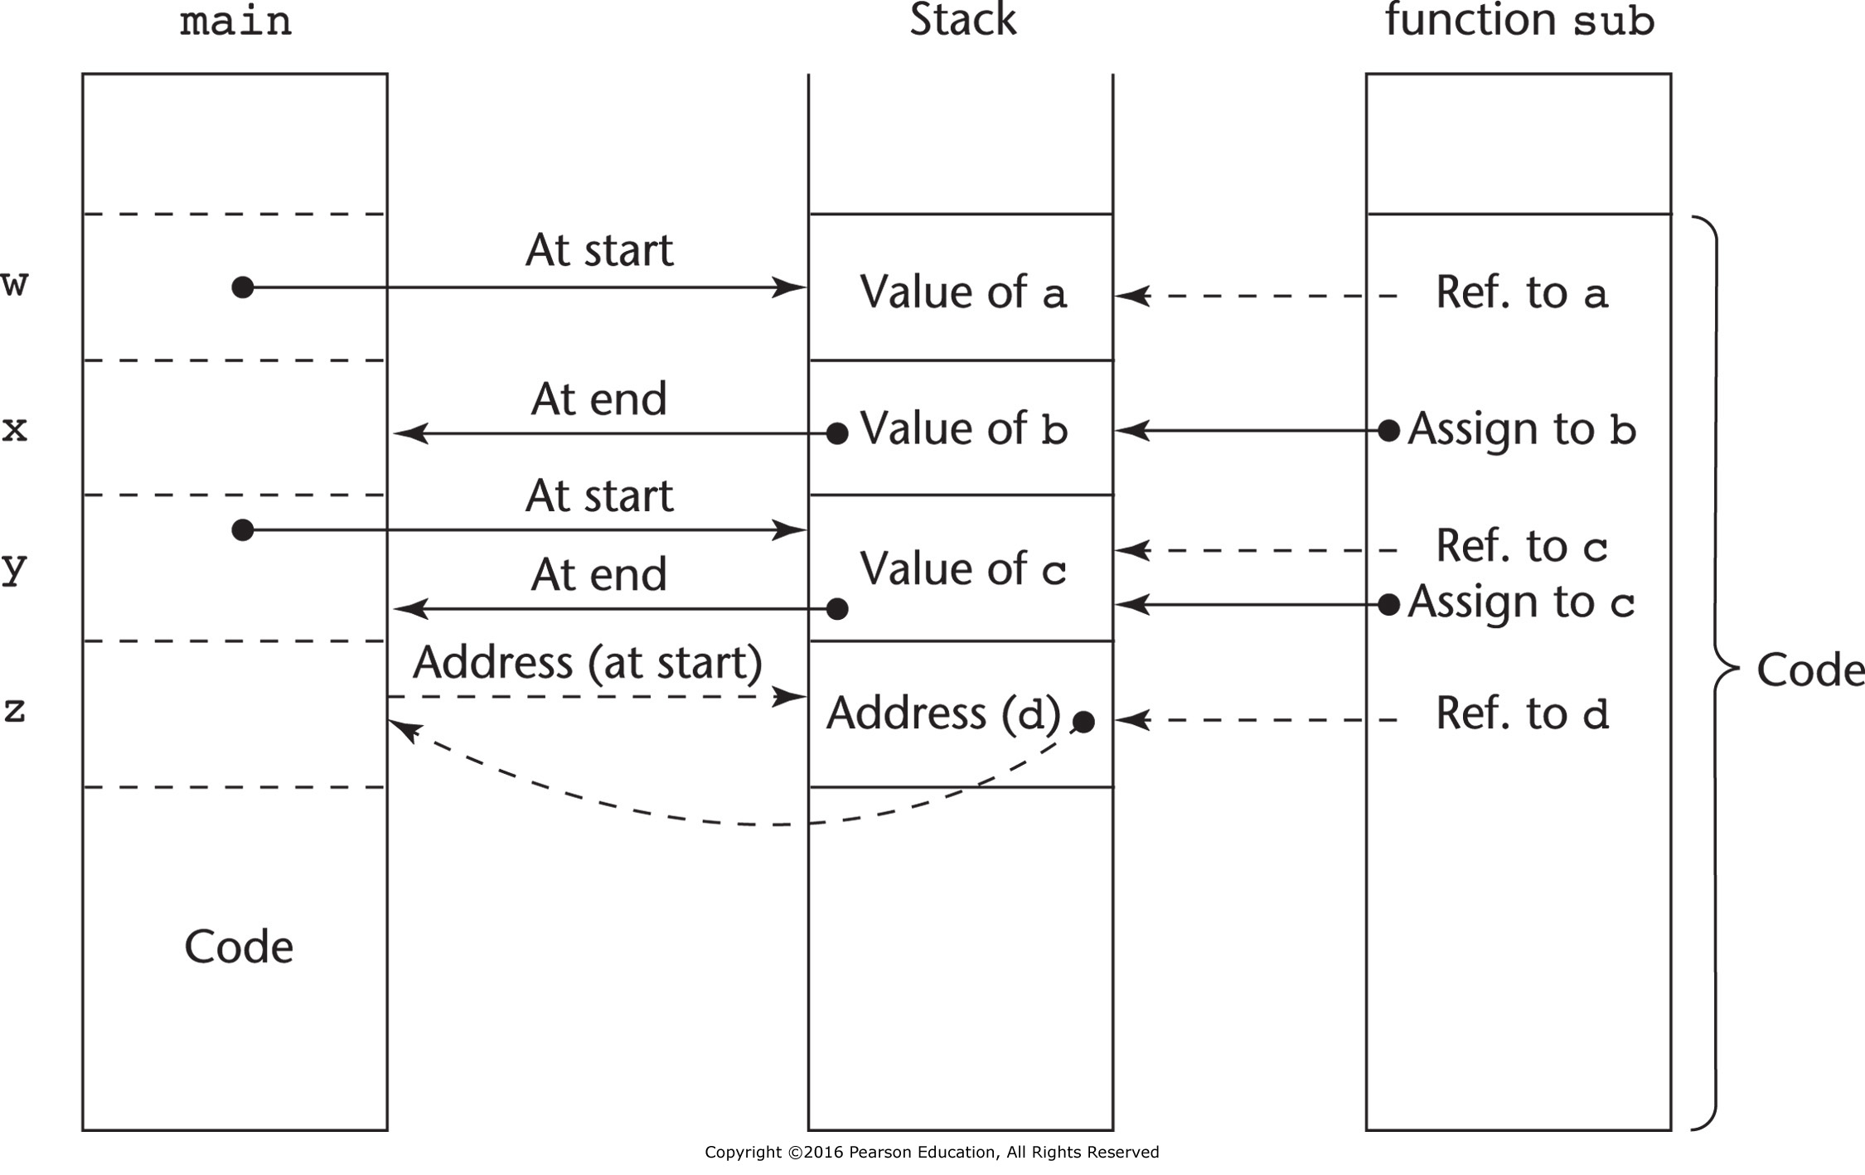
Figure 9.2 One possible stack implementation of the common parameter-passing methods

Slide 3
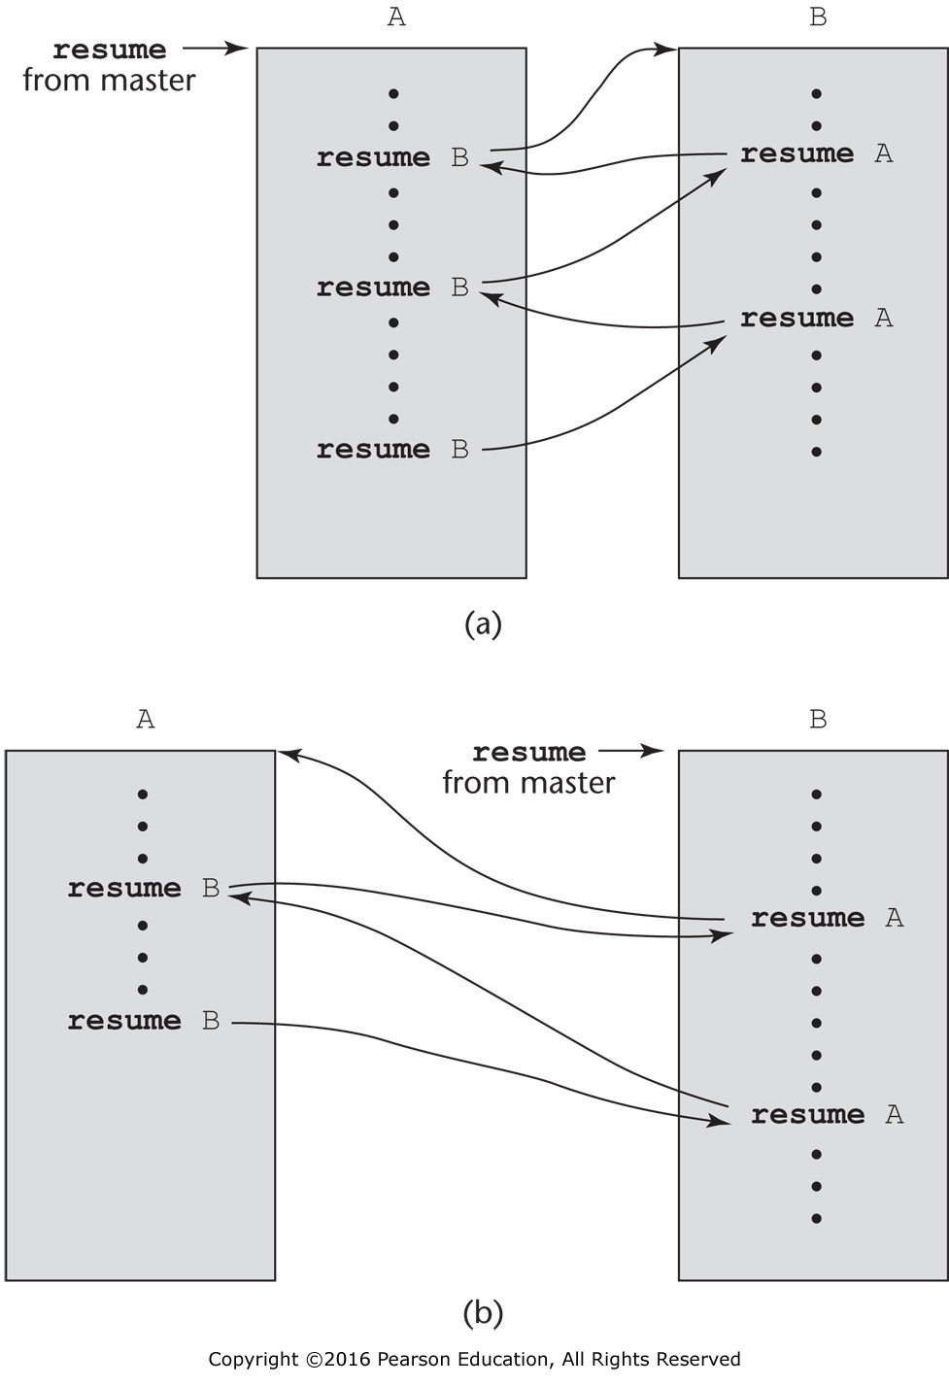
Figure 9.3 Two possible execution control sequences for two coroutines without loops

Slide 4
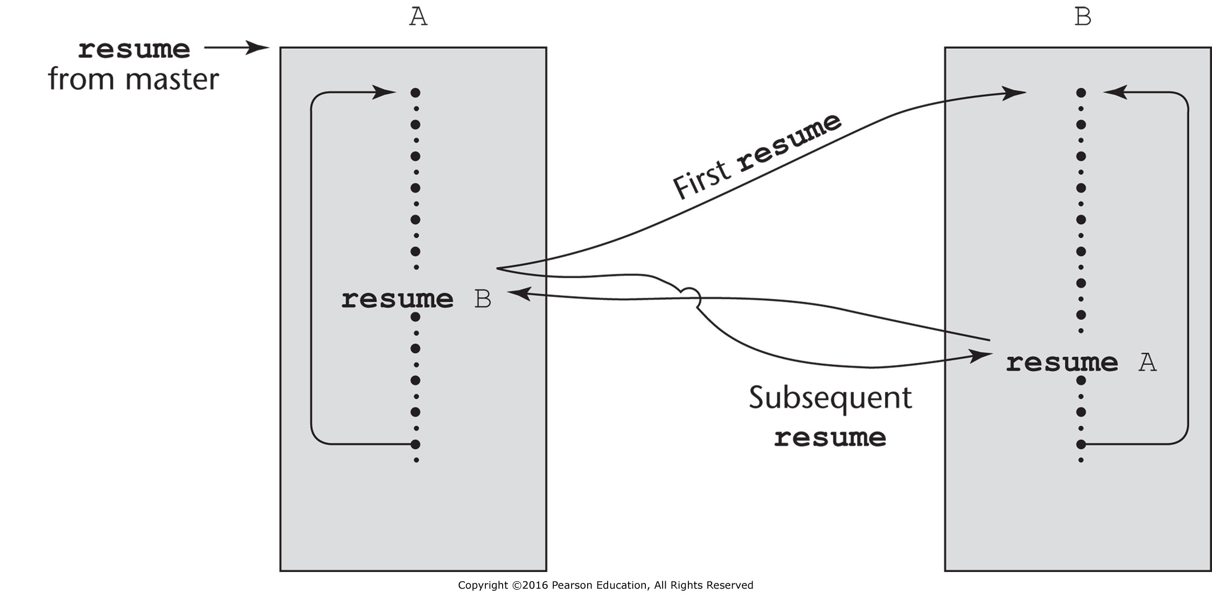
Figure 9.4 Coroutine execution sequence with loops

