Slide 1
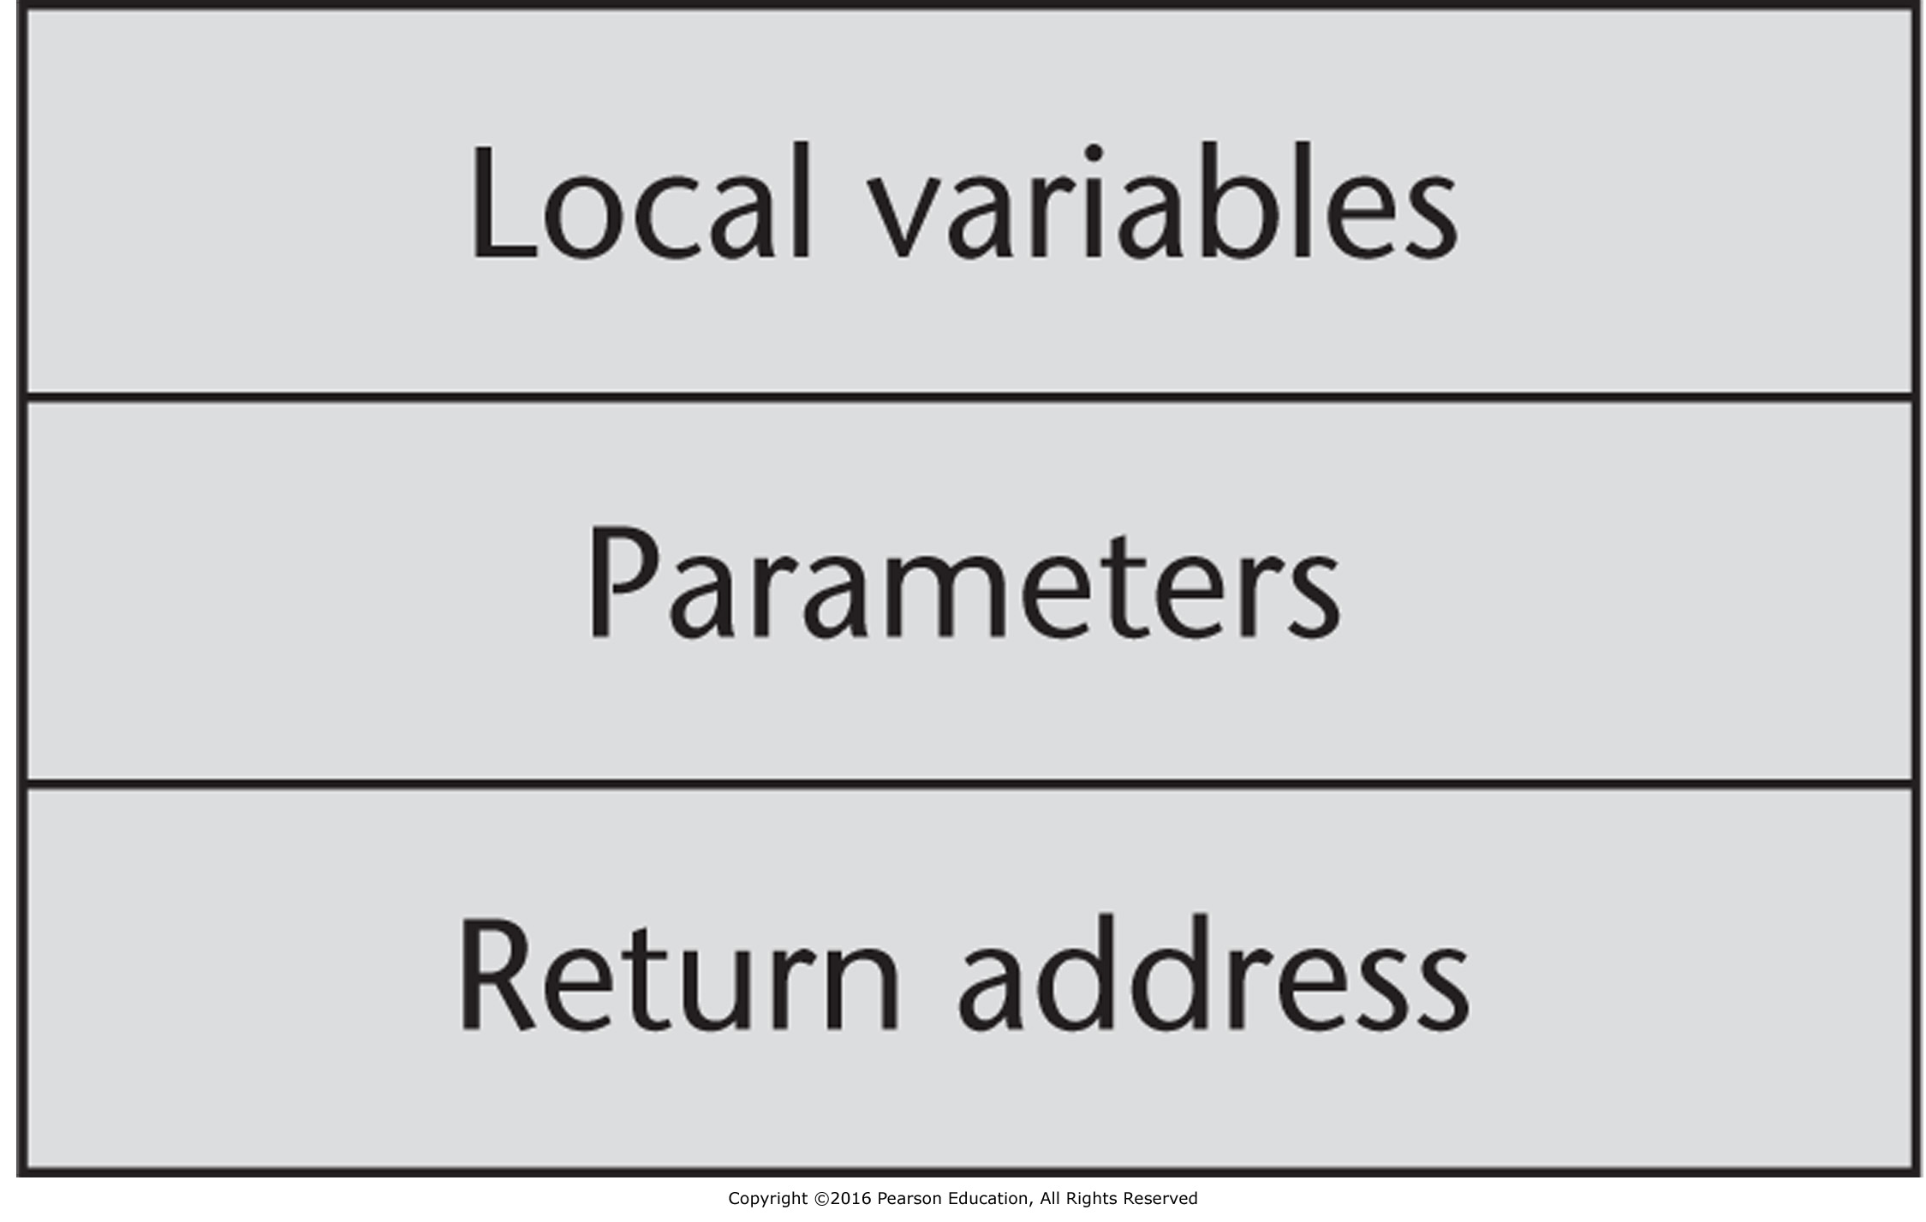
Figure 10.1 An activation record for simple subprogram

Slide 2
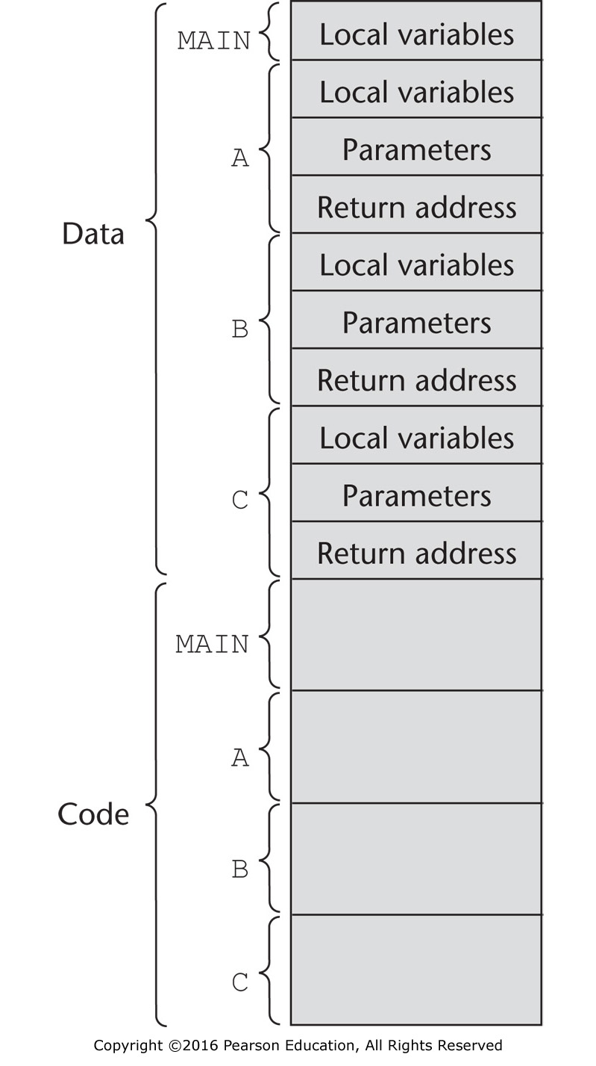
Figure 10.2 The code and activation records of a program with simple subprograms

Slide 3
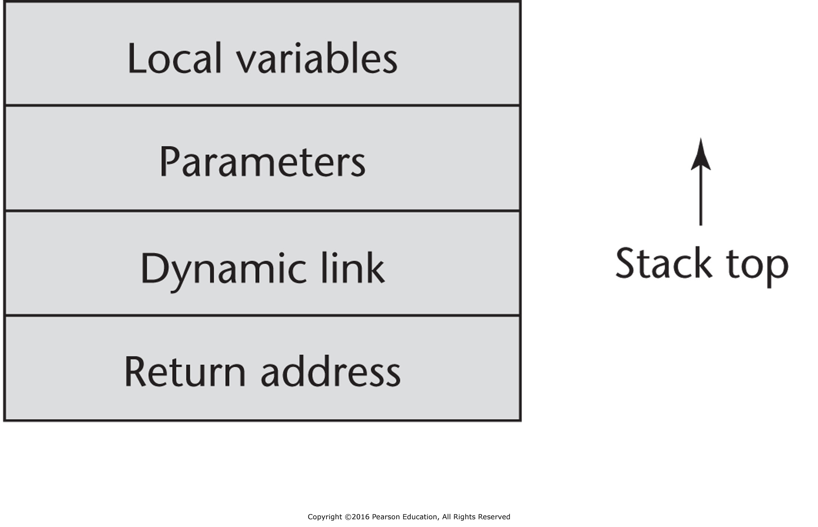
Figure 10.3 A typical activation record for a language with stack-dynamic local variables

Slide 4
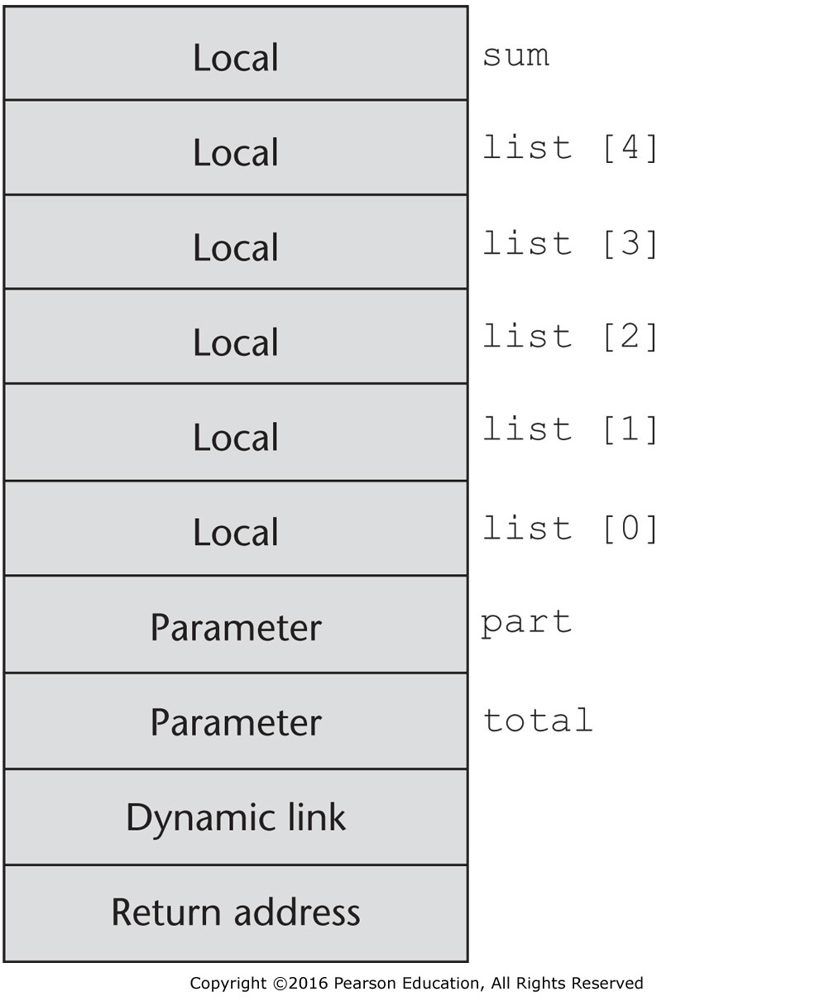
Figure 10.4 The activation record for function sub

Slide 5
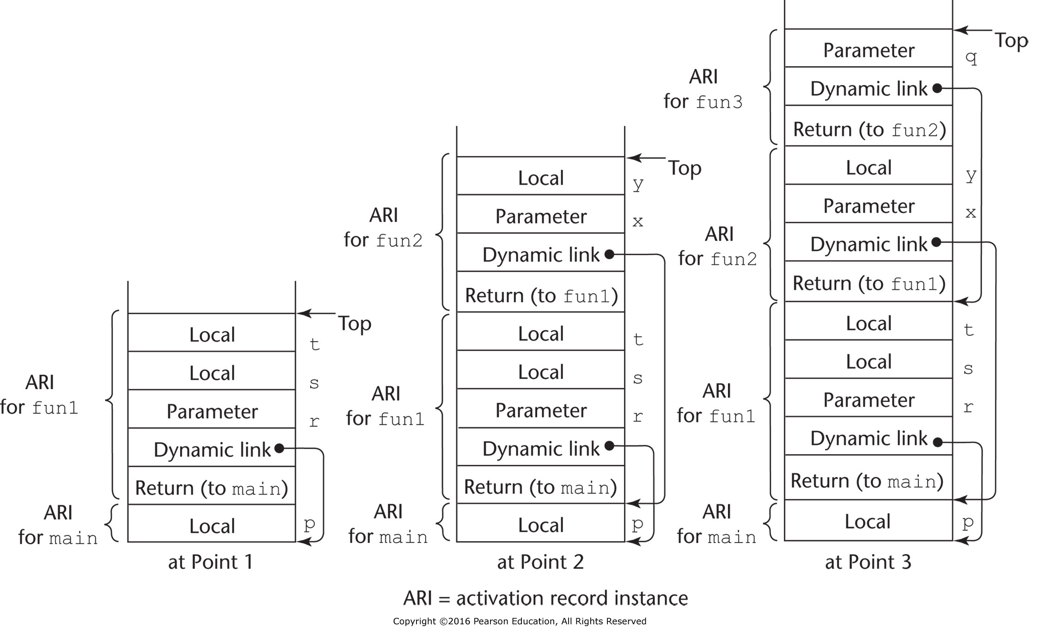
Figure 10.5 Stack contents for three points in a program

Slide 6
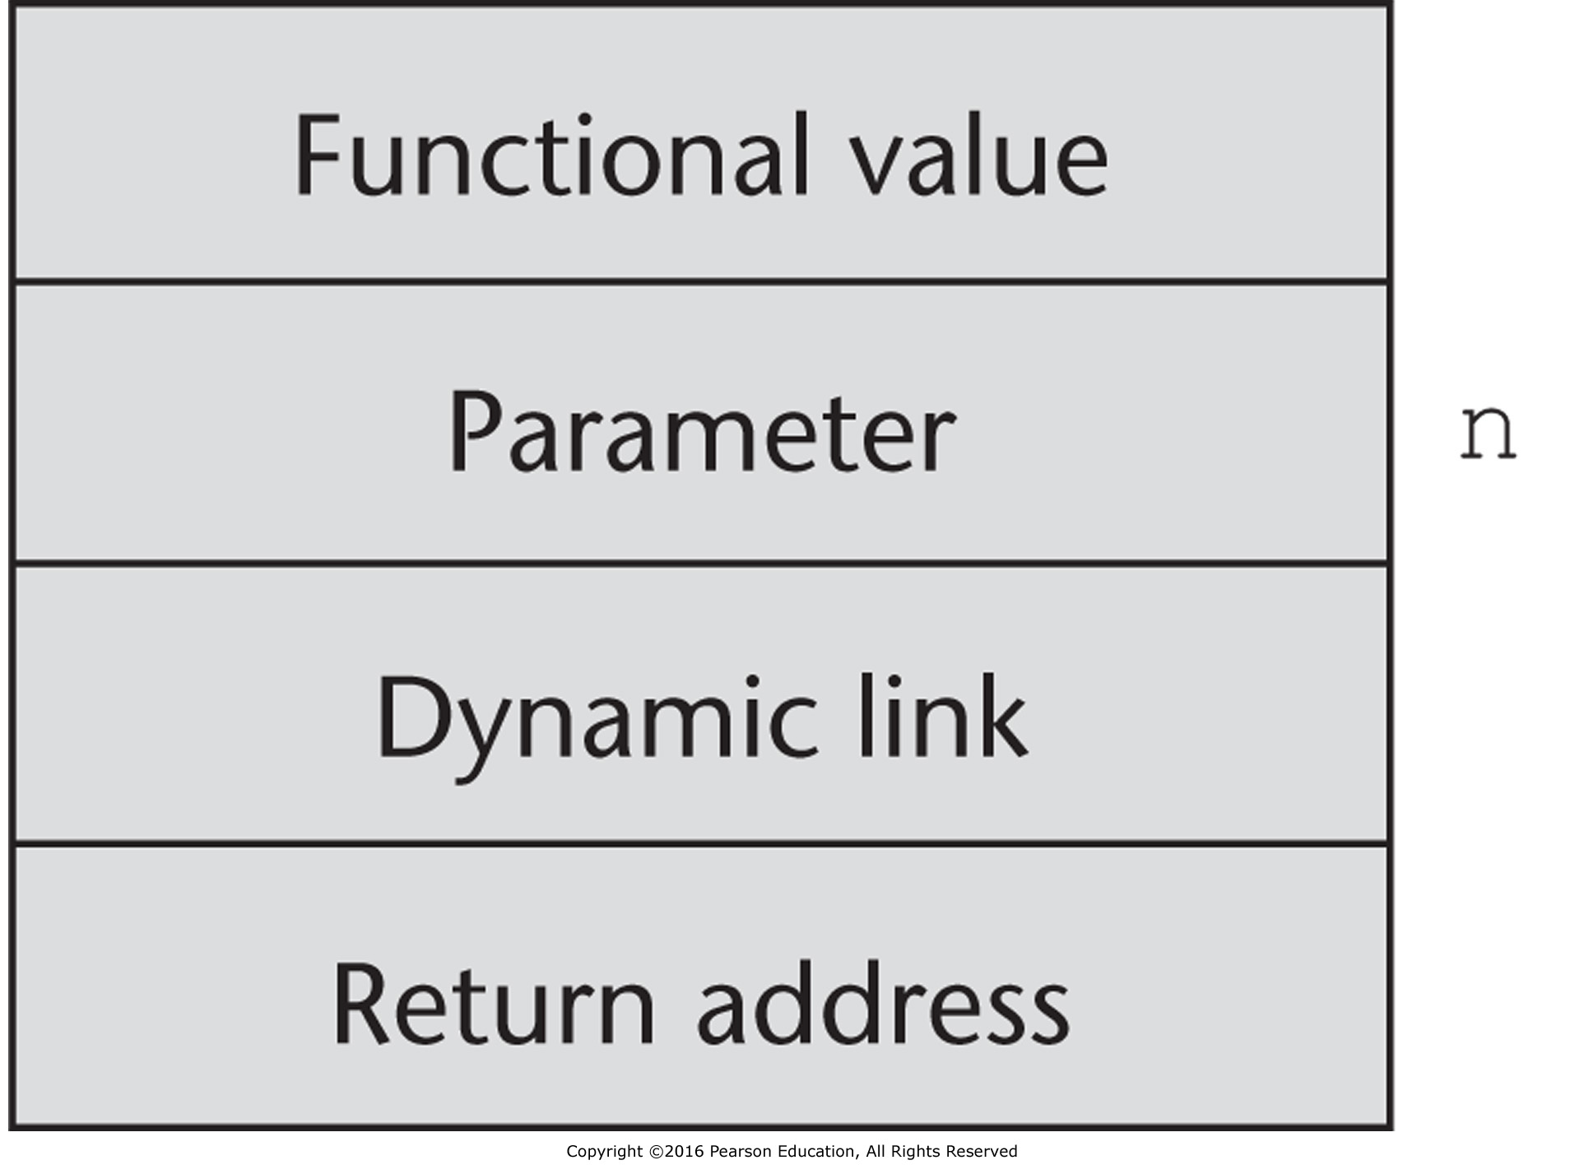
Figure 10.6 The activation record for factorial

Slide 7
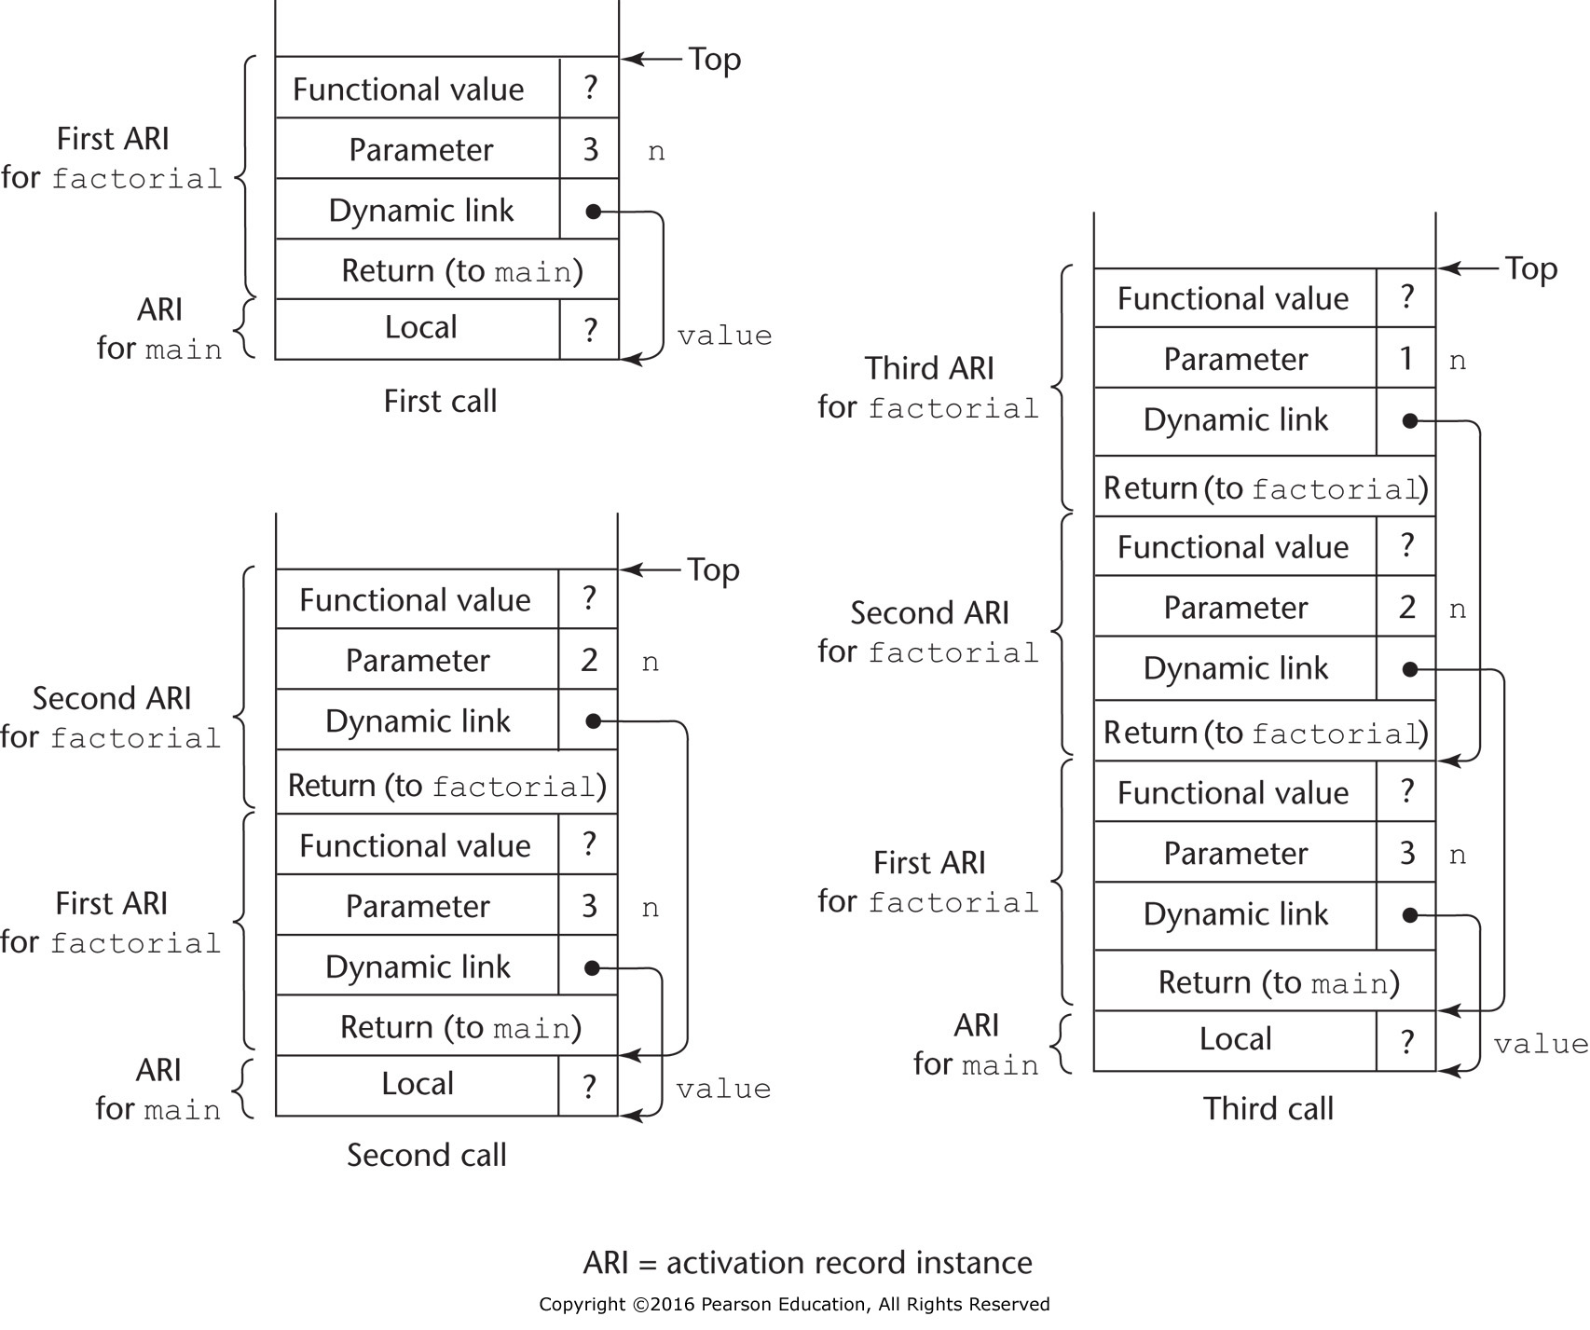
Figure 10.7 Stack contents at position 1 in factorial

Slide 8
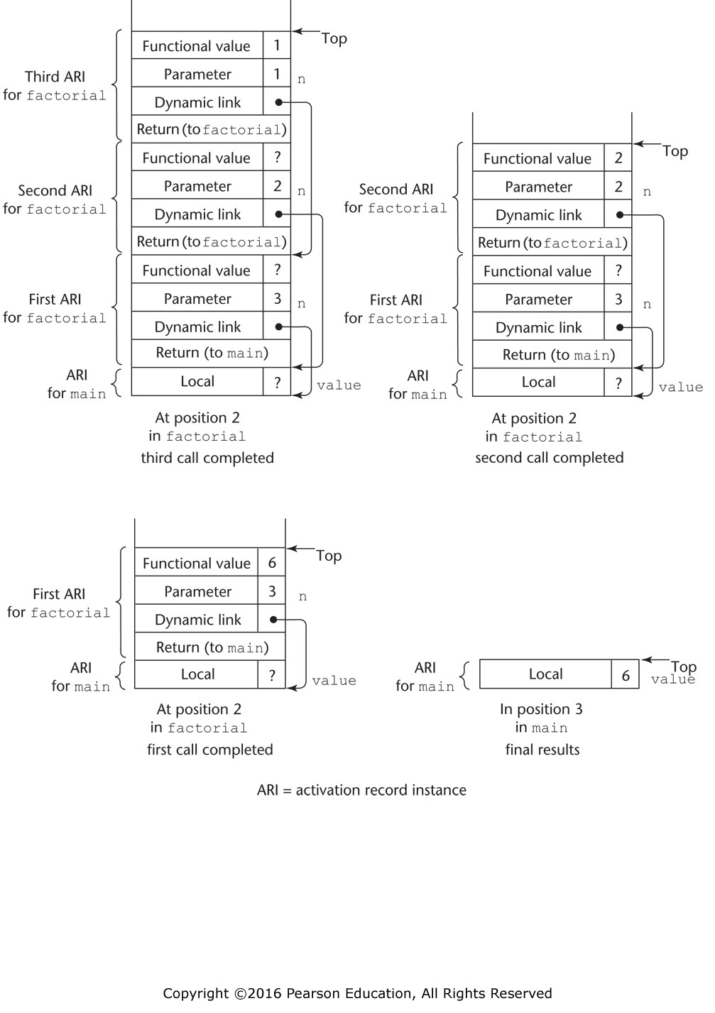
Figure 10.8 Stack contents during execution of main and factorial

Slide 9
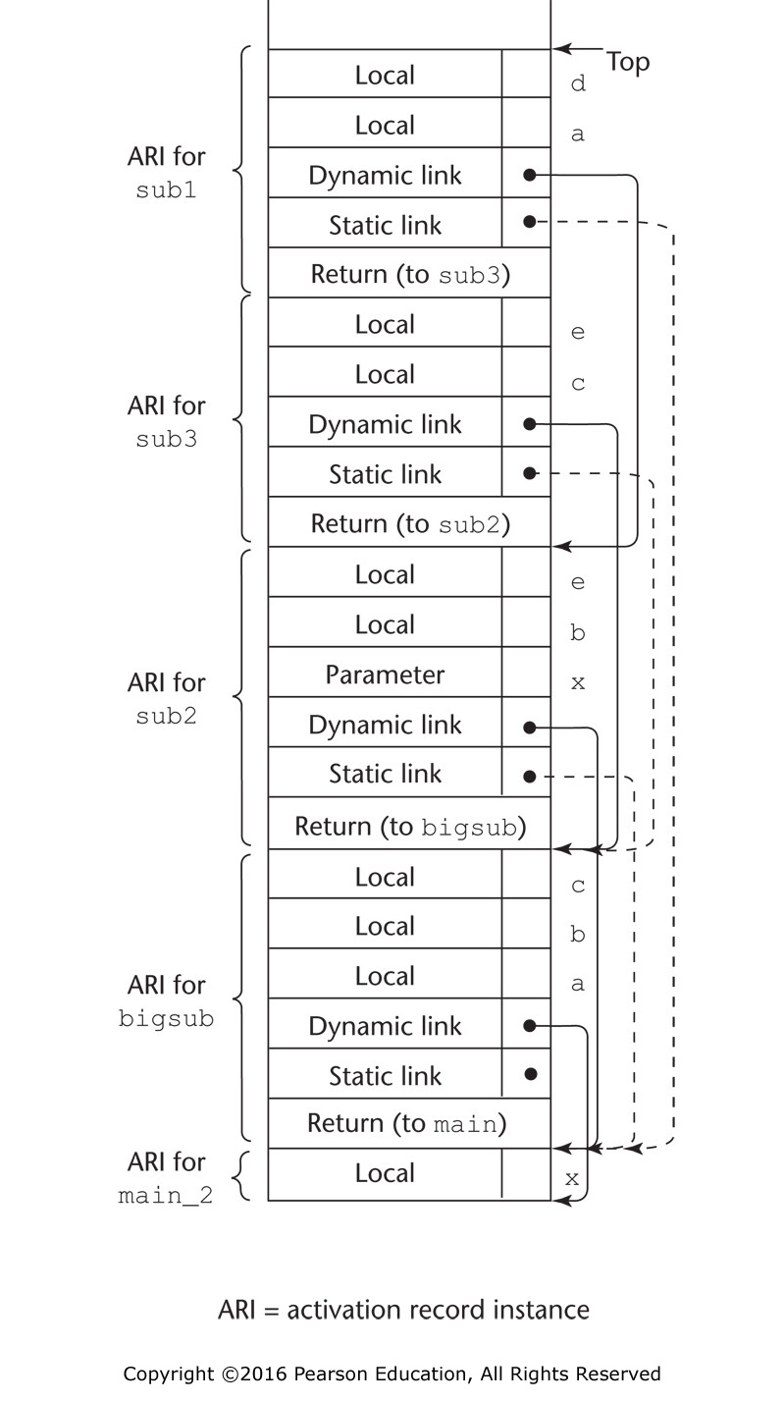
Figure 10.9 Stack contents at position 1 in the program main

Slide 10
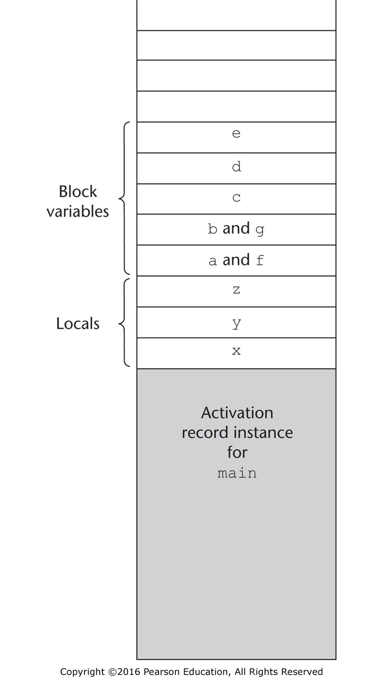
Figure 10.10 Block variable storage when blocks are not treated as parameterless procedures

Slide 11
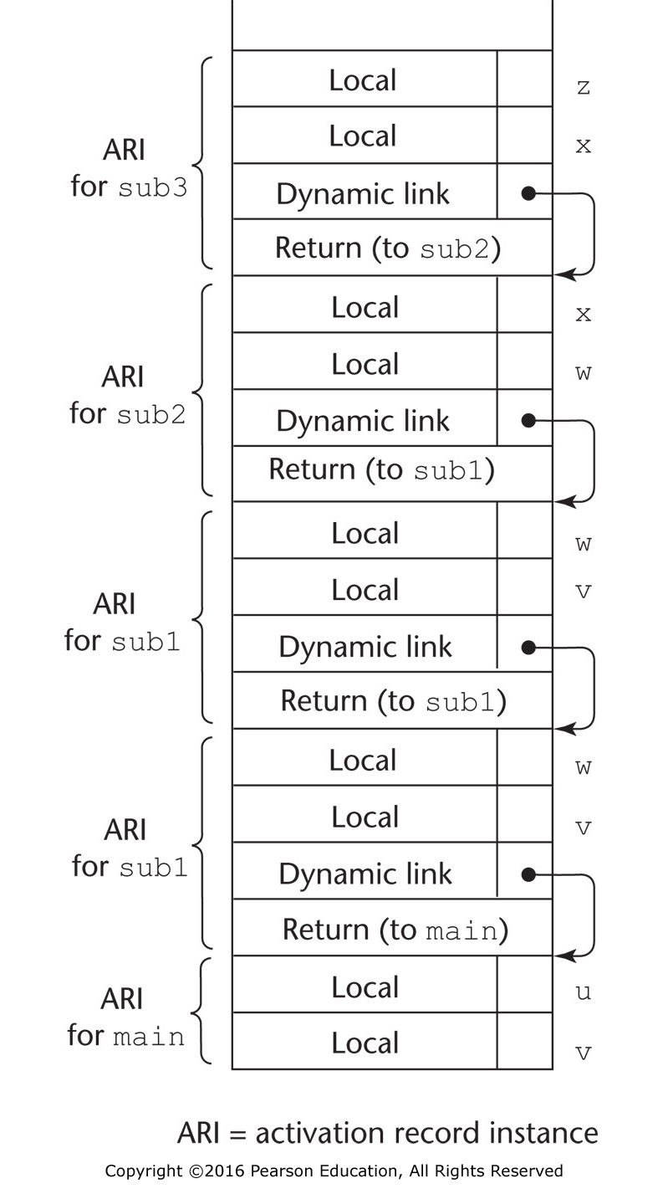
Figure 10.11 Stack contents for a dynamic-scoped program

Slide 12
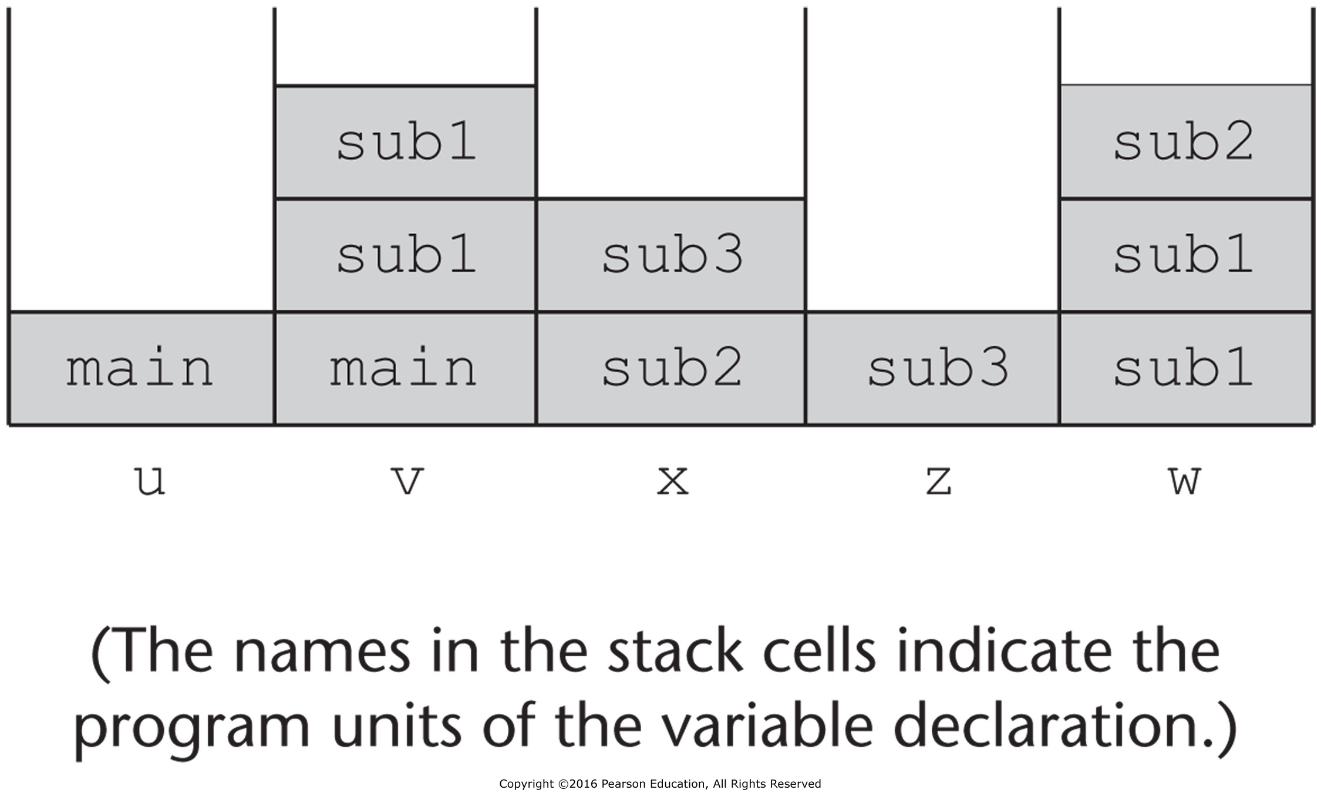
Figure 10.12 One method of using shallow access to implement dynamic scoping

