Slide 1
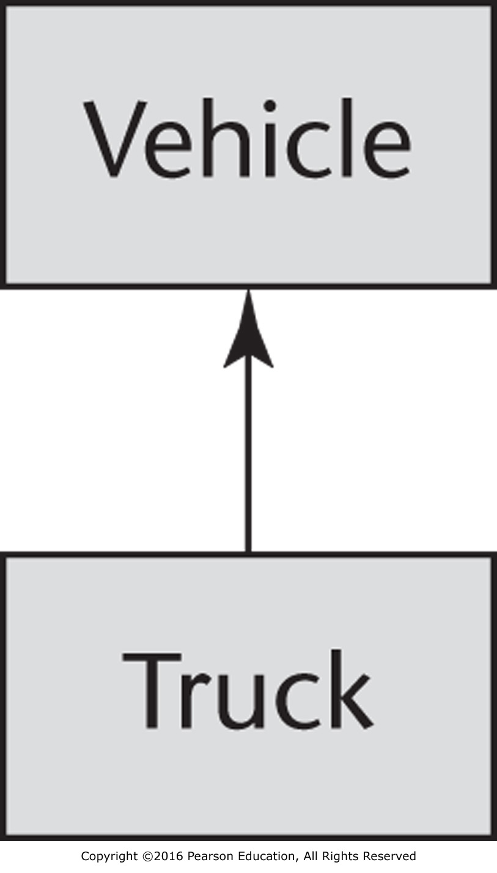
Figure 12.1 A simple example of inheritance

Slide 2
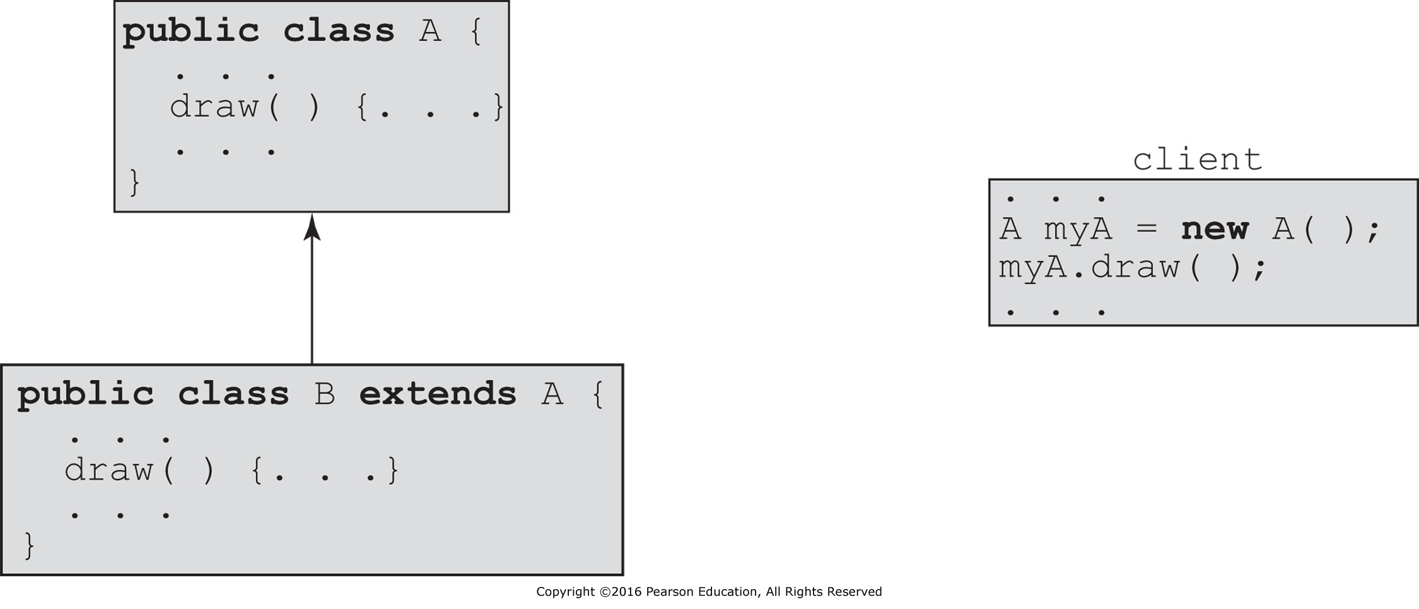
Figure 12.2 Dynamic binding

Slide 3
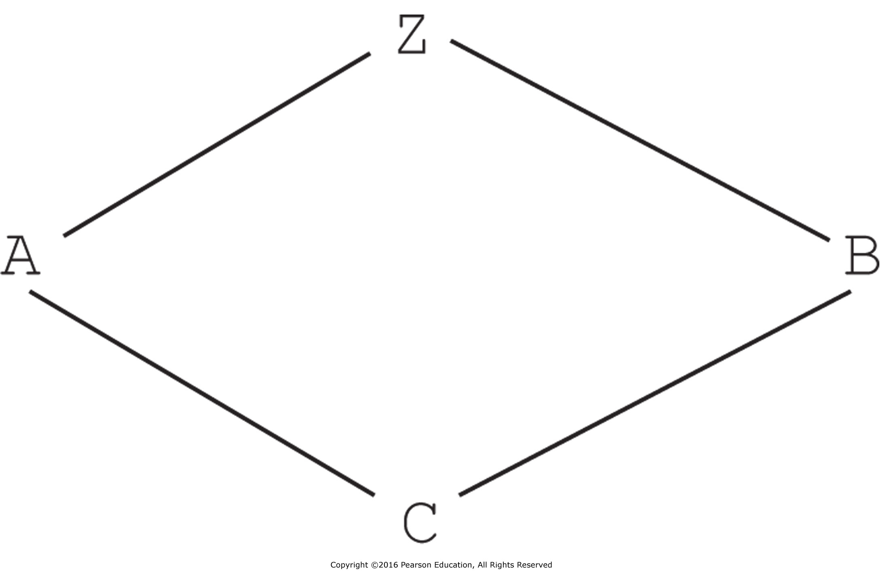
Figure 12.3 An example of diamond inheritance

Slide 4
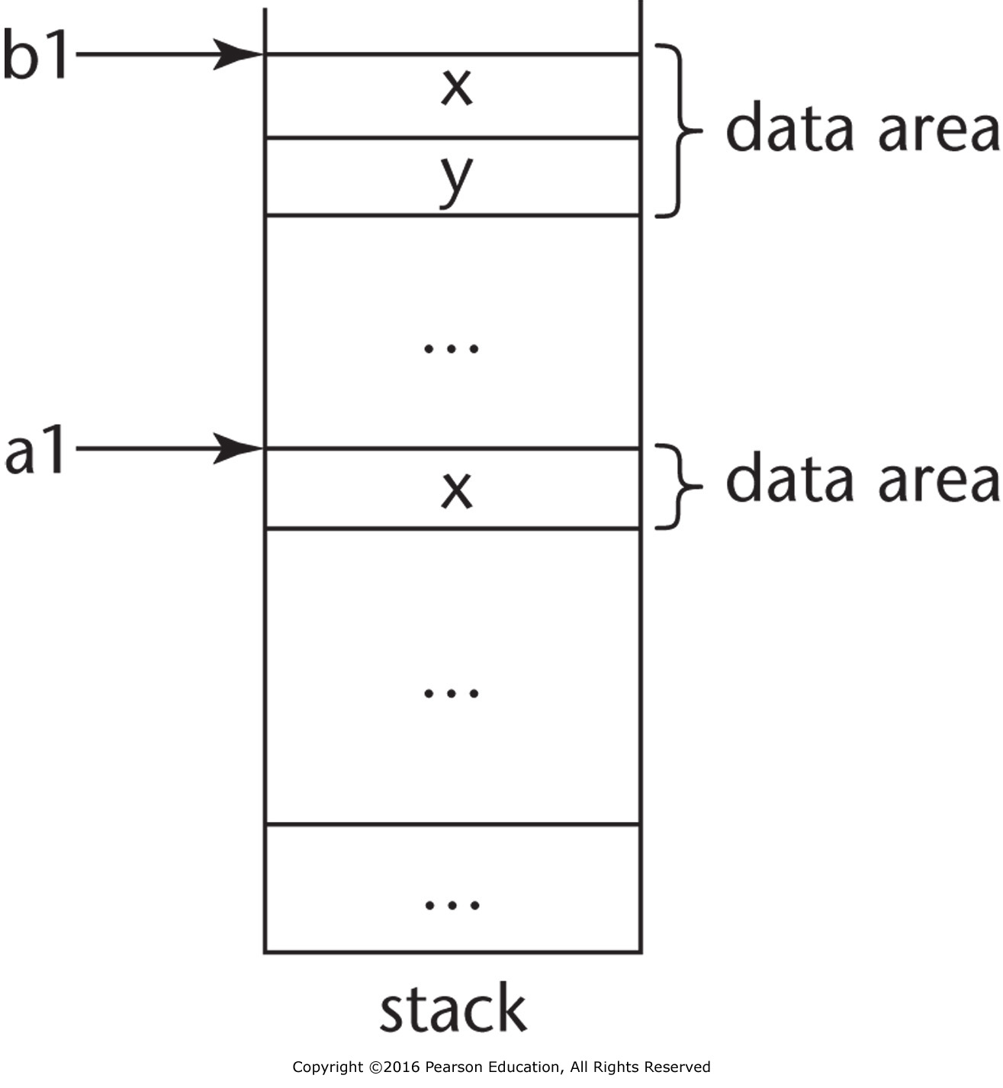
Figure 12.4 An example of object slicing

Slide 5
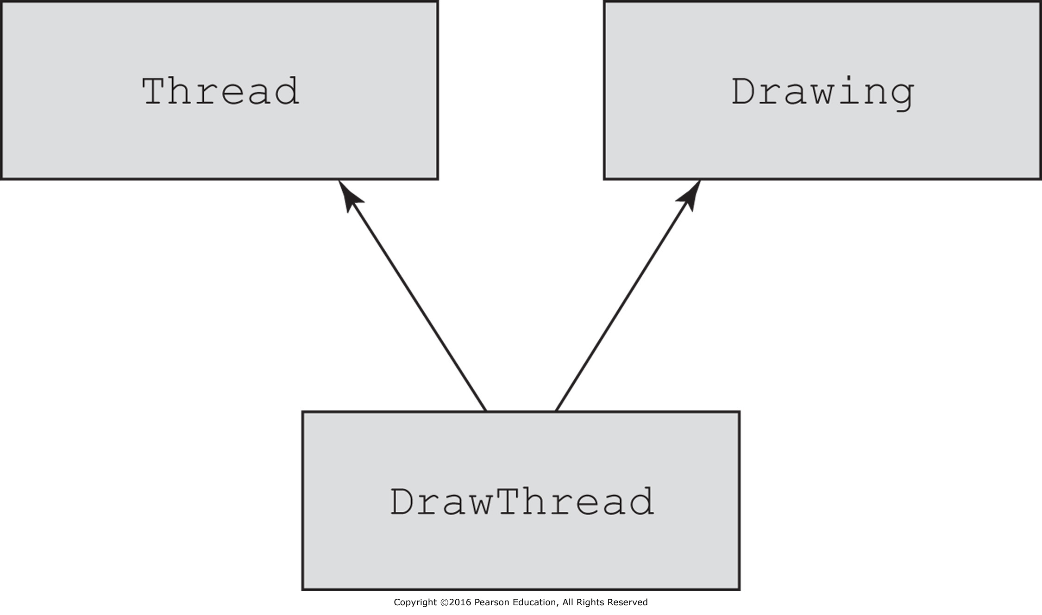
Figure 12.5 Multiple inheritance

Slide 6
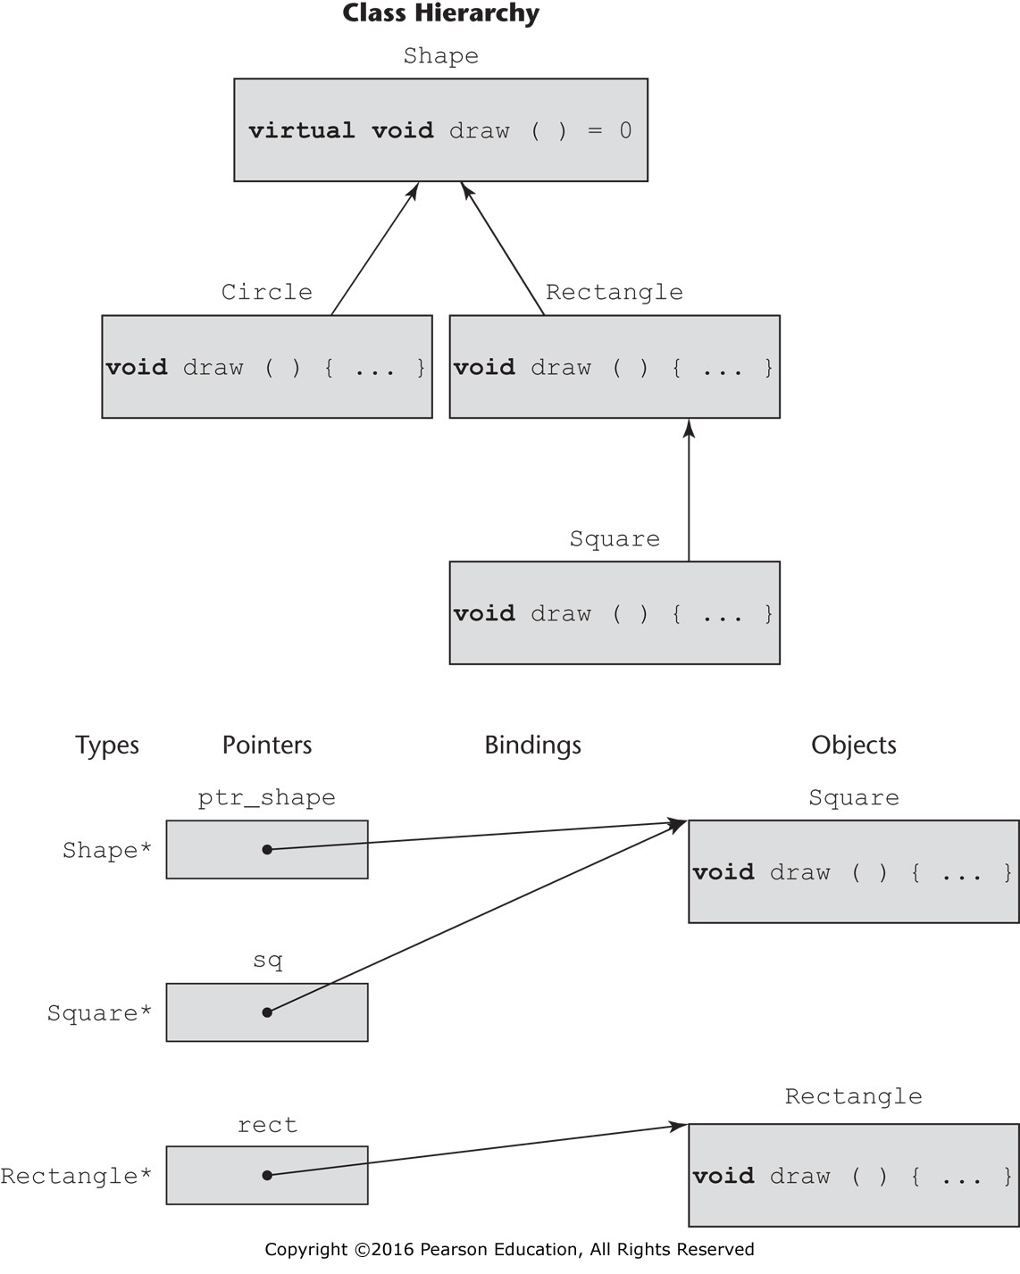
Figure 12.6 Dynamic binding

Slide 7
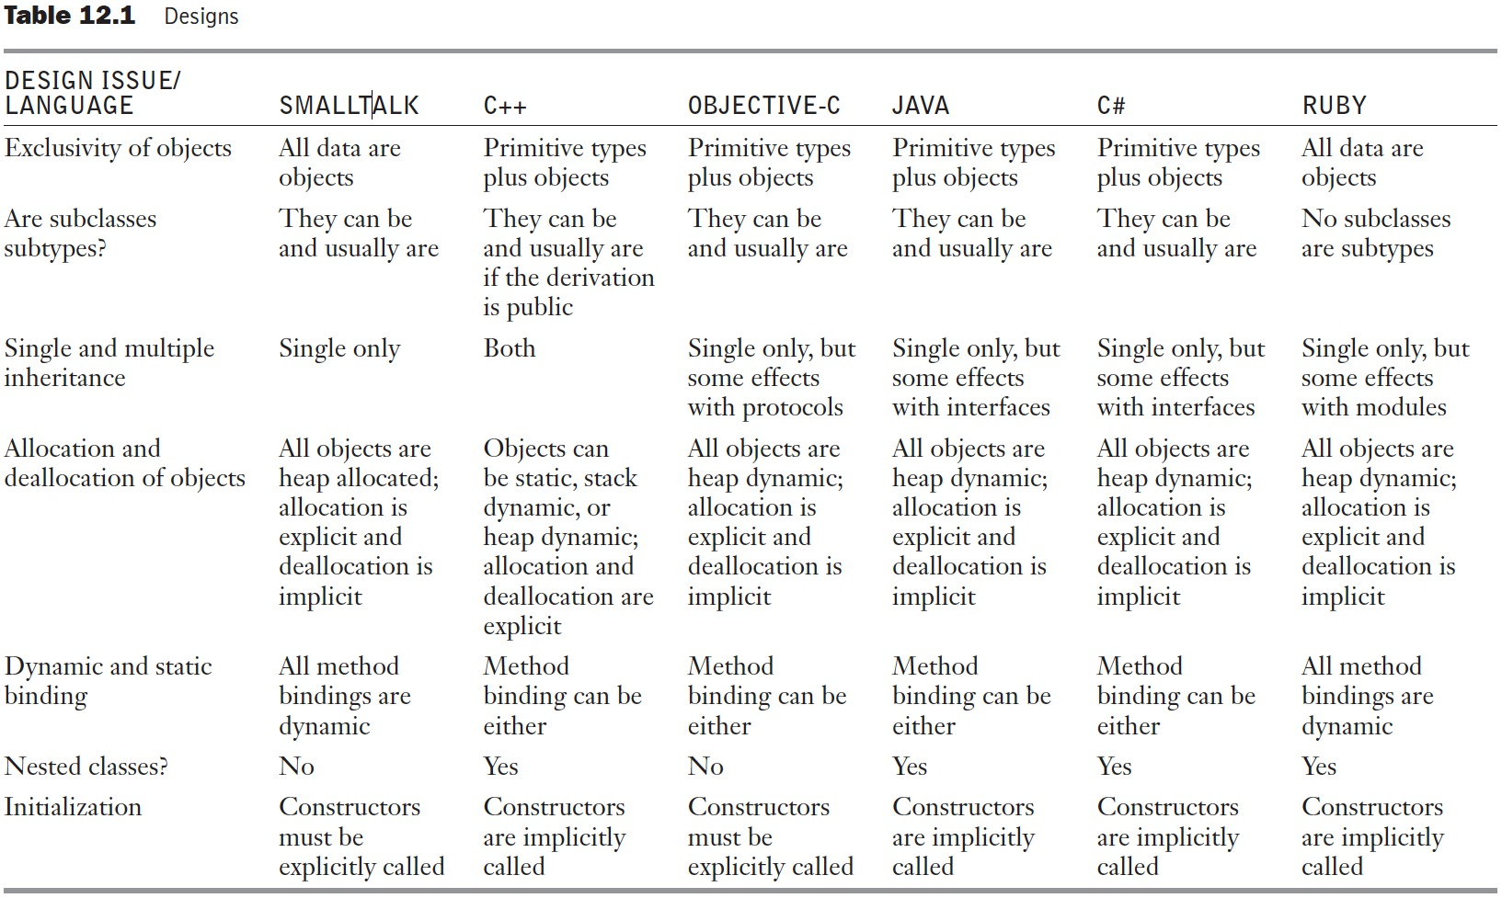
Table 12.1 Designs

Slide 8
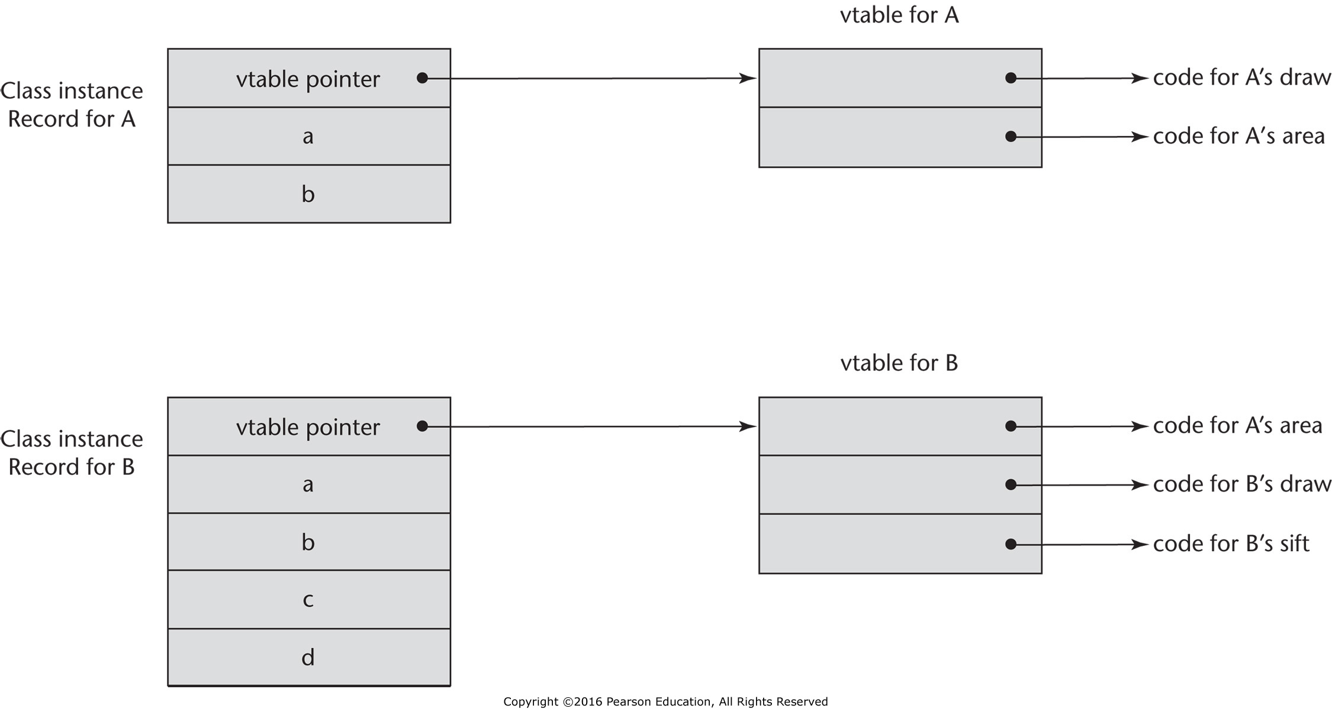
Figure 12.7 An example of the CIRs with single inheritance

Slide 9
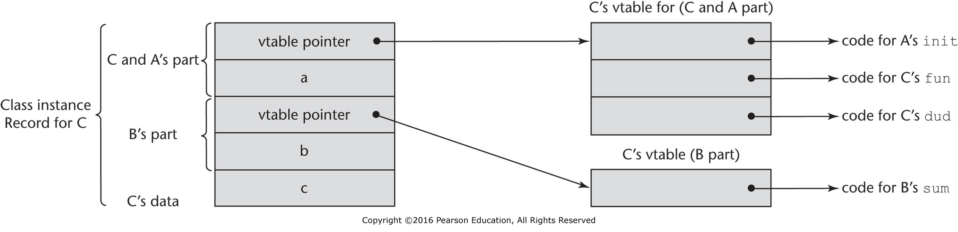
Figure 12.8 An example of a subclass CIR with multiple parents

