Slide 1
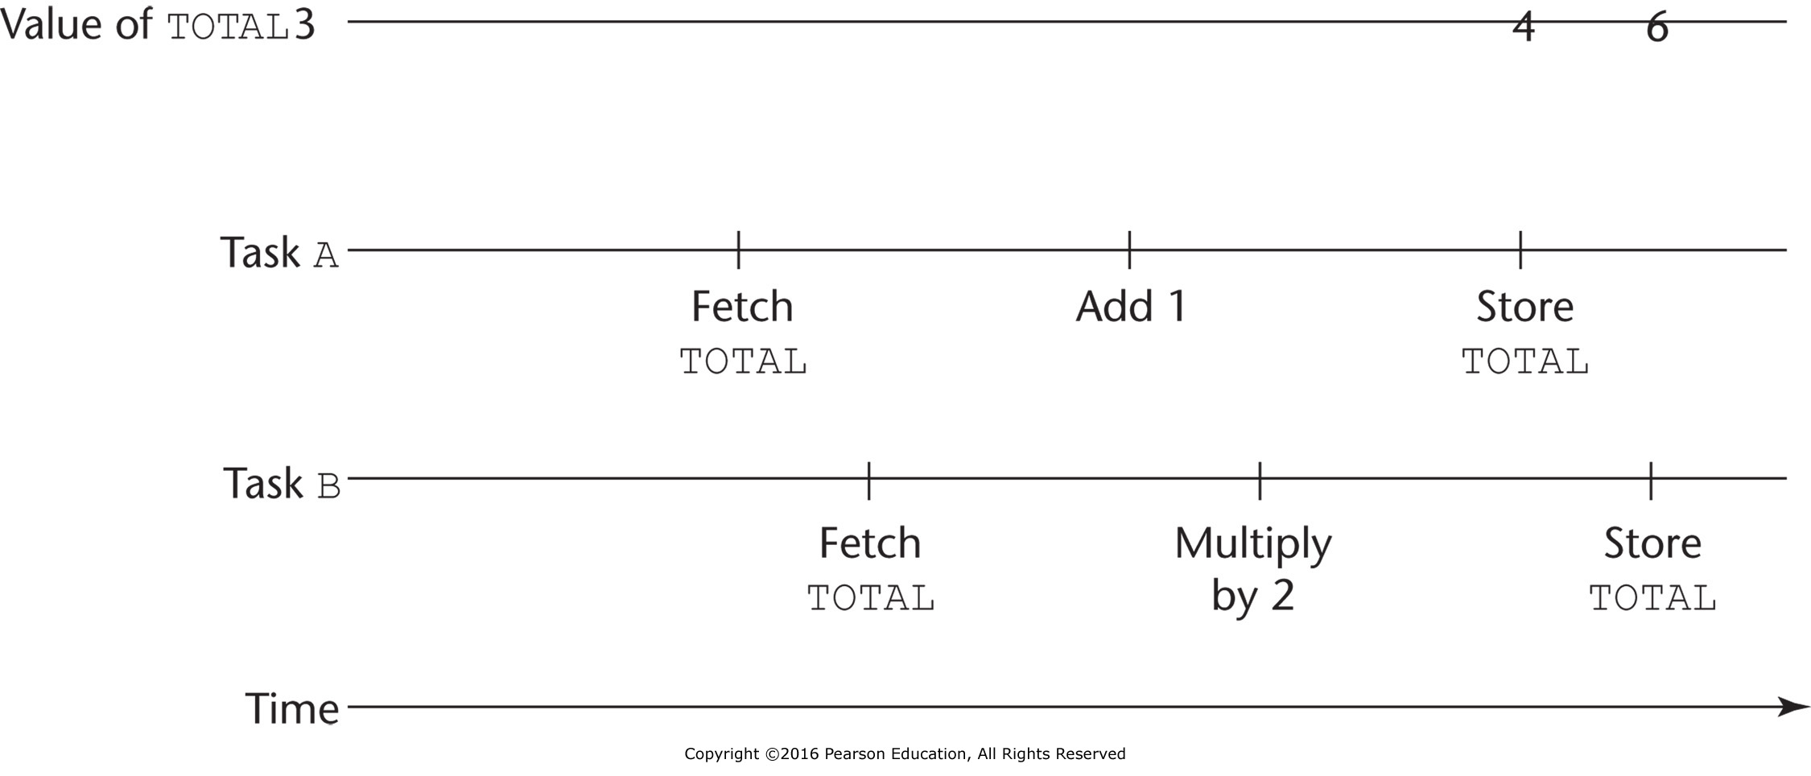
Figure 13.1 The need for competition synchronization

Slide 2
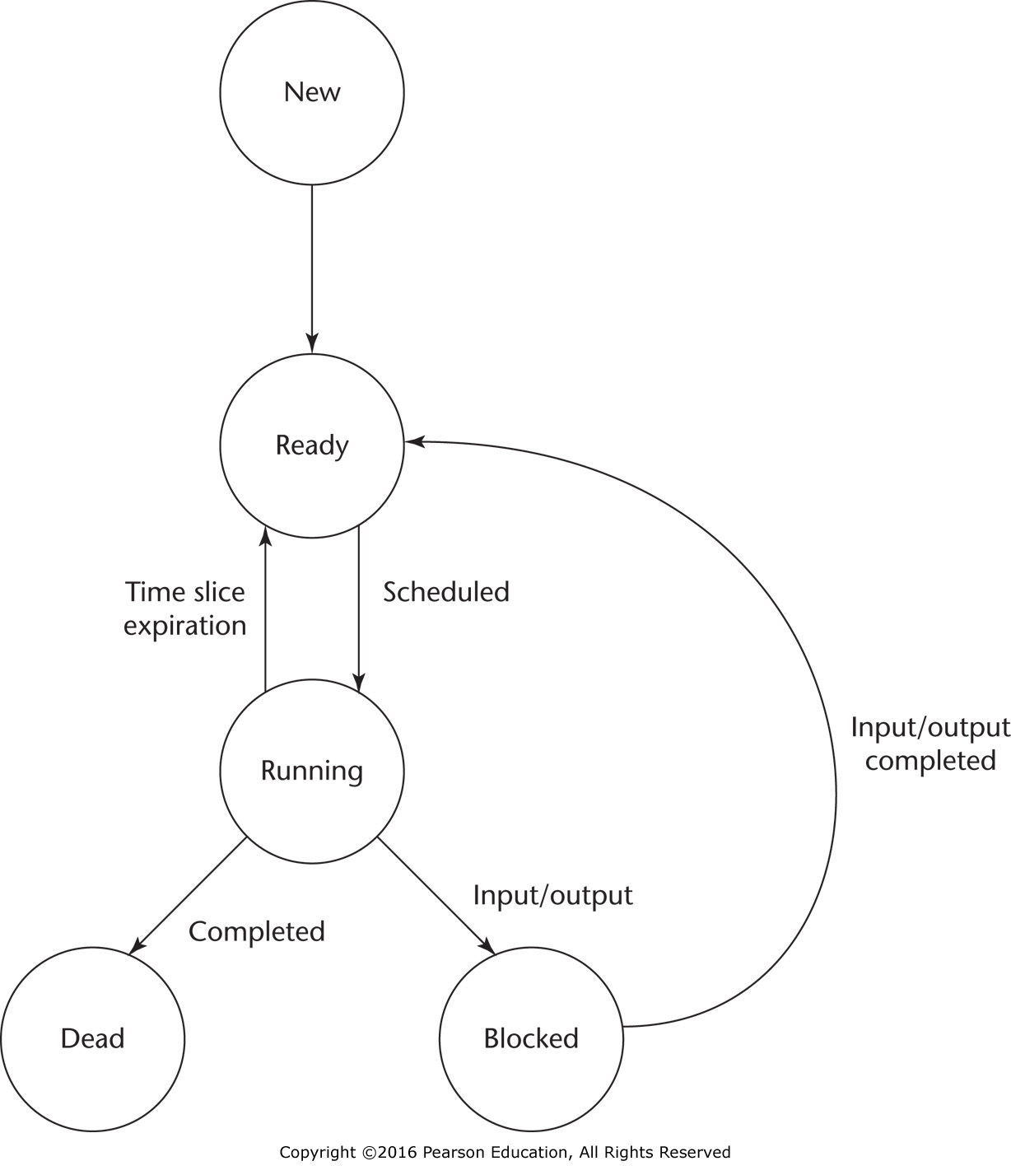
Figure 13.2 Flow diagram of task states

Slide 3
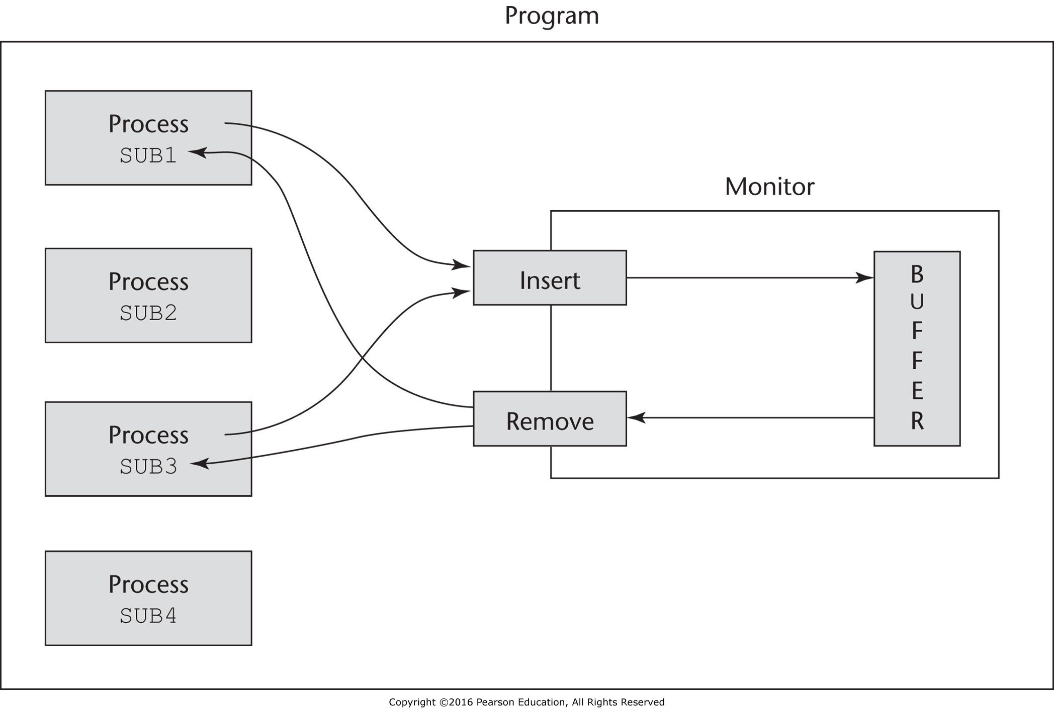
Figure 13.3 A program using a monitor to control access to a shared buffer

Slide 4
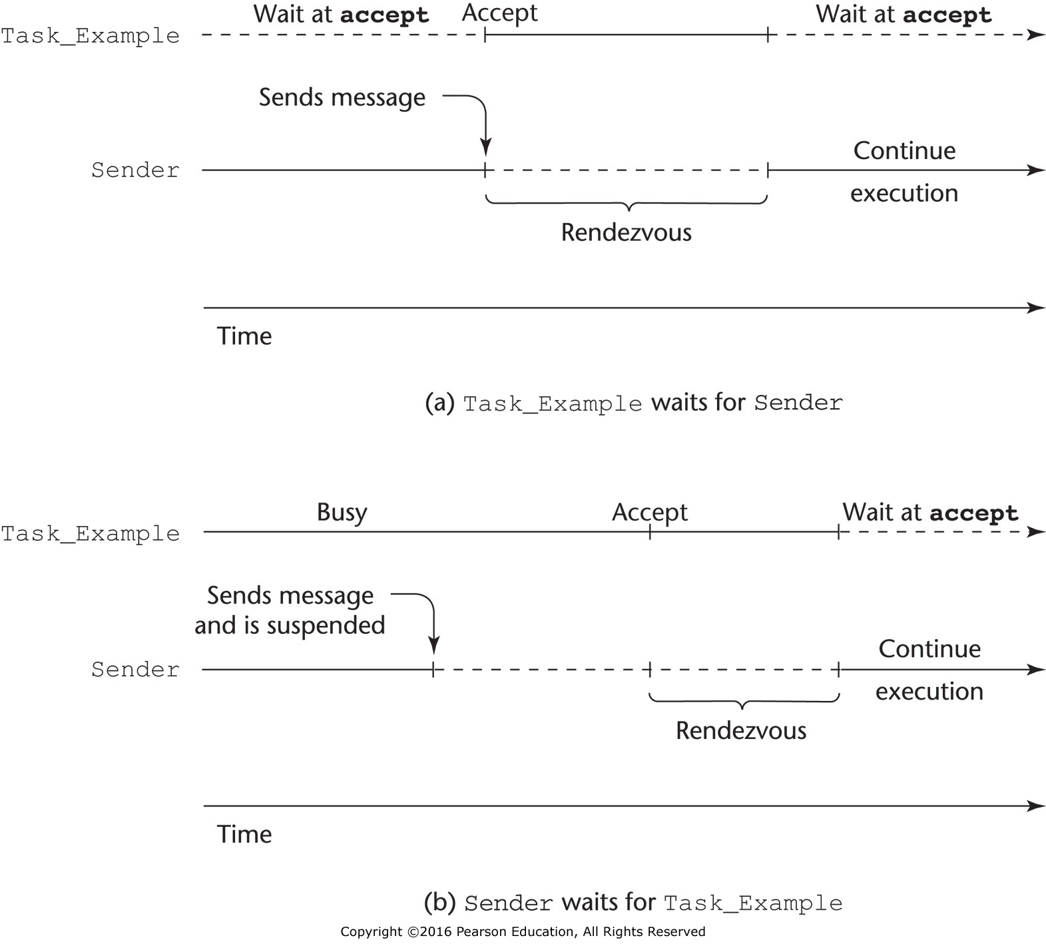
Figure 13.4 Two ways a rendezvous with Task_Example can occur

Slide 5
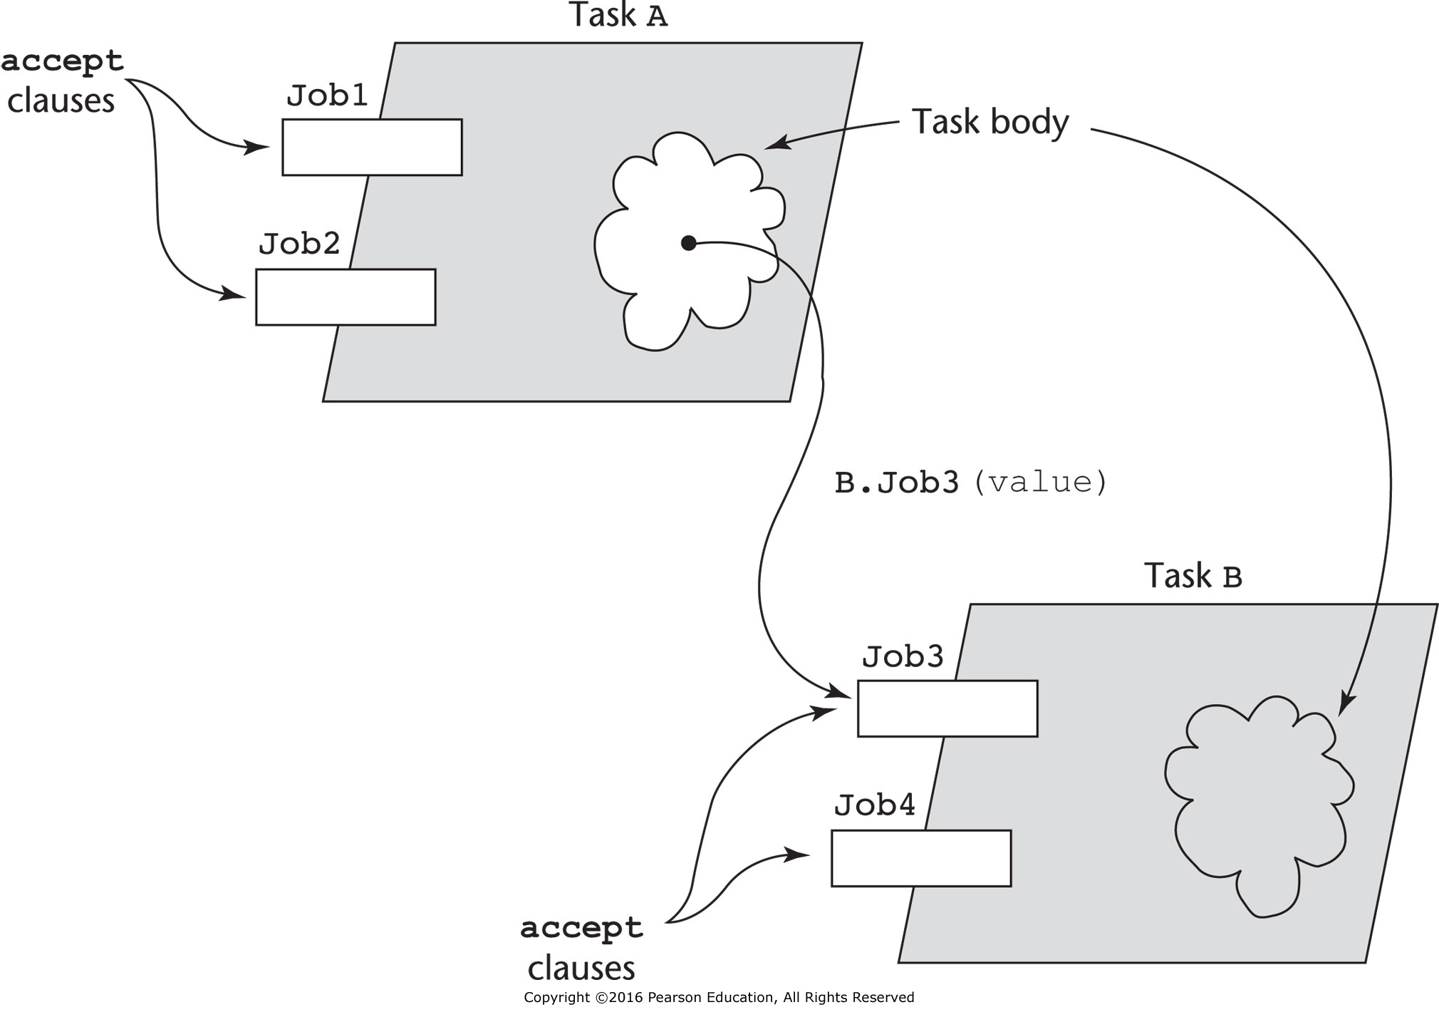
Figure 13.5 Graphical representation of a rendezvous caused by a message sent from task A to task B

