Slide 1
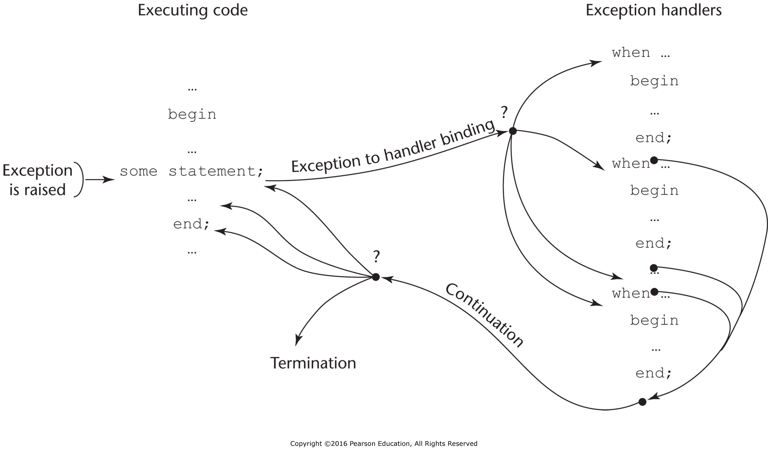
Figure 14.1 Exception-handling control flow

Slide 2
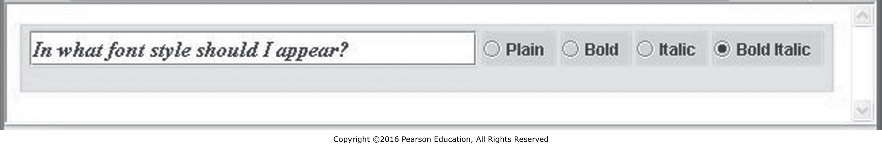
Figure 14.2 Output of RadioB.java
Source: Java radio applet screenshot.

