Slide 1
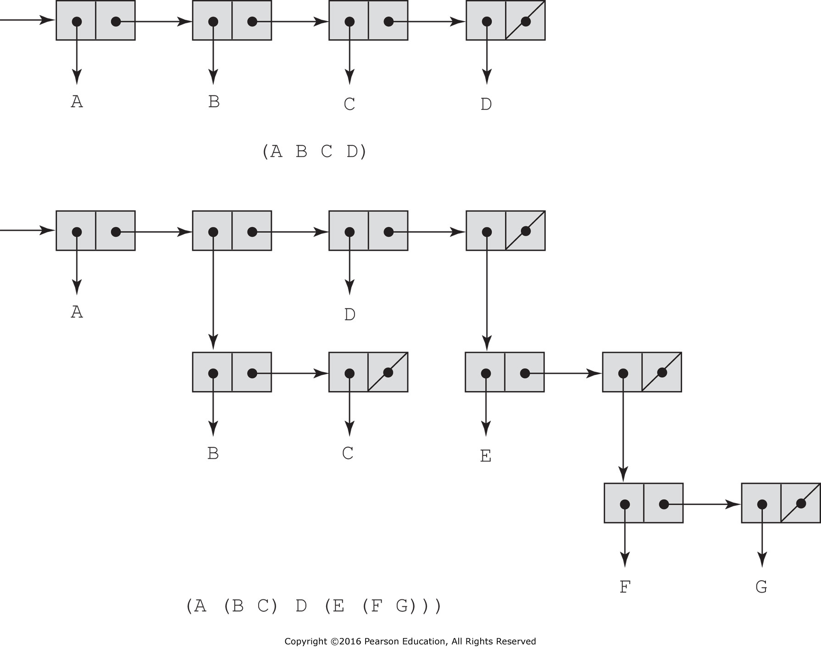
Figure 15.1 Internal representation of two Lisp lists

Slide 2
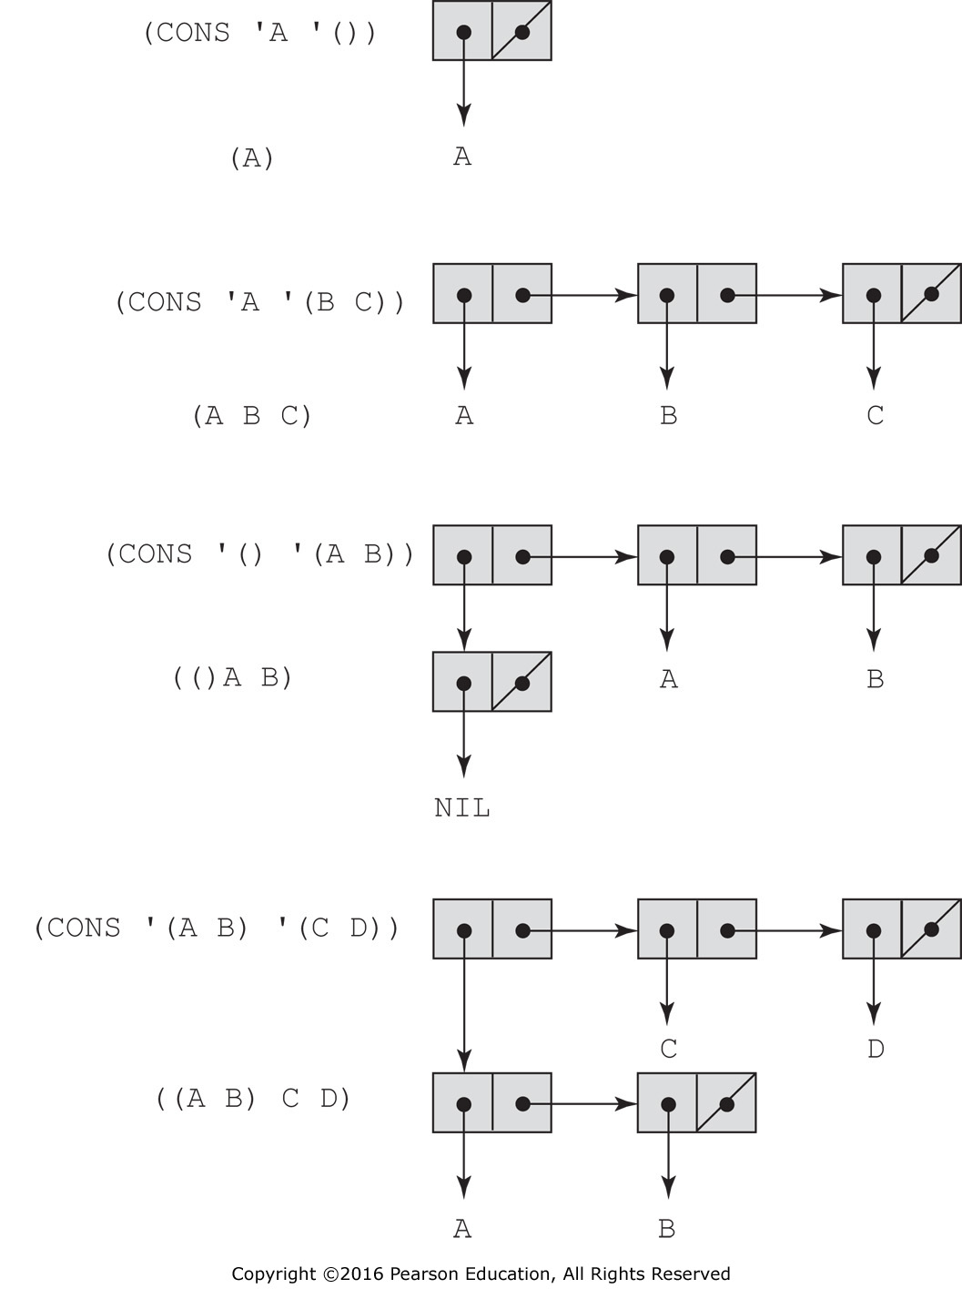
Figure 15.2 The result of several CONS operations

