Slide 1
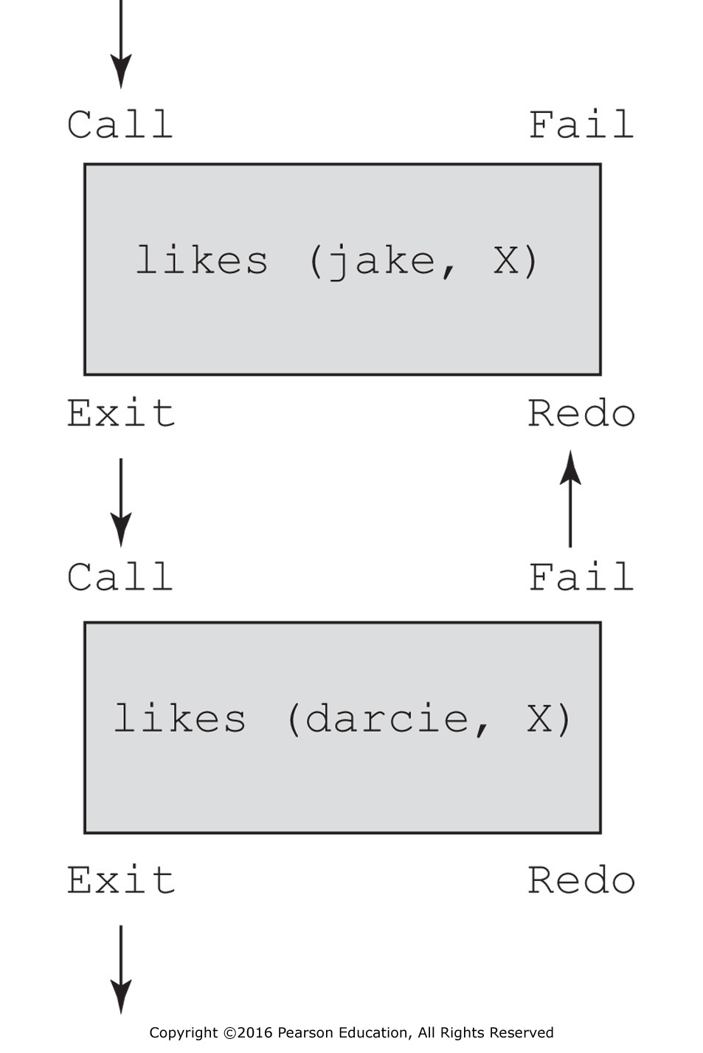
Figure 16.1 Control flow model for the goal likes (jake, X), likes (darcie, X)

