Slide 1
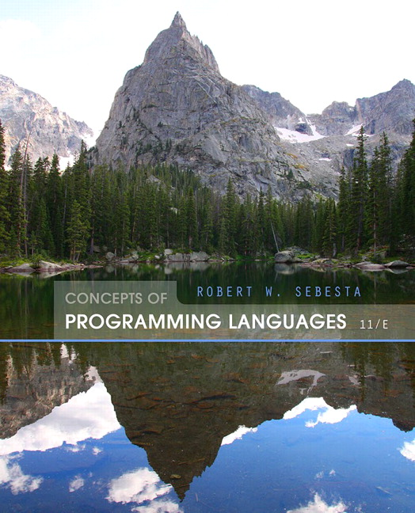
Chapter 1
Preliminaries

Slide 2
Chapter 1 Topics
Reasons for Studying Concepts of Programming Languages
Programming Domains
Language Evaluation Criteria
Influences on Language Design
Language Categories
Language Design Trade-Offs
Implementation Methods
Programming Environments
Copyright © 2015 Pearson. All rights reserved.
1-<number>

Slide 3
Reasons for Studying Concepts of Programming Languages
Increased ability to express ideas
Improved background for choosing appropriate languages
Increased ability to learn new languages
Better understanding of significance of implementation
Better use of languages that are already known
Overall advancement of computing
Copyright © 2015 Pearson. All rights reserved.
1-<number>

Slide 4
Programming Domains
Scientific applications
  Large numbers of floating point computations; use of arrays
  Fortran
Business applications
  Produce reports, use decimal numbers and characters
  COBOL
Artificial intelligence
  Symbols rather than numbers manipulated; use of linked lists
  LISP
Systems programming
  Need efficiency because of continuous use
  C
Web Software
  Eclectic collection of languages: markup (e.g., HTML), scripting (e.g., PHP), general-purpose (e.g., Java)
Copyright © 2015 Pearson. All rights reserved.
1-<number>

Slide 5
Language Evaluation Criteria
Readability: the ease with which programs can be read and understood
Writability: the ease with which a language can be used to create programs
Reliability: conformance to specifications (i.e., performs to its specifications)
Cost: the ultimate total cost
Copyright © 2015 Pearson. All rights reserved.
1-<number>

Slide 6
Evaluation Criteria: Readability
Overall simplicity
  A manageable set of features and constructs
  Minimal feature multiplicity
  Minimal operator overloading
Orthogonality
  A relatively small set of primitive constructs can be combined in a relatively small number of ways
  Every possible combination is legal
Data types
  Adequate predefined data types
Syntax considerations
  Identifier forms: flexible composition
  Special words and methods of forming compound statements
  Form and meaning: self-descriptive constructs, meaningful keywords
Copyright © 2015 Pearson. All rights reserved.
1-<number>

Slide 7
Evaluation Criteria: Writability
Simplicity and orthogonality
  Few constructs, a small number of primitives, a small set of rules for combining them
Support for abstraction
  The ability to define and use complex structures or operations in ways that allow details to be ignored
Expressivity
  A set of relatively convenient ways of specifying operations
  Strength and number of operators and predefined functions
Copyright © 2015 Pearson. All rights reserved.
1-<number>

Slide 8
Evaluation Criteria: Reliability
Type checking
  Testing for type errors
Exception handling
  Intercept run-time errors and take corrective measures
Aliasing
  Presence of two or more distinct referencing methods for the same memory location
Readability and writability
  A language that does not support “natural” ways of expressing an algorithm will require the use of “unnatural” approaches, and hence reduced reliability
Copyright © 2015 Pearson. All rights reserved.
1-<number>

Slide 9
Evaluation Criteria: Cost
Training programmers to use the language
Writing programs (closeness to particular applications)
Compiling programs
Executing programs
Language implementation system: availability of free compilers
Reliability: poor reliability leads to high costs
Maintaining programs
Copyright © 2015 Pearson. All rights reserved.
1-<number>

Slide 10
Evaluation Criteria: Others
Portability
  The ease with which programs can be moved from one implementation to another
Generality
  The applicability to a wide range of applications
Well-definedness
  The completeness and precision of the language’s official definition
Copyright © 2015 Pearson. All rights reserved.
1-<number>

Slide 11
Influences on Language Design
Computer Architecture
  Languages are developed around the prevalent computer architecture, known as the von Neumann architecture
Program Design Methodologies
  New software development methodologies (e.g., object-oriented software development) led to new programming paradigms and by extension, new programming languages
Copyright © 2015 Pearson. All rights reserved.
1-<number>

Slide 12
Computer Architecture Influence
Well-known computer architecture: Von Neumann
Imperative languages, most dominant, because of von Neumann computers
  Data and programs stored in memory
  Memory is separate from CPU
  Instructions and data are piped from memory to CPU
  Basis for imperative languages
    Variables model memory cells
    Assignment statements model piping
    Iteration is efficient
Copyright © 2015 Pearson. All rights reserved.
1-<number>

Slide 13

The von Neumann Architecture
Copyright © 2015 Pearson. All rights reserved.
1-<number>

Slide 14
The von Neumann Architecture
Fetch-execute-cycle (on a von Neumann architecture computer)
  initialize the program counter
  repeat forever
  fetch the instruction pointed by the counter
  increment the counter
  decode the instruction
  execute the instruction
  end repeat
Copyright © 2015 Pearson. All rights reserved.
1-<number>

Slide 15
Programming Methodologies Influences
1950s and early 1960s: Simple applications; worry about machine efficiency
Late 1960s: People efficiency became important; readability, better control structures
  structured programming
  top-down design and step-wise refinement
Late 1970s: Process-oriented to data-oriented
  data abstraction
Middle 1980s: Object-oriented programming
  Data abstraction + inheritance + polymorphism
Copyright © 2015 Pearson. All rights reserved.
1-<number>

Slide 16
Language Categories
Imperative
  Central features are variables, assignment statements, and iteration
  Include languages that support object-oriented programming
  Include scripting languages
  Include the visual languages
  Examples: C, Java, Perl, JavaScript, Visual BASIC .NET, C++
Functional
  Main means of making computations is by applying functions to given parameters
  Examples: LISP, Scheme, ML, F#
Logic
  Rule-based (rules are specified in no particular order)
  Example: Prolog
Markup/programming hybrid
  Markup languages extended to support some programming
  Examples: JSTL, XSLT
Copyright © 2015 Pearson. All rights reserved.
1-<number>

Slide 17
Language Design Trade-Offs
Reliability vs. cost of execution
  Example: Java demands all references to array elements be checked for proper indexing, which leads to increased execution costs
Readability vs. writability
  Example: APL provides many powerful operators (and a large number of new symbols), allowing complex computations to be written in a compact program but at the cost of poor readability
Writability (flexibility) vs. reliability
  Example: C++ pointers are powerful and very flexible but are unreliable
Copyright © 2015 Pearson. All rights reserved.
1-<number>

Slide 18
Implementation Methods
Compilation
  Programs are translated into machine language; includes JIT systems
  Use: Large commercial applications
Pure Interpretation
  Programs are interpreted by another program known as an interpreter
  Use: Small programs or when efficiency is not an issue
Hybrid Implementation Systems
  A compromise between compilers and pure interpreters
  Use: Small and medium systems when efficiency is not the first concern
Copyright © 2015 Pearson. All rights reserved.
1-<number>

Slide 19

Layered View of Computer
The operating system and language implementation are layered over
machine interface of a computer
Copyright © 2015 Pearson. All rights reserved.
1-<number>

Slide 20
Compilation
Translate high-level program (source language) into machine code (machine language)
Slow translation, fast execution
Compilation process has several phases:
  lexical analysis: converts characters in the source program into lexical units
  syntax analysis: transforms lexical units into parse trees which represent the syntactic structure of program
  Semantics analysis: generate intermediate code
  code generation: machine code is generated
Copyright © 2015 Pearson. All rights reserved.
1-<number>

Slide 21

The Compilation Process
Copyright © 2015 Pearson. All rights reserved.
1-<number>

Slide 22
Additional Compilation Terminologies
Load module (executable image): the user and system code together
Linking and loading: the process of collecting system program units and linking them to a user program
Copyright © 2015 Pearson. All rights reserved.
1-<number>

Slide 23
Von Neumann Bottleneck
Connection speed between a computer’s memory and its processor determines the speed of a computer
Program instructions often can be executed much faster than the speed of the connection; the connection speed thus results in a bottleneck
Known as the von Neumann bottleneck; it is the primary limiting factor in the speed of computers
Copyright © 2015 Pearson. All rights reserved.
1-<number>

Slide 24
Pure Interpretation
No translation
Easier implementation of programs (run-time errors can easily and immediately be displayed)
Slower execution (10 to 100 times slower than compiled programs)
Often requires more space
Now rare for traditional high-level languages
Significant comeback with some Web scripting languages (e.g., JavaScript, PHP)
Copyright © 2015 Pearson. All rights reserved.
1-<number>

Slide 25

Pure Interpretation Process
Copyright © 2015 Pearson. All rights reserved.
1-<number>

Slide 26
Hybrid Implementation Systems
A compromise between compilers and pure interpreters
A high-level language program is translated to an intermediate language that allows easy interpretation
Faster than pure interpretation
Examples
  Perl programs are partially compiled to detect errors before interpretation
  Initial implementations of Java were hybrid; the intermediate form, byte code, provides portability to any machine that has a byte code interpreter and a run-time system (together, these are called Java Virtual Machine)
Copyright © 2015 Pearson. All rights reserved.
1-<number>

Slide 27

Hybrid Implementation Process
Copyright © 2015 Pearson. All rights reserved.
1-<number>

Slide 28
Just-in-Time Implementation Systems
Initially translate programs to an intermediate language
Then compile the intermediate language of the subprograms into machine code when they are called
Machine code version is kept for subsequent calls
JIT systems are widely used for Java programs
.NET languages are implemented with a JIT system
In essence, JIT systems are delayed compilers
Copyright © 2015 Pearson. All rights reserved.
1-<number>

Slide 29
Preprocessors
Preprocessor macros (instructions) are commonly used to specify that code from another file is to be included
A preprocessor processes a program immediately before the program is compiled to expand embedded preprocessor macros
A well-known example: C preprocessor
  expands #include, #define, and similar macros
Copyright © 2015 Pearson. All rights reserved.
1-<number>

Slide 30
Programming Environments
A collection of tools used in software development
UNIX
  An older operating system and tool collection
  Nowadays often used through a GUI (e.g., CDE, KDE, or GNOME) that runs on top of UNIX
Microsoft Visual Studio.NET
  A large, complex visual environment
Used to build Web applications and non-Web applications in any .NET language
NetBeans
  Related to Visual Studio .NET, except for applications in Java
Copyright © 2015 Pearson. All rights reserved.
1-<number>

Slide 31
Summary
The study of programming languages is valuable for a number of reasons:
  Increase our capacity to use different constructs
  Enable us to choose languages more intelligently
  Makes learning new languages easier
Most important criteria for evaluating programming languages include:
  Readability, writability, reliability, cost
Major influences on language design have been machine architecture and software development methodologies
The major methods of implementing programming languages are: compilation, pure interpretation, and hybrid implementation
Copyright © 2015 Pearson. All rights reserved.
1-<number>

Slide 32
Chapter 3
Describing Syntax and Semantics

Slide 33
Chapter 3 Topics
Introduction
The General Problem of Describing Syntax
Formal Methods of Describing Syntax
Attribute Grammars
Describing the Meanings of Programs: Dynamic Semantics
Copyright © 2015 Pearson. All rights reserved.
1-<number>

Slide 34
Introduction
Syntax: the form or structure of the expressions, statements, and program units
Semantics: the meaning of the expressions, statements, and program units
Syntax and semantics provide a language’s definition
  Users of a language definition
    Other language designers
    Implementers
    Programmers (the users of the language)
Copyright © 2015 Pearson. All rights reserved.
1-<number>

Slide 35
The General Problem of Describing Syntax: Terminology
A sentence is a string of characters over some alphabet
A language is a set of sentences
A lexeme is the lowest level syntactic unit of a language (e.g., *, sum, begin)
A token is a category of lexemes (e.g., identifier)
Copyright © 2015 Pearson. All rights reserved.
1-<number>

Slide 36
Formal Definition of Languages
Recognizers
  A recognition device reads input strings over the alphabet of the language and decides whether the input strings belong to the language
  Example: syntax analysis part of a compiler
  - Detailed discussion of syntax analysis appears in
  Chapter 4
Generators
  A device that generates sentences of a language
  One can determine if the syntax of a particular sentence is syntactically correct by comparing it to the structure of the generator
Copyright © 2015 Pearson. All rights reserved.
1-<number>

Slide 37
BNF and Context-Free Grammars
Context-Free Grammars
  Developed by Noam Chomsky in the mid-1950s
  Language generators, meant to describe the syntax of natural languages
  Define a class of languages called context-free languages
Backus-Naur Form (1959)
  Invented by John Backus to describe the syntax of Algol 58
  BNF is equivalent to context-free grammars
Copyright © 2015 Pearson. All rights reserved.
1-<number>

Slide 38
BNF Fundamentals
In BNF, abstractions are used to represent classes of syntactic structures--they act like syntactic variables (also called nonterminal symbols, or just terminals)
Terminals are lexemes or tokens
A rule has a left-hand side (LHS), which is a nonterminal, and a right-hand side (RHS), which is a string of terminals and/or nonterminals
Copyright © 2015 Pearson. All rights reserved.
1-<number>

Slide 39
BNF Fundamentals (continued)
Nonterminals are often enclosed in angle brackets
  Examples of BNF rules:
  <ident_list> → identifier | identifier, <ident_list>
  <if_stmt> → if <logic_expr> then <stmt>
Grammar: a finite non-empty set of rules
A start symbol is a special element of the nonterminals of a grammar
Copyright © 2015 Pearson. All rights reserved.
1-<number>

Slide 40
BNF Rules
An abstraction (or nonterminal symbol) can have more than one RHS
<stmt> → <single_stmt>
| begin <stmt_list> end
Copyright © 2015 Pearson. All rights reserved.
1-<number>

Slide 41
Describing Lists
Syntactic lists are described using recursion
<ident_list> → ident
| ident, <ident_list>
A derivation is a repeated application of rules, starting with the start symbol and ending with a sentence (all terminal symbols)
Copyright © 2015 Pearson. All rights reserved.
1-<number>

Slide 42
An Example Grammar
<program> → <stmts>
<stmts> → <stmt> | <stmt> ; <stmts>
<stmt> → <var> = <expr>
<var> → a | b | c | d
<expr> → <term> + <term> | <term> - <term>
<term> → <var> | const
Copyright © 2015 Pearson. All rights reserved.
1-<number>

Slide 43
An Example Derivation
<program> => <stmts> => <stmt>
=> <var> = <expr>
=> a = <expr>
=> a = <term> + <term>
=> a = <var> + <term>
=> a = b + <term>
=> a = b + const
Copyright © 2015 Pearson. All rights reserved.
1-<number>

Slide 44
Derivations
Every string of symbols in a derivation is a sentential form
A sentence is a sentential form that has only terminal symbols
A leftmost derivation is one in which the leftmost nonterminal in each sentential form is the one that is expanded
A derivation may be neither leftmost nor rightmost
Copyright © 2015 Pearson. All rights reserved.
1-<number>

Slide 45
Parse Tree
A hierarchical representation of a derivation
<program>
<stmts>
<stmt>
<var>
=
<expr>
a
<term>
+
<term>
<var>
const
b
Copyright © 2015 Pearson. All rights reserved.
1-<number>

Slide 46
Ambiguity in Grammars
A grammar is ambiguous if and only if it generates a sentential form that has two or more distinct parse trees
Copyright © 2015 Pearson. All rights reserved.
1-<number>

Slide 47
An Ambiguous Expression Grammar
<expr> → <expr> <op> <expr> | const
<op> → / | -
<expr>
<expr>
<expr>
<op>
<expr>
<expr>
<op>
<op>
<expr>
<expr>
<op>
<expr>
<expr>
<op>
<expr>
const
-
const
/
const
const
-
const
/
const
Copyright © 2015 Pearson. All rights reserved.
1-<number>

Slide 48
An Unambiguous Expression Grammar
If we use the parse tree to indicate precedence levels of the operators, we cannot have ambiguity
<expr> → <expr> - <term> | <term>
<term> → <term> / const| const
<expr>
<expr>
-
<term>
<term>
<term>
/
const
const
const
Copyright © 2015 Pearson. All rights reserved.
1-<number>

Slide 49
Associativity of Operators
Operator associativity can also be indicated by a grammar
<expr> -> <expr> + <expr> | const (ambiguous)
<expr> -> <expr> + const | const (unambiguous)
<expr>
<expr>
<expr>
+
const
<expr>
+
const
const
Copyright © 2015 Pearson. All rights reserved.
1-<number>

Slide 50
Unambiguous Grammar for Selector
Java if-then-else grammar
<if_stmt> -> if (<logic_expr>) <stmt>
| if (<logic_expr>) <stmt> else <stmt>
Ambiguous!
- An unambiguous grammar for if-then-else
<stmt> -> <matched> | <unmatched>
<matched> -> if (<logic_expr>) <stmt>
| a non-if statement
<unmatched> -> if (<logic_expr>) <stmt>
| if (<logic_expr>) <matched> else
<unmatched>
Copyright © 2015 Pearson. All rights reserved.
1-<number>

Slide 51
Extended BNF
Optional parts are placed in brackets [ ]
<proc_call> -> ident [(<expr_list>)]
Alternative parts of RHSs are placed inside parentheses and separated via vertical bars
<term> → <term> (+|-) const
Repetitions (0 or more) are placed inside braces { }
<ident> → letter {letter|digit}
Copyright © 2015 Pearson. All rights reserved.
1-<number>

Slide 52
BNF and EBNF
BNF
<expr> → <expr> + <term>
| <expr> - <term>
| <term>
<term> → <term> * <factor>
| <term> / <factor>
| <factor>
EBNF
<expr> → <term> {(+ | -) <term>}
<term> → <factor> {(* | /) <factor>}
Copyright © 2015 Pearson. All rights reserved.
1-<number>

Slide 53
Recent Variations in EBNF
Alternative RHSs are put on separate lines
Use of a colon instead of =>
Use of _{opt} for optional parts
Use of oneof for choices
Copyright © 2015 Pearson. All rights reserved.
1-<number>

Slide 54
Static Semantics
Nothing to do with meaning
Context-free grammars (CFGs) cannot describe all of the syntax of programming languages
Categories of constructs that are trouble:
- Context-free, but cumbersome (e.g.,
types of operands in expressions)
- Non-context-free (e.g., variables must
be declared before they are used)
Copyright © 2015 Pearson. All rights reserved.
1-<number>

Slide 55
Attribute Grammars
Attribute grammars (AGs) have additions to CFGs to carry some semantic info on parse tree nodes
Primary value of AGs:
  Static semantics specification
  Compiler design (static semantics checking)
Copyright © 2015 Pearson. All rights reserved.
1-<number>

Slide 56
Attribute Grammars : Definition
Def: An attribute grammar is a context-free grammar G = (S, N, T, P) with the following additions:
  For each grammar symbol x there is a set A(x) of attribute values
  Each rule has a set of functions that define certain attributes of the nonterminals in the rule
  Each rule has a (possibly empty) set of predicates to check for attribute consistency
Copyright © 2015 Pearson. All rights reserved.
1-<number>

Slide 57
Attribute Grammars: Definition
Let X₀ → X₁ ... X_{n} be a rule
Functions of the form S(X₀) = f(A(X₁), ... , A(X_{n})) define synthesized attributes
Functions of the form I(X_{j}) = f(A(X₀), ... , A(X_{n})), for i <= j <= n, define inherited attributes
Initially, there are intrinsic attributes on the leaves
Copyright © 2015 Pearson. All rights reserved.
1-<number>

Slide 58
Attribute Grammars: An Example
Syntax
  <assign> -> <var> = <expr>
  <expr> -> <var> + <var> | <var>
  <var> A | B | C
actual_type: synthesized for <var> and <expr>
expected_type: inherited for <expr>
Copyright © 2015 Pearson. All rights reserved.
1-<number>

Slide 59
Attribute Grammar (continued)
Syntax rule: <expr> → <var>[1] + <var>[2]
Semantic rules:
<expr>.actual_type ← <var>[1].actual_type
Predicate:
<var>[1].actual_type == <var>[2].actual_type
<expr>.expected_type == <expr>.actual_type
Syntax rule: <var> → id
Semantic rule:
<var>.actual_type ← lookup (<var>.string)
Copyright © 2015 Pearson. All rights reserved.
1-<number>

Slide 60
Attribute Grammars (continued)
How are attribute values computed?
  If all attributes were inherited, the tree could be decorated in top-down order.
  If all attributes were synthesized, the tree could be decorated in bottom-up order.
  In many cases, both kinds of attributes are used, and it is some combination of top-down and bottom-up that must be used.
Copyright © 2015 Pearson. All rights reserved.
1-<number>

Slide 61
Attribute Grammars (continued)
<expr>.expected_type ← inherited from parent
<var>[1].actual_type ← lookup (A)
<var>[2].actual_type ← lookup (B)
<var>[1].actual_type =? <var>[2].actual_type
<expr>.actual_type ← <var>[1].actual_type
<expr>.actual_type =? <expr>.expected_type
Copyright © 2015 Pearson. All rights reserved.
1-<number>

Slide 62
Semantics
There is no single widely acceptable notation or formalism for describing semantics
Several needs for a methodology and notation for semantics:
  Programmers need to know what statements mean
  Compiler writers must know exactly what language constructs do
  Correctness proofs would be possible
  Compiler generators would be possible
  Designers could detect ambiguities and inconsistencies
Copyright © 2015 Pearson. All rights reserved.
1-<number>

Slide 63
Operational Semantics
Operational Semantics
  Describe the meaning of a program by executing its statements on a machine, either simulated or actual. The change in the state of the machine (memory, registers, etc.) defines the meaning of the statement
To use operational semantics for a high-level language, a virtual machine is needed
Copyright © 2015 Pearson. All rights reserved.
1-<number>

Slide 64
Operational Semantics
A hardware pure interpreter would be too expensive
A software pure interpreter also has problems
  The detailed characteristics of the particular computer would make actions difficult to understand
  Such a semantic definition would be machine- dependent
Copyright © 2015 Pearson. All rights reserved.
1-<number>

Slide 65
Operational Semantics (continued)
A better alternative: A complete computer simulation
The process:
  Build a translator (translates source code to the machine code of an idealized computer)
  Build a simulator for the idealized computer
Evaluation of operational semantics:
  Good if used informally (language manuals, etc.)
  Extremely complex if used formally (e.g., VDL), it was used for describing semantics of PL/I.
Copyright © 2015 Pearson. All rights reserved.
1-<number>

Slide 66
Operational Semantics (continued)
Uses of operational semantics:
- Language manuals and textbooks
- Teaching programming languages
Two different levels of uses of operational semantics:
- Natural operational semantics
- Structural operational semantics
Evaluation
- Good if used informally (language
manuals, etc.)
- Extremely complex if used formally (e.g.,VDL)
Copyright © 2015 Pearson. All rights reserved.
1-<number>

Slide 67
Denotational Semantics
Based on recursive function theory
The most abstract semantics description method
Originally developed by Scott and Strachey (1970)
Copyright © 2015 Pearson. All rights reserved.
1-<number>

Slide 68
Denotational Semantics - continued
The process of building a denotational specification for a language:
- Define a mathematical object for each language
entity
  Define a function that maps instances of the language entities onto instances of the corresponding mathematical objects
The meaning of language constructs are defined by only the values of the program's variables
Copyright © 2015 Pearson. All rights reserved.
1-<number>

Slide 69
Denotational Semantics: program state
The state of a program is the values of all its current variables
s = {<i₁, v₁>, <i₂, v₂>, …, <i_{n}, v_{n}>}
Let VARMAP be a function that, when given a variable name and a state, returns the current value of the variable
VARMAP(i_{j}, s) = v_{j}
Copyright © 2015 Pearson. All rights reserved.
1-<number>

Slide 70
Decimal Numbers
<dec_num> → '0' | '1' | '2' | '3' | '4' | '5' |
'6' | '7' | '8' | '9' |
<dec_num> ('0' | '1' | '2' | '3' |
'4' | '5' | '6' | '7' |
'8' | '9')
M_{dec}('0') = 0, M_{dec} ('1') = 1, …, M_{dec} ('9') = 9
M_{dec} (<dec_num> '0') = 10 * M_{dec} (<dec_num>)
M_{dec} (<dec_num> '1’) = 10 * M_{dec} (<dec_num>) + 1
…
M_{dec} (<dec_num> '9') = 10 * M_{dec} (<dec_num>) + 9
Copyright © 2015 Pearson. All rights reserved.
1-<number>

Slide 71
Expressions
Map expressions onto Z ∪ {error}
We assume expressions are decimal numbers, variables, or binary expressions having one arithmetic operator and two operands, each of which can be an expression
Copyright © 2015 Pearson. All rights reserved.
1-<number>

Slide 72
Expressions
M_{e}(<expr>, s) Δ=
case <expr> of
<dec_num> => M_{dec}(<dec_num>, s)
<var> =>
if VARMAP(<var>, s) == undef
then error
else VARMAP(<var>, s)
<binary_expr> =>
if (M_{e}(<binary_expr>.<left_expr>, s) == undef
OR M_{e}(<binary_expr>.<right_expr>, s) =
undef)
then error
    else
    if (<binary_expr>.<operator> == '+' then
    M_{e}(<binary_expr>.<left_expr>, s) +
    M_{e}(<binary_expr>.<right_expr>, s)
    else M_{e}(<binary_expr>.<left_expr>, s) *
    M_{e}(<binary_expr>.<right_expr>, s)
    ...
Copyright © 2015 Pearson. All rights reserved.
1-<number>

Slide 73
Assignment Statements
Maps state sets to state sets U {error}
M_{a}(x := E, s) Δ=
if M_{e}(E, s) == error
then error
else s’ = {<i₁,v₁’>,<i₂,v₂’>,...,<i_{n},v_{n}’>},
where for j = 1, 2, ..., n,
if i_{j} == x
then v_{j}’ = M_{e}(E, s)
else v_{j}’ = VARMAP(i_{j}, s)
Copyright © 2015 Pearson. All rights reserved.
1-<number>

Slide 74
Logical Pretest Loops
Maps state sets to state sets U {error}
M_{l}(while B do L, s) Δ=
if M_{b}(B, s) == undef
then error
else if M_{b}(B, s) == false
then s
else if M_{sl}(L, s) == error
then error
else M_{l}(while B do L, M_{sl}(L, s))
Copyright © 2015 Pearson. All rights reserved.
1-<number>

Slide 75
Loop Meaning
The meaning of the loop is the value of the program variables after the statements in the loop have been executed the prescribed number of times, assuming there have been no errors
In essence, the loop has been converted from iteration to recursion, where the recursive control is mathematically defined by other recursive state mapping functions
- Recursion, when compared to iteration, is easier
to describe with mathematical rigor
Copyright © 2015 Pearson. All rights reserved.
1-<number>

Slide 76
Evaluation of Denotational Semantics
Can be used to prove the correctness of programs
Provides a rigorous way to think about programs
Can be an aid to language design
Has been used in compiler generation systems
Because of its complexity, it are of little use to language users
Copyright © 2015 Pearson. All rights reserved.
1-<number>

Slide 77
Axiomatic Semantics
Based on formal logic (predicate calculus)
Original purpose: formal program verification
Axioms or inference rules are defined for each statement type in the language (to allow transformations of logic expressions into more formal logic expressions)
The logic expressions are called assertions
Copyright © 2015 Pearson. All rights reserved.
1-<number>

Slide 78
Axiomatic Semantics (continued)
An assertion before a statement (a precondition) states the relationships and constraints among variables that are true at that point in execution
An assertion following a statement is a postcondition
A weakest precondition is the least restrictive precondition that will guarantee the postcondition
Copyright © 2015 Pearson. All rights reserved.
1-<number>

Slide 79
Axiomatic Semantics Form
Pre-, post form: {P} statement {Q}
An example
  a = b + 1 {a > 1}
  One possible precondition: {b > 10}
  Weakest precondition: {b > 0}
Copyright © 2015 Pearson. All rights reserved.
1-<number>

Slide 80
Program Proof Process
The postcondition for the entire program is the desired result
  Work back through the program to the first statement. If the precondition on the first statement is the same as the program specification, the program is correct.
Copyright © 2015 Pearson. All rights reserved.
1-<number>

Slide 81
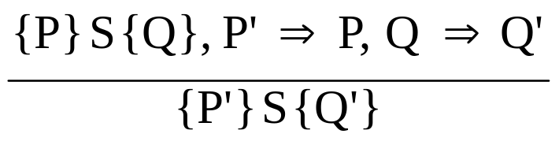
Axiomatic Semantics: Assignment
An axiom for assignment statements
(x = E): {Q_{x->E}} x = E {Q}
The Rule of Consequence:
Copyright © 2015 Pearson. All rights reserved.
1-<number>

Slide 82

Axiomatic Semantics: Sequences
An inference rule for sequences of the form S1; S2
{P1} S1 {P2}
{P2} S2 {P3}
Copyright © 2015 Pearson. All rights reserved.
1-<number>

Slide 83
Axiomatic Semantics: Selection
An inference rules for selection
- if B then S1 else S2
{B and P} S1 {Q}, {(not B) and P} S2 {Q}
{P} if B then S1 else S2 {Q}
Copyright © 2015 Pearson. All rights reserved.
1-<number>

Slide 84
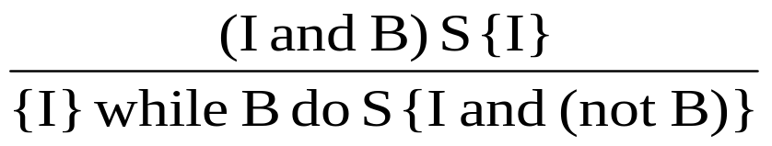
Axiomatic Semantics: Loops
An inference rule for logical pretest loops
{P} while B do S end {Q}
where I is the loop invariant (the inductive hypothesis)
Copyright © 2015 Pearson. All rights reserved.
1-<number>

Slide 85
Axiomatic Semantics: Axioms
Characteristics of the loop invariant: I must meet the following conditions:
  P => I -- the loop invariant must be true initially
  {I} B {I} -- evaluation of the Boolean must not change the validity of I
  {I and B} S {I} -- I is not changed by executing the body of the loop
  (I and (not B)) => Q -- if I is true and B is false, Q is implied
  The loop terminates -- can be difficult to prove
Copyright © 2015 Pearson. All rights reserved.
1-<number>

Slide 86
Loop Invariant
The loop invariant I is a weakened version of the loop postcondition, and it is also a precondition.
I must be weak enough to be satisfied prior to the beginning of the loop, but when combined with the loop exit condition, it must be strong enough to force the truth of the postcondition
Copyright © 2015 Pearson. All rights reserved.
1-<number>

Slide 87
Evaluation of Axiomatic Semantics
Developing axioms or inference rules for all of the statements in a language is difficult
It is a good tool for correctness proofs, and an excellent framework for reasoning about programs, but it is not as useful for language users and compiler writers
Its usefulness in describing the meaning of a programming language is limited for language users or compiler writers
Copyright © 2015 Pearson. All rights reserved.
1-<number>

Slide 88
Denotation Semantics vs Operational Semantics
In operational semantics, the state changes are defined by coded algorithms
In denotational semantics, the state changes are defined by rigorous mathematical functions
Copyright © 2015 Pearson. All rights reserved.
1-<number>

Slide 89
Summary
BNF and context-free grammars are equivalent meta-languages
  Well-suited for describing the syntax of programming languages
An attribute grammar is a descriptive formalism that can describe both the syntax and the semantics of a language
Three primary methods of semantics description
  Operation, axiomatic, denotational
Copyright © 2015 Pearson. All rights reserved.
1-<number>

Slide 90
Chapter 4
Lexical and Syntax Analysis

Slide 91
Chapter 4 Topics
Introduction
Lexical Analysis
The Parsing Problem
Recursive-Descent Parsing
Bottom-Up Parsing
Copyright © 2015 Pearson. All rights reserved.
1-<number>

Slide 92
Introduction
Language implementation systems must analyze source code, regardless of the specific implementation approach
Nearly all syntax analysis is based on a formal description of the syntax of the source language (BNF)
Copyright © 2015 Pearson. All rights reserved.
1-<number>

Slide 93
Syntax Analysis
The syntax analysis portion of a language processor nearly always consists of two parts:
  A low-level part called a lexical analyzer (mathematically, a finite automaton based on a regular grammar)
  A high-level part called a syntax analyzer, or parser (mathematically, a push-down automaton based on a context-free grammar, or BNF)
Copyright © 2015 Pearson. All rights reserved.
1-<number>

Slide 94
Advantages of Using BNF to Describe Syntax
Provides a clear and concise syntax description
The parser can be based directly on the BNF
Parsers based on BNF are easy to maintain
Copyright © 2015 Pearson. All rights reserved.
1-<number>

Slide 95
Reasons to Separate Lexical and Syntax Analysis
Simplicity - less complex approaches can be used for lexical analysis; separating them simplifies the parser
Efficiency - separation allows optimization of the lexical analyzer
Portability - parts of the lexical analyzer may not be portable, but the parser always is portable
Copyright © 2015 Pearson. All rights reserved.
1-<number>

Slide 96
Lexical Analysis
A lexical analyzer is a pattern matcher for character strings
A lexical analyzer is a “front-end” for the parser
Identifies substrings of the source program that belong together - lexemes
  Lexemes match a character pattern, which is associated with a lexical category called a token
  sum is a lexeme; its token may be IDENT
Copyright © 2015 Pearson. All rights reserved.
1-<number>

Slide 97
Lexical Analysis (continued)
The lexical analyzer is usually a function that is called by the parser when it needs the next token
Three approaches to building a lexical analyzer:
  Write a formal description of the tokens and use a software tool that constructs a table-driven lexical analyzer from such a description
  Design a state diagram that describes the tokens and write a program that implements the state diagram
  Design a state diagram that describes the tokens and hand-construct a table-driven implementation of the state diagram
Copyright © 2015 Pearson. All rights reserved.
1-<number>

Slide 98
State Diagram Design
  A naïve state diagram would have a transition from every state on every character in the source language - such a diagram would be very large!
Copyright © 2015 Pearson. All rights reserved.
1-<number>

Slide 99
Lexical Analysis (continued)
In many cases, transitions can be combined to simplify the state diagram
  When recognizing an identifier, all uppercase and lowercase letters are equivalent
    Use a character class that includes all letters
  When recognizing an integer literal, all digits are equivalent - use a digit class
Copyright © 2015 Pearson. All rights reserved.
1-<number>

Slide 100
Lexical Analysis (continued)
Reserved words and identifiers can be recognized together (rather than having a part of the diagram for each reserved word)
  Use a table lookup to determine whether a possible identifier is in fact a reserved word
Copyright © 2015 Pearson. All rights reserved.
1-<number>

Slide 101
Lexical Analysis (continued)
Convenient utility subprograms:
  getChar - gets the next character of input, puts it in nextChar, determines its class and puts the class in charClass
  addChar - puts the character from nextChar into the place the lexeme is being accumulated, lexeme
  lookup - determines whether the string in lexeme is a reserved word (returns a code)
Copyright © 2015 Pearson. All rights reserved.
1-<number>

Slide 102
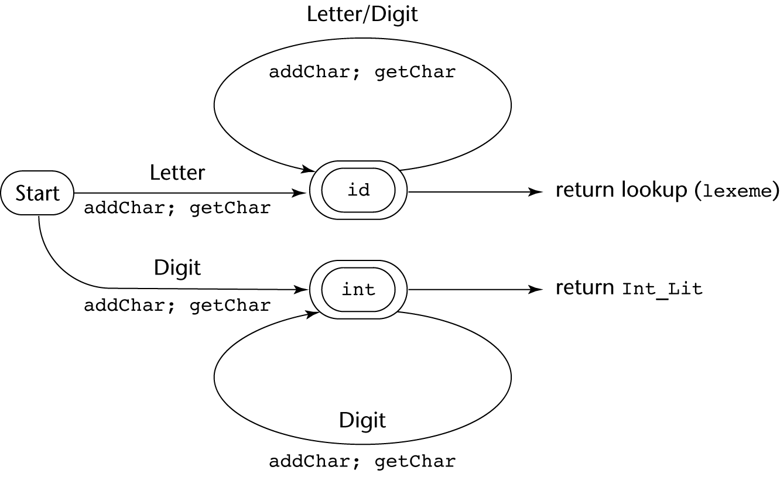
State Diagram
Copyright © 2015 Pearson. All rights reserved.
1-<number>

Slide 103
Lexical Analyzer
Implementation:
→ SHOW front.c (pp. 172-177)
- Following is the output of the lexical analyzer of
front.c when used on (sum + 47) / total
Next token is: 25 Next lexeme is (
Next token is: 11 Next lexeme is sum
Next token is: 21 Next lexeme is +
Next token is: 10 Next lexeme is 47
Next token is: 26 Next lexeme is )
Next token is: 24 Next lexeme is /
Next token is: 11 Next lexeme is total
Next token is: -1 Next lexeme is EOF
Copyright © 2015 Pearson. All rights reserved.
1-<number>

Slide 104
The Parsing Problem
Goals of the parser, given an input program:
  Find all syntax errors; for each, produce an appropriate diagnostic message and recover quickly
  Produce the parse tree, or at least a trace of the parse tree, for the program
Copyright © 2015 Pearson. All rights reserved.
1-<number>

Slide 105
The Parsing Problem (continued)
Two categories of parsers
  Top down - produce the parse tree, beginning at the root
    Order is that of a leftmost derivation
    Traces or builds the parse tree in preorder
  Bottom up - produce the parse tree, beginning at the leaves
    Order is that of the reverse of a rightmost derivation
Useful parsers look only one token ahead in the input
Copyright © 2015 Pearson. All rights reserved.
1-<number>

Slide 106
The Parsing Problem (continued)
Top-down Parsers
  Given a sentential form, xAα , the parser must choose the correct A-rule to get the next sentential form in the leftmost derivation, using only the first token produced by A
The most common top-down parsing algorithms:
  Recursive descent - a coded implementation
  LL parsers - table driven implementation
Copyright © 2015 Pearson. All rights reserved.
1-<number>

Slide 107
The Parsing Problem (continued)
Bottom-up parsers
  Given a right sentential form, α, determine what substring of α is the right-hand side of the rule in the grammar that must be reduced to produce the previous sentential form in the right derivation
  The most common bottom-up parsing algorithms are in the LR family
Copyright © 2015 Pearson. All rights reserved.
1-<number>

Slide 108
The Parsing Problem (continued)
The Complexity of Parsing
  Parsers that work for any unambiguous grammar are complex and inefficient ( O(n³), where n is the length of the input )
  Compilers use parsers that only work for a subset of all unambiguous grammars, but do it in linear time ( O(n), where n is the length of the input )
Copyright © 2015 Pearson. All rights reserved.
1-<number>

Slide 109
Recursive-Descent Parsing
There is a subprogram for each nonterminal in the grammar, which can parse sentences that can be generated by that nonterminal
EBNF is ideally suited for being the basis for a recursive-descent parser, because EBNF minimizes the number of nonterminals
Copyright © 2015 Pearson. All rights reserved.
1-<number>

Slide 110
Recursive-Descent Parsing (continued)
A grammar for simple expressions:
<expr> → <term> {(+ | -) <term>}
<term> → <factor> {(* | /) <factor>}
<factor> → id | int_constant | ( <expr> )
Copyright © 2015 Pearson. All rights reserved.
1-<number>

Slide 111
Recursive-Descent Parsing (continued)
Assume we have a lexical analyzer named lex, which puts the next token code in nextToken
The coding process when there is only one RHS:
  For each terminal symbol in the RHS, compare it with the next input token; if they match, continue, else there is an error
  For each nonterminal symbol in the RHS, call its associated parsing subprogram
Copyright © 2015 Pearson. All rights reserved.
1-<number>

Slide 112
Recursive-Descent Parsing (continued)
/* Function expr
Parses strings in the language
generated by the rule:
<expr> → <term> {(+ | -) <term>}
*/
void expr() {
/* Parse the first term */
term();
/* As long as the next token is + or -, call
lex to get the next token and parse the
next term */
while (nextToken == ADD_OP ||
nextToken == SUB_OP){
lex();
term();
}
}
Copyright © 2015 Pearson. All rights reserved.
1-<number>

Slide 113
Recursive-Descent Parsing (continued)
This particular routine does not detect errors
Convention: Every parsing routine leaves the next token in nextToken
Copyright © 2015 Pearson. All rights reserved.
1-<number>

Slide 114
Recursive-Descent Parsing (continued)
A nonterminal that has more than one RHS requires an initial process to determine which RHS it is to parse
  The correct RHS is chosen on the basis of the next token of input (the lookahead)
  The next token is compared with the first token that can be generated by each RHS until a match is found
  If no match is found, it is a syntax error
Copyright © 2015 Pearson. All rights reserved.
1-<number>

Slide 115
Recursive-Descent Parsing (continued)
/* term
Parses strings in the language generated by the rule:
<term> -> <factor> {(* | /) <factor>)
*/
void term() {
/* Parse the first factor */
factor();
/* As long as the next token is * or /,
next token and parse the next factor */
while (nextToken == MULT_OP || nextToken == DIV_OP) {
lex();
factor();
}
} /* End of function term */
Copyright © 2015 Pearson. All rights reserved.
1-<number>

Slide 116
Recursive-Descent Parsing (continued)
/* Function factor
Parses strings in the language
generated by the rule:
<factor> -> id | (<expr>) */
void factor() {
/* Determine which RHS */
if (nextToken) == ID_CODE || nextToken == INT_CODE)
/* For the RHS id, just call lex */
lex();
/* If the RHS is (<expr>) – call lex to pass over the left parenthesis,
call expr, and check for the right parenthesis */
else if (nextToken == LP_CODE) {
lex();
expr();
if (nextToken == RP_CODE)
lex();
else
error();
} /* End of else if (nextToken == ... */
else error(); /* Neither RHS matches */
}
Copyright © 2015 Pearson. All rights reserved.
1-<number>

Slide 117
Recursive-Descent Parsing (continued)
- Trace of the lexical and syntax analyzers on (sum + 47) / total
Next token is: 25 Next lexeme is ( Next token is: 11 Next lexeme is total
Enter <expr> Enter <factor>
Enter <term> Next token is: -1 Next lexeme is EOF
Enter <factor> Exit <factor>
Next token is: 11 Next lexeme is sum Exit <term>
Enter <expr> Exit <expr>
Enter <term>
Enter <factor>
Next token is: 21 Next lexeme is +
Exit <factor>
Exit <term>
Next token is: 10 Next lexeme is 47
Enter <term>
Enter <factor>
Next token is: 26 Next lexeme is )
Exit <factor>
Exit <term>
Exit <expr>
Next token is: 24 Next lexeme is /
Exit <factor>
Copyright © 2015 Pearson. All rights reserved.
1-<number>

Slide 118
Recursive-Descent Parsing (continued)
The LL Grammar Class
  The Left Recursion Problem
    If a grammar has left recursion, either direct or indirect, it cannot be the basis for a top-down parser
      A grammar can be modified to remove direct left recursion as follows:
      For each nonterminal, A,
      Group the A-rules as A → Aα₁ | … | Aα_{m} | β₁ | β₂ | … | β_{n}
      where none of the β‘s begins with A
      2. Replace the original A-rules with
      A → β₁A’ | β₂A’ | … | β_{n}A’
      A’ → α₁A’ | α₂A’ | … | α_{m}A’ | ε
Copyright © 2015 Pearson. All rights reserved.
1-<number>

Slide 119
Recursive-Descent Parsing (continued)
The other characteristic of grammars that disallows top-down parsing is the lack of pairwise disjointness
  The inability to determine the correct RHS on the basis of one token of lookahead
  Def: FIRST(α) = {a | α =>* aβ }
(If α =>* ε, ε is in FIRST(α))
Copyright © 2015 Pearson. All rights reserved.
1-<number>

Slide 120
Recursive-Descent Parsing (continued)
Pairwise Disjointness Test:
  For each nonterminal, A, in the grammar that has more than one RHS, for each pair of rules, A → α_{i} and A → α_{j}, it must be true that
FIRST(α_{i}) ⋂ FIRST(α_{j}) = φ
Example:
A → a | bB | cAb
A → a | aB
Copyright © 2015 Pearson. All rights reserved.
1-<number>

Slide 121
Recursive-Descent Parsing (continued)
Left factoring can resolve the problem
Replace
<variable> → identifier | identifier [<expression>]
with
<variable> → identifier <new>
<new> → ε | [<expression>]
or
<variable> → identifier [[<expression>]]
(the outer brackets are metasymbols of EBNF)
Copyright © 2015 Pearson. All rights reserved.
1-<number>

Slide 122
Bottom-up Parsing
The parsing problem is finding the correct RHS in a right-sentential form to reduce to get the previous right-sentential form in the derivation
Copyright © 2015 Pearson. All rights reserved.
1-<number>

Slide 123
Bottom-up Parsing (continued)
Intuition about handles:
  Def: β is the handle of the right sentential form
γ = αβw if and only if S =>*_{rm} αAw =>_{rm} αβw
  Def: β is a phrase of the right sentential form
γ if and only if S =>* γ = α₁Aα₂ =>+ α₁βα₂
  Def: β is a simple phrase of the right sentential form γ if and only if S =>* γ = α₁Aα₂ => α₁βα₂
Copyright © 2015 Pearson. All rights reserved.
1-<number>

Slide 124
Bottom-up Parsing (continued)
Intuition about handles (continued):
  The handle of a right sentential form is its leftmost simple phrase
  Given a parse tree, it is now easy to find the handle
  Parsing can be thought of as handle pruning
Copyright © 2015 Pearson. All rights reserved.
1-<number>

Slide 125
Bottom-up Parsing (continued)
Shift-Reduce Algorithms
  Reduce is the action of replacing the handle on the top of the parse stack with its corresponding LHS
  Shift is the action of moving the next token to the top of the parse stack
Copyright © 2015 Pearson. All rights reserved.
1-<number>

Slide 126
Bottom-up Parsing (continued)
Advantages of LR parsers:
  They will work for nearly all grammars that describe programming languages.
  They work on a larger class of grammars than other bottom-up algorithms, but are as efficient as any other bottom-up parser.
  They can detect syntax errors as soon as it is possible.
  The LR class of grammars is a superset of the class parsable by LL parsers.
Copyright © 2015 Pearson. All rights reserved.
1-<number>

Slide 127
Bottom-up Parsing (continued)
LR parsers must be constructed with a tool
Knuth’s insight: A bottom-up parser could use the entire history of the parse, up to the current point, to make parsing decisions
  There are only a finite and relatively small number of different parse situations that could have occurred, so the history could be stored in a parser state, on the parse stack
Copyright © 2015 Pearson. All rights reserved.
1-<number>

Slide 128
Bottom-up Parsing (continued)
An LR configuration stores the state of an LR parser
(S₀X₁S₁X₂S₂…X_{m}S_{m}, a_{i}a_{i+1}…a_{n}$)
Copyright © 2015 Pearson. All rights reserved.
1-<number>

Slide 129
Bottom-up Parsing (continued)
LR parsers are table driven, where the table has two components, an ACTION table and a GOTO table
  The ACTION table specifies the action of the parser, given the parser state and the next token
    Rows are state names; columns are terminals
  The GOTO table specifies which state to put on top of the parse stack after a reduction action is done
    Rows are state names; columns are nonterminals
Copyright © 2015 Pearson. All rights reserved.
1-<number>

Slide 130

Structure of An LR Parser
Copyright © 2015 Pearson. All rights reserved.
1-<number>

Slide 131
Bottom-up Parsing (continued)
Initial configuration: (S₀, a₁…a_{n}$)
Parser actions:
  For a Shift, the next symbol of input is pushed onto the stack, along with the state symbol that is part of the Shift specification in the Action table
  For a Reduce, remove the handle from the stack, along with its state symbols. Push the LHS of the rule. Push the state symbol from the GOTO table, using the state symbol just below the new LHS in the stack and the LHS of the new rule as the row and column into the GOTO table
Copyright © 2015 Pearson. All rights reserved.
1-<number>

Slide 132
Bottom-up Parsing (continued)
Parser actions (continued):
  For an Accept, the parse is complete and no errors were found.
  For an Error, the parser calls an error-handling routine.
Copyright © 2015 Pearson. All rights reserved.
1-<number>

Slide 133
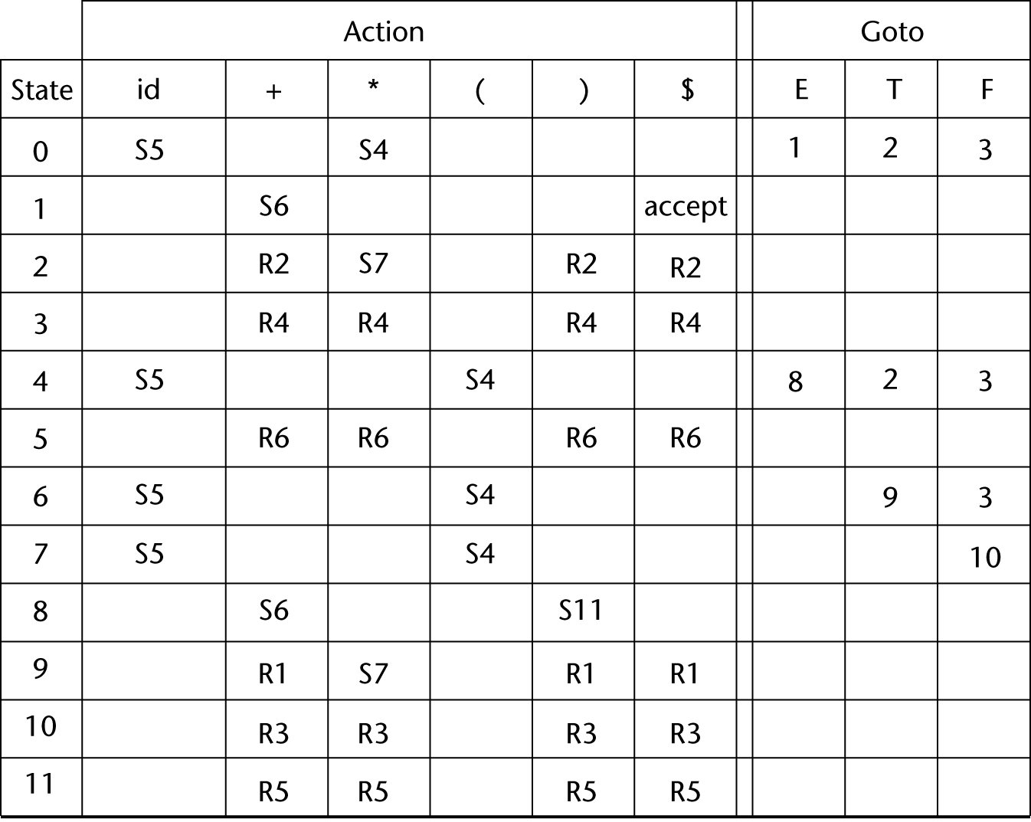
LR Parsing Table
Copyright © 2015 Pearson. All rights reserved.
1-<number>

Slide 134
Bottom-up Parsing (continued)
A parser table can be generated from a given grammar with a tool, e.g., yacc or bison
Copyright © 2015 Pearson. All rights reserved.
1-<number>

Slide 135
Summary
Syntax analysis is a common part of language implementation
A lexical analyzer is a pattern matcher that isolates small-scale parts of a program
  Detects syntax errors
  Produces a parse tree
A recursive-descent parser is an LL parser
  EBNF
Parsing problem for bottom-up parsers: find the substring of current sentential form
The LR family of shift-reduce parsers is the most common bottom-up parsing approach
Copyright © 2015 Pearson. All rights reserved.
1-<number>

Slide 136
Chapter 5
Names, Bindings, and Scopes

Slide 137
Chapter 5 Topics
Introduction
Names
Variables
The Concept of Binding
Scope
Scope and Lifetime
Referencing Environments
Named Constants
Copyright © 2015 Pearson. All rights reserved.
1-<number>

Slide 138
Introduction
Imperative languages are abstractions of von Neumann architecture
  Memory
  Processor
Variables are characterized by attributes
  To design a type, must consider scope, lifetime, type checking, initialization, and type compatibility
Copyright © 2015 Pearson. All rights reserved.
1-<number>

Slide 139
Names
Design issues for names:
  Are names case sensitive?
  Are special words reserved words or keywords?
Copyright © 2015 Pearson. All rights reserved.
1-<number>

Slide 140
Names (continued)
Length
  If too short, they cannot be connotative
  Language examples:
    C99: no limit but only the first 63 are significant; also, external names are limited to a maximum of 31
    C# and Java: no limit, and all are significant
    C++: no limit, but implementers often impose one
Copyright © 2015 Pearson. All rights reserved.
1-<number>

Slide 141
Names (continued)
Special characters
  PHP: all variable names must begin with dollar signs
  Perl: all variable names begin with special characters, which specify the variable’s type
  Ruby: variable names that begin with @ are instance variables; those that begin with @@ are class variables
Copyright © 2015 Pearson. All rights reserved.
1-<number>

Slide 142
Names (continued)
Case sensitivity
  Disadvantage: readability (names that look alike are different)
    Names in the C-based languages are case sensitive
    Names in others are not
    Worse in C++, Java, and C# because predefined names are mixed case (e.g. IndexOutOfBoundsException)
Copyright © 2015 Pearson. All rights reserved.
1-<number>

Slide 143
Names (continued)
Special words
  An aid to readability; used to delimit or separate statement clauses
  A keyword is a word that is special only in
  certain contexts
  A reserved word is a special word that cannot be used as a user-defined name
  Potential problem with reserved words: If there are too many, many collisions occur (e.g., COBOL has 300 reserved words!)
Copyright © 2015 Pearson. All rights reserved.
1-<number>

Slide 144
Variables
A variable is an abstraction of a memory cell
Variables can be characterized as a sextuple of attributes:
  Name
  Address
  Value
  Type
  Lifetime
  Scope
Copyright © 2015 Pearson. All rights reserved.
1-<number>

Slide 145
Variables Attributes
Name - not all variables have them
Address - the memory address with which it is associated
  A variable may have different addresses at different times during execution
  A variable may have different addresses at different places in a program
  If two variable names can be used to access the same memory location, they are called aliases
  Aliases are created via pointers, reference variables, C and C++ unions
  Aliases are harmful to readability (program readers must remember all of them)
Copyright © 2015 Pearson. All rights reserved.
1-<number>

Slide 146
Variables Attributes (continued)
Type - determines the range of values of variables and the set of operations that are defined for values of that type; in the case of floating point, type also determines the precision
Value - the contents of the location with which the variable is associated
- The l-value of a variable is its address
- The r-value of a variable is its value
Abstract memory cell - the physical cell or collection of cells associated with a variable
Copyright © 2015 Pearson. All rights reserved.
1-<number>

Slide 147
The Concept of Binding
A binding is an association between an entity and an attribute, such as between a variable and its type or value, or between an operation and a symbol
Binding time is the time at which a binding takes place.
Copyright © 2015 Pearson. All rights reserved.
1-<number>

Slide 148
Possible Binding Times
Language design time -- bind operator symbols to operations
Language implementation time-- bind floating point type to a representation
Compile time -- bind a variable to a type in C or Java
Load time -- bind a C or C++ static variable to a memory cell)
Runtime -- bind a nonstatic local variable to a memory cell
Copyright © 2015 Pearson. All rights reserved.
1-<number>

Slide 149
Static and Dynamic Binding
A binding is static if it first occurs before run time and remains unchanged throughout program execution.
A binding is dynamic if it first occurs during execution or can change during execution of the program
Copyright © 2015 Pearson. All rights reserved.
1-<number>

Slide 150
Type Binding
How is a type specified?
When does the binding take place?
If static, the type may be specified by either an explicit or an implicit declaration
Copyright © 2015 Pearson. All rights reserved.
1-<number>

Slide 151
Explicit/Implicit Declaration
An explicit declaration is a program statement used for declaring the types of variables
An implicit declaration is a default mechanism for specifying types of variables through default conventions, rather than declaration statements
Basic, Perl, Ruby, JavaScript, and PHP provide implicit declarations
  Advantage: writability (a minor convenience)
  Disadvantage: reliability (less trouble with Perl)
Copyright © 2015 Pearson. All rights reserved.
1-<number>

Slide 152
Explicit/Implicit Declaration (continued)
Some languages use type inferencing to determine types of variables (context)
  C# - a variable can be declared with var and an initial value. The initial value sets the type
  Visual Basic 9.0+, ML, Haskell, and F# use type inferencing. The context of the appearance of a variable determines its type
Copyright © 2015 Pearson. All rights reserved.
1-<number>

Slide 153
Dynamic Type Binding
Dynamic Type Binding (JavaScript, Python, Ruby, PHP, and C# (limited))
Specified through an assignment statement e.g., JavaScript
list = [2, 4.33, 6, 8];
list = 17.3;
  Advantage: flexibility (generic program units)
  Disadvantages:
    High cost (dynamic type checking and interpretation)
    Type error detection by the compiler is difficult
Copyright © 2015 Pearson. All rights reserved.
1-<number>

Slide 154
Variable Attributes (continued)
Storage Bindings & Lifetime
  Allocation - getting a cell from some pool of available cells
  Deallocation - putting a cell back into the pool
The lifetime of a variable is the time during which it is bound to a particular memory cell
Copyright © 2015 Pearson. All rights reserved.
1-<number>

Slide 155
Categories of Variables by Lifetimes
Static--bound to memory cells before execution begins and remains bound to the same memory cell throughout execution, e.g., C and C++ static variables in functions
  Advantages: efficiency (direct addressing), history-sensitive subprogram support
  Disadvantage: lack of flexibility (no recursion)
Copyright © 2015 Pearson. All rights reserved.
1-<number>

Slide 156
Categories of Variables by Lifetimes
Stack-dynamic--Storage bindings are created for variables when their declaration statements are elaborated.
(A declaration is elaborated when the executable code associated with it is executed)
If scalar, all attributes except address are statically bound
  local variables in C subprograms (not declared static) and Java methods
Advantage: allows recursion; conserves storage
Disadvantages:
  Overhead of allocation and deallocation
  Subprograms cannot be history sensitive
  Inefficient references (indirect addressing)
Copyright © 2015 Pearson. All rights reserved.
1-<number>

Slide 157
Categories of Variables by Lifetimes
Explicit heap-dynamic -- Allocated and deallocated by explicit directives, specified by the programmer, which take effect during execution
Referenced only through pointers or references, e.g. dynamic objects in C++ (via new and delete), all objects in Java
Advantage: provides for dynamic storage management
Disadvantage: inefficient and unreliable
Copyright © 2015 Pearson. All rights reserved.
1-<number>

Slide 158
Categories of Variables by Lifetimes
Implicit heap-dynamic--Allocation and deallocation caused by assignment statements
  all variables in APL; all strings and arrays in Perl, JavaScript, and PHP
Advantage: flexibility (generic code)
Disadvantages:
  Inefficient, because all attributes are dynamic
  Loss of error detection
Copyright © 2015 Pearson. All rights reserved.
1-<number>

Slide 159
Variable Attributes: Scope
The scope of a variable is the range of statements over which it is visible
The local variables of a program unit are those that are declared in that unit
The nonlocal variables of a program unit are those that are visible in the unit but not declared there
Global variables are a special category of nonlocal variables
The scope rules of a language determine how references to names are associated with variables
Copyright © 2015 Pearson. All rights reserved.
1-<number>

Slide 160
Static Scope
Based on program text
To connect a name reference to a variable, you (or the compiler) must find the declaration
Search process: search declarations, first locally, then in increasingly larger enclosing scopes, until one is found for the given name
Enclosing static scopes (to a specific scope) are called its static ancestors; the nearest static ancestor is called a static parent
Some languages allow nested subprogram definitions, which create nested static scopes (e.g., Ada, JavaScript, Common Lisp, Scheme, Fortran 2003+, F#, and Python)
Copyright © 2015 Pearson. All rights reserved.
1-<number>

Slide 161
Scope (continued)
Variables can be hidden from a unit by having a "closer" variable with the same name
Copyright © 2015 Pearson. All rights reserved.
1-<number>

Slide 162
Blocks
  A method of creating static scopes inside program units--from ALGOL 60
  Example in C:
void sub() {
int count;
while (...) {
int count;
count++;
...
}
…
}
- Note: legal in C and C++, but not in Java
and C# - too error-prone
Copyright © 2015 Pearson. All rights reserved.
1-<number>

Slide 163
The LET Construct
Most functional languages include some form of let construct
A let construct has two parts
  The first part binds names to values
  The second part uses the names defined in the first part
In Scheme:
(LET (
(name₁ expression₁)
…
(name_{n} expression_{n})
)
Copyright © 2015 Pearson. All rights reserved.
1-<number>

Slide 164
The LET Construct (continued)
In ML:
let
val name₁ = expression₁
…
val name_{n} = expression_{n}
in
expression
end;
In F#:
  First part: let left_side = expression
  (left_side is either a name or a tuple pattern)
  All that follows is the second part
Copyright © 2015 Pearson. All rights reserved.
1-<number>

Slide 165
Declaration Order
C99, C++, Java, and C# allow variable declarations to appear anywhere a statement can appear
  In C99, C++, and Java, the scope of all local variables is from the declaration to the end of the block
  In C#, the scope of any variable declared in a block is the whole block, regardless of the position of the declaration in the block
    However, a variable still must be declared before it can be used
Copyright © 2015 Pearson. All rights reserved.
1-<number>

Slide 166
Declaration Order (continued)
In C++, Java, and C#, variables can be declared in for statements
  The scope of such variables is restricted to the for construct
Copyright © 2015 Pearson. All rights reserved.
1-<number>

Slide 167
Global Scope
C, C++, PHP, and Python support a program structure that consists of a sequence of function definitions in a file
  These languages allow variable declarations to appear outside function definitions
C and C++have both declarations (just attributes) and definitions (attributes and storage)
  A declaration outside a function definition specifies that it is defined in another file
Copyright © 2015 Pearson. All rights reserved.
1-<number>

Slide 168
Global Scope (continued)
PHP
  Programs are embedded in HTML markup documents, in any number of fragments, some statements and some function definitions
  The scope of a variable (implicitly) declared in a function is local to the function
  The scope of a variable implicitly declared outside functions is from the declaration to the end of the program, but skips over any intervening functions
    Global variables can be accessed in a function through the $GLOBALS array or by declaring it global
Copyright © 2015 Pearson. All rights reserved.
1-<number>

Slide 169
Global Scope (continued)
Python
  A global variable can be referenced in functions, but can be assigned in a function only if it has been declared to be global in the function
Copyright © 2015 Pearson. All rights reserved.
1-<number>

Slide 170
Evaluation of Static Scoping
Works well in many situations
Problems:
  In most cases, too much access is possible
  As a program evolves, the initial structure is destroyed and local variables often become global; subprograms also gravitate toward become global, rather than nested
Copyright © 2015 Pearson. All rights reserved.
1-<number>

Slide 171
Dynamic Scope
Based on calling sequences of program units, not their textual layout (temporal versus spatial)
References to variables are connected to declarations by searching back through the chain of subprogram calls that forced execution to this point
Copyright © 2015 Pearson. All rights reserved.
1-<number>

Slide 172
Scope Example
function big() {
function sub1()
var x = 7;
function sub2() {
var y = x;
}
var x = 3;
}
  Static scoping
    Reference to x in sub2 is to big's x
  Dynamic scoping
    Reference to x in sub2 is to sub1's x
big calls sub1
sub1 calls sub2
sub2 uses x
Copyright © 2015 Pearson. All rights reserved.
1-<number>

Slide 173
Scope Example
Evaluation of Dynamic Scoping:
  Advantage: convenience
  Disadvantages:
    While a subprogram is executing, its variables are visible to all subprograms it calls
    Impossible to statically type check
    3. Poor readability- it is not possible to statically
    determine the type of a variable
Copyright © 2015 Pearson. All rights reserved.
1-<number>

Slide 174
Scope and Lifetime
Scope and lifetime are sometimes closely related, but are different concepts
Consider a static variable in a C or C++ function
Copyright © 2015 Pearson. All rights reserved.
1-<number>

Slide 175
Referencing Environments
The referencing environment of a statement is the collection of all names that are visible in the statement
In a static-scoped language, it is the local variables plus all of the visible variables in all of the enclosing scopes
A subprogram is active if its execution has begun but has not yet terminated
In a dynamic-scoped language, the referencing environment is the local variables plus all visible variables in all active subprograms
Copyright © 2015 Pearson. All rights reserved.
1-<number>

Slide 176
Named Constants
A named constant is a variable that is bound to a value only when it is bound to storage
Advantages: readability and modifiability
Used to parameterize programs
The binding of values to named constants can be either static (called manifest constants) or dynamic
Languages:
  C++ and Java: expressions of any kind, dynamically bound
  C# has two kinds, readonly and const
  - the values of const named constants are bound at
  compile time
  - The values of readonly named constants are
  dynamically bound
Copyright © 2015 Pearson. All rights reserved.
1-<number>

Slide 177
Summary
Case sensitivity and the relationship of names to special words represent design issues of names
Variables are characterized by the sextuples: name, address, value, type, lifetime, scope
Binding is the association of attributes with program entities
Scalar variables are categorized as: static, stack dynamic, explicit heap dynamic, implicit heap dynamic
Strong typing means detecting all type errors
Copyright © 2015 Pearson. All rights reserved.
1-<number>

Slide 178
Chapter 7
Expressions and
Assignment Statements

Slide 179
Chapter 7 Topics
Introduction
Arithmetic Expressions
Overloaded Operators
Type Conversions
Relational and Boolean Expressions
Short-Circuit Evaluation
Assignment Statements
Mixed-Mode Assignment
Copyright © 2015 Pearson. All rights reserved.
1-<number>

Slide 180
Introduction
Expressions are the fundamental means of specifying computations in a programming language
To understand expression evaluation, need to be familiar with the orders of operator and operand evaluation
Essence of imperative languages is dominant role of assignment statements
Copyright © 2015 Pearson. All rights reserved.
1-<number>

Slide 181
Arithmetic Expressions
Arithmetic evaluation was one of the motivations for the development of the first programming languages
Arithmetic expressions consist of operators, operands, parentheses, and function calls
Copyright © 2015 Pearson. All rights reserved.
1-<number>

Slide 182
Arithmetic Expressions: Design Issues
Design issues for arithmetic expressions
  Operator precedence rules?
  Operator associativity rules?
  Order of operand evaluation?
  Operand evaluation side effects?
  Operator overloading?
  Type mixing in expressions?
Copyright © 2015 Pearson. All rights reserved.
1-<number>

Slide 183
Arithmetic Expressions: Operators
A unary operator has one operand
A binary operator has two operands
A ternary operator has three operands
Copyright © 2015 Pearson. All rights reserved.
1-<number>

Slide 184
Arithmetic Expressions: Operator Precedence Rules
The operator precedence rules for expression evaluation define the order in which “adjacent” operators of different precedence levels are evaluated
Typical precedence levels
  parentheses
  unary operators
  ** (if the language supports it)
  *, /
  +, -
Copyright © 2015 Pearson. All rights reserved.
1-<number>

Slide 185
Arithmetic Expressions: Operator Associativity Rule
The operator associativity rules for expression evaluation define the order in which adjacent operators with the same precedence level are evaluated
Typical associativity rules
  Left to right, except **, which is right to left
  Sometimes unary operators associate right to left (e.g., in FORTRAN)
APL is different; all operators have equal precedence and all operators associate right to left
Precedence and associativity rules can be overriden with parentheses
Copyright © 2015 Pearson. All rights reserved.
1-<number>

Slide 186
Expressions in Ruby and Scheme
Ruby
  All arithmetic, relational, and assignment operators, as well as array indexing, shifts, and bit-wise logic operators, are implemented as methods
- One result of this is that these operators can all
be overriden by application programs
Scheme (and Common Lisp)
  All arithmetic and logic operations are by explicitly called subprograms
  a + b * c is coded as (+ a (* b c))
Copyright © 2015 Pearson. All rights reserved.
1-<number>

Slide 187
Arithmetic Expressions: Conditional Expressions
Conditional Expressions
  C-based languages (e.g., C, C++)
  An example:
average = (count == 0)? 0 : sum / count
  Evaluates as if written as follows:
  if (count == 0)
  average = 0
  else
  average = sum /count
Copyright © 2015 Pearson. All rights reserved.
1-<number>

Slide 188
Arithmetic Expressions: Operand Evaluation Order
Operand evaluation order
  Variables: fetch the value from memory
  Constants: sometimes a fetch from memory; sometimes the constant is in the machine language instruction
  Parenthesized expressions: evaluate all operands and operators first
  The most interesting case is when an operand is a function call
Copyright © 2015 Pearson. All rights reserved.
1-<number>

Slide 189
Arithmetic Expressions: Potentials for Side Effects
Functional side effects: when a function changes a two-way parameter or a non-local variable
Problem with functional side effects:
  When a function referenced in an expression alters another operand of the expression; e.g., for a parameter change:
a = 10;
/* assume that fun changes its parameter */
b = a + fun(&a);
Copyright © 2015 Pearson. All rights reserved.
1-<number>

Slide 190
Functional Side Effects
Two possible solutions to the problem
  Write the language definition to disallow functional side effects
    No two-way parameters in functions
    No non-local references in functions
    Advantage: it works!
    Disadvantage: inflexibility of one-way parameters and lack of non-local references
  Write the language definition to demand that operand evaluation order be fixed
    Disadvantage: limits some compiler optimizations
    Java requires that operands appear to be evaluated in left-to-right order
Copyright © 2015 Pearson. All rights reserved.
1-<number>

Slide 191
Referential Transparency
A program has the property of referential transparency if any two expressions in the program that have the same value can be substituted for one another anywhere in the program, without affecting the action of the program
  result1 = (fun(a) + b) / (fun(a) – c);
  temp = fun(a);
  result2 = (temp + b) / (temp – c);
  If fun has no side effects, result1 = result2
  Otherwise, not, and referential transparency is violated
Copyright © 2015 Pearson. All rights reserved.
1-<number>

Slide 192
Referential Transparency (continued)
Advantage of referential transparency
  Semantics of a program is much easier to understand if it has referential transparency
Because they do not have variables, programs in pure functional languages are referentially transparent
  Functions cannot have state, which would be stored in local variables
  If a function uses an outside value, it must be a constant (there are no variables). So, the value of a function depends only on its parameters
Copyright © 2015 Pearson. All rights reserved.
1-<number>

Slide 193
Overloaded Operators
Use of an operator for more than one purpose is called operator overloading
Some are common (e.g., + for int and float)
Some are potential trouble (e.g., * in C and C++)
  Loss of compiler error detection (omission of an operand should be a detectable error)
  Some loss of readability
Copyright © 2015 Pearson. All rights reserved.
1-<number>

Slide 194
Overloaded Operators (continued)
C++, C#, and F# allow user-defined overloaded operators
  When sensibly used, such operators can be an aid to readability (avoid method calls, expressions appear natural)
  Potential problems:
    Users can define nonsense operations
    Readability may suffer, even when the operators make sense
Copyright © 2015 Pearson. All rights reserved.
1-<number>

Slide 195
Type Conversions
A narrowing conversion is one that converts an object to a type that cannot include all of the values of the original type e.g., float to int
A widening conversion is one in which an object is converted to a type that can include at least approximations to all of the values of the original type e.g., int to float
Copyright © 2015 Pearson. All rights reserved.
1-<number>

Slide 196
Type Conversions: Mixed Mode
A mixed-mode expression is one that has operands of different types
A coercion is an implicit type conversion
Disadvantage of coercions:
  They decrease in the type error detection ability of the compiler
In most languages, all numeric types are coerced in expressions, using widening conversions
In ML and F#, there are no coercions in expressions
Copyright © 2015 Pearson. All rights reserved.
1-<number>

Slide 197
Explicit Type Conversions
Called casting in C-based languages
Examples
  C: (int)angle
  F#: float(sum)
  Note that F#’s syntax is similar to that of function calls
Copyright © 2015 Pearson. All rights reserved.
1-<number>

Slide 198
Errors in Expressions
Causes
  Inherent limitations of arithmetic e.g., division by zero
  Limitations of computer arithmetic e.g. overflow
Often ignored by the run-time system
Copyright © 2015 Pearson. All rights reserved.
1-<number>

Slide 199
Relational and Boolean Expressions
Relational Expressions
  Use relational operators and operands of various types
  Evaluate to some Boolean representation
  Operator symbols used vary somewhat among languages (!=, /=, ~=, .NE., <>, #)
JavaScript and PHP have two additional relational operator, === and !==
  - Similar to their cousins, == and !=, except that they do not coerce their operands
  Ruby uses == for equality relation operator that uses coercions and eql? for those that do not
Copyright © 2015 Pearson. All rights reserved.
1-<number>

Slide 200
Relational and Boolean Expressions
Boolean Expressions
  Operands are Boolean and the result is Boolean
  Example operators
C89 has no Boolean type--it uses int type with 0 for false and nonzero for true
One odd characteristic of C’s expressions: a < b < c is a legal expression, but the result is not what you might expect:
  Left operator is evaluated, producing 0 or 1
  The evaluation result is then compared with the third operand (i.e., c)
Copyright © 2015 Pearson. All rights reserved.
1-<number>

Slide 201
Short Circuit Evaluation
An expression in which the result is determined without evaluating all of the operands and/or operators
Example: (13 * a) * (b / 13 – 1)
  If a is zero, there is no need to evaluate (b /13 - 1)
Problem with non-short-circuit evaluation
  index = 0;
  while (index <= length) && (LIST[index] != value)
  index++;
  When index=length, LIST[index] will cause an indexing problem (assuming LIST is length - 1 long)
Copyright © 2015 Pearson. All rights reserved.
1-<number>

Slide 202
Short Circuit Evaluation (continued)
C, C++, and Java: use short-circuit evaluation for the usual Boolean operators (&& and ||), but also provide bitwise Boolean operators that are not short circuit (& and |)
All logic operators in Ruby, Perl, ML, F#, and Python are short-circuit evaluated
Short-circuit evaluation exposes the potential problem of side effects in expressions
e.g. (a > b) || (b++ / 3)
Copyright © 2015 Pearson. All rights reserved.
1-<number>

Slide 203
Assignment Statements
The general syntax
  <target_var> <assign_operator> <expression>
The assignment operator
  = Fortran, BASIC, the C-based languages
  := Ada
= can be bad when it is overloaded for the relational operator for equality (that’s why the C-based languages use == as the relational operator)
Copyright © 2015 Pearson. All rights reserved.
1-<number>

Slide 204
Assignment Statements: Conditional Targets
Conditional targets (Perl)
($flag ? $total : $subtotal) = 0
  Which is equivalent to
  if ($flag){
  $total = 0
  } else {
  $subtotal = 0
  }
Copyright © 2015 Pearson. All rights reserved.
1-<number>

Slide 205
Assignment Statements: Compound Assignment Operators
A shorthand method of specifying a commonly needed form of assignment
Introduced in ALGOL; adopted by C and the C-based languaes
  Example
    a = a + b
    can be written as
    a += b
Copyright © 2015 Pearson. All rights reserved.
1-<number>

Slide 206
Assignment Statements: Unary Assignment Operators
Unary assignment operators in C-based languages combine increment and decrement operations with assignment
Examples
  sum = ++count (count incremented, then assigned to sum)
  sum = count++ (count assigned to sum, then incremented
  count++ (count incremented)
  -count++ (count incremented then negated)
Copyright © 2015 Pearson. All rights reserved.
1-<number>

Slide 207
Assignment as an Expression
In the C-based languages, Perl, and JavaScript, the assignment statement produces a result and can be used as an operand
while ((ch = getchar())!= EOF){…}
ch = getchar() is carried out; the result (assigned to ch) is used as a conditional value for the while statement
Disadvantage: another kind of expression side effect
Copyright © 2015 Pearson. All rights reserved.
1-<number>

Slide 208
Multiple Assignments
Perl, Ruby, and Lua allow multiple-target multiple-source assignments
($first, $second, $third) = (20, 30, 40);
Also, the following is legal and performs an interchange:
($first, $second) = ($second, $first);
Copyright © 2015 Pearson. All rights reserved.
1-<number>

Slide 209
Assignment in Functional Languages
Identifiers in functional languages are only names of values
ML
  Names are bound to values with val
  val fruit = apples + oranges;
  If another val for fruit follows, it is a new and different name
F#
  F#’s let is like ML’s val, except let also creates a new scope
Copyright © 2015 Pearson. All rights reserved.
1-<number>

Slide 210
Mixed-Mode Assignment
Assignment statements can also be mixed-mode
In Fortran, C, Perl, and C++, any numeric type value can be assigned to any numeric type variable
In Java and C#, only widening assignment coercions are done
In Ada, there is no assignment coercion
Copyright © 2015 Pearson. All rights reserved.
1-<number>

Slide 211
Summary
Expressions
Operator precedence and associativity
Operator overloading
Mixed-type expressions
Various forms of assignment
Copyright © 2015 Pearson. All rights reserved.
1-<number>

Slide 212
Chapter 8
Statement-Level
Control Structures

Slide 213
Chapter 8 Topics
Introduction
Selection Statements
Iterative Statements
Unconditional Branching
Guarded Commands
Conclusions
Copyright © 2015 Pearson. All rights reserved.
1-<number>

Slide 214
Levels of Control Flow
Within expressions (Chapter 7)
Among program units (Chapter 9)
Among program statements (this chapter)
Copyright © 2015 Pearson. All rights reserved.
1-<number>

Slide 215
Control Statements: Evolution
FORTRAN I control statements were based directly on IBM 704 hardware
Much research and argument in the 1960s about the issue
  One important result: It was proven that all algorithms represented by flowcharts can be coded with only two-way selection and pretest logical loops
Copyright © 2015 Pearson. All rights reserved.
1-<number>

Slide 216
Control Structure
A control structure is a control statement and the statements whose execution it controls
Design question
  Should a control structure have multiple entries?
Copyright © 2015 Pearson. All rights reserved.
1-<number>

Slide 217
Selection Statements
A selection statement provides the means of choosing between two or more paths of execution
Two general categories:
  Two-way selectors
  Multiple-way selectors
Copyright © 2015 Pearson. All rights reserved.
1-<number>

Slide 218
Two-Way Selection Statements
General form:
if control_expression
then clause
else clause
Design Issues:
  What is the form and type of the control expression?
  How are the then and else clauses specified?
  How should the meaning of nested selectors be specified?
Copyright © 2015 Pearson. All rights reserved.
1-<number>

Slide 219
The Control Expression
If the then reserved word or some other syntactic marker is not used to introduce the then clause, the control expression is placed in parentheses
In C89, C99, Python, and C++, the control expression can be arithmetic
In most other languages, the control expression must be Boolean
Copyright © 2015 Pearson. All rights reserved.
1-<number>

Slide 220
Clause Form
In many contemporary languages, the then and else clauses can be single statements or compound statements
In Perl, all clauses must be delimited by braces (they must be compound)
In Python and Ruby, clauses are statement sequences
Python uses indentation to define clauses
if x > y :
x = y
print " x was greater than y"
Copyright © 2015 Pearson. All rights reserved.
1-<number>

Slide 221
Nesting Selectors
Java example
  if (sum == 0)
if (count == 0)
result = 0;
else result = 1;
Which if gets the else?
Java's static semantics rule: else matches with the nearest previous if
Copyright © 2015 Pearson. All rights reserved.
1-<number>

Slide 222
Nesting Selectors (continued)
To force an alternative semantics, compound statements may be used:
if (sum == 0) {
if (count == 0)
result = 0;
}
else result = 1;
The above solution is used in C, C++, and C#
Copyright © 2015 Pearson. All rights reserved.
1-<number>

Slide 223
Nesting Selectors (continued)
Statement sequences as clauses: Ruby
if sum == 0 then
if count == 0 then
result = 0
else
result = 1
end
end
Copyright © 2015 Pearson. All rights reserved.
1-<number>

Slide 224
Nesting Selectors (continued)
Python
if sum == 0 :
if count == 0 :
result = 0
else :
result = 1
Copyright © 2015 Pearson. All rights reserved.
1-<number>

Slide 225
Selector Expressions
In ML, F#, and Lisp, the selector is an expression; in F#:
let y =
if x > 0 then x
else 2 * x
  - If the if expression returns a value, there must be an else clause (the expression could produce a unit type, which has no value). The types of the values returned by then and else clauses must be the same.
Copyright © 2015 Pearson. All rights reserved.
1-<number>

Slide 226
Multiple-Way Selection Statements
Allow the selection of one of any number of statements or statement groups
Design Issues:
  What is the form and type of the control expression?
  How are the selectable segments specified?
  Is execution flow through the structure restricted to include just a single selectable segment?
  How are case values specified?
  What is done about unrepresented expression values?
Copyright © 2015 Pearson. All rights reserved.
1-<number>

Slide 227
Multiple-Way Selection: Examples
C, C++, Java, and JavaScript
switch (expression) {
case const_expr₁: stmt₁;
…
case const_expr_{n}: stmt_{n};
[default: stmt_{n+1}]
}
Copyright © 2015 Pearson. All rights reserved.
1-<number>

Slide 228
Multiple-Way Selection: Examples
Design choices for C’s switch statement
  Control expression can be only an integer type
  Selectable segments can be statement sequences, blocks, or compound statements
  Any number of segments can be executed in one execution of the construct (there is no implicit branch at the end of selectable segments)
  default clause is for unrepresented values (if there is no default, the whole statement does nothing)
Copyright © 2015 Pearson. All rights reserved.
1-<number>

Slide 229
Multiple-Way Selection: Examples
C#
  Differs from C in that it has a static semantics rule that disallows the implicit execution of more than one segment
  Each selectable segment must end with an unconditional branch (goto or break)
  Also, in C# the control expression and the case constants can be strings
Copyright © 2015 Pearson. All rights reserved.
1-<number>

Slide 230
Multiple-Way Selection: Examples
Ruby has two forms of case statements-we’ll cover
only one
leap = case
when year % 400 == 0 then true
when year % 100 == 0 then false
else year % 4 == 0
end
Copyright © 2015 Pearson. All rights reserved.
1-<number>

Slide 231
Implementing Multiple Selectors
Approaches:
  Multiple conditional branches
  Store case values in a table and use a linear search of the table
  When there are more than ten cases, a hash table of case values can be used
  If the number of cases is small and more than half of the whole range of case values are represented, an array whose indices are the case values and whose values are the case labels can be used
Copyright © 2015 Pearson. All rights reserved.
1-<number>

Slide 232
Multiple-Way Selection Using if
Multiple Selectors can appear as direct extensions to two-way selectors, using else-if clauses, for example in Python:
  if count < 10 :
  bag1 = True
  elif count < 100 :
  bag2 = True
  elif count < 1000 :
  bag3 = True
Copyright © 2015 Pearson. All rights reserved.
1-<number>

Slide 233
Multiple-Way Selection Using if
The Python example can be written as a Ruby case
case
when count < 10 then bag1 = true
when count < 100 then bag2 = true
when count < 1000 then bag3 = true
end
Copyright © 2015 Pearson. All rights reserved.
1-<number>

Slide 234
Scheme’s Multiple Selector
General form of a call to COND:
(COND
(predicate₁ expression₁)
…
(predicate_{n} expression_{n})
[(ELSE expression_{n+1})]
)
  The ELSE clause is optional; ELSE is a synonym for true
  Each predicate-expression pair is a parameter
  - Semantics: The value of the evaluation of COND is the value of the expression associated with the first predicate expression that is true
Copyright © 2015 Pearson. All rights reserved.
1-<number>

Slide 235
Iterative Statements
The repeated execution of a statement or compound statement is accomplished either by iteration or recursion
General design issues for iteration control statements:
  1. How is iteration controlled?
  2. Where is the control mechanism in the loop?
Copyright © 2015 Pearson. All rights reserved.
1-<number>

Slide 236
Counter-Controlled Loops
A counting iterative statement has a loop variable, and a means of specifying the initial and terminal, and stepsize values
Design Issues:
  What are the type and scope of the loop variable?
  Should it be legal for the loop variable or loop parameters to be changed in the loop body, and if so, does the change affect loop control?
  Should the loop parameters be evaluated only once, or once for every iteration?
Copyright © 2015 Pearson. All rights reserved.
1-<number>

Slide 237
Counter-Controlled Loops: Examples
C-based languages
  for ([expr_1] ; [expr_2] ; [expr_3]) statement
- The expressions can be whole statements, or even statement sequences, with the statements separated by commas
  The value of a multiple-statement expression is the value of the last statement in the expression
  If the second expression is absent, it is an infinite loop
Design choices:
  There is no explicit loop variable
  Everything can be changed in the loop
  The first expression is evaluated once, but the other two
  are evaluated with each iteration
  - It is legal to branch into the body of a for loop in C
Copyright © 2015 Pearson. All rights reserved.
1-<number>

Slide 238
Counter-Controlled Loops: Examples
C++ differs from C in two ways:
  The control expression can also be Boolean
  The initial expression can include variable definitions (scope is from the definition to the end of the loop body)
Java and C#
  Differs from C++ in that the control expression must be Boolean
Copyright © 2015 Pearson. All rights reserved.
1-<number>

Slide 239
Counter-Controlled Loops: Examples
Python
  for loop_variable in object:
  - loop body
  [else:
  - else clause]
  The object is often a range, which is either a list of values in brackets ([2, 4, 6]), or a call to the range function (range(5), which returns 0, 1, 2, 3, 4
  The loop variable takes on the values specified in the given range, one for each iteration
  The else clause, which is optional, is executed if the loop terminates normally
Copyright © 2015 Pearson. All rights reserved.
1-<number>

Slide 240
Counter-Controlled Loops: Examples
F#
  Because counters require variables, and functional languages do not have variables, counter-controlled loops must be simulated with recursive functions
  let rec forLoop loopBody reps =
  if reps <= 0 then ()
  else
  loopBody()
  forLoop loopBody, (reps – 1)
  This defines the recursive function forLoop with the parameters loopBody (a function that defines the loop’s body) and the number of repetitions
  () means do nothing and return nothing
Copyright © 2015 Pearson. All rights reserved.
1-<number>

Slide 241
Logically-Controlled Loops
Repetition control is based on a Boolean expression
Design issues:
  Pretest or posttest?
  Should the logically controlled loop be a special case of the counting loop statement or a separate statement?
Copyright © 2015 Pearson. All rights reserved.
1-<number>

Slide 242
Logically-Controlled Loops: Examples
C and C++ have both pretest and posttest forms, in which the control expression can be arithmetic:
while (control_expr) do
loop body loop body
while (control_expr)
- In both C and C++ it is legal to branch into the body
of a logically-controlled loop
Java is like C and C++, except the control expression must be Boolean (and the body can only be entered at the beginning -- Java has no goto
Copyright © 2015 Pearson. All rights reserved.
1-<number>

Slide 243
Logically-Controlled Loops: Examples
F#
  As with counter-controlled loops, logically-controlled loops can be simulated with recursive functions
  let rec whileLoop test body =
  if test() then
  body()
  whileLoop test body
  else ()
  - This defines the recursive function whileLoop with parameters test and body, both functions. test defines the control expression
Copyright © 2015 Pearson. All rights reserved.
1-<number>

Slide 244
User-Located Loop Control Mechanisms
Sometimes it is convenient for the programmers to decide a location for loop control (other than top or bottom of the loop)
Simple design for single loops (e.g., break)
Design issues for nested loops
  Should the conditional be part of the exit?
  Should control be transferable out of more than one loop?
Copyright © 2015 Pearson. All rights reserved.
1-<number>

Slide 245
User-Located Loop Control Mechanisms
C , C++, Python, Ruby, and C# have unconditional unlabeled exits (break)
Java and Perl have unconditional labeled exits (break in Java, last in Perl)
C, C++, and Python have an unlabeled control statement, continue, that skips the remainder of the current iteration, but does not exit the loop
Java and Perl have labeled versions of continue
Copyright © 2015 Pearson. All rights reserved.
1-<number>

Slide 246
Iteration Based on Data Structures
The number of elements in a data structure controls loop iteration
Control mechanism is a call to an iterator function that returns the next element in some chosen order, if there is one; else loop is terminate
C's for can be used to build a user-defined iterator:
for (p=root; p==NULL; traverse(p)){
...
}
Copyright © 2015 Pearson. All rights reserved.
1-<number>

Slide 247
Iteration Based on Data Structures (continued)
PHP
- current points at one element of the array
- next moves current to the next element
- reset moves current to the first element
Java 5.0 (uses for, although it is called foreach)
For arrays and any other class that implements the Iterable interface, e.g., ArrayList
  for (String myElement : myList) { … }
Copyright © 2015 Pearson. All rights reserved.
1-<number>

Slide 248
Iteration Based on Data Structures (continued)
C# and F# (and the other .NET languages) have
generic library classes, like Java 5.0 (for arrays,
lists, stacks, and queues). Can iterate over
these with the foreach statement. User-defined
collections can implement the IEnumerator
interface and also use foreach.
List<String> names = new List<String>();
names.Add("Bob");
names.Add("Carol");
names.Add("Ted");
foreach (Strings name in names)
Console.WriteLine ("Name: {0}", name);
Copyright © 2015 Pearson. All rights reserved.
1-<number>

Slide 249
Iteration Based on Data Structures (continued)
Ruby blocks are sequences of code, delimited by either braces or do and end
  Blocks can be used with methods to create iterators
  Predefined iterator methods (times, each, upto):
3.times {puts ″Hey!″}
list.each {|value| puts value}
(list is an array; value is a block parameter)
1.upto(5) {|x| print x, ″ ″}
  Iterators are implemented with blocks, which can also be defined by applications
Copyright © 2015 Pearson. All rights reserved.
1-<number>

Slide 250
Iteration Based on Data Structures (continued)
Ruby blocks are attached methods calls; they can have parameters (in vertical bars); they are executed when the method executes a yield statement
def fibonacci(last)
first, second = 1, 1
while first <= last
yield first
first, second = second, first + second
end
end
puts "Fibonacci numbers less than 100 are:"
fibonacci(100) {|num| print num, " "}
puts
  - Ruby has a for statement, but Ruby converts them to upto method calls
Copyright © 2015 Pearson. All rights reserved.
1-<number>

Slide 251
Unconditional Branching
Transfers execution control to a specified place in the program
Represented one of the most heated debates in 1960’s and 1970’s
Major concern: Readability
Some languages do not support goto statement (e.g., Java)
C# offers goto statement (can be used in switch statements)
Loop exit statements are restricted and somewhat camouflaged goto’s
Copyright © 2015 Pearson. All rights reserved.
1-<number>

Slide 252
Guarded Commands
Designed by Dijkstra
Purpose: to support a new programming methodology that supported verification (correctness) during development
Basis for two linguistic mechanisms for concurrent programming (in CSP)
Basic Idea: if the order of evaluation is not important, the program should not specify one
Copyright © 2015 Pearson. All rights reserved.
1-<number>

Slide 253
Selection Guarded Command
Form
  if <Boolean expr> -> <statement>
  [] <Boolean expr> -> <statement>
  ...
  [] <Boolean expr> -> <statement>
  fi
Semantics: when construct is reached,
  Evaluate all Boolean expressions
  If more than one are true, choose one non-deterministically
  If none are true, it is a runtime error
Copyright © 2015 Pearson. All rights reserved.
1-<number>

Slide 254
Loop Guarded Command
Form
  do <Boolean> -> <statement>
  [] <Boolean> -> <statement>
  ...
  [] <Boolean> -> <statement>
  od
Semantics: for each iteration
  Evaluate all Boolean expressions
  If more than one are true, choose one non-deterministically; then start loop again
  If none are true, exit loop
Copyright © 2015 Pearson. All rights reserved.
1-<number>

Slide 255
Guarded Commands: Rationale
Connection between control statements and program verification is intimate
Verification is impossible with goto statements
Verification is possible with only selection and logical pretest loops
Verification is relatively simple with only guarded commands
Copyright © 2015 Pearson. All rights reserved.
1-<number>

Slide 256
Conclusions
Variety of statement-level structures
Choice of control statements beyond selection and logical pretest loops is a trade-off between language size and writability
Functional and logic programming languages use quite different control structures
Copyright © 2015 Pearson. All rights reserved.
1-<number>

Slide 257
Chapter 9
Subprograms

Slide 258
Chapter 9 Topics
Introduction
Fundamentals of Subprograms
Design Issues for Subprograms
Local Referencing Environments
Parameter-Passing Methods
Parameters That Are Subprograms
Calling Subprograms Indirectly
Design Issues for Functions
Overloaded Subprograms
Generic Subprograms
User-Defined Overloaded Operators
Closures
Coroutines
Copyright © 2015 Pearson. All rights reserved.
1-<number>

Slide 259
Introduction
Two fundamental abstraction facilities
  Process abstraction
    Emphasized from early days
    Discussed in this chapter
  Data abstraction
    Emphasized in the1980s
    Discussed at length in Chapter 11
Copyright © 2015 Pearson. All rights reserved.
1-<number>

Slide 260
Fundamentals of Subprograms
Each subprogram has a single entry point
The calling program is suspended during execution of the called subprogram
Control always returns to the caller when the called subprogram’s execution terminates
Copyright © 2015 Pearson. All rights reserved.
1-<number>

Slide 261
Basic Definitions
A subprogram definition describes the interface to and the actions of the subprogram abstraction
  In Python, function definitions are executable; in all other languages, they are non-executable
  In Ruby, function definitions can appear either in or outside of class definitions. If outside, they are methods of Object. They can be called without an object, like a function
  In Lua, all functions are anonymous
A subprogram call is an explicit request that the subprogram be executed
A subprogram header is the first part of the definition, including the name, the kind of subprogram, and the formal parameters
The parameter profile (aka signature) of a subprogram is the number, order, and types of its parameters
The protocol is a subprogram’s parameter profile and, if it is a function, its return type
Copyright © 2015 Pearson. All rights reserved.
1-<number>

Slide 262
Basic Definitions (continued)
Function declarations in C and C++ are often called prototypes
A subprogram declaration provides the protocol, but not the body, of the subprogram
A formal parameter is a dummy variable listed in the subprogram header and used in the subprogram
An actual parameter represents a value or address used in the subprogram call statement
Copyright © 2015 Pearson. All rights reserved.
1-<number>

Slide 263
Actual/Formal Parameter Correspondence
Positional
  The binding of actual parameters to formal parameters is by position: the first actual parameter is bound to the first formal parameter and so forth
  Safe and effective
Keyword
  The name of the formal parameter to which an actual parameter is to be bound is specified with the actual parameter
  Advantage: Parameters can appear in any order, thereby avoiding parameter correspondence errors
  Disadvantage: User must know the formal parameter’s names
Copyright © 2015 Pearson. All rights reserved.
1-<number>

Slide 264
Formal Parameter Default Values
In certain languages (e.g., C++, Python, Ruby, PHP), formal parameters can have default values (if no actual parameter is passed)
  In C++, default parameters must appear last because parameters are positionally associated (no keyword parameters)
Variable numbers of parameters
  C# methods can accept a variable number of parameters as long as they are of the same type—the corresponding formal parameter is an array preceded by params
  In Ruby, the actual parameters are sent as elements of a hash literal and the corresponding formal parameter is preceded by an asterisk.
Copyright © 2015 Pearson. All rights reserved.
1-<number>

Slide 265
Variable Numbers of Parameters (continued)
  In Python, the actual is a list of values and the corresponding formal parameter is a name with an asterisk
  In Lua, a variable number of parameters is represented as a formal parameter with three periods; they are accessed with a for statement or with a multiple assignment from the three periods
Copyright © 2015 Pearson. All rights reserved.
1-<number>

Slide 266
Procedures and Functions
There are two categories of subprograms
  Procedures are collection of statements that define parameterized computations
  Functions structurally resemble procedures but are semantically modeled on mathematical functions
    They are expected to produce no side effects
    In practice, program functions have side effects
Copyright © 2015 Pearson. All rights reserved.
1-<number>

Slide 267
Design Issues for Subprograms
Are local variables static or dynamic?
Can subprogram definitions appear in other subprogram definitions?
What parameter passing methods are provided?
Are parameter types checked?
If subprograms can be passed as parameters and subprograms can be nested, what is the referencing environment of a passed subprogram?
Are functional side effects allowed?
What types of values can be returned from functions?
How many values can be returned from functions?
Can subprograms be overloaded?
Can subprogram be generic?
If the language allows nested subprograms, are closures supported?
Copyright © 2015 Pearson. All rights reserved.
1-<number>

Slide 268
Local Referencing Environments
Local variables can be stack-dynamic
- Advantages
    Support for recursion
    Storage for locals is shared among some subprograms
  Disadvantages
    Allocation/de-allocation, initialization time
    Indirect addressing
    Subprograms cannot be history sensitive
Local variables can be static
  Advantages and disadvantages are the opposite of those for stack-dynamic local variables
Copyright © 2015 Pearson. All rights reserved.
1-<number>

Slide 269
Local Referencing Environments: Examples
In most contemporary languages, locals are stack dynamic
In C-based languages, locals are by default stack dynamic, but can be declared static
The methods of C++, Java, Python, and C# only have stack dynamic locals
In Lua, all implicitly declared variables are global; local variables are declared with local and are stack dynamic
Copyright © 2015 Pearson. All rights reserved.
1-<number>

Slide 270
Semantic Models of Parameter Passing
In mode
Out mode
Inout mode
Copyright © 2015 Pearson. All rights reserved.
1-<number>

Slide 271
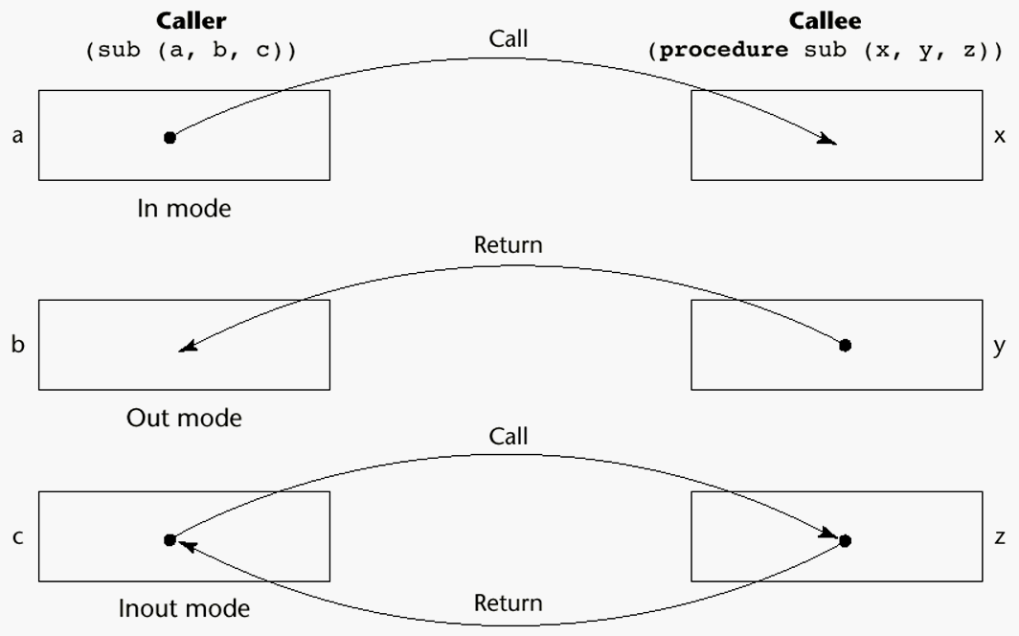
Models of Parameter Passing
Copyright © 2015 Pearson. All rights reserved.
1-<number>

Slide 272
Conceptual Models of Transfer
Physically move a value
Move an access path to a value
Copyright © 2015 Pearson. All rights reserved.
1-<number>

Slide 273
Pass-by-Value (In Mode)
The value of the actual parameter is used to initialize the corresponding formal parameter
  Normally implemented by copying
  Can be implemented by transmitting an access path but not recommended (enforcing write protection is not easy)
  Disadvantages (if by physical move): additional storage is required (stored twice) and the actual move can be costly (for large parameters)
  Disadvantages (if by access path method): must write-protect in the called subprogram and accesses cost more (indirect addressing)
Copyright © 2015 Pearson. All rights reserved.
1-<number>

Slide 274
Pass-by-Result (Out Mode)
When a parameter is passed by result, no value is transmitted to the subprogram; the corresponding formal parameter acts as a local variable; its value is transmitted to caller’s actual parameter when control is returned to the caller, by physical move
  Require extra storage location and copy operation
Potential problems:
  sub(p1, p1); whichever formal parameter is copied back will represent the current value of p1
  sub(list[sub], sub); Compute address of list[sub] at the beginning of the subprogram or end?
Copyright © 2015 Pearson. All rights reserved.
1-<number>

Slide 275
Pass-by-Value-Result (inout Mode)
A combination of pass-by-value and pass-by-result
Sometimes called pass-by-copy
Formal parameters have local storage
Disadvantages:
  Those of pass-by-result
  Those of pass-by-value
Copyright © 2015 Pearson. All rights reserved.
1-<number>

Slide 276
Pass-by-Reference (Inout Mode)
Pass an access path
Also called pass-by-sharing
Advantage: Passing process is efficient (no copying and no duplicated storage)
Disadvantages
  Slower accesses (compared to pass-by-value) to formal parameters
  Potentials for unwanted side effects (collisions)
  Unwanted aliases (access broadened)
  fun(total, total); fun(list[i], list[j]; fun(list[i], i);
Copyright © 2015 Pearson. All rights reserved.
1-<number>

Slide 277
Pass-by-Name (Inout Mode)
By textual substitution
Formals are bound to an access method at the time of the call, but actual binding to a value or address takes place at the time of a reference or assignment
Allows flexibility in late binding
Implementation requires that the referencing environment of the caller is passed with the parameter, so the actual parameter address can be calculated
Copyright © 2015 Pearson. All rights reserved.
1-<number>

Slide 278
Implementing Parameter-Passing Methods
In most languages parameter communication takes place thru the run-time stack
Pass-by-reference are the simplest to implement; only an address is placed in the stack
Copyright © 2015 Pearson. All rights reserved.
1-<number>

Slide 279
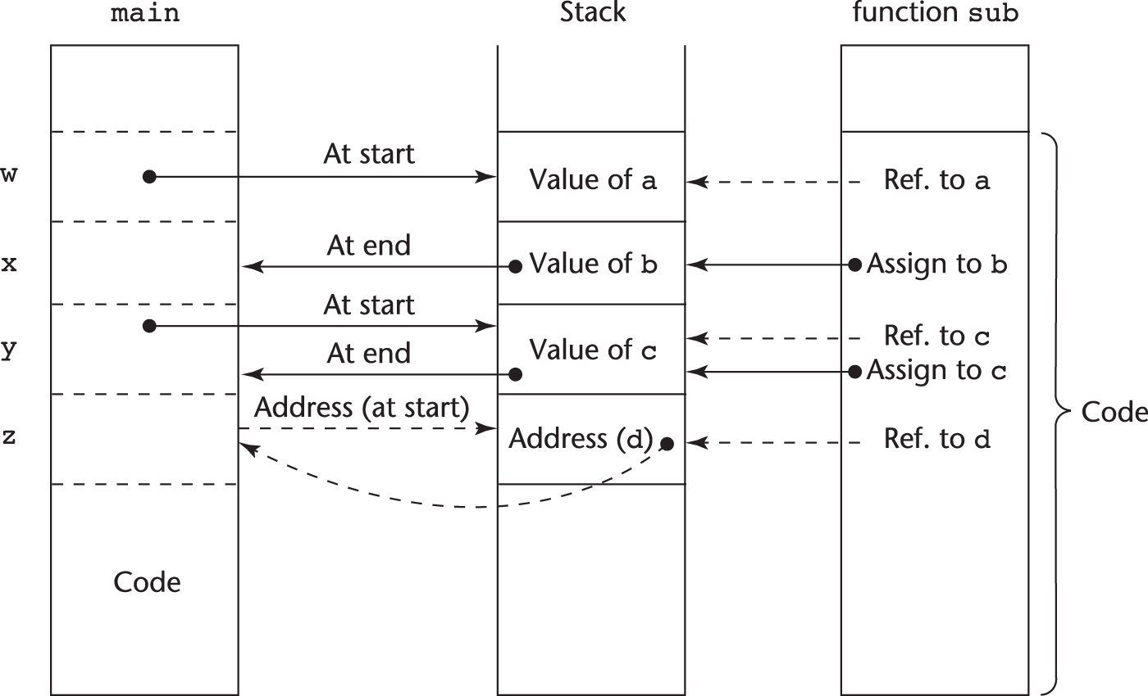
Implementing Parameter-Passing Methods
Function header: void sub(int a, int b, int c, int d)
Function call in main: sub(w, x, y, z)
(pass w by value, x by result, y by value-result, z by reference)
Copyright © 2015 Pearson. All rights reserved.
1-<number>

Slide 280
Parameter Passing Methods of Major Languages
C
  Pass-by-value
  Pass-by-reference is achieved by using pointers as parameters
C++
  A special pointer type called reference type for pass-by-reference
Java
  All parameters are passed are passed by value
  Object parameters are passed by reference
Copyright © 2015 Pearson. All rights reserved.
1-<number>

Slide 281
Parameter Passing Methods of Major Languages (continued)
Fortran 95+
- Parameters can be declared to be in, out, or inout mode
C#
- Default method: pass-by-value
  Pass-by-reference is specified by preceding both a formal parameter and its actual parameter with ref
PHP: very similar to C#, except that either the actual or the formal parameter can specify ref
Perl: all actual parameters are implicitly placed in a predefined array named @_
Python and Ruby use pass-by-assignment (all data values are objects); the actual is assigned to the formal
Copyright © 2015 Pearson. All rights reserved.
1-<number>

Slide 282
Type Checking Parameters
Considered very important for reliability
FORTRAN 77 and original C: none
Pascal and Java: it is always required
ANSI C and C++: choice is made by the user
  Prototypes
Relatively new languages Perl, JavaScript, and PHP do not require type checking
In Python and Ruby, variables do not have types (objects do), so parameter type checking is not possible
Copyright © 2015 Pearson. All rights reserved.
1-<number>

Slide 283
Multidimensional Arrays as Parameters
If a multidimensional array is passed to a subprogram and the subprogram is separately compiled, the compiler needs to know the declared size of that array to build the storage mapping function
Copyright © 2015 Pearson. All rights reserved.
1-<number>

Slide 284
Multidimensional Arrays as Parameters: C and C++
Programmer is required to include the declared sizes of all but the first subscript in the actual parameter
Disallows writing flexible subprograms
Solution: pass a pointer to the array and the sizes of the dimensions as other parameters; the user must include the storage mapping function in terms of the size parameters
Copyright © 2015 Pearson. All rights reserved.
1-<number>

Slide 285
Multidimensional Arrays as Parameters: Java and C#
Similar to Ada
Arrays are objects; they are all single-dimensioned, but the elements can be arrays
Each array inherits a named constant (length in Java, Length in C#) that is set to the length of the array when the array object is created
Copyright © 2015 Pearson. All rights reserved.
1-<number>

Slide 286
Design Considerations for Parameter Passing
Two important considerations
  Efficiency
  One-way or two-way data transfer
But the above considerations are in conflict
  Good programming suggest limited access to variables, which means one-way whenever possible
  But pass-by-reference is more efficient to pass structures of significant size
Copyright © 2015 Pearson. All rights reserved.
1-<number>

Slide 287
Parameters that are Subprogram Names
It is sometimes convenient to pass subprogram names as parameters
Issues:
  Are parameter types checked?
  What is the correct referencing environment for a subprogram that was sent as a parameter?
Copyright © 2015 Pearson. All rights reserved.
1-<number>

Slide 288
Parameters that are Subprogram Names: Referencing Environment
Shallow binding: The environment of the call statement that enacts the passed subprogram
- Most natural for dynamic-scoped
languages
Deep binding: The environment of the definition of the passed subprogram
- Most natural for static-scoped languages
Ad hoc binding: The environment of the call statement that passed the subprogram
Copyright © 2015 Pearson. All rights reserved.
1-<number>

Slide 289
Calling Subprograms Indirectly
Usually when there are several possible subprograms to be called and the correct one on a particular run of the program is not know until execution (e.g., event handling and GUIs)
In C and C++, such calls are made through function pointers
Copyright © 2015 Pearson. All rights reserved.
1-<number>

Slide 290
Calling Subprograms Indirectly (continued)
In C#, method pointers are implemented as objects called delegates
  A delegate declaration:
  public delegate int Change(int x);
  - This delegate type, named Change, can be instantiated with any method that takes an int parameter and returns an int value
  A method: static int fun1(int x) { … }
  Instantiate: Change chgfun1 = new Change(fun1);
  Can be called with: chgfun1(12);
  - A delegate can store more than one address, which is called a multicast delegate
Copyright © 2015 Pearson. All rights reserved.
1-<number>

Slide 291
Design Issues for Functions
Are side effects allowed?
  Parameters should always be in-mode to reduce side effect (like Ada)
What types of return values are allowed?
  Most imperative languages restrict the return types
  C allows any type except arrays and functions
  C++ is like C but also allows user-defined types
  Java and C# methods can return any type (but because methods are not types, they cannot be returned)
  Python and Ruby treat methods as first-class objects, so they can be returned, as well as any other class
  Lua allows functions to return multiple values
Copyright © 2015 Pearson. All rights reserved.
1-<number>

Slide 292
Overloaded Subprograms
An overloaded subprogram is one that has the same name as another subprogram in the same referencing environment
  Every version of an overloaded subprogram has a unique protocol
C++, Java, C#, and Ada include predefined overloaded subprograms
In Ada, the return type of an overloaded function can be used to disambiguate calls (thus two overloaded functions can have the same parameters)
Ada, Java, C++, and C# allow users to write multiple versions of subprograms with the same name
Copyright © 2015 Pearson. All rights reserved.
1-<number>

Slide 293
Generic Subprograms
A generic or polymorphic subprogram takes parameters of different types on different activations
Overloaded subprograms provide ad hoc polymorphism
Subtype polymorphism means that a variable of type T can access any object of type T or any type derived from T (OOP languages)
A subprogram that takes a generic parameter that is used in a type expression that describes the type of the parameters of the subprogram provides parametric polymorphism
- A cheap compile-time substitute for dynamic binding
Copyright © 2015 Pearson. All rights reserved.
1-<number>

Slide 294
Generic Subprograms (continued)
C++
  Versions of a generic subprogram are created implicitly when the subprogram is named in a call or when its address is taken with the & operator
  Generic subprograms are preceded by a template clause that lists the generic variables, which can be type names or class names
template <class Type>
Type max(Type first, Type second) {
return first > second ? first : second;
}
Copyright © 2015 Pearson. All rights reserved.
1-<number>

Slide 295
Generic Subprograms (continued)
Java 5.0
- Differences between generics in Java 5.0 and those of C++:
1. Generic parameters in Java 5.0 must be classes
2. Java 5.0 generic methods are instantiated just once as truly generic methods
3. Restrictions can be specified on the range of classes that can be passed to the generic method as generic parameters
4. Wildcard types of generic parameters
Copyright © 2015 Pearson. All rights reserved.
1-<number>

Slide 296
Generic Subprograms (continued)
Java 5.0 (continued)
  public static <T> T doIt(T[] list) { … }
  - The parameter is an array of generic elements (T is the name of the type)
  - A call:
  doIt<String>(myList);
  Generic parameters can have bounds:
  public static <T extends Comparable> T
  doIt(T[] list) { … }
  The generic type must be of a class that implements the Comparable interface
Copyright © 2015 Pearson. All rights reserved.
1-<number>

Slide 297
Generic Subprograms (continued)
Java 5.0 (continued)
  Wildcard types
  Collection<?> is a wildcard type for collection classes
  void printCollection(Collection<?> c) {
  for (Object e: c) {
  System.out.println(e);
  }
  }
  - Works for any collection class
Copyright © 2015 Pearson. All rights reserved.
1-<number>

Slide 298
Generic Subprograms (continued)
C# 2005
- Supports generic methods that are similar to those of Java 5.0
- One difference: actual type parameters in a call can be omitted if the compiler can infer the unspecified type
  Another – C# 2005 does not support wildcards
Copyright © 2015 Pearson. All rights reserved.
1-<number>

Slide 299
Generic Subprograms (continued)
F#
  Infers a generic type if it cannot determine the type of a parameter or the return type of a function – automatic generalization
  Such types are denoted with an apostrophe and a single letter, e.g., ′a
  Functions can be defined to have generic parameters
  let printPair (x: ′a) (y: ′a) =
  printfn ″%A %A″ x y
  - %A is a format code for any type
  - These parameters are not type constrained
Copyright © 2015 Pearson. All rights reserved.
1-<number>

Slide 300
Generic Subprograms (continued)
F# (continued)
  If the parameters of a function are used with arithmetic operators, they are type constrained, even if the parameters are specified to be generic
  Because of type inferencing and the lack of type coercions, F# generic functions are far less useful than those of C++, Java 5.0+, and C# 2005+
Copyright © 2015 Pearson. All rights reserved.
1-<number>

Slide 301
User-Defined Overloaded Operators
Operators can be overloaded in Ada, C++, Python, and Ruby
A Python example
  def __add__ (self, second) :
  return Complex(self.real + second.real,
  self.imag + second.imag)
  Use: To compute x + y, x.__add__(y)
Copyright © 2015 Pearson. All rights reserved.
1-<number>

Slide 302
Closures
A closure is a subprogram and the referencing environment where it was defined
  The referencing environment is needed if the subprogram can be called from any arbitrary place in the program
  A static-scoped language that does not permit nested subprograms doesn’t need closures
  Closures are only needed if a subprogram can access variables in nesting scopes and it can be called from anywhere
  To support closures, an implementation may need to provide unlimited extent to some variables (because a subprogram may access a nonlocal variable that is normally no longer alive)
Copyright © 2015 Pearson. All rights reserved.
1-<number>

Slide 303
Closures (continued)
A JavaScript closure:
function makeAdder(x) {
return function(y) {return x + y;}
}
...
var add10 = makeAdder(10);
var add5 = makeAdder(5);
document.write(″add 10 to 20: ″ + add10(20) +
″<br />″);
document.write(″add 5 to 20: ″ + add5(20) +
″<br />″);
- The closure is the anonymous function returned by makeAdder
Copyright © 2015 Pearson. All rights reserved.
1-<number>

Slide 304
Closures (continued)
C#
  We can write the same closure in C# using a nested anonymous delegate
  Func<int, int> (the return type) specifies a delegate that takes an int as a parameter and returns and int
static Func<int, int> makeAdder(int x) {
return delegate(int y) {return x + y;};
}
...
Func<int, int> Add10 = makeAdder(10);
Func<int, int> Add5 = makeAdder(5);
Console.WriteLine(″Add 10 to 20: {0}″, Add10(20));
Console.WriteLine(″Add 5 to 20: {0}″, Add5(20));
Copyright © 2015 Pearson. All rights reserved.
1-<number>

Slide 305
Coroutines
A coroutine is a subprogram that has multiple entries and controls them itself – supported directly in Lua
Also called symmetric control: caller and called coroutines are on a more equal basis
A coroutine call is named a resume
The first resume of a coroutine is to its beginning, but subsequent calls enter at the point just after the last executed statement in the coroutine
Coroutines repeatedly resume each other, possibly forever
Coroutines provide quasi-concurrent execution of program units (the coroutines); their execution is interleaved, but not overlapped
Copyright © 2015 Pearson. All rights reserved.
1-<number>

Slide 306
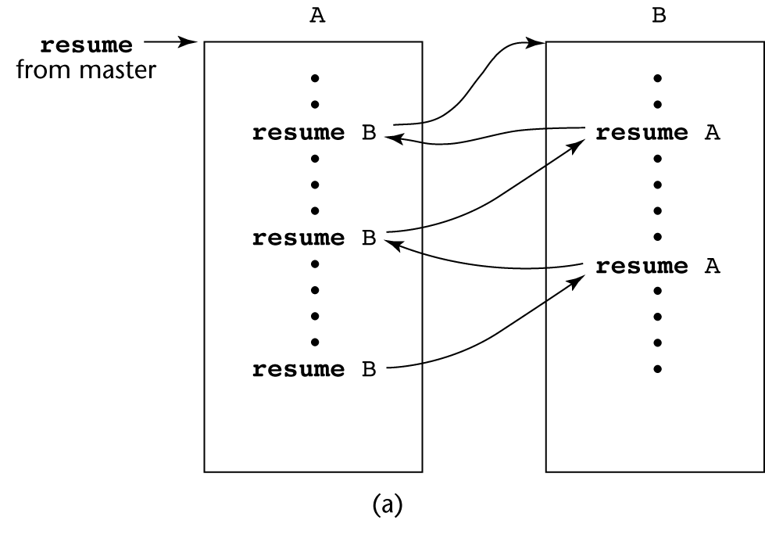
Coroutines Illustrated: Possible Execution Controls
Copyright © 2015 Pearson. All rights reserved.
1-<number>

Slide 307
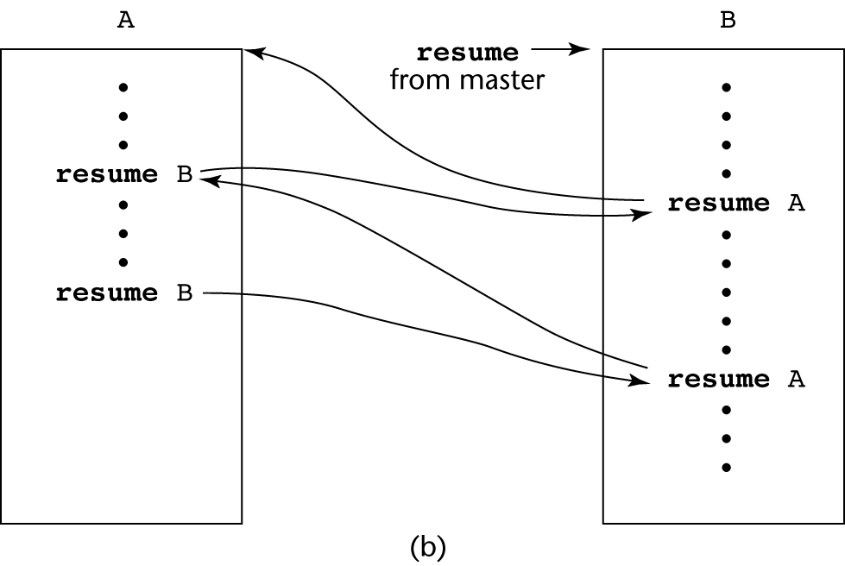
Coroutines Illustrated: Possible Execution Controls
Copyright © 2015 Pearson. All rights reserved.
1-<number>

Slide 308
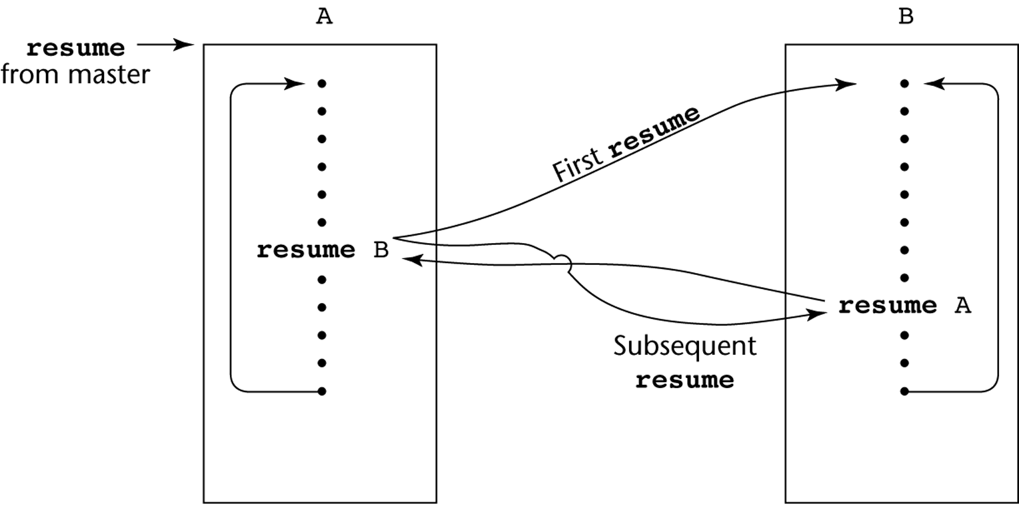
Coroutines Illustrated: Possible Execution Controls with Loops
Copyright © 2015 Pearson. All rights reserved.
1-<number>

Slide 309
Summary
A subprogram definition describes the actions represented by the subprogram
Subprograms can be either functions or procedures
Local variables in subprograms can be stack-dynamic or static
Three models of parameter passing: in mode, out mode, and inout mode
Some languages allow operator overloading
Subprograms can be generic
A closure is a subprogram and its ref. environment
A coroutine is a special subprogram with multiple entries
Copyright © 2015 Pearson. All rights reserved.
1-<number>

Slide 310
Chapter 10
Implementing Subprograms

Slide 311
Chapter 10 Topics
The General Semantics of Calls and Returns
Implementing “Simple” Subprograms
Implementing Subprograms with Stack-Dynamic Local Variables
Nested Subprograms
Blocks
Implementing Dynamic Scoping
Copyright © 2015 Pearson. All rights reserved.
1-<number>

Slide 312
The General Semantics of Calls and Returns
The subprogram call and return operations of a language are together called its subprogram linkage
General semantics of calls to a subprogram
  Parameter passing methods
  Stack-dynamic allocation of local variables
  Save the execution status of calling program
  Transfer of control and arrange for the return
  If subprogram nesting is supported, access to nonlocal variables must be arranged
Copyright © 2015 Pearson. All rights reserved.
1-<number>

Slide 313
The General Semantics of Calls and Returns
General semantics of subprogram returns:
  In mode and inout mode parameters must have their values returned
  Deallocation of stack-dynamic locals
  Restore the execution status
  Return control to the caller
Copyright © 2015 Pearson. All rights reserved.
1-<number>

Slide 314
Implementing “Simple” Subprograms
Call Semantics:
- Save the execution status of the caller
- Pass the parameters
- Pass the return address to the called
- Transfer control to the called
Copyright © 2015 Pearson. All rights reserved.
1-<number>

Slide 315
Implementing “Simple” Subprograms (continued)
Return Semantics:
  If pass-by-value-result or out mode parameters are used, move the current values of those parameters to their corresponding actual parameters
  If it is a function, move the functional value to a place the caller can get it
  Restore the execution status of the caller
  Transfer control back to the caller
Required storage:
  Status information, parameters, return address, return value for functions, temporaries
Copyright © 2015 Pearson. All rights reserved.
1-<number>

Slide 316
Implementing “Simple” Subprograms (continued)
Two separate parts: the actual code and the non-code part (local variables and data that can change)
The format, or layout, of the non-code part of an executing subprogram is called an activation record
An activation record instance is a concrete example of an activation record (the collection of data for a particular subprogram activation)
Copyright © 2015 Pearson. All rights reserved.
1-<number>

Slide 317
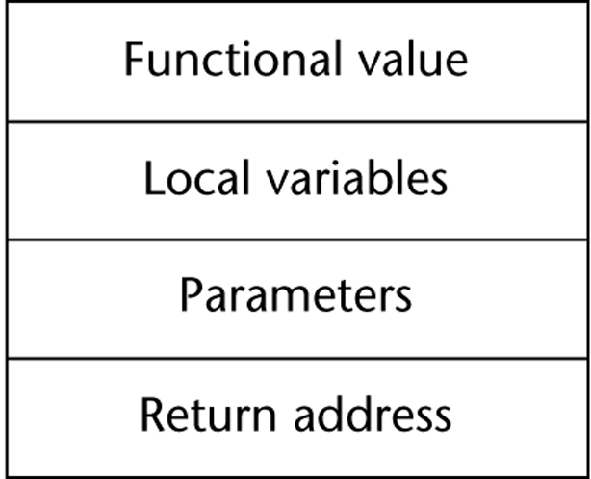
An Activation Record for “Simple” Subprograms
Copyright © 2015 Pearson. All rights reserved.
1-<number>

Slide 318
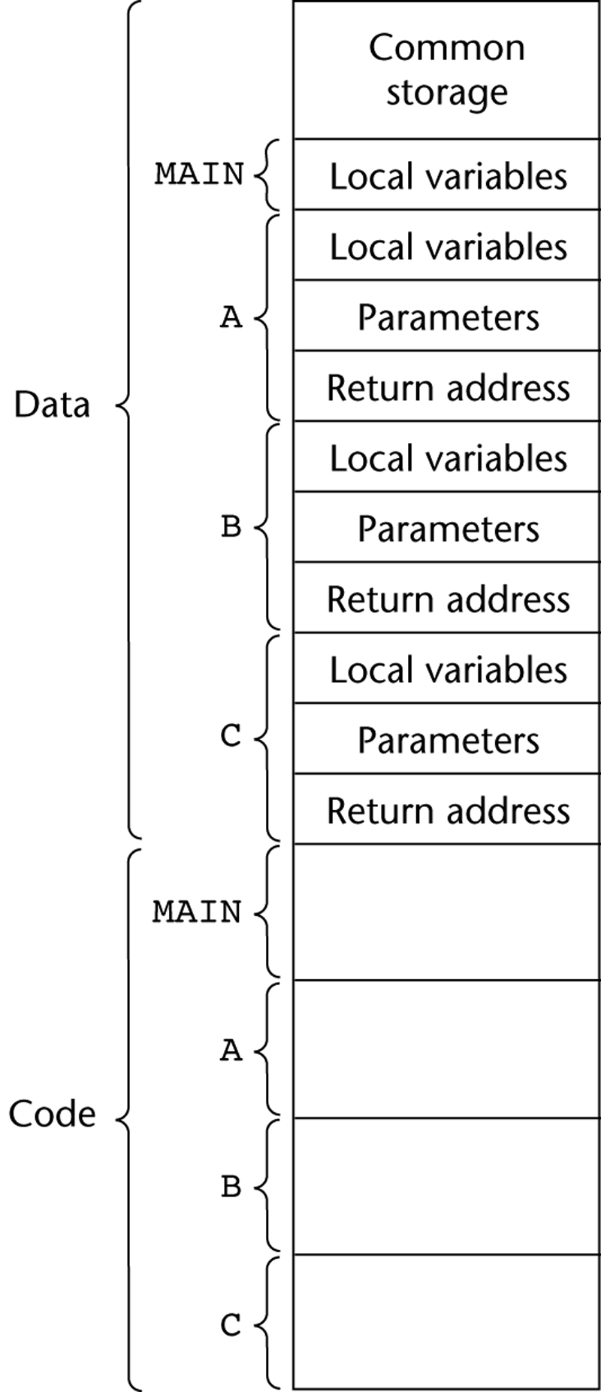
Code and Activation Records of a Program with “Simple” Subprograms
Copyright © 2015 Pearson. All rights reserved.
1-<number>

Slide 319
Implementing Subprograms with Stack-Dynamic Local Variables
More complex activation record
  The compiler must generate code to cause implicit allocation and deallocation of local variables
  Recursion must be supported (adds the possibility of multiple simultaneous activations of a subprogram)
Copyright © 2015 Pearson. All rights reserved.
1-<number>

Slide 320
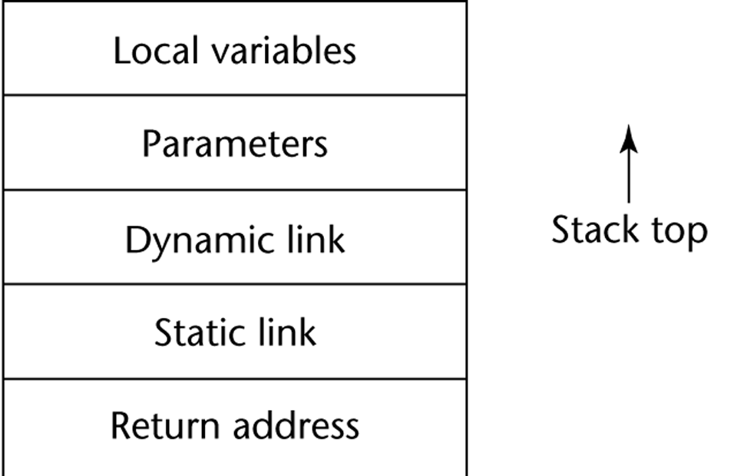
Typical Activation Record for a Language with Stack-Dynamic Local Variables
Copyright © 2015 Pearson. All rights reserved.
1-<number>

Slide 321
Implementing Subprograms with Stack-Dynamic Local Variables: Activation Record
The activation record format is static, but its size may be dynamic
The dynamic link points to the top of an instance of the activation record of the caller
An activation record instance is dynamically created when a subprogram is called
Activation record instances reside on the run-time stack
The Environment Pointer (EP) must be maintained by the run-time system. It always points at the base of the activation record instance of the currently executing program unit
Copyright © 2015 Pearson. All rights reserved.
1-<number>

Slide 322
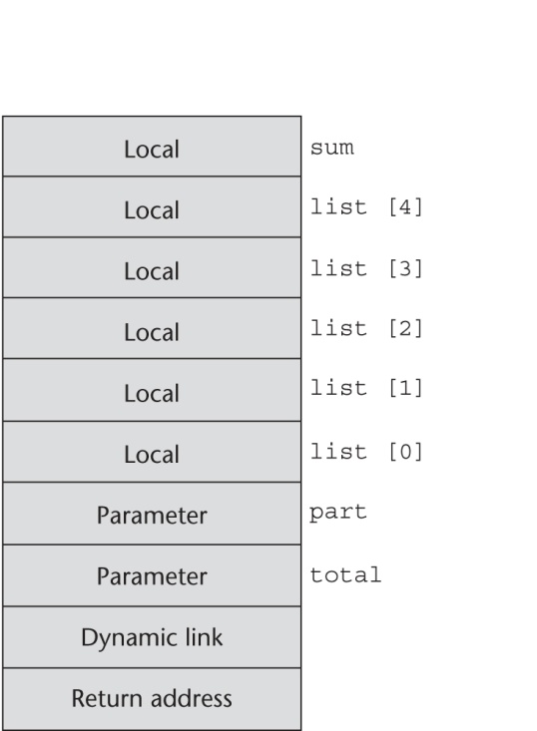
An Example: C Function
void sub(float total, int part)
{
int list[5];
float sum;
…
}
Copyright © 2015 Pearson. All rights reserved.
1-<number>

Slide 323
Revised Semantic Call/Return Actions
Caller Actions:
  Create an activation record instance
  Save the execution status of the current program unit
  Compute and pass the parameters
  Pass the return address to the called
  Transfer control to the called
Prologue actions of the called:
  Save the old EP in the stack as the dynamic link and create the new value
  Allocate local variables
Copyright © 2015 Pearson. All rights reserved.
1-<number>

Slide 324
Revised Semantic Call/Return Actions (continued)
Epilogue actions of the called:
  If there are pass-by-value-result or out-mode parameters, the current values of those parameters are moved to the corresponding actual parameters
  If the subprogram is a function, its value is moved to a place accessible to the caller
  Restore the stack pointer by setting it to the value of the current EP-1 and set the EP to the old dynamic link
  Restore the execution status of the caller
  Transfer control back to the caller
Copyright © 2015 Pearson. All rights reserved.
1-<number>

Slide 325
An Example Without Recursion
void fun1(float r) {
int s, t;
...
fun2(s);
...
}
void fun2(int x) {
int y;
...
fun3(y);
...
}
void fun3(int q) {
...
}
void main() {
float p;
...
fun1(p);
...
}
main calls fun1
fun1 calls fun2
fun2 calls fun3
Copyright © 2015 Pearson. All rights reserved.
1-<number>

Slide 326
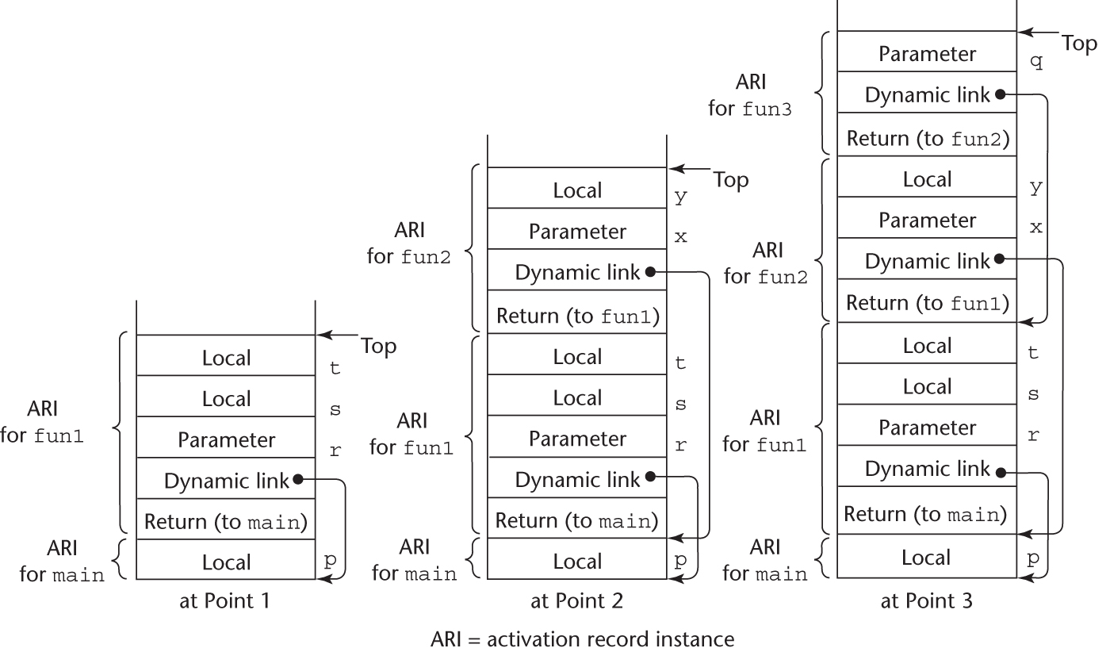
An Example Without Recursion
Copyright © 2015 Pearson. All rights reserved.
1-<number>

Slide 327
Dynamic Chain and Local Offset
The collection of dynamic links in the stack at a given time is called the dynamic chain, or call chain
Local variables can be accessed by their offset from the beginning of the activation record, whose address is in the EP. This offset is called the local_offset
The local_offset of a local variable can be determined by the compiler at compile time
Copyright © 2015 Pearson. All rights reserved.
1-<number>

Slide 328
An Example With Recursion
The activation record used in the previous example supports recursion
int factorial (int n) {
<-----------------------------1
if (n <= 1) return 1;
else return (n * factorial(n - 1));
<-----------------------------2
}
void main() {
int value;
value = factorial(3);
<-----------------------------3
}
Copyright © 2015 Pearson. All rights reserved.
1-<number>

Slide 329
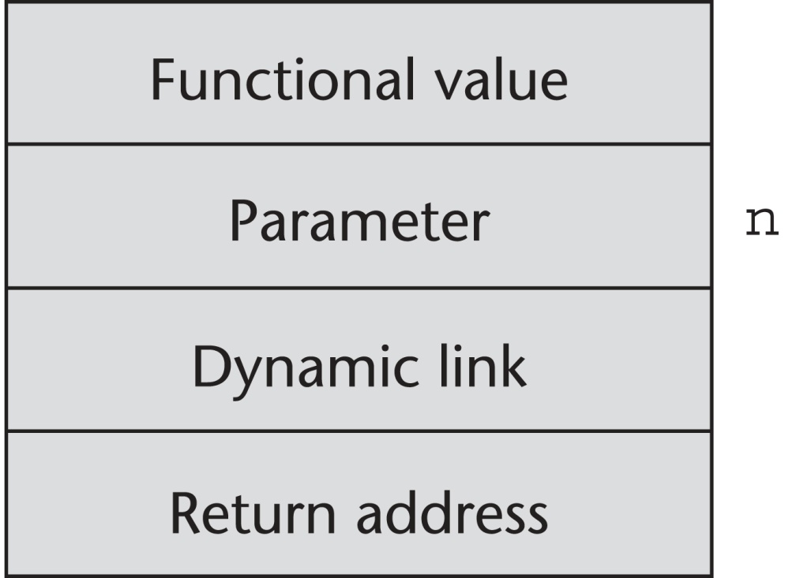
Activation Record for factorial
Copyright © 2015 Pearson. All rights reserved.
1-<number>

Slide 330
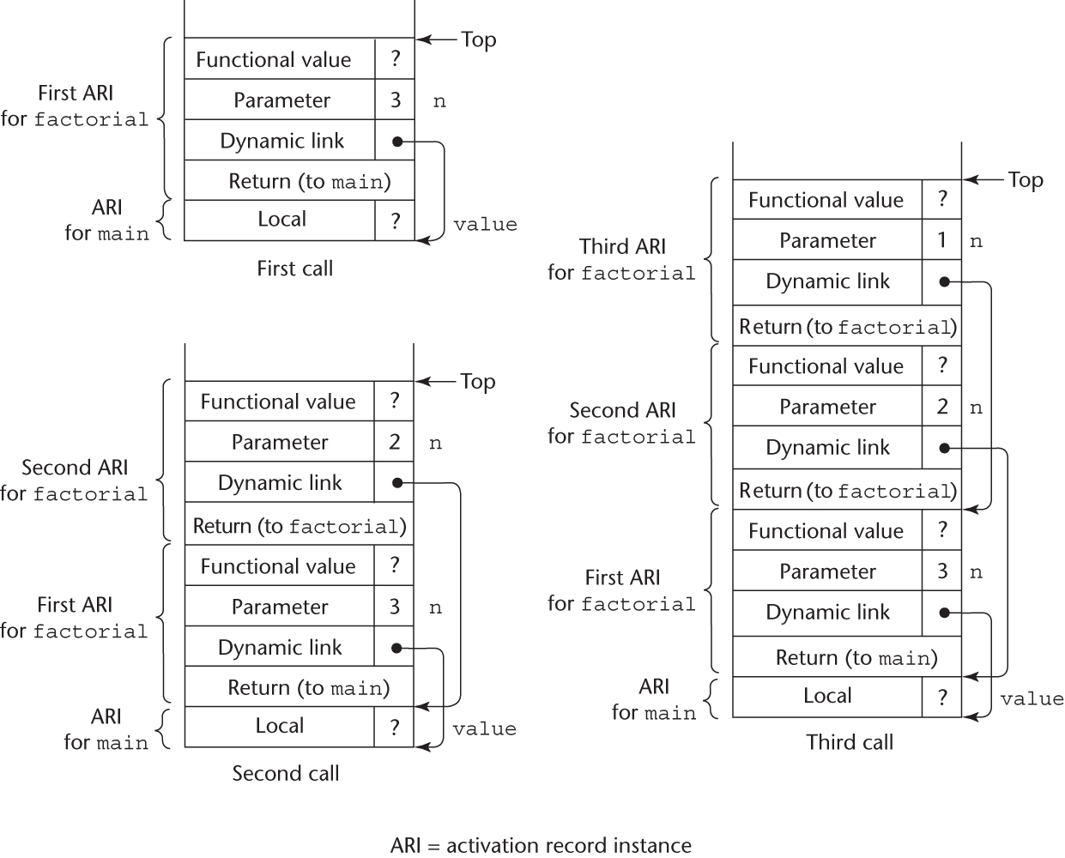
Stacks for calls to factorial
Copyright © 2015 Pearson. All rights reserved.
1-<number>

Slide 331
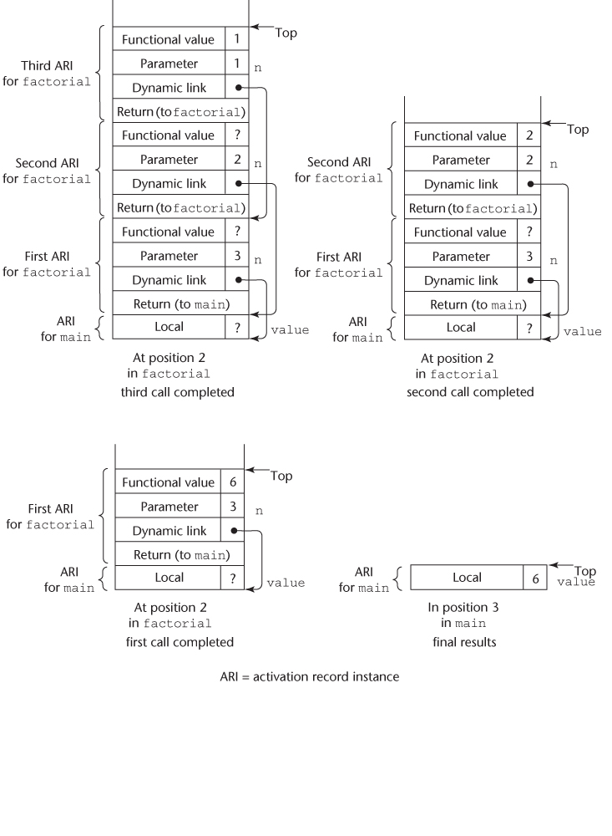
Stacks for returns from factorial
Copyright © 2015 Pearson. All rights reserved.
1-<number>

Slide 332
Nested Subprograms
Some non-C-based static-scoped languages (e.g., Fortran 95+, Ada, Python, JavaScript, Ruby, and Lua) use stack-dynamic local variables and allow subprograms to be nested
All variables that can be non-locally accessed reside in some activation record instance in the stack
The process of locating a non-local reference:
  Find the correct activation record instance
  Determine the correct offset within that activation record instance
Copyright © 2015 Pearson. All rights reserved.
1-<number>

Slide 333
Locating a Non-local Reference
Finding the offset is easy
Finding the correct activation record instance
  Static semantic rules guarantee that all non-local variables that can be referenced have been allocated in some activation record instance that is on the stack when the reference is made
Copyright © 2015 Pearson. All rights reserved.
1-<number>

Slide 334
Static Scoping
A static chain is a chain of static links that connects certain activation record instances
The static link in an activation record instance for subprogram A points to one of the activation record instances of A's static parent
The static chain from an activation record instance connects it to all of its static ancestors
Static_depth is an integer associated with a static scope whose value is the depth of nesting of that scope
Copyright © 2015 Pearson. All rights reserved.
1-<number>

Slide 335
Static Scoping (continued)
The chain_offset or nesting_depth of a nonlocal reference is the difference between the static_depth of the reference and that of the scope when it is declared
A reference to a variable can be represented by the pair:
(chain_offset, local_offset),
where local_offset is the offset in the activation
record of the variable being referenced
Copyright © 2015 Pearson. All rights reserved.
1-<number>

Slide 336
Example JavaScript Program
function main(){
var x;
function bigsub() {
var a, b, c;
function sub1 {
var a, d;
function main(){
var x;
function bigsub() {
var a, b, c;
function sub1 {
var a, d;
a = b + c; ←-------------------------------1
...
} // end of sub1
function sub2(x) {
var b, e;
Copyright © 2015 Pearson. All rights reserved.
1-<number>

Slide 337
Example JavaScript Program (continued)
function sub3() {
var c, e;
...
sub1();
...
e = b + a; ←------------------------------2
} // end of sub3 ...
sub3();
...
a = d + e; ←--------------------------------3
} // end of sub2
...
sub2(7);
...
} // end of bigsub
...
bigsub();
...
} // end of main
Copyright © 2015 Pearson. All rights reserved.
1-<number>

Slide 338
Example JavaScript Program (continued)
Call sequence for main
main calls bigsub
bigsub calls sub2
sub2 calls sub3
sub3 calls sub1
Copyright © 2015 Pearson. All rights reserved.
1-<number>

Slide 339
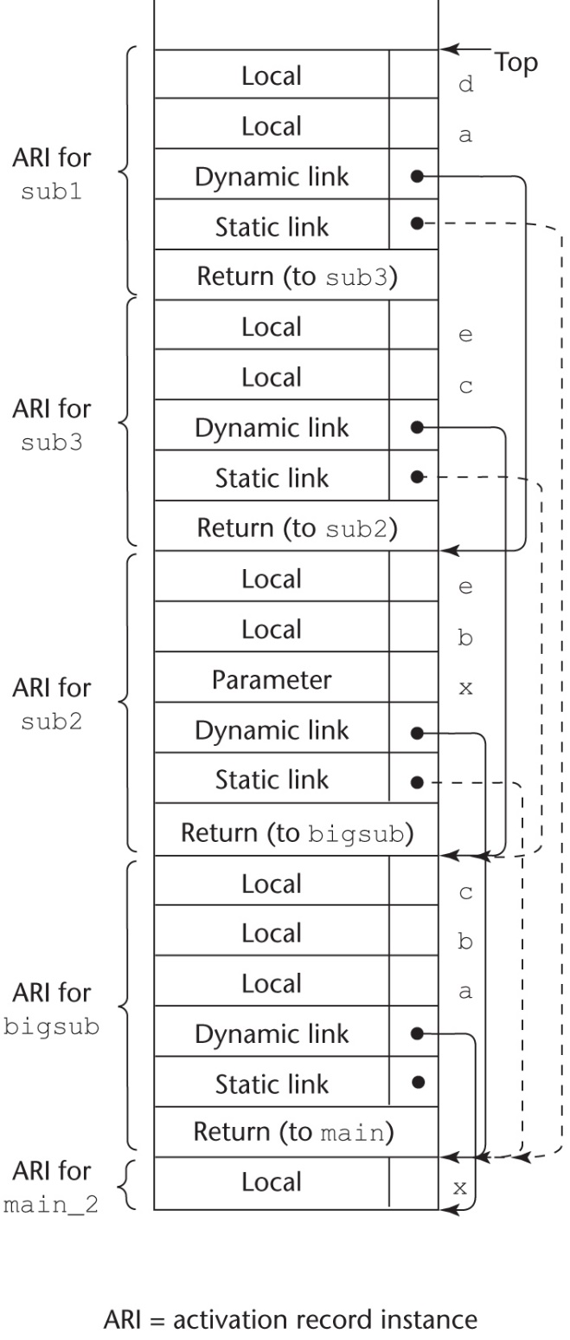
Stack Contents at Position 1
Copyright © 2015 Pearson. All rights reserved.
1-<number>

Slide 340
Static Chain Maintenance
At the call,
- The activation record instance must be built
- The dynamic link is just the old stack top pointer
- The static link must point to the most recent ari of the static parent
- Two methods:
1. Search the dynamic chain
2. Treat subprogram calls and
definitions like variable references
and definitions
Copyright © 2015 Pearson. All rights reserved.
1-<number>

Slide 341
Evaluation of Static Chains
Problems:
1. A nonlocal areference is slow if the
nesting depth is large
2. Time-critical code is difficult:
a. Costs of nonlocal references are
difficult to determine
b. Code changes can change the
nesting depth, and therefore the cost
Copyright © 2015 Pearson. All rights reserved.
1-<number>

Slide 342
Blocks
Blocks are user-specified local scopes for variables
An example in C
{int temp;
temp = list [upper];
list [upper] = list [lower];
list [lower] = temp
}
The lifetime of temp in the above example begins when control enters the block
An advantage of using a local variable like temp is that it cannot interfere with any other variable with the same name
Copyright © 2015 Pearson. All rights reserved.
1-<number>

Slide 343
Implementing Blocks
Two Methods:
  Treat blocks as parameter-less subprograms that are always called from the same location
    Every block has an activation record; an instance is created every time the block is executed
  2. Since the maximum storage required for a block can be statically determined, this amount of space can be allocated after the local variables in the activation record
Copyright © 2015 Pearson. All rights reserved.
1-<number>

Slide 344
Implementing Dynamic Scoping
Deep Access: non-local references are found by searching the activation record instances on the dynamic chain
- Length of the chain cannot be statically
determined
- Every activation record instance must
have variable names
Shallow Access: put locals in a central place
  One stack for each variable name
  Central table with an entry for each variable name
Copyright © 2015 Pearson. All rights reserved.
1-<number>

Slide 345
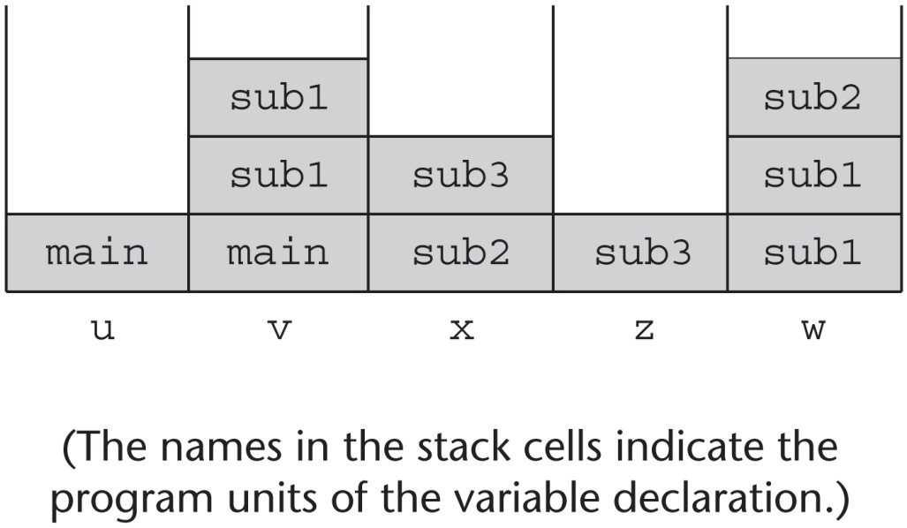
Using Shallow Access to Implement Dynamic Scoping
void sub3() {
int x, z;
x = u + v;
…
}
void sub2() {
int w, x;
…
}
void sub1() {
int v, w;
…
}
void main() {
int v, u;
…
}
Copyright © 2015 Pearson. All rights reserved.
1-<number>

Slide 346
Summary
Subprogram linkage semantics requires many action by the implementation
Simple subprograms have relatively basic actions
Stack-dynamic languages are more complex
Subprograms with stack-dynamic local variables and nested subprograms have two components
  actual code
  activation record
Copyright © 2015 Pearson. All rights reserved.
1-<number>

Slide 347
Summary (continued)
Activation record instances contain formal parameters and local variables among other things
Static chains are the primary method of implementing accesses to non-local variables in static-scoped languages with nested subprograms
Access to non-local variables in dynamic-scoped languages can be implemented by use of the dynamic chain or thru some central variable table method
Copyright © 2015 Pearson. All rights reserved.
1-<number>

