Slide 1
Lecture 2: MapReduce and Frequent Itemsets
CMSC5741 Big Data Tech. & Apps.
Prof. Michael R. Lyu
Computer Science & Engineering Dept.
The Chinese University of Hong Kong

Slide 2
Outline
Introduction
The Hadoop Distributed File System (HDFS)
MapReduce
Hadoop
Hadoop Streaming
Problems Suited for MapReduce
TensorFlow
Frequent Itemsets
Conclusion

Slide 3


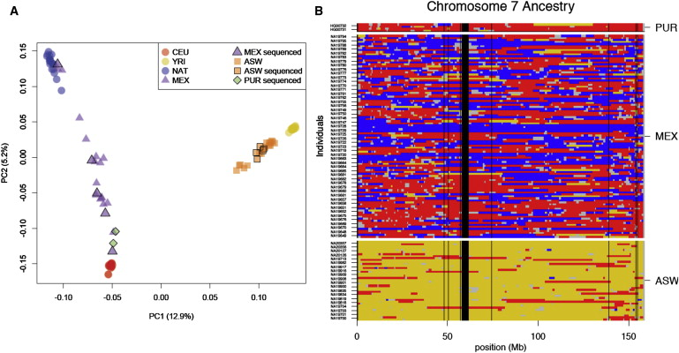

Introduction
Much of the course will be devoted to learning with big data
Twitter
Facebook
Netflix
Bioinformatics

Slide 4
Introduction
Challenges:
How to distribute computation?
Distributed/parallel programming is hard
MapReduce addresses all of the above
Google’s computational/data manipulation model
Elegant way to work with Big Data

Slide 5

Motivation: Data Volume Now
The scale of data today and tomorrow:
2008: Google processes 20 PB a day
2009: Facebook has 2.5 PB user data + 15 TB/day
2009: eBay has 6.5 PB user data + 50 TB/day
2013: Estimated size of digital world is 4.4 ZB
2016: 2.5 exabytes (EB) created everyday
2017: Google holds 10-15 exabytes of data
By 2020: 44ZB (10²¹) will be produced (5.2 TB for every person)

Slide 6

Motivation: Google Example
20+ billion web pages x 20KB = 400+ TB
1 computer reads 30-35 MB/sec from disk
~4 months to read the web
~1,000 hard drives to store the web (mainly text data)
Takes even more resources to do useful work with the data
Today, a standard architecture for such problem is emerging:
Cluster of commodity Linux nodes
Commodity network (ethernet) to connect them
It was estimated that Google had over 2.5M machines in 16 data centers worldwide (one center includes 9,941 miles of cable)
Notes:
Reports discussing Google’s new data center in Emeshaven, Netherlands, which opened in December 2016, didn’t mention size. Instead, they said the company has contracted for the entire 62 Megawatt output of a nearby windfarm and ran 9,941 miles of computer cable within the facility. The data center employs 150 people. USA’s perimeter is 8,878 miles.

Slide 7
Large-scale Computing
Large-scale computing for data mining problems on commodity hardware
Challenges:
How do you distribute computation?
How can we make it easy to write distributed programs?
How can you handle machine failures?
One server may stay up 3 years (1,000 days)
If you have 1,000 servers, expect to lose 1/day
It is estimated that Google had 2.5M machines in 2016
2,500 machine fails every day!

Slide 8
Idea and Solution
Issue: Copying data over a network takes time
Idea:
Bring computation close to the data
Store files multiple times for reliability
MapReduce addresses these problems
Google’s computational/data manipulation model
Elegant way to work with big data
Storage Infrastructure – File system
Google: GFS; Hadoop: HDFS
Programming model
Map-reduce

Slide 9
Relationship
Hardware & OS
HDFS
MapReduce
HBase
Hive
Mahout
Pig
ZooKeeper
Hadoop
Projects
Hadoop

Slide 10
Outline
Introduction
The Hadoop Distributed File System (HDFS)
MapReduce
Hadoop
Hadoop Streaming
Problems Suited for MapReduce
TensorFlow
Frequent Itemsets
Conclusion

Slide 11
The Hadoop Distributed File System (HDFS)
With hundreds of machines at hand, failure is the norm rather than exception
Traditional file storage system cannot cope with the scale and failure faced by large clusters
The Hadoop Distributed File System (HDFS) is a natural solution to this problem
Distributed File System
Provides global file namespace
Replica to ensure data recovery

Slide 12
The Hadoop Distributed File System (HDFS)
A HDFS instance may consist of thousands of server machines, each storing part of the file system’s data.
Since we have huge number of components, and each component has non-trivial probability of failure, it means that there is always some component that is non-functional.
Detection of faults and quick, automatic recovery from them are a core architectural goal of HDFS.

Slide 13
Data Characteristics
Streaming data access
Batch processing rather than interactive user access
Write-once-read-many: a file, once created, written and closed, need not be changed
This assumption simplifies coherency in concurrent accesses
Notes:
Other characteristics:
Applications need streaming access to data
Large data sets and files: gigabytes to terabytes size
High aggregate data bandwidth
Scale to hundreds of nodes in a cluster
Tens of millions of files in a single instance
Batch processing without user interaction
Write-once-read-many: order of concurrent accesses does not matter
This assumption simplifies coherency of concurrent accesses
A map-reduce application or web-crawler application fits perfectly with this model.

Slide 14
HDFS Architecture
Master/slave architecture
Master: NameNode
Slave: DataNode
HDFS exposes a file system namespace (NameNode) and allows user data to be stored in files.
A file is split into one or more blocks and set of blocks are stored in DataNodes.
Notes:
HDFS cluster consists of a single NameNode, a master server that manages the file system namespace and regulates access to files by clients.
There are a number of DataNodes usually one per node in a cluster.
The DataNodes manage storage attached to the nodes that they run on.
DataNodes: serves read, write requests, performs block creation, deletion, and replication upon instruction from NameNode.

Slide 15
HDFS Architecture
Namenode
Metadata(Name, replicas..)
(/home/foo/data,6. ..
Metadata ops
Client
Block ops
Read
Datanodes
Datanodes
B
replication
Blocks
Rack1
Write
Rack2
Client

Slide 16
File System Namespace
Namenode maintains the file system.
Hierarchical file system with directories and files.
Create, remove, move, rename, etc.
Any meta information changes to the file system is recorded by the Namenode.
An application can specify the number of replicas of the file needed: replication factor of the file. This information is stored in the Namenode.

Slide 17
Data Replication
HDFS is designed to store very large files across machines in a large cluster.
Each file is a sequence of blocks.
All blocks in the file except the last are of the same size.
Blocks are replicated for fault tolerance.
Block size and replicas are configurable per file.
The NameNode receives a Heartbeat and a BlockReport from each DataNode in the cluster.
BlockReport contains all the blocks on a DataNode.

Slide 18
Replica Selection
Replica selection for read operation: HDFS tries to minimize the bandwidth consumption and latency.
If there is a replica on the Reader node then that is preferred.
HDFS cluster may span multiple data centers: replica in the local data center is preferred over the remote one.

Slide 19
Safemode Startup
Each DataNode checks in with Heartbeat and BlockReport.
NameNode verifies that each block has acceptable number of replicas.
After a configurable percentage of safely replicated blocks check in with the NameNode, NameNode exits Safemode.
It then makes the list of blocks that need to be replicated.
NameNode then proceeds to replicate these blocks to other DataNodes.
Notes:
On startup NameNode enters Safemode.
Replication of data blocks do not occur in Safemode.

Slide 20
Filesystem Metadata
The HDFS namespace is stored by NameNode.
NameNode uses a transaction log called the EditLog to record every change that occurs to the filesystem meta data.
For example, creating a new file
Change replication factor of a file
EditLog is stored in the NameNode’s local filesystem
Notes:
Entire filesystem namespace including mapping of blocks to files and file system properties is stored in a file FsImage. Stored in Namenode’s local filesystem.

Slide 21
NameNode
Keeps image of entire file system namespace.
When the Namenode starts up
Gets the FsImage and Editlog.
Update FsImage with EditLog information.
Stores a copy of the FsImage as a checkpoint.
In case of crash
Last checkpoint is recovered.
Notes:
4GB of local RAM is sufficient to support the above data structures that represent the huge number of files and directories.

Slide 22
DataNode
A DataNode stores data in files in its local file system.
Each block of HDFS is a separate file.
These files are placed in different directories.
Creation of new directory is determined by heuristics.
When the filesystem starts up:
Generates Blockreport.
Sends this report to NameNode.
Notes:
DataNode has no knowledge about HDFS filesystem
DataNode does not create all files in the same directory.

Slide 23
HDFS Summary
Reliable distributed file system
Data kept in “chunks” spread across machines
Each chunk replicated on different machine and racks
Seamless recovery from disk or machine failure
C0
C1
D0
D1
C2
C1
C0
E1
….
C2
D6
C3
C6
D0
C6
A2
B6

Slide 24
Outline
Introduction
The Hadoop Distributed File System (HDFS)
MapReduce
Hadoop
Hadoop Streaming
Problems Suited for MapReduce
TensorFlow
Frequent Itemsets
Conclusion

Slide 25
MapReduce
Warm-up task
We have a huge text document
Count the number of times each distinct word appears in the file
Sample application
Analyze web server logs to find popular URLs

Slide 26
Task: Word Count
Using Unix tool chain, we can count the occurrences of words:
words (doc.txt) | sort | uniq –c
Where words takes a file and outputs the words in it, one per line
This way of counting captures the essence of MapReduce
Mapper (done by words)
Group by keys and sort (done by sort)
Reducer (done by uniq)
Hadoop handles the partition and parallelization

Slide 27
MapReduce: Overview
Sequentially read a lot of data
Map:
Extract something you care about
Group by key: Sort and Shuffle
Reduce:
Aggregate, summarize, filter or transform
Write the result

Slide 28
MapReduce
Input: a set of key-value paris
Programmer must specifies two methods:
Map(k,v) -> <k’, v’>
Takes a key-value pair and outputs a set of key-value pairs
There is one Map call for every (k,v) pair
Reduce (k’, <v’>) -> <k’, v’’>
All values v’ with the same key k’ are reduced together and processed in v’ order
There is one Reduce function call per unique key k’

Slide 29
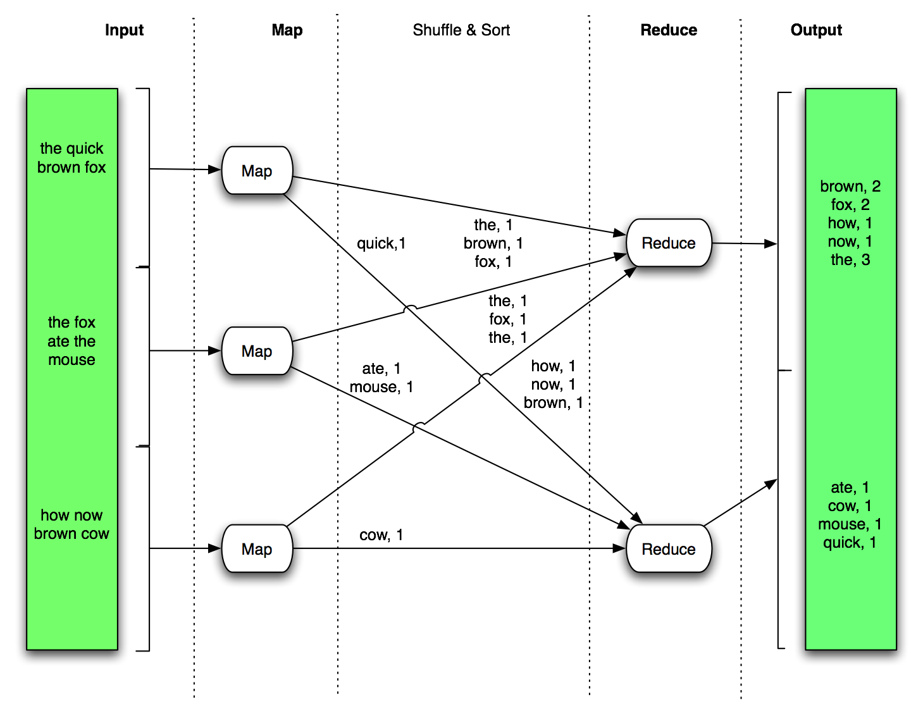
MapReduce: Word Count Example
Now that one document changes to a large corpus of documents

Slide 30
MapReduce: Word Count Example
// key: document name; value: text of the document
Map(key, value):
for each word w in value:
emit(w, 1)
// key: a word; value: an iterator over counts
Reduce(key, values):
result = 0
for each count v in values:
results += v
emit(key, result)

Slide 31
In-class Practice
Go to practice

Slide 32
MapReduce: Environment
MapReduce environment takes care of:
Partitioning the input data
Scheduling the program’s execution across a set of machines
Performing the “group by key” step
Handling machine failures
Managing required inter-machine communication

Slide 33
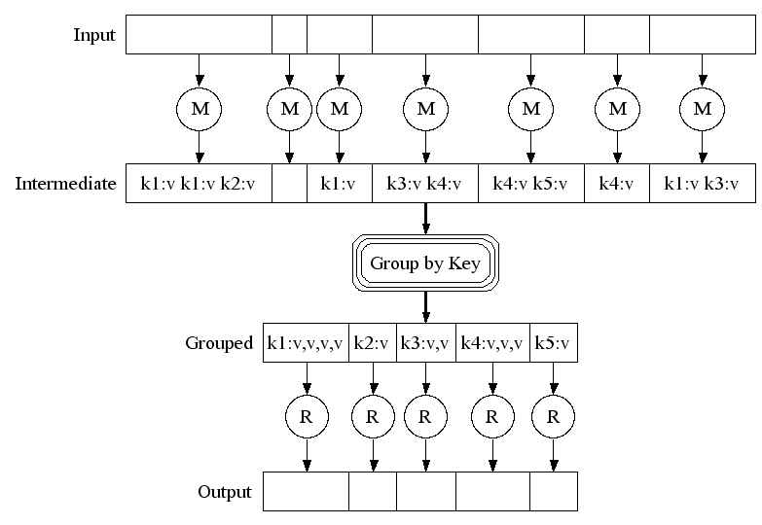
MapReduce
Map:
Read input and produces a set of key-value pairs
Group by key:
Collect all pairs with the same key
Reduce:
Collect all values belonging to the key and output

Slide 34
MapReduce
Move computation to the data
C0
C1
D0
D1
C2
C1
C3
E1
….
C2
D6
C3
C6
D0
C6
A2
B6
DataNode
DataNode
DataNode
DataNode
TaskTracker
TaskTracker
TaskTracker
TaskTracker
Bring computation directly to the data!
DataNode also serve as compute servers

Slide 35
Data Flow
Input and final output are stored on a distributed file system (FS):
Scheduler tries to schedule map tasks “close” to physical storage location of input data
Intermediate results are stored on local FS of Map and Reduce workers
Output is often input to another MapReduce task

Slide 36
Coordination: Master
Master node takes care of coordination:
Task status: (idle, in-progress, completed)
Idle tasks get scheduled as workers become available
When a map task completes, it sends the master the location and sizes of its R intermediate files, one for each reducer
Master pushes this info to reducers
Master pings workers periodically to detect failures

Slide 37
Dealing with Failures
Map worker failure
Map tasks completed or in-progress at worker are reset to idle
Reduce workers are notified when task is rescheduled on another worker
Reduce worker failure
Only in-progress tasks are reset to idle
Reduce task is restarted
Master failure
MapReduce task is aborted and client is notified.

Slide 38
How Many Map and Reduce Jobs?
M map tasks, R reduce tasks
Rule of a thumb:
Make M much larger than the number of nodes in the cluster
One chunk per map is common
Improves dynamic load balancing and speeds up recovery from worker failures
Usually R is smaller than M
Output is spread across R files

Slide 39
Refinement: Combiners
Often a Map task will produce many pairs of the form (k,v1), (k,v2), … for the same key k
E.g., popular words in the word count example
Can save network time by pre-aggregating values in the mapper:
Combine(k, list(v)) -> v2
Combiner is usually the same as the reduce function
Works only if reduce function is commutative and associative

Slide 40
Refinement: Partition Function
Want to control how keys get partitioned
Inputs to map tasks are created by contiguous splits of input file
Reduce needs to ensure that records with the same intermediate key end up at the same worker
System uses a default partition function:
Hash(key) mod R
Sometimes useful to override the hash function:
E.g., hash(hostname(URL)) mod R ensures URLs from a host end up in the same output file

Slide 41
Outline
Introduction
The Hadoop Distributed File System (HDFS)
MapReduce
Hadoop
Hadoop Streaming
Problems Suited for MapReduce
TensorFlow
Frequent Itemsets
Conclusion

Slide 42
Hadoop
Hadoop is an open source implementation of MapReduce framework
Hadoop Distributed File System (HDFS) as storage
Hadoop handles the task split, task distribution, task monitoring and failure recovery
All you need to do is to write two Java classes
Mapper
Reducer

Slide 43
Hadoop
Follow the MapReduce architecture, the Hadoop has a master/slave design
 | master | slave
MapReduce | jobtracker | tasktracker
HDFS | namenode | datanode

Slide 44
Word Count in Hadoop
Mapper
public static class MapClass extends MapReduceBase
implements Mapper {
private final static IntWritable one = new IntWritable(1);
private Text word = new Text();
public void map(WritableComparable key, Writable value,
OutputCollector output, Reporter reporter)
throws IOException {
String line = ((Text)value).toString();
StringTokenizer itr = new StringTokenizer(line);
while (itr.hasMoreTokens()) {
word.set(itr.nextToken());
output.collect(word, one);
}
}
}

Slide 45
Word Count in Hadoop
Reducer
public static class Reduce extends MapReduceBase implements Reducer {
public void reduce(WritableComparable key, Iterator
values, OutputCollector output, Reporter reporter)
throws IOException {
int sum = 0;
while (values.hasNext()) {
sum += ((IntWritable) values.next()).get();
}
output.collect(key, new IntWritable(sum));
}
}

Slide 46
Word Count in Hadoop
Main
public static void main(String[] args) throws IOException {
//checking goes here
JobConf conf = new JobConf();
conf.setOutputKeyClass(Text.class);
conf.setOutputValueClass(IntWritable.class);
conf.setMapperClass(MapClass.class);
conf.setCombinerClass(Reduce.class);
conf.setReducerClass(Reduce.class);
conf.setInputPath(new Path(args[0]));
conf.setOutputPath(new Path(args[1]));
JobClient.runJob(conf);
}

Slide 47
Outline
Introduction
The Hadoop Distributed File System (HDFS)
MapReduce
Hadoop
Hadoop Streaming
Problems Suited for MapReduce
TensorFlow
Frequent Itemsets
Conclusion

Slide 48
Hadoop Streaming
To enjoy the convenience brought by Hadoop, one has to implement mapper and reducer in Java
Hadoop defines a lot of data types and complex class hierarchy
There is a learning curve
Hadoop streaming allows you to use any language to write the mapper and reducer

Slide 49
Hadoop Streaming
Using Hadoop Streaming, you need to write
Mapper
Read input from standard input (STDIN)
Write map result to standard output (STDOUT)
Key value are separated using tab
Group by key
Done by Hadoop
Reducer
Read input (Mapper’s output) from standard input (STDIN)
Write output (Final result) to standard output (STDOUT)

Slide 50
Hadoop Streaming
Allows you to start writing MapReduce application that can be readily deployed without having to learn Hadoop class structure and data types
Speed up development
Utilize rich features and handy libraries from other languages (Python, Ruby)
Efficiency critical application can be implemented in efficient language (C, C++)

Slide 51
Hadoop Streaming: Word Count Mapper
#!/usr/bin/env python
import sys
# input comes from STDIN (standard input)
for line in sys.stdin:
# remove leading and trailing whitespace
line = line.strip()
# split the line into words
words = line.split()
# increase counters
for word in words:
# write the results to STDOUT (standard output);
# what we output here will be the input for the
# Reduce step, i.e. the input for reducer.py
#
# tab-delimited; the trivial word count is 1
print '%s\t%s' % (word, 1)

Slide 52
Hadoop Streaming: Word Count Reducer
#!/usr/bin/env python
from operator import itemgetter
import sys
current_word = None
current_count = 0
word = None
for line in sys.stdin:
line = line.strip()
word, count = line.split('\t', 1)
try:
count = int(count)
except ValueError:
continue
if current_word == word:
current_count += count
else:
if current_word:
print '%s\t%s' % (current_word, current_count)
current_count = count
current_word = word
if current_word == word:
print '%s\t%s' % (current_word, current_count)

Slide 53
Hadoop Streaming: How to Run?
To run the sample code
-file caches the argument to every tasktracker
The above command distribute the mapper.py and reducer.py to every tasktracker
$HADOOP_HOME/bin/hadoop jar $HADOOP_HOME/hadoop-streaming.jar \
-input inputPathonHDFS \
-output outputPathonHDFS \
-file pathToMapper.py \
-mapper mapper.py \
-file pathToReducer.py \
-reducer reducer.py

Slide 54
Hadoop Streaming: Word Count
#!/usr/bin/env python
"""A more advanced Mapper, using Python iterators and generators."""
import sys
def read_input(file):
for line in file:
yield line.split()
def main(separator='\t'):
# input comes from STDIN (standard input)
data = read_input(sys.stdin)
for words in data:
# write the results to STDOUT (standard output);
# what we output here will be the input for the
# Reduce step, i.e. the input for reducer.py
#
# tab-delimited; the trivial word count is 1
for word in words:
print '%s%s%d' % (word, separator, 1)
if __name__ == "__main__":
main()

Slide 55
Hadoop Streaming: Word Count
#!/usr/bin/env python
"""A more advanced Reducer, using Python iterators and generators."""
from itertools import groupby
from operator import itemgetter
import sys
def read_mapper_output(file, separator='\t'):
for line in file:
yield line.rstrip().split(separator, 1)
def main(separator='\t'):
# input comes from STDIN (standard input)
data = read_mapper_output(sys.stdin, separator=separator)
# groupby groups multiple word-count pairs by word,
# and creates an iterator that returns consecutive keys and their group:
# current_word - string containing a word (the key)
# group - iterator yielding all ["&lt;current_word&gt;", "&lt;count&gt;"] items
for current_word, group in groupby(data, itemgetter(0)):
try:
total_count = sum(int(count) for current_word, count in group)
print "%s%s%d" % (current_word, separator, total_count)
except ValueError:
# count was not a number, so silently discard this item
pass
if __name__ == "__main__":
main()

Slide 56
Demo
Given a list of academic paper authors and their papers, we try to output:
The most used non-trivial words in the title for each author
We use a python based MapReduce framework implementation called mincemeat.

Slide 57
Demo
Input Data
Books, Ph.D. Thesis, web pages, academic papers
Input format
Publication type
Affiliation
Abbreviation code
Authors
Title
tr/gte/TM-0014-06-88-165:::Frank Manola:::Distributed Object Management Technology.
tr/ibm/IWBS94:::Christoph Beierle::Udo Pletat:::The Algebra of Feature Graph Specifications

Slide 58
Demo
To run the demo:
In terminal 1, type:
python demo.py
This set the mapper, reducer and start the main program
In terminal 2, type:
python mincemeat.py -p changeme 127.0.0.1
“changeme” is the authentication password
127.0.0.1 is the server address
This starts the Map-Reduce framework

Slide 59
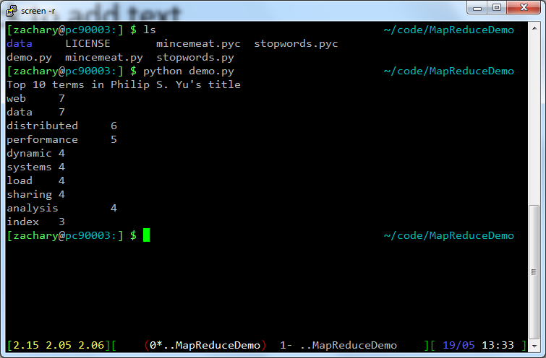
Demo

Slide 60
Outline
Introduction
The Hadoop Distributed File System (HDFS)
MapReduce
Hadoop
Hadoop Streaming
Problems Suited for MapReduce
TensorFlow
Frequent Itemsets
Conclusion

Slide 61
Example: Host Size
Suppose we have a large web corpus
Look at the metadata file
Lines of the form: (URL, size, date, …)
For each host, find the total number of bytes
That is, the sum of the page sizes for all URLs from that particular host
Other examples:
Link analysis and graph processing
Machine learning algorithms

Slide 62
Example: Language Model
Statistical machine translation:
Need to count number of times every 5-word sequence occurs in a large corpus of documents
Very easy with MapReduce
Map:
Extract (5-word sequence, count) from document
Reduce:
Combine the counts

Slide 63
Example: Join By MapReduce
Compute the natural join R(A,B) x S(B,C)
R and S are each stored in files
Tuples are pairs (a, b) or (b,c)
A | B
a1 | b1
a2 | b1
a3 | b2
a4 | b3
B | C
b2 | c1
b2 | c2
b3 | c3
A | C
a3 | c1
a3 | c2
a4 | c3
X
=
Note – Other relational-algebra operations: Selection, Projection,
Union/Interaction/Difference, Grouping/Aggregation

Slide 64
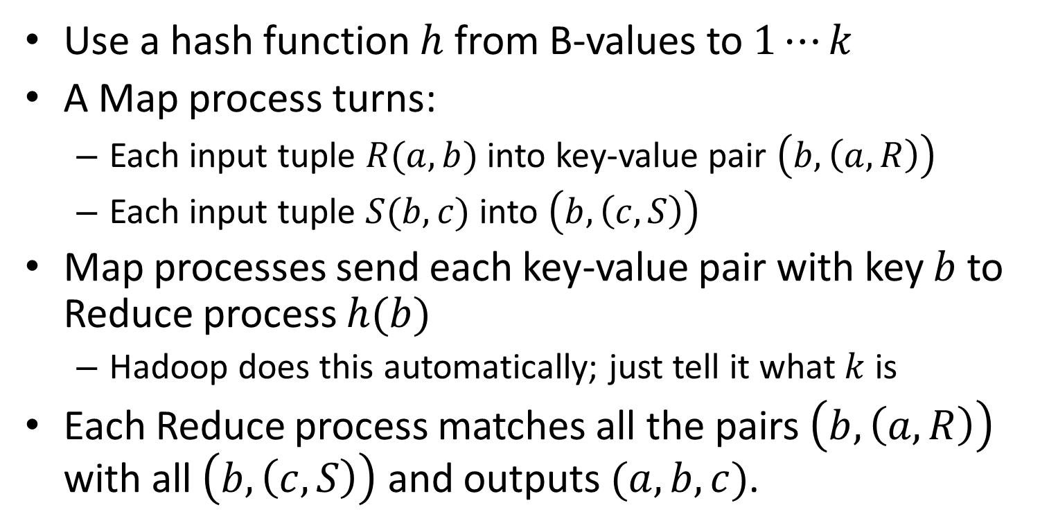
MapReduce Join
Use a hash function $h$ from B-values to $1⋯k$
A Map process turns:
Each input tuple $R(a,b)$ into key-value pair $\left(b, \left(a,R\right)\right)$
Each input tuple $S(b,c)$ into $\left(b, \left(c, S\right)\right)$
Map processes send each key-value pair with key $b$ to Reduce process $h(b)$
Hadoop does this automatically; just tell it what $k$ is
Each Reduce process matches all the pairs $\left(b, \left(a, R\right)\right)$ with all $\left(b,\left(c,S\right)\right)$ and outputs $(a,b,c)$.

Slide 65
Cost Measures for Algorithms
In MapReduce we quantify the cost of an algorithm using
Communication cost
total I/O of all processes
Elapsed communication cost
Max of I/O along any path
(Elapsed) computation cost
Analogous, but count only running time of processes
Note that here the big-O notation is not the most useful (adding more machines is always an option)

Slide 66
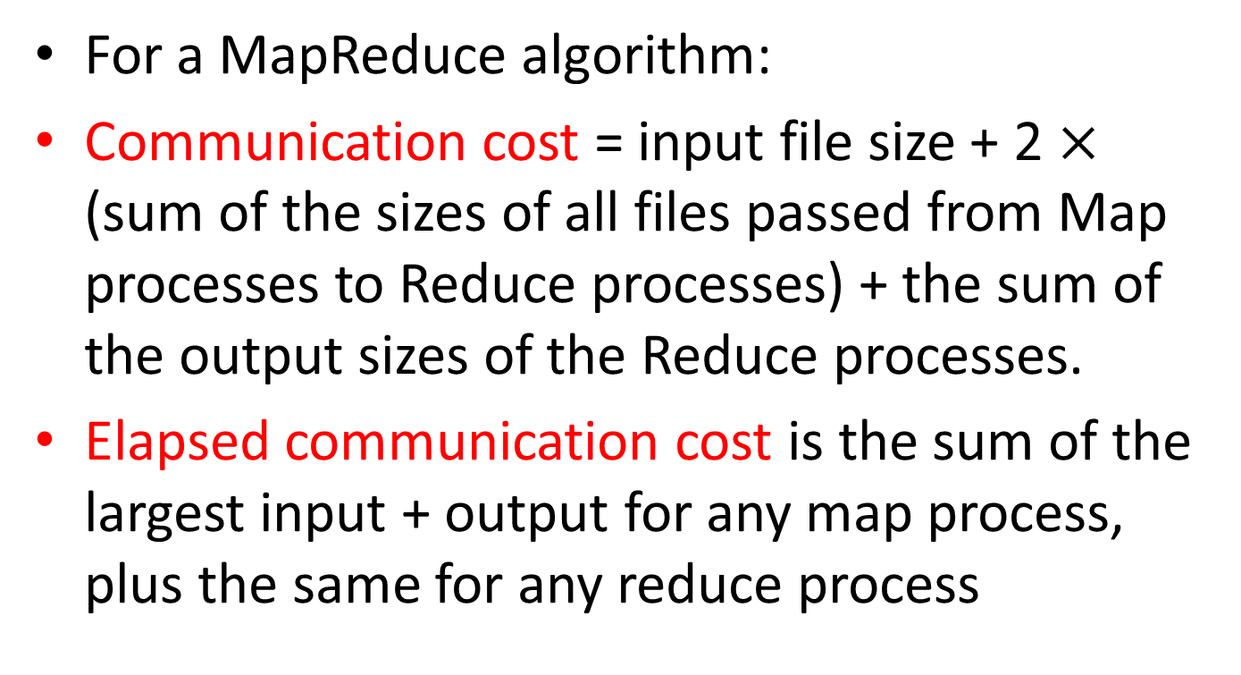
Example: Cost Measures
For a MapReduce algorithm:
Communication cost = input file size + 2 $×$ (sum of the sizes of all files passed from Map processes to Reduce processes) + the sum of the output sizes of the Reduce processes.
Elapsed communication cost is the sum of the largest input + output for any map process, plus the same for any reduce process

Slide 67
What Cost Measures Mean
Either the I/O (communication) or processing (computation) cost dominates
Ignore one or the other
Total cost tells what you pay in rent from your friendly neighborhood cloud
Elapsed cost is wall-clock time using parallelism

Slide 68
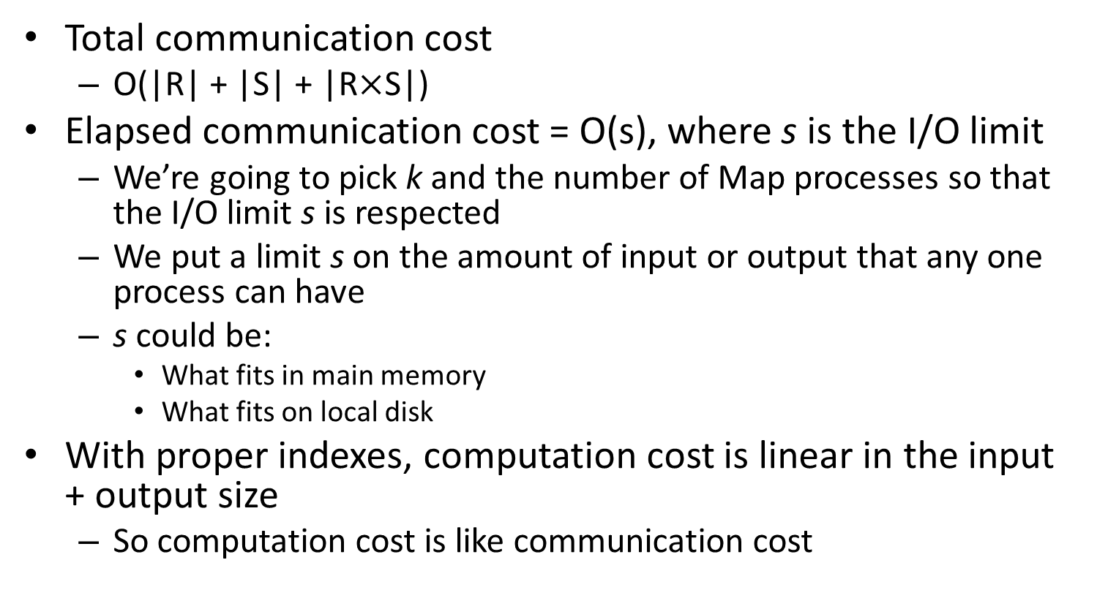
Cost of MapReduce Join
Total communication cost
O(|R| + |S| + |R$×$S|)
Elapsed communication cost = O(s), where s is the I/O limit
We’re going to pick k and the number of Map processes so that the I/O limit s is respected
We put a limit s on the amount of input or output that any one process can have
s could be:
What fits in main memory
What fits on local disk
With proper indexes, computation cost is linear in the input + output size
So computation cost is like communication cost

Slide 69
Outline
Introduction
The Hadoop Distributed File System (HDFS)
MapReduce
Hadoop
Hadoop Streaming
Problems Suited for MapReduce
TensorFlow
Frequent Itemsets
Conclusion

Slide 70
TensorFlow
Interface for expressing machine learning algorithms, and an implementation for executing large-scale algorithms
Dataflow framework that compiles to native CPU / GPU code
Drastic reduction in development time
Visualization (TensorBoard)

Slide 71
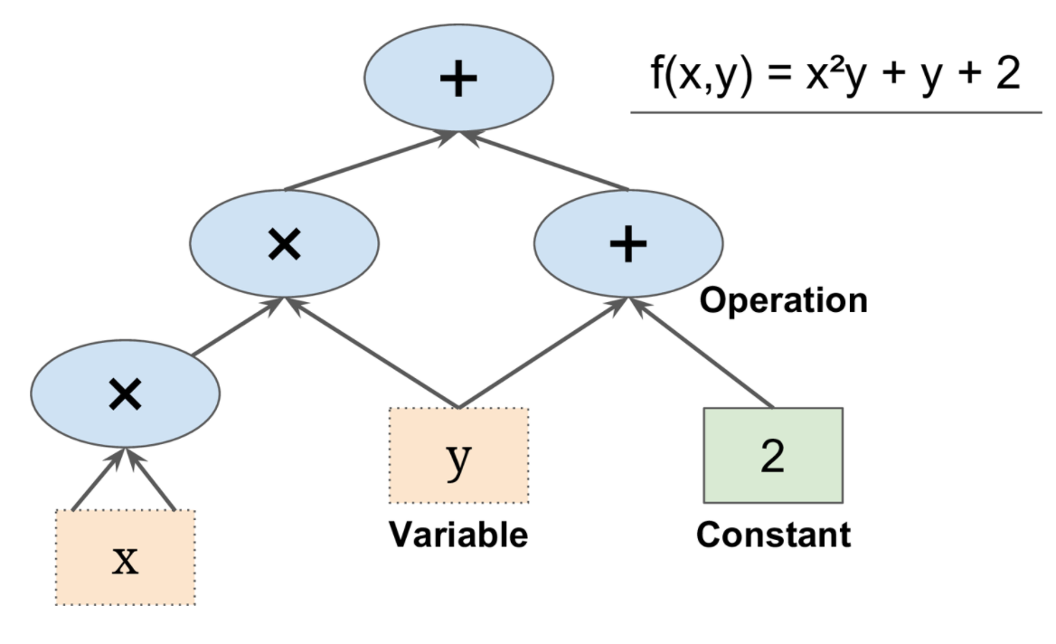
Programming Model
Express a numeric computation as a graph
Graph nodes are operations which have any number of inputs and outputs
Graph edges are tensors which flow between nodes

Slide 72
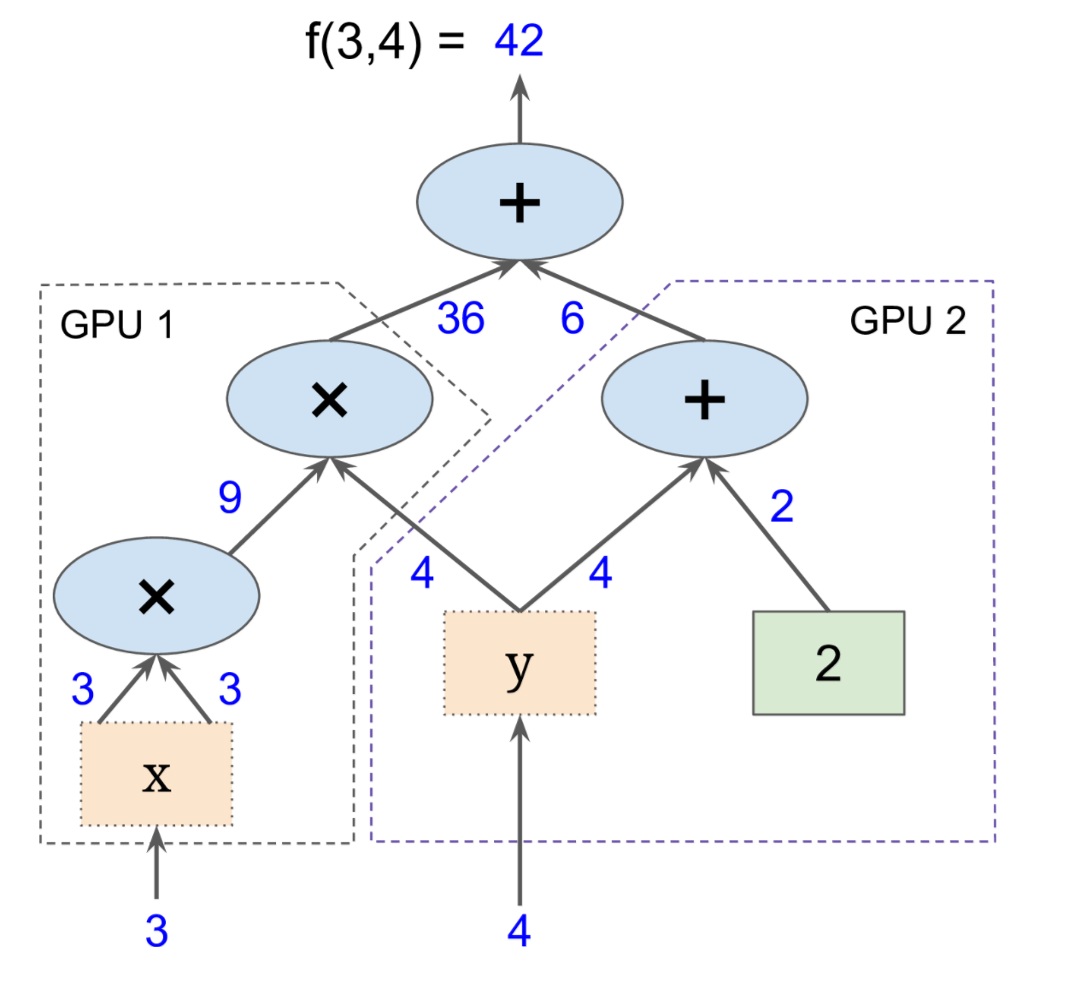
Big Data: Distributed Environment
Portability: deploy computation to one or more CPUs or GPUs in a desktop, server, or mobile device with a single API

Slide 73
Outline
Introduction
The Hadoop Distributed File System (HDFS)
MapReduce
Hadoop
Hadoop Streaming
Problems Suited for MapReduce
TensorFlow
Frequent Itemsets
Conclusion

Slide 74
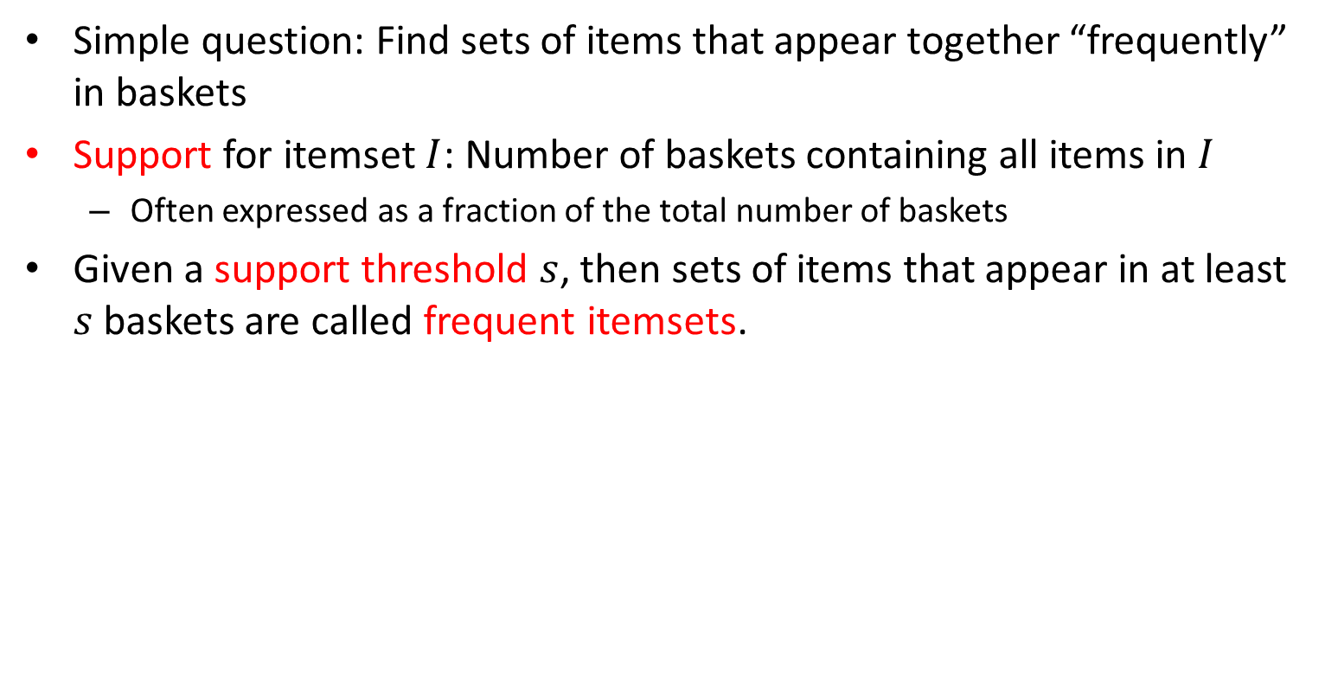
Frequent Itemsets
Simple question: Find sets of items that appear together “frequently” in baskets
Support for itemset $I$: Number of baskets containing all items in $I$
Often expressed as a fraction of the total number of baskets
Given a support threshold $s$, then sets of items that appear in at least $s$ baskets are called frequent itemsets.
TID | Items
1 | Bread, Coke, Milk
2 | Beer, Bread
3 | Beer, Coke, Diaper, Milk
4 | Beer, Bread, Diaper, Milk
5 | Coke, Diaper, Milk
Support of {Beer, Bread} = 2

Slide 75
Example: Frequent Itemsets
Items = {milk, coke, pepsi, beer, juice}
Minimum support = 3 baskets
Frequent itemsets: {m}, {c}, {b}, {j},
{m,b}, {b,c}, {c,j}
B1 = {m,c,b} | B2 = {m,p,j}
B3 = {m,b} | B4 = {c,j}
B5 = {m,p,b} | B6 = {m,c,b,j}
B7 = {c,b,j} | B8 = {b,c}

Slide 76
Itemsets: Computation Model
Typically, data is kept in flat files rather than in a database system:
Stored on disk
Stored basket-by-basket
Baskets are small but we have many baskets and many items
Expand baskets into pairs, triples, etc. as you read baskets
Use k nested loops to generate all sets of size k
Items are positive integers,
and boundaries between
baskets are –1.

Slide 77
Computation Model
The true cost of mining disk-resident data is usually the number of disk I/O’s
In practice, association-rule algorithms read the data in passes – all baskets read in turn
We measure the cost by the number of passes an algorithm makes over the data

Slide 78
Main-Memory Bottleneck
For many frequent-itemset algorithms, main-memory is the critical resource
As we read baskets, we need to count something, e.g., occurrences of pairs of items
The number of different things we can count is limited by main memory
Swapping counts in/out is a disaster

Slide 79
Naïve Algorithm to Count Pairs
Read file once, counting in main memory the occurrences of each pair:
From each basket of n items, generate its n(n-1)/2 pairs by two nested loops
Fails if (#items)² exceeds main memory
Remember: #items can be 100K (Wal-Mart) or 10B (Web pages)
Suppose 10⁵ items, counts are 4-byte integers
Number of pairs of items: 10⁵(10⁵-1)/2 = 5*10⁹
Therefore, 2*10¹⁰ (20 gigabytes) of memory needed

Slide 80
A-Priori Algorithm
A two-pass approach called a-priori limits the need for main memory
Key idea: monotonicity
If a set of items I appears at least s times, so does every subset J of I.
Contrapositive for pairs:
If item i does not appear in s baskets, then no pair including i can appear in s baskets

Slide 81
A-Priori Algorithm
Pass 1: Read baskets and count in main memory the occurrences of each individual item
Requires only memory proportional to #items
Items that appear at least s times are the frequent items
Pass 2: Read baskets again and count in main memory only those pairs where both elements are frequent (from Pass 1)
Requires memory proportional to square of frequent items only (for counts)
Plus a list of the frequent items (so you know what must be counted)

Slide 82
Main-Memory: Picture of A-Priori

Slide 83
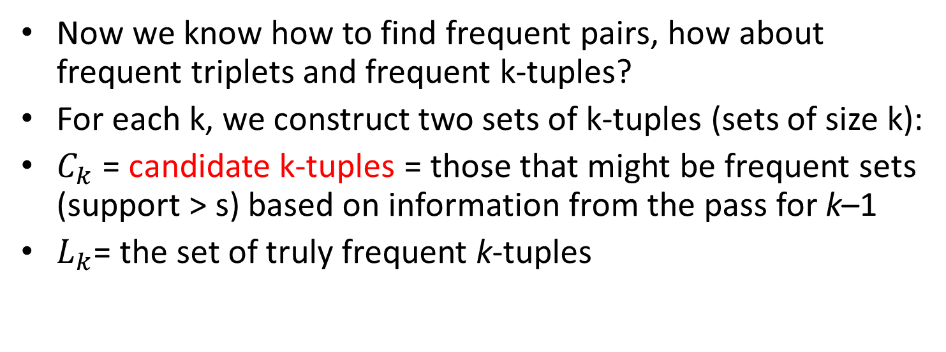
Frequent Triplets, Etc.
Now we know how to find frequent pairs, how about frequent triplets and frequent k-tuples?
For each k, we construct two sets of k-tuples (sets of size k):
$C_{k}$ = candidate k-tuples = those that might be frequent sets (support > s) based on information from the pass for k–1
$L_{k}$= the set of truly frequent k-tuples

Slide 84
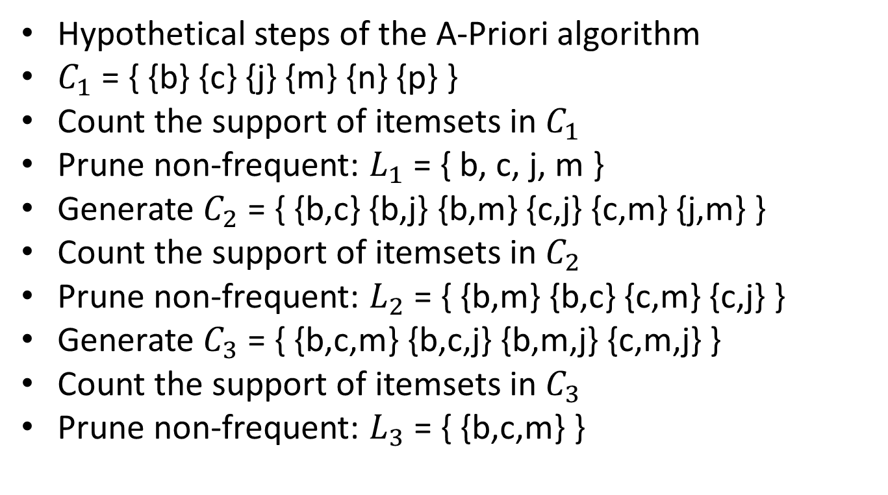
Example
Hypothetical steps of the A-Priori algorithm
$C_{1}$ = { {b} {c} {j} {m} {n} {p} }
Count the support of itemsets in $C_{1}$
Prune non-frequent: $L_{1}$ = { b, c, j, m }
Generate $C_{2}$ = { {b,c} {b,j} {b,m} {c,j} {c,m} {j,m} }
Count the support of itemsets in $C_{2}$
Prune non-frequent: $L_{2}$ = { {b,m} {b,c} {c,m} {c,j} }
Generate $C_{3}$ = { {b,c,m} {b,c,j} {b,m,j} {c,m,j} }
Count the support of itemsets in $C_{3}$
Prune non-frequent: $L_{3}$ = { {b,c,m} }
Notes:
In this slide, C₃ is conservation; it can directly be {{b,c,m}}. However, it would take additional effort to find out.

Slide 85
A-Priori for All Frequent Itemsets
One pass for each k (itemset size)
Needs room in main memory to count each candidate k-tuple
For typical market-basket data and reasonable support (e.g., 1%), k = 2 requires the most memory
Many possible extensions: Lower the support s as itemset gets bigger
Association rules with intervals:
For example: Men over 65 have 2 cars
Association rules when items are in a taxonomy
Bread, Butter → FruitJam
BakedGoods, MilkProduct → PreservedGoods

Slide 86
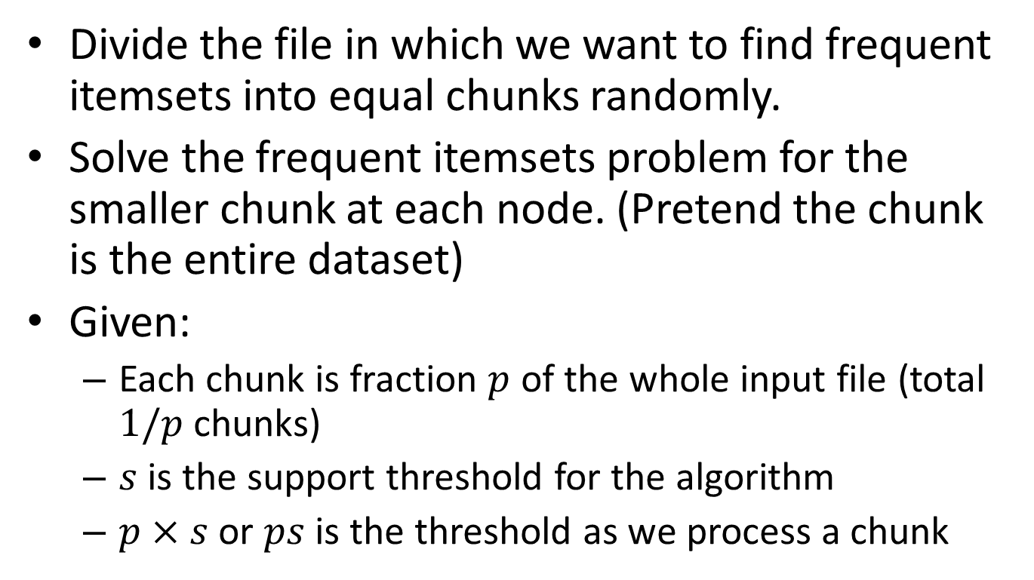
Map-Reduce Implementation
Divide the file in which we want to find frequent itemsets into equal chunks randomly.
Solve the frequent itemsets problem for the smaller chunk at each node. (Pretend the chunk is the entire dataset)
Given:
Each chunk is fraction $p$ of the whole input file (total $1/p$ chunks)
$s$ is the support threshold for the algorithm
$p×s$ or $ps$ is the threshold as we process a chunk

Slide 87
Map-Reduce Implementation
At each node, we can use A-Priori algorithm to solve the smaller problem
Take the group of all the itemsets that have been found frequent for one or more chunks.
Every itemset that is frequent in the whole file is frequent in at least one chunk
All the true frequent itemsets are among the candidates

Slide 88
Map-Reduce Implementation
We can arrange the aforementioned algorithm in a two-pass Map-Reduce framework
First Map-Reduce cycle to produce the candidate itemsets
Second Map-Reduce cycle to calculate the true frequent itemsets.

Slide 89
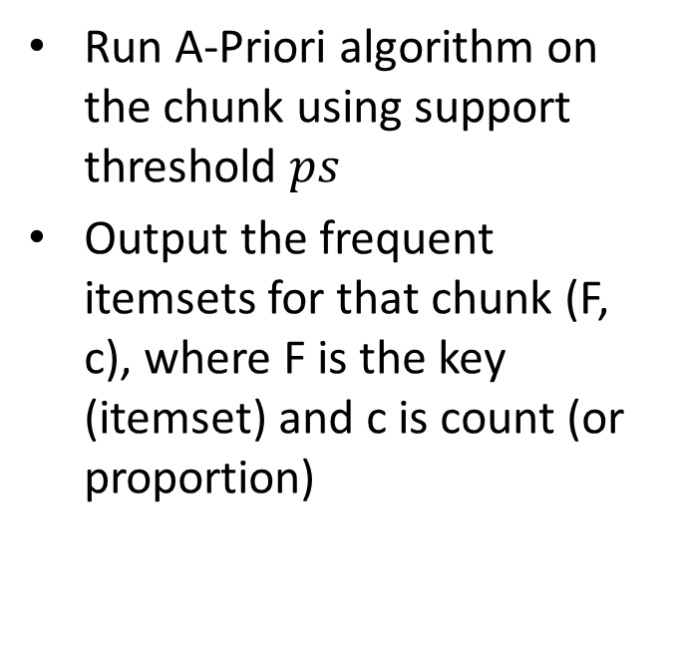
Map-Reduce Implementation
First Mapper
First Reducer
Run A-Priori algorithm on the chunk using support threshold $ps$
Output the frequent itemsets for that chunk (F, c), where F is the key (itemset) and c is count (or proportion)
Input the candidate itemsets to verify in the second pass
Given (F,c), discard c and output all candidate itemsets Fs

Slide 90
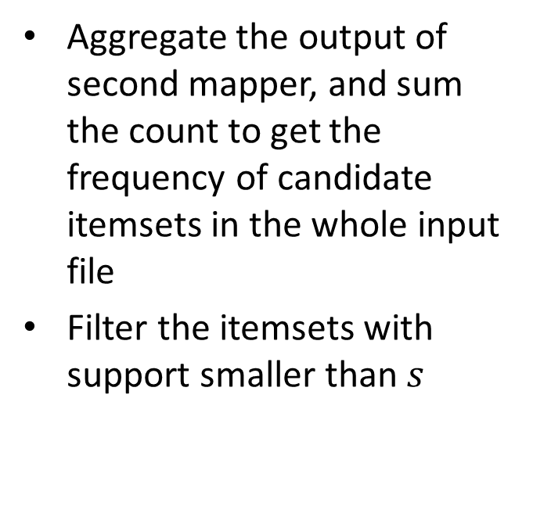
Map-Reduce Implementation
Second Mapper
Second Reducer
For all the candidate itemsets produced by first reducer, count the frequency in local chunk
Aggregate the output of second mapper, and sum the count to get the frequency of candidate itemsets in the whole input file
Filter the itemsets with support smaller than $s$

Slide 91
Outline
Introduction
The Hadoop Distributed File System (HDFS)
MapReduce
Hadoop
Hadoop Streaming
Problems Suited for MapReduce
TensorFlow
Frequent Itemsets
Conclusion

Slide 92
Conclusion
HDFS is a reliable distributed file system
MapReduce is a distributed computing environment
Hadoop is an open-source implementation of MapReduce
Hadoop Streaming allow you to use any language to write MapReduce code
Frequent Itemsets problem can be solved efficiently using its monotonicity property
A-Priori algorithm

Slide 93
One-Slide Takeaway
HDFS is a distributed file system built with robust in mind
MapReduce is a convenient paradigm to implement parallel program
Hadoop is an open source implementation of MapReduce
Hadoop streaming allows you to use any language to program mapper and reducer
Monotonicity property enable efficient algorithms for Frequent Itemsets problem

Slide 94
References
MapReduce: Simplified Data Processing on Large Clusters, Jeffrey Dean and Sanjay Ghemawat
The Hadoop Distributed File System: Architecture and Design by Apache Foundation Inc
Hadoop in Action, Chuck Lam
Hadoop File System, ppt by B. Ramamurthy
Intro & MapReduce, pdf by Jure Leskovec
Association Rules, pdf by Jure Leskovec
Writing an Hadoop MapReduce Program in Python, http://www.michael-noll.com/tutorials/writing-an-hadoop-mapreduce-program-in-python/

Slide 95
In-Class Practice
Given the following input:
I spent long spells at sea on all types of vessel; I followed officer training with the Surface Fleet and with the Royal Marines.
1. Write the word count mapper’s output for the above input.
2. Write the word count mapper’s output after the shuffle process.
3. Write the word count reducer’s output for the above input.

