Slide 1
Lecture 5: Scalable Clustering
CMSC5741 Big Data Tech. & Apps.
Prof. Michael R. Lyu
Computer Science & Engineering Dept.
The Chinese University of Hong Kong

Slide 2
Scopes of Big Data
High dim. data
Locality Sensitive Hashing
Clustering
Graph data
PageRank, SimRank
Community Detection
Infinite data
Filtering Data Streams
Web Advertising
Dimensionality Reduction
Spam Detection
Queries on Streams
Machine learning
SVM
Decision Trees
Perceptron, kNN
Apps
Recommender Systems
Association Rules
Duplicate Document Detection

Slide 3
Scopes of Big Data
High dim. data
Locality Sensitive Hashing
Clustering
Graph data
PageRank, SimRank
Community Detection
Infinite data
Filtering Data Streams
Web Advertising
Dimensionality Reduction
Spam Detection
Queries on Streams
Machine learning
SVM
Decision Trees
Perceptron, kNN
Apps
Recommender Systems
Association Rules
Duplicate Document Detection

Slide 4
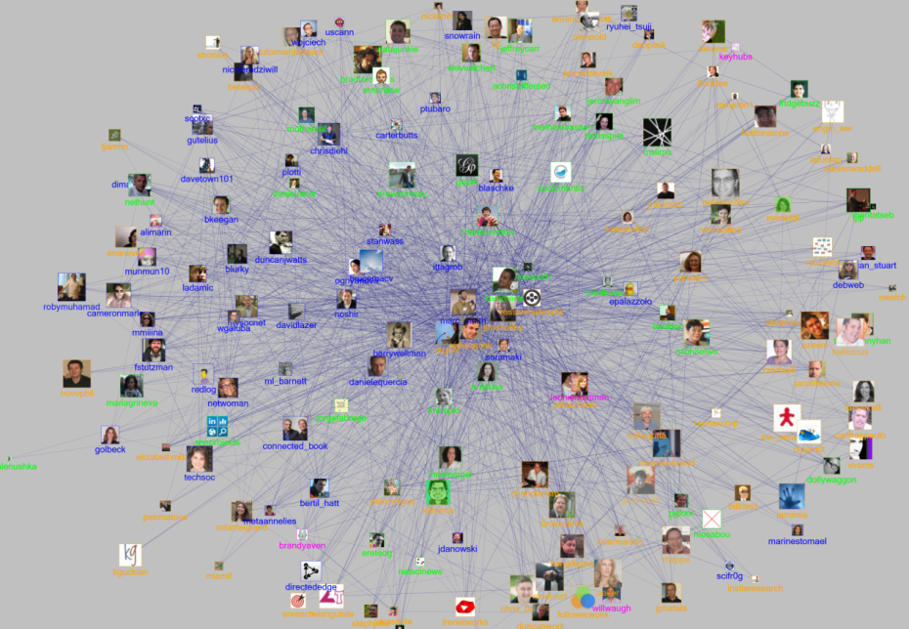
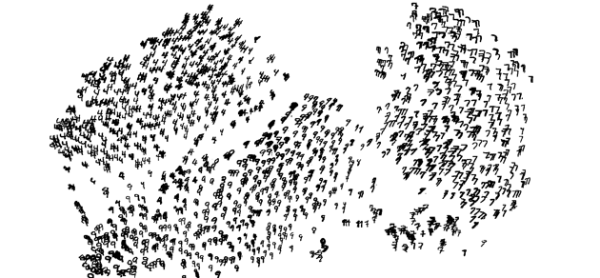
Motivation
Large-scale and high dimensional data
Social networks
Images
Web documents
…
We want to understand the structure of data

Slide 5
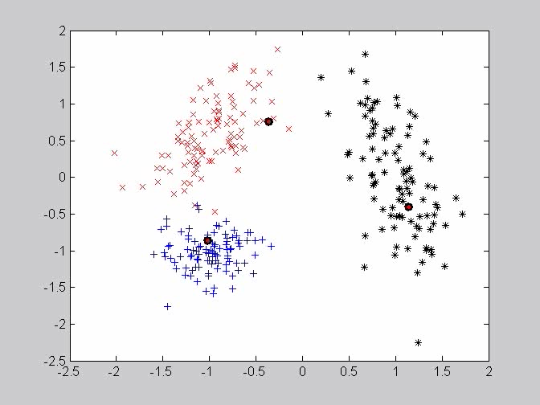

Motivation
Traditional clustering methods (e.g., K-means)
Takes many iterations to converge
Very sensitive to initialization

Slide 6
Outline
Introduction
Hierarchical Clustering
K-means
Scalable K-means
K-means||
BFR
The CURE Algorithm

Slide 7
Outline
Introduction
Hierarchical Clustering
K-means
Scalable K-means
K-means||
BFR
The CURE Algorithm

Slide 8
The Problem of Clustering
Given a set of points, with a notion of distance between points, group the points into some number of clusters, so that
Members of a cluster are close/similar to each other
Members of different clusters are dissimilar
Usually:
Points are in a high-dimensional space
Similarity is defined using a distance measure
Euclidean, Cosine, Jaccard, edit distance, …

Slide 9
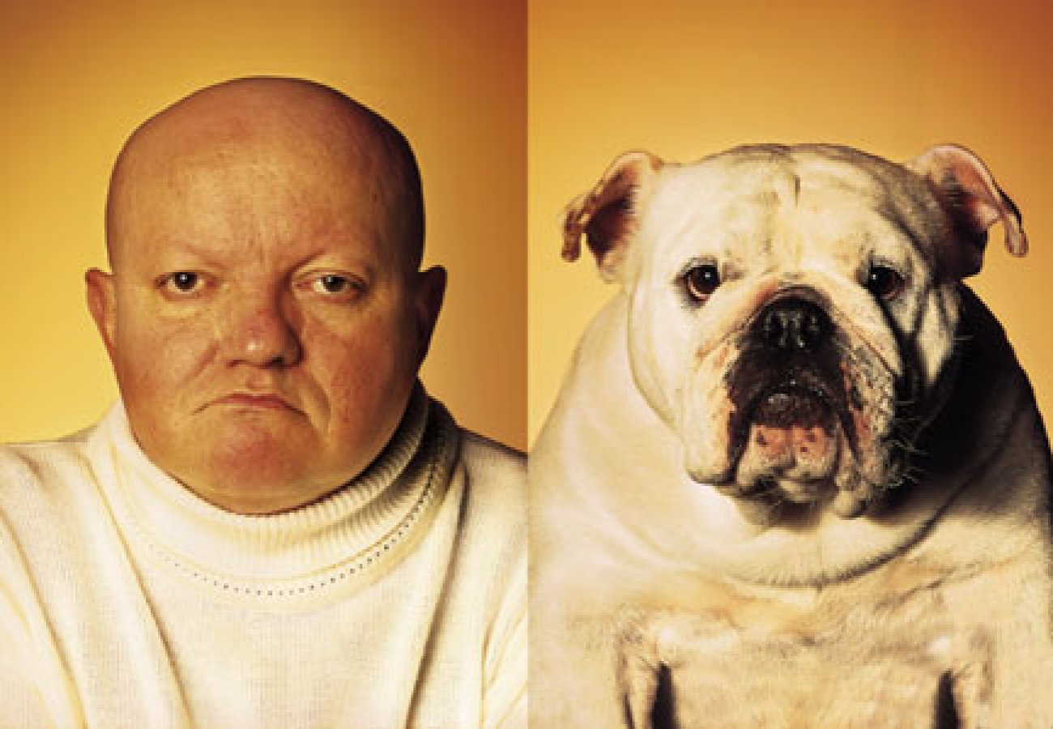
Similarity is Subjective

Slide 10
Example: Clusters & Outliers
x
xx x
x x
x x x
x
x x x
x
x
xx x
x x
x x x
x
x x x
x
x
x x
x x x x
x x x x
x x x
x x
x x
x x x x
x x x x
x x x
x x
x x
x x x x
x x x
x
x x
x x x x
x x x
x
x
Outlier
Cluster

Slide 11
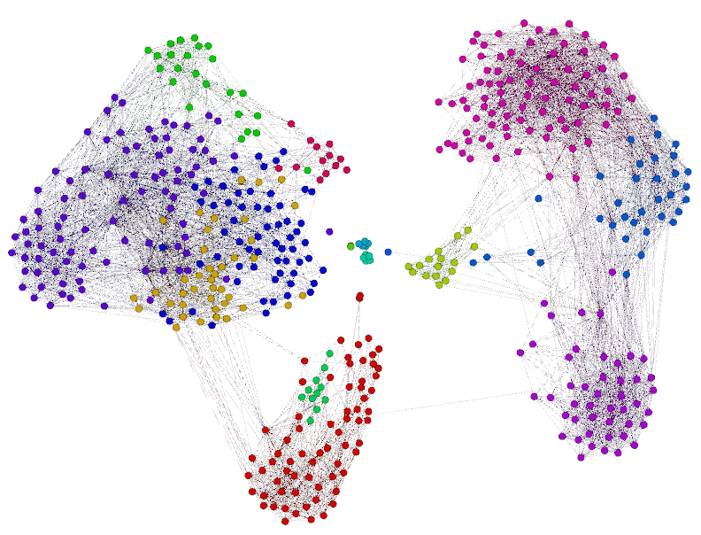
Clustering is a Hard Problem!

Slide 12
Why is it Hard?
Clustering in two dimensions looks easy
Clustering small amounts of data looks easy
And in most cases, looks are not deceiving
Many applications involve not 2, but 10 or 10,000 dimensions
High-dimensional spaces look different:
Almost all pairs of points are at about the same distance
Almost all pairs of vectors (formed between two points) are orthogonal

Slide 13
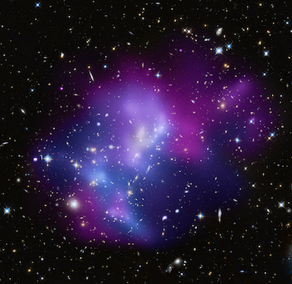
Example 1: Clustering Galaxies
SkyCat: A catalog of 2 billion “sky objects” represents objects by their radiation in 7 dimensions (frequency bands)
Problem: Cluster into similar objects, e.g., galaxies, nearby stars, quasars, etc.
Sloan Digital Sky Survey is a newer, better version of this

Slide 14
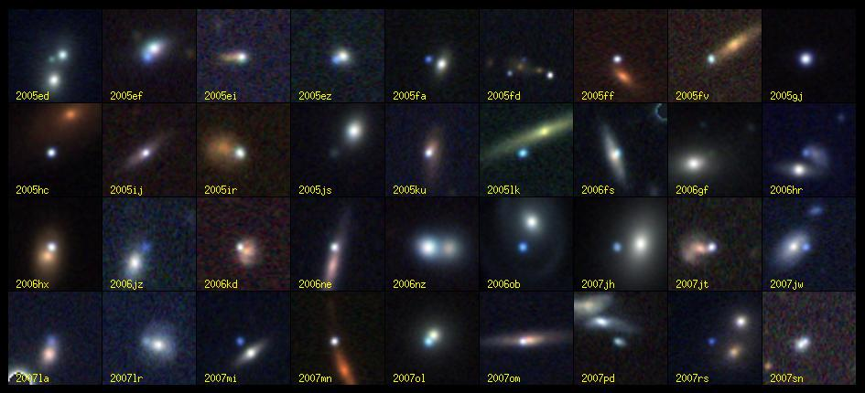
Clustering Problem: Galaxies
Sloan Digital Sky Survey

Slide 15
Example 2: Clustering Movies
Intuitively: Movies divide into categories, and customers prefer a few categories
But what are categories really?
Represent a movie by a set of customers who bought it
Similar movies have similar sets of customers, and vice-versa

Slide 16
Example 2: Clustering Movies
Space of all movies:
Think of a space with one dim. for each customer
Values in a dimension may be 0 or 1 only
A movie is a point in this space is (x₁, x₂,…, x_{k}),
where x_{i} = 1 if and only if the i^{th} customer bought the movie
Compare with Boolean matrix: rows = customers; cols. = movies
For Amazon, the dimension is tens of millions
Task: Find clusters of similar movies
Problem: too many comparisons!
An alternative: Use Minhash/LSH to get Jaccard distance between “close” movies
Standard approach: Use that as input to clustering

Slide 17
Example 3: Clustering Documents
Finding topics:
Represent a document by a vector(x₁, x₂,…, x_{k}), where x_{i} = 1 iff the i^{th} word (in some order) appears in the document
It actually doesn’t matter if k is infinite; i.e., we don’t limit the set of words
Documents with similar sets of words may be about the same topic

Slide 18
Cosine, Jaccard, and Euclidean
As with movies we have a choice when we think of documents as sets of words or shingles:
Sets as vectors: measure similarity by the cosine distance
Sets as sets: measure similarity by the Jaccard distance
Sets as points: measure similarity by Euclidean distance

Slide 19
Overview: Methods of Clustering
x
xx x
x x
x x x
x
x x x
x
Question: How to cluster?
x
x x
x x x x
x x x x
x x x
x x
x x
x x x x
x x x
x
x

Slide 20
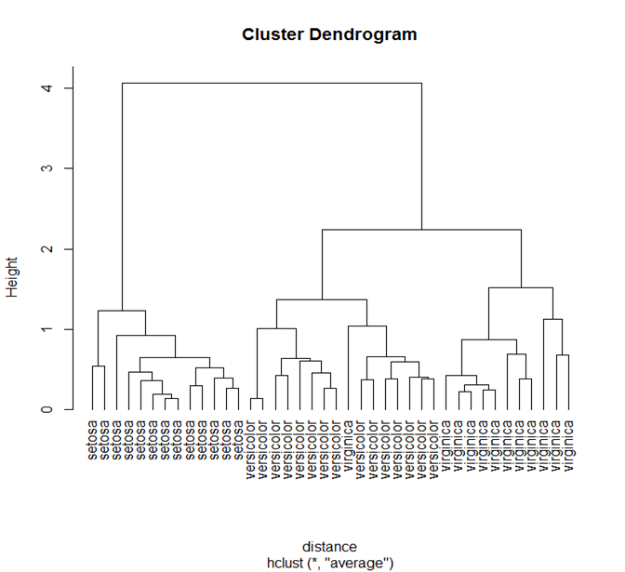
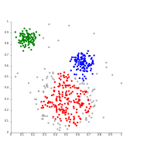
Overview: Methods of Clustering
Hierarchical:
Agglomerative (bottom up):
Initially, each point is a cluster
Repeatedly combine the two “nearest” clusters into one
General complexity: O(n²log(n))
Divisive (top down):
Start with one cluster and recursively split it
General complexity: O(2^{n})
Flat (Point assignment):
Maintain a set of clusters
Points belong to “nearest” cluster
No explicit structure among clusters
K-means is most popular
Notes:
In the general case, the complexity of agglomerative clustering is O(n²log(n)), which makes them too slow for large data sets. Divisive clustering with an exhaustive search is O(2^{n}), which is even worse.

Slide 21
Outline
Introduction
Hierarchical Clustering
K-means
Scalable K-means
K-means||
BFR
The CURE Algorithm

Slide 22
Hierarchical Clustering
Key operation:
Repeatedly combine two nearest clusters
Three important questions:
How do you represent a cluster of more than one point?
How do you determine the “nearness” of clusters?
When to stop combining clusters?

Slide 23
Hierarchical Clustering
Key operation: Repeatedly combine two nearest clusters
(1) How to represent a cluster of many points?
Key problem: As you build clusters, how do you represent the location of each cluster, to tell which pair of clusters is closest?
Euclidean case: each cluster has a centroid = average of its (data) points
(2) How to determine “nearness” of clusters?
Measure cluster distances by distances of centroids

Slide 24
Example: Hierarchical clustering
(5,3)
o
(1,2)
o
o (2,1) o (4,1)
o (0,0) o (5,0)
x (1.5,1.5)
x (4.7,1.3)
x (1,1)
x (4.5,0.5)
Data:
o … data point
x … centroid
Dendrogram

Slide 25
And in the Non-Euclidean Case?
What about the Non-Euclidean case?
The only “locations” we can talk about are the points themselves
i.e., there is no “average” of two points
Approach 1:
(1) How to represent a cluster of many points? Define clustroid = (data)point “closest” to other points
(2) How do you determine the “nearness” of clusters? Treat clustroid as if it were centroid, when computing intercluster distances
Notes:
Intercluster distances can be easily defined for all Euclidean cases. The concept can also be applied to non-Euclidean cases.

Slide 26
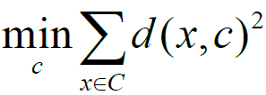
“Closest” Point?
(1) How to represent a cluster of many points? clustroid = point “closest” to other points
Possible meanings of “closest”:
Smallest maximum distance to other points
Smallest average distance to other points
Smallest sum of squares of distances to other points
For distance metric d clustroid c of cluster C is:
Data point
Centroid
Centroid is the avg. of all (data) points in the cluster. This means centroid is an “artificial” point.
Clustroid is an existing (data) point that is “closest” to all other points in the cluster.
X
A cluster on 3 data points
Clustroid

Slide 27
Defining “Nearness” of Clusters
(2) How do you determine the “nearness” of clusters?
Approach 2:
Intercluster distance = minimum of the distances between any two points, one from each cluster
Approach 3:
Pick a notion of “cohesion” of clusters, e.g., maximum distance from the clustroid
Merge clusters whose union is most cohesive
Notes:
These measures are applicable to both Euclidean and non-Euclidean cases.

Slide 28
Cohesion
Approach 3.1: Use the diameter of the merged cluster = maximum distance between points in the cluster
Approach 3.2: Use the average distance between points in the cluster
Approach 3.3: Use a density-based approach
Take the number of points in the cluster divided by the diameter or avg. distance of the cluster
Perhaps raise the diameter or avg. distance to a power first, e.g., 1 or 2
Notes:
These measures are applicable to both Euclidean and non-Euclidean cases.

Slide 29
Implementation
Naïve implementation of hierarchical clustering:
At each step, compute pairwise distances between all pairs of clusters, then merge
Complexity: O(N³)
Careful implementation using priority queue can reduce time to O(N² log N)
Still too expensive for really big datasets that do not fit in memory

Slide 30
Outline
Introduction
Hierarchical Clustering
K-means
Scalable K-means
K-means||
BFR
The CURE Algorithm

Slide 31
K-means Clustering
Fundamental algorithm in data analysis and machine learning
“By far the most popular clustering algorithm used in scientific and industrial applications” [Berkhin ’06]
Identified as one of the top 10 algorithms in data mining [Wu et al ’07]

Slide 32
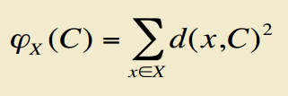
Problem Setting
Input
A set X = {x₁, x₂, …, x_{n}} of n data points
Number of clusters k
For a set C= {c₁, c₂, …, c_{k}} of cluster “centers”, define:
where d(x,C) = the distance from x to the closest center in C
Goal: To find a set C of centers that minimizes the objective function

Slide 33
K-means Algorithm
Start with k arbitrary centers {c₁, c₂, …, c_{k}} (typically chosen uniformly at random from data points)
Performs an EM-type local search till convergence

Slide 34
Expectation Maximization (EM)
An EM algorithm is an iterative method for finding maximum likelihood or maximum a posteriori estimates of parameters in statistical models
Expectation (E) step
Create a function for the expectation of the log-likelihood evaluated using the current estimate for the parameters
Maximization (M) step
Compute parameters maximizing the expected log-likelihood found on the E step

Slide 35
EM in K-means
E step (Assignment)
Keep centers of clusters unchanged, assign points to closest clusters to minimizes the objective function
M step (Update)
Keep the assignments of points unchanged, re-estimate cluster centers to minimizes the objective function

Slide 36
Example: Assigning Clusters
x
x
x
x
x
x
x
x
x
x
x
Initialization of Centroids
E-Step (Assignment)
x … data point
… centroid
Clusters after round 1

Slide 37
Example: Assigning Clusters
x
x
x
x
x
x
x
x
x
x
x
M-Step (Update of Centroids)
E-Step (Assignment)
x … data point
… centroid
Clusters after round 2

Slide 38
Example: Assigning Clusters
x
x
x
x
x
x
x
x
x
x
x
M-Step (Update of Centroids)
E-Step (Assignment)
Converged (no more changes of
assignment)
x … data point
… centroid
Clusters at the end

Slide 39
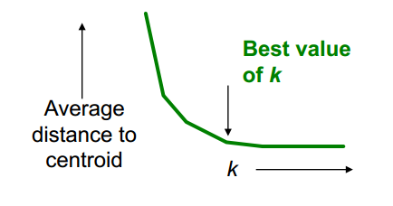
Getting the k Right
How to select k ?
Try different k, looking at the change in the average distance to centroid, as k increases
Average falls rapidly until right k, then changes little

Slide 40
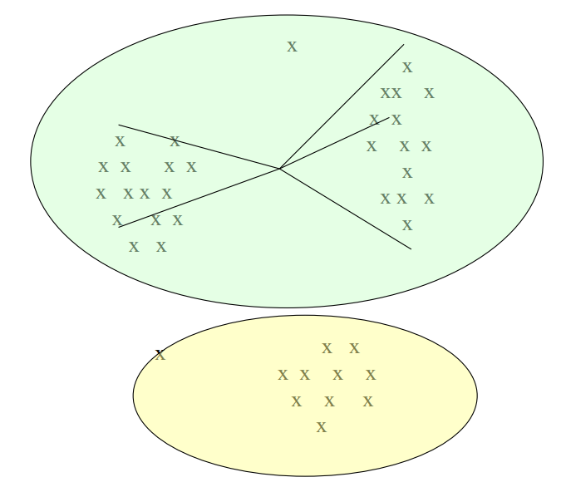
Example: Picking k
Too few:
many long
distances
to centroid

Slide 41
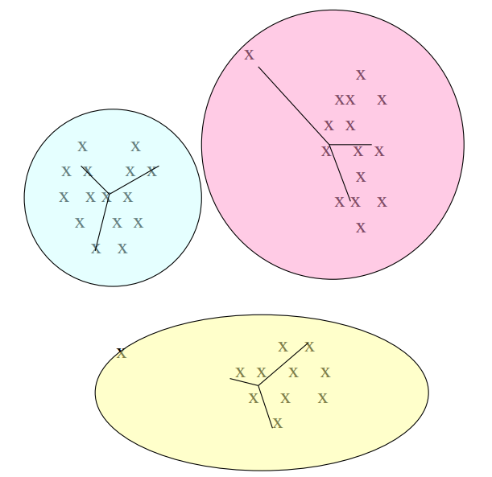
Example: Picking k
Just right:
distances
rather short

Slide 42
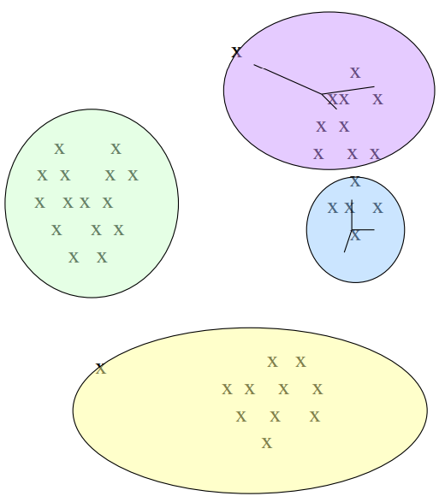
Example: Picking k
Too many:
little improvement
in average
distance.

Slide 43
Pros & Cons
Advantages
Simplicity
Scalability
Disadvantages
Takes many iterations to converge
Very sensitive to initialization
Random initialization can easily get two centers in the same cluster
May get stuck in a local optimum

Slide 44
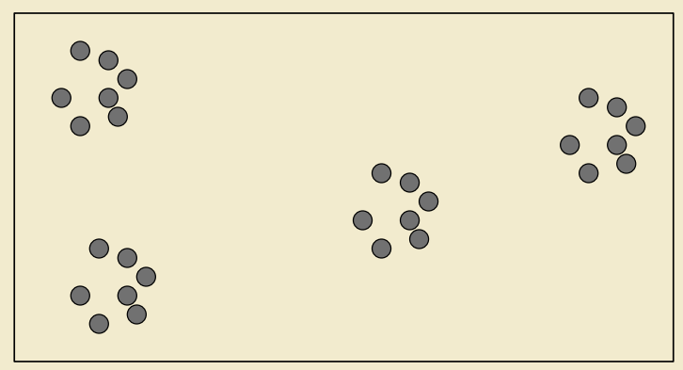
K-means: Initialization

Slide 45
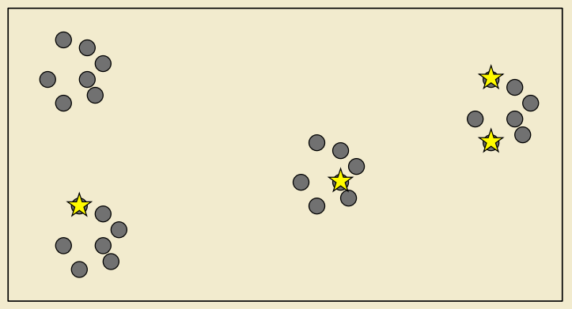
K-means: Initialization

Slide 46
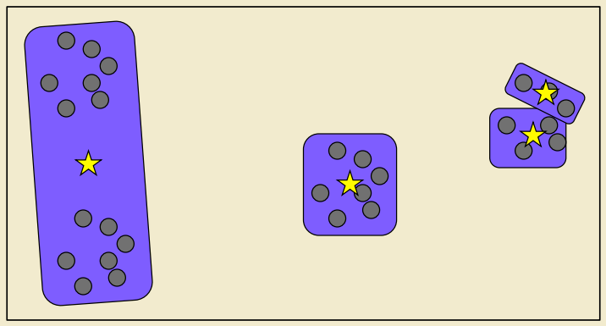
K-means: Results

Slide 47
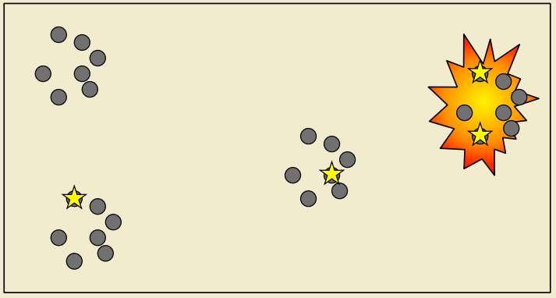
K-means: Initialization Problem!

Slide 48
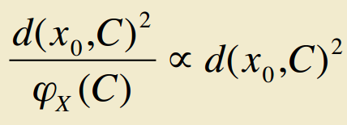
K-means++ [Arthur et al. ’07]
Spreads out the centers
Choose first center, c₁, uniformly at random from the data set
Repeat for 2 ≤ i ≤ k:
Choose c_{i} to be equal to a data point x₀ sampled from the distribution (farthest point from current centers has highest probability):
Theorem: O(log k)-approximation to optimum, right after initialization
Notes:
We first sample a data point x0 from this distribution (the farther x0 from current centers, the higher probability to be sampled), and then let c_{i}=x₀.
Theorem: O(log k)-approximation to optimum, right after initialization. The k-means++ algorithm guarantees an approximation ratio O(log k) in expectation (over the randomness of the algorithm), where k is the number of clusters used. This is in contrast to original k-means, which can generate clustering which is arbitrarily worse than the optimum.

Slide 49
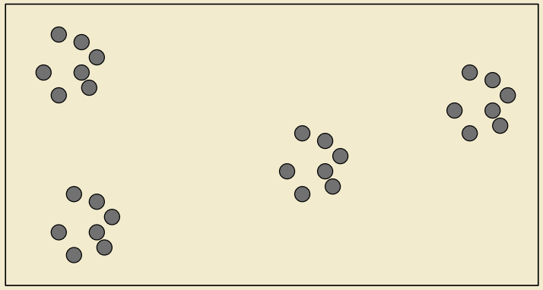
K-means++ Initialization

Slide 50
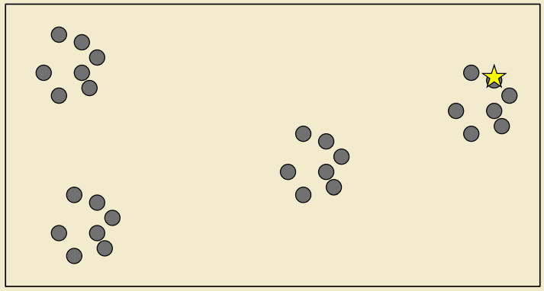
K-means++ Initialization

Slide 51
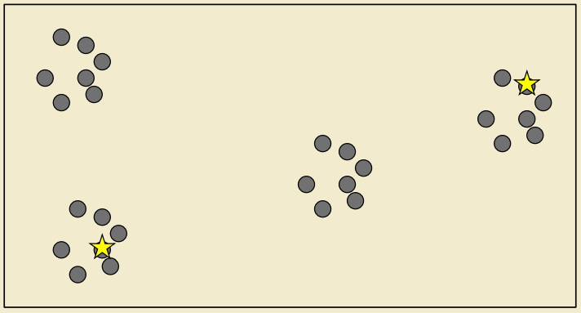
K-means++ Initialization

Slide 52
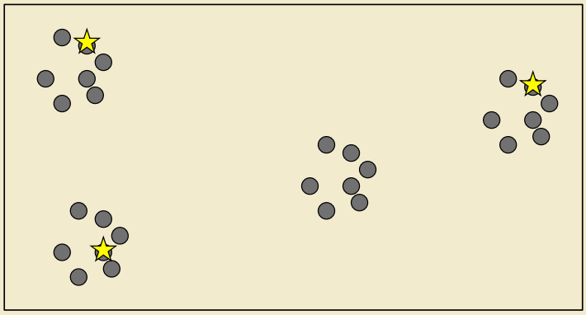
K-means++ Initialization

Slide 53
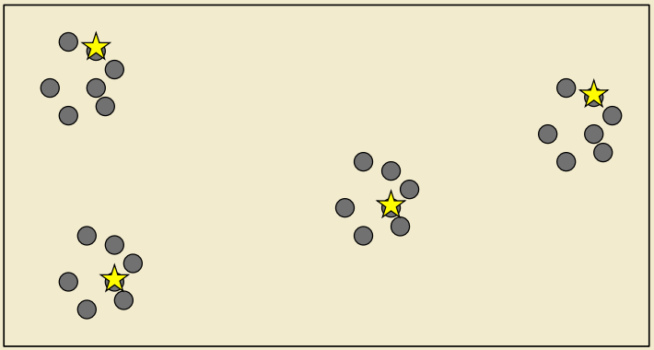
K-means++ Initialization

Slide 54
What’s Wrong with K-means++?
Needs K passes over the data
In large data applications, not only the data is massive, but also K is typically large (e.g., easily 1000).
Does not scale!

Slide 55
In-class Practice 1
Go to Practice

Slide 56
Outline
Introduction
Hierarchical Clustering
K-means
Scalable K-means
K-means||
BFR
The CURE Algorithm

Slide 57
Intuition of K-means||
K-means++ samples one point per iteration and updates its distribution
What if we oversample by sampling each point independently with a larger probability?
Intuitively equivalent to updating the distribution much less frequently
Coarser sampling
Turns out to be sufficient

Slide 58
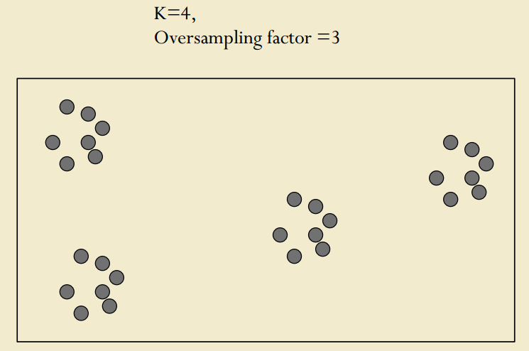
K-means|| Initialization

Slide 59
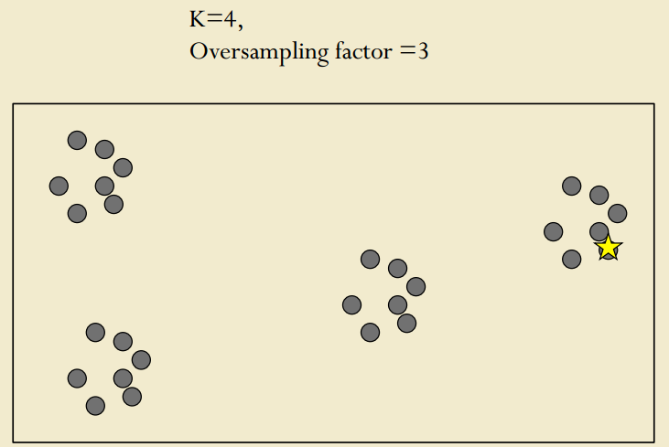
K-means|| Initialization

Slide 60
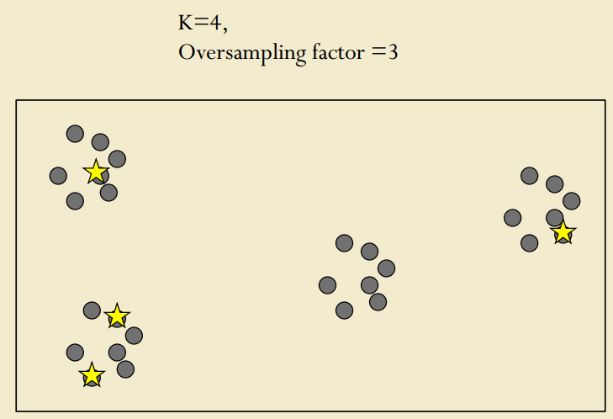
K-means|| Initialization

Slide 61
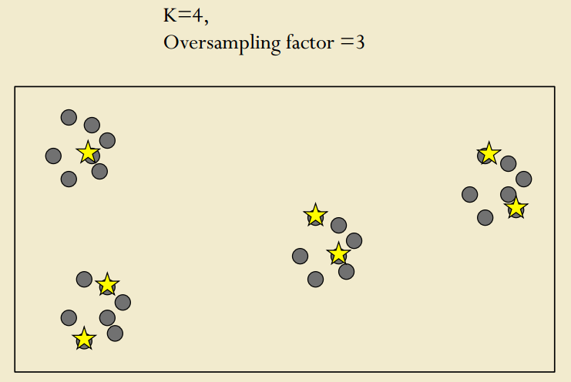
K-means|| Initialization

Slide 62
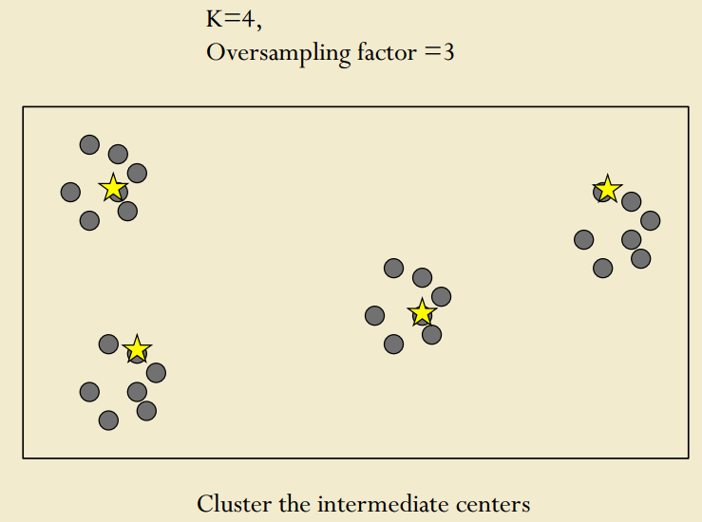
K-means|| Initialization
Cluster the intermediate centers.

Slide 63
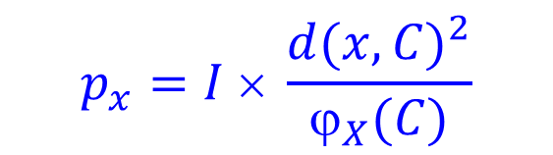
K-means|| [Bahmani et al. ’12]
Choose oversampling factor l > 1 [Think l = Θ(k)]
Initialize C to an arbitrary set of points
For R iterations do:
Each point x in X independently with probability
The expected number of sampled points is l
Add all the sampled points to C
Cluster the (weighted) points in C to find the final k centers
Apply K-means with these k centers
$$p_{x}=I × \frac{d{(x,C)}^{2}}{ϕ_{X}(C)}$$
Notes:
k is the number of clusters, l is the oversampling factor, which can be a function of k (i.e., theta(k)). For each iteration, K-means|| samples each point with higher probability than K-means++. Note that each point can be sampled multiple times. After R iterations, we will get more than k intermediate clusters (The expected number of points in C is l*R) in C. These clusters are then clustered to find the final k centers.

Slide 64
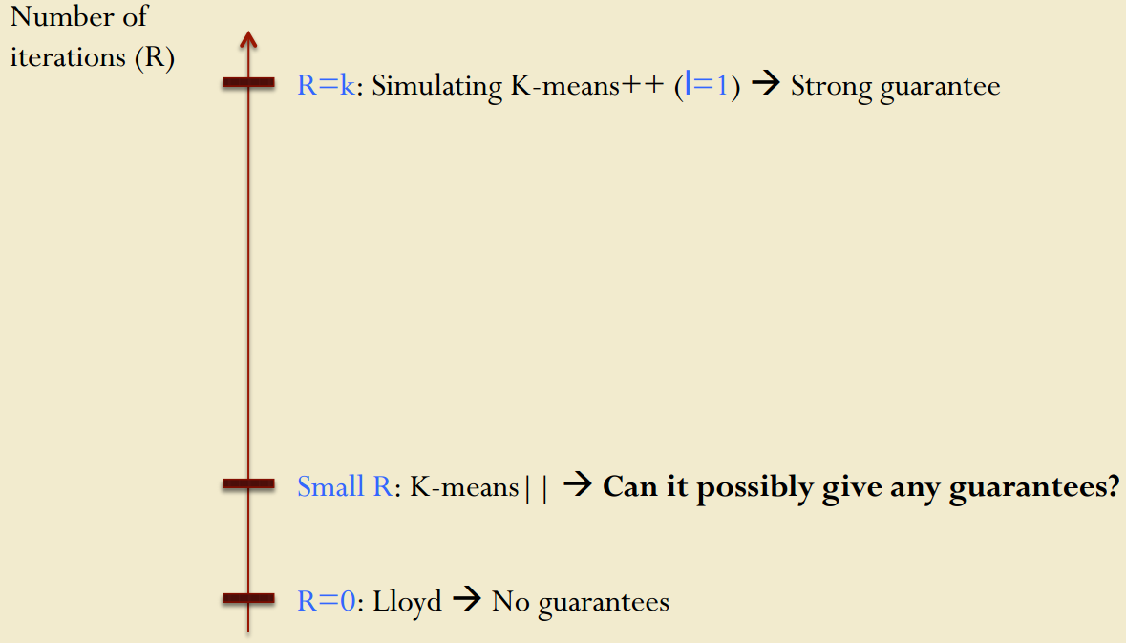

K-means, K-means++, and K-means||

Slide 65
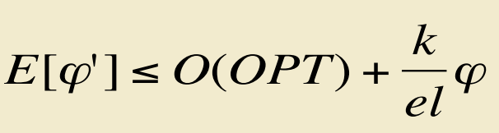
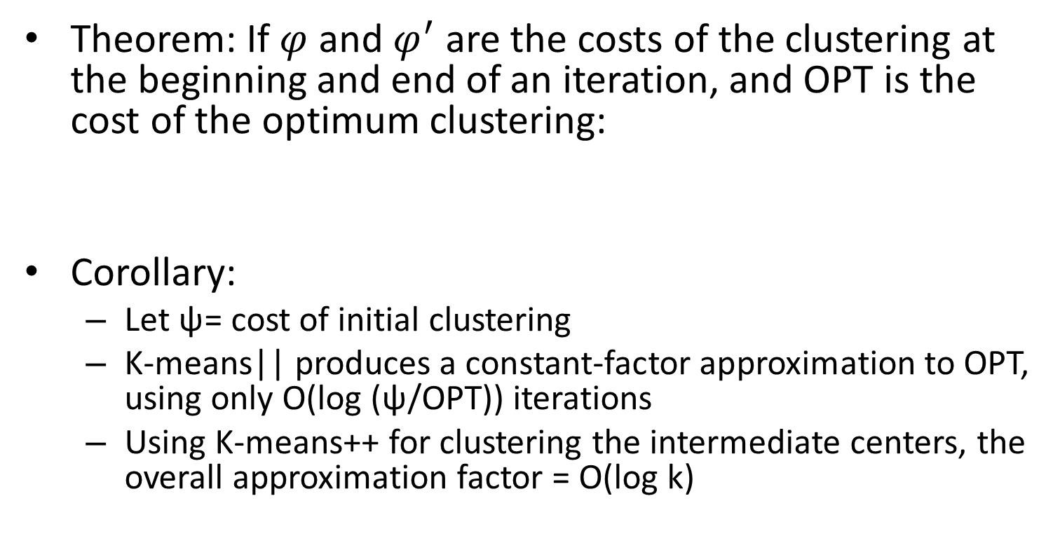
Theorem
Theorem: If $φ$ and $φ^{′}$ are the costs of the clustering at the beginning and end of an iteration, and OPT is the cost of the optimum clustering:
Corollary:
Let ψ= cost of initial clustering
K-means|| produces a constant-factor approximation to OPT, using only O(log (ψ/OPT)) iterations
Using K-means++ for clustering the intermediate centers, the overall approximation factor = O(log k)

Slide 66
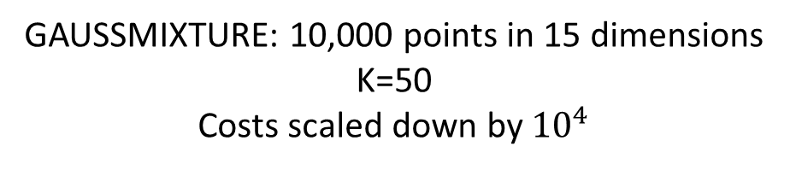
Experimental Results: Quality
 | Clustering Cost Right After Initialization | Clustering Cost After Convergence
Random | NA | 22,000
K-means++ | 430 | 65
K-means|| | 16 | 14
GAUSSMIXTURE: 10,000 points in 15 dimensions
K=50
Costs scaled down by ${10}^{4}$
K-means|| is much harder than K-means++ to get confused with noisy outliers

Slide 67
Experimental Results: Convergence
K-means|| reduces number of iterations even more than K-means++
 | Number of Iterations till Convergence
Random | 167
K-means++ | 42
K-means|| | 28
SPAM: 4,601 points in 58 dimensions
K=50

Slide 68
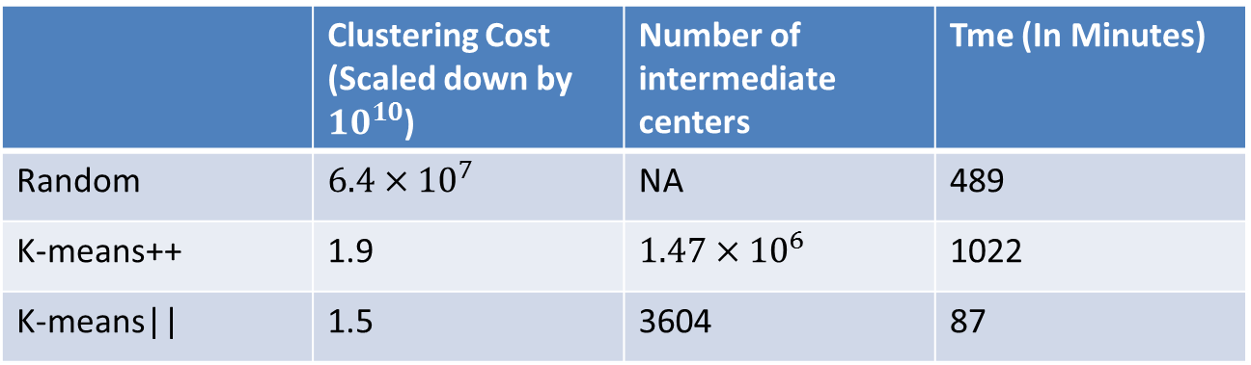
Experimental Results
K-means|| needs a small number of intermediate centers
Better than K-means++ as soon as ~K centers chosen
 |  | Number of intermediate centers | Time (In Minutes)
Random |  | NA | 489
Partition | 1.9 |  | 1022
K-means|| | 1.5 | 3604 | 87
KDDCUP1999: 4.8M points in 42 dimensions; K=1000

Slide 69
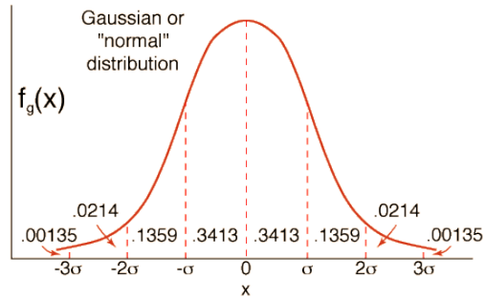
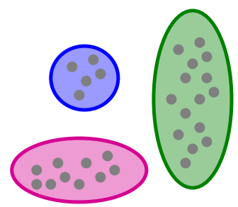
BFR Algorithm
BFR [Bradley-Fayyad-Reina] is a variant of k-means designed to handle very large (disk-resident) data sets
Assumes that clusters are normally distributed around a centroid in a Euclidean space
Standard deviations in different
dimensions may vary
Clusters are axis-aligned ellipses
For every point we can quantify the likelihood that it belongs to a particular cluster

Slide 70
BFR Algorithm
Points are read from disk one main-memory full at a time
Most points from previous memory loads are summarized by simple statistics
To begin, from the initial load we select the initial k centroids by some sensible approach
Take k random points
Take a small random sample and cluster optimally
Take a sample; pick a random point, and then
k–1 more points, each as far from the previously
selected points as possible

Slide 71
Three Classes of Points
3 sets of points which we keep track of
Discard set (DS):
Points close enough to a centroid to be summarized
Compression set (CS):
Groups of points that are close together but not close to any existing centroid
These points are summarized, but not assigned to a cluster
Retained set (RS):
Isolated points waiting to be assigned to a compression set

Slide 72
BFR: “Galaxy” Picture
Points in
the RS
Compressed sets.
Their points are in
the CS.
A cluster. Its points
are in the DS.
The centroid
Discard set (DS): Close enough to a centroid to be summarized
Compression set (CS): Summarized, but not assigned to a cluster
Retained set (RS): Isolated points

Slide 73
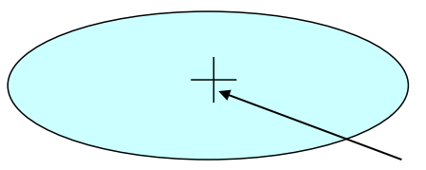
Summarizing Sets of Points
For each cluster, the discard set (DS) is summarized by:
The number of points, N
The vector SUM, whose i^{th} component is the sum of the coordinates of the points in the i^{th} dimension
The vector SUMSQ: i^{th} component = sum of squares of coordinates in i^{th} dimension
A cluster.
All its points are in the DS.
The centroid

Slide 74
Summarizing Points: Comments
2d + 1 values represent any size cluster
d = number of dimensions
Average in each dimension (the centroid) can be calculated as SUM_{i}/ N
SUM_{i} = i^{th} component of SUM
Variance of a cluster’s discard set in dimension i is: (SUMSQ_{i}/ N) – (SUM_{i}/ N)²
And standard deviation is the square root of that
Next step: Actual clustering

Slide 75
The “Memory-load” of Points
Processing the “Memory-Load” of points (1):
Find those points that are “sufficiently close” to a cluster centroid
Add those points to that cluster and the DS
These points are so close to the centroid that they can be summarized and then discarded
Use any main-memory clustering algorithm to cluster the remaining points and the old RS
Clusters go to the CS; outlying points to the RS
Discard set (DS): Close enough to a centroid to be summarized
Compression set (CS): Summarized, but not assigned to a cluster
Retained set (RS): Isolated points

Slide 76
The “Memory-load” of Points
Processing the “Memory-Load” of points (2):
DS set: Adjust statistics of the clusters to account for the new points
Add Ns, SUMs, SUMSQs
Consider merging compressed sets in the CS
If this is the last round, merge all compressed sets in the CS and all RS points into their nearest cluster
Discard set (DS): Close enough to a centroid to be summarized
Compression set (CS): Summarized, but not assigned to a cluster
Retained set (RS): Isolated points

Slide 77
A Few Details…
Q1: How do we decide if a point is “close enough” to a cluster that we will add the point to that cluster?
Q2: How do we decide whether two compressed sets (CS) deserve to be combined into one?

Slide 78
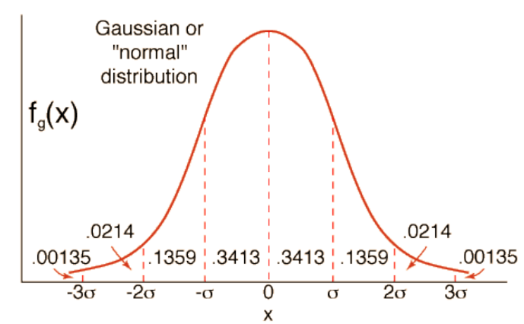
How Close is Close Enough?
Q1: We need a way to decide whether to put a new point into a cluster (and discard)
BFR suggest two ways:
The Mahalanobis distance is less than a threshold
High likelihood of the point belonging to currently nearest centroid

Slide 79
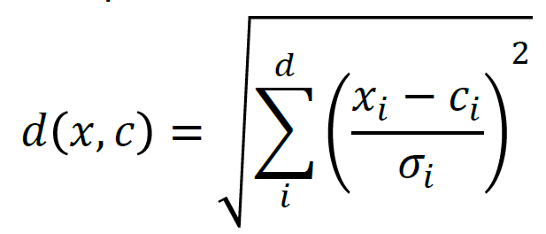
Mahalanobis Distance
Normalized Euclidean distance from centroid
For point (x₁, …, x_{d}) and centroid (c₁, …, c_{d})
Normalize in each dimension: y_{i}= (x_{i} - c_{i}) /σ_{i}
Take sum of the squares of the y_{i}
Take the square root
σ_{i}: standard deviation of points in the cluster in the i^{th} dimension

Slide 80
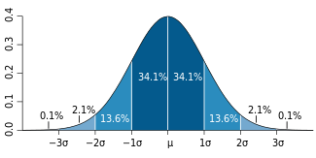
Mahalanobis Distance
If clusters are normally distributed in d dimensions, then after transformation, one standard deviation =
i.e., 68% of the points of the cluster will have a Mahalanobis distance <
Accept a point for a cluster if its M.D. is < some threshold, e.g. 2 standard deviations

Slide 81
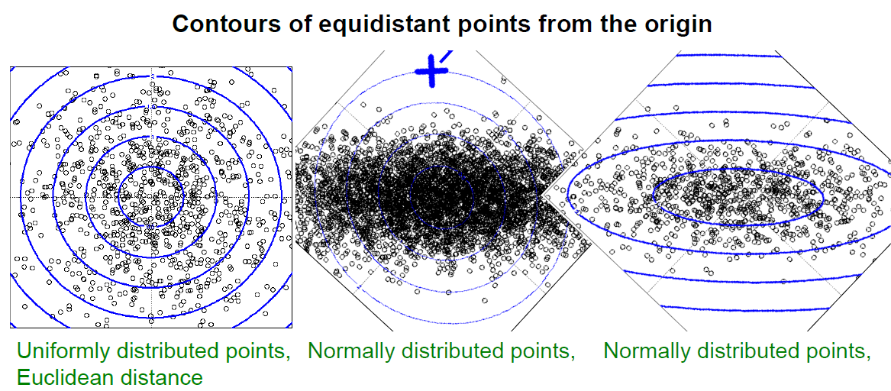
Euclidean vs. Mahalanobis Distance

Slide 82
Should 2 CS Clusters be Combined?
Q2: Should 2 CS subclusters be combined?
Compute the variance of the combined subcluster
N, SUM, and SUMSQ allow us to make that calculation quickly
Combine if the combined variance is below some threshold
Many alternatives: Treat dimensions differently, consider density

Slide 83
In-class Practice 2
Go to Practice

Slide 84
Outline
Introduction
Hierarchical Clustering
K-means
Scalable K-means
K-means||
BFR
The CURE Algorithm

Slide 85
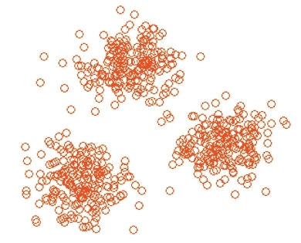
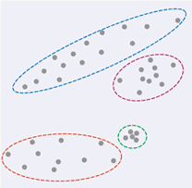
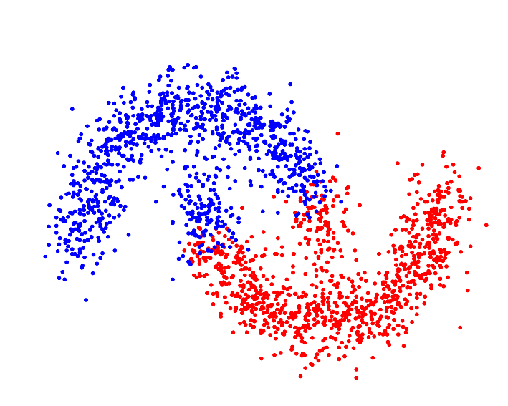
The CURE Algorithm
Problem with BFR/k-means:
Assumes clusters are normally distributed in each dimension
And axes are fixed – ellipses at an angle are not OK
CURE (Clustering Using REpresentatives):
Assumes a Euclidean distance
Allows clusters to assume any shape
Uses a collection of representative points to represent clusters
vs.

Slide 86
Example: Stanford Faculty Salaries
h
h
h
e
e
e
h
e
e
e
h
e
e
e
e
salary
h
e
h
h
h
h
h
h
h
age

Slide 87
Starting CURE
Pick a random sample of points that fit in main memory.
Cluster these points hierarchically --- group nearest points/clusters.
For each cluster, pick a sample of points, as dispersed as possible.
From the sample, pick representatives by moving them (say) 20% toward the centroid of the cluster.

Slide 88
Example: Initial Clusters
h
h
h
e
e
e
h
e
e
e
h
e
e
e
e
h
salary
e
h
h
h
h
h
h
h
age

Slide 89
Example: Pick Dispersed Points
h
h
h
e
e
e
h
e
e
e
h
e
e
e
e
h
salary
e
Pick (say) 4
remote points
for each
cluster.
h
h
h
h
h
h
h
age

Slide 90
Example: Pick Dispersed Points
h
h
h
e
e
e
h
e
e
e
h
e
e
e
e
h
salary
e
Move points
(say) 20%
toward the
centroid.
h
h
h
h
h
h
h
age

Slide 91
Finishing CURE
Now, visit each point p in the data set.
Place it in the “closest cluster.”
Each point p is brought from secondary storage and compared with the representative points. We assign p to the cluster of the representative point that is closest to p.
Normal definition of “closest”: that cluster with the closest (to p) among all the sample points of all the clusters.

Slide 92
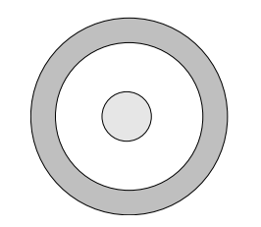
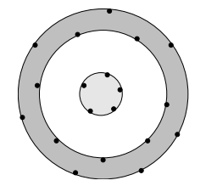
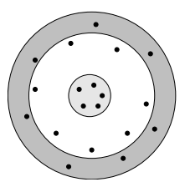
Another Running Example
Two Clusters, One Surrounding the Other
Select representative points from each cluster, as far from one another as possible
Moving the representative points 20% toward centroids
Point Assignment: bring in all points for assignment to the clusters.

Slide 93
One-Slide Takeaway
Clustering: Given a set of points, with a notion of distance between points, group the points into some number of clusters
Algorithms:
Agglomerative hierarchical clustering:
Centroid and clustroid
k-means:
Initialization, picking k
k-means++
k-means||
BFR
CURE

Slide 94
References
Bahmani, Bahman, et al. "Scalable k means++." Proceedings of the VLDB Endowment 5.7 (2012): 622-633.
Arthur, David, and Sergei Vassilvitskii. "k-means++: The advantages of careful seeding." Proceedings of the eighteenth annual ACM-SIAM symposium on Discrete algorithms. Society for Industrial and Applied Mathematics, 2007.
Wu, Xindong, et al. "Top 10 algorithms in data mining." Knowledge and Information Systems 14.1 (2008): 1-37.
Berkhin, Pavel. "A survey of clustering data mining techniques." Grouping multidimensional data. Springer Berlin Heidelberg, 2006. 25-71.

Slide 95
References
G. Scott and H. Longuet-Higgins. An algorithm for associating the features of two patterns. In Proc. Royal Society London, volume B244, pages 21-26, 1991.
A. Ng, M. Jordan, Y. Weiss. On Spectral clustering: analysis and algorithm. In Advances in Neural Information Processing Systems (2001), pp. 849-856
Pietro Perona and William Freeman. A factorization approach to grouping. In ECCV'98, pp. 655-670.
Jianbo Shi and Jitendra Malik. 2000. Normalized Cuts and Image Segmentation. IEEE Trans. Pattern Anal. Mach. Intell. 22, 8 (August 2000), 888-905.

Slide 96
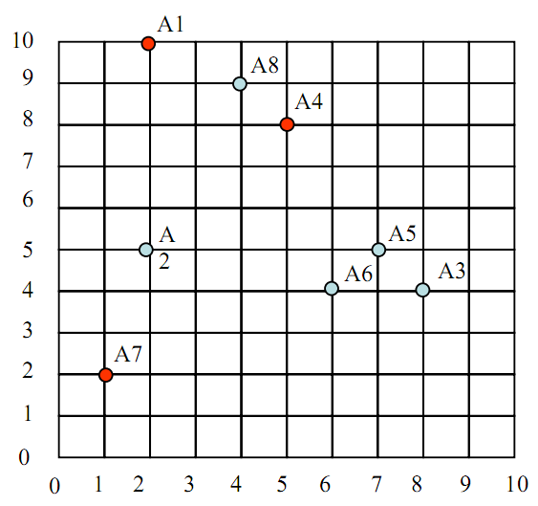
In-class Practice 1
Given 8 points in the left 2D space, suppose that the initial seeds (centers of each cluster) are A1, A4 and A7. Run the k-means algorithm.
Using Euclidean distance show the clusters after the first epoch and the new centroids.
How many more iterations are needed to converge? Draw the result for each epoch.
If we apply K-means++ to the data and choose A4 as the first seed, which point will be chosen as the second seed?

Slide 97

In-class Practice 2
For the three clusters of the left figure, compute:
the representation of the cluster as in the BFR Algorithm. That is, compute N, SUM, and SUMSQ.
the variance and standard deviation of each cluster in each of the two dimensions.
Suppose a cluster of three-dimensional points has standard deviations of 2, 3, and 5, in the three dimensions, in that order. Compute the Mahalanobis distance between the origin (0,0,0) and the point (1,−3,4).

