Slide 1
Lecture 10: Large Scale Support Vector Machines
CMSC5741 Big Data Tech. & Apps.
Prof. Michael R. Lyu
Computer Science & Engineering Dept.
The Chinese University of Hong Kong

Slide 2
Motivation
Introduce the widely used classification tool: Support Vector Machine (SVM)
Understand the model and parameter estimation method in terms of big data

Slide 3
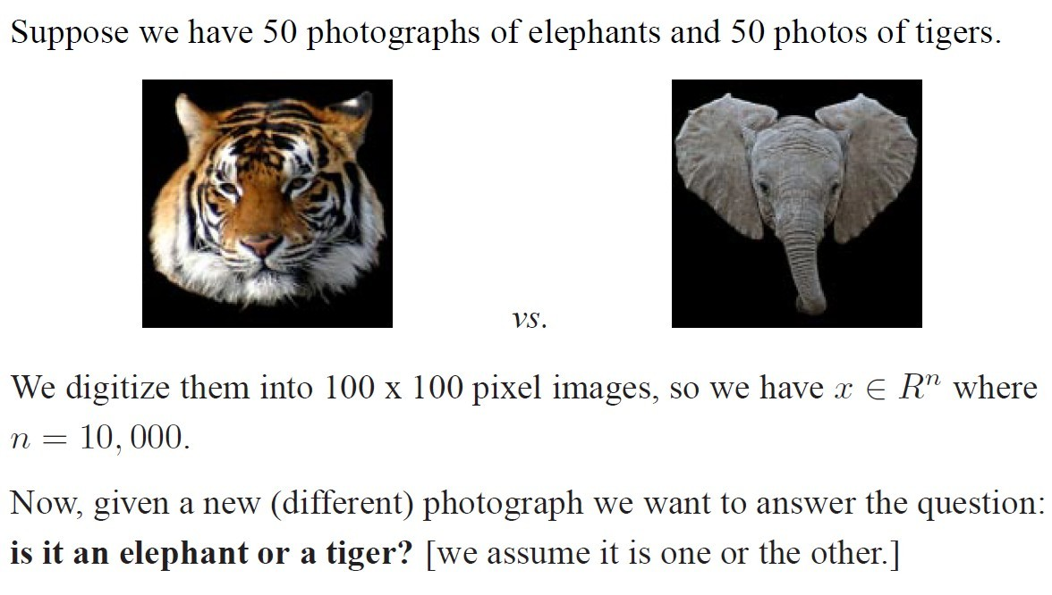
Motivation

Slide 4


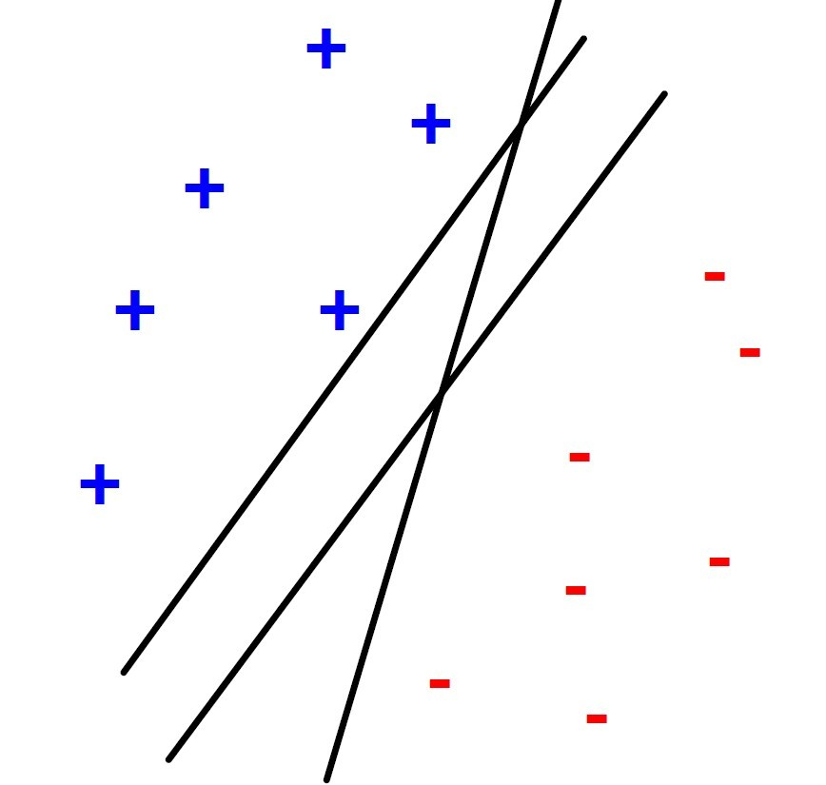
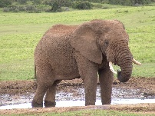
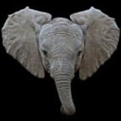

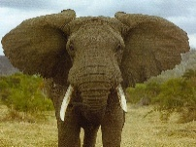


Motivation
What if there are millions of photos, how to make the SVM training scalable?

Slide 5
Outline
Support Vector Machines
History
Linear Separable SVMs
Non-linear Separable SVMs
Soft Margin
Kernel Trick
Parameter Estimation
Further Reading

Slide 6
Outline
Support Vector Machines
History
Linear Separable SVMs
Non-linear Separable SVMs
Soft Margin
Kernel Trick
Parameter Estimation
Further Reading

Slide 7
SVMs: History
SVMs introduced in COLT-92 by Boser, Guyon & Vapnik. Became rather popular since.
Theoretically well motivated algorithm: developed from Statistical Learning Theory (Vapnik & Chervonenkis) since the 60s.
Empirically good performance: successful applications in many fields (bioinformatics, text, image recognition, . . . )

Slide 8
SVMs: History
Centralized website: www.kernel-machines.org.
Several textbooks, e.g. “An introduction to Support Vector Machines” by Cristianini and Shawe-Taylor is one.
A large and diverse community work on them: from machine learning, optimization, statistics, neural networks, functional analysis, etc.

Slide 9
Outline
Support Vector Machines
History
Linear SVMs
Non-linear SVMs
Soft Margin
Kernel Trick
Parameter Estimation
Further Reading

Slide 10

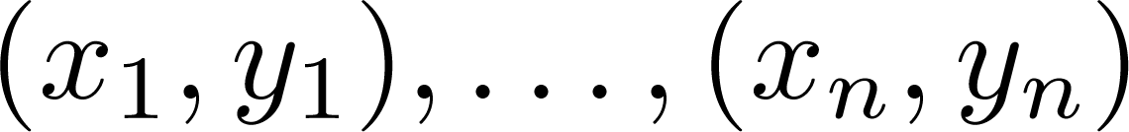
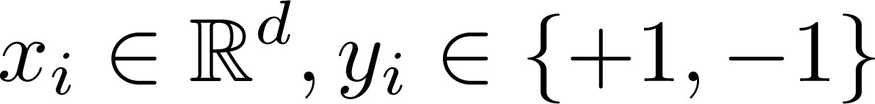
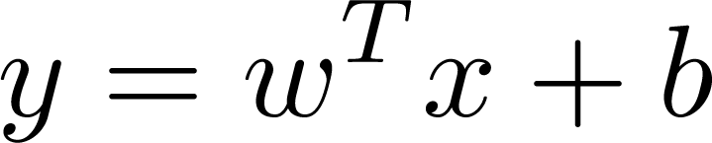

Linear SVMs
Data
Training examples:
Each
Want to find a hyperplane
to separate “+” from “-”
What’s the best hyperplane defined by ?

Slide 11
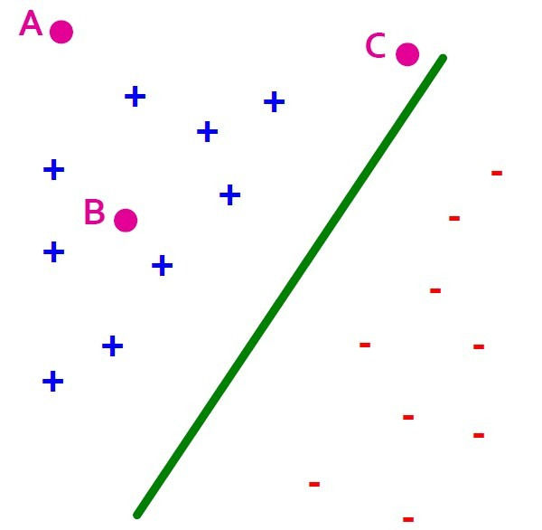
Largest Margin
Distance from the separating hyperplance corresponds to the “confidence” of prediction
Example: We have more confidence to say A and B belong to “+” than C

Slide 12

Largest Margin
Support Vectors: Examples closest to the hyperplane
Margin : width of separation between support vectors of classes.
x
ρ
r
x′
w
Support vector

Slide 13
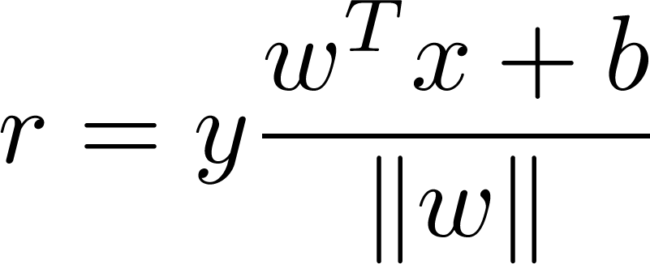
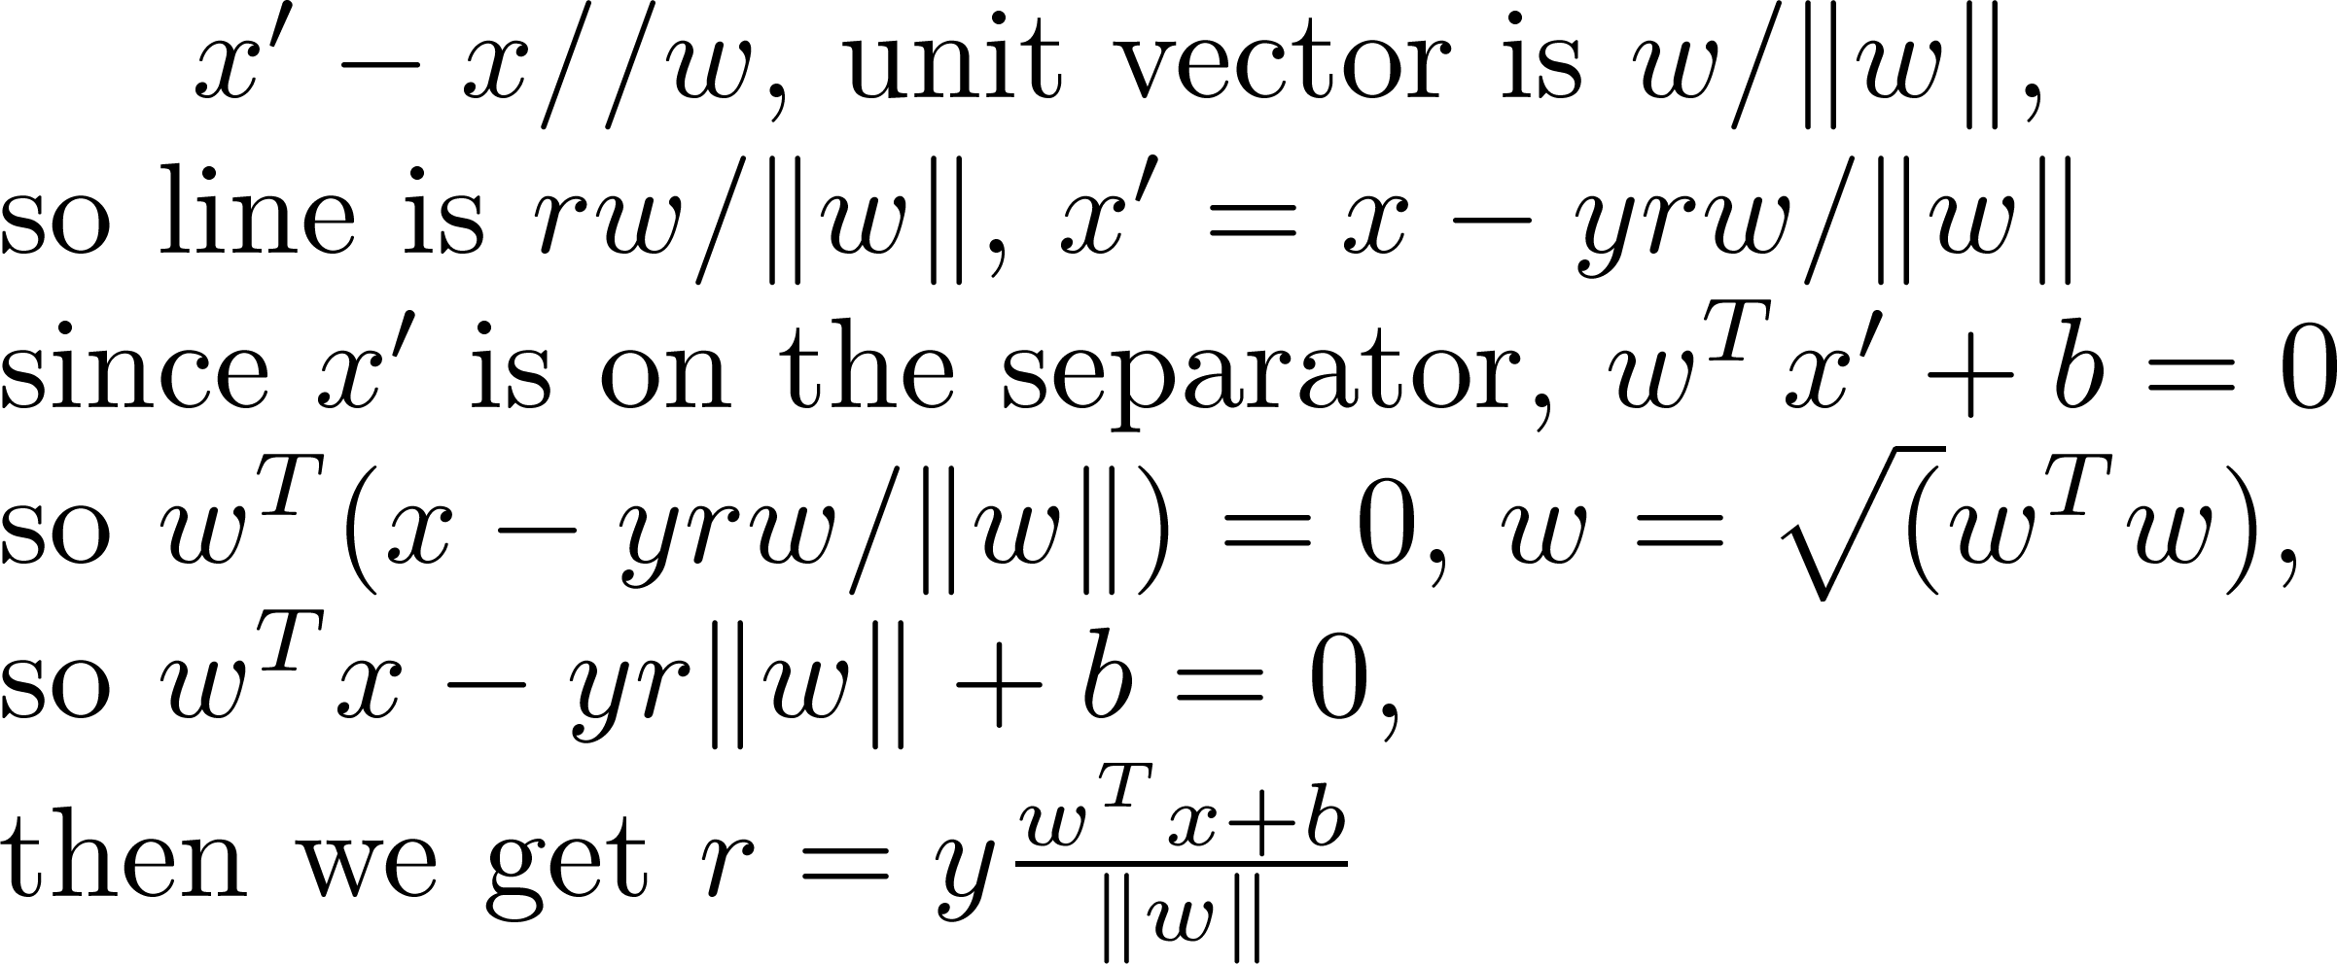
Largest Margin
Distance from example to the separator is :
Proof:
x
ρ
r
x′
+b=0,
||w||
w
Notes:
||w||: the length of w vector, which is L₂ norm = square root of the inner product of the vector itself.

Slide 14
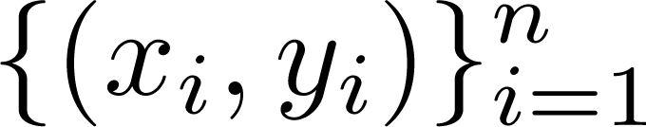
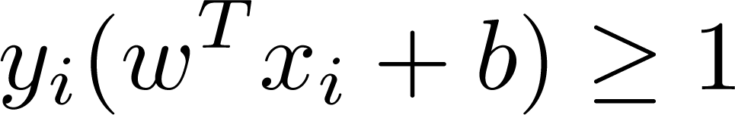
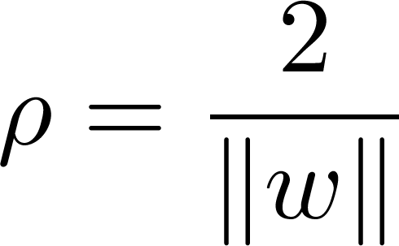
Largest Margin
Assume that all data is at least distance 1 from the hyperplane, then the following constraints follow for a training set
For support vectors, the inequality becomes an equality
Recall that
Margin is:

Slide 15
Linear SVMs
Note that we assume that all data points are linearly separated by the hyperplane.
The margin is invariant to scaling of parameters.
i.e. by changing w, b to 5w, 5b, the margin doesn’t change

Slide 16
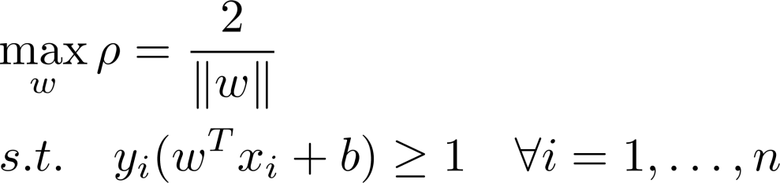
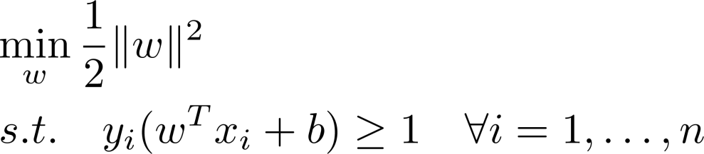
Linear SVMs
Maximize the margin
Good according to intuition, theory (VC dimension) & practice
The problem of linear SVMs is formulated as:
An equivalent form is:
Notes:
VC dimension (for Vapnik Chervonenkis dimension) (Vapnik and Chervonenkis (1968, 1971), Vapnik (1979)) measures the capacity of a hypothesis space. Capacity is a measure of complexity and measures the expressive power, richness or flexibility of a set of functions by assessing how wiggly its members can be. Sewell (2006)
"Let us say we have a dataset containing N points. These N points can be labeled in 2^{N} ways as positive and negative. Therefore, 2^{N} different learning problems can be defined by N data points. If for any of these problems, we can find a hypothesis h ∈ H that separates the positive examples from the negative, then we say H shatters N points. That is, any learning problem definable by N examples can be learned with no error by a hypothesis drawn from H. The maximum number of points that can be shattered by H is called the Vapnik-Chervonekis (VC) dimension of H, is denoted as VC(H), and measures the capacity of the hypothesis class H.”

Slide 17
Outline
Support Vector Machines
History
Linear Separable SVMs
Non-linear Separable SVMs
Soft Margin
Kernel Trick
Parameter Estimation
Further Reading

Slide 18
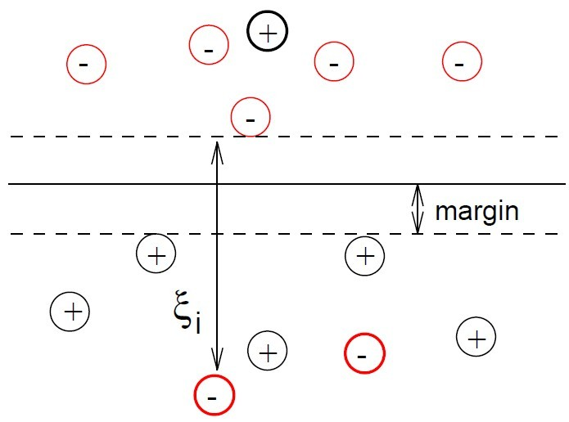

Non-Linear Separable SVMs
In reality, training samples are usually not linearly separable.
Soft Margin Classification
Idea: allow errors but introduce slack variable to penalize errors
Still try to minimize training set errors, and to place hyperplane “far” from each class (large margin)
Notes:
Greek letter ξ: xi

Slide 19
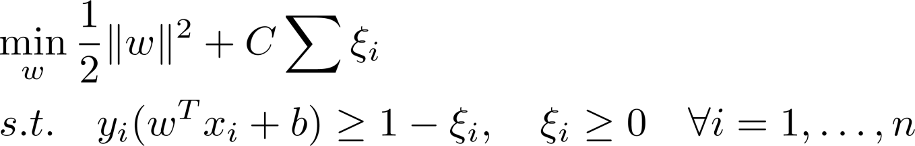

Soft Margin Classification
The problem becomes:
Minimize plus the number of training mistakes
Set C using cross validation

Slide 20
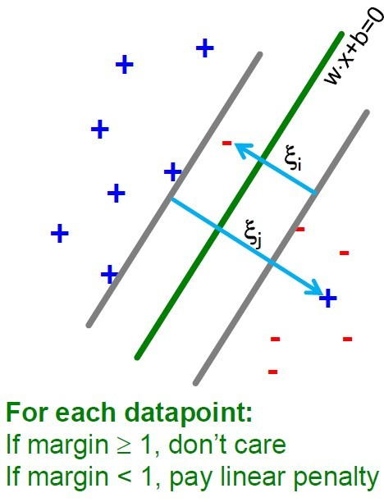

Soft Margin Classification
If point is on the wrong side of the margin then get penalty
Thus all mistakes are not equally bad!

Slide 21
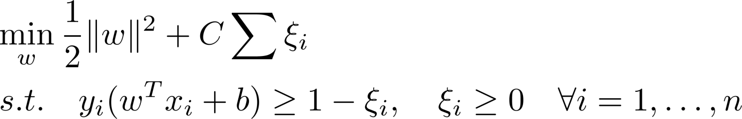
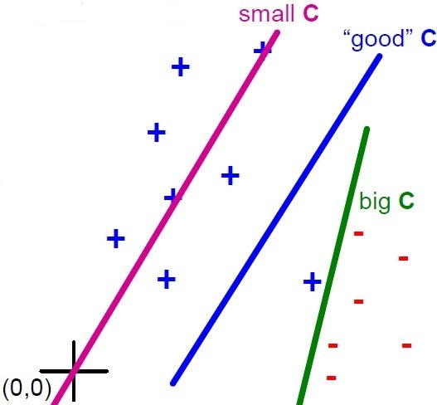


Slack Penalty C
What is the role of penalty C:
: can set to anything, then w=0 (basically ignore the data)
: Only want w, b to separate the data

Slide 22
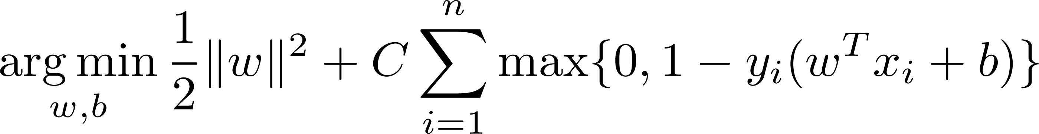
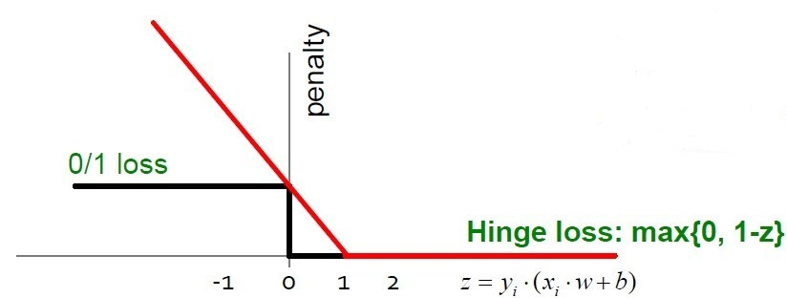
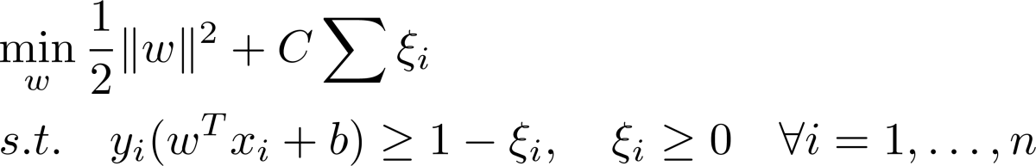
Soft Margin Classification
SVM in the “natural” form
SVM uses “Hinge Loss”:
Margin
Regularization Parameter
Empirical loss L
Notes:
SVM in the “natural” form with Hinge Loss can be solved the object function is convex. Solving 0/1 loss has 2^{n} possibilities, which is an NP-complete problem.

Slide 23
In-class Practice
Go to practice

Slide 24
Outline
Support Vector Machines
History
Linear SVMs
Non-linear SVMs
Soft Margin
Kernel Trick
Parameter Estimation
Further Reading

Slide 25
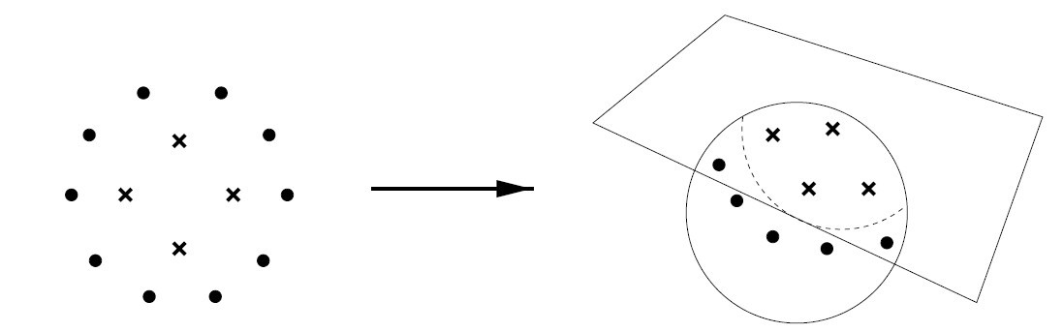
Non-linear Separable SVMs
Linear classifiers aren’t complex enough sometimes.
Map data into a richer feature space including non-linear features
Then construct a hyperplane in that space so all other equations are the same

Slide 26
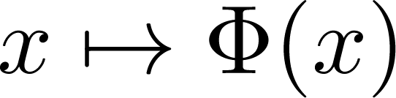
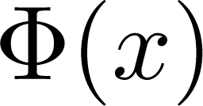

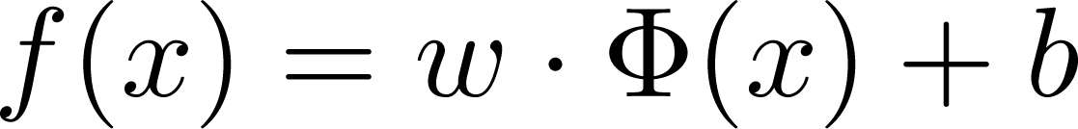
Non-linear Separable SVMs
Formally, process the data with:
Then learn the map from to

Slide 27
Example: Polynomial Mapping
x²
0
x
0
x

Slide 28
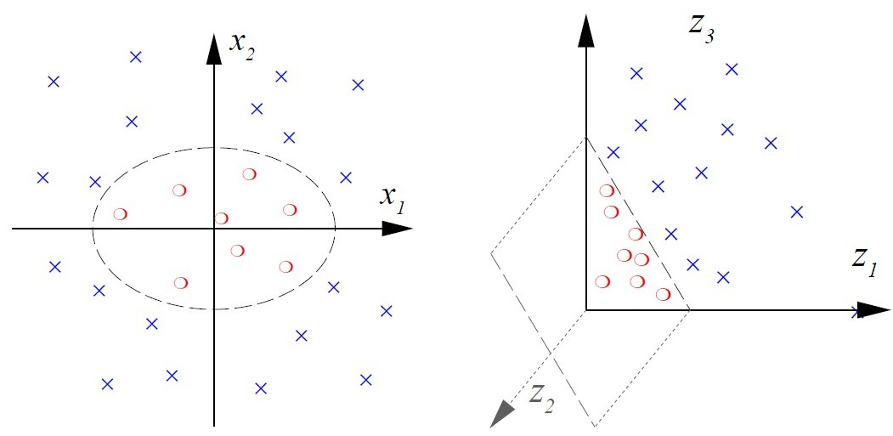
Example: Polynomial Mapping

Slide 29
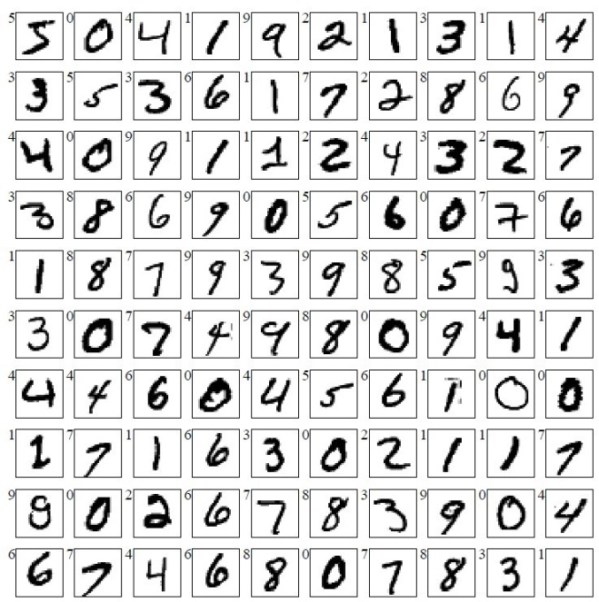
Example: MNIST
Data: 60,000 training examples, 10000 test examples, 28x28
Linear SVM has around 8.5% test error. Polynomial SVM has around 1% test error.

Slide 30
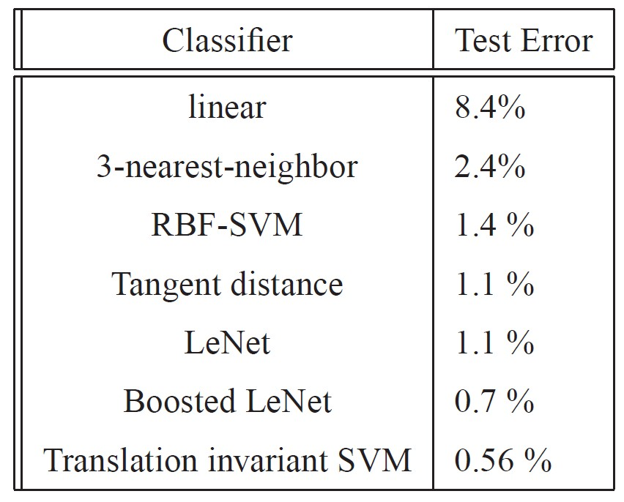

MINST Results
Choosing a good mapping (encoding prior knowledge + getting right complexity of function class) for your problem improves results.

Slide 31
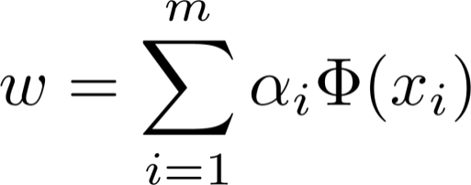


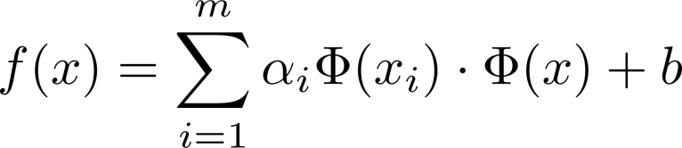
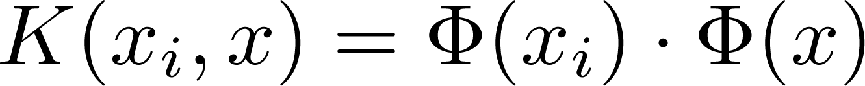
SVMs: Kernel Trick
The Representer theorem (Kimeldorf & Wahba, 1971) shows that (for SVMs as a special case):
for some variables , instead of optimizing directly, we can optimize .
The decision rule is:
We call the kernel function.
Notes:
Greek letter Φ: phi

Slide 32
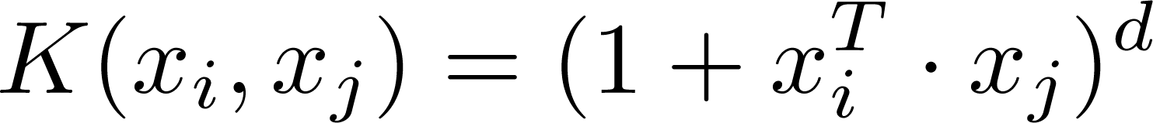
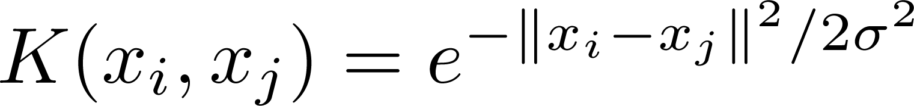
Kernels
Why kernels?
Make non-separable problem separable.
Map data into better representational space
Common used kernels
Linear
Polynomial
Gives feature conjunctions
Radial basis function

Slide 33
Outline
Support Vector Machines
History
Linear Separable SVMs
Non-linear Separable SVMs
Soft Margin
Kernel Trick
Parameter Estimation
Further Reading

Slide 34
SVM: How to Estimate w, b
We take the soft margin classification for example:
Standard way: Use a solver!
Solver: software for finding solutions to “common” optimization problems, e.g. LIBSVM (http://www.csie.ntu.edu.tw/~cjlin/libsvm/)
Problems: Solvers are inefficient for big data!

Slide 35
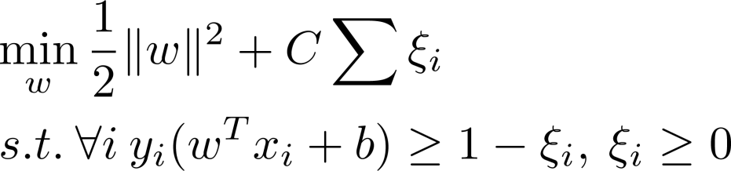
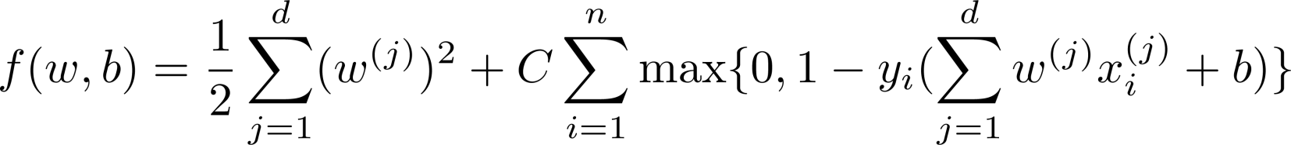
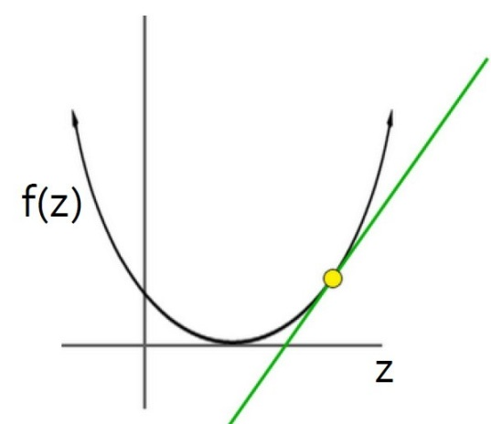


SVM: How to Estimate w, b
Want to estimate w, b !
Alternative approach:
Want to minimize f(w,b)
How to minimize convex functions f(z)
Use gradient descent:
Iterate:

Slide 36
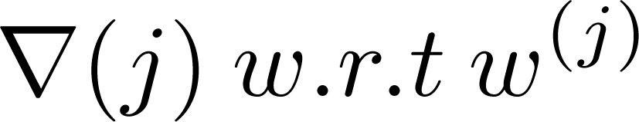
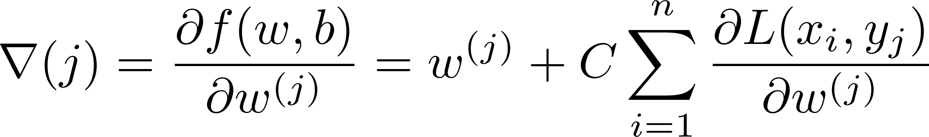
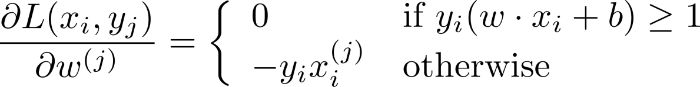
SVM: How to Estimate w?
Want to minimize f(w,b):
Compute the gradient
Empirical loss L

Slide 37
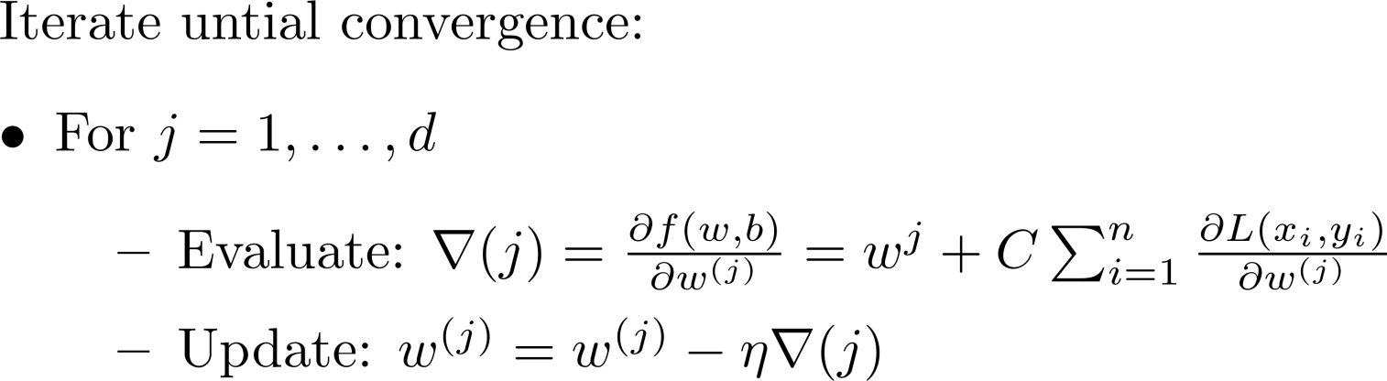
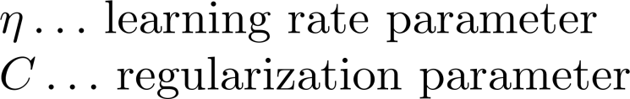

SVM: How to Estimate w?
Gradient descent:
Problem:
Computing takes O(n) time
n … size of the training dataset
Notes:
The sum-minimization problem also arises for empirical risk minimization: In this case, is the value of the loss function at i-th example, and is the empirical risk.
When used to minimize the above function, a standard (or "batch") gradient descent method would perform the iterations shown in this slide, where η is a step size (sometimes called the learning rate in machine learning).
In many cases, the summand functions have a simple form that enables inexpensive evaluations of the sum-function and the sum gradient. For example, in statistics, one-parameter exponential families allow economical function-evaluations and gradient-evaluations.
However, in other cases, evaluating the sum-gradient may require expensive evaluations of the gradients from all summand functions. When the training set is enormous and no simple formulas exist, evaluating the sums of gradients becomes very expensive, because evaluating the gradient requires evaluating all the summand functions' gradients. To economize on the computational cost at every iteration, stochastic gradient descent samples a subset of summand functions at every step. This is very effective in the case of large-scale machine learning problems. We show another approach in the next slide.

Slide 38
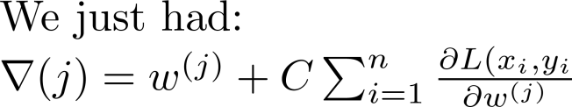
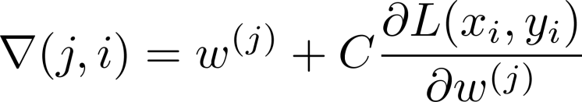
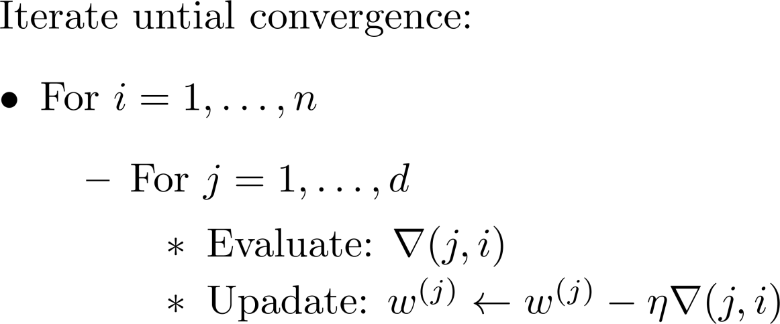
SVM: How to Estimate w?
Stochastic Gradient Descent
Instead of evaluating gradient over all examples, evaluate it for each individual training example
Stochastic gradient descent (SGD):
)
Notes:
In stochastic (or "on-line") gradient descent, the true gradient of is approximated by a gradient at a single example: w^{(j)} ← w^{(j)} - η∇ (j,i)
As the algorithm sweeps through the training set, it performs the above update for each training example. Several passes can be made over the training set until the algorithm converges. If this is done, the data can be shuffled for each pass to prevent cycles. Typical implementations may use an adaptive learning rate so that the algorithm converges.
A compromise between computing the true gradient and the gradient at a single example, is to compute the gradient against more than one training example (called a "mini-batch") at each step. This can perform significantly better than true stochastic gradient descent because the code can make use of vectorization libraries rather than computing each step separately. It may also result in smoother convergence, as the gradient computed at each step uses more training examples.

Slide 39
Example: Text Categorization
Example by Leon Bottou:
Reuters RCV1 document corpus
Predict a category of a document
One vs. the rest classification
n = 781,000 training examples (documents)
23,000 test examples
d = 50, 000 features
One feature per word
Remove stop-words
Remove low frequency words

Slide 40
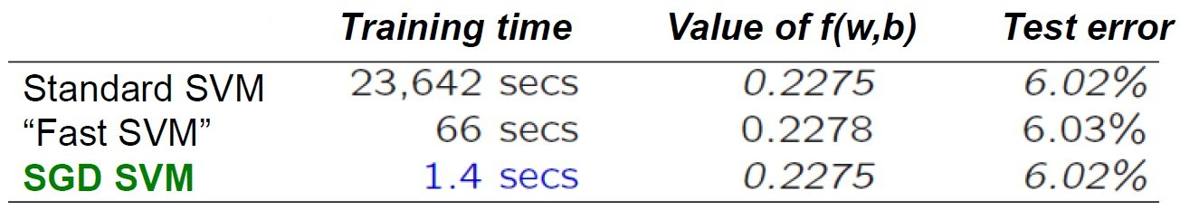
Examples: Text Categorization
Questions:
Is SGD successful at minimizing f(w,b)?
How quickly does SGD find the min of f(w,b)?
What is the error on a test set?
SGD-SVM is successful at minimizing the value of f(w,b)
SGD-SVM is super fast
SGD-SVM test set error is comparable

Slide 41
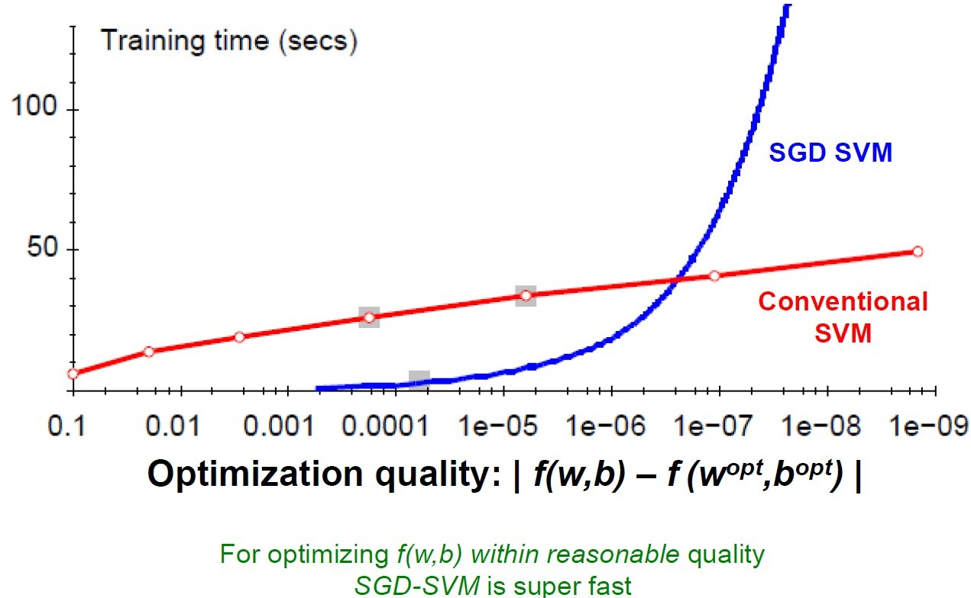
Optimization “Accuracy”

Slide 42
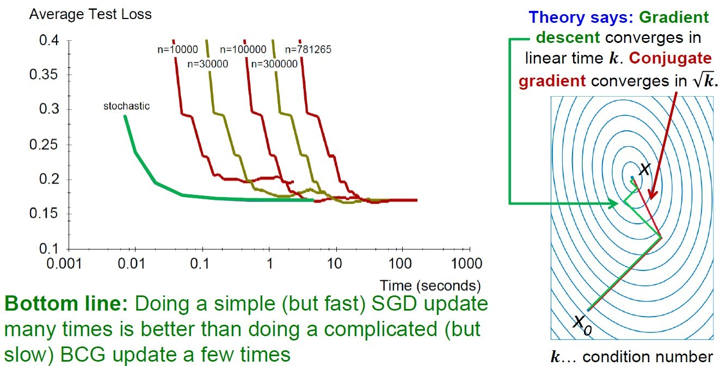
SGD vs. Batch Conjugate Gradient
SGD on full dataset vs. Batch Conjugate
Gradient on a sample of n training examples

Slide 43




Practical Considerations
Need to choose learning rate
Leon suggests:
Choose so that the expected initial updates are comparable with the expected size of the weights
Choose :
Select a small subsample
Try various rates (e.g., 10,1,0.1,0.01,…)
Pick the one that most reduces the cost
Use for next 100k iterations on the full dataset

Slide 44





Practical Considerations
Sparse Linear SVM:
Feature vector is sparse (contains many zeros)
Do not do:
But represent as a sparse vector
Can we do the SGD update more efficiently?
Approximated in 2 steps:
Cheap: is sparse and so few coordinates j of w will be updates
Expensive: w is not sparse, all coordinates need to be updated

Slide 45




Practical Considerations
Solution 1:
Represent vector w as the product of scalar s and the vector v
Then the update procedure is:
1)
2)
Solution 2:
Perform only step 1) for each training example
Perform step 2) with lower frequency and higher

Slide 46
Practical Considerations
Stopping criteria:
How many iterations of SGD?
Early stopping with cross validation
Create validation set
Monitor cost function on the validation set
Stop when loss stops decreasing

Slide 47
Practical Considerations
Stopping criteria:
How many iterations of SGD?
Early Stopping
Extract two disjoint subsamples A and B of training data
Train on A, stop by validating on B
Number of epochs is an estimate of k
Train for k epochs on the full dataset

Slide 48



What about Multiple Classes?
Idea 1:
One against all
Learn 3 classifiers
+ vs. {o,-}
- vs. {o,+}
o vs. {+,-}
Obtain:
Return class c

Slide 49

What about Multiple Classes?
Idea 2:
Learn 3 sets of weights simultaneously
Want the correct class to have highest margin:

Slide 50


Multiclass SVM
Optimization problem:
To obtain parameters for each class c, we can use similar techniques as for 2 class SVM
SVM is widely perceived a very powerful learning algorithm

Slide 51
Demo
Libsvm package for R:
http://cran.r-project.org/web/packages/e1071/index.html

Slide 52
Demo
> # load library, class, a dependence for the SVM library
> library(class)
> # load library, SVM
> library(e1071)
> # load library, mlbench, a collection of some datasets from the UCI repository
> library(mlbench)
> # load data, has 7 classes, details of data: http://archive.ics.uci.edu/ml/datasets/Glass+Identification
> data(Glass, package = "mlbench")
> # get the index of all data
> index <- 1:nrow(Glass)
> # generate test index
> testindex <- sample(index, trunc(length(index)/3))
> # generate test set
> testset <- Glass[testindex, ]
> # generate trainin set
> trainset <- Glass[-testindex, ]

Slide 53
Demo
> # train svm on the training set
> # cost=100: the penalizing parameter for C-classification
> # gamma=1: the radial basis function-specific kernel parameter
> # Output values include SV, index, coefs, rho, sigma, probA, probB
> svm.model <- svm(Type~ ., data = trainset, cost = 100, gamma = 1)
> # a vector of predicted values,
> # for classification: a vector of labels
> svm.pred <- predict(svm.model, testset[, -10])
> # a cross-tabulation of the true
> # versus the predicted values
> table(pred = svm.pred, true = testset[, 10])

Slide 54
One-slide Takeaway
SVM:
Linear Separable SVMs
Non-linear Separable SVMs: Soft Margin and Kernel Trick
Parameter Estimation:
Solver: e.g. libsvm, not efficient
Stochastic gradient descent

Slide 55
Outline
Support Vector Machines
History
Linear Separable SVMs
Non-linear Separable SVMs
Soft Margin
Kernel Trick
Parameter Estimation
Further Reading

Slide 56
Further Reading
Early paper about SVM algorithm: http://link.springer.com/content/pdf/10.1007%2FBF00994018.pdf
More kernel techniques:
Schölkopf, Bernhard; Burges, Christopher J. C.; and Smola, Alexander J. (editors); Advances in Kernel Methods: Support Vector Learning, MIT Press, Cambridge, MA, 1999. ISBN 0-262-19416-3.

Slide 57
Further Reading
More efficient learning algorithm for SVM:
Parallelizing Support Vector Machines on Distributed Computers: https://code.google.com/p/psvm/

Slide 58
Reference
http://www.stanford.edu/class/cs246/slides/13-svm.pdf
http://www.stanford.edu/class/cs276/handouts/lecture14-SVMs.ppt
http://i.stanford.edu/~ullman/pub/ch12.pdf
http://www.svms.org/tutorials/
http://www.cs.columbia.edu/~kathy/cs4701/documents/jason_svm_tutorial.pdf
http://www.csie.ntu.edu.tw/~cjlin/libsvm/
Chang, E, Zhu, K, Wang, H, Bai, H, Li, J, Qiu, Z, and Cui, H. PSVM: Parallelizing support vector machines on distributed computers. NIPS, 20:257-264. 2007.
58

Slide 59

In-class Practice
(2,3)
Consider building an SVM over the (very little) data set shown in above figure, compute the each SVM decision boundary.

