Slide 1
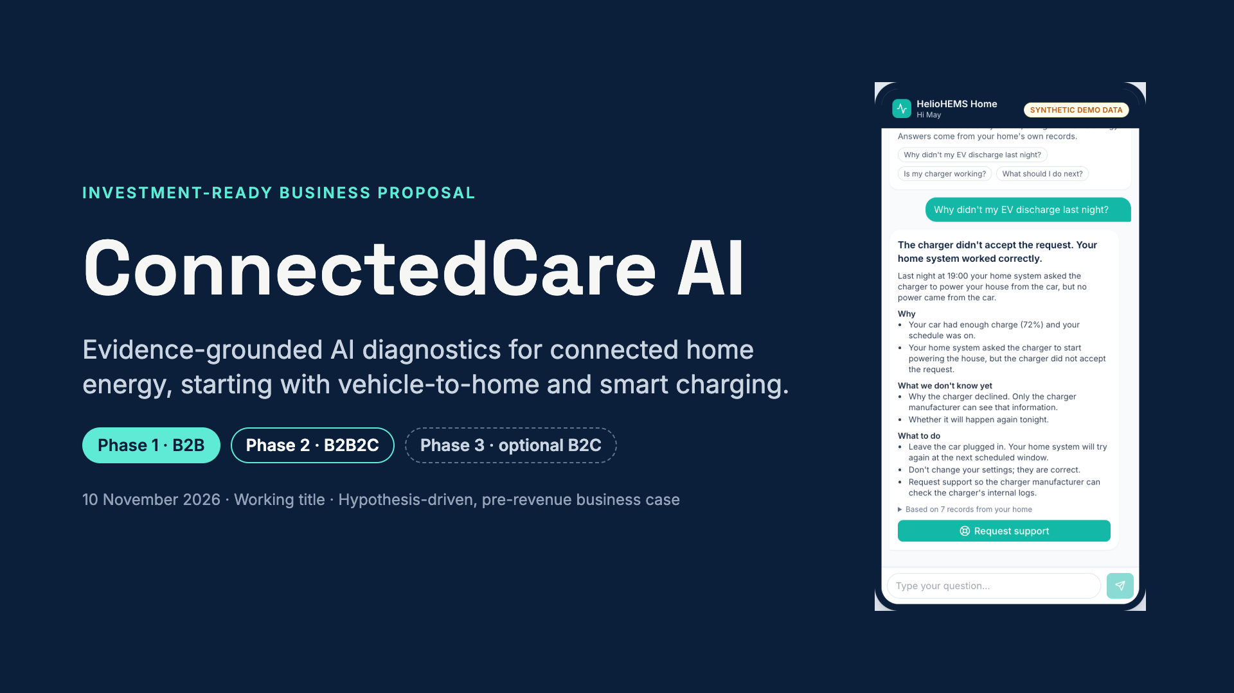
Notes:
ConnectedCare AI helps home-energy manufacturers diagnose connected-device failures from evidence, not guesses. We start inside the manufacturer’s support team (B2B), then extend the same evidence and workflows to the homeowner app (B2B2C). An independent consumer product is an option, not a plan. The screenshot is the working prototype.

Slide 2
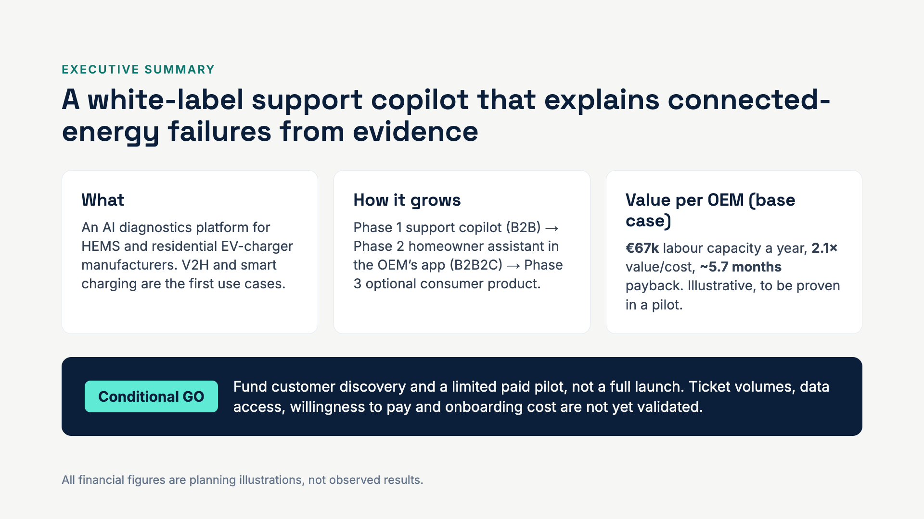
Notes:
One line: we turn scattered device data into an evidence-backed diagnosis a support agent can trust. The ask is small and staged: discovery plus a paid pilot. The numbers are illustrative; the pilot exists to prove or disprove them.

Slide 3
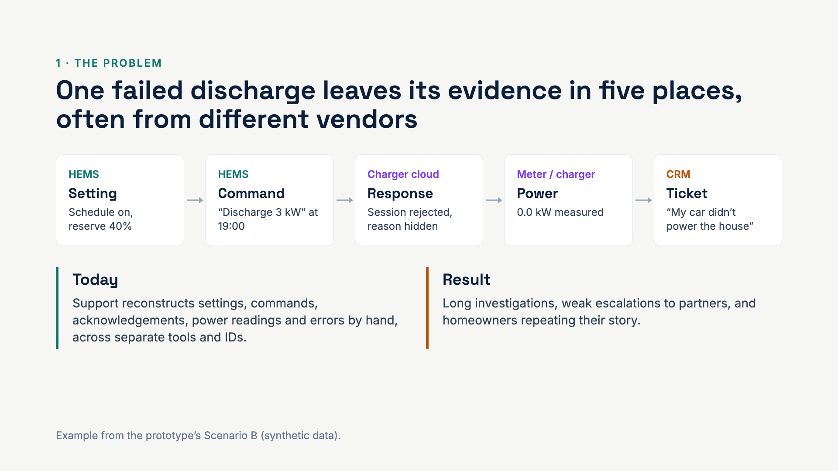
Notes:
Connected homes mix a HEMS, a charger, an EV, meters and batteries from different suppliers. When discharging fails, the story is spread across systems that don’t share IDs or time formats. That reconstruction is the work we automate.

Slide 4
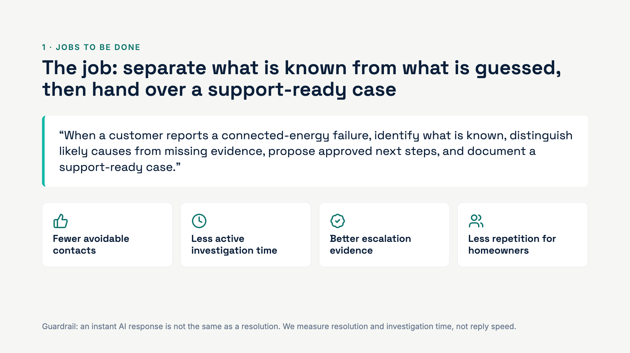
Notes:
The customer is the support organisation. Their job is not “answer fast”, it is “know what happened and what to do next”. The four outcomes are what a pilot should measure.

Slide 5
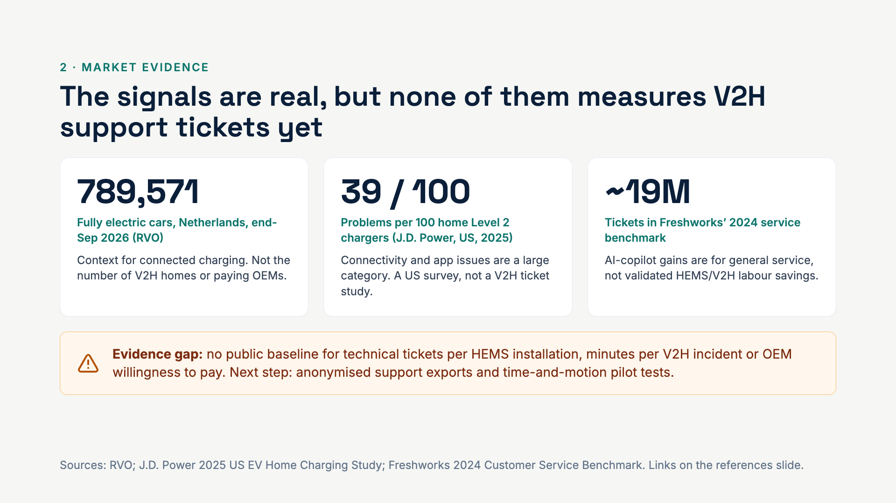
Notes:
Be precise with investors: these numbers show the space is growing and messy, but they do not size our niche. The evidence gap is exactly what the discovery phase buys.

Slide 6
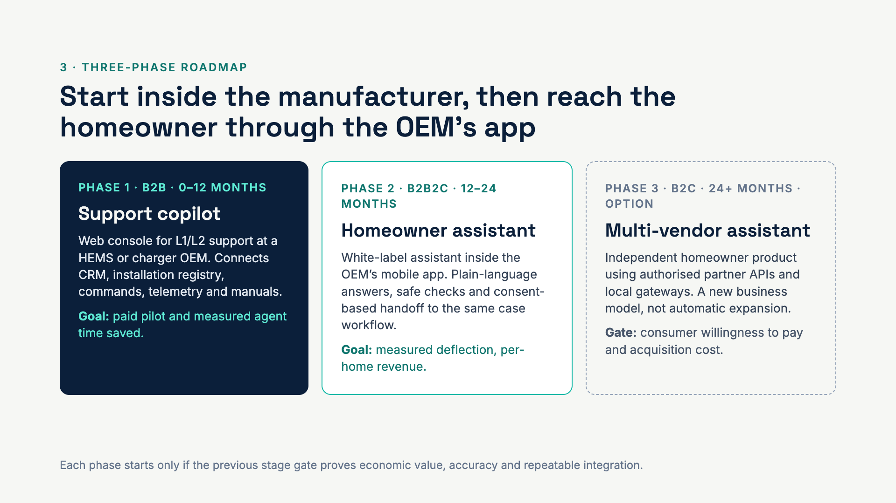
Notes:
Phase 1 sells to the support organisation and proves value with time savings. Phase 2 reuses the same evidence engine and case workflow, but puts it in front of the homeowner inside the manufacturer’s app. Phase 3 is optional: it needs consumer economics and data access we don’t have yet.

Slide 7
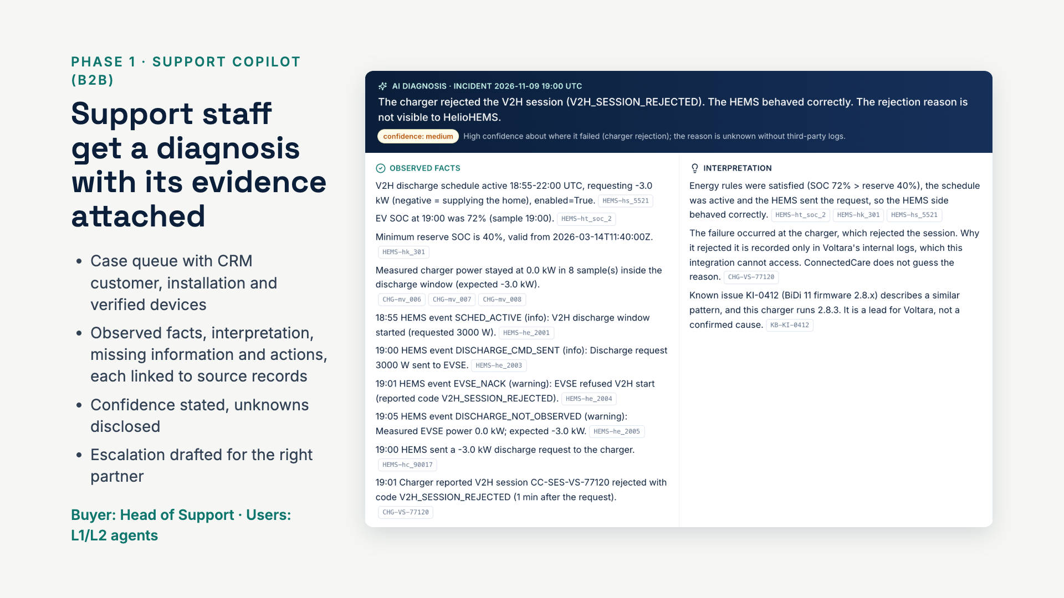
Notes:
This is the working support console. The diagnosis says what was observed, what that means, and what is missing, and every statement carries the IDs of the records it came from. Nothing is presented as fact without a source.

Slide 8
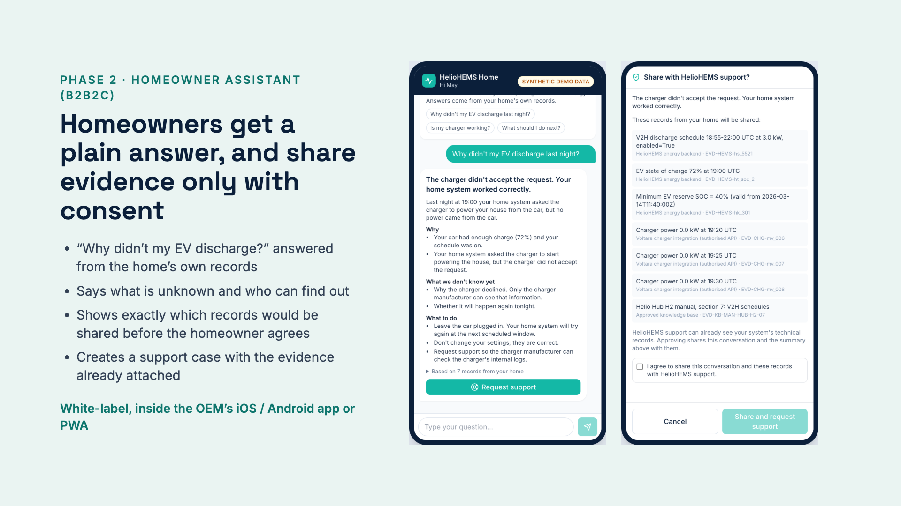
Notes:
The homeowner side reuses the same engine but with a different view: no internal codes, no security records. Approving the consent screen creates the support case on the right of the journey; the support agent starts with everything the homeowner already saw.

Slide 9
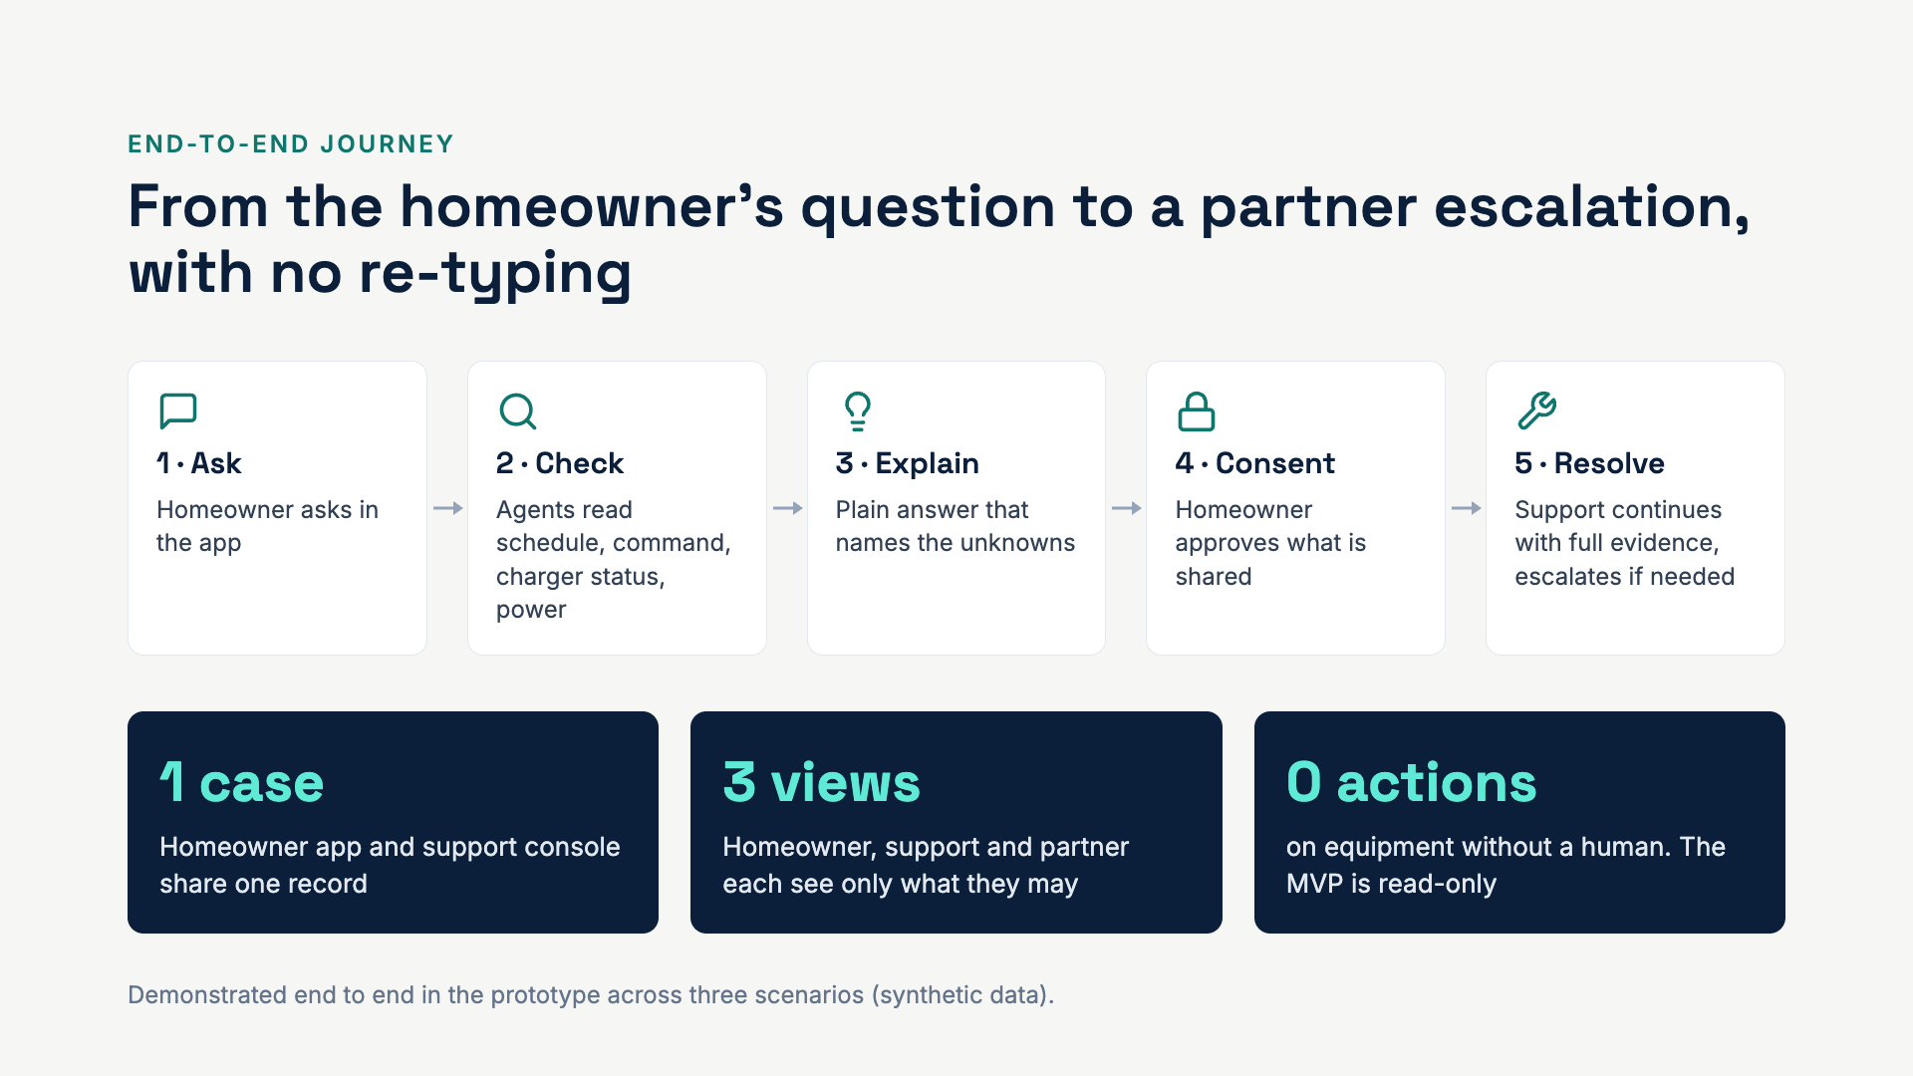
Notes:
This is the live demo flow. Ask on the phone, show the consent screen, then switch to the laptop: the case is already in the queue with the evidence attached.

Slide 10
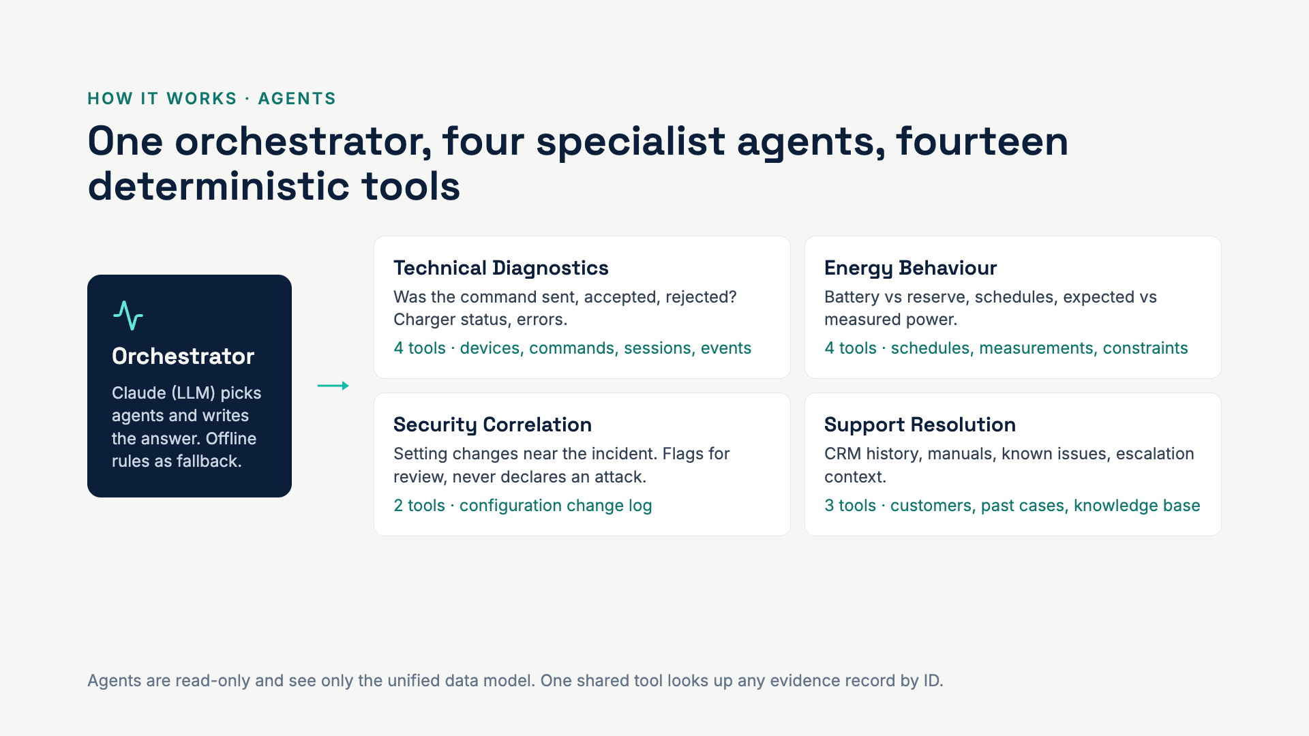
Notes:
The LLM decides which specialists to consult and how to explain the result. The specialists themselves are deterministic code: they query data and apply rules, so every fact is reproducible. The Security agent only runs when settings are relevant, and the deck’s next slide shows it marked as not used, with the reason.

Slide 11
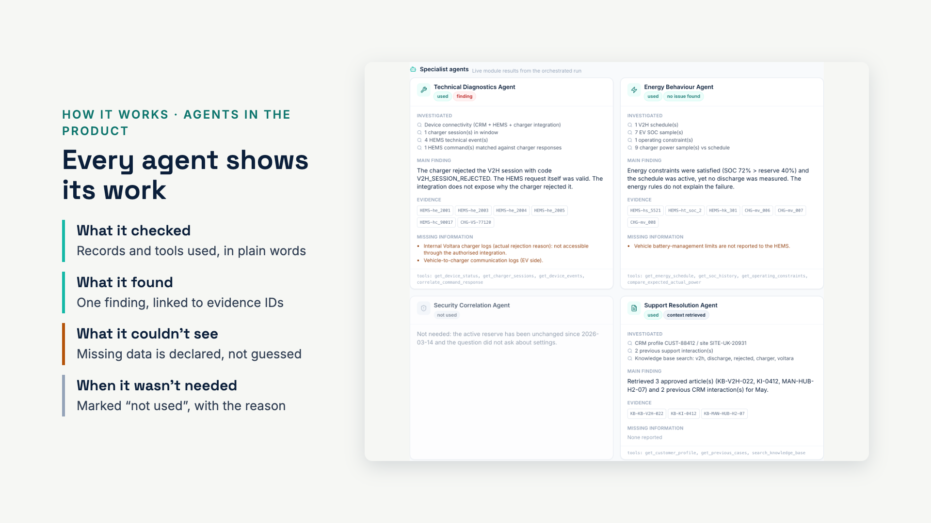
Notes:
Scenario B in the prototype: the Technical agent finds the charger rejected the session; the Energy agent confirms battery and schedule were fine; Security was not needed; Support Resolution pulled the known issue and manual. This transparency is what lets an agent trust and reuse the output.

Slide 12
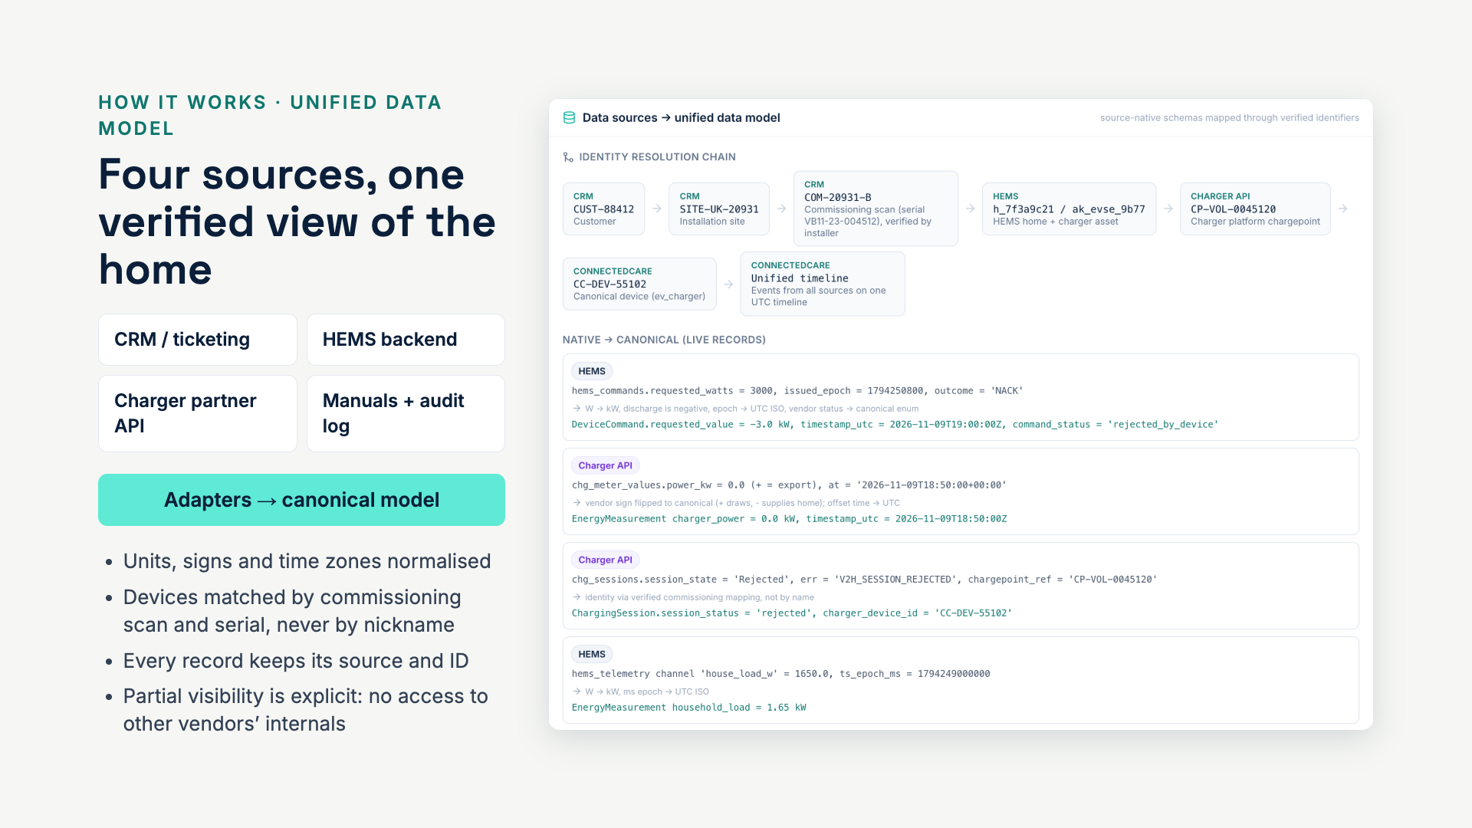
Notes:
This is the reusable asset. Each OEM integration maps into the same canonical model (Customer, Installation, Device, Command, Measurement, Session, Event, Evidence, Case, Consent), so agents and rules are written once. In the demo a neighbour’s charger with a near-identical nickname is rejected as a match.

Slide 13
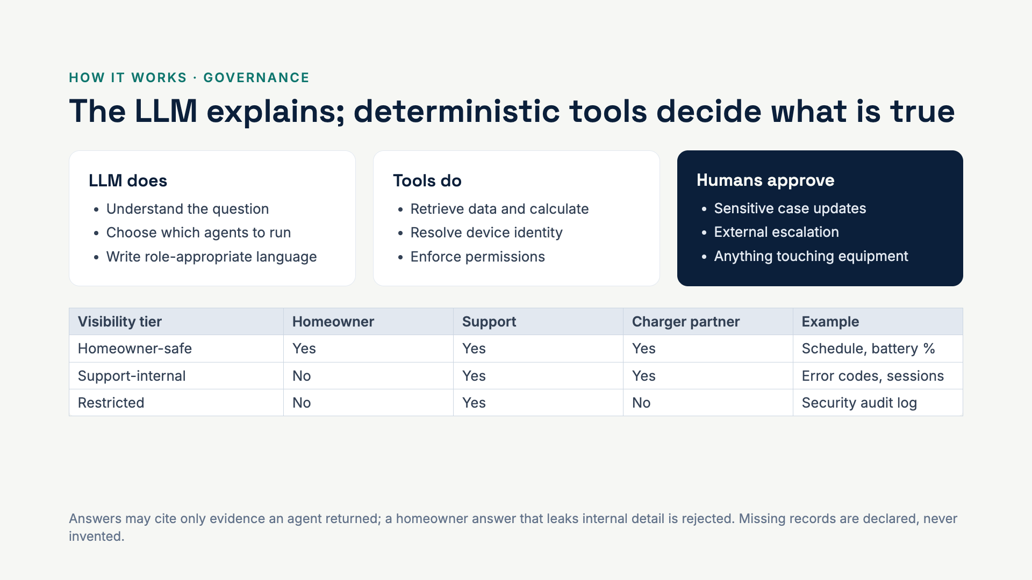
Notes:
Three guardrails. Separation of duties between LLM and tools. Visibility enforced on the server, not in the app. Human approval for anything sensitive. The MVP is read-only on synthetic data.

Slide 14
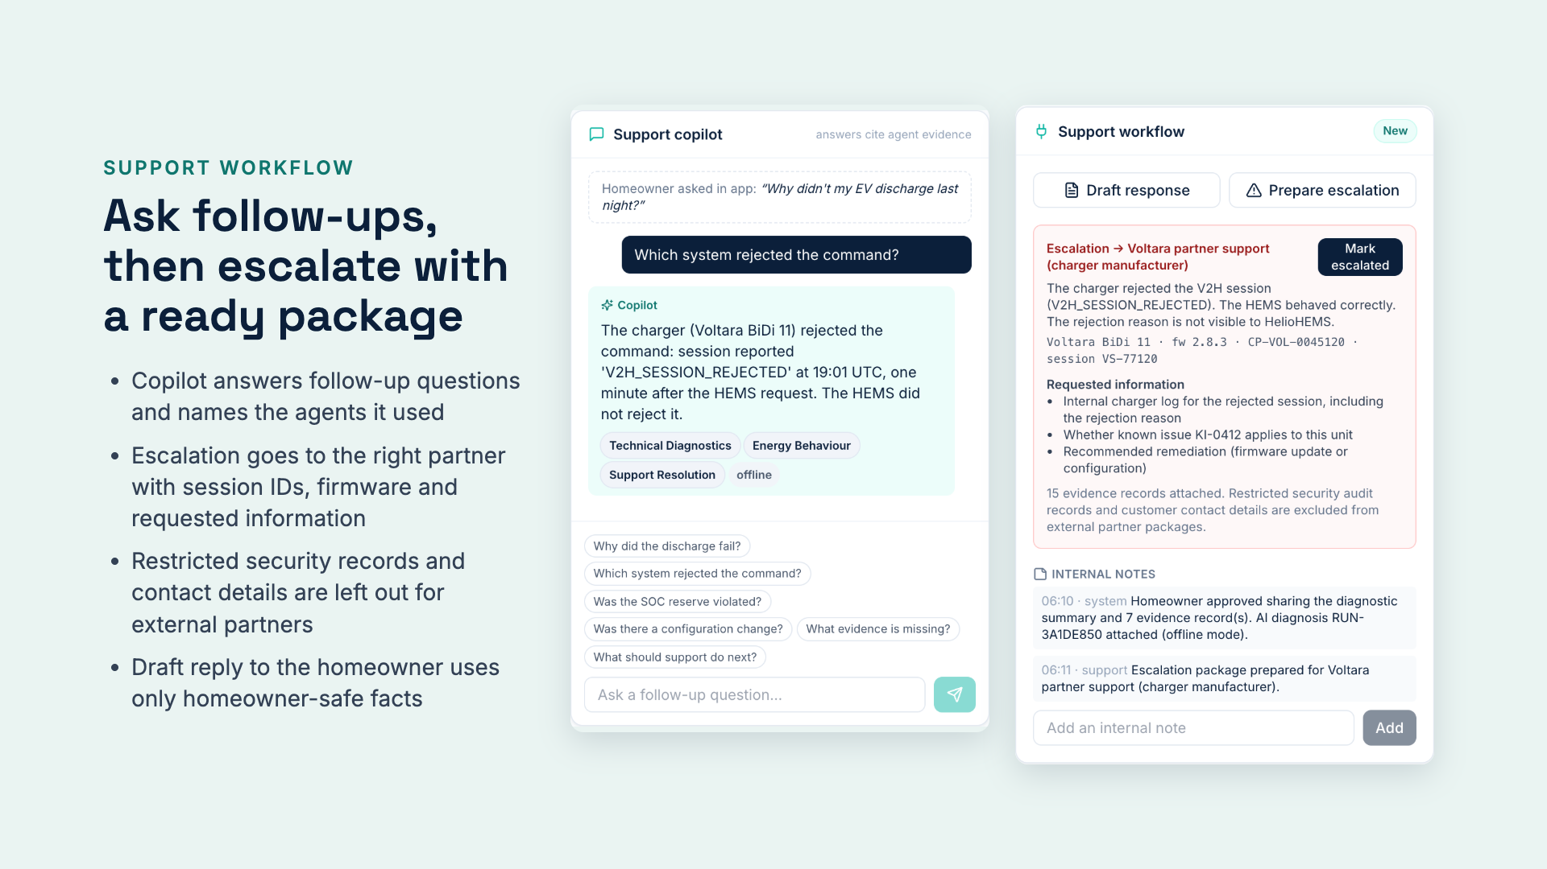
Notes:
A good escalation is where much of the time goes today. The package states what HelioHEMS knows, what it needs from the charger manufacturer and why, and automatically excludes records the partner must not see.

Slide 15
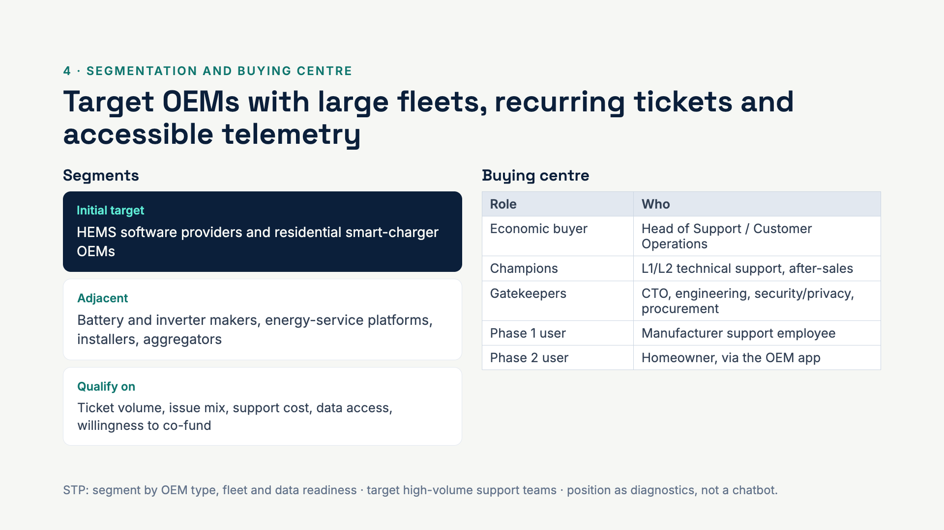
Notes:
The buyer is the support leader, who owns the cost. Champions are the agents who feel the pain. Security and engineering are gatekeepers because we need data access, so we design for them from day one.

Slide 16
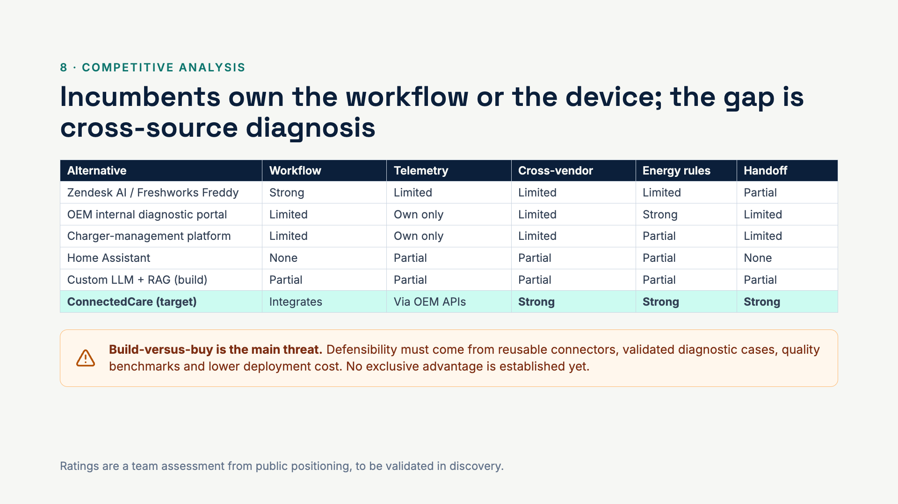
Notes:
We do not compete with Zendesk on ticketing; we plug into it. The honest threat is an OEM wiring an LLM to its own data. Our answer is speed and lower cost through reusable connectors, energy rules and a benchmark of validated cases.

Slide 17
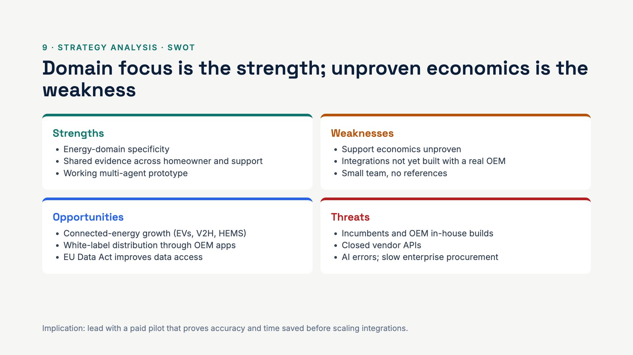
Notes:
The SWOT tells us where to spend the next euro: proving the economics, not adding features.

Slide 18
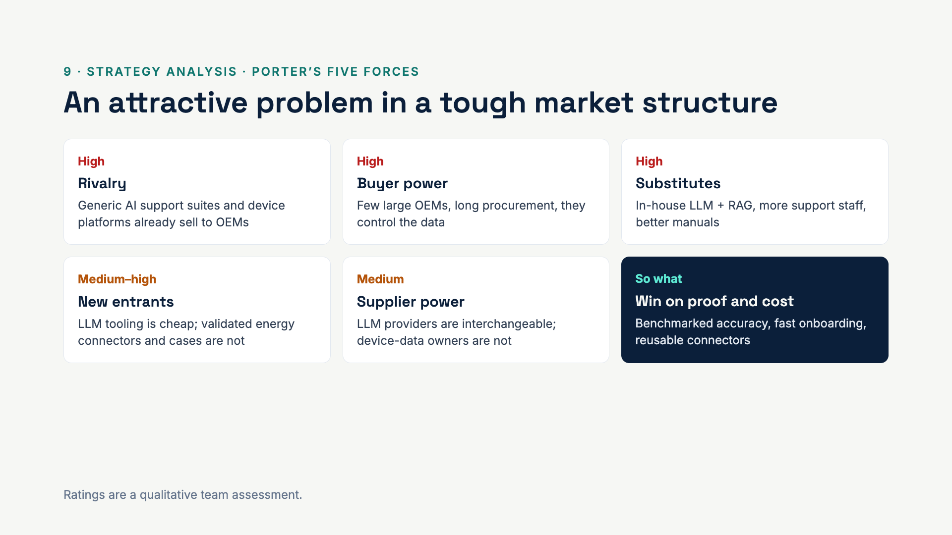
Notes:
Three forces are high, which is why we don’t ask for launch money. The moat has to be built: validated cases, connectors, and the switching cost of being embedded in the support workflow.

Slide 19
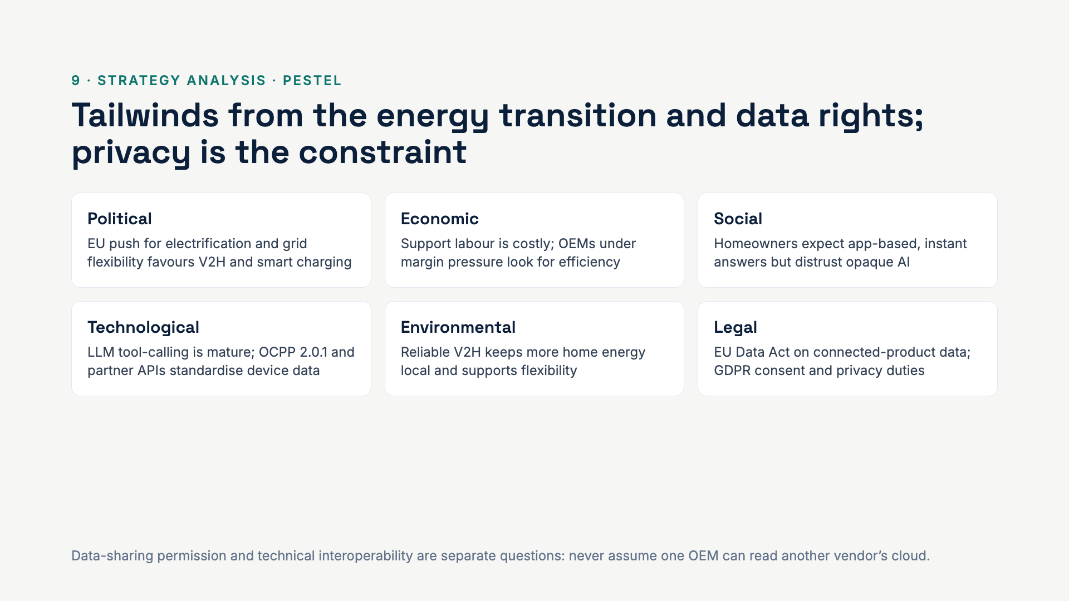
Notes:
The Data Act helps users and authorised parties access connected-product data, but it does not make third-party clouds open by default. Consent is built into the product for that reason.

Slide 20
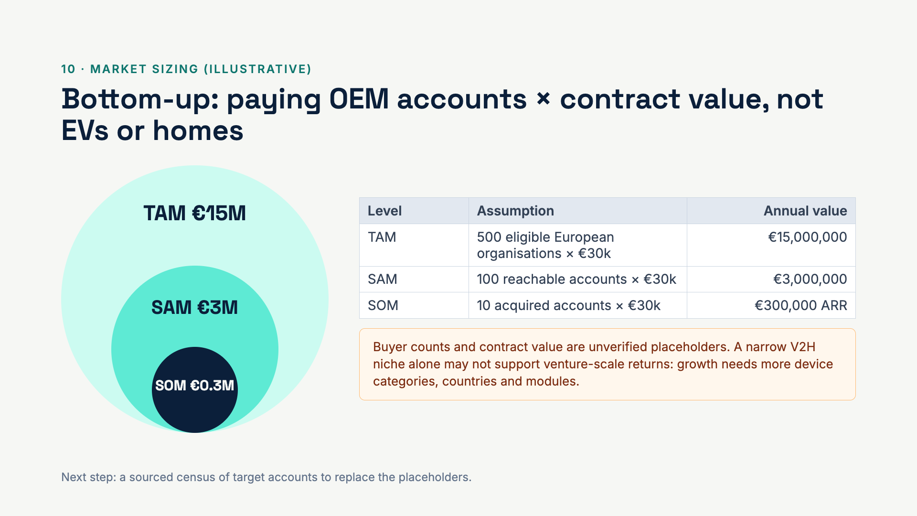
Notes:
We deliberately size by paying organisations, not by cars or homes. The figures are planning placeholders and the slide says so.

Slide 21
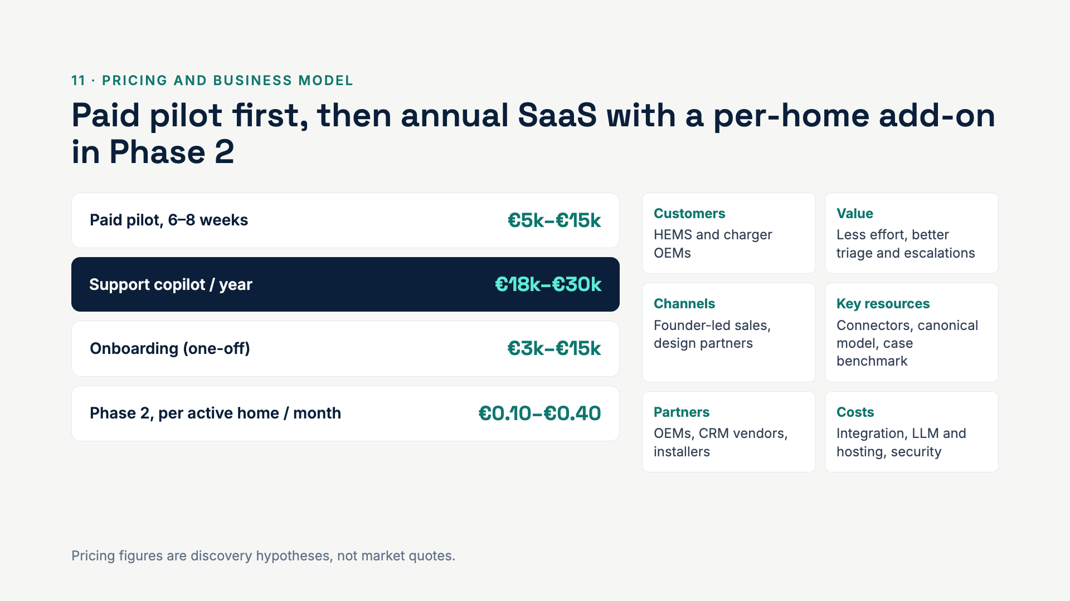
Notes:
Left: what we would charge, to be tested in discovery. Right: the business model canvas in brief. The pilot is paid on purpose: it tests willingness to pay from day one.

Slide 22
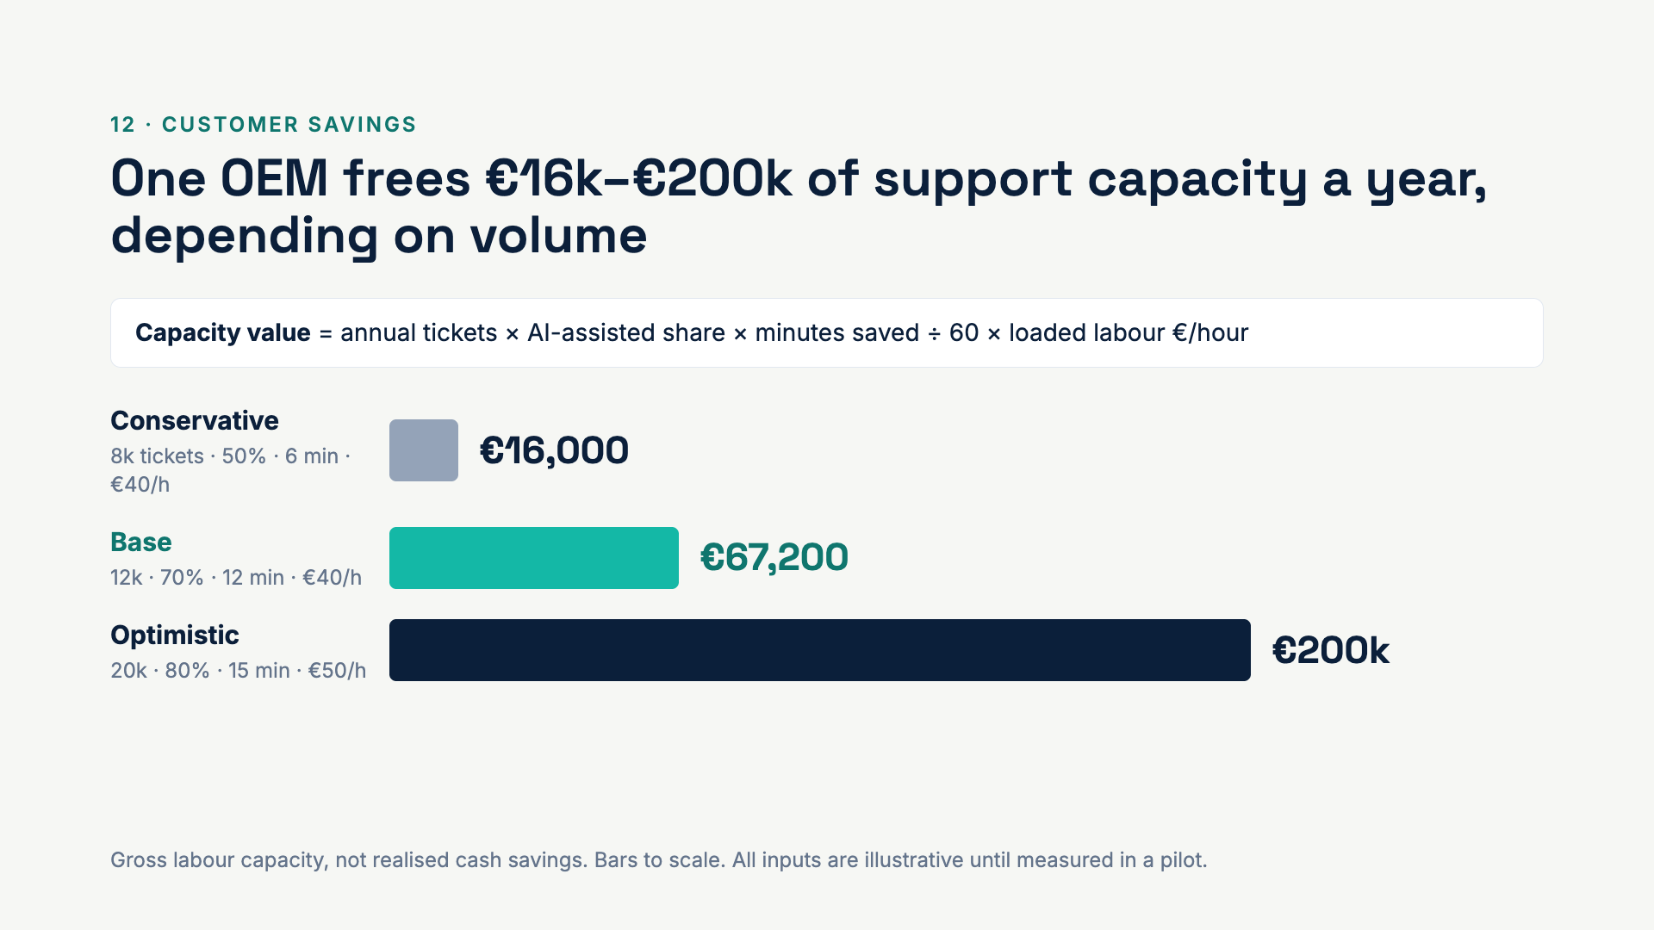
Notes:
The formula is simple on purpose so a support leader can plug in their own numbers. Even the conservative case covers a meaningful share of the licence; the base case is about 2× its cost.

Slide 23
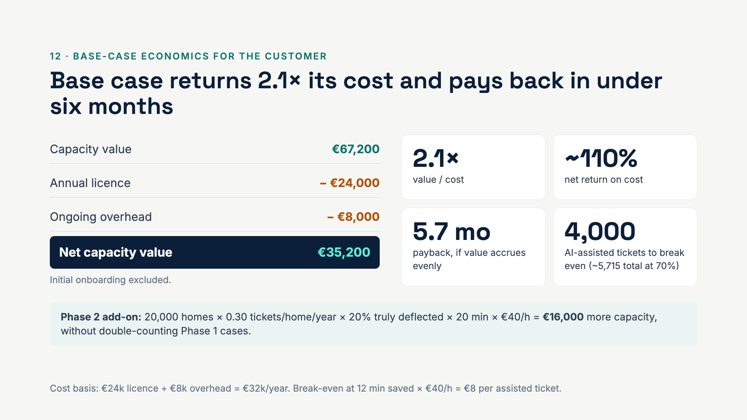
Notes:
Walk through the bridge: €67k of freed capacity minus €32k of cost leaves €35k. The break-even point is the number to validate first: an OEM needs about 4,000 assisted tickets a year for the copilot to pay for itself.

Slide 24
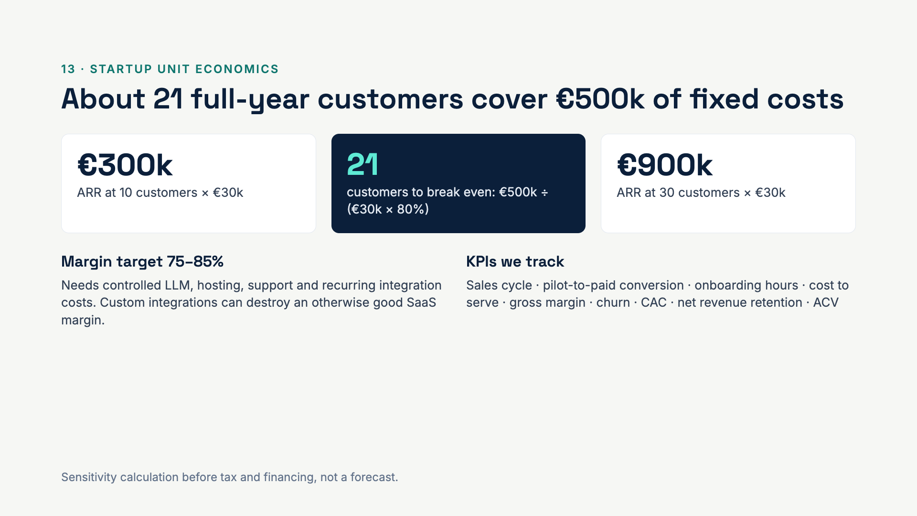
Notes:
This is the company’s side of the economics. The break-even customer count is sensitive to contract value and margin; reusable connectors are what keep margin high.

Slide 25
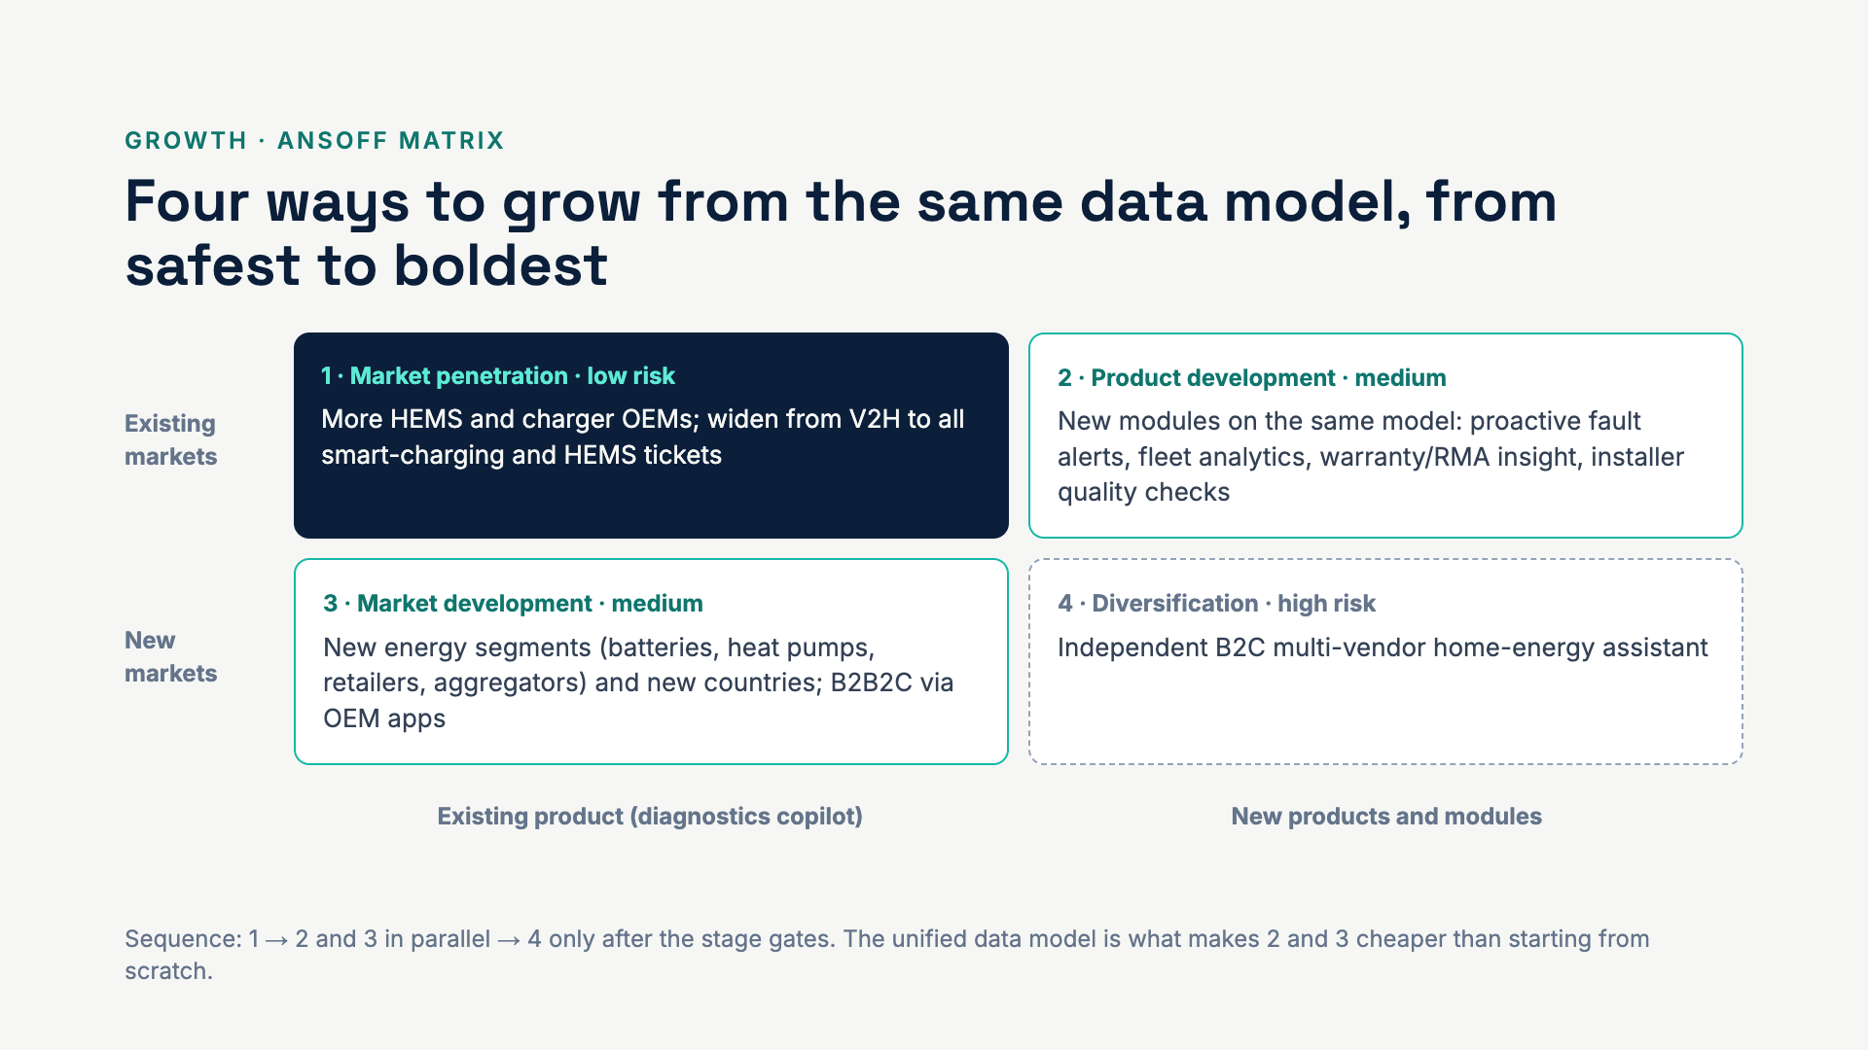
Notes:
Ansoff frames the growth story. Penetration first, because it reuses everything. Product and market development both ride on the same canonical model. B2C is true diversification: new customer, new channel, new brand, so it stays an option.

Slide 26
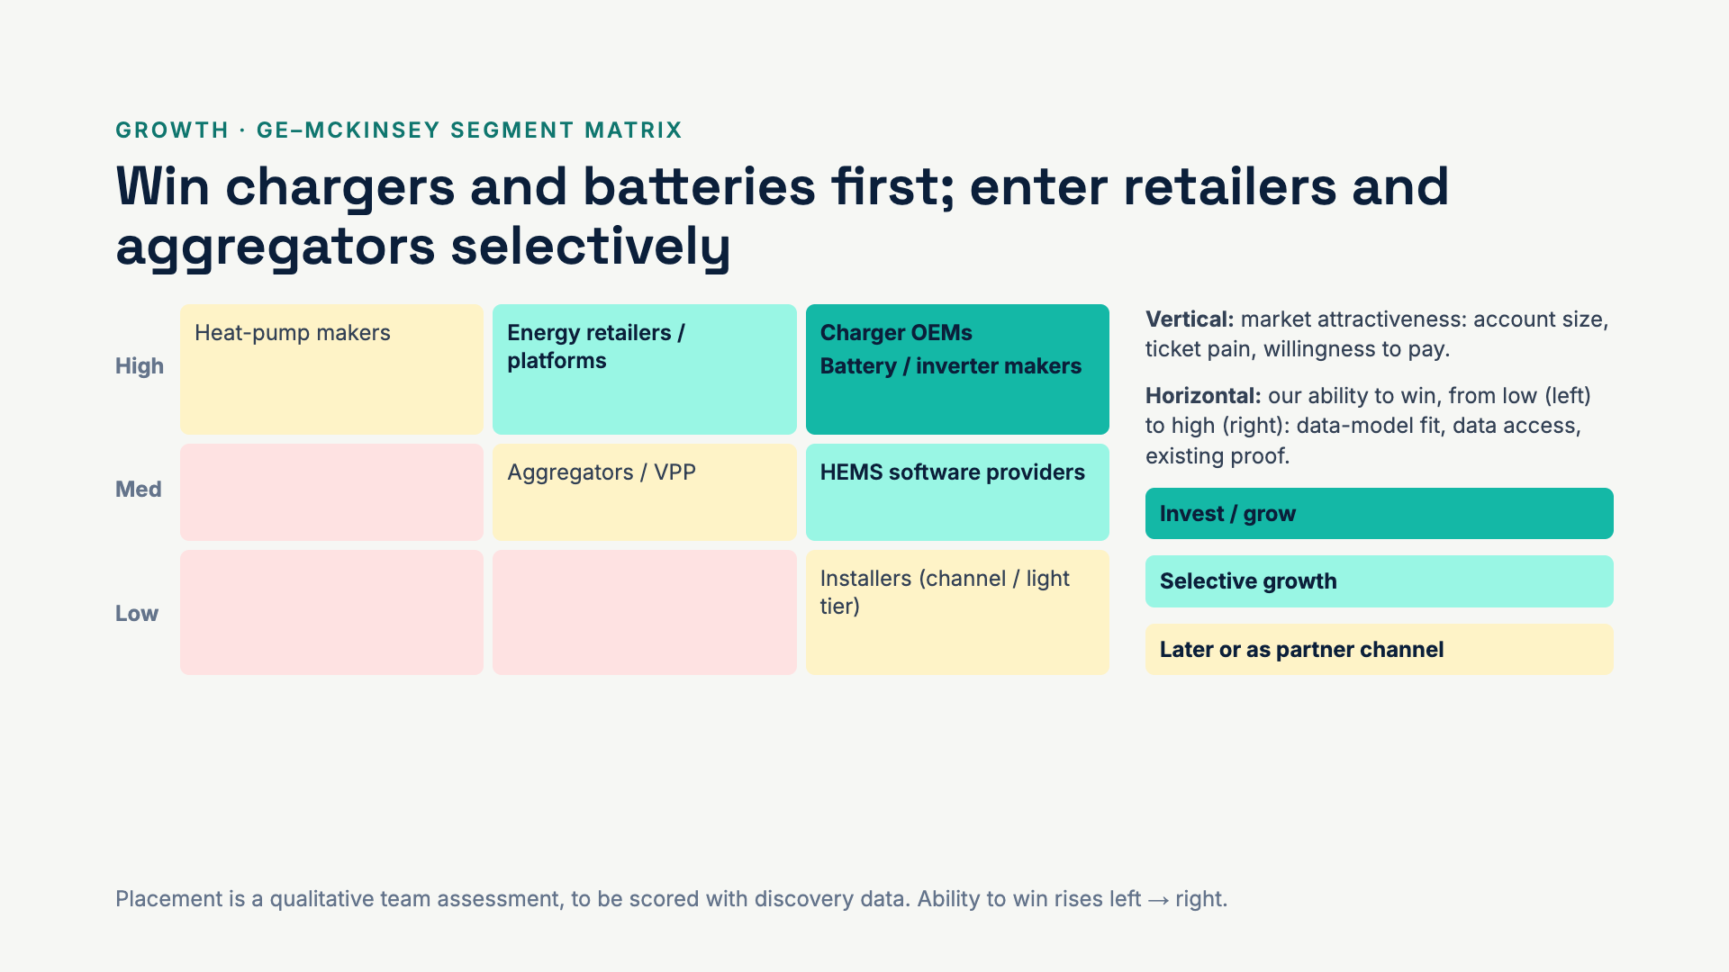
Notes:
The GE–McKinsey matrix ranks where to play. Charger and battery makers sit top right: same devices, same data model, same pain. Retailers are attractive but need new data such as tariffs and billing. Heat pumps are a later step because they need thermal data.

Slide 27
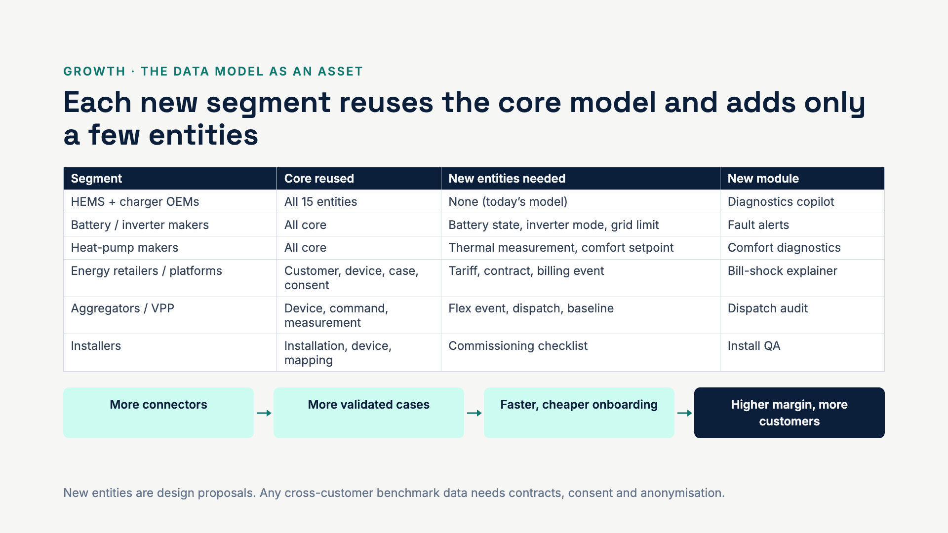
Notes:
This is why the data model is an asset, not just code. Each integration adds connectors and validated diagnostic cases that the next customer benefits from. That flywheel is the moat against an OEM building its own LLM integration.

Slide 28
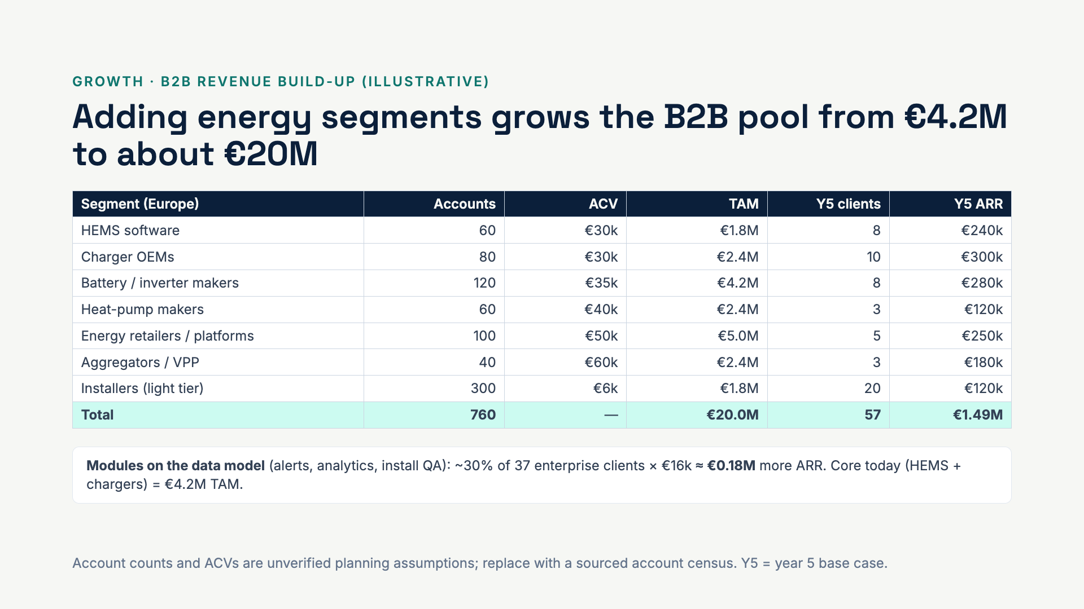
Notes:
The single €15M placeholder becomes a segment-by-segment build. The point is not the exact total but the shape: the core is small, and adjacent segments are three to four times bigger because they reuse the same data model.

Slide 29
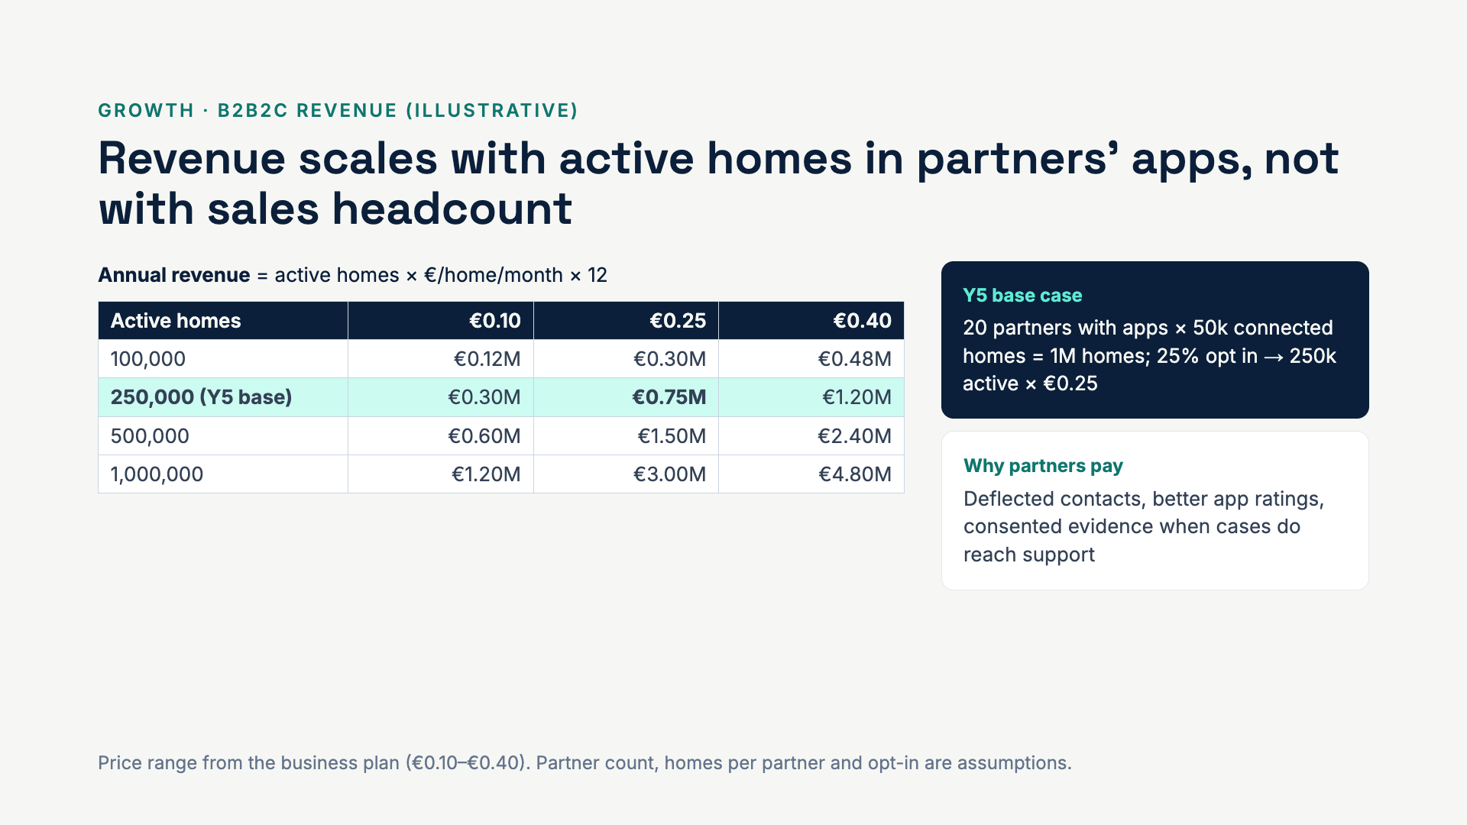
Notes:
B2B2C turns the per-customer contract into a usage line. The grid lets the audience pick their own assumption. The base case needs only a quarter of homes in partner apps to use the assistant.

Slide 30
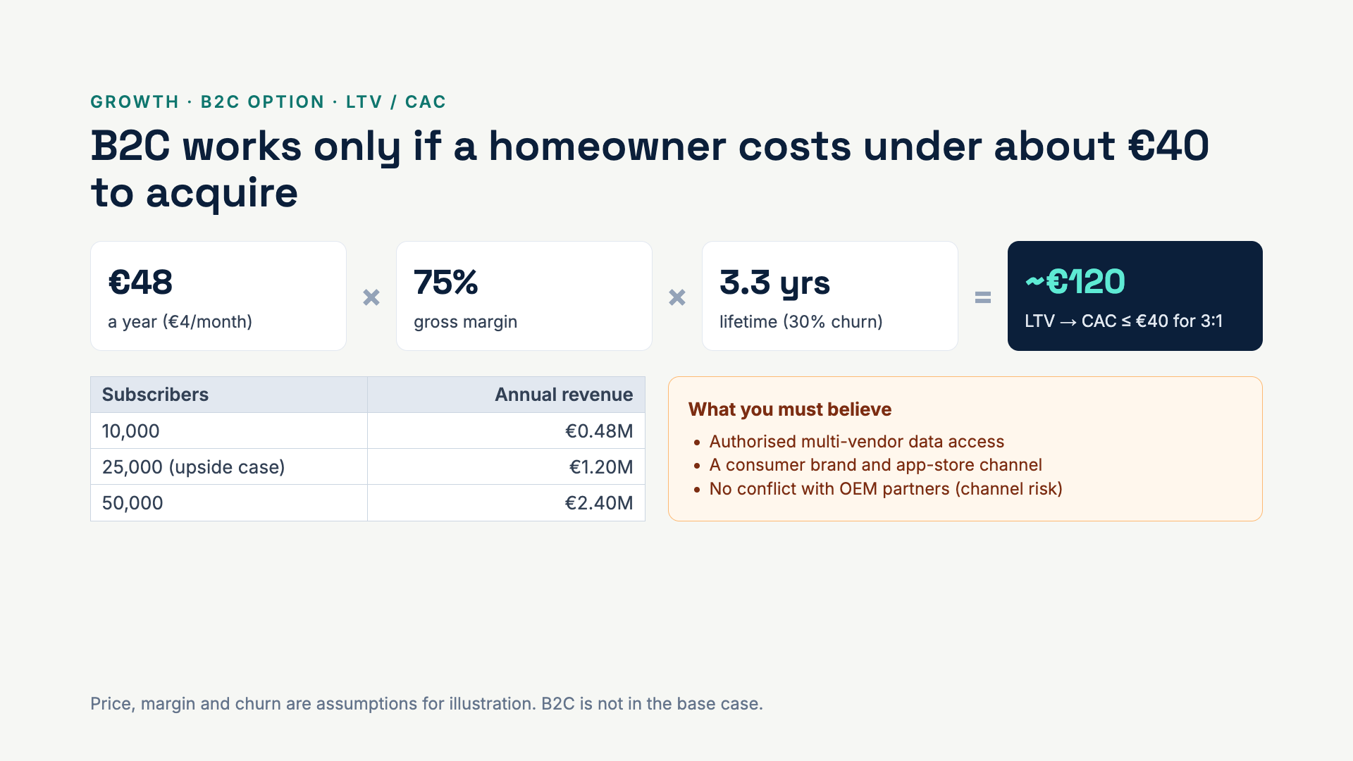
Notes:
For B2C we flip the question: instead of forecasting, we show what has to be true. A €4 subscription only works if acquisition costs stay around €40 per homeowner, and if selling direct does not upset the OEMs who are our B2B customers.

Slide 31
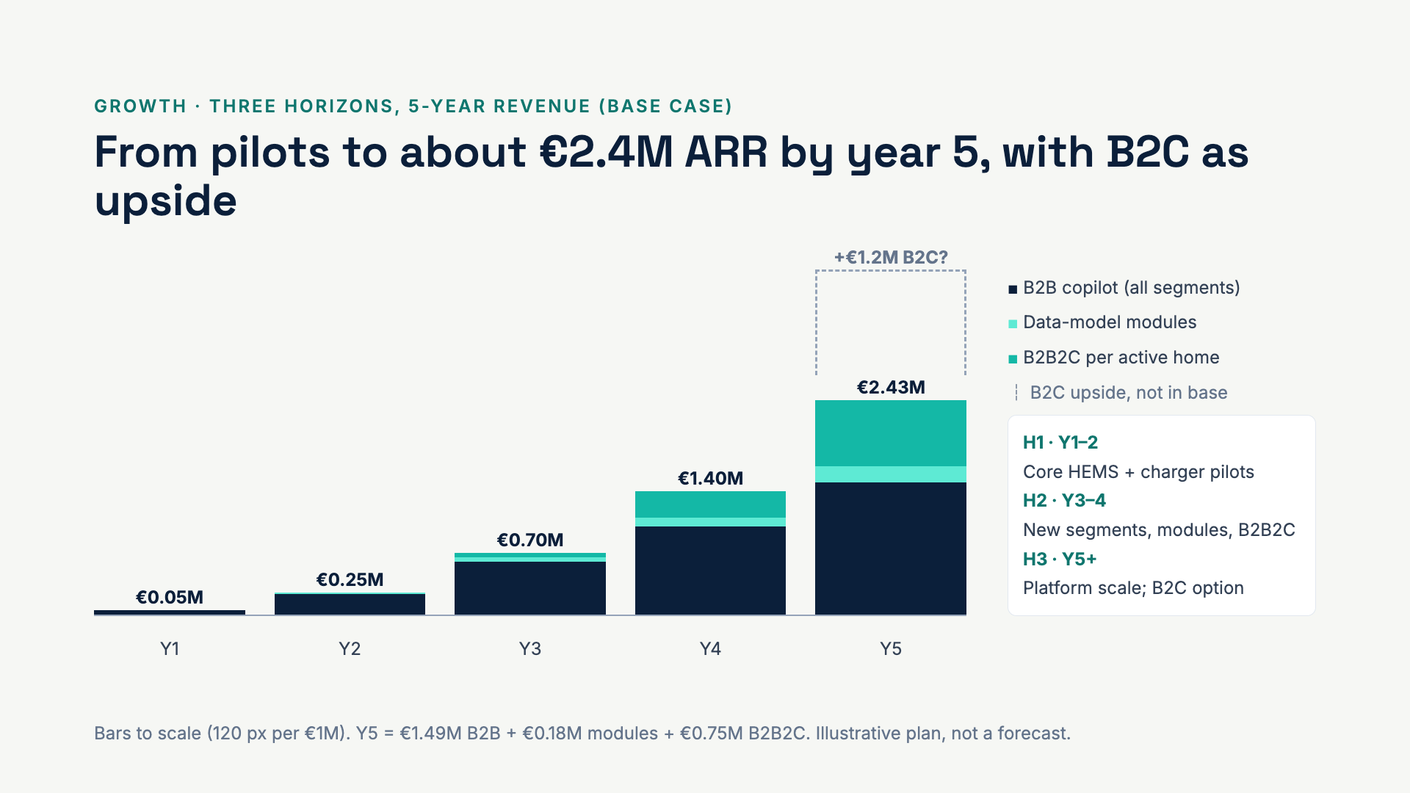
Notes:
McKinsey’s three horizons map onto our phases. Horizon 1 proves the core. Horizon 2 is where the data model pays off: new segments, modules and the homeowner channel. Horizon 3 is platform scale and the optional consumer bet. In this base case the company crosses its ~€0.5M fixed-cost break-even between year 3 and year 4.

Slide 32
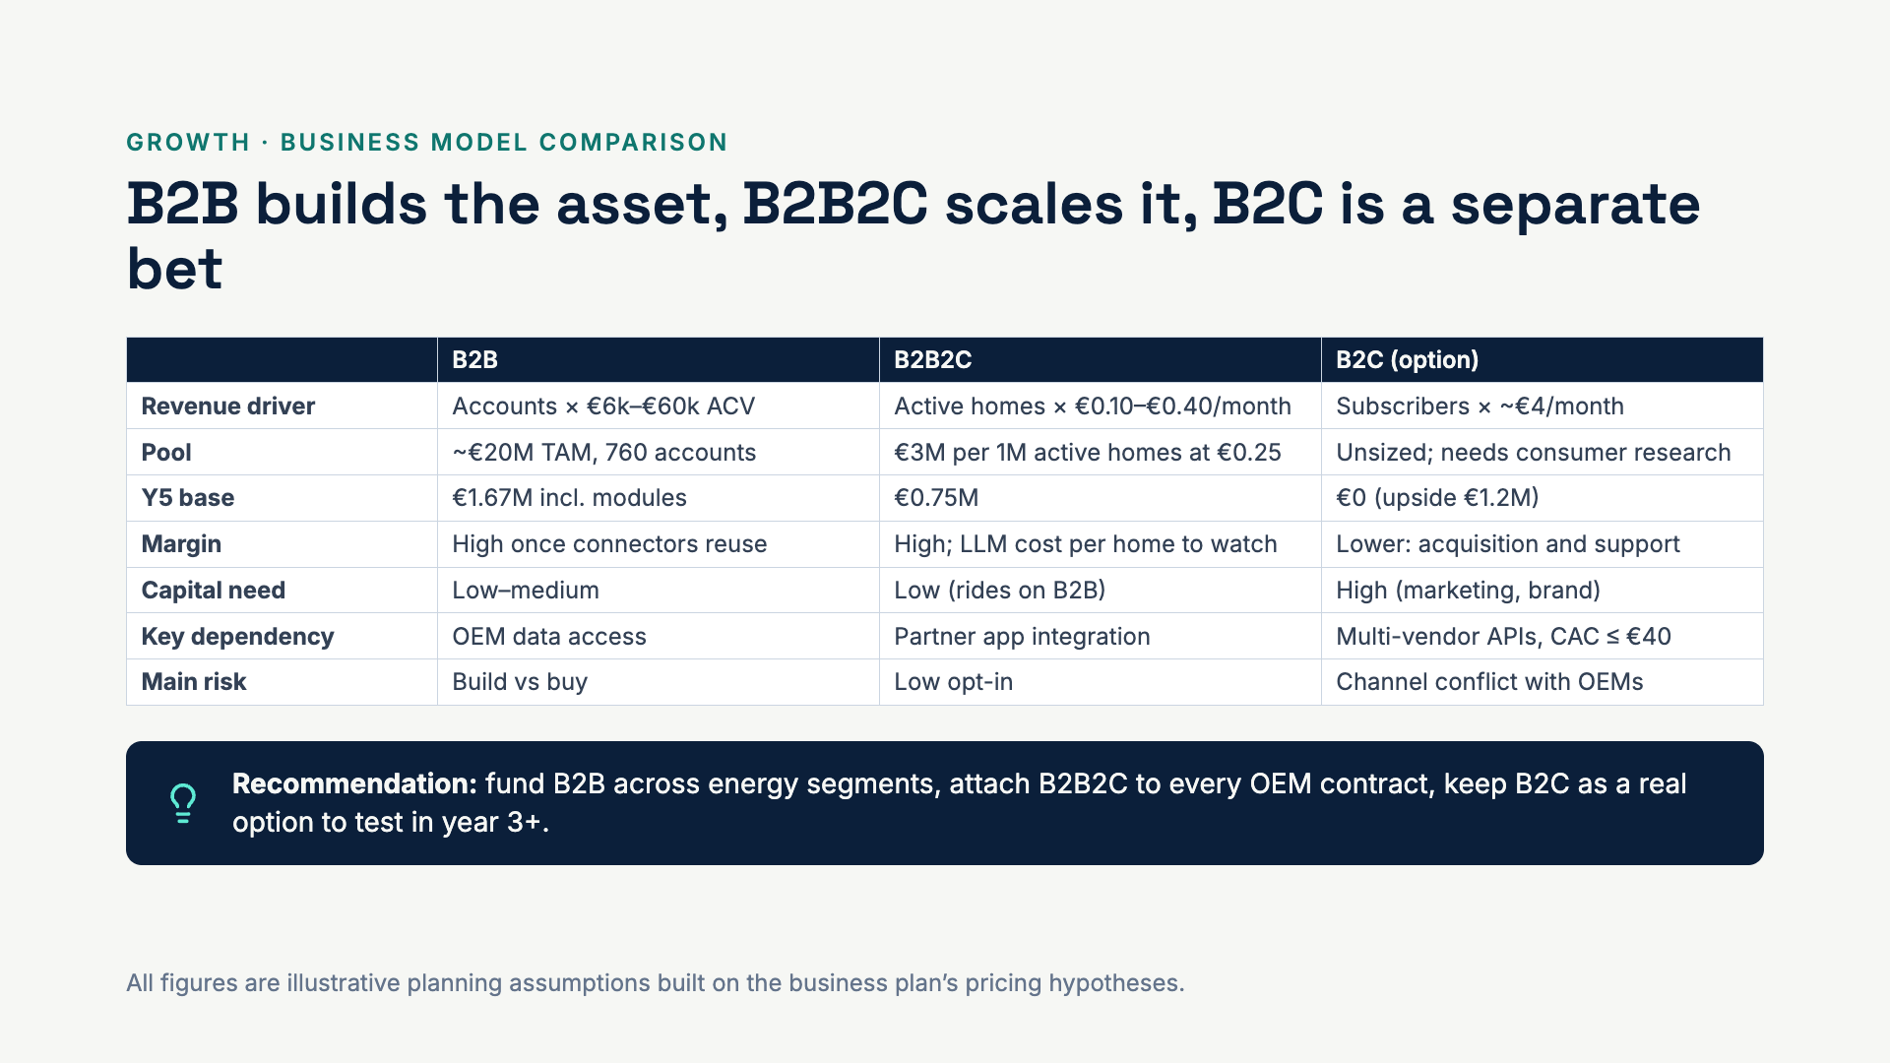
Notes:
Close the growth section here. The three models are not alternatives; they stack. B2B pays for the data model, B2B2C monetises it per home at almost no extra sales cost, and B2C is only worth testing once the first two are proven.

Slide 33
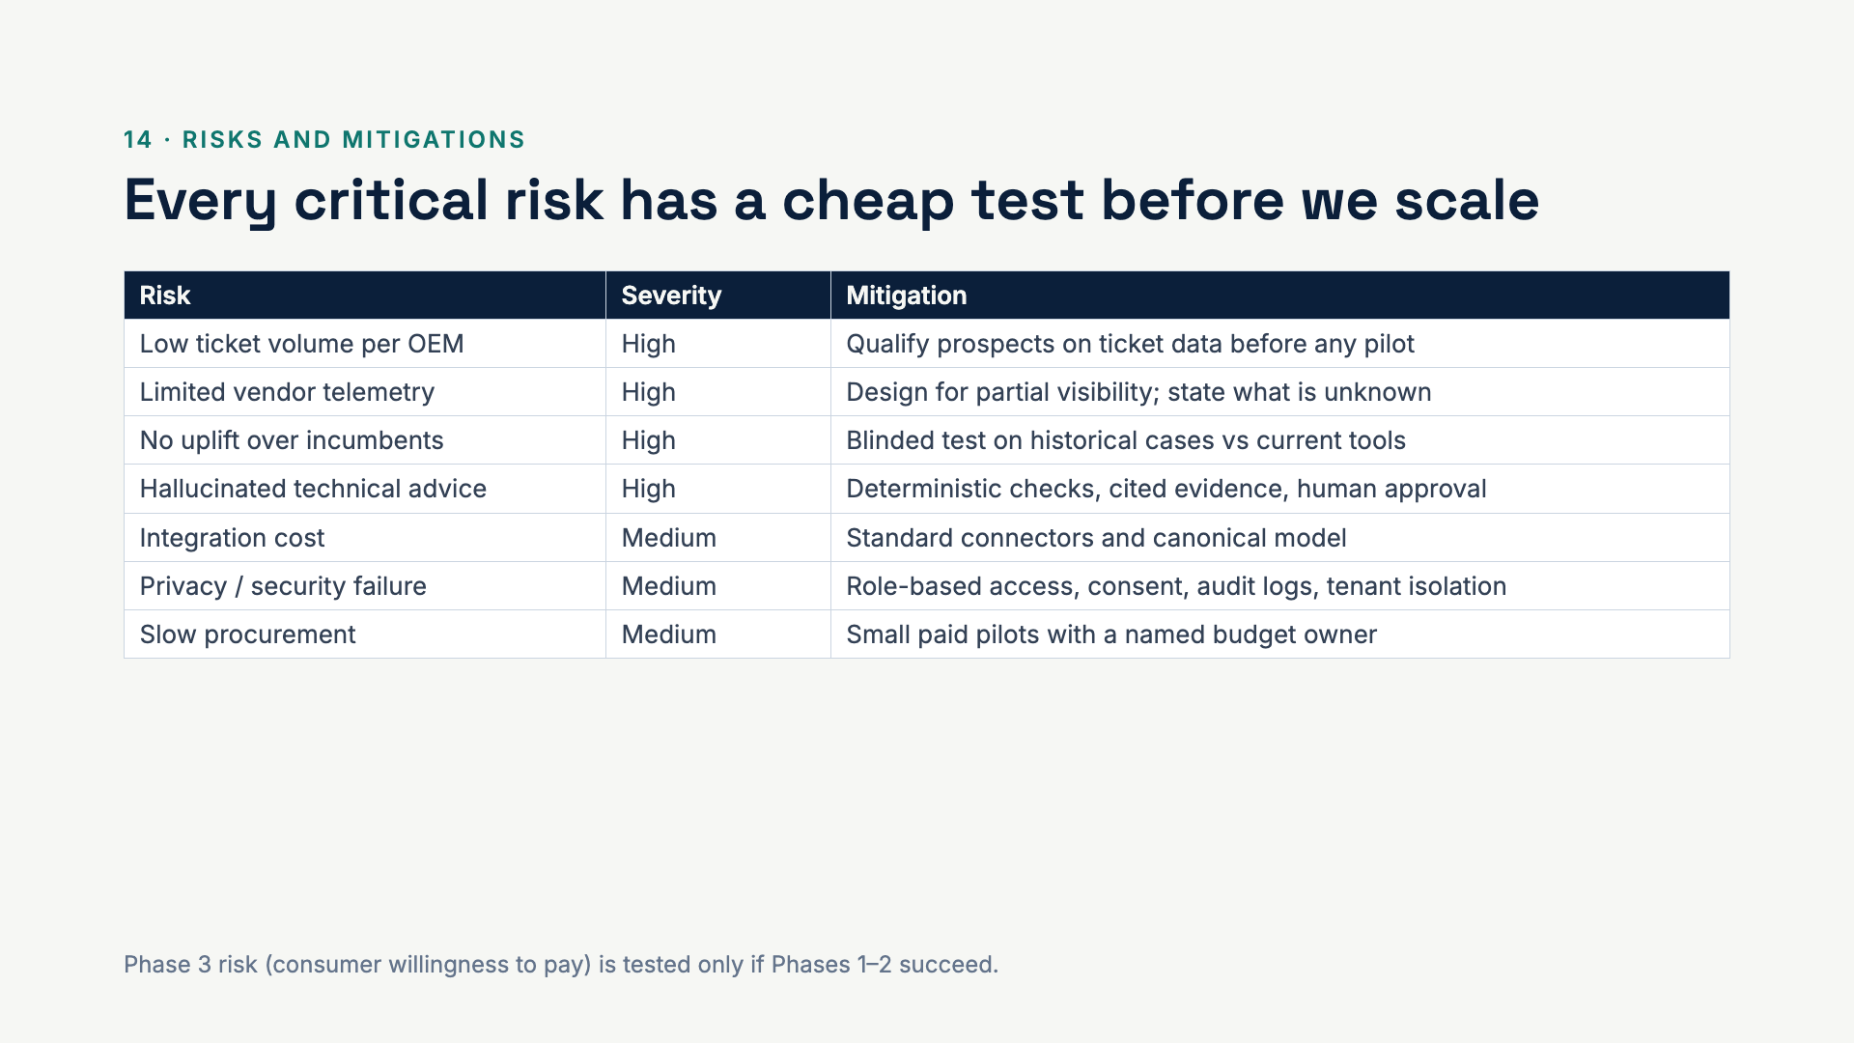
Notes:
The biggest risks are commercial, not technical: do OEMs have enough tickets and will they pay? The prototype already addresses the hallucination risk by design.

Slide 34
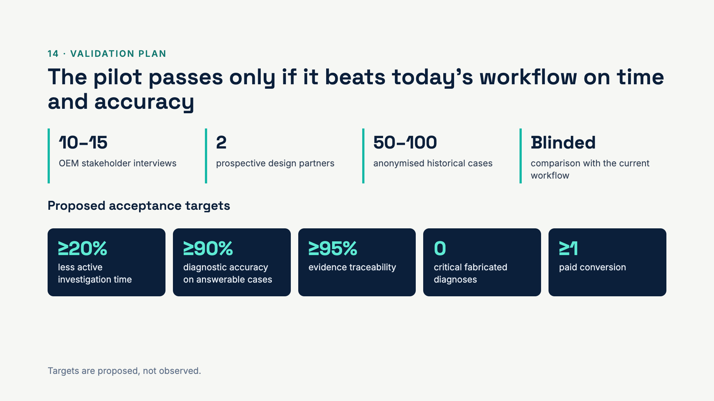
Notes:
These five numbers are the stage gate. If we can’t hit them with real OEM data, we don’t scale.

Slide 35
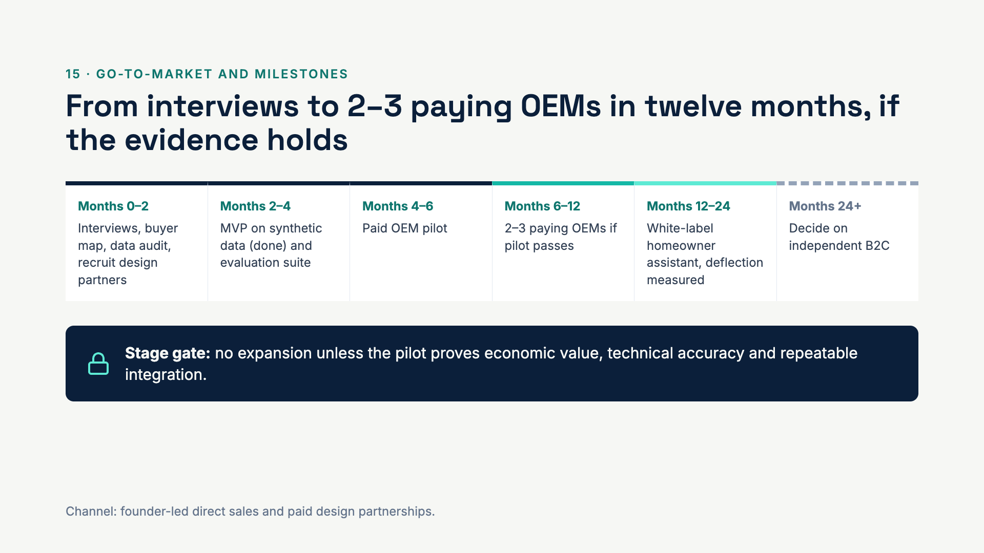
Notes:
We are already past the MVP milestone with the prototype. The next money buys discovery and one paid pilot.

Slide 36
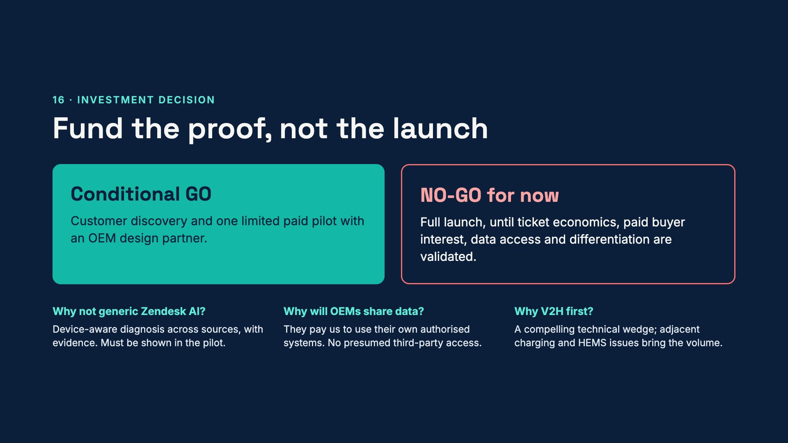
Notes:
Close on the ask: a small, staged investment that buys evidence. If the pilot hits the targets, the next round funds Phase 1 scale-up and Phase 2.

Slide 37
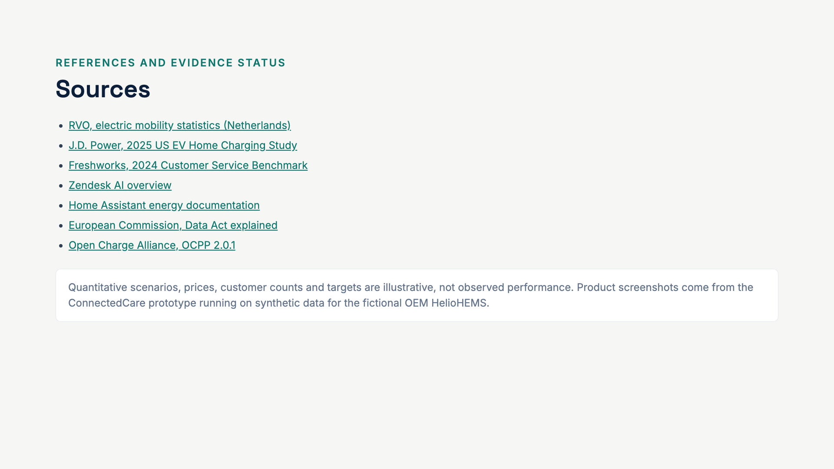
Notes:
All links are for verification. The prototype screenshots are real, but the data is synthetic.

