Slide 1
Generalised & Mixed Effects Linear Models
Data Science
Week 6

Slide 2
Today
Lecture
Quick recap of last week
Generalised Linear Models
Mixed Effects Models
Group Quiz
Worksheet on Hummingbirds!

Slide 3
Linear Models
Linear Models Estimate:
Average Slope
(Continuous predictors)
Average Intercept
(Categorical predictors)
Pollution Level
Pollution Level
Devon
Somerset
Cornwall
Distance of River to City
County

Slide 4
Linear Models
Linear Models Estimate:
Or both!
(Continuous & Categorical predictor)
Pollution Level
Cornwall
Somerset
Devon
Distance of River to City

Slide 5
Linear Models
Have 5 Assumptions – What are they?

Slide 6
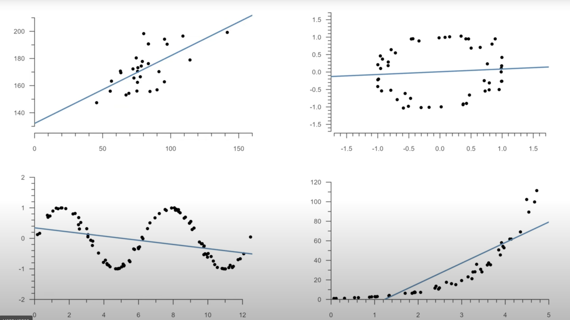
Linear Models
Have 5 Assumptions – What are they?
Data points aren’t related to each other
✗
✅
Independence
Linear Relationship
Normal Residuals
Constant Variance
No Major Outliers
✗
✗
✅
✗
Pollution Level
Number of Birds
Distance of River to City
Food availability
✗
✅
✗
Pollution Level
Pollution Level
Pollution Level
Distance of River to City
Distance of River to City
Distance of River to City

Slide 7
Linear Models
But what if we violate them? Is it the end?
Tell the model about how your data isn’t independent. Either using predictor variables, or a ‘Mixed Effects’ Linear Model
Independence
Linear Relationship
Normal Residuals
Constant Variance
No Major Outliers
Sometimes our data violates these in predictable ways. In these cases we can consider a ‘Generalised’ Linear Model
You just need to think about your data and make educated decisions with this one!

Slide 8
Linear Models
But what if we violate them? Is it the end?
Tell the model about how your data isn’t independent. Either using predictor variables, or a ‘Mixed Effects’ Linear Model
Independence
Linear Relationship
Normal Residuals
Constant Variance
No Major Outliers
Sometimes our data violates these in predictable ways. In these cases we can consider a ‘Generalised’ Linear Model
Start here
You just need to think about your data and make educated decisions with this one!

Slide 9
Generalised Linear Models
Sometimes we have data that doesn’t behave according to linearity, normality and constant variance in a predictable way

Slide 10
Generalised Linear Models
Sometimes we have data that doesn’t behave according to linearity, normality and constant variance in a predictable way
(Hannah please stop with the stats Jargon)

Slide 11
Generalised Linear Models
Sometimes we want to ask linear models data with not technically linear data.
e.g. Count Data
How does the size of my bacteria population change with temperature?
e.g. Yes-No Data
How does whether a student passes an exam (yes or no) depend on hours of study?

Slide 12
Generalised Linear Models
Sometimes we want to ask linear models data with not technically linear data.
e.g. Count Data
How does the size of my bacteria population change with temperature?
e.g. Yes-No Data
How does whether a student passes an exam (yes or no) depend on hours of study?
Exponential growth (not linear)
Population Size
Temperature

Slide 13
Generalised Linear Models
Sometimes we want to ask linear models data with not technically linear data.
e.g. Count Data
How does the size of my bacteria population change with temperature?
e.g. Yes-No Data
How does whether a student passes an exam (yes or no) depend on hours of study?
Population Size
Non-normal residuals
Temperature

Slide 14
Generalised Linear Models
Sometimes we want to ask linear models data with not technically linear data.
e.g. Count Data
How does the size of my bacteria population change with temperature?
e.g. Yes-No Data
How does whether a student passes an exam (yes or no) depend on hours of study?
Variance increases as the average line does
Population Size
Temperature

Slide 15
Generalised Linear Models
Sometimes we want to ask linear models data with not technically linear data.
e.g. Count Data
How does the size of my bacteria population change with temperature?
e.g. Yes-No Data
How does whether a student passes an exam (yes or no) depend on hours of study?
Yes
Passed exam?
No
Hours of Study

Slide 16
Generalised Linear Models
Sometimes we want to ask linear models data with not technically linear data.
e.g. Count Data
How does the size of my bacteria population change with temperature?
e.g. Yes-No Data
How does whether a student passes an exam (yes or no) depend on hours of study?
(We fit a probability of passing line)
Yes
Passed exam?
No
Hours of Study

Slide 17
Generalised Linear Models
Sometimes we want to ask linear models data with not technically linear data.
e.g. Count Data
How does the size of my bacteria population change with temperature?
e.g. Yes-No Data
How does whether a student passes an exam (yes or no) depend on hours of study?
Line not at all linear
Yes
Passed exam?
No
Hours of Study

Slide 18
Generalised Linear Models
Sometimes we want to ask linear models data with not technically linear data.
e.g. Count Data
How does the size of my bacteria population change with temperature?
e.g. Yes-No Data
How does whether a student passes an exam (yes or no) depend on hours of study?
Yes
Residuals very not normal
Passed exam?
No
Hours of Study

Slide 19
Generalised Linear Models
Sometimes we want to ask linear models data with not technically linear data.
e.g. Count Data
How does the size of my bacteria population change with temperature?
e.g. Yes-No Data
How does whether a student passes an exam (yes or no) depend on hours of study?
Yes
Variance all over the place
Passed exam?
No
Hours of Study

Slide 20
Generalised Linear Models
To cover some of these predictable situations, Generalised Linear Models were invented.
They do maths under the hood to transform the data, in a way that allows R to then basically apply all the linear model logic we’ve just learnt

Slide 21
Data Transformations
To cover some of these predictable situations, Generalised Linear Models were invented.
They do maths under the hood to transform the data, in a way that allows R to then basically apply all the linear model logic we’ve just learnt
(I’ll explain in a sec)

Slide 22
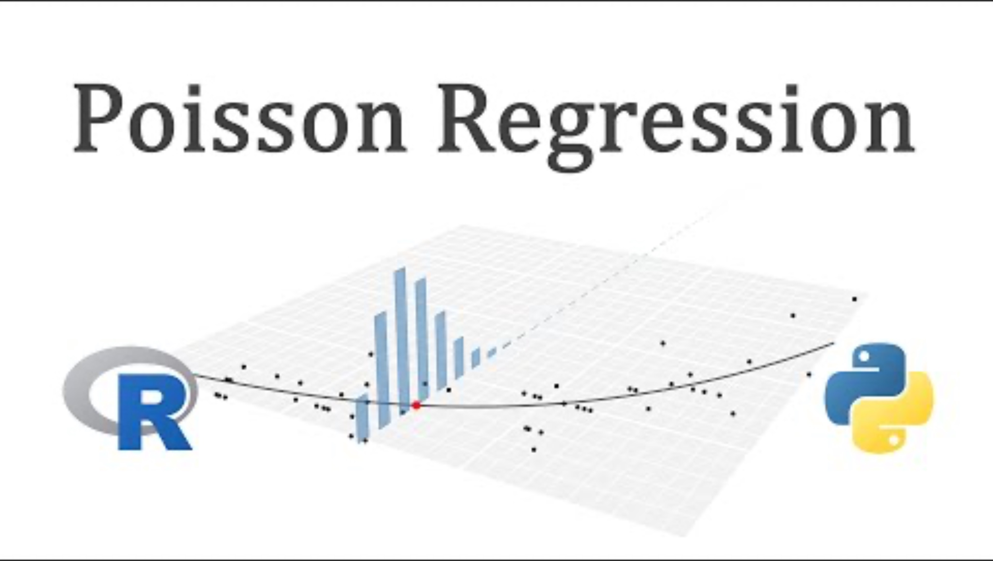
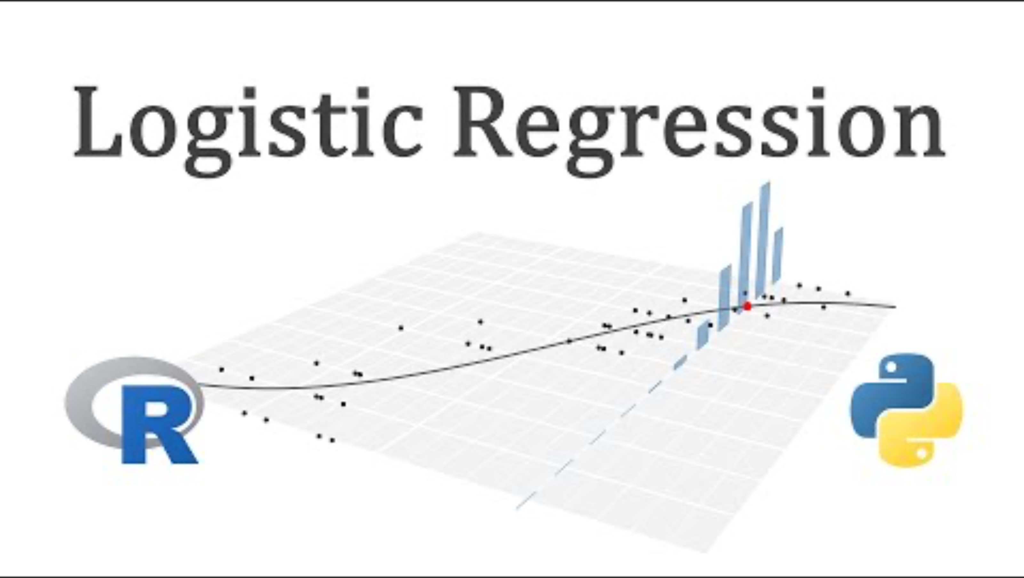
Data Transformations
The kind of transformation depends on the kind of data and what we expect. Two of the most common:
e.g. Count Data
e.g. Yes-No Data
6:07
“Poisson Distribution”
“Binomial Distribution”
(Which gets called ‘Logistic Regression’ because Stats hates us)
4:33

Slide 23
Data Transformations
What do I mean by transformation?
Poisson Models Transform Data into Log Space

Slide 24
Data Transformations
What do I mean by transformation?
Poisson Models Transform Data into Log Space
Population Size
Temperature

Slide 25
They do more to get the variance behaving as well, that’s a deep dive for you if you’re a keen bean
Data Transformations
What do I mean by transformation?
Poisson Models Transform Data into Log Space
Log (Population Size)
Population Size
Temperature
Temperature

Slide 26
Data Transformations
What do I mean by transformation?
Binomial Models Transform Data into Logit Space

Slide 27
Data Transformations
What do I mean by transformation?
Binomial Models Transform Data into Logit Space
Likelihood of Passing Exam
Hours of Study

Slide 28
They do more to get the variance behaving as well, that’s a deep dive for you if you’re a keen bean
Data Transformations
What do I mean by transformation?
Binomial Models Transform Data into Logit Space
Likelihood of Passing Exam
Logit (Likelihood of Passing)
Hours of Study
Hours of Study

Slide 29
There are more!
A common one is the ‘beta’ distribution for proportion data
Or the ‘negative binomial’ distribution for count data where you have really high variance

Slide 30
Coding GLMs
Super simple. There are a number of R packages, we use ‘lme4’.
You do as you would before, with a couple of extras:
glm(Response ~ Predictor, family=“poisson”, data=Data)
Add a ‘g’
Specify what kind of glm you want

Slide 31
Interpreting GLM Output
Crucial to understand!! Stats hates us, so GLM model output is not user friendly. It doesn’t back transform the data, it keeps it in the transformed space. So you need to do it yourself (See worksheet)
log

Slide 32
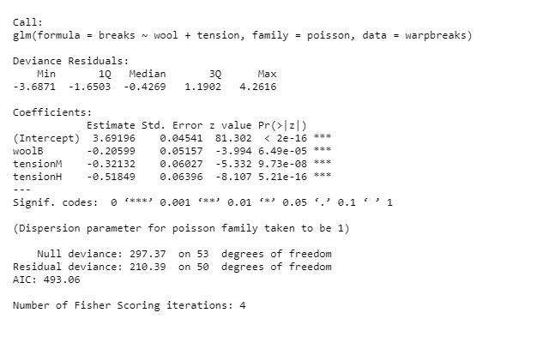
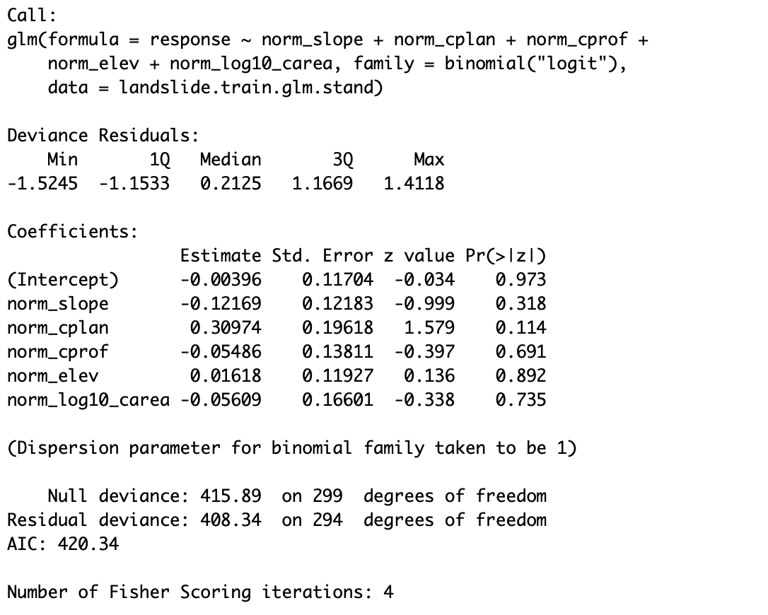
Interpreting GLM Output
Crucial to understand!! Stats hates us, so GLM model output is not user friendly. It doesn’t back transform the data, it keeps it in the transformed space. So you need to do it yourself (See worksheet)
Some random poisson model
Some random binomial model
log
log(
)
logit(
)
log(
)
logit(
)
etc
etc

Slide 33
Have A Breather…

Slide 34
Linear Models
But what if we violate them? Is it the end?
Tell the model about how your data isn’t independent. Either using predictor variables, or a ‘Mixed Effects’ Linear Model
Independence
Linear Relationship
Normal Residuals
Constant Variance
No Major Outliers
Sometimes our data violates these in predictable ways. In these cases we can consider a ‘Generalised’ Linear Model
You just need to think about your data and make educated decisions with this one!

Slide 35
Linear Models
But what if we violate them? Is it the end?
Tell the model about how your data isn’t independent. Either using predictor variables, or a ‘Mixed Effects’ Linear Model
Independence
Linear Relationship
Normal Residuals
Constant Variance
No Major Outliers
And now
Sometimes our data violates these in predictable ways. In these cases we can consider a ‘Generalised’ Linear Model
You just need to think about your data and make educated decisions with this one!

Slide 36
Mixed Effects Models!
Aka Linear Mixed Models
Aka Hierarchical Models

Slide 37

Let’s stay we’re sampling trees, we want to know if soil conditions affect leaf size.
We pick these 8 trees, and sample 10 leaves per tree
Are our samples independent?

Slide 38
Let’s stay we’re sampling trees, we want to know if soil conditions affect leaf size.
We pick these 8 trees, and sample 10 leaves per tree
Are our samples independent?
What can we do?

Slide 39
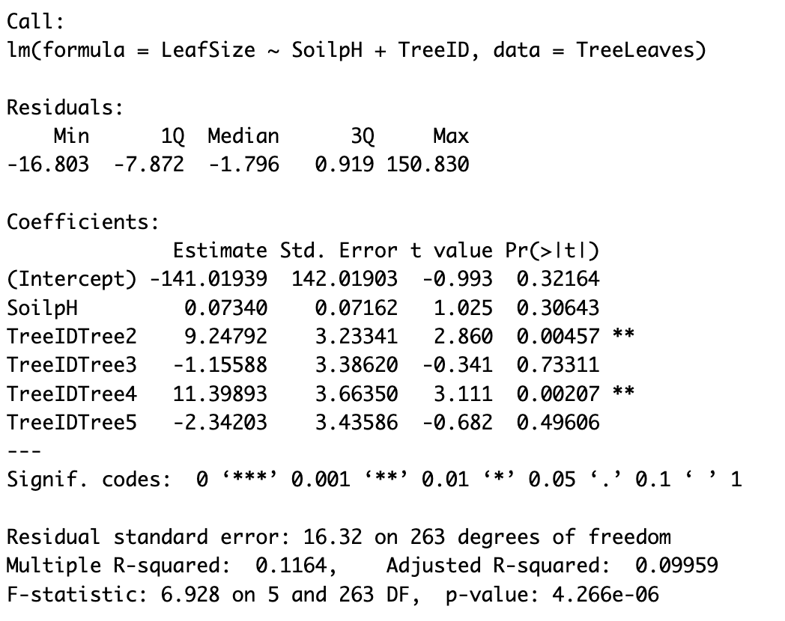
Fixing Independence
We could include ‘TreeID’ as a predictor in our model
But then we’ll get an estimate for every tree

Slide 40
Fixing Independence
We could include ‘TreeID’ as a predictor in our model
But then we’ll get an estimate for every tree
Do we care about every tree??

Slide 41
Fixing Independence
We could include ‘TreeID’ as a predictor in our model
But then we’ll get an estimate for every tree
What if we sampled 500 trees?!

Slide 42
Enter Mixed Effects Models
In these, we have two types of predictor variables:
Random effect = how you tell the model there are groups (that you don’t care about)
Fixed effect = ‘Normal’ predictors (Fixed effects can also be groups!! They’re just groups you do care about)

Slide 43
Random Effects
Account for the fact there’s non-independence, without giving us loads of estimates (and with other statistical benefits)
Model assumes that each group in your variable is a random sample of a potentially bigger pool of samples, hence the name

Slide 44
Random Effects Rules(ish)
There should be at least five levels in the variable (e.g. if your Random Effect is TreeID, you should have at least 5 trees)

Slide 45
Random Effects Rules(ish)
There should be at least five levels in the variable (e.g. if your Random Effect is TreeID, you should have at least 5 trees)
Each level (in our example, each tree) should have at least 3 data points

Slide 46
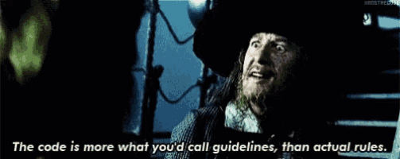
Random Effects Rules(ish)
There should be at least five levels in the variable (e.g. if your Random Effect is TreeID, you should have at least 5 trees)
Each level (in our example, each tree) should have at least 3 data points

Slide 47
Coding Mixed Models
lm(Count ~ Year, data = MyData)
lmer(Count ~ Year + (1|Site), data = MyData)

Slide 48
Linear Mixed Models
Fixed effect
lm(Count ~ Year, data = MyData)
lmer(Count ~ Year + (1|Site), data = MyData)
Random effect

Slide 49
Linear Mixed Models
Fixed effect
lm(Count ~ Year, data = MyData)
lmer(Count ~ Year + (1|Site), data = MyData)
Don’t worry about the ‘1|’
(unless you’re feeling very keen in which case it’s because we’re only setting a random intercept, not a random slope. Feel free to google further)
Random effect

Slide 50
Want your model generalised?
Fixed effect
lm(Count ~ Year, data = MyData)
glmer(Count ~ Year + (1|Site), family=“poisson” data = MyData)
Add a g here!
Add your family in

Slide 51
What if I have more than one group?

Slide 52
I’m not going to go into this, because I fear your brains will be noodles

Slide 53
But refer back to this if your data contains more than one group…
You can sometimes have more than one group.
Sometimes you can treat this like normal predictors, where you just add more random effects into your model using ‘+’

Slide 54
But refer back to this if your data contains more than one group…
BUT there are cases where you shouldn’t do this.
E.g. what if you took ten samples from each tree, but you sampled trees across multiple sites in Scotland?
Now you have Tree AND Site as grouping IDs.
If one of your groups can only occur inside the other, you need to nest them.
In this example, Tree1 can only occur in Site1

Slide 55
But refer back to this if your data contains more than one group…
What do I mean by that? In this example, Tree 1 can only occur at Site 1 (maybe a particular tree in Rothiemurchus). Trees aren’t magic – that same tree can’t also be on Skye
In these cases, we need to tell the model “one group lives inside another”. You code it like this:
The bigger “nest” goes first
lmer(LeafSize ~ SoilpH + (1|Site/Tree), data = MyData)

Slide 56
A final thing about Random Effects – unless you specify, they only consider the *Intercept*
Average
Leaf Size
SoilpH
The model will assume the relationship between your predictor and response is the SAME for every group.
e.g. if you think species richness increases through time,
HOW TO INCLUDE THIS
ALSO TO INCLUDE – COMPARING AICs
Add a graph of the levels???

Slide 57
INTERCEPT NOT SLOPE
Tree 1
Tree 2
Tree 3
Average
Tree 4
Tree 5
Leaf Size
SoilpH
The model will assume the relationship between your predictor and response is the SAME for every group.
e.g. if you think species richness increases through time,
HOW TO INCLUDE THIS
ALSO TO INCLUDE – COMPARING AICs
Add a graph of the levels???

Slide 58
INTERCEPT NOT SLOPE
Do we always expect this? (Maybe not!)
The model will assume the relationship between your predictor and response is the SAME for every group.
e.g. if you think species richness increases through time,
HOW TO INCLUDE THIS
ALSO TO INCLUDE – COMPARING AICs
Add a graph of the levels???

Slide 59
INTERCEPT NOT SLOPE
You CAN make random effects vary in slope as well, but that’s beyond what we have time for today.
We’ll touch on it a bit next week
The model will assume the relationship between your predictor and response is the SAME for every group.
e.g. if you think species richness increases through time,
HOW TO INCLUDE THIS
ALSO TO INCLUDE – COMPARING AICs
Add a graph of the levels???

Slide 60
FINAL THING
BEWARE when using AI for random effects! The term ‘random effect’ is used differently in different fields, sometimes with VERY different meanings. I find it does okay if I specify I’m thinking in ecology terms, but much safer to rely on other sources.
The model will assume the relationship between your predictor and response is the SAME for every group.
e.g. if you think species richness increases through time,
HOW TO INCLUDE THIS
ALSO TO INCLUDE – COMPARING AICs
Add a graph of the levels???

Slide 61
Summary
Does your data have groups?
 | No | Yes (you must specify random effects, i.e. your grouping variables)
Yes | Linear Model (LM) | Linear Mixed Model (LMM)
No (you must specify the distribution, e.g. poisson) | Generalised Linear Model (GLM) | Generalised Linear Mixed Model (GLMM)
Is your data ‘Normal’?

Slide 62
Summary – Code calls
Does your data have groups?
 | No | Yes (you must specify random effects, i.e. your grouping variables)
Yes | Linear Model (LM) stats::lm | Linear Mixed Model (LMM) lme4::lmer
No (you must specify the distribution, e.g. poisson) | Generalised Linear Model (GLM) stats::glm | Generalised Linear Mixed Model (GLMM) lme4::glmer
Is your data ‘Normal’?
*note! You’ll find that other packages offer mixed models. lme4 is a common one, but feel free to shop around. E.g. nlme or glmmTMB

Slide 63
Terminology confusion
This | Is also referred to as this…
Predictor | Independent Variable, Explanatory variable, Covariate, X
Response | Dependent Variable, Y
A linear model where the predictors are categorial | ANOVA
A ‘normal’, basic linear model | Linear regression, ordinary linear regression, ordinary least squares (OLS) linear regression (also VERY confusingly, sometimes a ‘general’ linear model, if you have multiple predictors. Different from a ‘generalized’ linear model)
A ‘normal’ predictor in a linear model | A fixed effect
Normal distribution | Gaussian distribution
A linear mixed model | A hierarchical model, mixed effects model, multi-level model
Random effect | Random factor*
Estimate | Effect size*, coefficient*
*one could argue there are technically differences between these terms but in practice they’re used interchangeably

Slide 64
Why? It’s very important to *actually* get to know data you’re going to use before working with it!
Activity
Before we begin!!
In groups, take five minutes to research the following Hummingbird Species. Primarily use Audubon.org. Note down the top 3 words listed for each under “Habitat”.
Violet-crowned Hummingbird
Black-chinned Hummingbird
Ruby-throated Hummingbird
Broad-billed Hummingbird
Magnificent Hummingbird
Then, take 5 minutes to google to following places. Note down (and look at pics!) of the primary habitat types in each region
Arizona
Mexico
Guatemala

Slide 65
WWF Report
A hint…
The WWF data is a random collation from all sorts of different sources
Each population (a particular species in a particular place) is measured according to very different units
Bear that in mind as we work through today’s activity, and you think about your report….

