Slide 1
I’ve built a model. What does it say?
Data Science
Week 7

Slide 2
Interpreting Models
Today we will go through
What all of those numbers mean in the model output
P VALUES ARE NOT INTERESTING
Understanding estimates of continuous and categorical predictors
Interaction terms
GLM conversions
Presenting results: Plots and Tables

Slide 3
“All models are wrong,
some are useful”
A model is not a wizard. It does not magically reveal things in the data that aren’t already there.
It’s just a means of simplifying and summarizing relationships.
Interpret with care!!!

Slide 4
What’s not especially useful?
P Values

Slide 5
What’s not especially useful?
P Values
(esp with bigger datasets)

Slide 6
THE FOLLOWING PLOTS ARE ILLUSTRATIVE ONLY (I have not checked the numbers but the general point stands

Slide 7
This is probably a significant relationship
Response
Predictor

Slide 8
So is this.
Response
Predictor

Slide 9
So is this.
Response
Predictor

Slide 10
So is this.
Response
Predictor

Slide 11
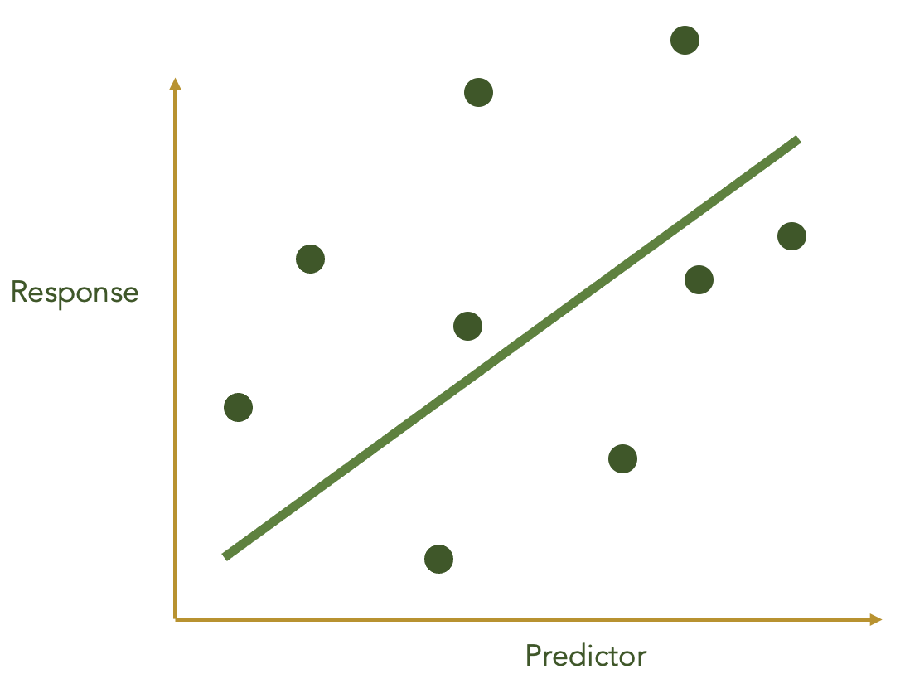
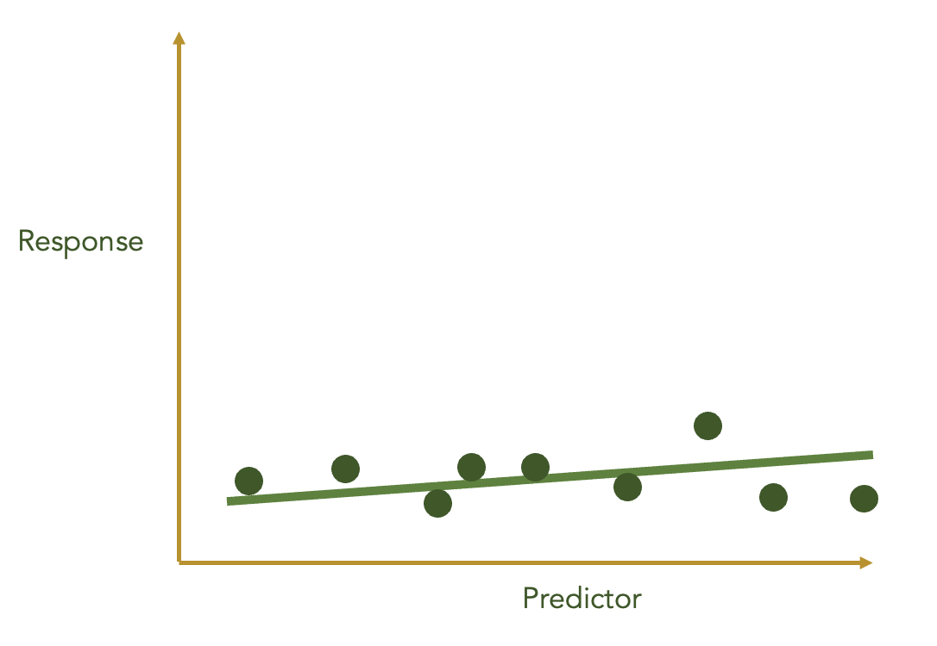
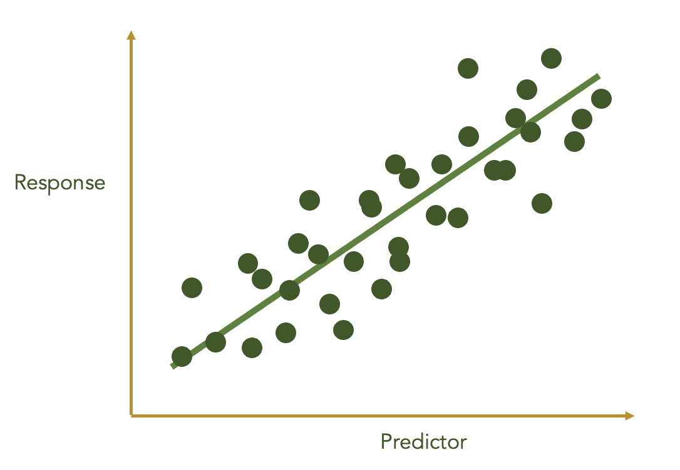
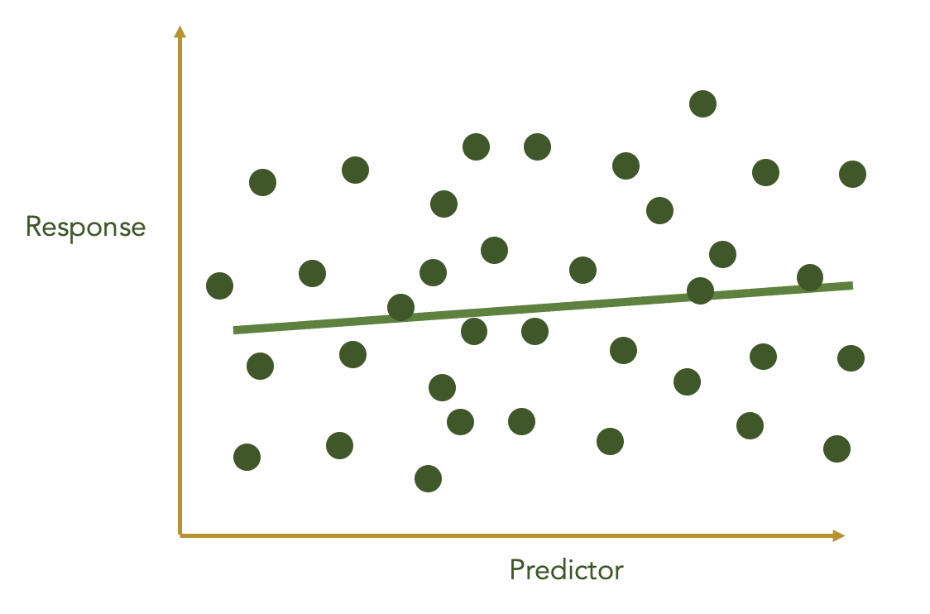

Slide 12
What’s more useful?
Small effect size
Small confidence interval
Big effect size
Big confidence interval
Effect Size
(aka coefficient, aka estimate)
Confidence Intervals
(similar to BUT NOT THE SAME AS standard error, standard deviation)
Small effect size
Big confidence interval
Big effect size
Small confidence interval

Slide 13
What’s more useful?
Small effect size
Small confidence interval
Big effect size
Big confidence interval
Effect Size
(aka coefficient, aka estimate)
Confidence Intervals
(similar to BUT NOT THE SAME AS standard error, standard deviation)
Small effect size
Big confidence interval
Big effect size
Small confidence interval
It may be significant, but it’s not especially useful

Slide 14
That’s the logic.

Slide 15
Side note: this is also why with DHARMa/other diagnostics (e.g. Shapiro test!) you should use common sense. If it’s significant, but the graphs don’t look crazy, it’s probably just cos you have a large dataset

Slide 16
Interpreting your model
glm(Count ~ Year, family = “poisson”)
5
4
 | Estimate | Std. Error | z value (or T or F) | Pr(>|z|)
(Intercept) | 1
Year | 0.5
log
(Count)
3
2
1
0
1 2 3 4 5
Year

Slide 17
Interpreting your model
glm(Count ~ Year, family = “poisson”)
5
4
 | Estimate | Std. Error | z value (or T or F) | Pr(>|z|)
(Intercept) | 1
Year | 0.5
log
(Count)
3
2
Line intercepts y axis at log(count) = 1
1
0
1 2 3 4 5
Year

Slide 18
Interpreting your model
glm(Count ~ Year, family = “poisson”)
5
4
 | Estimate | Std. Error | z value (or T or F) | Pr(>|z|)
(Intercept) | 1
Year | 0.5
log
(Count)
3
2
log(count) goes up by 0.5 every year (so at Year 1, it’s 1.5)
1
0
1 2 3 4 5
Year

Slide 19
Interpreting your model
glm(Count ~ Year, family = “poisson”)
5
4
 | Estimate | Std. Error | z value (or T or F) | Pr(>|z|)
(Intercept) | 3
Year | -1
log
(Count)
3
2
1
0
1 2 3 4 5
Year

Slide 20
Interpreting your model
glm(Count ~ Year, family = “poisson”)
5
4
 | Estimate | Std. Error | z value (or T or F) | Pr(>|z|)
(Intercept) | 3
Year | -1
log
(Count)
3
2
1
0
1 2 3 4 5
Year

Slide 21
Interpreting your model
glm(Count ~ Year + Site, family = “poisson”)
We have count data across four sites: Site1, Site2, Site 3
5
4
 | Estimate | Std. Error | z value (or T or F) | Pr(>|z|)
(Intercept)
Year
Site2
Site3
log
(Count)
3
2
1
0
1 2 3 4 5
Year

Slide 22
Interpreting your model
glm(Count ~ Year + Site, family = “poisson”)
We have count data across four sites: Site1, Site2, Site 3
5
4
 | Estimate | Std. Error | z value (or T or F) | Pr(>|z|)
(Intercept)
Year
Site2
Site3
log
(Count)
3
2
1
0
1 2 3 4 5
Where’s Site 1 gone?
Year

Slide 23
Interpreting your model
glm(Count ~ Year + Site, family = “poisson”)
We have count data across four sites: Site1, Site2, Site 3
5
4
 | Estimate | Std. Error | z value (or T or F) | Pr(>|z|)
(Intercept)
Year
Site2
Site3
log
(Count)
3
2
1
0
1 2 3 4 5
Where’s Site 1 gone?
Answer: it’s hiding in the intercept!
Year

Slide 24
Interpreting your model
glm(Count ~ Year + Site, family = “poisson”)
Site 1
5
4
 | Estimate | Std. Error | z value (or T or F) | Pr(>|z|)
(Intercept) | 3
Year | 0.5
Site2
Site3
log
(Count)
3
2
1
0
1 2 3 4 5
This is the estimate for Site 1
Year

Slide 25
Interpreting your model
glm(Count ~ Year + Site, family = “poisson”)
Site 1
5
4
 | Estimate | Std. Error | z value (or T or F) | Pr(>|z|)
(Intercept) | 3
Year | 0.5
Site2 | -1
Site3
log
(Count)
3
2
1
0
1 2 3 4 5
Year
This is Site 2’s estimate relative to Site 1

Slide 26
Interpreting your model
glm(Count ~ Year + Site, family = “poisson”)
Site 1
5
Site 2
4
 | Estimate | Std. Error | z value (or T or F) | Pr(>|z|)
(Intercept) | 3
Year | 0.5
Site2 | -1
Site3
log
(Count)
3
2
3 + -1 = 2
1
0
1 2 3 4 5
Year

Slide 27
Interpreting your model
glm(Count ~ Year + Site, family = “poisson”)
Site 1
5
Site 2
4
 | Estimate | Std. Error | z value (or T or F) | Pr(>|z|)
(Intercept) | 3
Year | 0.5
Site2 | -1
Site3 | -2
log
(Count)
3
2
1
0
1 2 3 4 5
Year

Slide 28
What if you have two categorical variables?
glm(Count ~ Year + Site + Species, family = “poisson”)
Site 1, Toed Sloth
Site 1, Furry Sloth
Site 1, Mossy Sloth
Count ~ Intercept + Year + Site + Species
Site 2, Toed Sloths
5
Site 2, FurrySloths
Count ~ 3 + 0 + -1 + -0.1 =
Site 2, Mossy Sloths
4
 | Estimate | Std. Error | z value (or T or F) | Pr(>|z|)
(Intercept) | 3
Year | 0.5
Site2 | -1
Site3 | -2
Site 3
log
(Count)
3
2
1
ToedSloth | 0.3
MossySloth | -0.1
0
1 2 3 4 5
(Intercept) is now Y intercept for Furry Sloths in Site 1
Year

Slide 29
What if you have two categorical variables?
glm(Count ~ Year + Site + Species, family = “poisson”)
Site 1, Toed Sloth
Site 1, Furry Sloth
Site 1, Mossy Sloth
Count ~ Intercept + Year + Site + Species
Site 2, Toed Sloths
5
Site 2, FurrySloths
Count ~ 3 + 0 + -1 + -0.1 =
Site 2, Mossy Sloths
Toed sloth intercept in Site 1 is 3 + 0.3
4
 | Estimate | Std. Error | z value (or T or F) | Pr(>|z|)
(Intercept) | 3
Year | 0.5
Site2 | -1
Site3 | -2
Site 3
log
(Count)
3
2
1
ToedSloth | 0.3
MossySloth | -0.1
0
1 2 3 4 5
Year

Slide 30
What if you have two categorical variables?
glm(Count ~ Year + Site + Species, family = “poisson”)
Site 1, Toed Sloth
Site 1, Furry Sloth
Site 1, Mossy Sloth
Count ~ Intercept + Year + Site + Species
Site 2, Toed Sloths
5
Site 2, FurrySloths
Count ~ 3 + 0 + -1 + -0.1 =
Site 2, Mossy Sloths
Mossy sloth intercept in Site 1 is 3 - 0.1
4
 | Estimate | Std. Error | z value (or T or F) | Pr(>|z|)
(Intercept) | 3
Year | 0.5
Site2 | -1
Site3 | -2
Site 3
log
(Count)
3
2
1
ToedSloth | 0.3
MossySloth | -0.1
0
1 2 3 4 5
Year

Slide 31
What if you have two categorical variables?
glm(Count ~ Year + Site + Species, family = “poisson”)
Site 1, Toed Sloth
Site 1, Furry Sloth
Site 1, Mossy Sloth
Count ~ Intercept + Year + Site + Species
Site 2, Toed Sloths
5
Site 2, FurrySloths
Count ~ 3 + 0 + -1 + -0.1 =
Site 2, Mossy Sloths
4
 | Estimate | Std. Error | z value (or T or F) | Pr(>|z|)
(Intercept) | 3
Year | 0.5
Site2 | -1
Site3 | -2
Site 3
log
(Count)
3
2
Furry Sloth Intercept in Site 2 is 3 -1 (remember the ‘Intercept’ is the Furry Sloth Base Level)
1
ToedSloth | 0.3
MossySloth | -0.1
0
1 2 3 4 5
Year

Slide 32
What if you have two categorical variables?
glm(Count ~ Year + Site + Species, family = “poisson”)
Site 1, Toed Sloth
Site 1, Furry Sloth
Site 1, Mossy Sloth
Count ~ Intercept + Year + Site + Species
Site 2, Toed Sloths
5
Site 2, FurrySloths
Count ~ 3 + 0 + -1 + -0.1 =
Site 2, Mossy Sloths
4
 | Estimate | Std. Error | z value (or T or F) | Pr(>|z|)
(Intercept) | 3
Year | 0.5
Site2 | -1
Site3 | -2
Site 3
log
(Count)
3
2
Toed Sloth Intercept in Site 2 is 3 -1 + 0.3 (now we have to adjust for both species and site, as neither is the ‘base’ level!)
1
ToedSloth | 0.3
MossySloth | -0.1
0
1 2 3 4 5
Year

Slide 33
What if you have two categorical variables?
glm(Count ~ Year + Site + Species, family = “poisson”)
Site 1, Toed Sloth
Site 1, Furry Sloth
Site 1, Mossy Sloth
Count ~ Intercept + Year + Site + Species
Site 2, Toed Sloths
5
Site 2, FurrySloths
Count ~ 3 + 0 + -1 + -0.1 =
Site 2, Mossy Sloths
4
 | Estimate | Std. Error | z value (or T or F) | Pr(>|z|)
(Intercept) | 3
Year | 0.5
Site2 | -1
Site3 | -2
Site 3
log
(Count)
3
2
Mossy Sloth Intercept in Site 2 is 3 -1 - 0.1
1
ToedSloth | 0.3
MossySloth | -0.1
0
1 2 3 4 5
Year

Slide 34
What if you have two categorical variables?
glm(Count ~ Year + Site + Species, family = “poisson”)
Site 1, Toed Sloth
Site 1, Furry Sloth
Site 1, Mossy Sloth
Count ~ Intercept + Year + Site + Species
Site 2, Toed Sloths
5
Site 2, FurrySloths
Count ~ 3 + 0 + -1 + -0.1 =
Site 2, Mossy Sloths
4
 | Estimate | Std. Error | z value (or T or F) | Pr(>|z|)
(Intercept) | 3
Year | 0.5
Site2 | -1
Site3 | -2
Site 3
log
(Count)
3
2
1
ToedSloth | 0.3
MossySloth | -0.1
Etc. But notice how in all cases we can get the general gist from the table – Toed Sloth is always a bit higher than Furry sloth, and Mossy sloth is always a bit lower than Furry Sloth. Sites 2 and 3 are both lower than Site 1.
0
1 2 3 4 5
Year

Slide 35
What if you have two categorical variables?
glm(Count ~ Year + Site + Species, family = “poisson”)
Site 1, Toed Sloth
Site 1, Furry Sloth
Site 1, Mossy Sloth
Count ~ Intercept + Year + Site + Species
Site 2, Toed Sloths
5
Site 2, FurrySloths
Count ~ 3 + 0 + -1 + -0.1 =
Site 2, Mossy Sloths
4
 | Estimate | Std. Error | z value (or T or F) | Pr(>|z|)
(Intercept) | 3
Year | 0.5
Site2 | -1
Site3 | -2
Site 3
log
(Count)
3
2
1
ToedSloth | 0.3
MossySloth | -0.1
What the model is always doing is assuming that the relationship between each variable is independent of the others (e.g. it doesn’t matter which site you’re at, there will always be more Toed sloths than Furry sloths. And it doesn’t matter which sloth we’re talking about, there will always be less at Site 2 than Site 1)
0
1 2 3 4 5
Year

Slide 36
Interpreting your model
glm(Count ~ Year + Site, family = “poisson”)
But what if we don’t expect our sites to be doing the same thing through time?!
Site 1
5
Site 2
4
 | Estimate | Std. Error | z value (or T or F) | Pr(>|z|)
(Intercept) | 3
Year | 0.5
Site2 | -1
Site3 | -2
Site 3
log
(Count)
3
2
1
0
1 2 3 4 5
Year

Slide 37
Interpreting your model
glm(Count ~ Year * Site, family = “poisson”)
What if we don’t expect our sites to be doing the same thing through time?!
An interaction term!
Site 1
5
Site 2
4
 | Estimate | Std. Error | z value (or T or F) | Pr(>|z|)
(Intercept) | 3
Year | 0.5
Site2 | -1
Site3 | -2
Site 3
log
(Count)
3
2
1
0
1 2 3 4 5
Year

Slide 38
Pause – what are interaction terms?

Slide 39
Interaction terms
Models assume each variable is independent in its relationship to the response
In this case, that the relationship between predictor and response (Year and Count) is independent of site
Site 1
5
Site 2
4
Site 3
log
(Count)
3
2
1
0
1 2 3 4 5
Year

Slide 40
Interaction terms
Site 3
Models assume each variable is independent in its relationship to the response
In this case, that the relationship between predictor and response (Year and Count) is independent of site
But what if we know things should look more like this, for example?
Site 1
5
4
log
(Count)
3
2
Site 2
1
0
1 2 3 4 5
Year

Slide 41
Interaction terms
Site 3
Models assume each variable is independent in its relationship to the response
In this case, that the relationship between predictor and response (Year and Count) is independent of site
But what if we know things should look more like this, for example?
Interaction terms let us estimate one predictor based on another (e.g. we estimate the relationship between Year and Count depending on Site)
Site 1
5
4
log
(Count)
3
2
Site 2
1
0
1 2 3 4 5
Year

Slide 42
Interaction terms
Do I need an interaction term?
Ask yourself: does the relationship between my predictor and the response depend on another predictor?

Slide 43
Interaction terms
glm(Count ~ Year * Site, family = “poisson”)
What if we don’t expect our sites to be doing the same thing through time?!
An interaction term!
Site 1
5
Site 2
4
 | Estimate | Std. Error | z value (or T or F) | Pr(>|z|)
(Intercept) | 3
Year | 0.5
Site2 | -1
Site3 | -2
Site 3
log
(Count)
3
2
1
0
1 2 3 4 5
Year

Slide 44
Interpreting your model
glm(Count ~ Year * Site, family = “poisson”)
Site 1
5
Site 2
4
 | Estimate | Std. Error | z value (or T or F) | Pr(>|z|)
(Intercept) | 3
Year | 0.5
Site2 | -1
Site3 | -2
Year:Site2
Year:Site3
Site 3
log
(Count)
3
2
1
0
1 2 3 4 5
Year
Now, Year refers to the Slope of Site 1

Slide 45
Interpreting your model
glm(Count ~ Year * Site, family = “poisson”)
Site 1
5
Site 2
4
 | Estimate | Std. Error | z value (or T or F) | Pr(>|z|)
(Intercept) | 3
Year | 0.5
Site2 | -1
Site3 | -2
Year:Site2 | 1
Year:Site3
Site 3
log
(Count)
3
2
1
0
1 2 3 4 5
Year
This interaction term refers to the slope of Site 2, relative to Site 1

Slide 46
Interpreting your model
glm(Count ~ Year * Site, family = “poisson”)
log(count) changes by 0.5 + 1 = 1.5 per year
Site 2
Site 1
5
4
 | Estimate | Std. Error | z value (or T or F) | Pr(>|z|)
(Intercept) | 3
Year | 0.5
Site2 | -1
Site3 | -2
Year:Site2 | 1
Year:Site3
Site 3
log
(Count)
3
2
1
0
1 2 3 4 5
Year

Slide 47
Interpreting your model
glm(Count ~ Year * Site, family = “poisson”)
Site 2
Site 1
5
4
 | Estimate | Std. Error | z value (or T or F) | Pr(>|z|)
(Intercept) | 3
Year | 0.5
Site2 | -1
Site3 | -2
Year:Site2 | 1
Year:Site3 | -0.3
Site 4
log
(Count)
3
2
1
0
1 2 3 4 5
Year

Slide 48
Interpreting your model
glm(Count ~ Year * Site, family = “poisson”)
Site 2
Site 1
5
4
 | Estimate | Std. Error | z value (or T or F) | Pr(>|z|)
(Intercept) | 3
Year | 0.5
Site2 | -1
Site3 | -2
Year:Site2 | 1
Year:Site3 | -0.3
log
(Count)
3
Site 4
2
1
0
1 2 3 4 5
Year

Slide 49
Interpreting your model
glm(Count ~ Year * Site, family = “poisson”)
Site 2
Site 1
How confident are we in these estimates?
5
4
 | Estimate | Std. Error | z value (or T or F) | Pr(>|z|)
(Intercept) | 3
Year | 0.5
Site2 | -1
Site3 | -2
Year:Site2 | 1
Year:Site3 | -0.3
log
(Count)
3
Site 4
2
log(count) changes by 0.5 + -0.3 = 0.2 per year
1
0
1 2 3 4 5
Year

Slide 50
Interpreting your model
glm(Count ~ Year * Site, family = “poisson”)
Site 2
Site 1
How confident are we in these estimates?
5
4
 | Estimate | Std. Error | z value (or T or F) | Pr(>|z|)
(Intercept) | 3
Year | 0.5 | 0.1
Site2 | -1 | 0.1
Site3 | -2 | 1
Year:Site2 | 1 | 0.8
Year:Site3 | -0.3 | 0.05
log
(Count)
3
Site 4
2
1
0
1 2 3 4 5
Year

Slide 51
Note that the Std. Error output isn’t the best. Better to use 95% confidence intervals, which can be computed.
We use confint() or ggpredict() to do this!

Slide 52
Before you do all this maths any time you have a model, first visualise it using ggpredict(). It makes things *much* easier!

Slide 53
Last thing…

Slide 54
Interpreting your model
glm(Count ~ Year * Site, family = “poisson”)
Site 2
Site 1
5
4
What’s up with the log?
 | Estimate | Std. Error | z value (or T or F) | Pr(>|z|)
(Intercept) | 3
Year | 0.5 | 0.1
Site2 | -1 | 0.1
Site3 | -2 | 1
Year:Site2 | 1 | 0.8
Year:Site3 | -0.3 | 0.05
log
(Count)
3
Site 4
2
1
0
1 2 3 4 5
Year

Slide 55
Interpreting your model
glm(Count ~ Year * Site, family = “poisson”)
Site 2
Site 1
5
4
What’s up with the log?
 | Estimate | Std. Error | z value (or T or F) | Pr(>|z|)
(Intercept) | 3
Year | 0.5 | 0.1
Site2 | -1 | 0.1
Site3 | -2 | 1
Year:Site2 | 1 | 0.8
Year:Site3 | -0.3 | 0.05
log
(Count)
3
Site 4
2
1
0
1 2 3 4 5
Year

Slide 56
5
Is the same as…
4
log
(Count)
3
2
1
0
Year

Slide 57
5
148
4
55
log
(Count)
3
Count
20
2
7
1
3
0
1 2 3 4 5
0
1 2 3 4 5
Year
Year
* General concept – the numbers on the axes are right but the points and lines are rough!

Slide 58
5
148
4
55
log
(Count)
3
Count
20
2
7
1
3
0
1 2 3 4 5
0
1 2 3 4 5
Year
Year
In year 0, the log of the number of birds is 1.
 | Estimate | Std. Error | z value (or T or F) | Pr(>|z|)
(Intercept) | 1
Year | 0.08

Slide 59
5
148
4
55
log
(Count)
3
Count
20
2
7
1
3
0
1 2 3 4 5
0
1 2 3 4 5
Year
Year
In year 0, the log of the number of birds is 1.
 | Estimate | Std. Error | z value (or T or F) | Pr(>|z|)
(Intercept) | 1
Year | 0.08
If log_{e}a = b then e^{b} = a

Slide 60
5
148
4
55
log
(Count)
3
Count
20
2
7
1
3
0
1 2 3 4 5
0
1 2 3 4 5
Year
Year
In year 0, the log of the number of birds is 1.
 | Estimate | Std. Error | z value (or T or F) | Pr(>|z|)
(Intercept) | 1
Year | 0.08
If log_{e}a = b then e^{b} = a
If log_{e}(NumBirds) = 1 then NumBirds = e¹

Slide 61
5
148
4
55
log
(Count)
3
Count
20
2
7
1
3
0
1 2 3 4 5
0
1 2 3 4 5
Year
Year
In year 0, the log of the number of birds is 1.
 | Estimate | Std. Error | z value (or T or F) | Pr(>|z|)
(Intercept) | 1
Year | 0.08
If log_{e}a = b then e^{b} = a
If log_{e}(NumBirds) = 1 then NumBirds = e¹
e¹ = 2.7, so there are 2.7 birds in Year 0.

Slide 62
5
148
4
55
log
(Count)
3
Count
20
2
7
1
3
0
1 2 3 4 5
0
1 2 3 4 5
Year
Year
log(Count) goes up by 0.08 each year.
 | Estimate | Std. Error | z value (or T or F) | Pr(>|z|)
(Intercept) | 1
Year | 0.08
e^{0.08} = 1.08
Now, the population is multiplied by 1.08 every year
In other words, it goes up by 8% every year

Slide 63
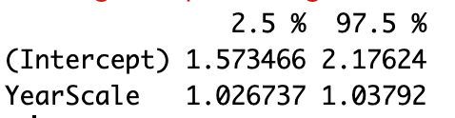
Worksheet!
Exercise 4 hint: remember to run exp(…) on your estimate. You can run exp(confint(…)) to get your 95% confidence intervals too!
In this case the 95% CIs of Intercept at 1.6 and 2.2

Slide 64
WWF Report Reminders!
Due Next Friday
MAKE SURE you push your edits to the repo (check in the web browser that it looks right). Make sure you haven’t manually forked your repo
We will be discussing data representativeness next week, and thinking about biases in your data. We want you to talk about this in your report, so make sure you come to class! (We’ll allow some time for report updating)
I’ll extend repos that have extensions, good to let me know to be safe

