Slide 1
Linear Models 4
Does my model represent reality?
Data Science
Week 8

Slide 2
First up
Impress my Nieces Winner!
Class in Two Parts

Slide 3
Impress my Nieces!

Slide 4
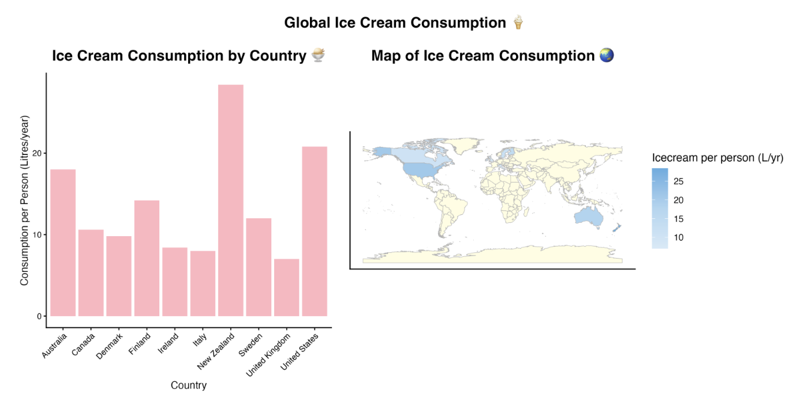
Impress my Nieces!

Slide 5
“All models are wrong,
some are useful”
A model is not a wizard. It does not magically reveal things in the data that aren’t already there.
It’s just a means of simplifying and summarizing relationships.
Interpret with care!!!

Slide 6
Interpreting Models
We’ve discussed how to interpret what the model says
You can have a *perfect* model
But what if it doesn’t represent reality right?

Slide 7
Class in Two Parts!
First, we’re going to think about confounding factors. This is NOT especially relevant for your WWF report, and I don’t want you to stress trying to apply it.
Second, we’re going to think about data biases and representativeness. This IS relevant for your WWF report, and we’ll use the activity time for you to apply the thinking.

Slide 8
Interpreting Models
Today: no maths, no numbers (just some graphs)
Grounding back to reality

Slide 9
Interpreting Models
Today: no maths, no numbers (just some graphs)
Grounding back to reality
CRUCIAL to being a good statistician (/person in the world)

Slide 10
Models can lie… easily
Y
X

Slide 11
Models can lie… easily
Strong correlation between X and Y?
Y
X

Slide 12
Models can lie… easily
Y
X

Slide 13
Models can lie… easily
No correlation between X and Y
Y
X

Slide 14
‘Simpson’s Paradox’
Y
X

Slide 15
‘Simpson’s Paradox’
Y
X

Slide 16
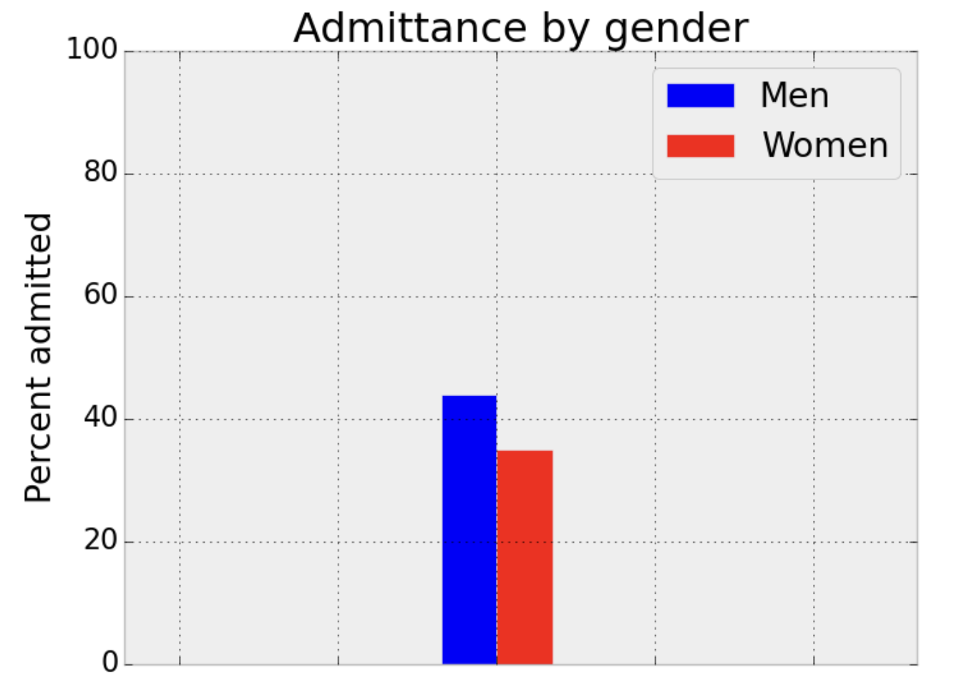
‘Simpson’s Paradox’
Most classic example from Berkley:
Thanks to http://corysimon.github.io/articles/simpsons-paradox/ for graphs

Slide 17
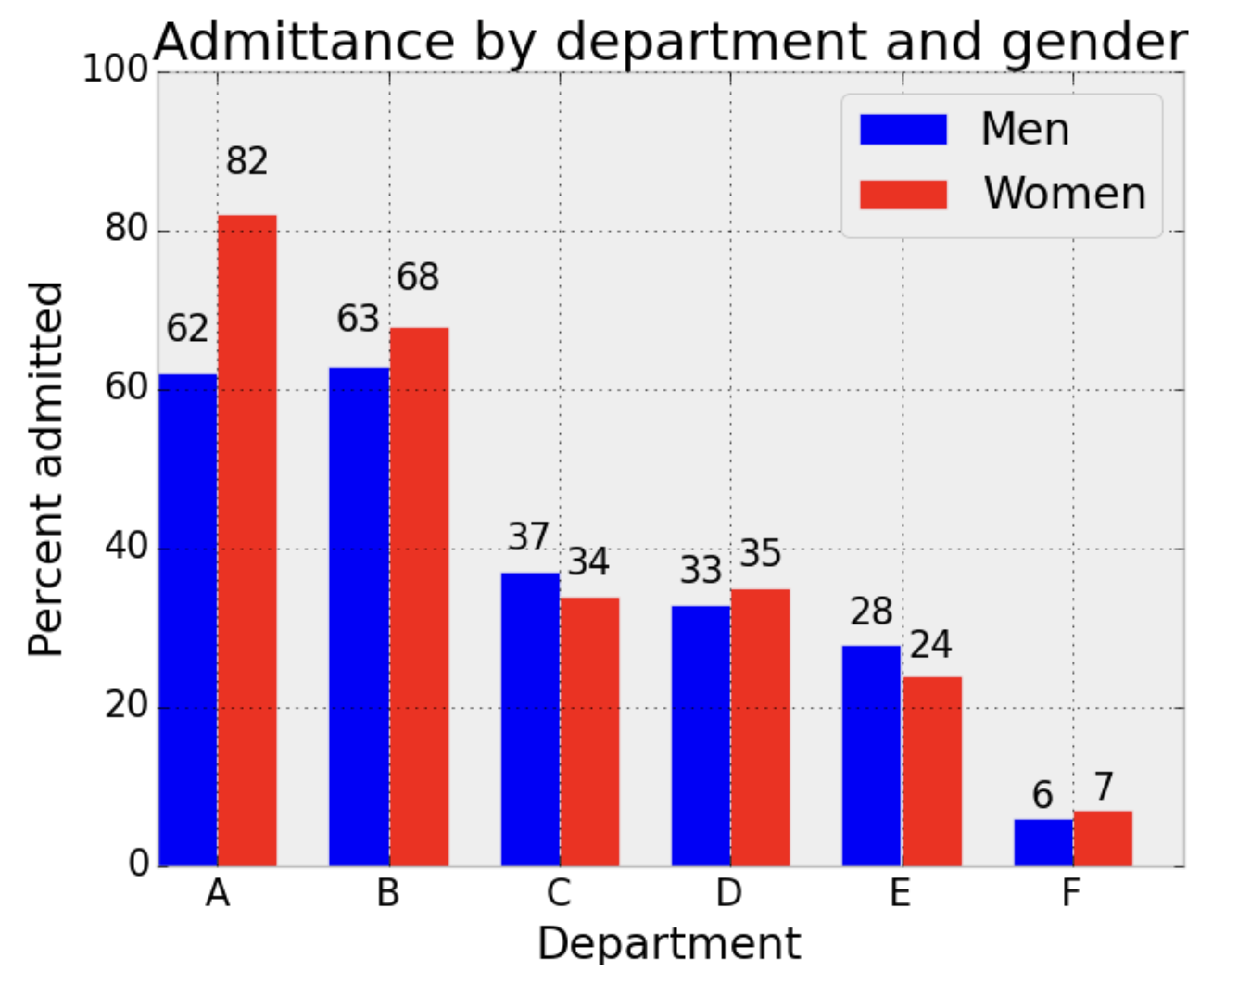
‘Simpson’s Paradox’
Most classic example from Berkley:
Thanks to http://corysimon.github.io/articles/simpsons-paradox/ for graphs

Slide 18
‘Simpson’s Paradox’
At its core: we have failed to account for ‘confounding factors’ in our data

Slide 19
Here’s another example…
Remember our penguin data?

Slide 20
Models can lie… easily
I browsed a book from a divorce lawyer in the train station the other day…
“Couples counselling doesn’t work. Every couple I’ve seen in my office that decides to try counselling ends up back here a few months later”

Slide 21
Models can lie… easily
“How likely are arguing couples to get divorced, based on whether or not they have counselling?
Chance of Divorce
Did Counselling
Didn’t do counselling

Slide 22
Models can lie… easily
“How likely are arguing couples to get divorced, based on whether or not they have counselling?
What are we missing??
Chance of Divorce
Did Counselling
Didn’t do counselling

Slide 23
Models can lie… easily
“How likely are arguing couples to get divorced, based on whether or not they have counselling?
Tried counselling before/after deciding to speak to a divorce lawyer
Chance of Divorce
After
Before
Did Counselling
Didn’t do counselling

Slide 24
Models can lie… easily
“How likely are arguing couples to get divorced, based on whether or not they have counselling?
Chance of Divorce
Did Counselling
Didn’t do counselling

Slide 25
‘Selection Bias’
We have added considered only one group in our data, but in this case we SHOULDN’T have had groups
(when we want to know about the effectiveness of couples counselling, we want to know for couples in general, not couples that have or haven’t spoken to a divorce lawyer first)

Slide 26
Your Turn

Slide 27
Temperature is a confounding factor (it affects both how much ice cream we eat and whether we’re sunburnt)

Slide 28
Temperature is a confounding factor (it affects both how much ice cream we eat and whether we’re sunburnt)
Age is a confounding factor (it affects both a child’s height, and their reading ability)
Literacy
Height

Slide 29
Temperature is a confounding factor (it affects both how much ice cream we eat and whether we’re sunburnt)
Age is a confounding factor (it affects both a child’s height, and their reading ability)
Literacy
Data grouped by age
Height

Slide 30
3. Confounding factor: We haven’t considered bird abundance *before* the sites were protected. What if bird abundances were already high in those areas, and that’s why we decided to protect them?

Slide 31
4. Selection Bias: we are only considering NBA players. Why might someone get into the NBA? The number of hoops they shoot – we’ve artificially sliced the data

Slide 32
4. Selection Bias: we are only considering NBA players. Why might someone get into the NBA? The number of hoops they shoot – we’ve artificially sliced the data
Avg Hoops per Game
Height

Slide 33
4. Selection Bias: we are only considering NBA players. Why might someone get into the NBA? The number of hoops they shoot – we’ve artificially sliced the data
Avg Hoops per Game
Height

Slide 34
5. Confounder: Fishing pressure is the obvious confounder. It makes no sense that more fish can come from less habitat, unless fishing was SO intense in the early years that it kept fish numbers way below what the environment could support

Slide 35
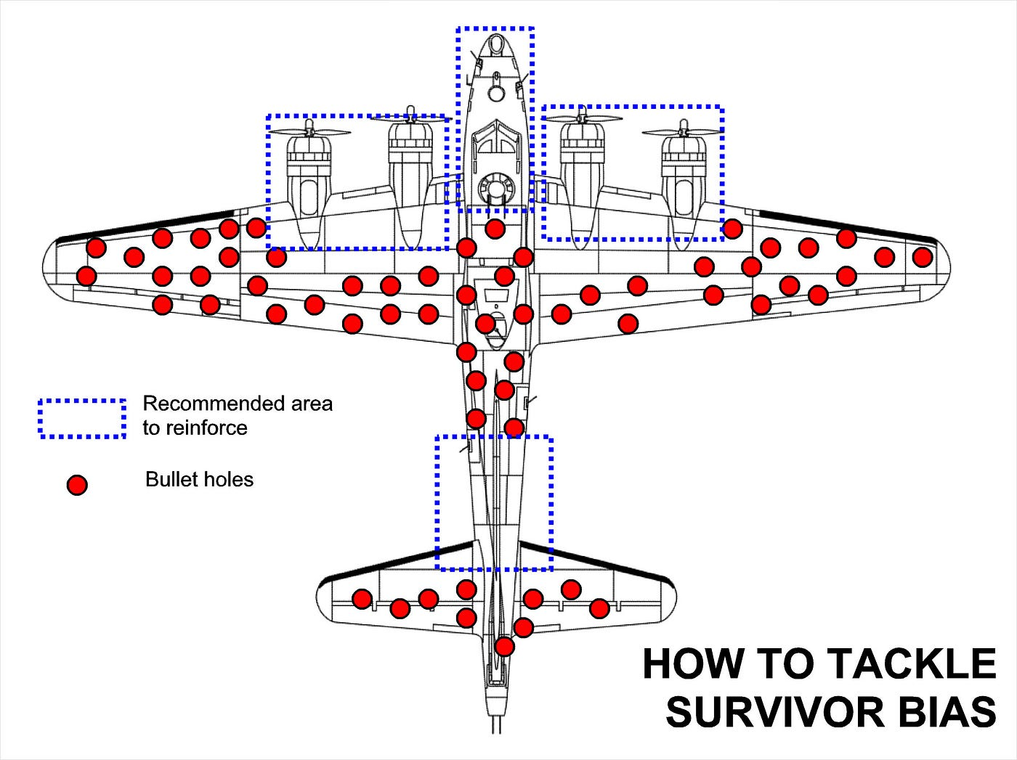
6. Selection Bias: They were only considering planes that survived! This is ‘survivorship bias’. They need to consider where there weren’t bullet holes in the returning planes – this is the areas that are weak and clearly causing the others to crash

Slide 36
Correlation Does Not Equal Causation

Slide 37
Correlation Does Not Equal Causation
Why not? Because we’re missing important factors

Slide 38
Correlation Does Not Equal Causation
What’s normally the solution in Science to this problem?

Slide 39
Correlation Does Not Equal Causation
Randomised Controlled Trial

Slide 40
Trusting your Model
What if we can’t do a randomized controlled trial?
What if we have (or are collecting) observational data, but want to understand likely causal relationships anyway?
How do we know which groups to control for, and which groups we *shouldn’t* select for?

Slide 41
Trusting your Model
What if we can’t do a randomized controlled trial?
What if we have (or are collecting) observational data, but want to understand likely causal relationships anyway?
How do we know which groups to control for, and which groups we *shouldn’t* select for?
It alllll relies on your common sense, logic, and your knowledge of the system

Slide 42

Causal Inference
If correlation isn’t causation, what is?
Field emerged in part from the ‘Great Smoking Debate’
Does smoking cause cancer? How do we test this?

Slide 43
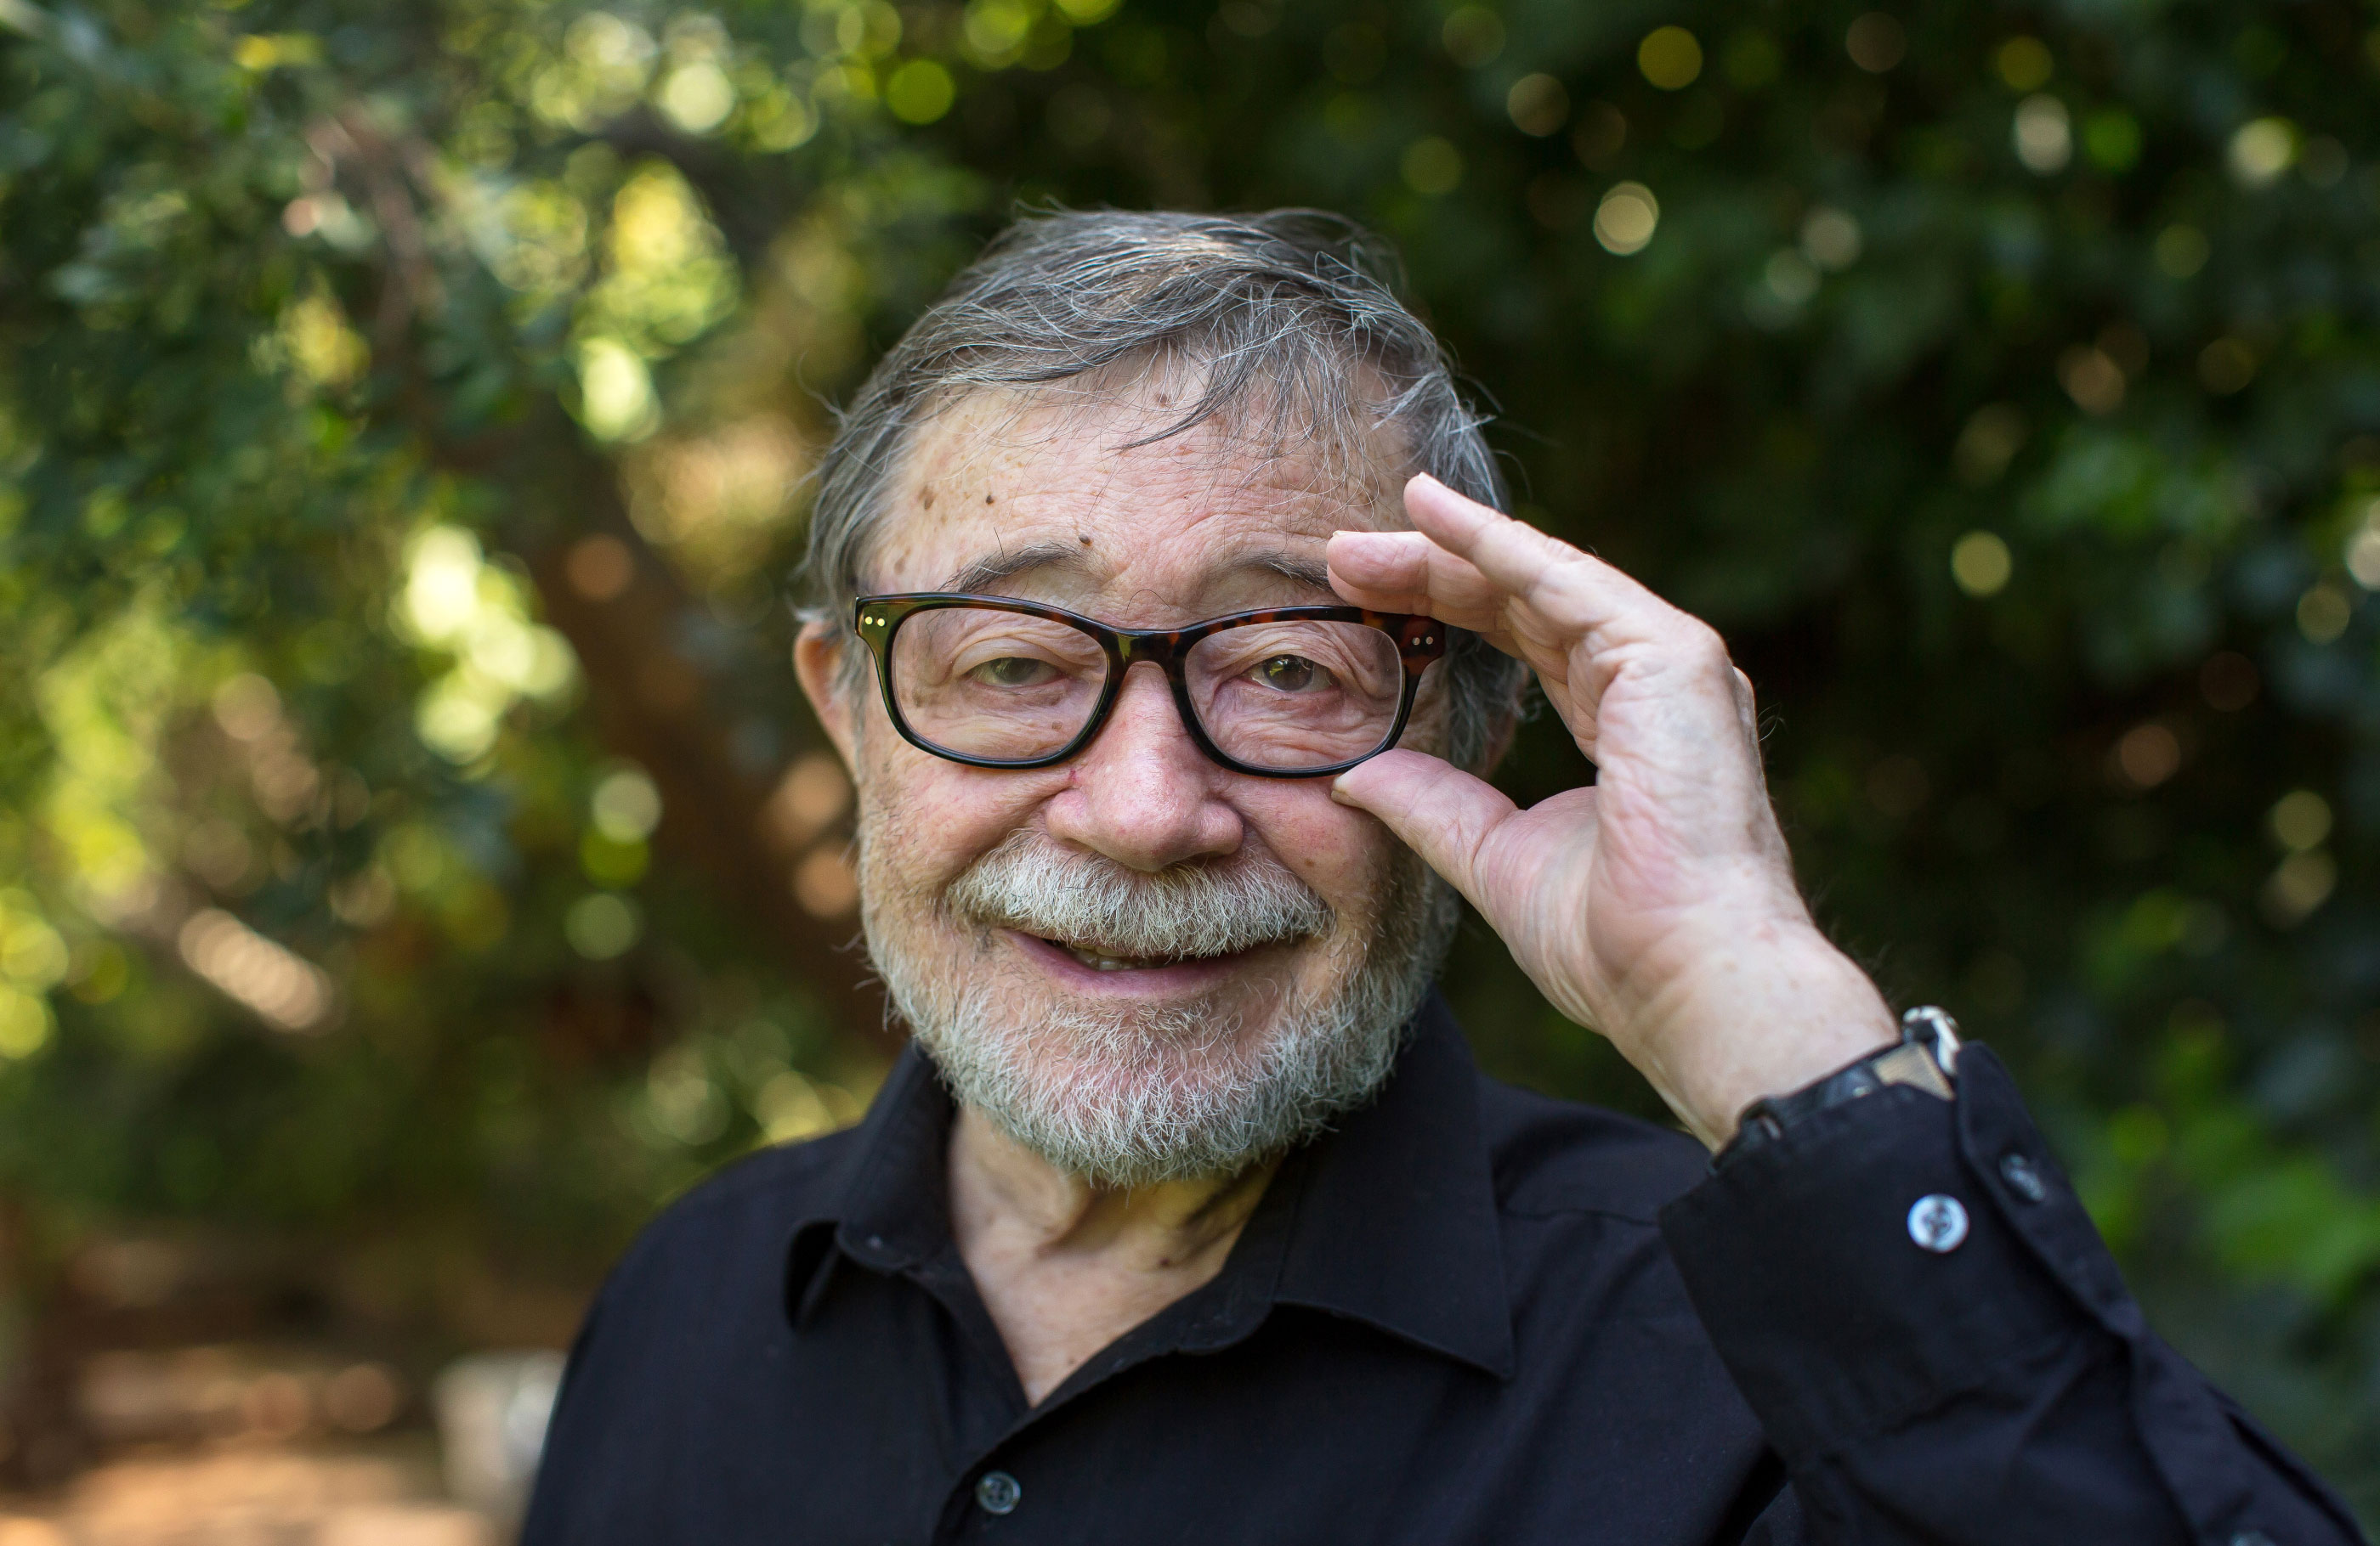
Causal Inference
Developed by Judea Pearl →
General idea: if you control for the right set of variables, you can make causal inferences from non-experimental data

Slide 44
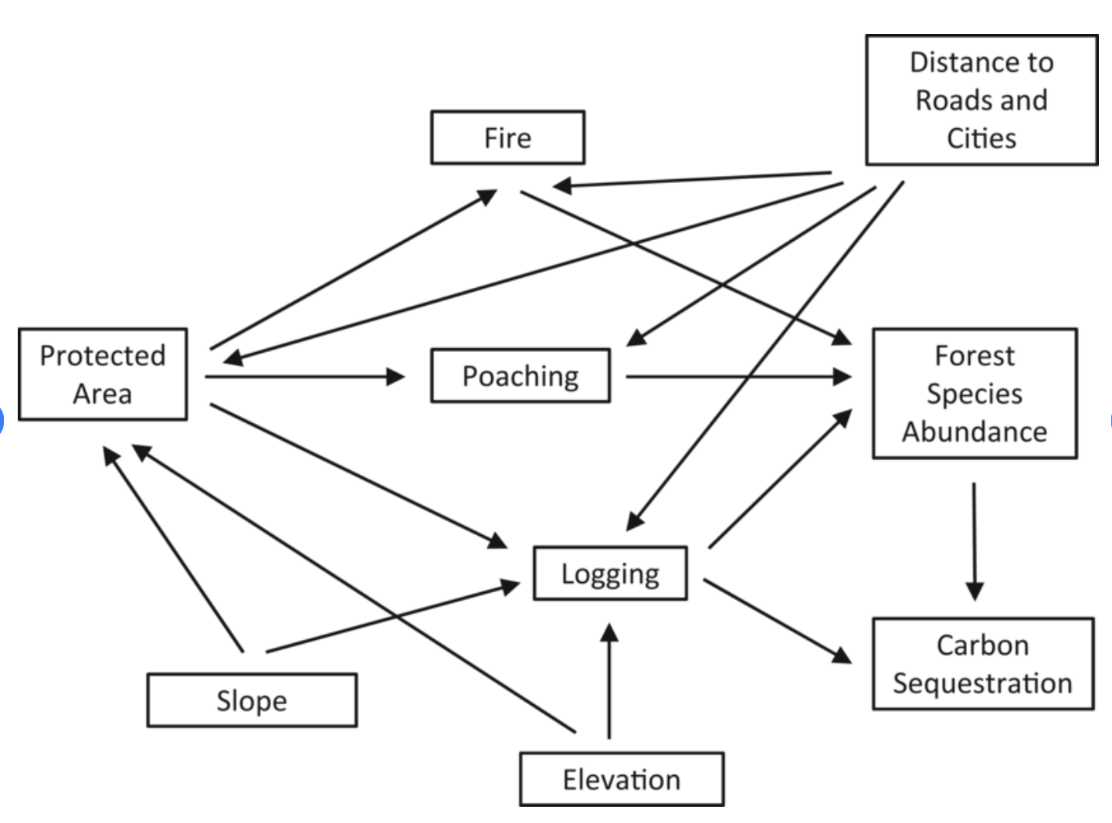
Causal Inference
Developed by Judea Pearl →
General idea: if you control for the right set of variables, you can make causal inferences from non-experimental data
Relies on scientific reasoning and judgement to draw ‘causal diagrams’

Slide 45
Causal Inference
“Two people who believe in two different causal diagrams can analyse the same data and never come to the same conclusion, regardless of how ‘big’ the data are. That is a terrifying prospect for advocates of scientific objectivity”
Judea Pearl (‘The Book of Why’)

Slide 46
Causal Inference
This has been developing since the 70s
But – exciting times in ecology – we’re only just cottoning on!
(If you were studying psychology or social science you likely would’ve been taught this early on)

Slide 47

Causal Inference
If you want to learn more, this book is brilliant

Slide 48
Why should I care?
You need to stay CRITICAL of any statistics you see. Even in top papers!

Slide 49
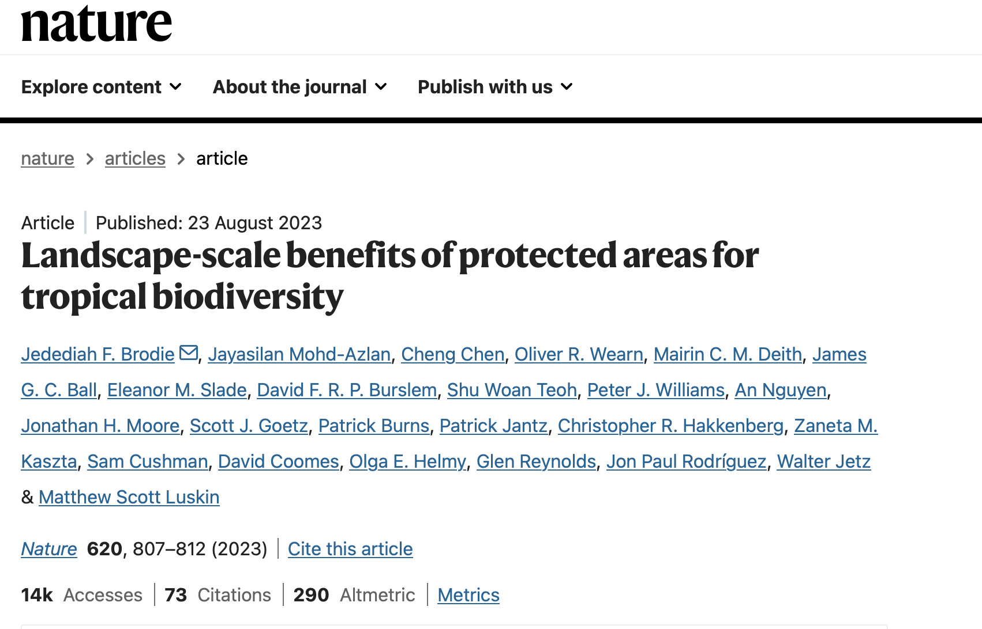
Why should I care?
You need to stay CRITICAL of any statistics you see. Even in top papers!

Slide 50
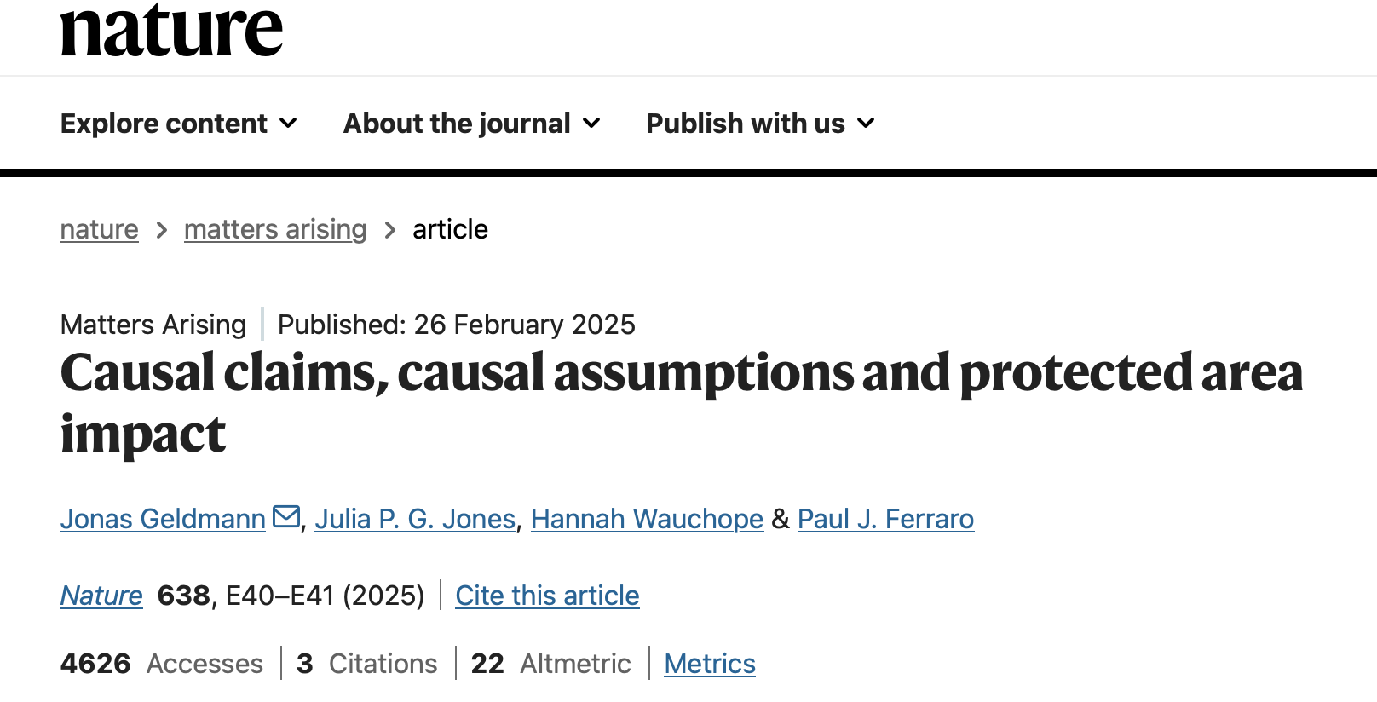
Why should I care?
You need to stay CRITICAL of any statistics you see. Even in top papers!

Slide 51
Why should I care?
Be really careful when you run models, especially if you’re using lots of predictor variables
“p-hacking”
“Hypothesising After Results are Known” (HARKing)

Slide 52
Why should I care?
Be really careful when you run models, especially if you’re using lots of predictor variables
“p-hacking”
“Hypothesising After Results are Known” (HARKing)
Throwing a tonne of variables into a model can mean you accidentally make your model reveal relationships that aren’t real

Slide 53
What should I do
Any time you’re doing a study that isn’t experimental:
Define your question very clearly
Think very clearly about what variables could affect your conclusions
Think very clearly about which variables you include a model, and have clear reasons for why you think each is important
Do *not* just test a bunch of models and pick the one that gives you the result you like the most (and try not to even look at results until you’re decided on a final model!)

Slide 54
What should I do
Be critical in your every-day life! Of stats on the news! ESPECIALLY if it tugs at your emotions – that switches your critical brain off and makes it way more likely you will fall prey to false claims
Think “what is this stat missing” “which data is in the sample?” “are there potential biases?”

Slide 55
BREAK

Slide 56
Data Representativeness
You guys have been working with the Living Planet Database
It is an aggregate of smaller studies, not a systematic survey

Slide 57
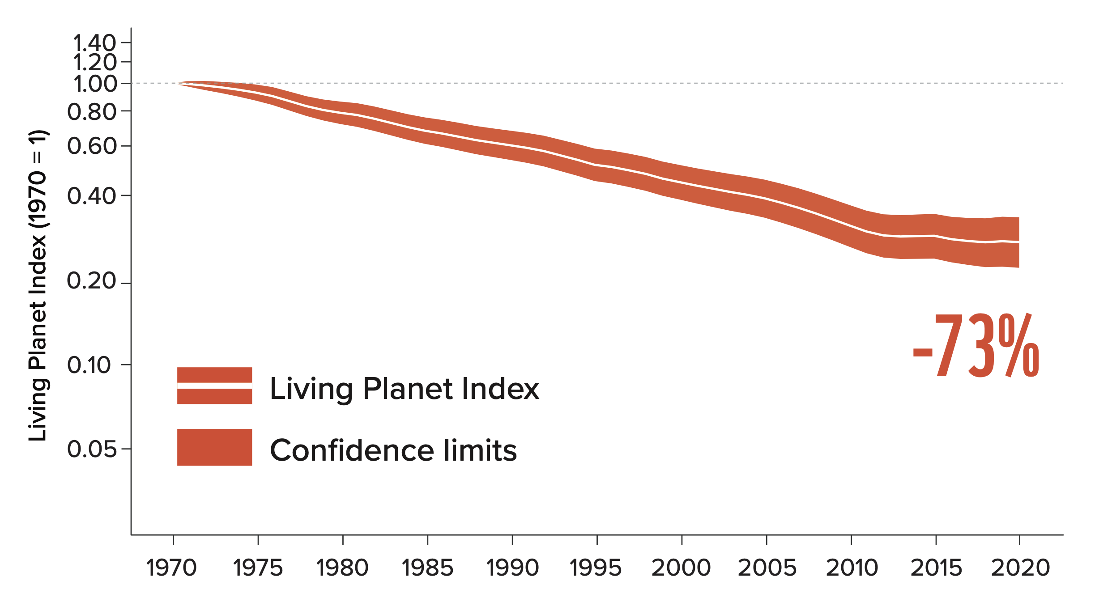
Data Representativeness
You guys have been working with the Living Planet Database

Slide 58
Data Representativeness
This number is quoted EVERYWHERE

Slide 59
Data Representativeness
Thoughts?

Slide 60
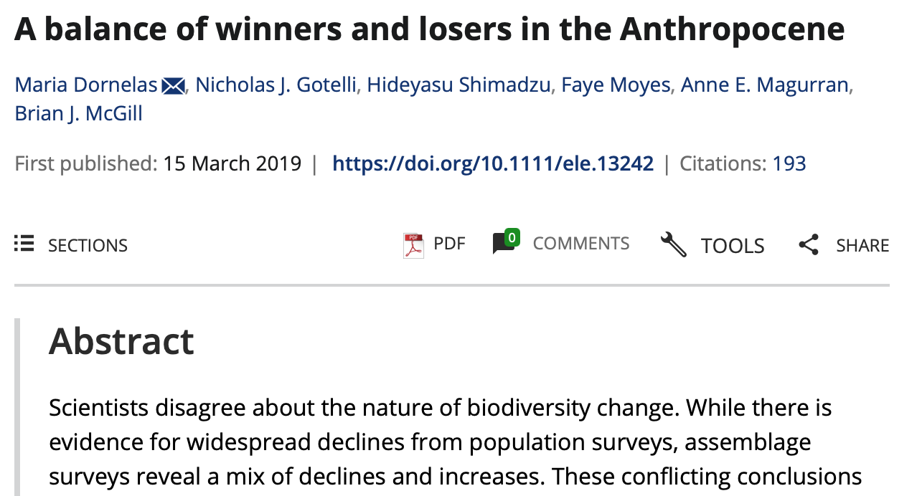
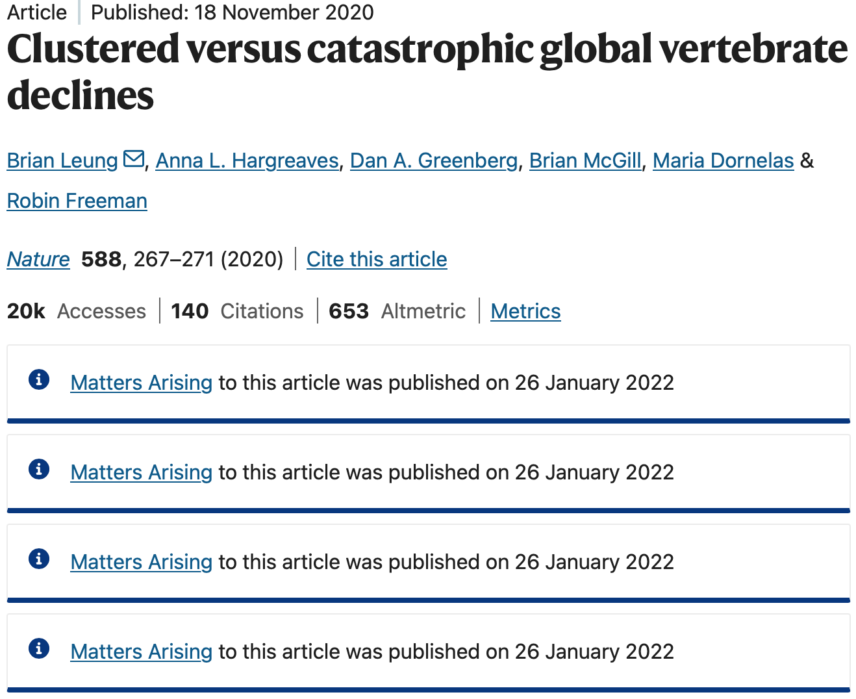
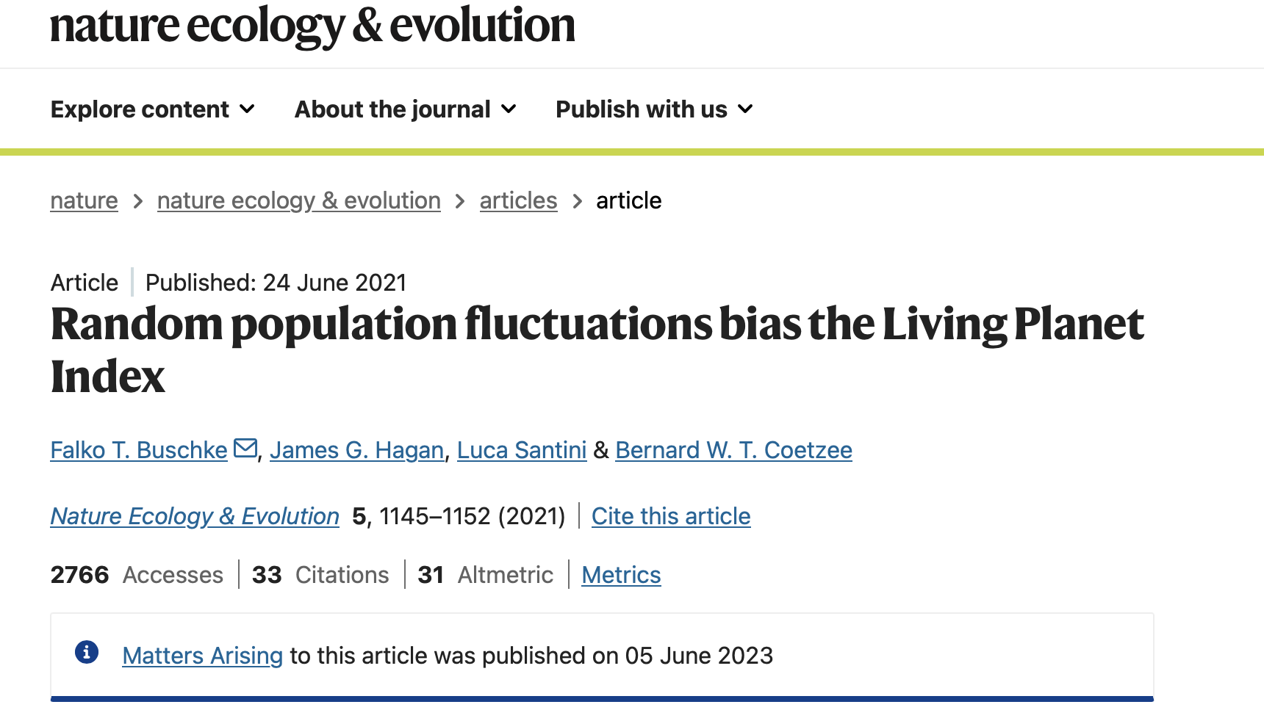
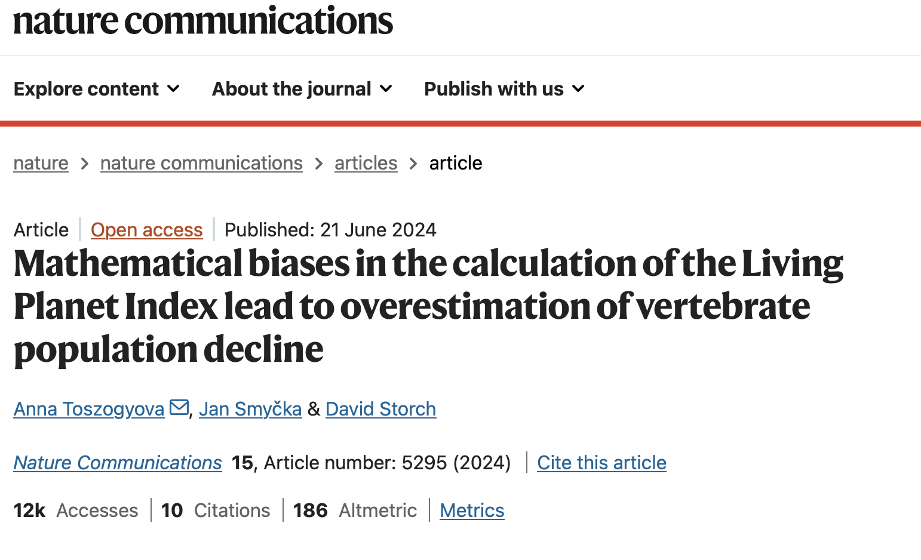
There have been a number of challenges

Slide 61
There have been a number of challenges
What does the data *actually* show?

Slide 62
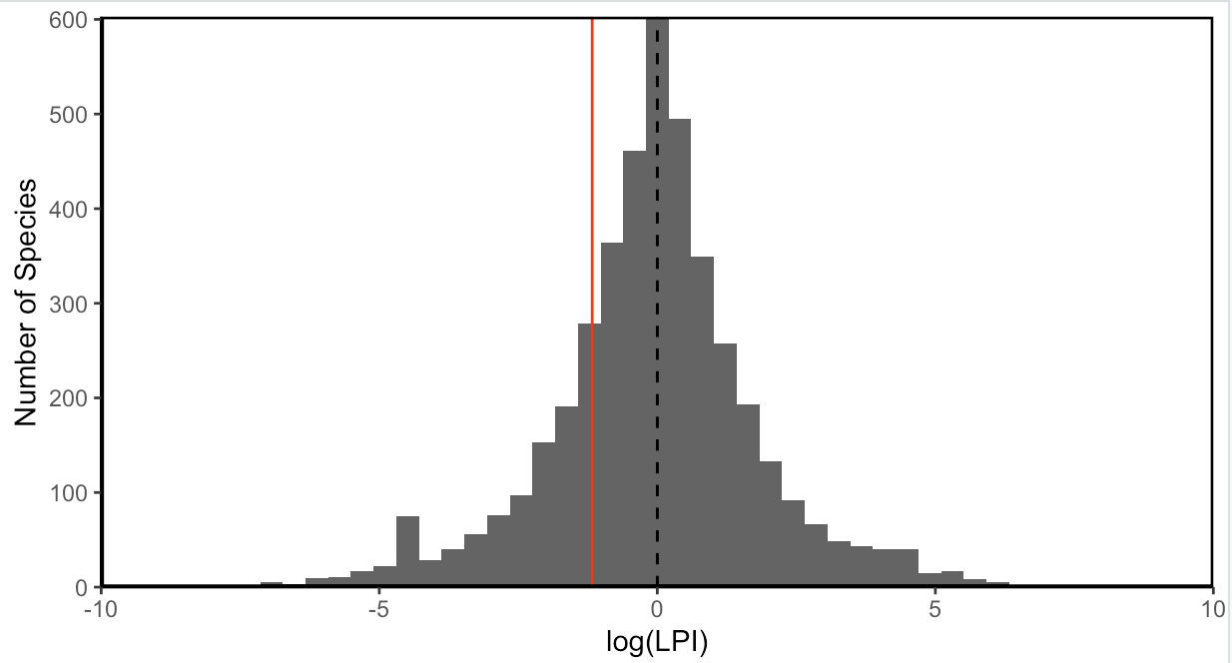
What does the data show?

Slide 63
Does that represent what’s going on in the world?

Slide 64
When are we likely to collect data on a population?

Slide 65
Have we representatively sampled every species?

Slide 66
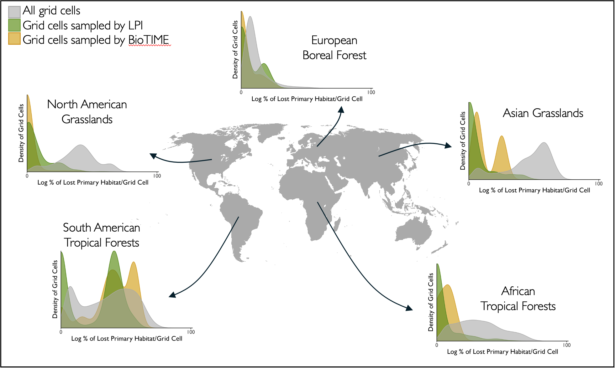
Are we sampling intact habitat more?

Slide 67
Your Turn – For your WWF Species…
Where do you have data from? (If you have lots of populations, just look at which countries, if you have only a few you could google specific locations)
(Ask if you’ve deleted those columns and need a hand recovering)
Now, research your species. Where does it occur? How much of its range do you have data for?
Do NOT try and do formal analysis/collect data. But do do some more research and thinking. How likely is it that the areas you do have data for are representative of the total range of your species?
Include 2-3 sentences discussing this in your report! Use them to warn (or reassure!) WWF about how likely it is that the data and model you’re using represent the species overall.
1hr for this, after that I’ll introduce the Tutorial Assignment, and then you can use the rest of class to keep working on this/ask Qs about WWF report

Slide 68
Final Assessments (Tutorial 40% + Reflection 20%)
Create a Coding Club Tutorial (40%). We will release a repo with full instructions.
Write a 500 word reflection about your experience on this course (20%)
Submission: Submit a word doc with two parts. First – the URL to your tutorial, then the Reflection.

Slide 69
Tutorial
On a topic of your choice (at a level that would teach someone who has taken this course something new).
Structure like the ‘Coding Club’ tutorials (example links in repo)
3-5 Learning Objectives, each taking ~10mins to complete (no word limit, but don’t make it crazy long – that would be a bad tutorial!)

Slide 70
Tutorial - Criteria
Topic and Structure (20%) - Have you picked an appropriate, cohesive topic, with the right number of learning objectives?
Content (40%) - Have you written clearly and with good structure, have you explained concepts clearly, can the reader follow along easily with access to all data/code etc?
Creativity (40%) - Have you made full use of the web format, markdown, and images to produce a tutorial that is visually attractive, and teaches in creative ways?

Slide 71
Tutorial - Criteria
Read the marking rubric in detail! This is what we mark to!!

Slide 72
Reflection
Personal
How has course content shaped your understanding of critical skills, ethical perspectives and/or analytical approaches? (Challenged assumptions, broadened insights, new ways to problem solve, new ways of thinking about data)
Have you developed new ways of thinking? In what ways?
Talk about the past and the future (why is what you’ve learnt particularly relevant given your past, and how will you take what you’ve learnt into the future)

Slide 73
Reflection
Use *specific* examples (from the course, and your life)
Concise, formal, writing (Think a ‘think piece’ in the newspaper)
BUT don’t get too technical! Write to an educated, but NON data-science-specialist audience. If you reference technical points, explain them.
(Your friend who’s studying e.g. law or business should be able to understand.)

Slide 74
Reflection
We do not release a repo for this – just write in a word doc and submit to learn!
(Be sure to include your tutorial link at the start of the doc)

Slide 75
Reflection - Criteria
Connections (25%) – Have you connected specific course topics to development of your own thinking/skills
Relevance (25%) – Have you made it clear why this is personal? Why is what you’re talking about particularly relevant to you? (e.g. connect to past experiences)
Impact (25%) – How will what you’ve learnt affect your future? Will you take new ways of thinking forward into your degree/career/life?
Clarity (25%) – Have you written clearly and professionally, and explained concepts well to a non-expert?

Slide 76
Reflection - Criteria
Read the marking rubric in detail! This is what we mark to!!

