Slide 1
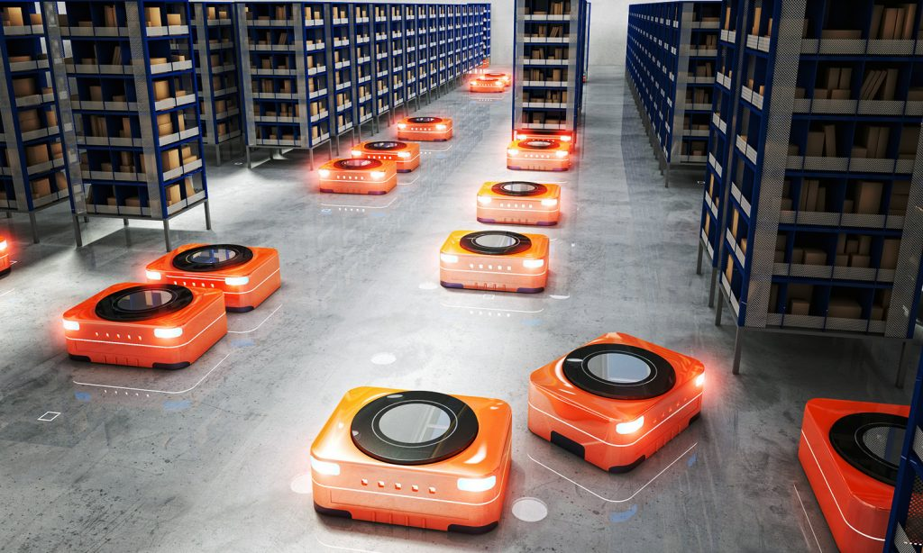




PERR – Package-Exchange Robot-Routing Problem
By: Hanna Keller
Based on the paper:
“Multi-Agent Path Finding with Payload Transfers and the Package-Exchange Robot-Routing Problem” by Hang Ma, Craig Tovey, Guny Sharon, T. K. Satish Kumar and Sven Koenig

Slide 2
Overview
Motivation | 1
Package-Exchange Robot-Routing Problem (PERR) definition | 2
proof that PERR is NP-hard to approximate within any factor less than 4/3 for makespan minimization and NP-hard to solve for flowtime minimization | 3
experimental results | 4
Summary and conclusions | 5
Future R&D | 6

Slide 3

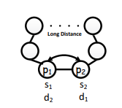
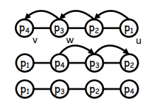
Motivation

Slide 4

Package-Exchange Robot-Routing Problem (PERR) – formal definition
$G=(V,E)$ (undirected connected graph)
M packages $\left\{p_{1},p_{2},…,p_{M}\right\}$
$s_{i}$ - the source vertex of the package $p_{i}$
$d_{i}$ - the destination vertex of the package $p_{i}$

Slide 5

Package-Exchange Robot-Routing Problem (PERR) - definition
$l_{i}$(t) - the vertex of $p_{i}$ at time t = 0 ... ∞
Plan - assigns a function $l_{i}$ to each package $p_{i}$
Solution - a plan that satisfies the following conditions:
For all packages i, $l_{i}$(0) = $s_{i}$
For all packages i, there exists a time $T_{i}^{end}$ such that, for all times t = $T_{i}^{end}$ ... ∞, $l_{i}$(t) = $d_{i}$ ($T_{i}^{end}$ is the smallest such time)
For all packages i and all times t, (${l_{i}\text{(}\text{t}\text{)}\text{,}l}_{i}$(t+1)) ∈ E or $l_{i}$(t) = $l_{i}$(t+1)
For all pairs of different packages i and j and all times t, $l_{i}$(t) ≠ $l_{j}$(t)

Slide 6

Package-Exchange Robot-Routing Problem (PERR) - definition
Makespan - the time in which the last package reaches its destination, therefore the makespan of a solution is $\max_{i}$( $T_{i}^{end}$).
flowtime - the sum of the times when each package reaches its destination, so the flowtime of the solution is $\sum_{i}{T_{i}^{end}}$ .
Package exchange - two packages $p_{i}$ and $p_{j}$ can be exchanged in a single time step:
If they are at adjacent vertices.
Formally, $l_{i}\text{(}\text{t}\text{)}=l_{j}\text{(}\text{t}\text{+}\text{1}\text{)}$ and $l_{j}\text{(}\text{t}\text{)}=l_{i}\text{(}\text{t}\text{+}\text{1}\text{)}$ at the corresponding time t.

Slide 7
All PERR instances are solvable! Solutions with polynomial makespans and flowtimes can be found in polynomial time!

Slide 8

Proof:
we assume that all vertices are initially occupied by robots carrying packages.
Let <u . . . w, v> be a shortest path from u to v, where w is the vertex on the path directly before v.
Any two packages $p_{i}$ and $p_{j}$ can switch vertices without affecting the vertices of the other packages:
A series of exchange operations along this path moves $p_{i}$ to v (in at most |V|−1 time steps).
A series of exchange operations against the path <u...w> then moves $p_{j}$ to u and every other package on this path back to its original vertex (in at most |V|−2 time steps).

Slide 9
Proof:
Letting two packages switch vertices takes at most (|V| − 1) + (|V| − 2) = 2|V| − 3 time steps.
all packages can be routed to their destination vertices one at a time.
The algorithm performs only a polynomial number of operations.
The makespans and flowtimes of the resulting solutions are also polynomial! □

Slide 10
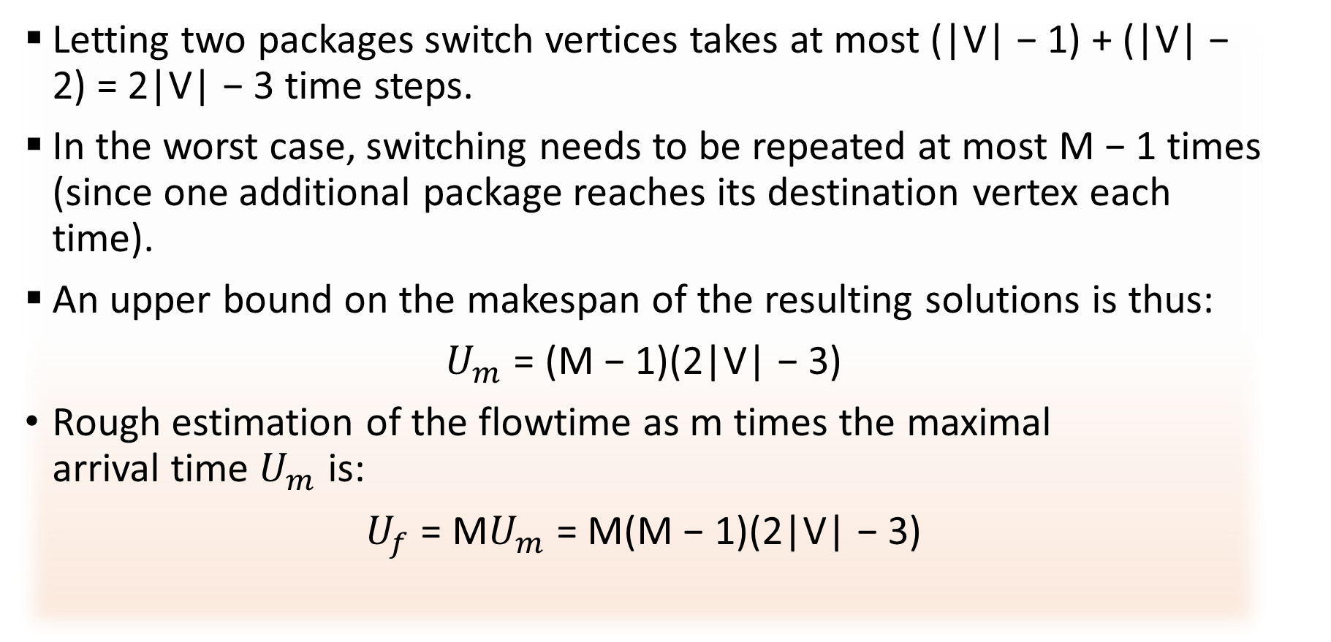
upper bounds:
Letting two packages switch vertices takes at most (|V| − 1) + (|V| − 2) = 2|V| − 3 time steps.
In the worst case, switching needs to be repeated at most M − 1 times (since one additional package reaches its destination vertex each time).
An upper bound on the makespan of the resulting solutions is thus:
$U_{m}$ = (M − 1)(2|V| − 3)
Rough estimation of the flowtime as m times the maximal arrival time $U_{m}$ is:
$U_{f}$ = M$U_{m}$ = M(M − 1)(2|V| − 3)

Slide 11

PERR is NP-hard to approximate within any factor less than $\frac{4}{3}$ for makespan minimization and NP-hard to solve for flowtime minimization

Slide 12
3-SAT problem: reminder
3SAT is the set of satisfiable boolean expressions that are expressed in 3CNF.
For an expression to be in 3CNF form, it must satisfy two constraints:
The expression is made up of ANDed together clauses, which themselves are made up of ORred together literals.
Each clause contains at most 3 literals: there can be any number of clauses ANDed together, but there can only be one, two or three literals in each clause.
The decision question asks if the expression is satisfiable.
Example: ($x_{1}$ ∨ $x_{2}$∨ $x_{3}$)∧($x_{4}$∨ ¬$x_{2}$)

Slide 13

≤3,=3-SAT problem
n boolean variables $X_{1}…X_{n}$.
m disjunctive clauses $C_{1}$ ... $C_{m}$.
Each variable appears in exactly three clauses.
Each variable is uncomplemented at least once.
Each variable is complemented at least once.
Each clause contains at most three literals.
The decision question asks whether the instance is satisfiable.
There is a simple randomized algorithm due to Schöning (1999) that runs in time ${(\frac{4}{3})}^{n}$ where n is the number of variables in the 3-SAT proposition, and succeeds with high probability to correctly decide 3-SAT.
Example: (${\text{¬}x}_{1}$ ∨ $x_{2}$∨ $x_{3}$)∧(¬$x_{2}$) ∧($x_{1}$∨ ¬$x_{3}$) ∧($x_{1}$∨ ¬$x_{2}$ ∨ $x_{3}$)

Slide 14

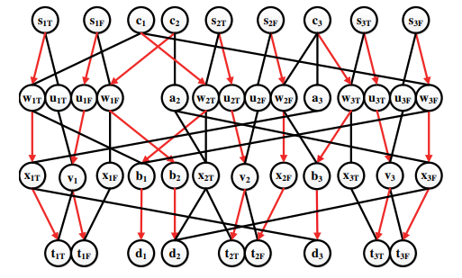
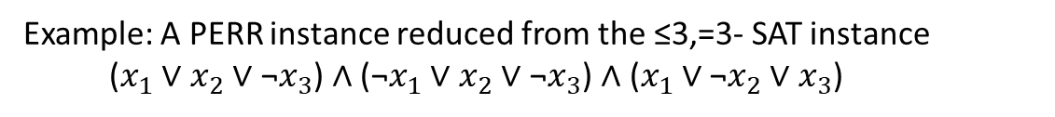
We will construct a PERR instance that has a solution with makespan=3 if and only if a given ≤3,=3-SAT instance is satisfiable
Example: A PERR instance reduced from the ≤3,=3- SAT instance ($x_{1}$ ∨ $x_{2}$∨ ${\text{¬}x}_{3}$) ∧ (${\text{¬}x}_{1}$ ∨ $x_{2}$∨ $\text{¬}x_{3}$) ∧ ($x_{1}$ ∨ ${\text{¬}x}_{2}$∨ $x_{3}$)

Slide 15


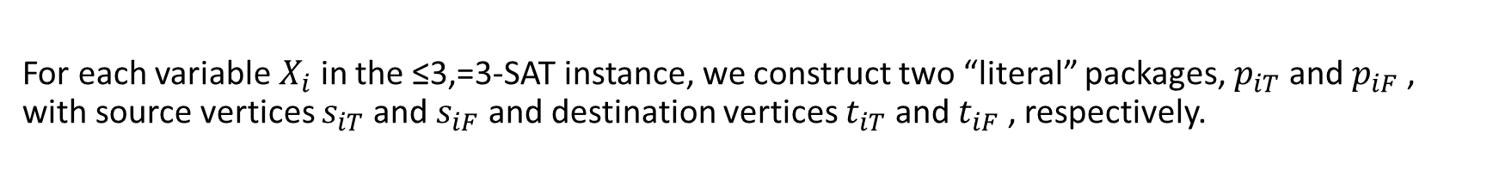










For each variable $X_{i}$ in the ≤3,=3-SAT instance, we construct two “literal” packages, $p_{iT}$ and $p_{iF}$ , with source vertices $s_{iT}$ and $s_{iF}$ and destination vertices $t_{iT}$ and $t_{iF}$ , respectively.
$$s_{1T}$$
$$s_{1F}$$
$$s_{2T}$$
$$s_{2F}$$
$$s_{3T}$$
$$s_{3F}$$
$$t_{1T}$$
$$t_{1F}$$
$$t_{2T}$$
$$t_{2F}$$
$$t_{3T}$$
$$t_{3F}$$
≤3,=3-SAT instance: ($x_{1}$ ∨ $x_{2}$∨ ${\text{¬}x}_{3}$) ∧ (${\text{¬}x}_{1}$ ∨ $x_{2}$∨ $\text{¬}x_{3}$) ∧ ($x_{1}$ ∨ ${\text{¬}x}_{2}$∨ $x_{3}$)

Slide 16

































For each literal package, we construct two paths to get to its destination vertex in three time steps: a “shared” path, and a “private” path.
Private path
$$s_{1T}$$
$$s_{1F}$$
$$s_{2T}$$
$$s_{2F}$$
$$s_{3T}$$
$$s_{3F}$$
Shared path
$$w_{1T}$$
$$u_{1T}$$
$$u_{1F}$$
$$w_{1F}$$
$$w_{2T}$$
$$u_{2T}$$
$$u_{2F}$$
$$w_{2F}$$
$$w_{3T}$$
$$u_{3T}$$
$$u_{3F}$$
$$w_{3F}$$
$$x_{1T}$$
$$v_{1}$$
$$x_{1F}$$
$$x_{2T}$$
$$v_{2}$$
$$x_{2F}$$
$$x_{3T}$$
$$v_{3}$$
$$x_{3F}$$
$$t_{1T}$$
$$t_{1F}$$
$$t_{2T}$$
$$t_{2F}$$
$$t_{3T}$$
$$t_{3F}$$
≤3,=3-SAT instance: ($x_{1}$ ∨ $x_{2}$∨ ${\text{¬}x}_{3}$) ∧ (${\text{¬}x}_{1}$ ∨ $x_{2}$∨ $\text{¬}x_{3}$) ∧ ($x_{1}$ ∨ ${\text{¬}x}_{2}$∨ $x_{3}$)

Slide 17



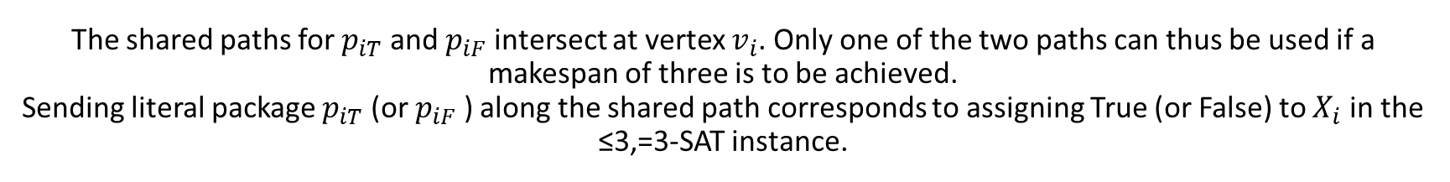
The shared paths for $p_{iT}$ and $p_{iF}$ intersect at vertex $v_{i}$. Only one of the two paths can thus be used if a makespan of three is to be achieved. Sending literal package $p_{iT}$ (or $p_{iF}$ ) along the shared path corresponds to assigning True (or False) to $X_{i}$ in the ≤3,=3-SAT instance.
Private path
$$s_{1T}$$
$$s_{1F}$$
$$s_{2T}$$
$$s_{2F}$$
$$s_{3T}$$
$$s_{3F}$$
Shared path
$$w_{1T}$$
$$u_{1T}$$
$$u_{1F}$$
$$w_{1F}$$
$$w_{2T}$$
$$u_{2T}$$
$$u_{2F}$$
$$w_{2F}$$
$$w_{3T}$$
$$u_{3T}$$
$$u_{3F}$$
$$w_{3F}$$
$$x_{1T}$$
$$v_{1}$$
$$x_{1F}$$
$$x_{2T}$$
$$v_{2}$$
$$x_{2F}$$
$$x_{3T}$$
$$v_{3}$$
$$x_{3F}$$
$$t_{1T}$$
$$t_{1F}$$
$$t_{2T}$$
$$t_{2F}$$
$$t_{3T}$$
$$t_{3F}$$
≤3,=3-SAT instance: ($x_{1}$ ∨ $x_{2}$∨ ${\text{¬}x}_{3}$) ∧ (${\text{¬}x}_{1}$ ∨ $x_{2}$∨ $\text{¬}x_{3}$) ∧ ($x_{1}$ ∨ ${\text{¬}x}_{2}$∨ $x_{3}$)

Slide 18







For each clause $C_{j}$ in the ≤3,=3-SAT instance, we construct a “clause” package $p_{j}$ with source vertex $c_{j}$ and destination vertex $d_{j}$ .
Private path
$$s_{1T}$$
$$s_{1F}$$
$$c_{1}$$
$$c_{2}$$
$$s_{2T}$$
$$s_{2F}$$
$$c_{3}$$
$$s_{3T}$$
$$s_{3F}$$
Shared path
$$w_{1T}$$
$$u_{1T}$$
$$u_{1F}$$
$$w_{1F}$$
$$w_{2T}$$
$$u_{2T}$$
$$u_{2F}$$
$$w_{2F}$$
$$w_{3T}$$
$$u_{3T}$$
$$u_{3F}$$
$$w_{3F}$$
$$x_{1T}$$
$$v_{1}$$
$$x_{1F}$$
$$x_{2T}$$
$$v_{2}$$
$$x_{2F}$$
$$x_{3T}$$
$$v_{3}$$
$$x_{3F}$$
$$t_{1T}$$
$$t_{1F}$$
$$d_{1}$$
$$d_{2}$$
$$t_{2T}$$
$$t_{2F}$$
$$d_{3}$$
$$t_{3T}$$
$$t_{3F}$$
≤3,=3-SAT instance: ($x_{1}$ ∨ $x_{2}$∨ ${\text{¬}x}_{3}$) ∧ (${\text{¬}x}_{1}$ ∨ $x_{2}$∨ $\text{¬}x_{3}$) ∧ ($x_{1}$ ∨ ${\text{¬}x}_{2}$∨ $x_{3}$)

Slide 19

























The ≤3,=3-SAT instance has multiple (but at most three) “clause” paths to get to its destination vertex in 3 time steps, which have a one-to-one correspondence to the literals in $c_{j}$.
Private path
$$s_{1T}$$
$$s_{1F}$$
$$c_{1}$$
$$c_{2}$$
$$s_{2T}$$
$$s_{2F}$$
$$c_{3}$$
$$s_{3T}$$
$$s_{3F}$$
Shared path
Clause path
$$w_{1T}$$
$$u_{1T}$$
$$u_{1F}$$
$$w_{1F}$$
$$w_{2T}$$
$$u_{2T}$$
$$u_{2F}$$
$$w_{2F}$$
$$w_{3T}$$
$$u_{3T}$$
$$u_{3F}$$
$$w_{3F}$$
$$x_{1T}$$
$$v_{1}$$
$$x_{1F}$$
$$b_{1}$$
$$x_{2T}$$
$$v_{2}$$
$$x_{2F}$$
$$x_{3T}$$
$$v_{3}$$
$$x_{3F}$$
$$t_{1T}$$
$$t_{1F}$$
$$d_{1}$$
$$d_{2}$$
$$t_{2T}$$
$$t_{2F}$$
$$d_{3}$$
$$t_{3T}$$
$$t_{3F}$$
≤3,=3-SAT instance: ($x_{1}$ ∨ $x_{2}$∨ ${\text{¬}x}_{3}$) ∧ (${\text{¬}x}_{1}$ ∨ $x_{2}$∨ $\text{¬}x_{3}$) ∧ ($x_{1}$ ∨ ${\text{¬}x}_{2}$∨ $x_{3}$)

Slide 20












Every literal $x_{i}$(or ${\text{¬}x}_{i}$) can appear in at most two clauses. If $c_{j}$ is the first clause that it appears in, then the clause path is < $c_{j}$ , $w_{iT}$ , $b_{j}$ , $d_{j}$ > (or < $c_{j}$ , $w_{iF}$ , $b_{j}$ , $d_{j}$ > ). If $c_{j}$ is the second clause that it appears in, a vertex $a_{j}$ is introduced and the clause path is instead < $c_{j}$ , $a_{j}$ , $x_{iT}$ , $d_{j}$ > (or < $c_{j}$ , $a_{j}$ , $x_{iF}$ , $d_{j}$ > ).
Private path
$$s_{1T}$$
$$s_{1F}$$
$$c_{1}$$
$$c_{2}$$
$$s_{2T}$$
$$s_{2F}$$
$$c_{3}$$
$$s_{3T}$$
$$s_{3F}$$
Shared path
Clause path
$$w_{1T}$$
$$u_{1T}$$
$$u_{1F}$$
$$w_{1F}$$
$$a_{2}$$
$$w_{2T}$$
$$u_{2T}$$
$$u_{2F}$$
$$w_{2F}$$
$$a_{3}$$
$$w_{3T}$$
$$u_{3T}$$
$$u_{3F}$$
$$w_{3F}$$
$$x_{1T}$$
$$v_{1}$$
$$x_{1F}$$
$$b_{1}$$
$$b_{2}$$
$$x_{2T}$$
$$v_{2}$$
$$x_{2F}$$
$$b_{3}$$
$$x_{3T}$$
$$v_{3}$$
$$x_{3F}$$
$$t_{1T}$$
$$t_{1F}$$
$$d_{1}$$
$$d_{2}$$
$$t_{2T}$$
$$t_{2F}$$
$$d_{3}$$
$$t_{3T}$$
$$t_{3F}$$
≤3,=3-SAT instance: ($x_{1}$ ∨ $x_{2}$∨ ${\text{¬}x}_{3}$) ∧ (${\text{¬}x}_{1}$ ∨ $x_{2}$∨ $\text{¬}x_{3}$) ∧ ($x_{1}$ ∨ ${\text{¬}x}_{2}$∨ $x_{3}$)

Slide 21












The clause path of each $c_{j}$ with respect to any literal in that clause and the private path of the literal intersect. Only one of the two paths can thus be used if a makespan of three is to be achieved.
Private path
$$s_{1T}$$
$$s_{1F}$$
$$c_{1}$$
$$c_{2}$$
$$s_{2T}$$
$$s_{2F}$$
$$c_{3}$$
$$s_{3T}$$
$$s_{3F}$$
Shared path
Clause path
$$w_{1T}$$
$$u_{1T}$$
$$u_{1F}$$
$$w_{1F}$$
$$a_{2}$$
$$w_{2T}$$
$$u_{2T}$$
$$u_{2F}$$
$$w_{2F}$$
$$a_{3}$$
$$w_{3T}$$
$$u_{3T}$$
$$u_{3F}$$
$$w_{3F}$$
$$x_{1T}$$
$$v_{1}$$
$$x_{1F}$$
$$b_{1}$$
$$b_{2}$$
$$x_{2T}$$
$$v_{2}$$
$$x_{2F}$$
$$b_{3}$$
$$x_{3T}$$
$$v_{3}$$
$$x_{3F}$$
$$t_{1T}$$
$$t_{1F}$$
$$d_{1}$$
$$d_{2}$$
$$t_{2T}$$
$$t_{2F}$$
$$d_{3}$$
$$t_{3T}$$
$$t_{3F}$$
≤3,=3-SAT instance: ($x_{1}$ ∨ $x_{2}$∨ ${\text{¬}x}_{3}$) ∧ (${\text{¬}x}_{1}$ ∨ $x_{2}$∨ $\text{¬}x_{3}$) ∧ ($x_{1}$ ∨ ${\text{¬}x}_{2}$∨ $x_{3}$)

Slide 22






Suppose that a satisfying assignment to the ≤3,=3-SAT instance exists. Then, a solution with makespan three is obtained by sending literal packages of true literals along their shared paths, the other literal packages along their private paths and clause packages along the clause paths corresponding to one of the true literals in those clauses.
${Solution: x}_{1}$ = True, $x_{2}$ = True, $x_{3}$ = False
Private path
$$c_{3}$$
$x_{1}$ = True
$$s_{2F}$$
$$c_{3}$$
$$s_{3T}$$
$$s_{1T}$$
$$s_{1F}$$
$$c_{1}$$
$$s_{2T}$$
$$s_{3F}$$
$$c_{1}$$
$$c_{2}$$
$x_{2}$ = True
$x_{3}$ = False
$$c_{2}$$
Shared path
Clause path
$$w_{1T}$$
$$u_{1T}$$
$$u_{1F}$$
$$w_{1F}$$
$$a_{2}$$
$$w_{2T}$$
$$u_{2T}$$
$$u_{2F}$$
$$w_{2F}$$
$$a_{3}$$
$$w_{3T}$$
$$u_{3T}$$
$$u_{3F}$$
$$w_{3F}$$
$$x_{1T}$$
$$v_{1}$$
$$x_{1F}$$
$$b_{1}$$
$$b_{2}$$
$$x_{2T}$$
$$v_{2}$$
$$x_{2F}$$
$$b_{3}$$
$$x_{3T}$$
$$v_{3}$$
$$x_{3F}$$
$$t_{1T}$$
$$t_{1F}$$
$$d_{1}$$
$$d_{2}$$
$$t_{2T}$$
$$t_{2F}$$
$$d_{3}$$
$$t_{3T}$$
$$t_{3F}$$
≤3,=3-SAT instance: ($x_{1}$ ∨ $x_{2}$∨ ${\text{¬}x}_{3}$) ∧ (${\text{¬}x}_{1}$ ∨ $x_{2}$∨ $\text{¬}x_{3}$) ∧ ($x_{1}$ ∨ ${\text{¬}x}_{2}$∨ $x_{3}$)

Slide 23


, suppose that a solution with makespan=3 exists. Then, each clause package traverses the clause path corresponding to one of the literals in that clause, and the corresponding literal package traverses its shared path.
Private path
$$s_{1T}$$
$$s_{1F}$$
$$c_{1}$$
$$c_{2}$$
$$s_{2T}$$
$$s_{2F}$$
$$c_{3}$$
$$s_{3T}$$
$$s_{3F}$$
Shared path
Clause path
$$w_{1T}$$
$$u_{1T}$$
$$u_{1F}$$
$$w_{1F}$$
$$a_{2}$$
$$w_{2T}$$
$$u_{2T}$$
$$u_{2F}$$
$$w_{2F}$$
$$a_{3}$$
$$w_{3T}$$
$$u_{3T}$$
$$u_{3F}$$
$$w_{3F}$$
$$x_{1T}$$
$$v_{1}$$
$$x_{1F}$$
$$b_{1}$$
$$b_{2}$$
$$x_{2T}$$
$$v_{2}$$
$$x_{2F}$$
$$b_{3}$$
$$x_{3T}$$
$$v_{3}$$
$$x_{3F}$$
$$t_{1T}$$
$$t_{1F}$$
$$d_{1}$$
$$d_{2}$$
$$t_{2T}$$
$$t_{2F}$$
$$d_{3}$$
$$t_{3T}$$
$$t_{3F}$$
≤3,=3-SAT instance: ($x_{1}$ ∨ $x_{2}$∨ ${\text{¬}x}_{3}$) ∧ (${\text{¬}x}_{1}$ ∨ $x_{2}$∨ $\text{¬}x_{3}$) ∧ ($x_{1}$ ∨ ${\text{¬}x}_{2}$∨ $x_{3}$)

Slide 24

Since the packages of a literal and its complement cannot both use their shared path if a makespan=3 is to be achieved, we can assign True to every literal whose package uses its shared path without assigning True to both the uncomplemented and complemented literals.
Private path
$$s_{1T}$$
$$s_{1F}$$
$$c_{1}$$
$$c_{2}$$
$$s_{2T}$$
$$s_{2F}$$
$$c_{3}$$
$$s_{3T}$$
$$s_{3F}$$
Shared path
Clause path
$$w_{1T}$$
$$u_{1T}$$
$$u_{1F}$$
$$w_{1F}$$
$$a_{2}$$
$$w_{2T}$$
$$u_{2T}$$
$$u_{2F}$$
$$w_{2F}$$
$$a_{3}$$
$$w_{3T}$$
$$u_{3T}$$
$$u_{3F}$$
$$w_{3F}$$
$$x_{1T}$$
$$v_{1}$$
$$x_{1F}$$
$$b_{1}$$
$$b_{2}$$
$$x_{2T}$$
$$v_{2}$$
$$x_{2F}$$
$$b_{3}$$
$$x_{3T}$$
$$v_{3}$$
$$x_{3F}$$
$$t_{1T}$$
$$t_{1F}$$
$$d_{1}$$
$$d_{2}$$
$$t_{2T}$$
$$t_{2F}$$
$$d_{3}$$
$$t_{3T}$$
$$t_{3F}$$
≤3,=3-SAT instance: ($x_{1}$ ∨ $x_{2}$∨ ${\text{¬}x}_{3}$) ∧ (${\text{¬}x}_{1}$ ∨ $x_{2}$∨ $\text{¬}x_{3}$) ∧ ($x_{1}$ ∨ ${\text{¬}x}_{2}$∨ $x_{3}$)

Slide 25
If the packages of both literals use their private paths, we can assign True to any one of the literals and False to the other one. A solution to the PERR instance with makespan three thus yields a satisfying assignment to the ≤3,=3-SAT instance!
Private path
$$s_{1T}$$
$$s_{1F}$$
$$c_{1}$$
$$c_{2}$$
$$s_{2T}$$
$$s_{2F}$$
$$c_{3}$$
$$s_{3T}$$
$$s_{3F}$$
Shared path
Clause path
$$w_{1T}$$
$$u_{1T}$$
$$u_{1F}$$
$$w_{1F}$$
$$a_{2}$$
$$w_{2T}$$
$$u_{2T}$$
$$u_{2F}$$
$$w_{2F}$$
$$a_{3}$$
$$w_{3T}$$
$$u_{3T}$$
$$u_{3F}$$
$$w_{3F}$$
$$x_{1T}$$
$$v_{1}$$
$$x_{1F}$$
$$b_{1}$$
$$b_{2}$$
$$x_{2T}$$
$$v_{2}$$
$$x_{2F}$$
$$b_{3}$$
$$x_{3T}$$
$$v_{3}$$
$$x_{3F}$$
$$t_{1T}$$
$$t_{1F}$$
$$d_{1}$$
$$d_{2}$$
$$t_{2T}$$
$$t_{2F}$$
$$d_{3}$$
$$t_{3T}$$
$$t_{3F}$$
≤3,=3-SAT instance: ($x_{1}$ ∨ $x_{2}$∨ ${\text{¬}x}_{3}$) ∧ (${\text{¬}x}_{1}$ ∨ $x_{2}$∨ $\text{¬}x_{3}$) ∧ ($x_{1}$ ∨ ${\text{¬}x}_{2}$∨ $x_{3}$)

Slide 26

Conclusions
The PERR instance has a solution with makespan = 3 if and only if the ≤3,=3-SAT instance is satisfiable.
The PERR instance cannot have a solution with makespan < 3 and always has a solution with makespan = 4, even if the ≤3,=3-SAT instance is unsatisfiable.
For any ε > 0, any approximation algorithm for PERR with ratio $\frac{4}{3}$ − ε thus computes a solution with makespan = 3 whenever the ≤3,=3-SAT instance is satisfiable and therefore solves ≤3,=3-SAT.
With a very similar reduction we can prove that it is NP-hard to minimize the flowtime for PERR.

Slide 27
Generalization
The shown proof didn’t require exchange operations. Thus, it applies unchanged to many variants of PERR, including:
1. robots exchange packages more slowly or more quickly than moving along an edge.
2. packages or robots disappear upon delivery.
3. robots can carry more than one package.
4. robots cannot exchange packages…

Slide 28

Generalization
The shown proof apply unchanged to MAPF!
So we can conclude that:
For any ε > 0, it is NP-hard to find a $\frac{4}{3}$ − ε approximate solution to MAPF for makespan minimization
This result improves the state-of-the-art NP-hardness result of MAPF for makespan minimization (Yu and LaValle 2013b), which is based on reducing 2/2/4-SAT to the ($n^{2}$− 1)-puzzle (Ratner and Warmuth 1990), since it shows not only the NP-hardness of solving MAPF but also the NP-hardness of approximating it with constant-factor approximations (Besides, their proof does not transfer to PERR).

Slide 29
Experimental results

Slide 30

MAPF VS PERR
Makespans on small benchmark maps (with the numbers of exchange operations for some PERR solutions given in parentheses). Dashed entries indicate that the ten minute runtime limit was reached

Slide 31

The scalability of PERR optimal solver
Results on four-neighbor connected 20×15 grid maps for different numbers of robots and obstacle densities (given as averages over the instances solved within the ten minute runtime limit). The number of exchange operations is given in parentheses. Black entries indicate that all instances were solved. Red entries indicate that only some instances were solved. Blue entries indicate that one or more solutions were suboptimal

Slide 32

The scalability of PERR optimal solver
Makespans, numbers of exchange operations and runtimes of the optimal flow-based solver for different numbers of robots (colors) and obstacle densities (x-axis)

Slide 33

Real game map
Results on benchmark game map brc202d for different numbers of robots (given as averages over the instances solved within the ten-minute runtime limit)

Slide 34

Summery
We introduced the PERR problem.
We proved that PERR is NP-hard to approximate within any factor less than $\frac{4}{3}$ for makespan minimization and NP-hard to solve for flowtime minimization.
From the proof we concluded that for any ε > 0, MAPF is NP-hard to find a $\frac{4}{3}$ − ε approximate solution to MAPF for makespan minimization.

Slide 35
Summery
From the empirical results we observed:
PERR instances are easier to solve than the corresponding MAPF instances and have smaller makespans.
Flow-based solvers perform better on instances with many robots, while the adapted CBS solver performs better on instances with few robots.
Both flow-based solvers don’t work well on sparse grid map with many bottlenecks. While adapted CBS solver (CBS with exchanges) scales well. Therefore, adapted CBS solver can perform well on a grid map from an actual game.

Slide 36
Future R&D
Adopting the CBS with disjoint splitting algorithm to PERR problems (then comparing it to previous results and other PERR solvers) .
Experimenting with PERR solvers on Lifelong MAPF instances.
Looking for a better heuristic for PERR problems.
Finding a combination of CBS-adopted solver and flow-based solver that can handle both big number of agents and sparse grid map with many bottlenecks.

Slide 37
Thanks!

