Slide 1
Sd31

Slide 2
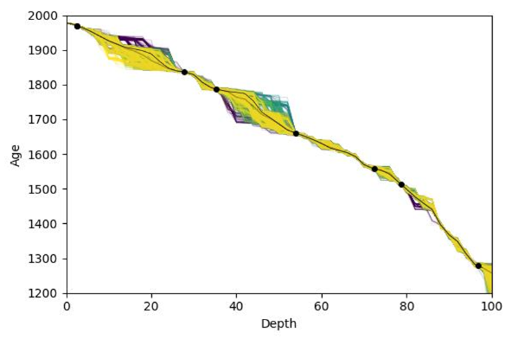
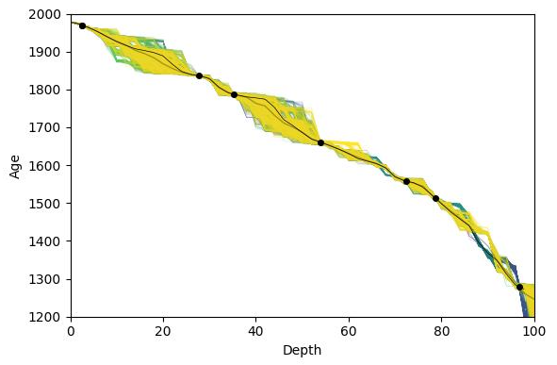
Samples, T = 1 to 3, 20 temps
T = 1 to 3, start at worse places
T = 1 to 3, start in bottom

Slide 3
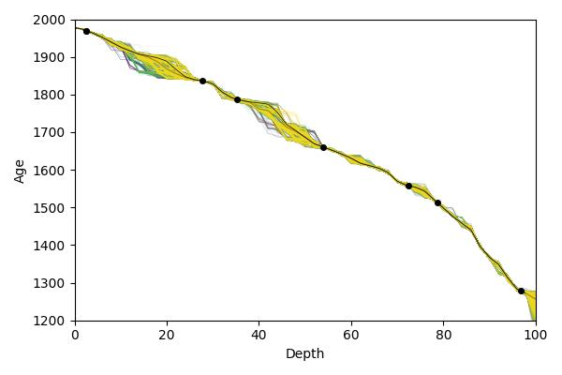
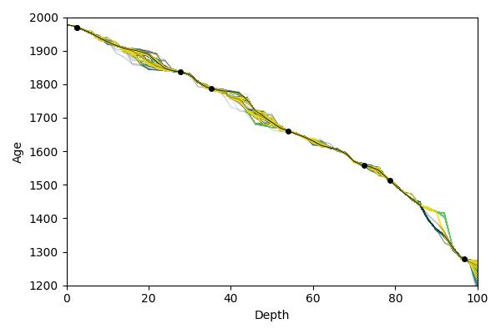
Reweighted samples, T = 1 to 3, 20 temps
Start at worse places
start in bottom

Slide 4
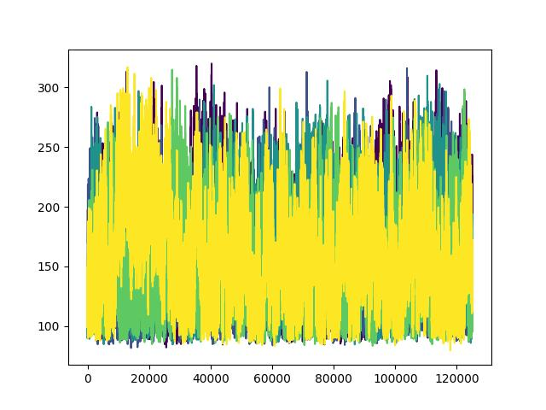
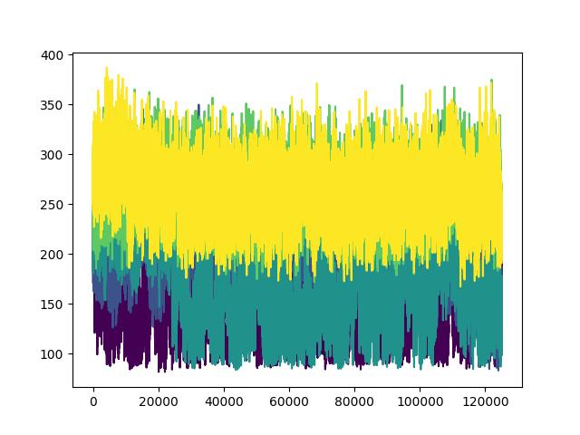
Energies, T = 1 to 3, 20 temps
start at worse places
start in bottom

Slide 5
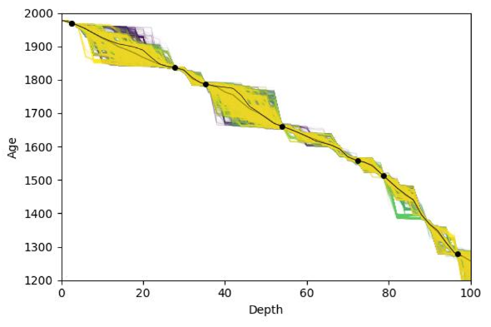
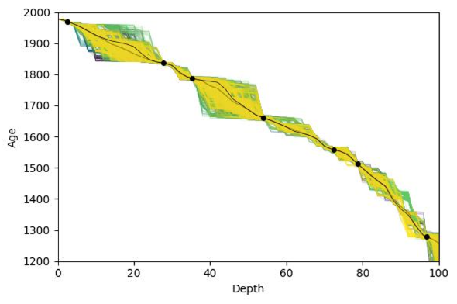
Samples, T = 1 to 5, 20 temps
start at worse places
start in bottom

Slide 6
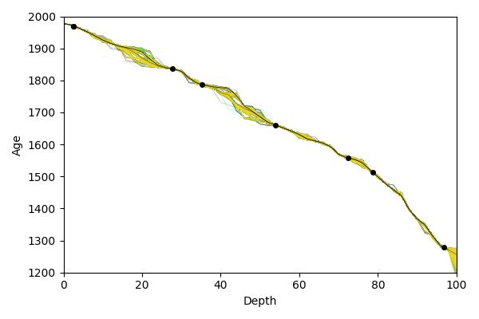
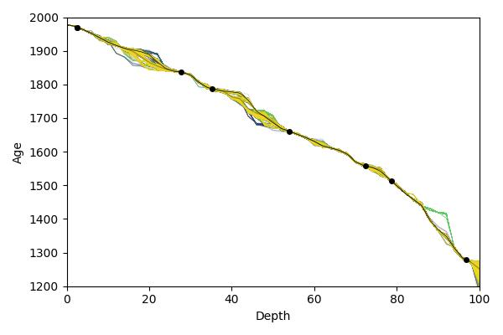
Reweighted samples, T = 1 to 5, 20 temps
Start at worse places
start in bottom

Slide 7
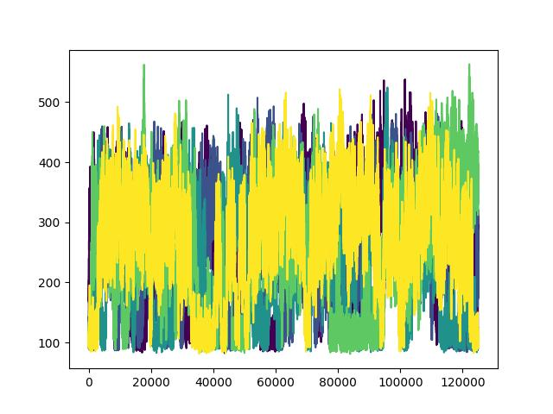
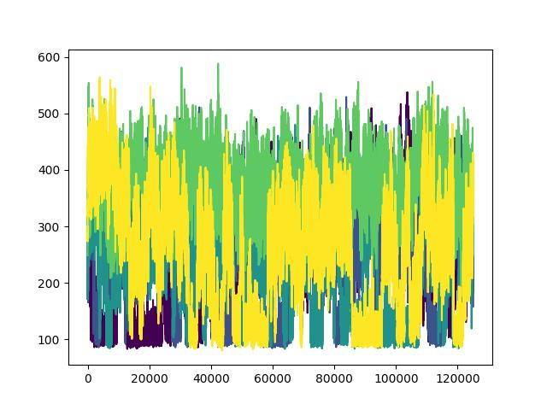
Energies, T = 1 to 5, 20 temps
start at worse places
start in bottom

Slide 8
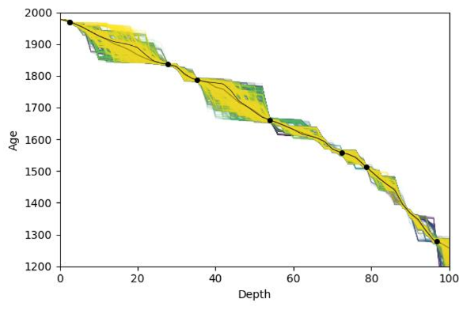
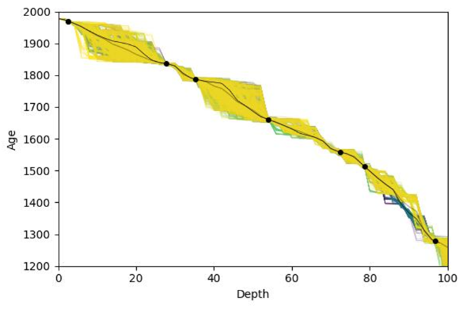
Samples, T = 1 to 5, 40 temps
start at worse places
start in bottom

Slide 9
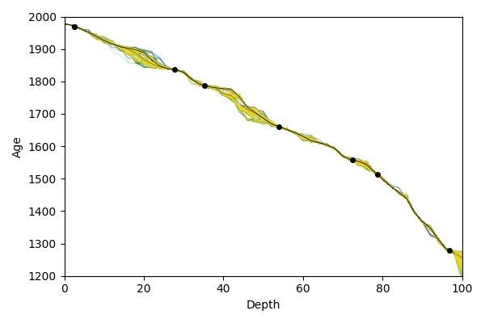
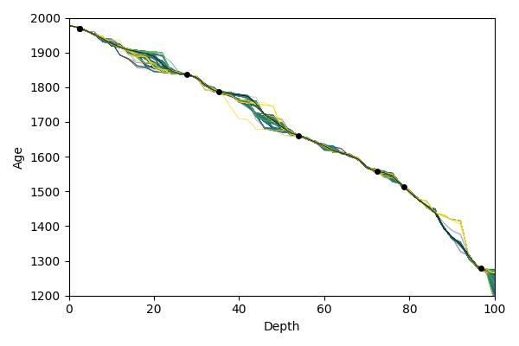
Reweighted samples, T = 1 to 5, 40 temps
Start at worse places
start in bottom

Slide 10
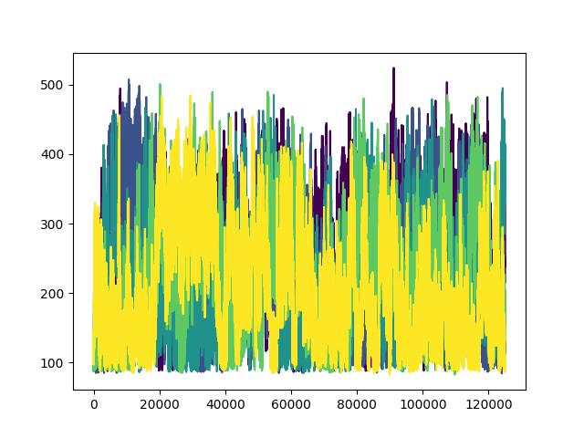
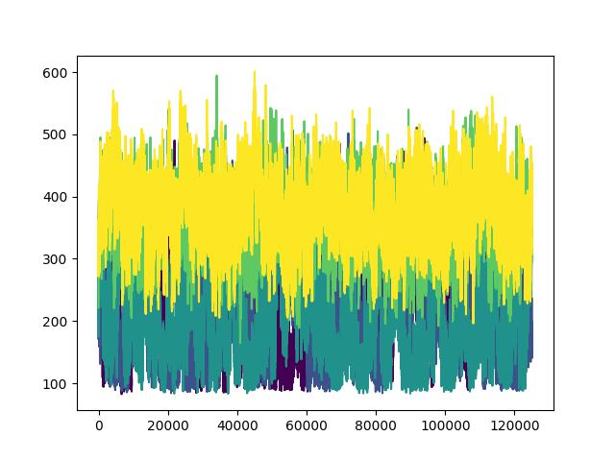
Energies, T = 1 to 5, 40 temps
start at worse places
start in bottom

Slide 11
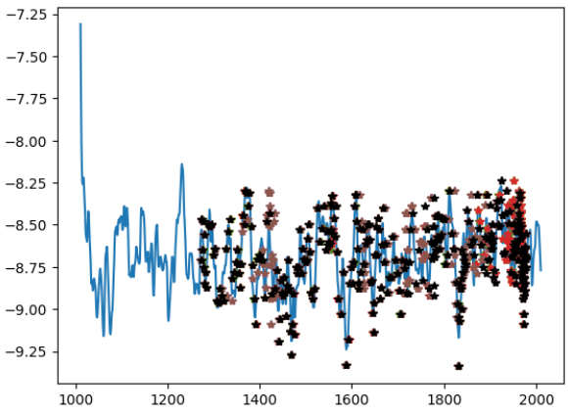
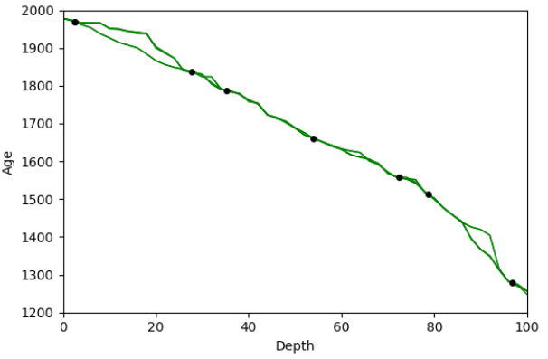

Slide 12
Questions
My variables are not standardized, could this be an issue, and maybe explain why pymc is doing better when sampling?

Slide 13
Questions
Medelenergi som function av T
Bimodal -> bara energi
Förstå bimodala
pymc

