Slide 1
CAI2C08 · PITCH
ChurnGuard
Know who is leaving, while you can still act.
Predicting telecom customer churn to power smarter, cheaper retention.
Hannan Noor · [Student ID] · [Class]
Machine Learning for Developers · Temasek Polytechnic
Notes:
Cover (~5s). Project name + the one-line promise: know who is leaving while you can still act.

Slide 2
THE PROBLEM
Customers leave silently
Telecoms lose roughly one in four customers every year.
Winning a new customer costs about five times more than keeping one, so every cancellation hits revenue hard.
The catch: you usually only find out a customer is unhappy after they have already cancelled, when it is too late to act.
5x
~25%
costlier to win a new customer than keep one
of customers churn every year
If we could see churn coming, we could act before it happens. That is the whole idea behind ChurnGuard.
ChurnGuard
01
Notes:
Problem (~20s): lead with the money. Churn is expensive and it is invisible until the customer has already gone.

Slide 3
THE DATA
A real telecom customer dataset
Telco Customer Churn: a public IBM sample dataset (via Kaggle) of real telecom customer accounts.
7,043
21
26.5%
customers (rows)
account features
churned (the target)
Why it fits: the features are exactly what a provider already knows about a customer: contract type, tenure, services, and charges, so every prediction points to an action the business can actually take.
ChurnGuard
02
Notes:
Dataset (~20s): name, source, size. Mildly imbalanced (26.5%), real account data, and every field maps to something the business controls.

Slide 4
HOW WE BUILT IT
From raw data to a chosen model
1
2
3
4
5
Explore
Engineer
Train
Tune
Select
EDA on churn drivers
tenure band, service count, avg spend
baseline + 4 ML models
RandomizedSearchCV
Logistic Regression
Scoring metric: weighted F1 to handle the class imbalance, with churn recall as the business number, because we care most about catching the customers who will actually leave.
ChurnGuard
03
Notes:
Approach (~30s): a clean CRISP-DM flow. Four models including two ensembles, all tuned with RandomizedSearchCV, and we deliberately chose the simple, explainable winner.

Slide 5
RESULTS
Half the churners caught, from zero
0.79
weighted F1 score
53%
of churners caught
0%
Top churn drivers: month-to-month contract, low tenure, fibre-optic internet, and electronic-check payment.
caught by a naive baseline
ChurnGuard
04
Notes:
Results (~25s): about half the churners caught versus zero for a naive model, at 0.79 weighted F1. Then name the drivers; they match business intuition, which builds trust.

Slide 6
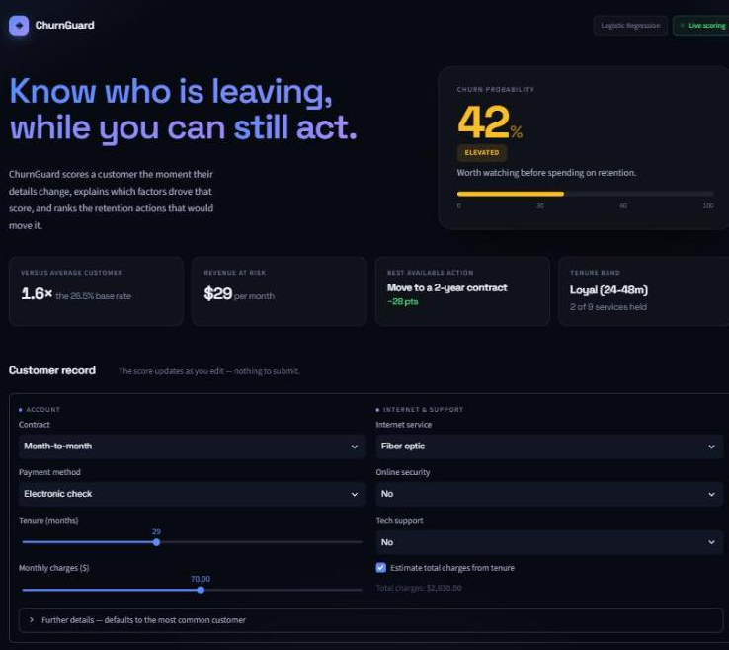
THE PRODUCT
ChurnGuard, live in the browser
WHAT IT DOES
Scores live as you edit: the churn probability updates on every change, nothing to submit.
Explains the score: revenue at risk, how the customer compares to the base rate, and their tenure band.
Ranks retention levers: the actions that remove the most risk, like moving to a two-year contract.
Built with Streamlit and deployed to the cloud, so any non-technical staff member can use it.
Live: hannan-noor-repo-urnb4gmsdju7kjo5dz585d.streamlit.app
ChurnGuard
05
Notes:
App (~35s): walk the screenshot. Pick a customer, the score updates live, the cards explain WHY, and the retention levers say what to do about it. It is deployed and usable by non-technical staff. Screenshots here for timing; live tab open as backup.

Slide 7
WHY IT MATTERS
Turning a score into a decision
1
2
3
Flag early
Target spend
Explain churn
Spot at-risk customers before they cancel, not in the exit survey afterwards.
Focus retention offers on the customers who actually need them, protecting revenue instead of wasting it.
The model shows what drives churn, so the business can fix root causes: contracts, onboarding, billing.
ChurnGuard
06
Notes:
Impact (~25s): the value is not the number itself; it is early warning, targeted spend, and an explanation the business can act on.

Slide 8
CONCLUSION
A simple, explainable, deployed tool
It turns raw account data into a ranked retention action list: the score, the reason, and the next move.
Next steps
Tune the decision threshold to the retention team’s real capacity.
Add dollar costs to weigh false alarms against missed churners.
Retrain on live data and track results as retention offers go out.
Simple to run, cheap to deploy, and it explains itself. That is why it is worth using.
Notes:
Conclusion (~20s): restate the value in one breath, give two or three next steps, land the closing line. Stop before 3:00.

Slide 9
REFERENCES
Sources & tools
BlastChar. (2018). Telco customer churn [Data set]. Kaggle. https://www.kaggle.com/datasets/blastchar/telco-customer-churn
Pedregosa, F., et al. (2011). Scikit-learn: Machine learning in Python. Journal of Machine Learning Research, 12, 2825-2830.
Harris, C. R., et al. (2020). Array programming with NumPy. Nature, 585, 357-362.
McKinney, W. (2010). Data structures for statistical computing in Python. Proceedings of the 9th Python in Science Conference, 56-61.
Hunter, J. D. (2007). Matplotlib: A 2D graphics environment. Computing in Science & Engineering, 9(3), 90-95.
Streamlit Inc. (2019). Streamlit: A faster way to build and share data apps [Computer software]. https://streamlit.io
Anthropic. (2026). Claude [Large language model]. https://claude.ai
Notes:
References. Not counted in the 10-slide limit.

