Slide 1
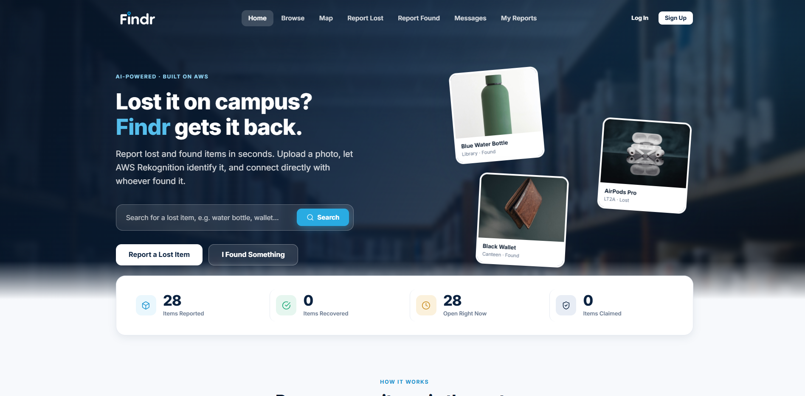

CAI2C09 CLOUD TECHNOLOGIES FOR AI
Findr
A cloud-native campus lost and found platform
Find it. Prove it's yours. Get it back.
Mohammed Hannan Noor
XXXXXXXX · Class group PC02 · Tutor: Lee Jin

Slide 2
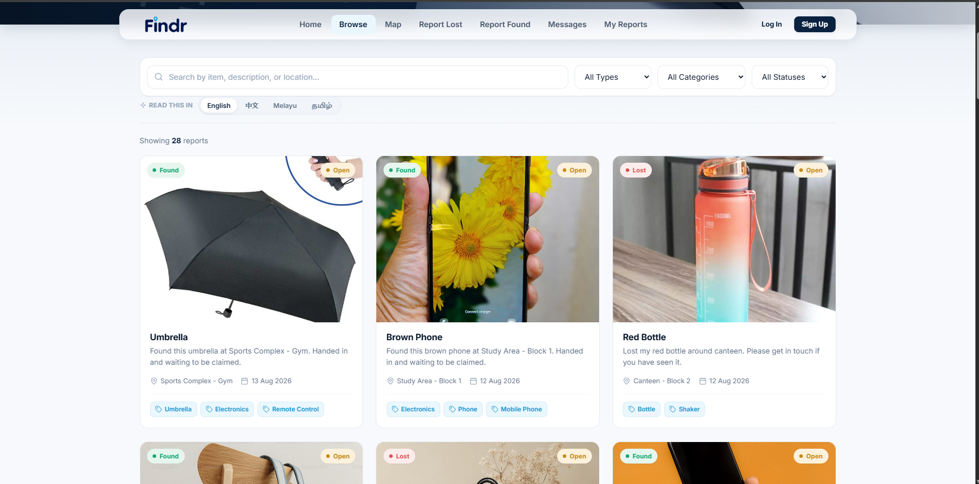
THE PROBLEM
Overview of website
Lost property at TP is scattered. The main security office holds some, there is a box at the sports hall near the grandstand, and the canteens keep their own. Nothing connects them, so a student has to guess which one to try.
1
One place to look
Every collection point in one list
2
Filled in for you
A photograph is the whole form
3
Provably yours
Questions only the owner can answer
d3d5h347656j6.cloudfront.net

Slide 3
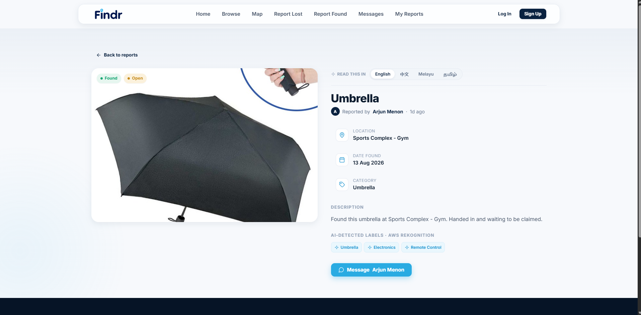
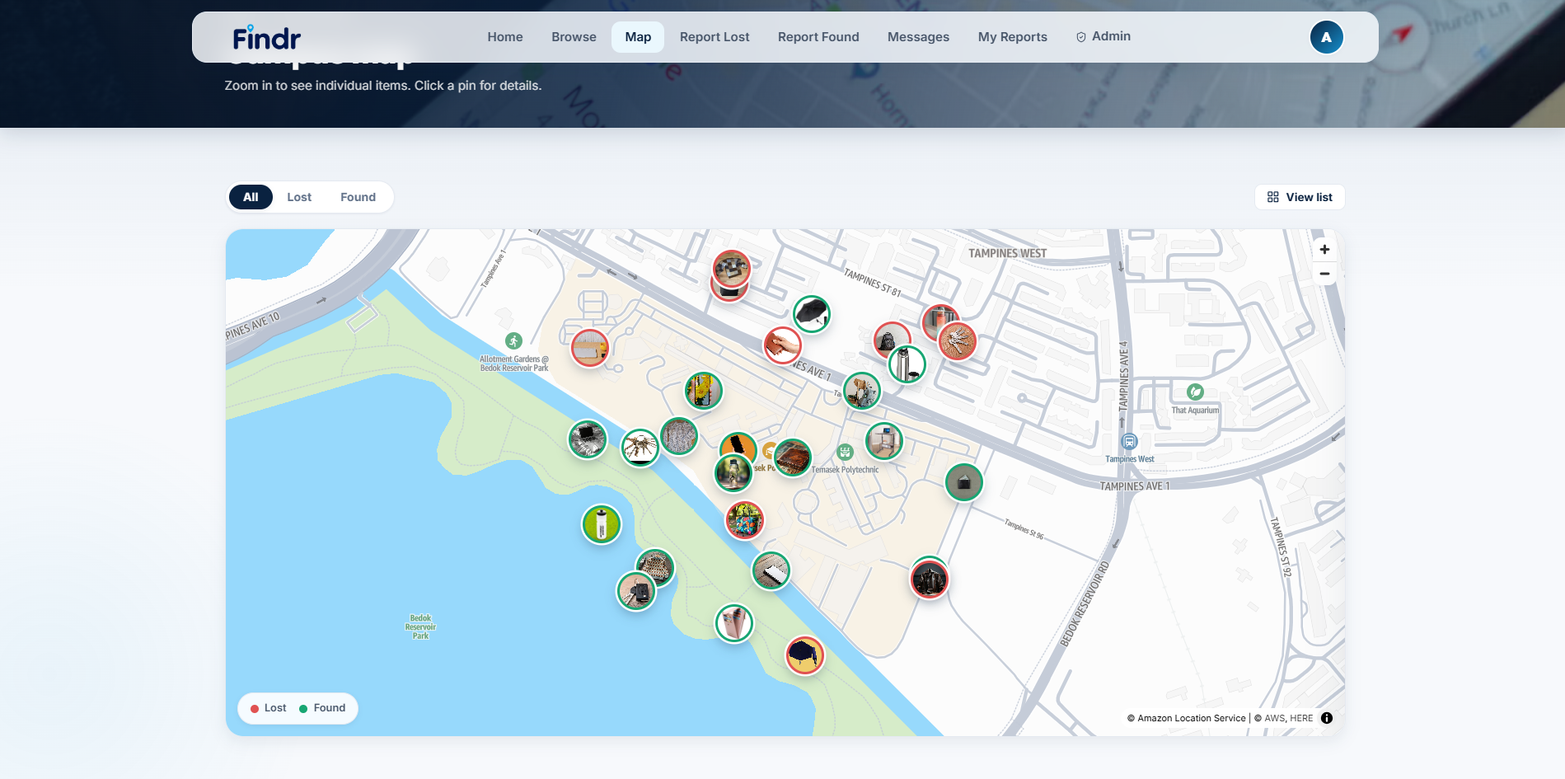
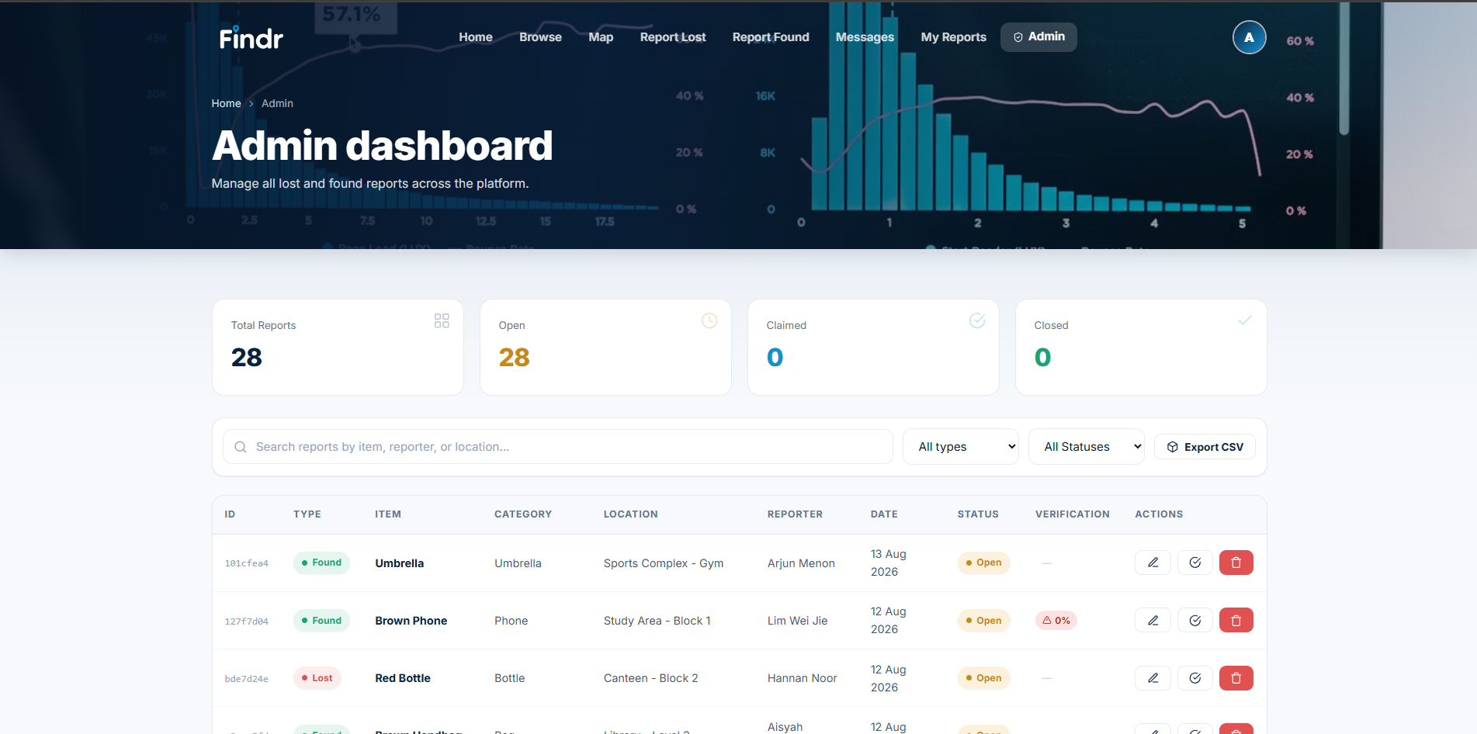
THIRTEEN PAGES, ONE JOB EACH
Inside the app
Campus map. Each marker is the item's own photograph.
Item details. The photograph, where it was found, and the labels the image recognition returned.
Report in seconds Upload a photo and the category and description arrive filled in.
Talk without sharing a number Messaging keeps the handover inside the platform.
Administrator dashboard. Every report, filterable and exportable.
Read it in your language Any listing, in English, Chinese, Malay or Tamil.

Slide 4
FIFTEEN SERVICES, THREE JOBS
Breakdown of services used
DELIVERY AND SECURITY
APPLICATION
INTELLIGENCE
CloudFront + WAF
API Gateway
Rekognition
HTTPS delivery, managed firewall
REST API, token checked before compute
Custom classifier, moderation, text
S3
Lambda
Bedrock
Private site bucket and photo storage
Six functions, all the logic
Descriptions, matching, verification
Cognito
DynamoDB
Translate + Comprehend
Sign-in, JWTs, the admin group
Reports and messages
Four languages, detected automatically
IAM
SNS
Location Service
One least-privilege Lambda role
Emails a finder when a claim is made
The campus map

Slide 5
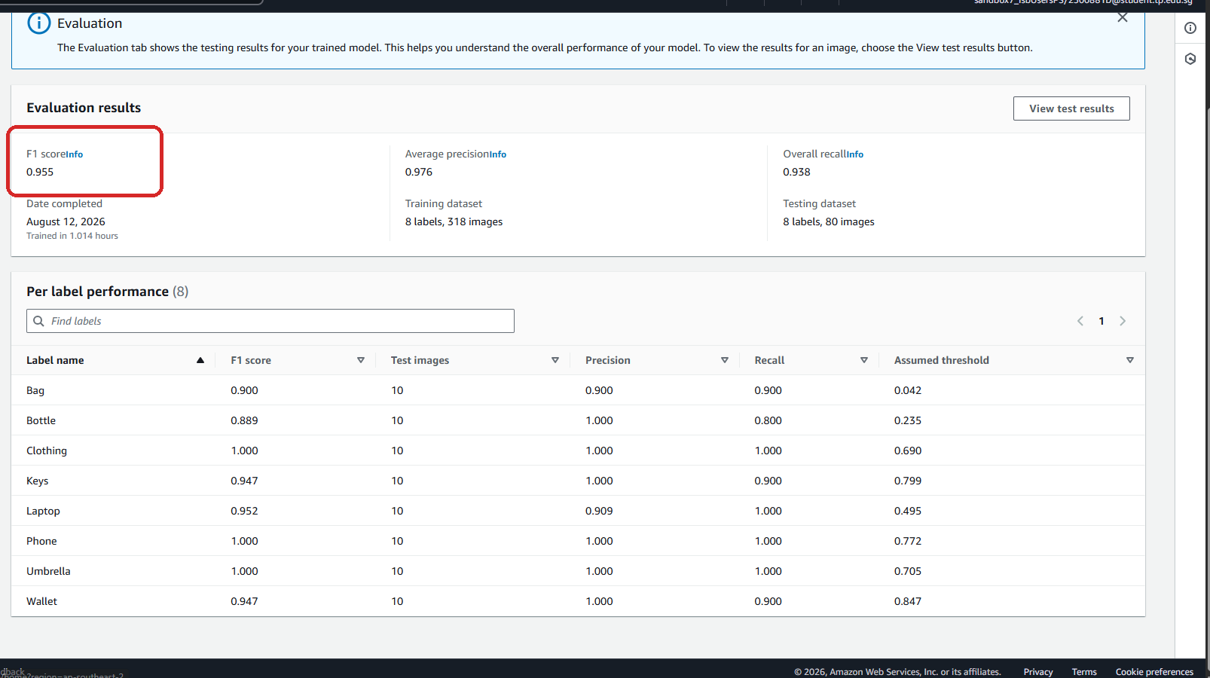
AMAZON REKOGNITION CUSTOM LABELS
A model trained for this problem
0.955
0.976
8
398
1.0 h
F1 score
avg precision
categories
training images
to train
The pretrained model does not know my categories. It called a set of keys a weapon and a bottle a mason jar, so I trained a classifier on the eight categories a lost property counter actually files items under.
Precision is the metric that matters here.
The classification pre-fills a field the user confirms, so a confidently wrong category is far worse than a missed one. Six of the eight labels score a precision of 1.000, meaning the model never puts the wrong category in front of a user for those items.
Stopped model? Still works. Custom Labels bills per hour while running, so the app falls back to the pretrained labels and says so on screen.
Evaluation results across the eight labels

Slide 6
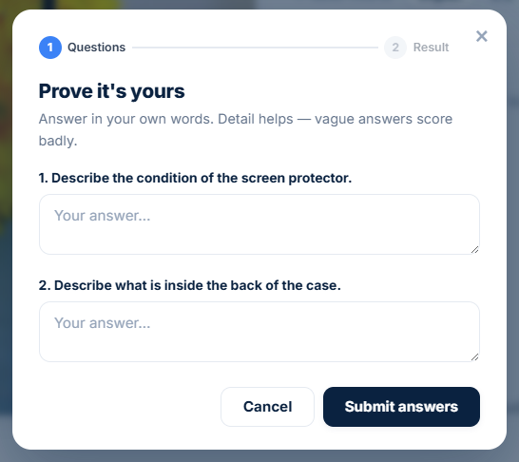
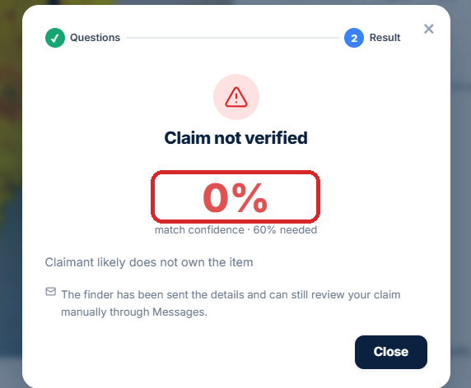
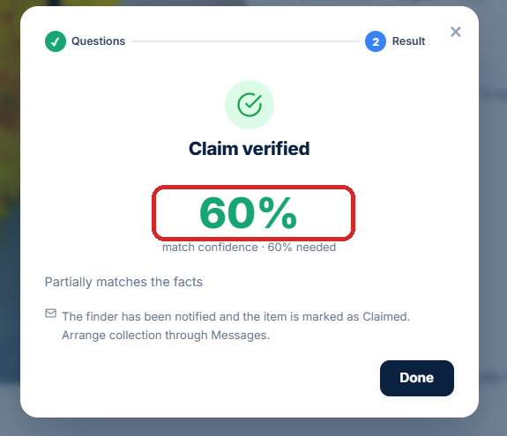
AMAZON BEDROCK
Proving an item is yours
A public listing describes the item, so anybody who reads it can describe it back. Verification uses details the listing never shows.
1
Finder records private details
2
Bedrock writes questions that do not reveal them
3
Claimant answers in their own words
4
Bedrock scores out of 100, 60 to pass
Neither question gives away its fact
Both outcomes were tested. A guess fails, a real owner passes.

Slide 7
AND WHAT FIXED THEM
Challenges faced
1
Questions a real owner could not answer
Problem Told not to reveal the fact "there is a coin compartment inside", the model stripped the word coin and asked how many compartments the wallet had. The fact never gave a number, so the genuine owner would have failed.
Fix Added a constraint that every question must be answerable from the fact alone, moved generation to Nova Pro, and dropped the temperature to 0.1 so the output is consistent.
2
Descriptions of watermarks, not items
Problem Detected text was being passed to Bedrock as "visible text on the item", so stock photo watermarks came back as "a wallet with labels Mag, Magnit, Magnific".
Fix Sent the image itself to a multimodal model and dropped the false claim, so the model can judge for itself what is printed on the object.
3
A trained model that cannot stay running
Problem Custom Labels bills per hour while a model is running, which is not something a student account can leave on permanently.
Fix The analysis path detects a stopped model and falls back to the pretrained labels, and the interface states which model produced the result.

Slide 8
WHAT I WOULD BUILD NEXT
Potential enhancements
HIGHEST VALUE
2
A wider training set
1
Match on submission
More variety for Bottle and Bag, the two categories where the model is most conservative.
Matching runs only when somebody asks for it. Running it the moment a report is created, then notifying both parties when a strong match appears, turns Findr from a service people have to search into one that contacts them. It is the single change that would recover the most items.
3
Push notifications
Shortens the gap between an item being handed in and its owner hearing about it.
New report
Auto match
Both notified
4
Multi-factor sign-in
Cognito supports it once Amazon SES is configured for the pool.
No user action required, which is the point. The information already exists in the database; today it just waits for somebody to go looking for it.
5
Counter integration
Items handed in physically would appear on the platform automatically.

Slide 9
DEMONSTRATION
Video link
Findr
d3d5h347656j6.cloudfront.net
Mohammed Hannan Noor
XXXXXXXX · PC02
https://youtu.be/hrbYugO_jg8
Uploaded to YouTube and set to Unlisted.
Thank you

