Slide 1
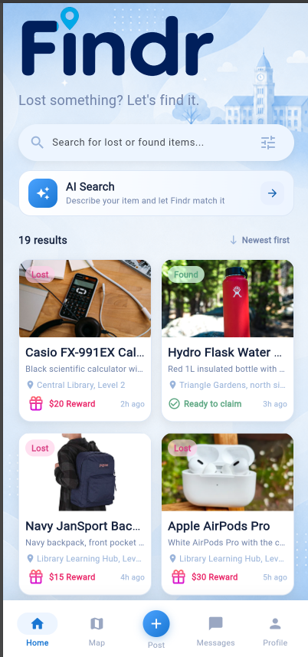
MBAP PART 3
Findr
A campus lost and found application for Temasek Polytechnic,
built with Flutter and Cloud Firestore.
STUDENT
Admin Number NUMBER
CLASS
Hannan Noor
XXXXXXXX
PC02

Slide 2
BACKGROUND
The Problem Findr Solves
Lost property at Temasek Polytechnic is scattered across Telegram channels, class chat groups and physical counters, so items and their owners rarely meet.
1
No single place to post
2
No way to search
TARGET AUDIENCE
A student who finds a wallet posts it to whichever group they happen to be in, so the notice never reaches the owner.
Someone who has lost something must scroll several chats by hand, and older messages cannot be searched at all.
students and staff sharing one campus, one bus loop and one set of lecture theatres.
3
No proof of ownership
4
No incentive to return
One campus should have one board and one search.
Nothing stops the wrong person from collecting an item, so finders are reluctant to hand anything over.
Handing an item in costs time and gains the finder nothing, so many items are simply left where they are.
Findr · Background
2

Slide 3
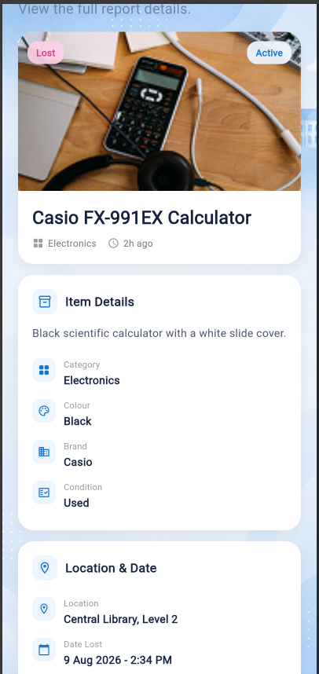
OVERVIEW
What Findr Does
One board for the whole campus, with matching, verification and payment built around it.
1
Post a Report
2
AI Item Matching
A lost or found item with photo, details and a map pin.
Describe what was lost; every open report is scored against it.
3
Claim and Verify
4
In-App Chat
The claimer proves ownership; the finder accepts or rejects.
Arrange the handover without exchanging phone numbers.
5
NETS QR Reward
6
Campus Map
A reward held in escrow until the item is actually returned.
Every report as a pin, so students see what was lost near them.
Example of a Report
Findr · Overview
3

Slide 4
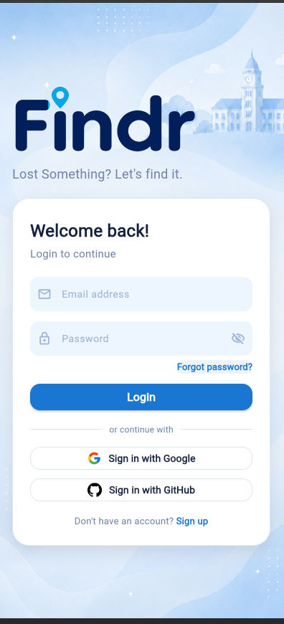
PART 2 FOUNDATION
User Authentication
Firebase Authentication provides the full basic set, plus two account management features and two sign-in methods that were not covered in class.
1
Basic set
Register, log in, log out and forgot password, each with validation and SnackBar feedback.
2
Email verification gate
An unverified account cannot reach the app, and the mail can be resent on request.
2
3
Change password and delete account
Handled in Profile; deleting an account also removes that user's reports.
4
Google Sign-In
OAuth through the google_sign_in package. Not taught in class.
5
GitHub Sign-In
A second external provider through Firebase OAuth. Also not taught in class.
Google and GitHub sign-in
Findr · Authentication
4

Slide 5
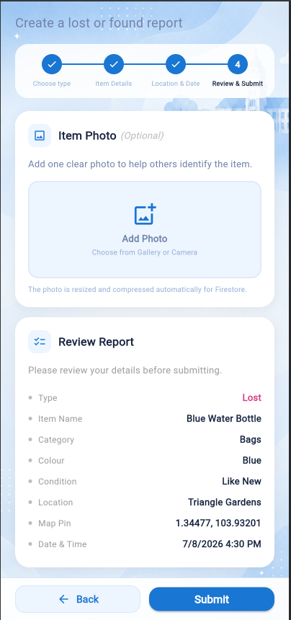
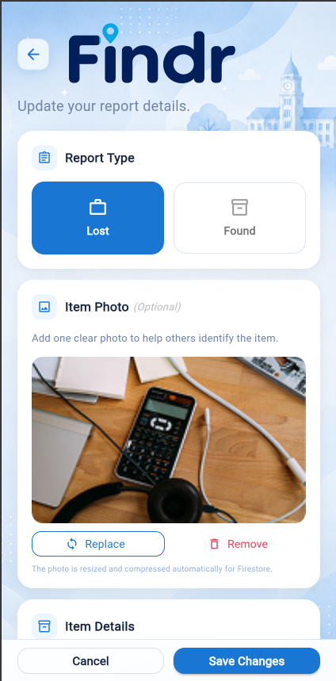
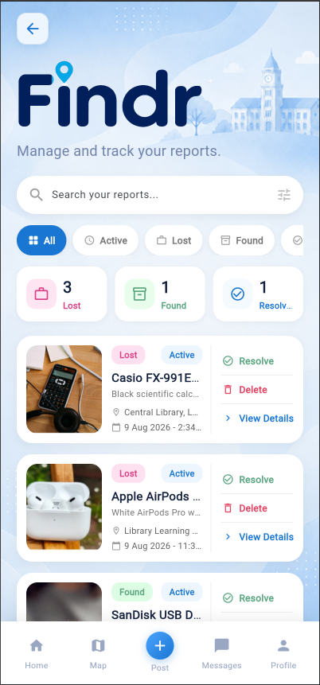
DATA PERSISTENCY
One Full CRUD Set on Item Reports
Reports are the core domain object, so all five Cloud Firestore operations act on that one collection.
1
Insert
2
Select all
3
Select one
4
Update
5
Delete
A four step form writes one document with addReport().
A StreamProvider watches the collection, newest first.
A family provider streams a single document by its id.
Edit rewrites the document; resolving changes status alone.
Removes the report with its claims and chats in one batch.
Insert · review and submit
Update · edit a report
Select and delete · My Reports
Findr · CRUD
5

Slide 6
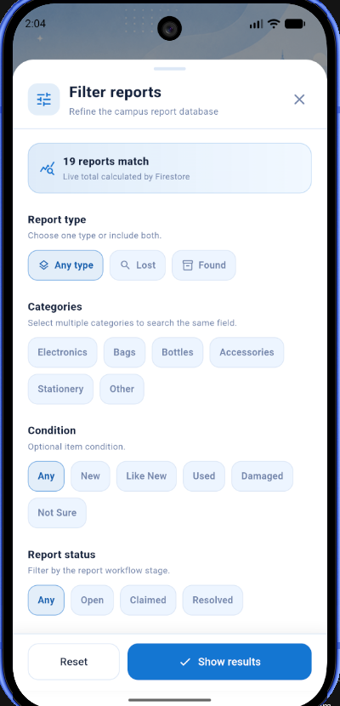
DATA PERSISTENCY
Advanced Firestore Queries
The filter sheet composes a real Firestore query rather than filtering a downloaded list, which covers all five categories of advanced selection.
1
Filter on a non-identifier field
Selects by a property of the item rather than by its document id.
where('reportType', isEqualTo: 'Lost')
2
Multiple criteria on the same field
Several categories are matched at once inside a single query.
where('category', whereIn: [...])
3
Multiple criteria on different fields
Chained clauses combine four independent fields.
where(type).where(category).where(status)
4
Sort order
Drives the newest first and oldest first options in the sheet.
orderBy('createdAt', descending: true)
5
Aggregation
Returns the number of matches from the server without downloading the documents.
count().get()
The filter sheet, with the live Firestore count
Findr · Advanced Queries
6

Slide 7
DATA
The Firestore Data Set
Four collections hold the application data, spread across four real accounts so claims and conversations run between genuine users rather than placeholders.
19
2
3
9
reports
claims
conversations
notifications
Lost, found, claimed and resolved items.
One accepted and one still pending.
Messages held in a subcollection.
Six alert types, read and unread.
Every report document carries
WHY IT IS FULLY POPULATED
name, category, colour, brand, condition
description and free text location
Sparse data hides bugs. Filling every field, across four accounts and every report state, is what surfaced the claim, chat and reward flows during testing.
latitude and longitude for the campus map
reportType, reportStatus and timestamps
the photo, stored as Base64 in the document
reward, escrow state and payment reference
Findr · Data
7

Slide 8
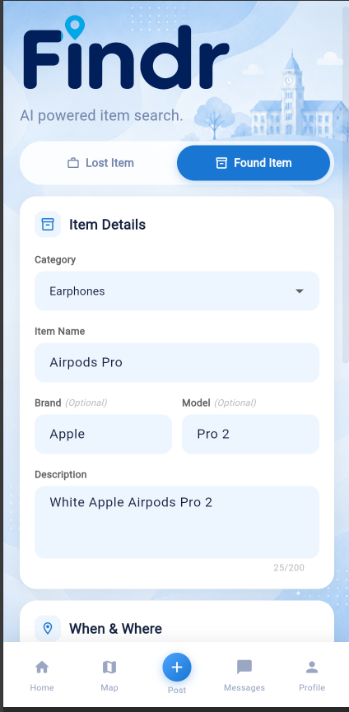
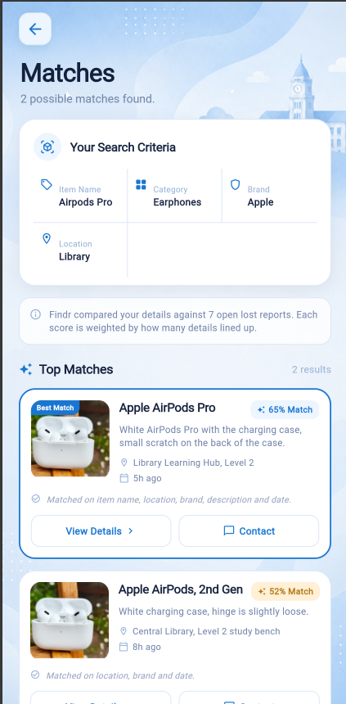
APPLIED AI FEATURE
AI Item Matching
A student describes what they lost, and Findr scores every open report against that description before explaining why each one matched.
1
Weighted scoring engine
Eight signals weighted by how strongly they identify an object: category 22, colour 18, item name 16, location 14, brand 10, description 10, date 6, condition 4.
2
Fuzzy text comparison
Levenshtein distance, fifteen synonym groups and word overlap let “earphones” match “ear phones” and “AirPod”.
3
Identity guard
A score is capped at 35 when nothing actually identifies the item, so a wallet cannot match a bottle on shared category alone. The threshold to report a match is 38.
4
Language model layer
Groq llama-3.1-8b-instant re-ranks the shortlist and writes the plain English reason shown on each result card.
5
Graceful fallback
If the model is unreachable the local engine still returns ranked results, so the feature never fails outright.
Describe the item
Ranked, explained matches
Findr · Applied AI
8

Slide 9
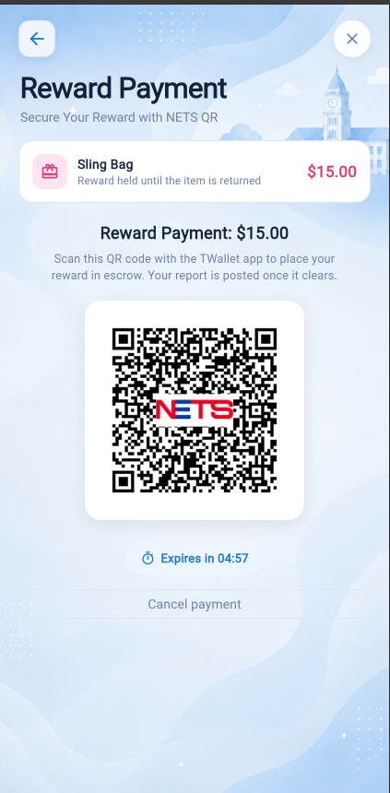
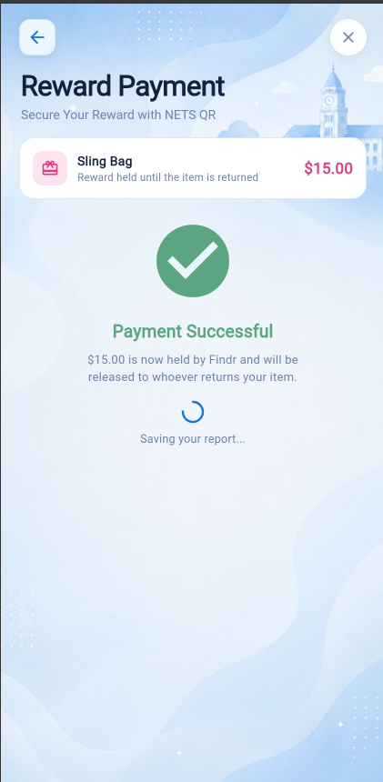
ENHANCED NETS PAYMENT
NETS QR Reward Escrow
A reward only works if the finder trusts it will be paid and the owner trusts it will not be taken early, so Findr holds it in escrow between them.
1
2
3
4
5
Offer
Secure
List
Return
Release
The owner attaches a reward when posting the lost item.
NETS QR takes the payment and Findr holds it in escrow.
Only then is the report shown as ready to claim.
The finder hands the item over in person.
The owner releases the reward from the report screen.
•
Sandbox integration
RequestAPI generates the code, the S2S webhook streams updates over SSE, and QueryAPI confirms the outcome.
•
Verifying properly
A scanned code only means the wallet read it, so Findr polls QueryAPI until the transaction really settles rather than declaring success early.
QR with expiry
Confirmed
Findr · NETS QR Payment
9

Slide 10
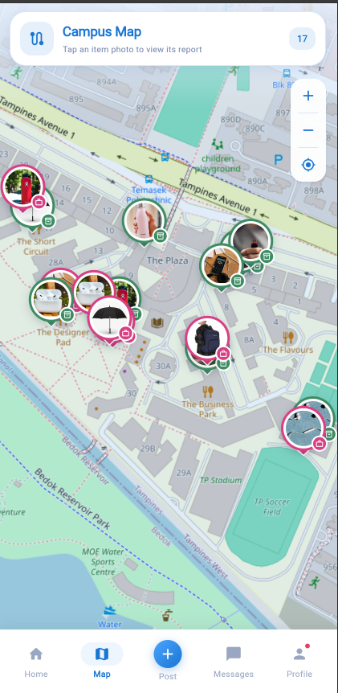
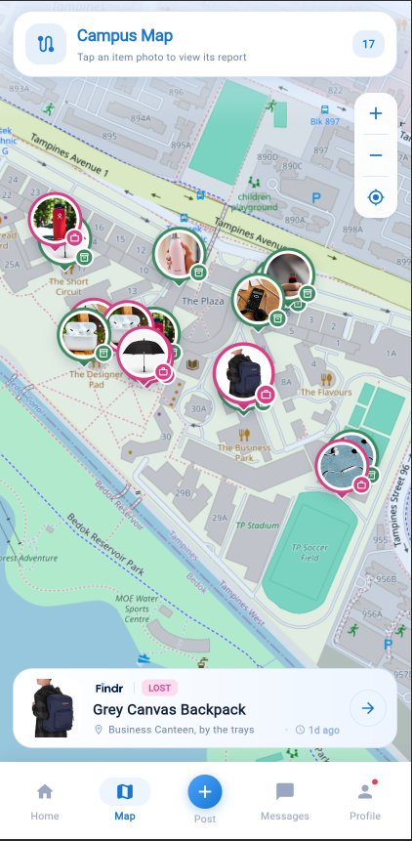
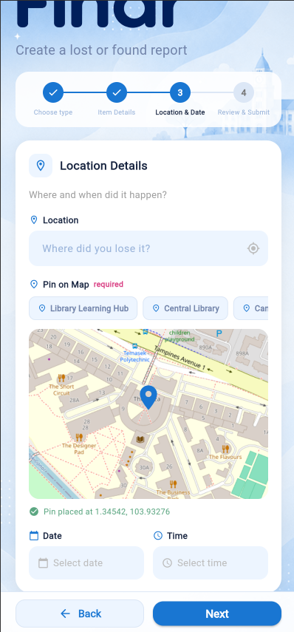
ADDITIONAL FEATURE
Campus Map
Location is the most useful clue about a lost item, so every report carries a pin and the whole campus can be browsed at once.
1
flutter_map with OpenStreetMap
Free tiles, no API key and no billing account, which also satisfies the rule against paid services such as Google Maps.
2
A pin is compulsory
The posting form will not advance until a pin is dropped, so the map is never sparse.
3
Nine campus locations
The Library Learning Hub, Horseshoe Plaza, Short Circuit and others are one tap presets.
4
Bounded to campus
Panning and pin placement are clamped to Temasek Polytechnic, so a pin cannot drift off site.
5
Tap to open
Each pin carries the item photo, and tapping it opens a card that leads to the full report.
Reports across campus
Tap a pin for the item
Dropping a pin when posting
Findr · Additional Features
10

Slide 11
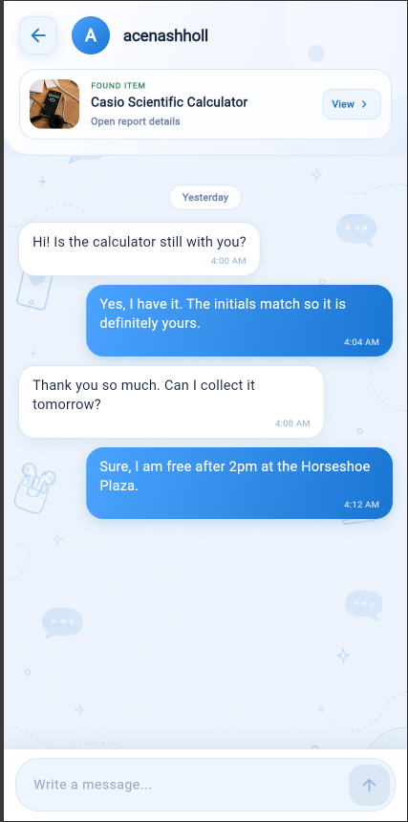
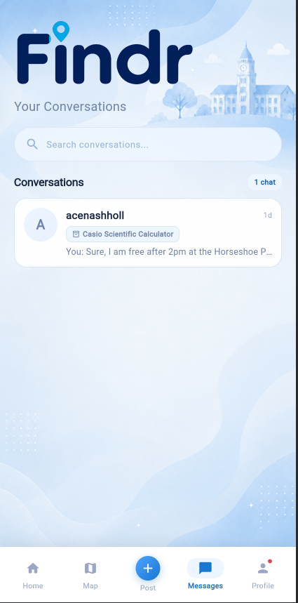
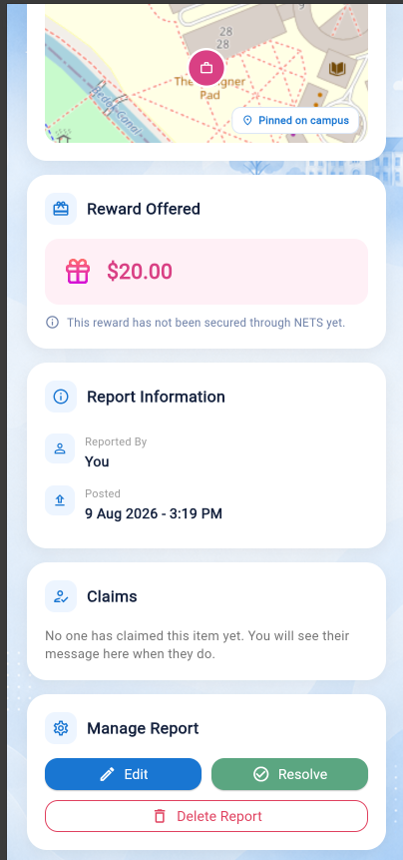
ADDITIONAL FEATURES
In-App Chat and Notifications
Once two students are matched they need to talk, and both need to know when something has happened.
1
Deterministic conversations
A conversation id is built from the report and the two sorted user ids, so the same pair always lands in the same thread.
2
Atomic message writes
One batch writes the message, updates the conversation preview and increments the other person's unread counter together.
3
No numbers exchanged
Students arrange a handover without giving out a phone number, which matters when strangers meet over a lost wallet.
4
Local notifications
flutter_local_notifications raises a device alert, with a toggle in Settings to turn it off.
5
In-app inbox
Six alert types covering claims, decisions, messages, rewards and AI matches, each with read and unread state.
Arranging a handover
Conversation list
Claims on a report
Findr · Additional Features
11

Slide 12
ADDITIONAL FEATURES
Six Additional Features
Two simple features drawn from the topics taught in class, and four advanced features built on packages beyond them.
SIMPLE · 2
ADVANCED · 4
1
Enhanced NETS QR Payment
3
Campus Map
flutter_map with OpenStreetMap tiles. A pin is compulsory when posting, so every report is placed.
A reward is held in escrow through the NETS sandbox until the item is returned, with QueryAPI polled until the transaction actually settles.
4
In-App Chat
Live conversations in Firestore with per-user unread counters, so no phone numbers are exchanged.
2
Image Upload from Camera or Gallery
image_picker captures or selects a photo, which is compressed and stored as Base64 in Firestore, because Cloud Storage needs a paid plan.
5
Local Notifications
flutter_local_notifications device alerts, plus an in-app inbox covering six alert types.
Every one of the six is functional and demonstrated in the recording.
6
Biometric Authentication
local_auth adds a fingerprint gate on top of the Firebase account sign-in.
Findr · Additional Features
12

Slide 13
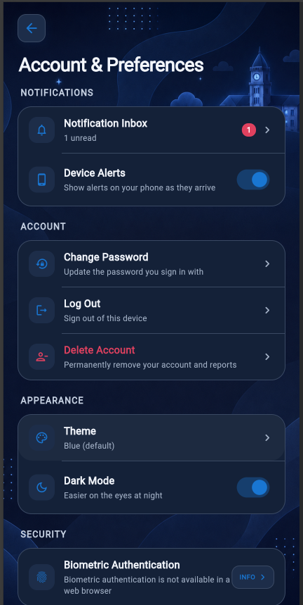
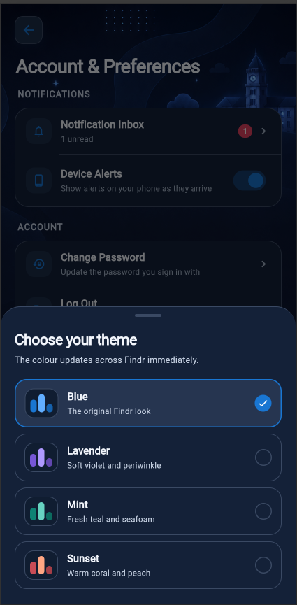
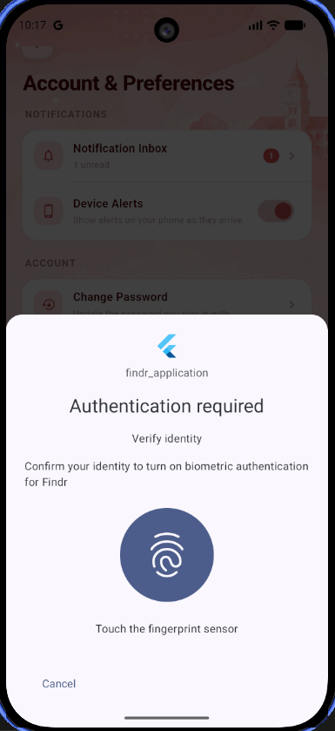
PERSONALISATION
Themes, Dark Mode and Biometrics
Every colour in Findr is read from a theme object, so the whole application restyles itself rather than only the settings page.
1
Four colour palettes
Blue, Lavender, Mint and Sunset, each defining its own full set of surface, border and text colours.
2
Light and dark mode
Both are complete across every screen, including the map header and the illustrated backgrounds.
3
Choices are remembered
shared_preferences stores the palette, the mode and the alert settings between launches.
4
Biometric authentication
local_auth guards the app with a fingerprint on device, and reports honestly that it is unavailable in a browser.
Settings in dark mode
Four palettes
Fingerprint authentication
Findr · Personalisation
13

Slide 14
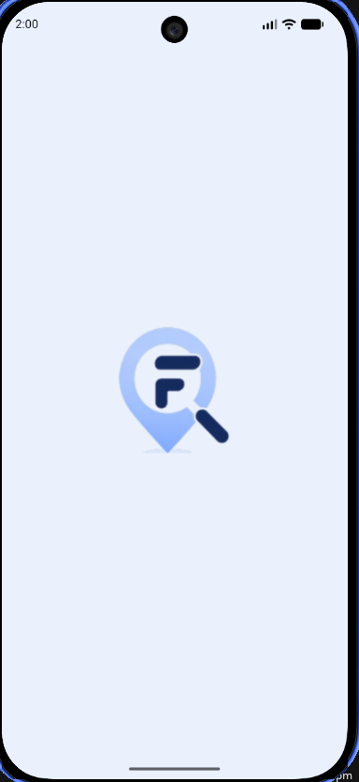

PERSONALISATION
App Icon and Splash Screen
Findr looks like itself from the moment it is launched, rather than showing the default Flutter icon and a blank white window.
1
Custom launcher icon
The Findr mark is generated into every screen density with flutter_launcher_icons, following Mini-Project 12.
2
Adaptive icon
A separate foreground layer keeps the mark inside Android's safe area, so it survives being masked into a circle or a squircle.
3
Branded launch screen
The mark and wordmark sit on the app's own background colour, so there is no white flash before the first frame.
On the device home screen
4
Android 12 splash screen
Newer Android ignores the old launch background, so the platform splash API is configured separately.
APP NAME
5
Application name
Findr
The app presents itself as Findr on the launcher, the web manifest and the browser tab.
The launch screen
Findr · Personalisation
14

Slide 15
ENGINEERING
Architecture and Design Decisions
Riverpod separates the interface from the logic, and several deliberate constraints keep the whole application on free services.
Screens
•
Project structure
17 screens
lib is divided into models, providers, screens, services, theme and widgets, with commented code throughout.
Providers
•
Riverpod state management
Riverpod state
StreamProvider for live reads, family providers for parameterised queries, autoDispose for temporary screens and a StateNotifier for the theme.
Services
•
Images without paid storage
Firebase, AI, NETS, map
Photos are compressed and stored as Base64 in Firestore, because Cloud Storage requires a billing account.
Cloud Firestore
•
Alerts without paid messaging
4 collections
Local notifications replace Firebase Cloud Messaging, which also needs the paid plan.
•
No manual indexes required
Compound selections avoid the Firestore composite index requirement, so the app runs on a fresh project.
Findr · Engineering
15

Slide 16
Video Demonstration
A recorded walkthrough of Findr, five minutes maximum, as required by the project specification.
YOUTUBE LINK
https://youtu.be/EPEnVfJLQjo
THE RECORDING COVERS
Sign in · post a report with a map pin · run an AI search · submit and accept a claim · pay and release a NETS QR reward · switch theme and dark mode

