Slide 1
SUPPLYR
Automated stock detection and supplier reordering robot
Robotic Process Automation (CAI2C01) · AY2026/2027 April Semester
Mohammed Hannan Noor · XXXXXXXX

Slide 2
THE BUSINESS CASE
Problem statement
Current scenario — done by hand
20
Staff open the inventory system and read stock levels product by product
For each shortage they look up which suppliers carry the item
They compare prices and delivery times across suppliers manually
They type a purchase order and email it
Nothing is recorded, so the same item is often ordered twice
of 50 products sit below their minimum stock level with no order in flight
The database also contains 5 rows with missing stock values and 2 suppliers with no email address — deliberate bad data used to test the robot’s validation.
Why it needs automating
What the robot must do
Slow and repetitive — 50 products checked one at a time
Easy to miss a shortage, or to reorder something already on its way
A shortage that appears at 11am waits until someone notices it
Judgement is simple and rule-based — ideal for a robot
Detect every product below minimum, unattended
Choose the best supplier that can actually be contacted
Generate a purchase order and email it
Refuse to act on anything it is unsure about
Record what it did so it never repeats itself
Supplyr | Mohammed Hannan Noor | XXXXXXXX
1

Slide 3
END TO END
Process
1
Detect
Query all inventory, validate each row, flag products below minimum and mark them REORDER_PENDING
MySQL database
2
Decide
Calculate reorder priority, pick the best supplier by tier, mark each row READY or REVIEW
Python
3
Document
Fill a purchase order template per supplier, insert line items, save as PDF, verify the output
Microsoft Word
4
Deliver
Email the purchase order to the supplier and send exceptions to procurement staff
Microsoft Outlook
5
Record
Write a summary report, update reorder status to REORDER_SENT, export any error logs
Microsoft Excel
Supplyr | Mohammed Hannan Noor | XXXXXXXX
2

Slide 4
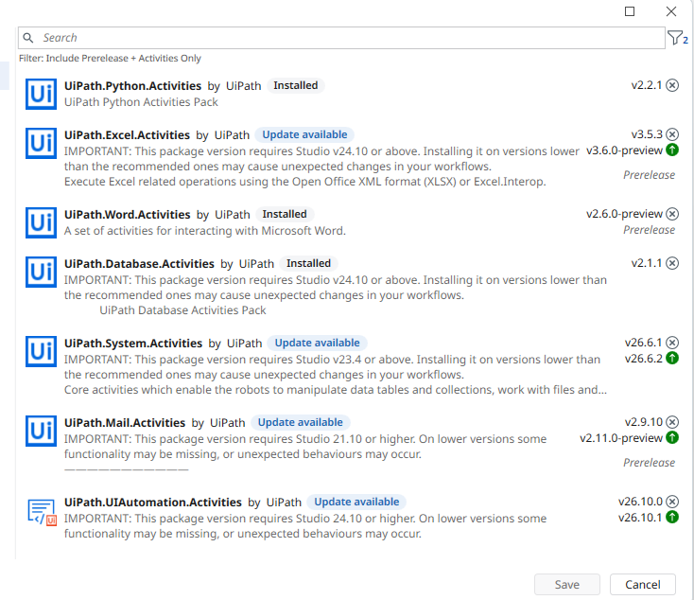
SEVEN PACKAGES USED
Packages (project dependencies)
UiPath.Database.Activities
2.1.1
Connect to Database, Run Query, Run Command, Disconnect
UiPath.Python.Activities
2.2.1
Python Scope, Load Script, Invoke Method, Get Object
UiPath.Word.Activities
2.6.0
Word Application Scope, Replace Text, Insert DataTable, Save as PDF
UiPath.Mail.Activities
2.9.10
Outlook Desktop Mail Message
UiPath.Excel.Activities
3.5.3
Excel Application Scope, Write Cell, Write Range
UiPath.System.Activities
26.6.1
Try Catch, If, For Each, Assign, Filter Data Table, file and log activities
Studio → Manage Packages → Project Dependencies
UiPath.UIAutomation.Activities
26.10.0
Base UI automation dependency
Supplyr | Mohammed Hannan Noor | XXXXXXXX
3

Slide 5
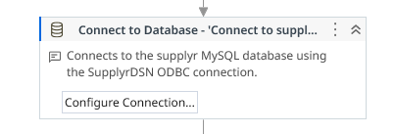
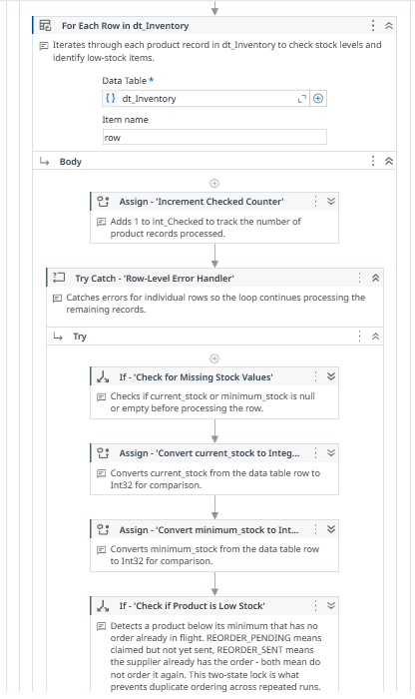
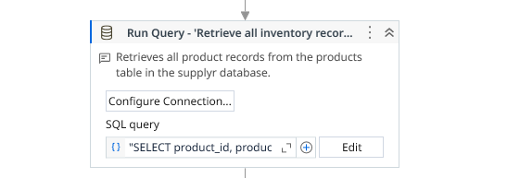
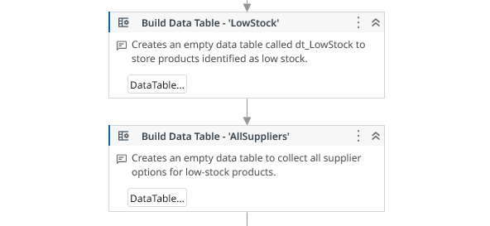
SOLUTION 1 OF 4
Detection — database and validation
Activities used
Connect to Database — opens the MySQL connection
If — throws immediately if the connection failed
Run Query ×3 — pre-flight check that every table and column exists
Run Query — retrieves all 50 inventory records
Build Data Table ×2 — dt_LowStock and dt_AllSuppliers
For Each Row — iterates every product
If / Continue — skips rows with missing stock values
Assign — calculates reorder priority (HIGH / MEDIUM / LOW)
Add Data Row — collects the low-stock product
Run Command — sets reorder_status to REORDER_PENDING
Why REORDER_PENDING matters
Marking the product before ordering is what stops the same 20 items being reordered on every later run. The watcher’s query excludes anything already in flight.
Connect to Database → Run Query → Build Data Table
For Each Row in dt_Inventory
Supplyr | Mohammed Hannan Noor | XXXXXXXX
4

Slide 6
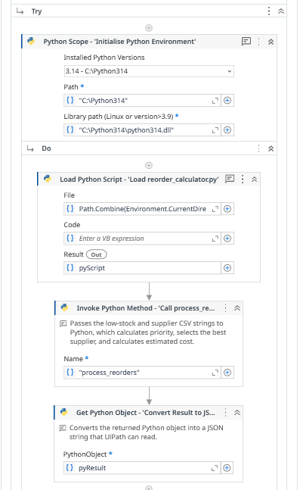
SOLUTION 2 OF 4
Decision — Python reorder calculator
Activities used
What the script decides
Output Data Table ×2 — converts both tables to CSV strings
Python Scope — initialises the Python 3.14 environment
Load Python Script — loads reorder_calculator.py
Invoke Python Method — calls process_reorders
Get Python Object — converts the result to a JSON string
Assign — deserialises the JSON into dt_Reorders
Reorder priority — HIGH when stock is zero or at 25% of minimum or below, MEDIUM at 60% or below, otherwise LOW.
The best supplier — filtered through the four tiers, then cheapest price and fastest delivery within the winning tier.
Estimated cost — supplier price multiplied by the reorder quantity, and formatted currency text for the purchase order.
A status of READY or REVIEW — REVIEW if the stock data is invalid, the quantity is not a number, no supplier was found or the price is zero.
A written note explaining every REVIEW decision, which is what procurement staff receive.
Supplier selection — four tiers
Tier 1 — valid email and can fulfil the full quantity
Tier 2 — valid email but partial fulfilment only
Tier 3 / 4 — can supply but has no usable email address
Within a tier: cheapest price, then fastest delivery
Python Scope
Supplyr | Mohammed Hannan Noor | XXXXXXXX
5

Slide 7
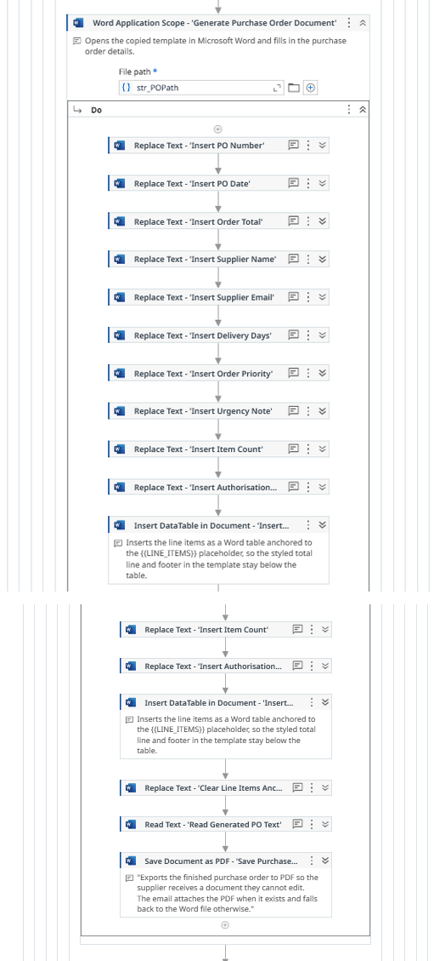
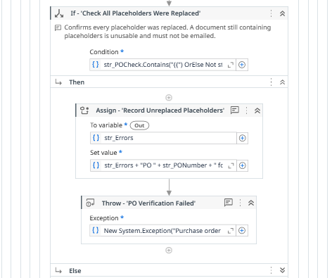
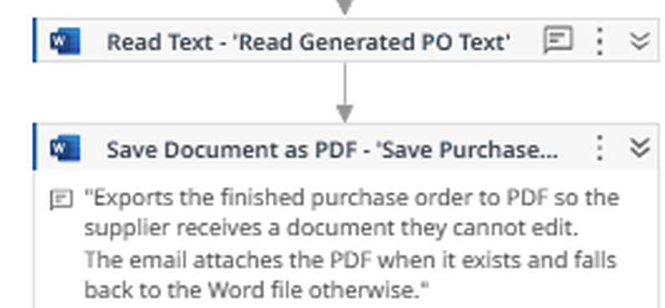
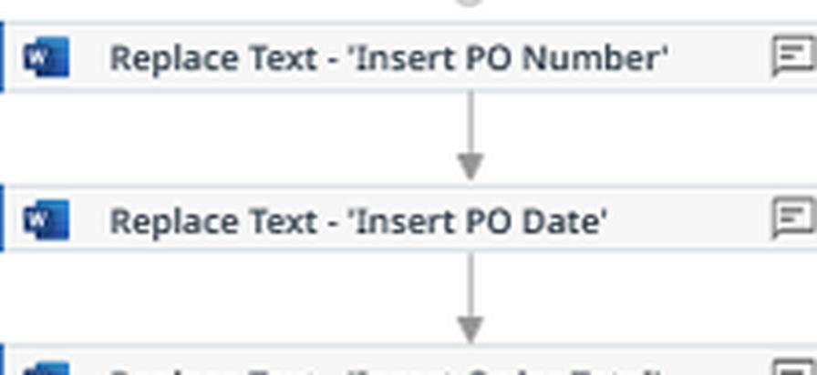
SOLUTION 3 OF 4
Documentation — purchase orders in Word
Activities used
Filter Data Table — keeps only READY rows
For Each — one purchase order per supplier
Copy File — copies the Word purchase order template
Word Application Scope — opens the copied document
Replace Text ×11 — PO number, date, supplier, delivery, totals
Insert DataTable in Document — writes the order line items
Read Text — reads the finished document back in
Save Document as PDF — produces the sendable copy
If / Throw — fails if any placeholder was left unreplaced
Check All Placeholders Were Replaced
Detail — Replace Text
Eleven of these fill the purchase order template, one per placeholder — PO number, date, supplier details, totals and priority.
Word Application Scope
Detail — the robot reads its own document back, then saves it as PDF
Supplyr | Mohammed Hannan Noor | XXXXXXXX
6

Slide 8
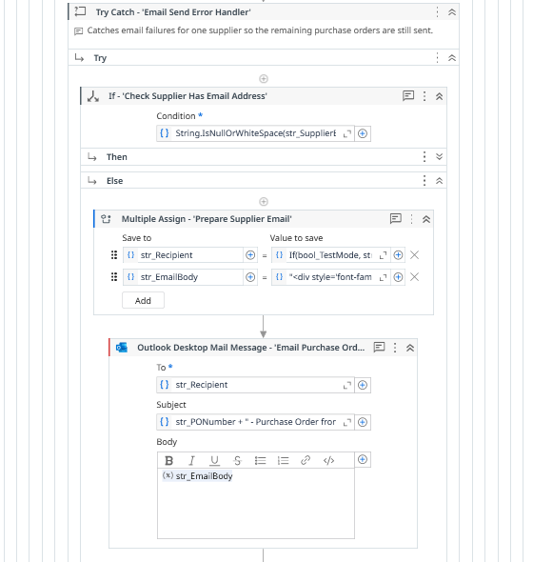
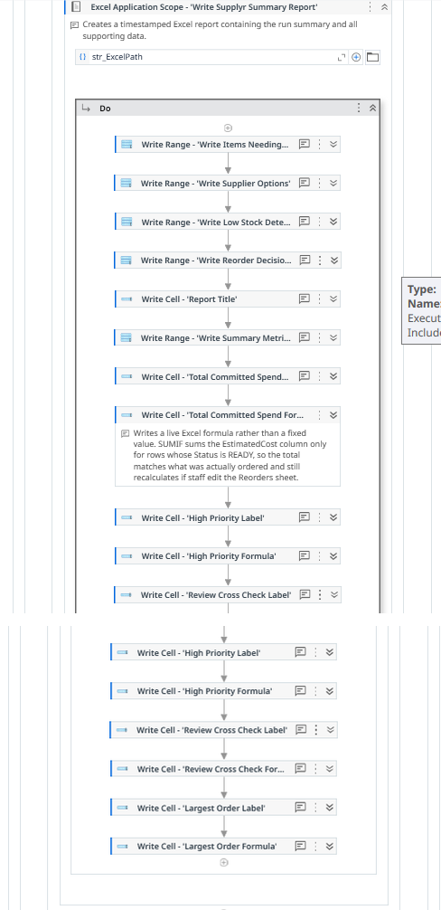
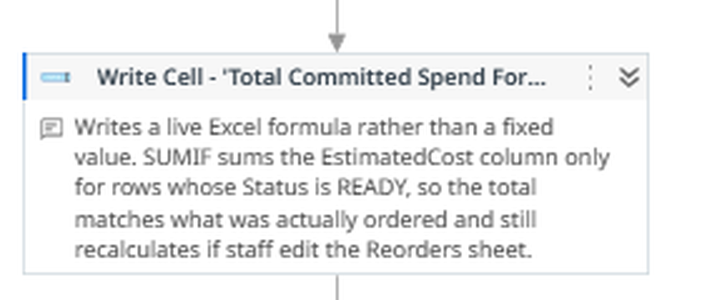
SOLUTION 4 OF 4
Delivery and reporting — Outlook and Excel
Email — Outlook
Outlook Desktop Mail Message — sends the purchase order
Recipient is If(bool_TestMode, str_TestInbox, str_SupplierEmail)
Run Command — updates status to REORDER_SENT after sending
Filter Data Table — selects the rows marked REVIEW
Send Outlook Mail — review summary to procurement staff
Reporting — Excel
Build Data Table + Add Data Row ×7 — the summary metrics
Excel Application Scope — opens the timestamped workbook
Write Cell / Write Range — title, metrics and live formulas
SUMIF formula totals committed spend for READY rows only
Separate ranges for reorder decisions, low stock detection, supplier options and review items
Email Send Error Handler and the Outlook activity
Detail — a live SUMIF formula, not a fixed value
Excel Application Scope
Supplyr | Mohammed Hannan Noor | XXXXXXXX
7

Slide 9
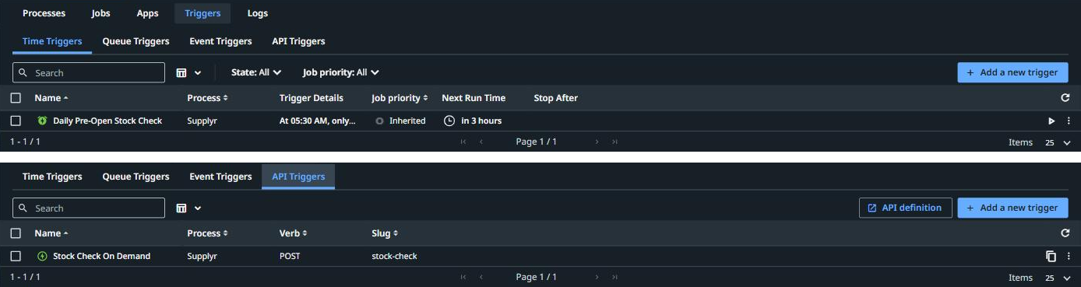
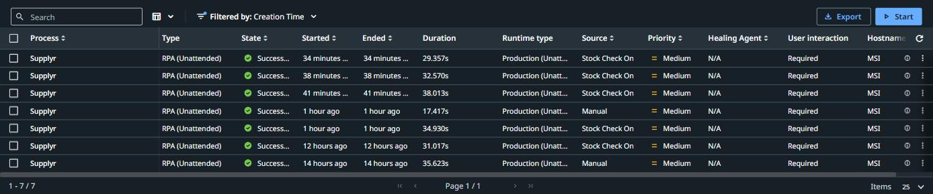
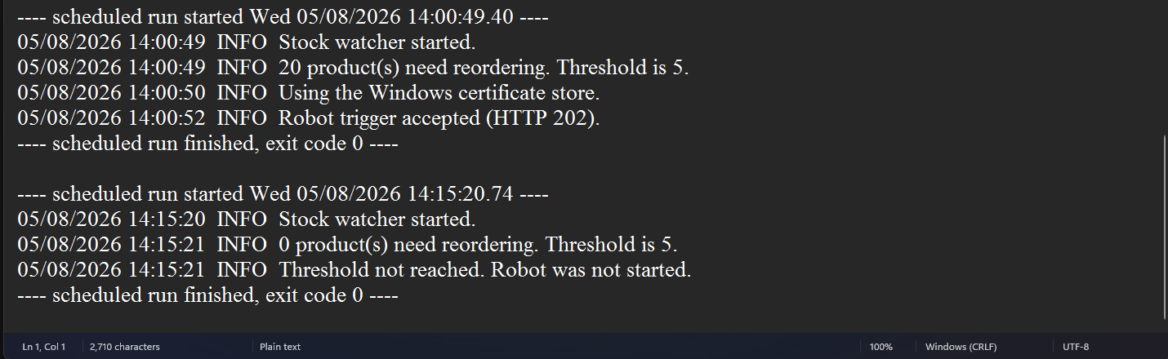
DEPLOYMENT
Orchestrator — running it unattended
Two ways the robot starts
Time trigger — 05:30 every weekday, clears overnight shortages
API trigger — fired on demand when stock crosses the threshold
The stock watcher
stock_watcher.py represents the store POS system
Windows Task Scheduler runs it every 30 minutes, 08:00–20:00, weekdays
It counts products below minimum with no order in flight
Below the threshold of 5 it exits without contacting Orchestrator
Above it, it authenticates as an External Application using OAuth client credentials and POSTs to the API trigger
Authorisation is folder level — the app needs the OR.Jobs scope and the Automation User role inside the Supplyr folder
Time trigger and API trigger in the Supplyr folder
Jobs started by the API trigger — Source: Stock Check On Demand
Why not just a 30-minute time trigger?
That would run the whole robot 25 times a day to find nothing to do 23 of those times. A cheap COUNT query guards an expensive process — and every job in Orchestrator stays a real reorder event.
Supplyr | Mohammed Hannan Noor | XXXXXXXX
Watcher log — fires at 14:00, stands down at 14:15
8

Slide 10
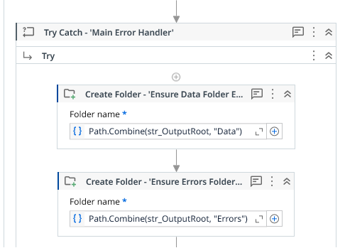
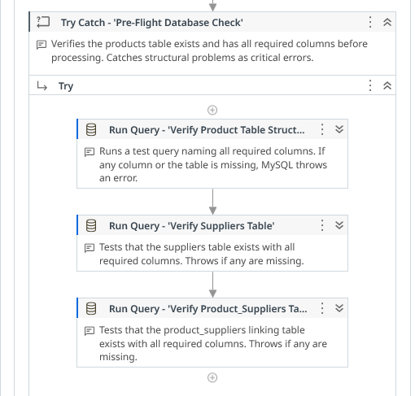
RELIABILITY
Error handling and results
Three layers of error handling
Result of a clean run
Row level — every product sits in its own Try Catch, so one bad record is counted as skipped and the loop continues
Section level — separate handlers around the database check, supplier query, Python call, purchase order, email and Excel stages
Outer level — one Main Error Handler catches anything that escapes, writes a critical error log and still disconnects the database
50 products checked
20 below minimum detected
5 bad rows skipped safely
How problems reach a person
Small errors — a bad row, a missing supplier email, a failed status update — are collected as the run goes and written to a timestamped error log
The same list is appended to the summary email sent to procurement staff, so a skipped product is always reported rather than silently lost
A critical failure aborts the run, writes a separate critical error log, and sends a HIGH importance alert email to the support inbox
Either way the database connection is still closed properly before the robot exits
The outer Main Error Handler
Supplyr | Mohammed Hannan Noor | XXXXXXXX
Pre-Flight Database Check
9

Slide 11
DEMONSTRATION
Watch Supplyr run
https://youtu.be/GeLmaBBpvoU
The recording covers a full run end to end: low stock detected in MySQL, the watcher firing the API trigger, the job executing in Orchestrator, the purchase orders and Excel report produced, and a second run standing down because the orders are already in flight.

Slide 12
References
UiPath Documentation — Orchestrator API triggers. https://docs.uipath.com/orchestrator/automation-cloud/latest/user-guide/api-triggers
UiPath Documentation — Managing external applications and OAuth scopes. https://docs.uipath.com/automation-suite/automation-suite/latest/admin-guide/managing-external-applications
UiPath Activities Guide — Database, Word, Excel, Mail and Python activity packages. https://docs.uipath.com/activities
Microsoft Learn — Task Scheduler and the PowerShell ScheduledTasks cmdlets. https://learn.microsoft.com/en-us/powershell/module/scheduledtasks/
Python Software Foundation — urllib.request and ssl module documentation. https://docs.python.org/3/library/urllib.request.html
MySQL — SELECT statement and UPDATE syntax reference. https://dev.mysql.com/doc/refman/8.0/en/

