Slide 1


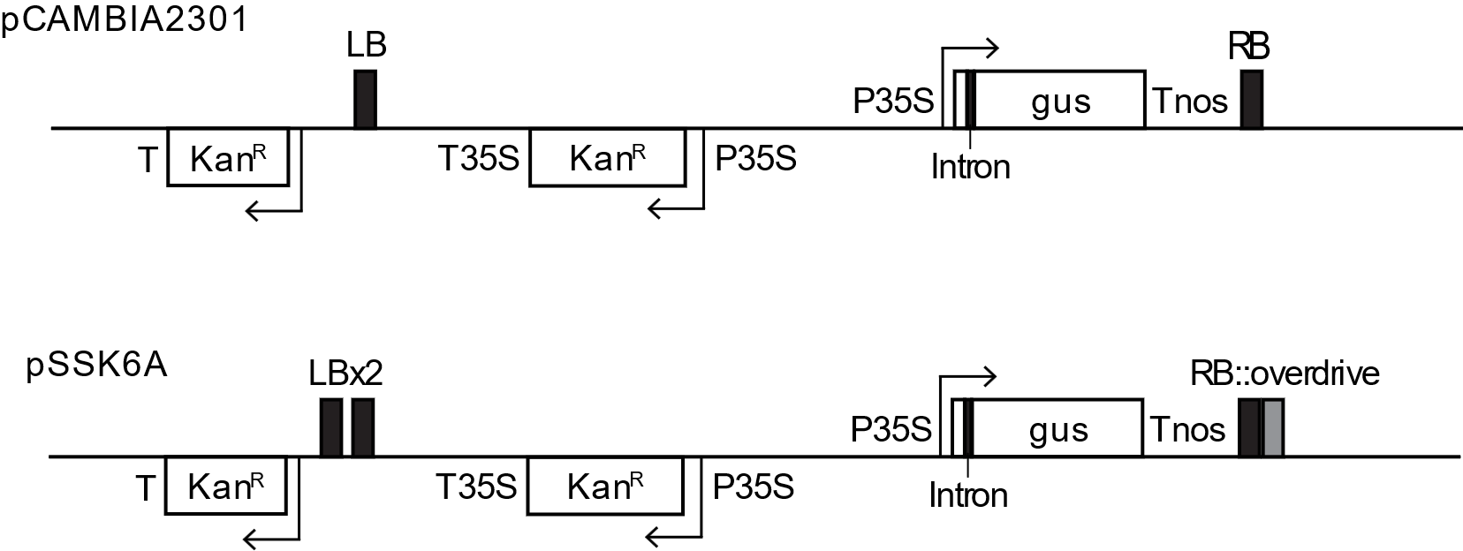
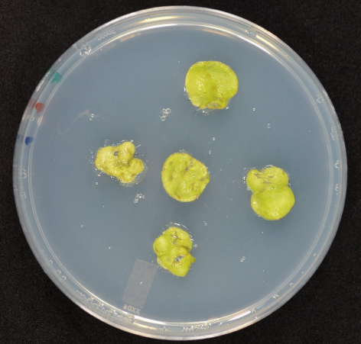
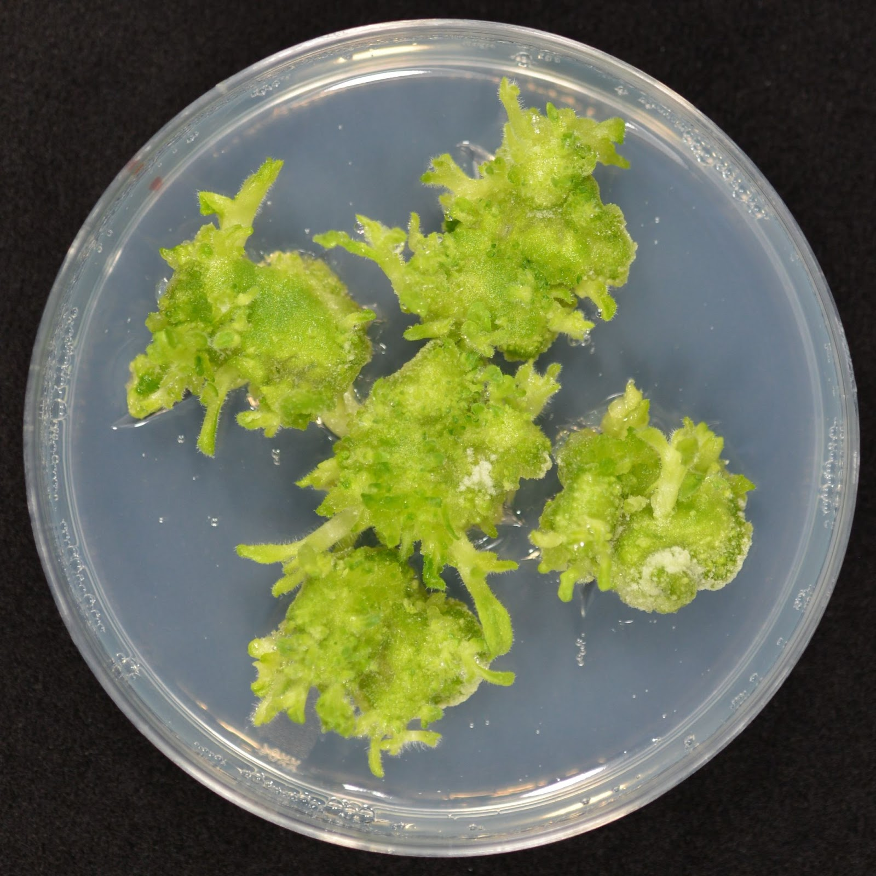
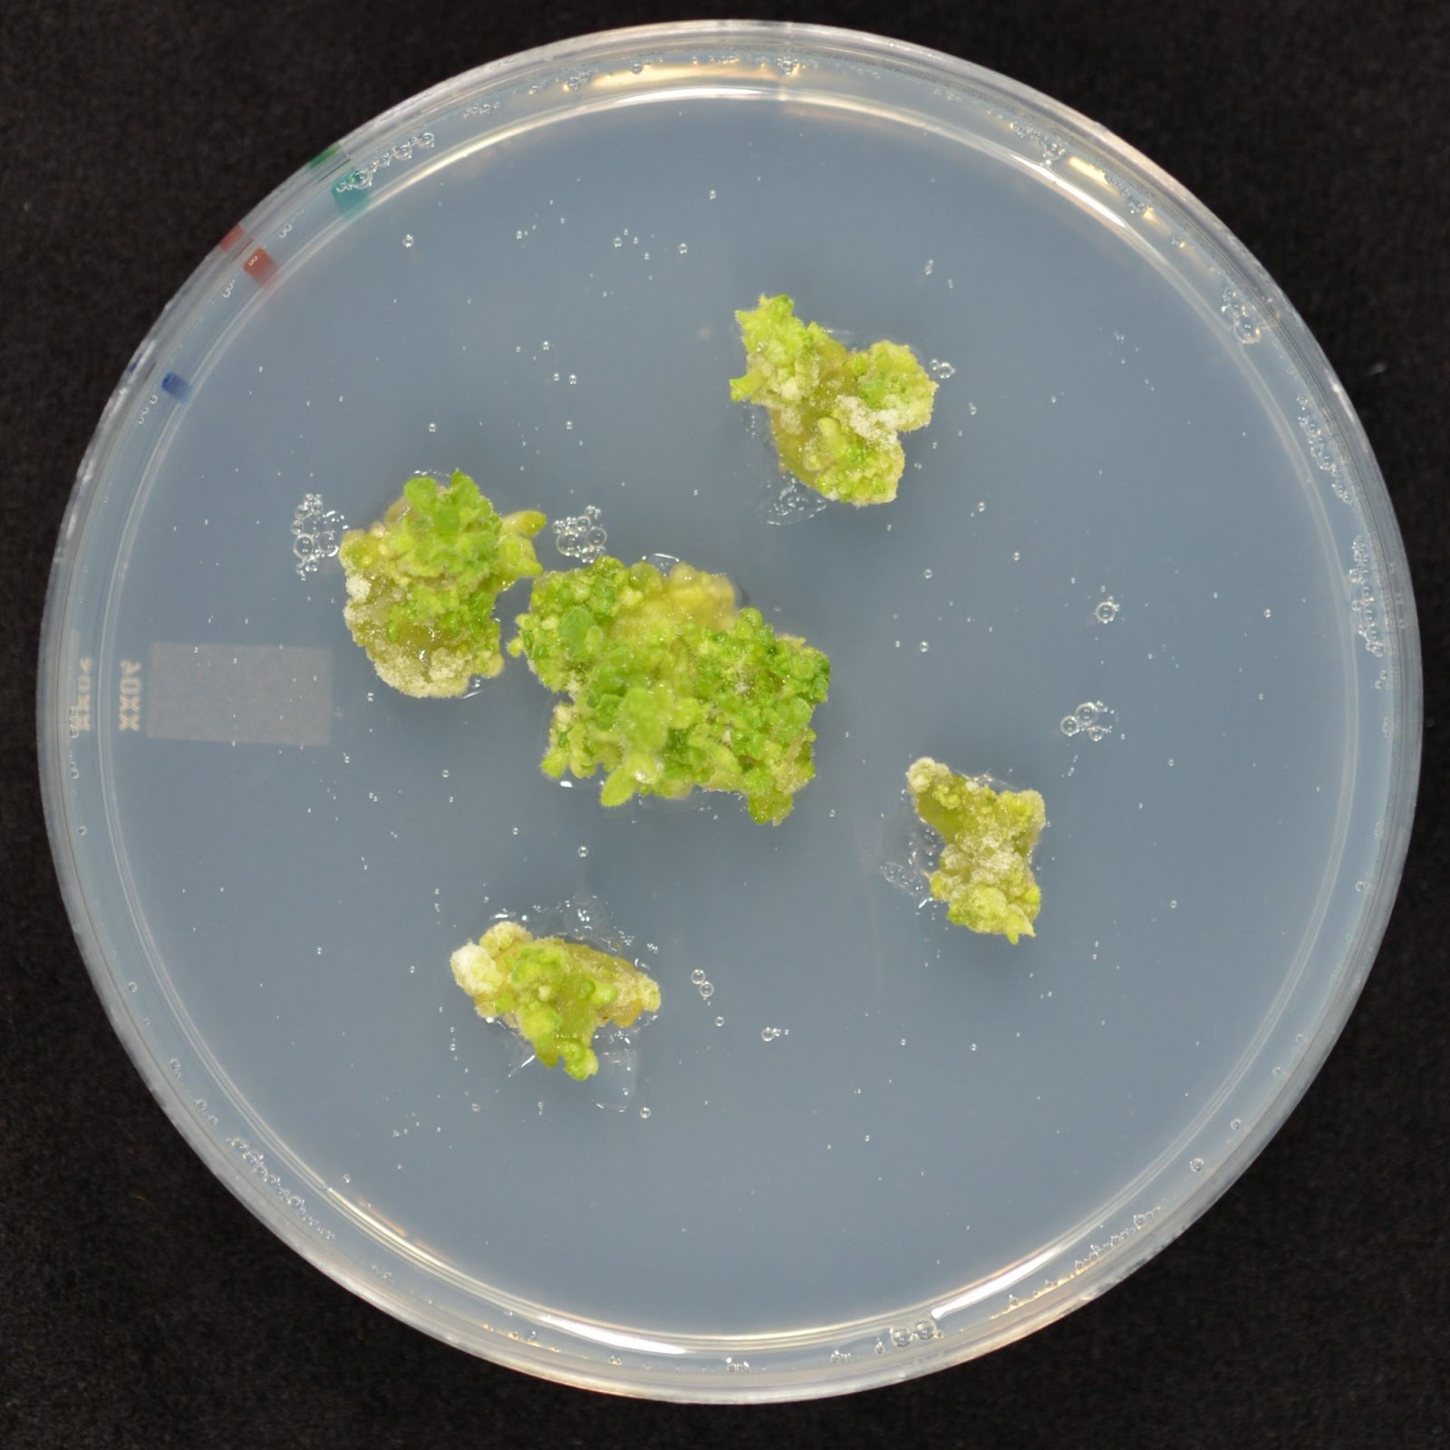
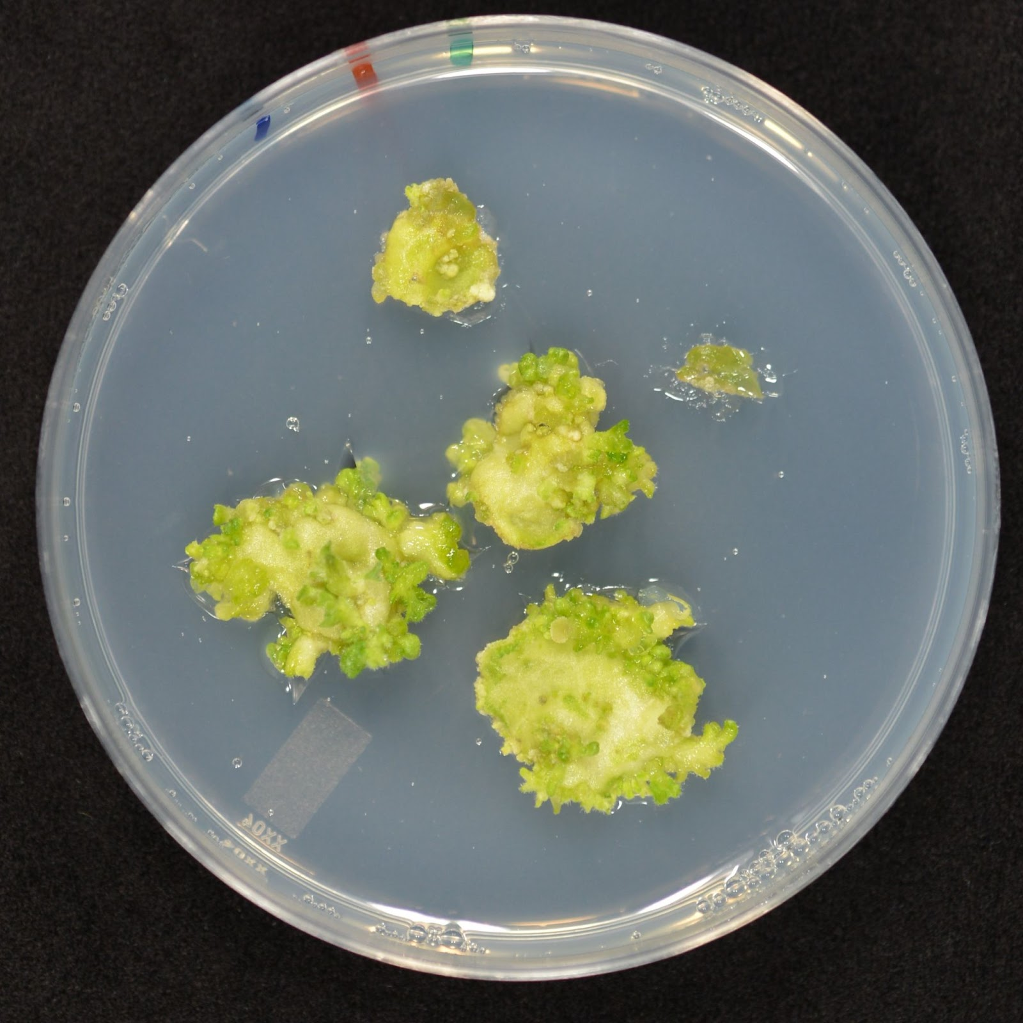
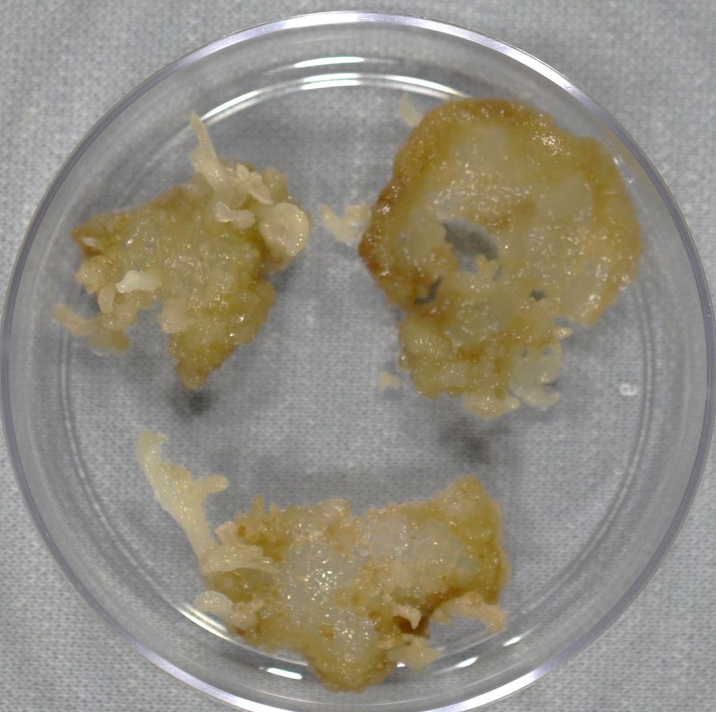
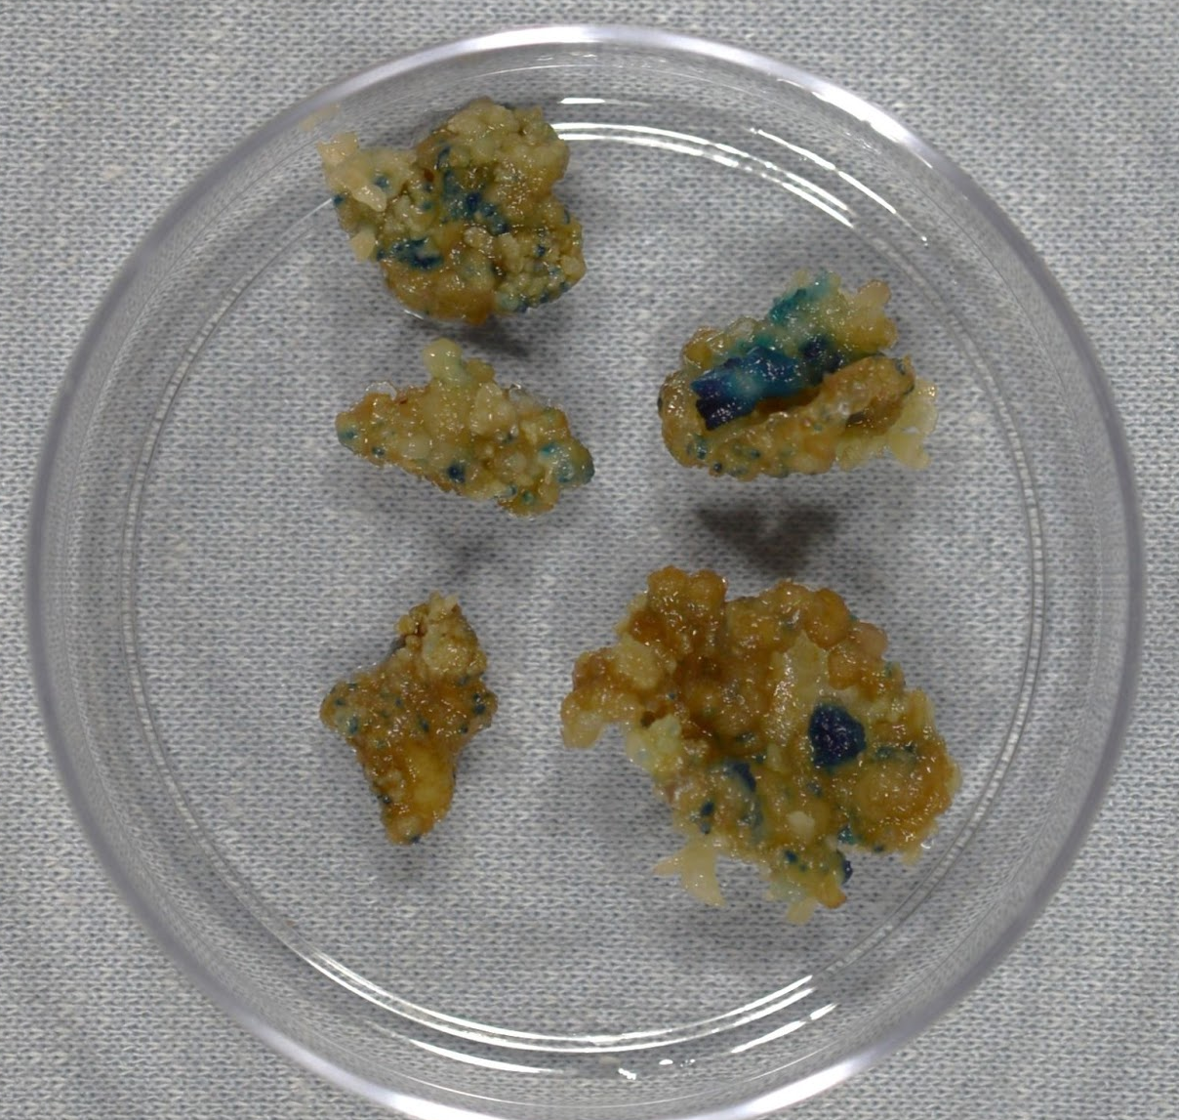
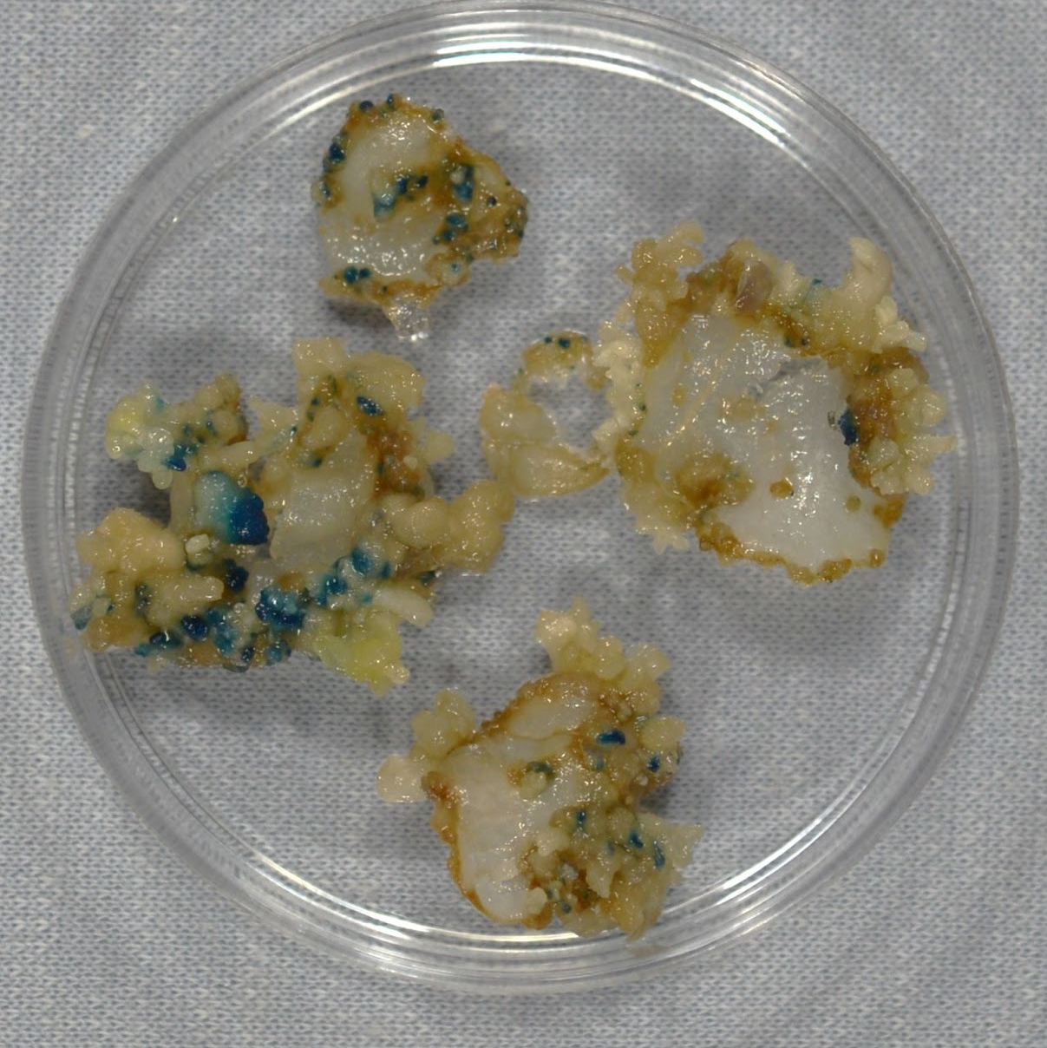
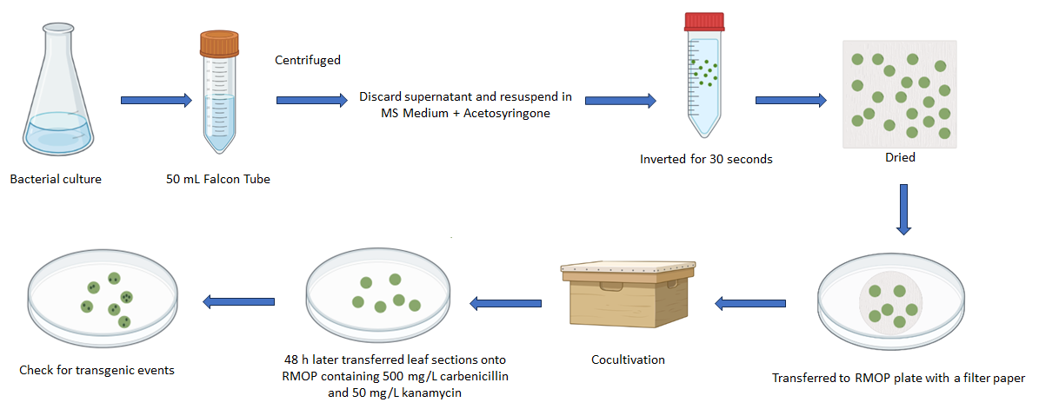
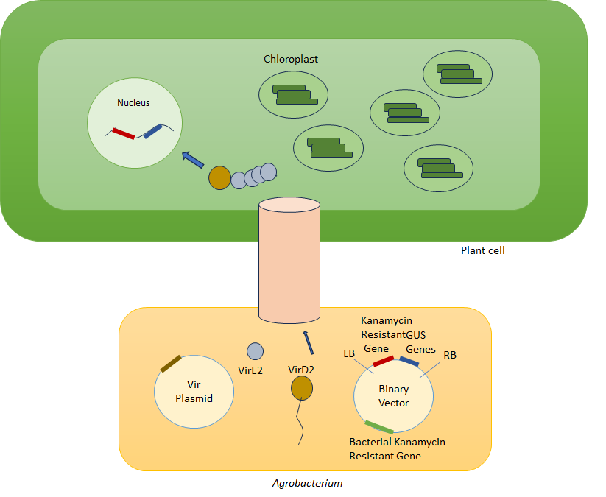
Testing Agrobacterium binary vectors with kanamycin resistance and
β-glucuronidase (gus) genes for plant transformation
Hannan Syed Shah, Aki Matsuoka and Pal Maliga
Waksman Institute of Microbiology, Rutgers University, 190 Frelinghuysen Road, Piscataway, NJ, 08854
Abstract
Materials and Methods
Results
Agrobacterium tumefaciens is a plant pathogen which can transfer its DNA (transferred DNA, T-DNA) to the plant nucleus. Many Agrobacterium virulence (Vir) proteins play roles in the transformation process. In a binary vector system, the T-DNA and the vir genes are located in the binary vector and the vir plasmid, respectively. This system is commonly used to obtain transgenic plants. During the plant transformation process, T-DNA is delivered by linkage to the VirD2 protein, which guides the T-DNA through the Type IV secretion system. Subsequently, the T-DNA is integrated into the plant nuclear genome. Our goal is to test the functionality of a newly constructed binary vector, pSSK6A, carrying a kanamycin resistance gene as a selection marker and the β-glucuronidase (gus) reporter gene. We transformed tobacco leaves with pSSK6A and pCAMBIA2301 as positive control and selected for kanamycin resistance. Newly emerged shoots and calli were used for histochemical GUS detection. We observed blue staining from transformed leaves. In conclusion, our newly constructed pSSK6A is functional. Transformation efficiently will be quantified by comparing with pCAMBIA2301 in the future.
pCAMBIA2301
Wt for the selection and growth control
Kan+
Kan-
pCAMBIA2301
pSSK6A
Before
GUS staining
pSSK6A
Fig 2. Binary vectors used for tobacco leaf transformation. pCAMBIA2301 has a kanamycin resistance gene and a gus gene in the T-DNA region. pSSK6A binary contains also a kanamycin resistance gene and a gus gene in the T-DNA region, and it also has two LB and RB with overdrive sequence. P35S, the CaMV 35S promoter; T35S, the CaMV 35S terminator; Tnos, the nopaline synthase terminator.
After
GUS staining
Fig 4. 13 days post Agrobacterium-mediated tobacco leaf transformation. Non-transformed leaves were plated on RMOP without kanamycin (Kan-) as a growth control and with kanamycin (Kan+) as a selection control. GUS histochemical analysis was done using X-gluc solution. Chlorophyll was removed by incubating several times in 70% ethanol. Blue staining was observed from newly formed shoots/calli transformed with pCAMBIA2301 and pSSK6A.
Introduction
Conclusion
Results indicated that newly constructed pSSK6A was functional to select transgenic events for kanamycin resistance and the gus expression. This binary vector will be used for further research.
References
Fig 3. A schematics of Agrobacterium-mediated tobacco leaf transformation. Agrobacterium strain XYA105*(pCAMBIA2310 or pSSK6A) was used to transform tobacco leaves. Agrobacterium was inoculated in 50 mL LB containing 50 mg/L kanamycin and incubated at 28ºC with shaking overnight. Cultures were centrifuged. The supernantant was discarded, and bacterial cells were resuspended in the MS medium with acetosyringone. Tobacco leaf sections were placed in the bacterial suspension and then inverted gently for 30 sec. After leaf sections were dried on the sterilized paper towels, they were placed on a filter paper on a RMOP plate. Plates were placed in the dark for 48 hours. Leaf sections were transferred onto RMOP with 500 mg/L carbenicillin and 50 mg/L kanamycin. Carbenicillin was used to prevent Agrobacterium overgrowth. Kanamycin was used for selection. A few days later, shoots/calli were observed. They were used for GUS histochemical analysis for transgenic events.
SB;, Lee LY;Gelvin. “T-DNA Binary Vectors and Systems.” Plant Physiology, pubmed.ncbi.nlm.nih.gov/18250230/.
V;, Lacroix B;Citovsky. “Pathways of DNA Transfer to Plants from Agrobacterium Tumefaciens and Related Bacterial Species.” Annual Review of Phytopathology, pubmed.ncbi.nlm.nih.gov/31226020/.
WILKINSON, M. D. “Methods in Molecular Biology, Volume 286. Transgenic Plants. Methods and Protocols. Peña L, Ed. 2005. Totowa, New Jersey: Humana Press. $115 (Hardback). 448 PP.” Annals of Botany, May 2005,
www.ncbi.nlm.nih.gov/pmc/articles/PMC4246766/.
Fig 1. Agrobacterium-mediated plant nuclear transformation using a binary vector system. VirD2 nicks the left and right borders (LB and RB) and then attaches at the 5’ end of single-stranded T-DNA (T-strand), forming the T-complex. The complex is exported to the plant cell through the type IV secretion system. VirE2 proteins coat the T-strand in the plant cell to protect from degradation. The complex is directed to the plant nucleus due to the nuclear localization signals (NLSs) in VirD2. The T-strand is integrated into the plant nuclear genome at random locations (add two references).
Acknowledgments
My most heartfelt gratitude goes especially towards Dr. Aki Matsuoka, without whose guidance this summer would be a difficult journey to surmount, and Professor Maliga. Additionally, I am grateful towards my fellow undergraduate students Angela Kitanski and Shaunak Kinare, as well as the Aresty Research Center for providing the funding to make this research possible.

