Slide 1
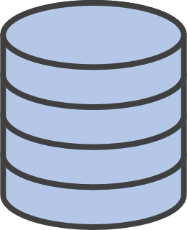

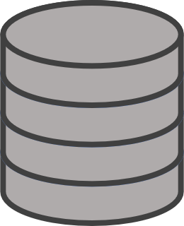


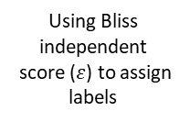

A. Data preprocessing and curation workflow
Brochado
(HTS)
Inchikey mapping
Filter to approved antibacterials
Exclude non-antibacterial compounds
Handle inconsistencies
$ε<$0.1
Synergy
Final DF – 3,160 drug pair-strain instances 97 antibacterials | 10 strains
Cacace
(HTS)
Using Bliss independent
score ($ε$) to assign labels
$$−0.1≤ε≤+0.1$$
Additivity
ACDB database
(literature-based)
$$ε>+0.1$$
Antagonism
Raw ≈ 13,854 rows

Slide 2
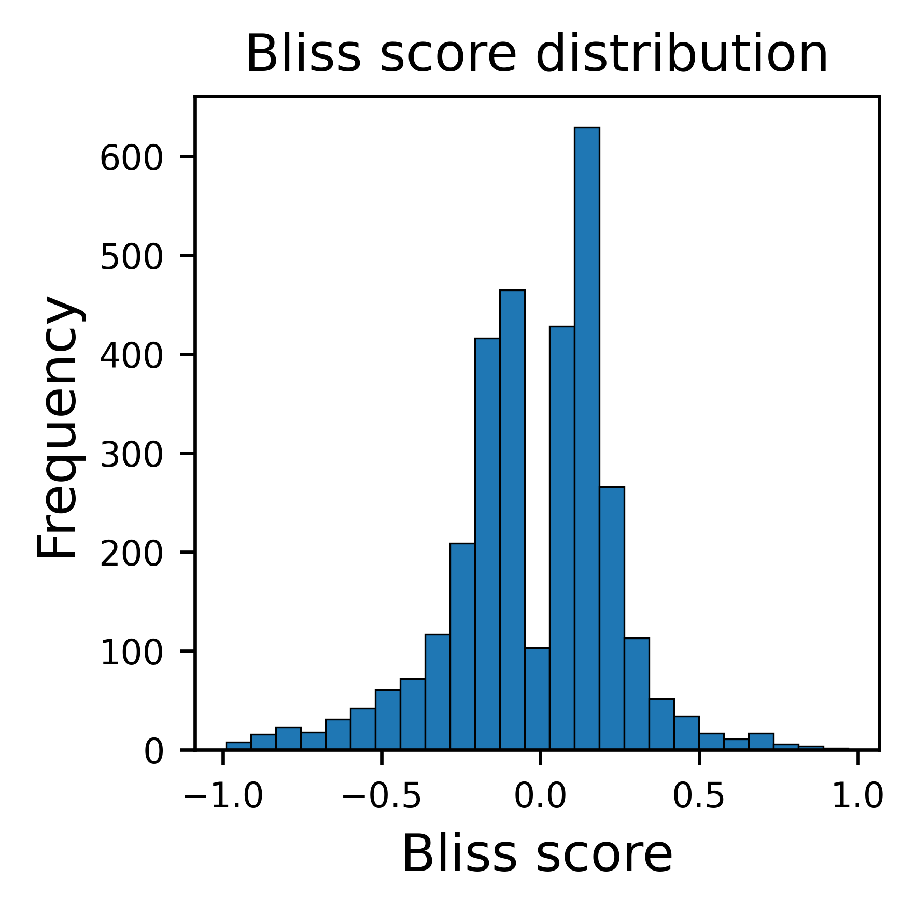
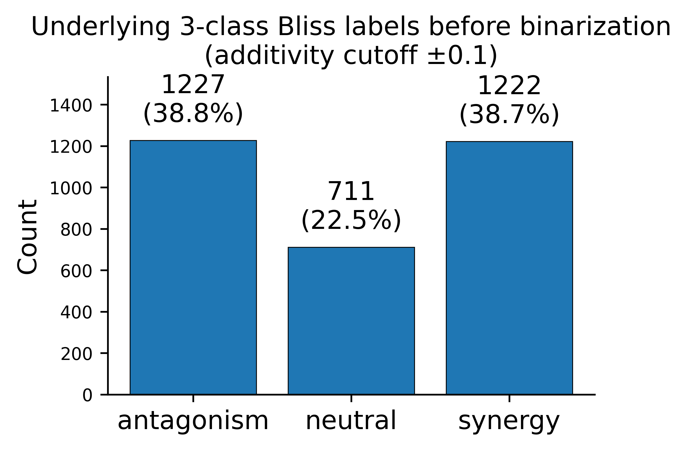
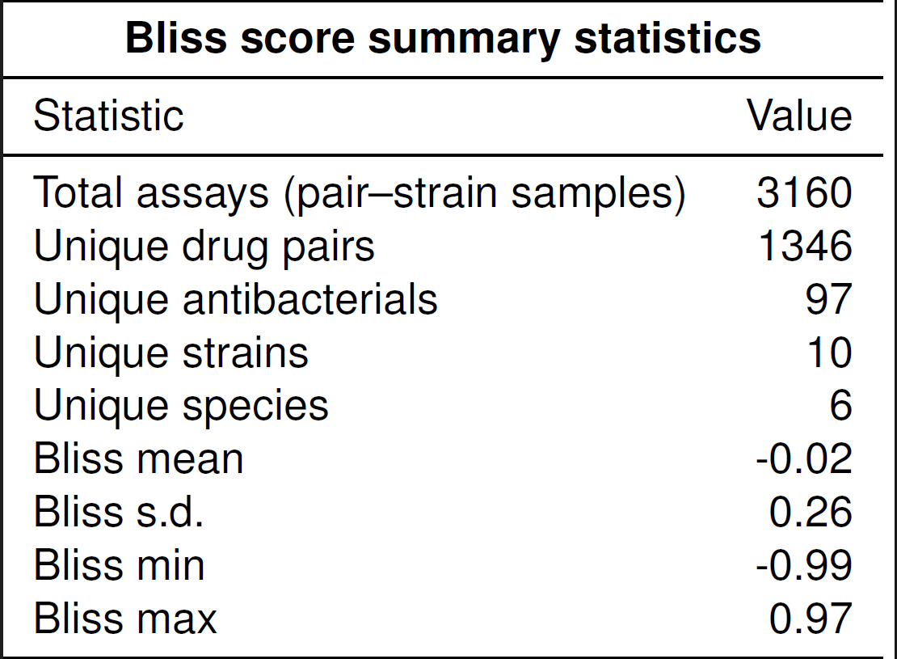
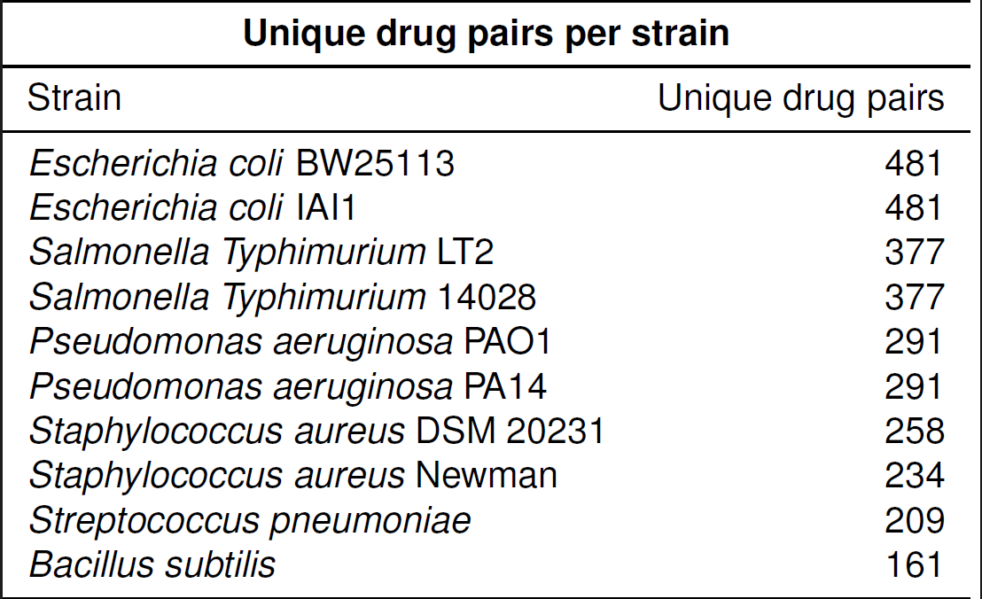
B. Dataset statistics after curation
Notes:
Figure 1B. Dataset overview after curation.
(B) Bliss score–based interaction statistics. Top left: distribution of Bliss scores across all pair–strain assays. Top right: counts of 3-class Bliss interaction labels (antagonism, neutral, synergy). Bottom left: summary dataset statistics. Bottom right: number of unique drug pairs per strain.
The final dataset contained 3,164 unique drug pairs tested across 22 species. Histogram shows the continuous distribution of Bliss scores, while the class balance plot demonstrates that synergistic, additive, and antagonistic interactions are not trivially balanced.
Figure 1B. Dataset summary after curation. The final dataset includes 1,324 unique drug pairs tested across 10 strains (6 species), totaling 3,164 assays. The Bliss-score distribution (right) spans −1 to +1 with mean −0.03 ± 0.27, while class proportions (bottom-left) show near-balanced synergy, additivity, and antagonism at ε threshold ±0.12.

Slide 3
C. Input features from Chemical Checker embeddings
Drug A
Drug B
Level A. Chemistry
Chemical Checker
embeddings
Level B. Targets
Level C. Networks
Level D. Cells
Level E. Clinics
CC (3200D)
CC (3200D)
For each drug:
Each level → 128D
Full CC: 25 × 128 = 3200D
S-space 128D vector (strain embedding); Used only in some model variants
S-space (128D)
S-space (128D)
Drug A feature set
Drug B feature set
Elementwise similarity (cosine alignment + absolute difference)
Pair feature vector

